Slide 1
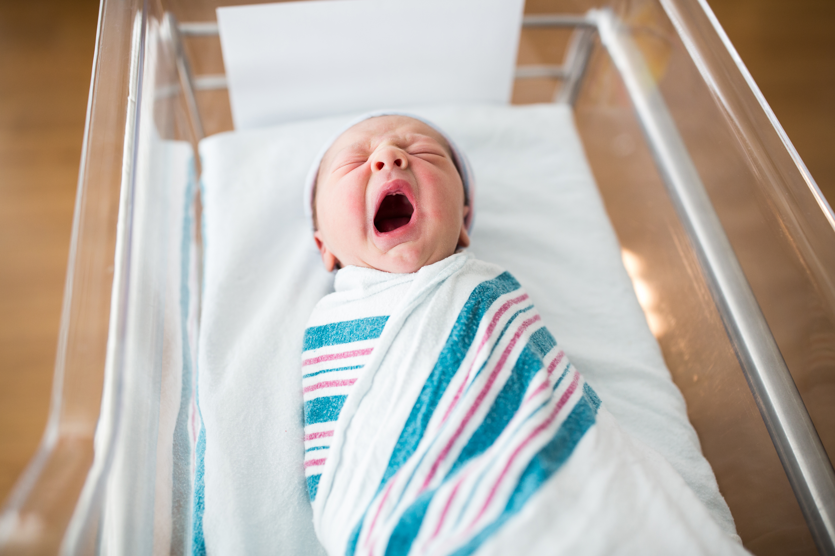
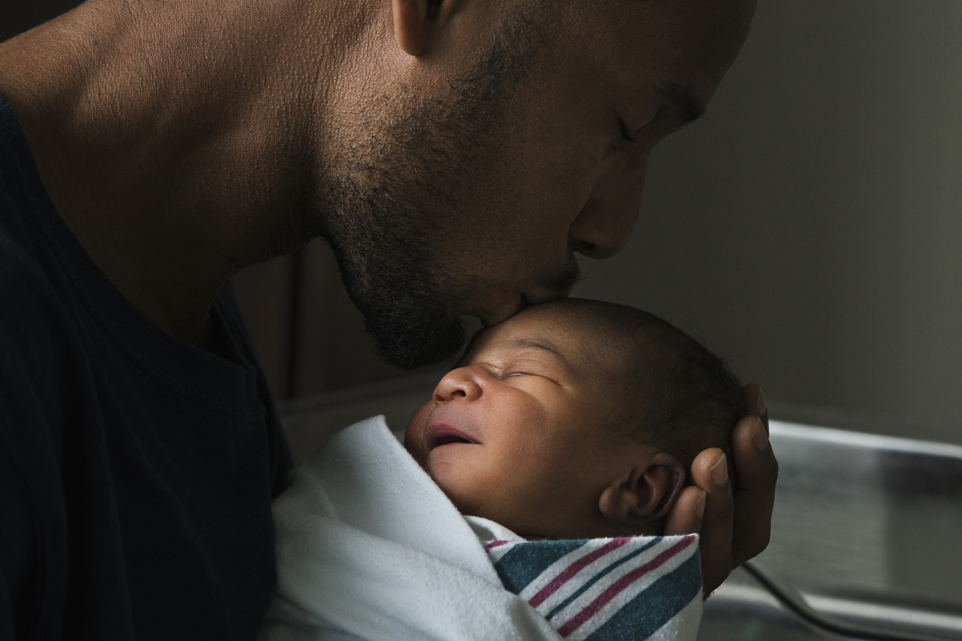
Born at the Right Place:
Reducing Very Low Birth Weight Infant Deliveries in Non-Tertiary Care Hospitals
Notes:
In 2022, CDC awarded a 5-year award to address Preterm birth and expand the quality improvement capabilities of the WV Perinatal Partnership and birthing hospitals throughout the state. This presentation is going to highlight some of the work that is being done under this award.

Slide 2
Percentage of Preterm Births in West Virginia
Source: March of Dime, September 2024.
Notes:
West Virginia’s preterm birth rate is rising. In 2022, we were ranked 48 out of all the states for our preterm births, behind only Mississippi and Louisiana, with a preterm birth percentage of 13%, far above the national average of 10.4%. And this percentage is rising, particularly amongst the late preterm birth. Because of this the WV Perinatal Partnership has been focusing on improving preterm birth outcomes.
Percentage of all live births

Slide 3
Source: WV Health Statistics Center, Vital Statistics System, September 2024
Notes:
During years 1 and 2, the Partnership has focused on very low birth rate babies, as these very premature babies are some of the most vulnerable West Virginians.
The national goal is to have only 10% of very low birth weight infants born outside of tertiary care hospitals. West Virginia averages around 18% of these births outside tertiary care hospitals. It is a goal of the Partnership to reduce this number.
As such, the Partnership has worked diligently with stake holders to determine the causes and find solutions.
Very low birth weight infants have a better chance of survival if the mother transferred prior to delivery and the infant is born in a tertiary care center, rather than being transferred after delivery, so this has been our focus.

Slide 4
Methods
2020-2022 births
Developed data collection tool
For 4 tertiary and 6 non-tertiary care hospitals
All non-tertiary VLBW/Low GA births
Sample of tertiary VLBW and GA births
Notes:
The Partnership formed the multi-disciinplinary Preterm Birth Workgroup and overseen by the newly formed Quality Improvement Advisory Council. The workgroup began by looking at birth certificate data form 2020-2022 to get general idea of what is happening and where. From this data, we were able to highlight 6 non-tertiary care hospitals to join the preterm group along with the 4 tertiary care hospitals that we felt would be the most impactful for decreasing the percentage.
Using this data along with clinical knowledge, we created a data collection tool to allow the hospitals to have a systematic way to review VLBW births for 2020-2022. The 5 non-tertiary care hospitals reviewd all their cases while the tertiary care reviewed a random sample of cases.

Slide 5
Sample pages from data collection tool
Notes:
Sample pages of the data collection tool. It was 5 pages long with a 1-page infant addendum.

Slide 6
Aggregated Data summary
Non-tertiary hospitals
86 cases reviewed
12% had no prenatal care, several unknowns
8% attempted pre-delivery transfer
5 out of 6 hospitals reported average time to birth: 30-60 mins
Tertiary hospitals
Total: 102 cases reviews, about 12% sample
5% had no prenatal care with no unknowns
About 30% transferred from another hospital
Average time to birth: variable, lowest was 4 hours to 4.4 days
Notes:
This is the summary of the aggregated data from the 10 hospitals- 6 non-tertiary and 4 tertiary. I want to draw your attention to the percentage of no prenatal care- 12% for the non-teariaries with several unknowns, whereas the tertiary hospitals reported only 5% with no unknowns.
Also, the non-tertiary hospitals reported that the average time from arrival to birth was 6- minutes or less.

Slide 7
Factors impeding transport to tertiary care
Factors | # of hospitals | Percentage
Unstable mother and/or infant | 6 | 100%
Precipitous delivery or advanced labor | 5 | 83%
No transport team available | 1 | 16%
Notes:
The main reasons that the non-terariary where unable to transport were unstable mother and/or infant and hasty deliveries. Only one of the hospitals reported transport issues.

Slide 8
Common trends by hospital type
Non-tertiary
Limited prenatal care
No prenatal care
Tertiary
Pre-eclampsia
Hemorrhage/abruption
Twin/multiple gestation
Tobacco
HTN
SUD
Medicaid
White
C-section
Notes:
Here are the common trends by hospital type in the population that gives birth to VLBW. The trends in both hospitals speak to the population in WV and risk factors for preterm birth. The tertiary care hospitals report conditions that are often identified, treated and monitored during prenatal visits, while the non-tertiary care hospitals report limited to no prenatal care. WE saw 12% reported no prenatal care, even more had limited prenatal care.

Slide 9
Next steps
Focus on interventions to:
Remove barriers to prenatal care
Educate on signs and symptoms of preterm birth
Partner with EMS to efficiently and safely transport pregnant and laboring people
Continue to systematically review cases
Expanding into late preterm birth
Notes:
The work to help improve preterm birth is ongoing. We are looking at how to increase prenatal care visits, as this is the main factor associated with VLBW births in non-tertiary care hospitals, educate on the signs and symptoms of preterm birth- with hopes that laboring people will get to the hospitals sooner, work with the EMS system for safe and efficient transportation, and continue monitoring.
We are also looking at expanding our work in 2025 to include late preterm births- as this is the group where we are seeing the rise in in preterm birth rates.

Slide 10
Special Acknowledgements
Individuals |  |  | Institutions
Aliff, Dara + Allen, Stacie * Anderson, Timothy Atkins, Amy + Baber, Anastasia * Belin, Leigh * Brant, Richard Breyel, Janine Brindle, Shawnee Burley, Clinton * Ceci, Mandy * Chaney, Tonya + Christiansen, Matthew + Copenhaver, Elizabeth + Cremeans, Kelley Crews, Alyssa * Dameron, Luke +* Dawson, Martha Didden, David + Evans, Joseph + Farry, Kimberly + Frohna, John + Garris, Shauna Gunasekaren, Vignesh * | Harlow, Misty * Hayes, Tammy * Hendrick, Kelly * Honaker, Matthew Irvin, Heather Jackson, Katana * Jamison, Marsha Jefferies, James + Jones, Valerie * Jude, David: QIAC Co-chair + Kwon, Byounjin Lilly, Brian Lingenfelter, Brandon Maxwell, Stephan: QIAC Co-Chair +* Miller, Pamela * Mincy, Jacqueline * Mousattat, Youmna * Natalie Kemp Osborne, Shelly * Perkins, Lewis Pirie, Kathryn * Povroznik, Mark | Richardson, Samantha Riley, Jennifer Riley, Melanie * Rowan, Shon + Schmitt, Maureen * Seamann, Paul * Siegel, Norman Sitler, Michael Sloane, Emily + Smart, Stephanie Smith, Cody +* Stewart, Mary Beth Sulver, Hannah Suttle, Allison + Tabler-Mayle, Amanda * Taylor, Lisa Tolliver, Amy + Wallace, Jennifer * Whanger, Michelle * Youssuck, Pantin "Pete" * | WV Health Statistics Center Cabell Huntington Hospital CAMC Women and Children’s Raleigh General Hospital Berkeley Medical Center Camden Clark Medical Center Princeton Community Hospital Thomas Memorial Hospital Wheeling Hospital WVU Medicine Children's
* Active Member of Preterm Birth workgroup
+ Member of the Quality Improvement Advisory Council

