Slide 1
Abusive HEAD TRAUMA IN WV: epidemiology and Prevention Efforts, and Suggestions GOING FORWARD WV Perinatal SUMMIT oct 17, 2024
Joan Phillips, MD
Child Abuse Pediatrician
Medical Director Child Advocacy Center
CAMC
Associate Professor of Pediatrics WVU, Charleston
Jim McJunkin, MD
Injury Prevention Committee Chair
WV Chapter, American Academy of Pediatrics
Professor Emeritus of Pediatrics CAMC

Slide 2
AHT in WV Infants and Toddlers(<24 mos): Epidemiology and Efforts at Prevention
- Incidence and Other Characteristics of AHT in WV : 2000-2010
- Prevention Efforts in WV and Other States/Provinces: 2010-present
- Looking ahead collaboratively
WV AIM team (AHT Incidence Monitoring Team)
New Task force of Partners (? AMP Team?)

Slide 3
THE WV AIM TEAM THANKS THESE PARTNERS IN ADVANCE
WV Perinatal Partnership
WV Chapter AAP
Our Babies Safe and Sound
Right from the Start
Notes:
Thank in general funders such as hospital auxiliaries, Kohls and Wehrle Fndtn

Slide 5
Epidemiology of abusive head trauma in West Virginia children <24 months: 2000–2010
Beth Bloom Emrick, Eleanor Smith, Lauren Thompson, Charles Mullet, Eduardo Pino, Katherine Snyder, Mary-Ann Kroll, Susan Ayoubi, Joan Phillips, Sharon Istfan, Christine A. Welch, James E. McJunkin
Child Abuse & Neglect
Volume 93, July 2019, Pages 215-221
Study by WV AIM Team of the Incidence and Demographics of AHT in 120 Infants and Toddlers (< 24 mos) in WV from 2000-2010

Slide 6
Dr. Sharon Istfan

Slide 7
Epidemiology of AHT iN WV INFANTS (<12 mos) AND TODDLERS (<24 mos) 2000-2010: METHODS
Case-finding: ICD Codes screen for certain injuries/assaults followed by MR review to confirm a case
CDC’s “narrow definition for AHT” = intracranial injury
Case-finding also via ME’s office
Incidence in infants = annual cases div by annual births
Demographics and other features of AHT studied by Med Rec review

Slide 8
ICD -9 codes used to identify injuries possibly consistent with AHT (page 1)
362.81 | Retinal hemorrhage
800.1-800.49 | Closed skull vault fracture with intracranial injury
800.6-800.99 | Open skull vault fracture with intracranial injury
801.1-801.49 | Closed fracture of base of skull with intracranial injury
801.6-801.99 | Open fracture base of skull with intracranial injury
803.1-803.49 | Other closed skull fractures with intracranial injury
803.6-803.99 | Other open skull fractures with intracranial injury
804.1-804.49 | Multiple closed fractures to skull or face with intracranial injury
804.6-804.99 | Multiple open fractures to skull or face with intracranial injury

Slide 9
ICD -9 codes used to identify injuries possibly c/w AHT (con)
850.0-850.99 | Concussion (violent jar or shock or the condition that results from such injury)
851.0-851.99 | Cerebral laceration and concussion
852.0-852.59 | Subarachnoid, subdural, and extradural hemorrhage
853.0-853.19 | Other and unspecified intracranial hemorrhage
854.0-854.19 | Other and unspecified intracranial injury
959.01 | Other and unspecified injury to head
959.8-959.9 | Other and unspecified injury to other sites

Slide 10
Basic Demographics of AHT Victims
DEMOGRAPHICS
Male | 55.8 (67)
Female | 44.2 (53)
Race
Caucasian | 90.7 (98)
Other | 9.3 (10)
Unknown | (12)
State of Residence
West Virginia | 83.3 (100)
Adjacent states (Maryland, Ohio, Kentucky, Pennsylvania) | 16.7 (20)
Age
< 12 months | 86.7 (104)
12-24 months | 13.3 (16)

Slide 11
Age Distribution of AHT cases

Slide 12
WV AHT cases: Presenting symptoms
Symptom | Percent (n)
Seizures | 43.5 (50)
Unresponsive | 40.0 (46)
Vomiting | 38.3 (44)
Irritability | 27.6 (32)
Apnea | 18.3 (21)
Poor feeding | 16.5 (19)
Upper respiratory symptoms | 14.8 (17)
Diarrhea | 7.8 (9)
Cyanosis | 2.6 (3)

Slide 13
WV AHT :Injuries sustained
Injury | Percent(n)
Intracranial injury | 100 (115)
Intracranial Hemorrhage | 96.5 (111)
Cerebral Edema | 22.6 (26)
Retinal Hemorrhage | 70.4 (81)
Impact Trauma | 55.7 (64)
Fractures
Skull | 27.8 (32)
Rib | 15.7 (18)
Long Bone | 19.1 (22)
Any Fracture | 44.3 (51)

Slide 14
AHT in WV Children <24 mos: Mortality, Morbidity, and Home Placement
Mortality: 19.2 Percent
Morbidity
Of 97 survivors, at time of discharge:
44 (45%) had some kind of morbidity, including:
6 - Blindness
7 - hydrocephalus treated with V-P shunt
31 – seizures
Discharge placement of survivors: 87 percent were discharged to a custody placement other than their admission custodian
Notes:
Longterm morbidity in national studies ranges from

Slide 15
WV AHT Incidence Compared to Other Studies
 | Incidence <1 year old (95% Confidence Interval) | Incidence <2 years old (95% Confidence Interval)
West Virginia | 36.6 (24.3-49.0) | 21.6 (14.1-29.2)
California | 22.4 | 14.0
North Carolina (Keenan, 2003) | 29.7 (22.9-36.7) | 17.0 (13.3-20.7)
National (Shanahan, 2013) | 33.4 (31.4-35.4) | (Not reported)
South Region (Shanahan, 2013) | 32.0 (28.4-35.9) | (Not reported)
Notes:
May need to add British columbia

Slide 16
The WV AHT incidence* (2000-2010) increased over time
 | 2000-2005 | 2006-2010 | p-value
Incidence <12 months old | 24.0 (15.7-32.4) | 51.8 (32.4-71.2) | <0.01
Incidence <24 months old | 14.5 (10.3-18.7) | 30.3 (16.3-44.2) | <0.05
*Incidence is per 100,000 live births

Slide 17
WV AHT incidence rates (per 100,000) by year
Notes:
Possible causes of inc incidence are increased substance abuse as indicated by increased OD deaths during the latter years of study period
And the economic recession around 2008

Slide 18
AHT prevention efforts in WV birthing hospitals
Based on information from questionnaire of the state’s birthing hospitals and from Our Babies Safe and Sound (n=20):
A large majority (80%) reported distributing “The Keep Your Cool (when baby cries)” booklet to parents before post-partum DC.
Slightly more than half (55%) reported using Period of PURPLE Crying educ. in some form
Notes:
Thankyou to the Perinatal Partnership and to all of you who participated in the Nursing Leadership Questionnaire
Consider this a bit preliminary since some nurse managers reported they were fairly new in their positions but the efforts made are truly appreciated

Slide 21
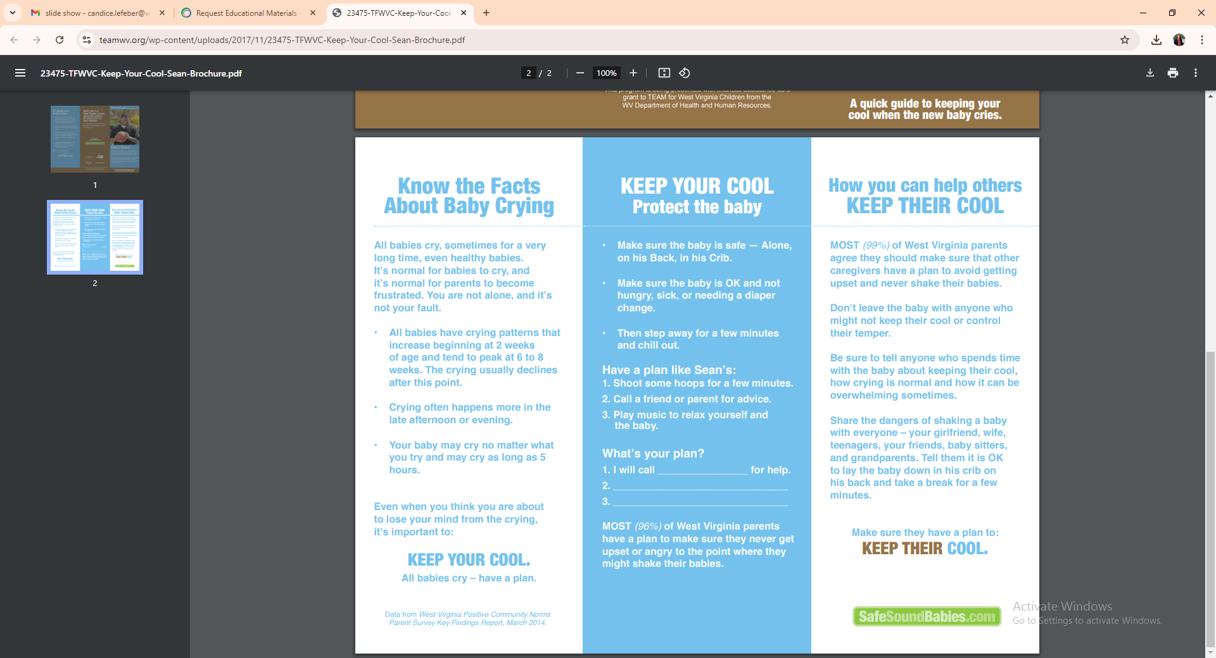

Slide 22
Summary of US Studies Designed to Prevent AHT
Early study by Dias et al (2005) shows reduction in AHT cases in Upstate NY
However AHT reduction was NOT replicated in two large statewide studies:
NC (Zolotor et al,2015) and PA (Dias et al,2017)
Meta-analyses of the above and other AHT prevention programs showed:
- Little evidence of reducing AHT in infants (<12 mos)
- Some evidence of promoting positive behaviors in parents

Slide 23
AHT PREVENTION: WHY PERSIST In VIEW OF US RESULTS?
Economic recession (Dec 2007- July 2009) may have confounded results
US Studies did find encouraging results for parents’ knowledge and behaviors:
Improved knowledge about infant crying (Dias et al, 2017)
Less calls for baby’s crying to health care providers (Zolotor et al, 2015)
The financial impact of AHT is so high that a 2 % reduction of AHT cases may justify the cost of prevention programs. (Barr et al)
A more recent study British Columbia (Barr et al 2018) showed:
- Reduction of AHT incidence by 35% in children < 2yrs old
- A trend toward positive in reducing incidence in < 1 yr old (p=.09)
Notes:
Barr and Fujikawa found improved ability of parents to walk away from crying baby for a period
US studies intervention period coincided with economic recession –

Slide 24
Possible lessons learned from Barr’s AHT prevention study
Dose 1 PPT education involved counseling by trained nurses via talking points
Fathers often included (74%)
More than 80% received booklet/video before DC
(Video viewed only by a minority of parents (17%) before DC)
Dose 2 Nurse followup reinforcement of talking points within 2 weeks most often by telephone and less by home visit
NOTE: Use of the video or the booklet by mothers rose to 70% by 2-4 mos
Dose 3 Community awareness: purple caps knitted for babies annually
Notes:
I
Dose 1Nurse prior training involved in-person and on-line training and certification - in person training 30 min dose 1 and 2 thus use of the video and booklet occurs prn for crying after DC Dose 3 Click for babies.org

Slide 25
Possible factors favoring success in Barr’s AHT prevention study (con)
Paid Parental leave (ppl) is in place in British Columbia
- Many US states had increased rates of AHT during recession of 2008
- Notably California which had ppl did not have an increase
Other positive features emphasized for use in prevention efforts by Leventhal*:
- Receiving education from multiple diverse sources
- Home visiting programs
- Focusing parents on their own frustration rather than child’s anger
*Leventhal, Asnes, Bechtel et in JAMA Pediatrics 171(3), 218-220
Notes:
PPL speaks to the need for adequate daycare as well

Slide 26
AHT Monitoring and Prevention: Suggestions Going FOrward
Pre-Dose 1. Include infant crying educ in health classes in HS
Include in Child-Birth Education Classes
Dose 1. Nurse counseling is still key
Inclusion of fathers
Consistent giving of materials before DC
(QR codes increasingly used)
Notes:
As for prevention efforts
The mixed results of studies gives us time to assess next steps as a TEAM.
The current level of participation of WV birthing centers confirms a wide-spread culture of prevention efforts for AHT.
Dose 1 key partner is Ppship and OBSS, Dose 2 key partner are WV AAP and Ppship and RFTS

Slide 27
AHT Monitoring and Prevention: Suggestions Going forward (Con)
Dose 2. Consistent reinforcement of messaging
May be enhanced by texting and resending QR code
Right from the Start already helps in reaching some families
Dose 3. Public Service Announcements
CLICK for babies.com previously used
Public Advocacy for Paid Parental Lv and Improved Child Care
Notes:
Dose 2 RFTS, PARENTS AS TEACHERS
Dose 3 OBSS,

Slide 28
WV AHT Monitoring and Prevention: A Building YEar
Joan Phillips, MD, AIM Team Leader
Candice Lefeber, MPH, AHT Prevention Coordinator
AHT Monitoring
AIM Team: Continue study epidemiology of AHT to inform prevention:
- key focus: more complete data on perpetrators
- potential role of substance abuse in families affected by AHT
- complete incidence study through 2020
AHT Prevention: Birthing hospital current efforts encouraging as we reassess
Notes:
The findings of the majority of birthing hospitals providing AHT prevention efforts is encouraging, but it is definitely a reassess and rebuid yrTHANKYOU TP Perinatal Partnership

Slide 29
Case Presentation
• 2 month old
• Usual state of health on Saturday
• On Sunday, Mom went to work 5 pm. Baby, 4 yr old and 9 yr old were left in care of the dad.
• Baby fed between 6-7pm
• Baby vomited at 10pm and “eyes went in different directions”
• Mom returned home 12:15 to 12:30am (Monday) - baby limp
• Presented to ED 1am (Monday)
• Baby unresponsive with shallow respirations

Slide 30
History of Trauma per father
On Friday, 3 days prior to ED, Dad reported that he was walking fast through house with infant cradled in in right arm. The baby’s head hit the bedroom door on the inset frame. The baby did not cry and acted normal.

Slide 31
Findings
• Subdural and subarachnoid hematomas
• Cerebral edema
• Retinal hemorrhages
• Metaphyseal fracture left distal femur
• Bruises on head, right clavicle, right upper arm, left lateral arm and abdomen

Slide 32
MECHANISMS OF INJURY

Slide 33
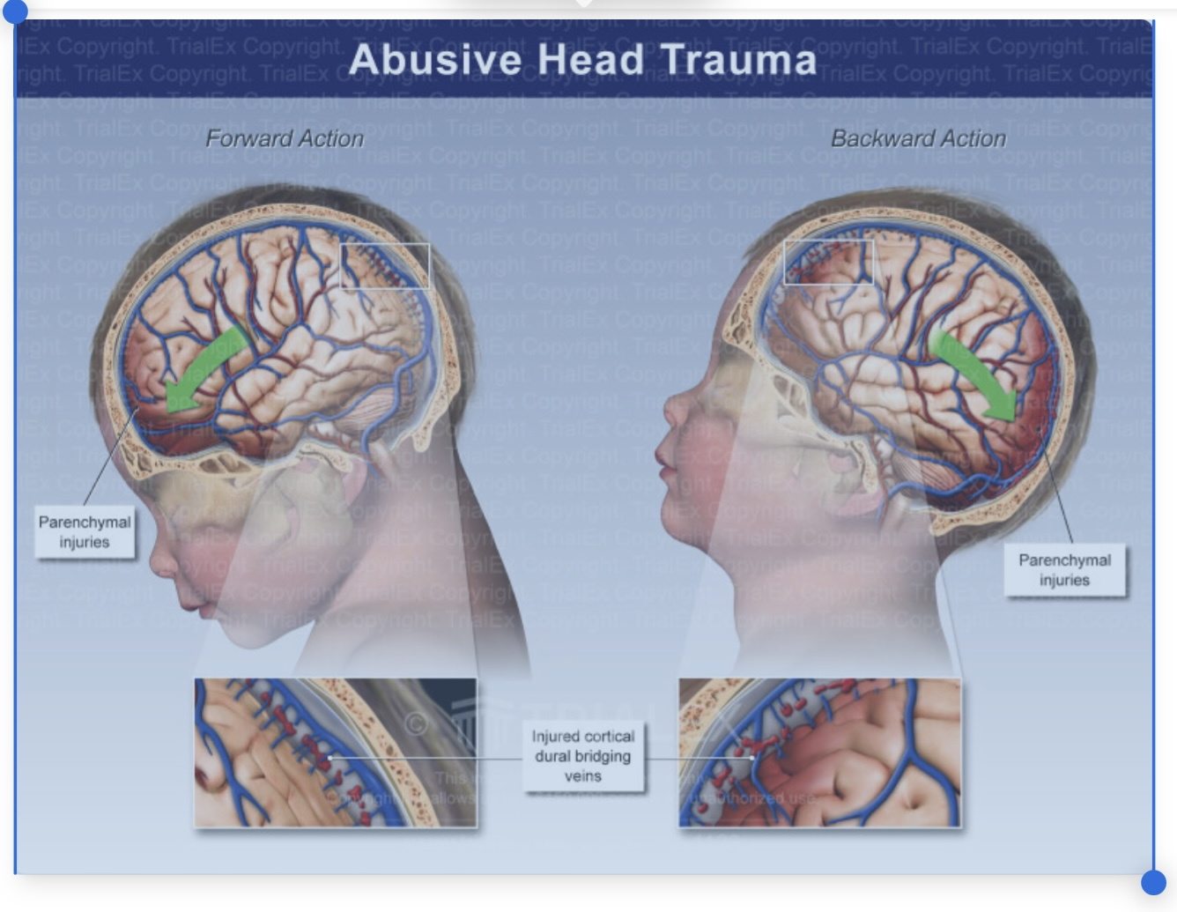

Slide 34
SDH and Cerebral edema

Slide 35
Retinal hemorrhage
• 85% of cases have retinal hemorrhage
• "Hemorrhages too numerous to count, multilayered and extending to the ora serrata are specific: Morad,etal, Clin Exp Ophthamol
• Acceleration-deceleration

Slide 36
Retinal hemorrhages

Slide 37
Fractures
• 42% OCCULT FRACTURES
• POSTERIOR RIBS
• CLASSIC METAPHYSEAL FRACTURES-HIGHLY SPECIFIC

Slide 39
Brain Injury
• Diffuse axonal injury
• Metabolic cascades contribute to secondary neuronal injury
• Cebral ischemia
• Cerebral edema

Slide 40
Outcome
Nuclear cerebral flow test verified no blood flow
Patient died 48 hour after admission

Slide 41
THANKYOU! QUESTIONS?

