Slide 1
Pitfalls of Drug Testing
Ominous in Nature – Trevor Pottelberg
Danyel H. Tacker, PhD, FADLM, D(ABCC)
Associate Medical Director of Clinical Laboratories, WVU Hospital
Section Medical Director, WVUH Special Chemistry & Mass Spectrometry
CLIA Medical Director, WVU Medicine Fairmont Medical Center Laboratory

Slide 2
Disclosures
I have no commercial or financial agreements with manufacturers relating to drug testing/topics covered in this talk.
Activity outside WVU:
ADLM – Policy & External Affairs Core Committee (Member, 2023-2025); Annual Scientific Meeting Speaker (July 2024)
MedicalLab Management – Editorial Advisory Board (Member); occasional writer/contributor
Ad-hoc reviewer for 8 journals
Consulting, fall 2024 - Werfen/IL (fall webinar event re: blood-gas testing)

Slide 3
Learning Objectives
At the end of the session, the attendee should be able to:
distinguish truth from myth relating to drug testing capabilities; and
differentiate the utility of, and methods used for, screening versus confirmatory or definitive drug testing methods.

Slide 4
Pre-Questions…for each, is this Truth, Myth, or Somewhere in Between?
Drug screening should be universal.
One test is as good as another.
Any unexpected drug testing result should be confirmed with a more stringent test.
A positive result means “use”, and a negative result means “compliance”.

Slide 5
The Ethical Debate of Universal Screening Approaches
“Risk based” testing can be risky…
Universal testing eliminates bias, delivers interventions as needed…but is costly.
Delivery of drug testing = largely situational decision at WVUH
Some programs are universal, some are risk-based

Slide 6
SO: Truth, Myth, or Somewhere in Between?
Drug screening should be universal. [Somewhere in between]
One test is as good as another.
Any unexpected drug testing result should be confirmed with a more stringent test.
A positive result means “use”, and a negative result means “compliance”.

Slide 7
Characteristics of Testing Categories
 | Screening test | Definitive test | Confirmatory test
Rapid? | Yes/typically | Not typically | Not typically
Technology used | Immunoassay most common | Mass spectrometry most common | Mass-spectrometry most common
Target | Compound or drug class | Compounds & their fragments | Compounds/fragments confirmed w/internal standards
Cross-reactivity | Common (variable) | Uncommon/Rare | Uncommon/Rare
Utility | Rapid checks Medical vs forensic* | Compliance testing Identifying unknowns Confirm a screen result Medical | Compliance testing Confirm a screen result Medical Forensic & medicolegal
Results | Qualitative, presumptive | Qualitative, Semi-quantitative, or Quantitative | Semi-quantitative (medical) Quantitative (forensic)

Slide 8
Therapeutic & Toxic Drug Testing Are Inherently Different
Clinical drug screening blends detections of purely illicit drugs with licit drugs at risk for misuse
Classical UDS used DOT-based cutoffs intended to detect intoxication for FDA approvals (no change in >40 years for most of those tests)
Lower-level dosing, with compliance, CAN fail to screen positive
Toxic
Concentration
Supra-Therapeutic – Potentially Toxic
Therapeutic - Effective, Toxicity risk acceptable
Sub-Therapeutic – No Effect, Minimal toxicity
Time
Rifai, Horvath, Wittwer, eds. Tietz Textbook of Clinical Chemistry & Molecular Diagnostics. 6th ed, 2018.

Slide 9
Cutoffs/Decision Points of Drug Screening Tests – WVUH Core Lab Example
Drug/Class | Decision Point | Calibrator | In UDS panel Since
Amphetamines | 500 ng/mL | d-methamphetamine | 1970s; cutoff updated 2021
Barbiturates | 200 ng/mL | Secobarbital | 1970s
Benzodiazepines | 200 ng/mL | Oxazepam | 1970s
Buprenorphine | 5 ng/mL | Buprenorphine | 2012
Cannabinoid | 50 ng/mL | Δ9−THC-COOH | 1970s
Cocaine metabolite | 150 ng/mL | Benzoylecgonine | 1970s; cutoff updated 2021
Fentanyl | 1 ng/mL | Fentanyl | 2021
MDMA/Ecstasy | 500 ng/mL | MDMA | 2014
Methadone | 300 ng/mL | Methadone | 2012
Opiates | 300 ng/mL | Morphine | 1970s
Oxycodone | 100 ng/mL | Oxycodone | 2014

Slide 10
Case 1: “Is my patient diverting?”
Initial U-BZO UDS Negative (200 ng/mL cutoff)
Patient is elderly and on Alprazolam per provider
Sounds like?
Confirmatory test suggested (100 ng/mL cutoff; panel does contain alprazolam) → NEG
Called reference lab, spoke to section director
Alprazolam WAS “present” but below cutoff; had to call it NEG (regulations)
Back to Provider: “Well, patient is on a low dose every other day”
No current monitoring options for patient on low-dose, low-frequency BZO!!

Slide 11
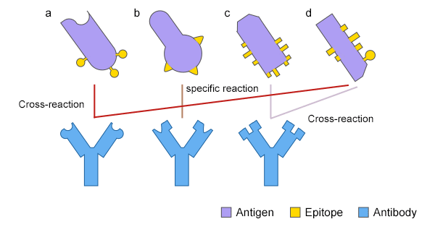
Cross-Reactivity
Common to immunoassay (IA)
Less common in definitive & confirmatory methods when tandem mass analysis is involved – but not impossible
Ions instead of antibodies
https://www.cusabio.com/manage/upload/202109/antibody-cross-reaction.png

Slide 12
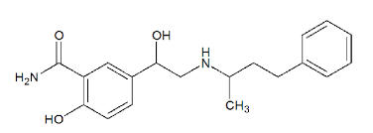
Case 2: “How are so many taking fentanyl?”
Fentanyl (FEN) added to drug screening panel after several unexpected FEN-positive confirmatory tests found & data presented to BMED, Medical Executive Committee (2021)
Shortly after that, OB clinic called – “everyone” is FEN-positive on screen, NEG on confirmation.
Examples requested - 20 given in short order
Chart reviews showed a common thread
All examples: hypertension in pregnancy, treated with labetalol
Labetalol
Fentanyl (rotated)

Slide 13
Case 2 findings have been seen elsewhere
J Addict Med 2022 Nov-Dec;16(6):e417-e419. Epub 2022 Aug 17.
https://doi.org/10.1097/ADM.0000000000001010
https://www.medscape.com/viewarticle/993830?form=fpf [How to interpret a drug test]
Boston Med Center Tox Lab OB testing sheet
Drug Alcohol Depend. 2024 Jun 1:259:111287. https://doi.org/10.1016/j.drugalcdep.2024.111287

Slide 14
WVUH/Ruby Fentanyl Screen Result Report/Comments, After the Issue Found

Slide 15
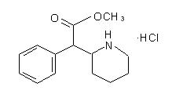
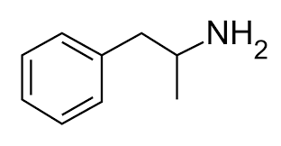
Case 3: “Why was AMP negative?”
13Y M patient on Ritalin screened by provider as a compliance check
Negative for AMP; provider questioned result, ordered confirmation
Negative again for AMP
Why?
Ritalin/methylphenidate does NOT cross-react with AMP screen per IFU, is NOT in the targeted mass spectrometry confirmation test for AMP
Ritalin
Amphetamine

Slide 16
Case 4: “So, What’s New?”
43Y F patient in MOUD clinic with 2-year history of solid compliance
Recent cup test POS for AMP, confirmed with MS
Patient firmly denied any use
Sounds like?
Relapse, substitute drugs metabolized to AMP…
Actually…
Pt was taking herbal energy formula, felt great
Mass analytic behaviors of components → ion signatures consistent with AMP
Plausible MS confusion vs potentially a spiked supplement; not FDA regulated
Patient quit the supplement; next AMP screen & confirm tests NEG

Slide 17
SO: Truth, Myth, or Somewhere in Between?
Drug screening should be universal. [Somewhere in between]
One test is as good as another.
[Myth – different tests have different purposes and are NOT equal.]
Any unexpected drug screening result should be confirmed with a more stringent test.
[Truth]
A positive result means “use”, and a negative result means “compliance”.

Slide 18
Case 5: “I do not think it means, what you think it means…”
56Y M patient with 5-year history of solid compliance
Randomly screened for alcohol biomarkers test in group → POS
Patient firmly denied any use
Sounds like?
Relapse
Actually…
Pt seeing endocrinologist for low-T syndrome, transdermal T therapy selected
Transdermal formulations for steroids need a CARRIER molecule - ETHANOL
Patient WAS exposed daily to low-dose alcohol…via his T therapy!

Slide 19
SO: Truth, Myth, or Somewhere in Between?
Drug screening should be universal. [Somewhere in between]
One test is as good as another. [Myth – different tests have different purposes and are NOT equal.]
Any unexpected drug screening result should be confirmed with a more stringent test. [Truth]
A positive result means “use”, and a negative result means “compliance”.
[Somewhere in between – depends on setting, patient, etc]

Slide 21
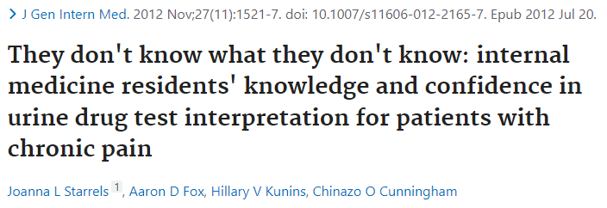
Providers Are Challenged

Slide 22
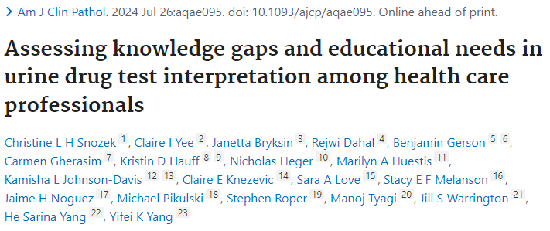
Many Testing Labs Are Behind, Too!

Slide 23
Are We Looking in the Right Place at the Right Time, in the Right Setting, on the Right Patient…?
Matrix, def: a natural and “complete” biological specimen
How methods perform depends highly on the matrix tested
Consider if & when the compound is expected to appear there (dynamics vs kinetics)
Also, for how long (clearance rate)
minutes
hours
days
weeks
months
years
Blood
Sweat
Oral fluid
Urine
Tissue(umbilical)
Meconium
Hair, nails, teeth, bone
Dose

Slide 24
What Kind of Evidence is Needed?
Clinical/Medical Testing
Forensic Confirmatory Assays
No chain of custody = lower level of evidence
“Confirmatory” here = compliance-checking or checking a screen result
Intent: medical use
People performing the tests are typically not toxicology experts
Tox/drug testing is part of a larger clinical menu, general licensing
Full chain of custody = best level of evidence
“Confirmatory” here = virtually anything present is detected, reported with precision & accuracy at a forensic level, to endpoint
Intent: medicolegal use
Toxicology experts control all aspects of testing & reporting
Tox/drug testing IS the menu & reason for licensure

Slide 25
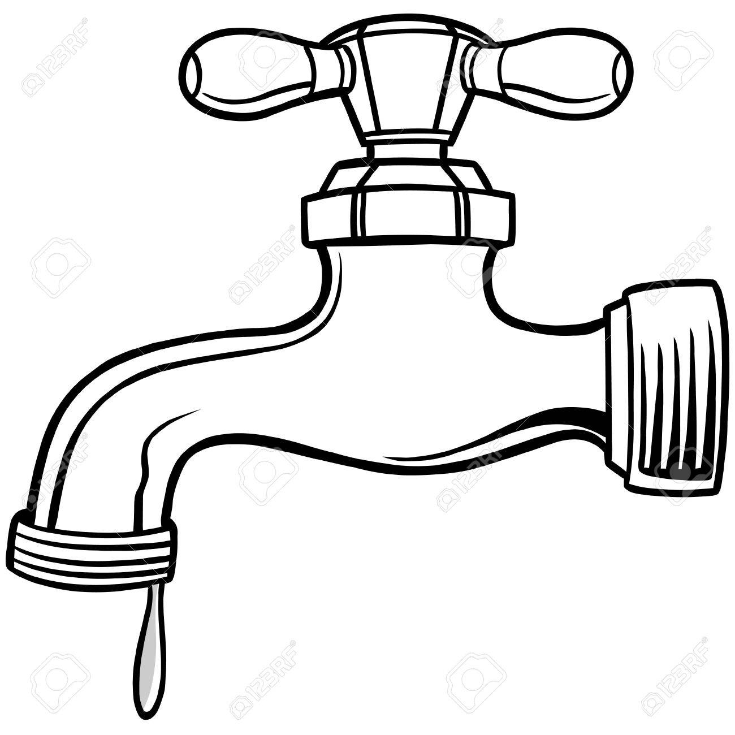
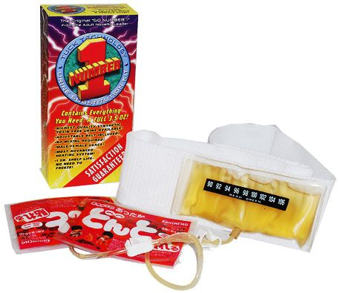
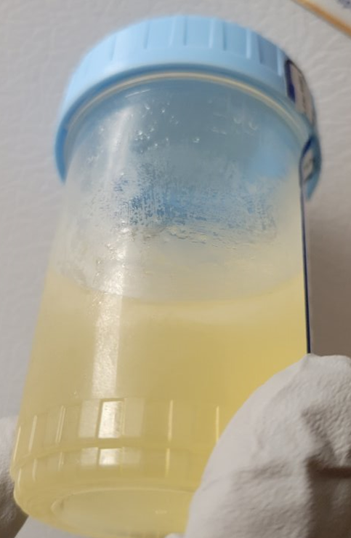
People Can Be Tricky
May try to conceal results for an array of reasons - not all are malignant
May have real medical issues giving unusual testing results
Deliberate Trickery
Substitution
Dilution
Adulteration
Simulated compliance

Slide 26
Concluding Thoughts
Drug testing is a complex topic/subject area
Context is critical
Building policy around drug testing needs to be mindful to the benefits & limitations of the involved testing
The higher the level of evidence needed, the better the testing lab needs to be in its practices/QA/regulatory compliance

Slide 27
Thank you! ~ dtacker@hsc.wvu.edu

Slide 28
Pros & Cons of Immunoassay-Based Drug Tests
Pro
Con
Rapid (≤1 hour usually)
Relatively inexpensive
Most relevant classical drug classes available, some newer drugs
Broad array of equipment can run screening tests
Automated analyzers
Lateral flow “dipsticks”
Drug cups
Not definitive
Cross-reactivity possible (→ FP)
Cutoffs can be inappropriate to clinical need (→ FN); usually not altered due to regulations
Looking in the wrong place for the wrong drug → FN
Time, cost for manufacturers to develop reagents, get them through FDA is a dis-incentive → gaps as new drugs emerge

Slide 29
Pros & Cons of Confirmatory/Mass Spectrometry-Based Drug Tests
Pro
Con
Interference is rare
More compound specific
Many different approaches to isolating any single drug
Superior measuring sensitivity
Wide detection range
Can be quant or qual, depending on method built
Fills menu gaps
Interference is not “zero”
Targeted & untargeted methods have different limitations
TAT slower (days – weeks)
Completely lab-developed
Not many labs have MS labs → have to use “reference” labs → longer TAT
Non-standardized
Expensive

Slide 30
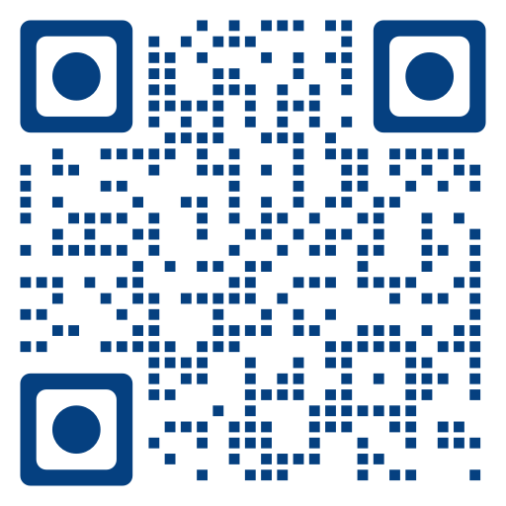
QR code for testing links

