Slide 1
EMERGING DESIGNER DRUGS
Detection of a Growing Threat to Public Health
Savannah R. Clary, Pharm.D., BCPS
For Aegis Internal Use Only – Do Not Distribute

Slide 2
DISCLOSURES
Dr. Clary is employed by Aegis Sciences Corporation in Nashville, TN

Slide 3
LEARNING OBJECTIVES
Describe changes in overdose death rates and impact of polydrug use.
Provide an overview of illicitly-manufactured drugs that have been found in circulation within the United States.
Discuss testing methodologies required for detection of novel psychoactive substances in healthcare specimens using an example case.
What's next? Discuss the need for ongoing surveillance and updated methodology to identify use of illicitly-manufactured substances in the healthcare setting.

Slide 4
Describe changes in overdose death rates and impact of polydrug use.

Slide 5
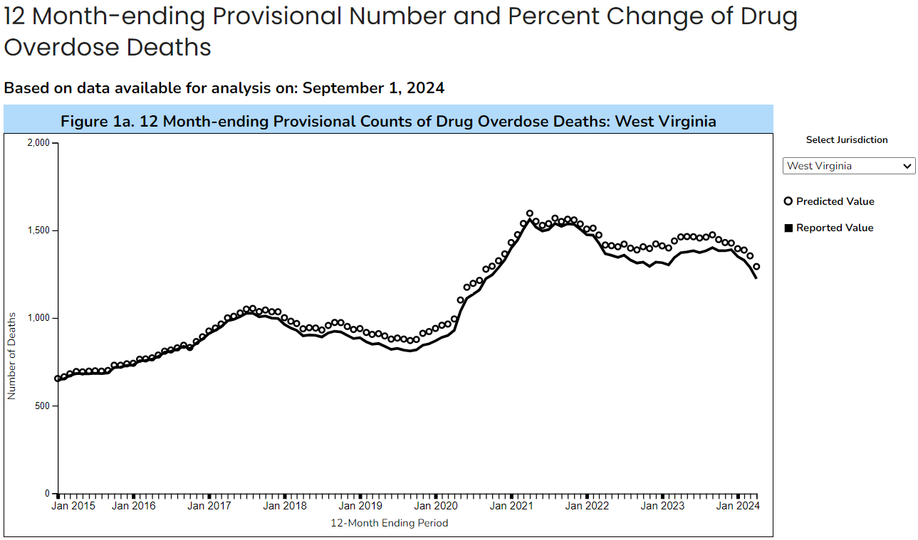
DRUG OVERDOSE DEATHS HAVE INCREASED SIGNIFICANTLY SINCE 2020 AND RATES REMAIN HIGH.
Why?
Ahmad FB, Cisewski JA, Rossen LM, Sutton P. Provisional drug overdose death counts. National Center for Health Statistics. 2023.

Slide 6
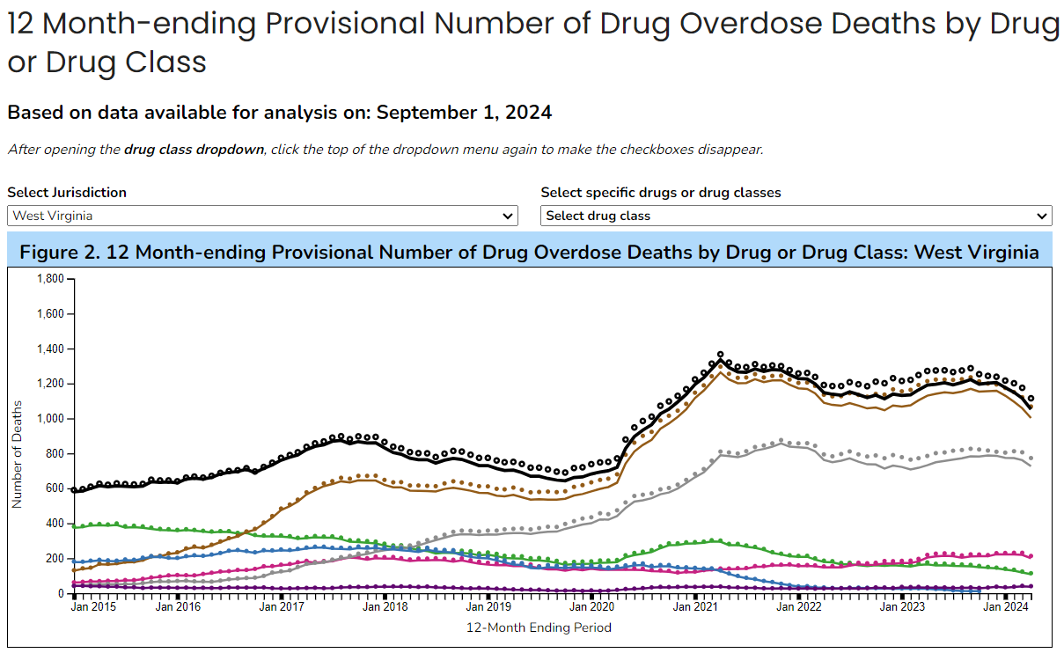
THE RISE OF ILLICITLY-MANUFACTURED DRUGS HAS CREATED NEW CLINICAL CHALLENGES.
Why?
Ahmad FB, Cisewski JA, Rossen LM, Sutton P. Provisional drug overdose death counts. National Center for Health Statistics. 2023.

Slide 7
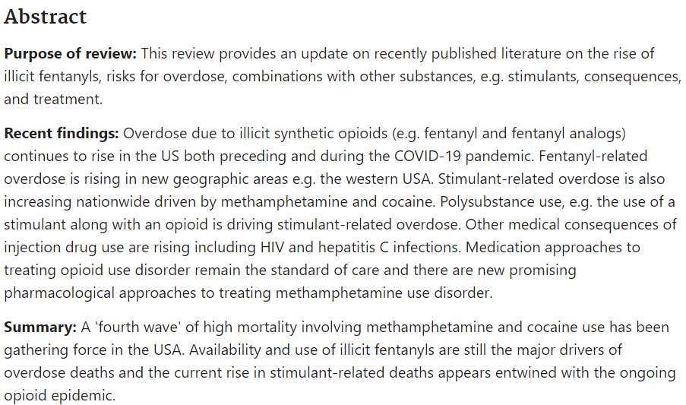
FOURTH WAVE OF THE OPIOID EPIDEMIC
Ciccarone D. The rise of illicit fentanyls, stimulants and the fourth wave of the opioid overdose crisis. Curr Opin Psychiatry. 2021;34(4):344-350. doi:10.1097/YCO.0000000000000717

Slide 8
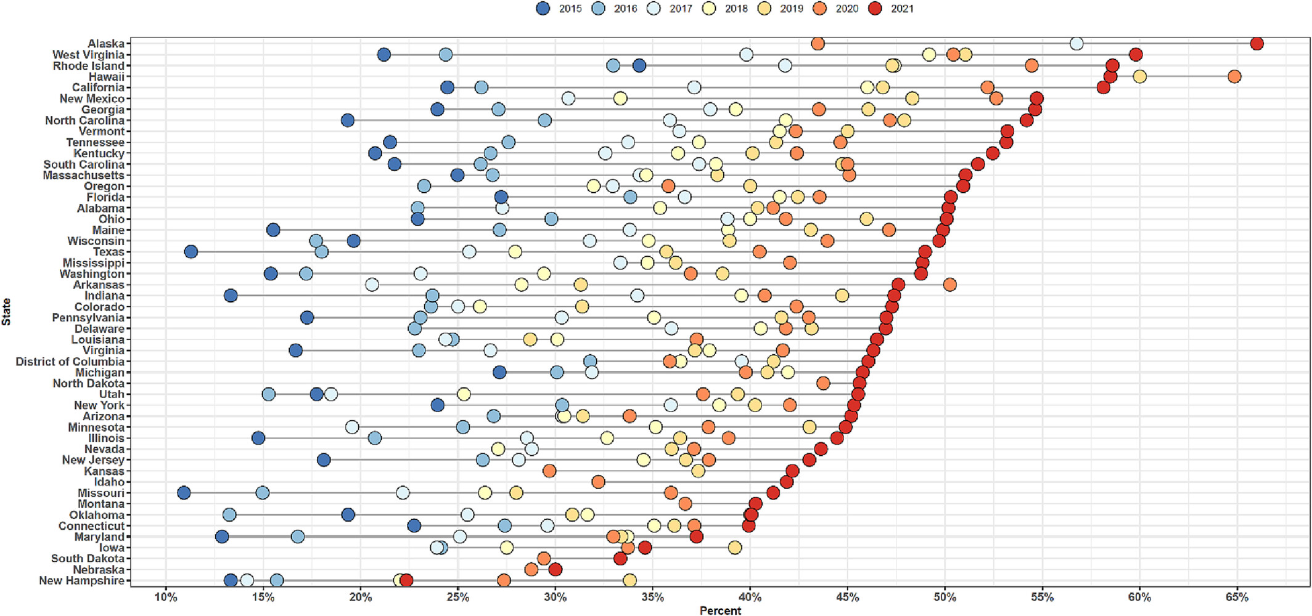
INCREASING COMPLEXITY OF DRUG MARKET IS DRIVING OVERDOSE DEATHS AND CHALLENGING CLINICIANS U.S. WIDE.
Percent of Fentanyl‐Involved Overdose Deaths Co‐Involving Stimulants
by State & Year 2015-2021
Friedman J, Shover CL. Charting the fourth wave: Geographic, temporal, race/ethnicity and demographic trends in polysubstance fentanyl overdose deaths in the United States, 2010-2021 [published online ahead of print, 2023 Sep 13]. Addiction. 2023;10.1111/add.16318. doi:10.1111/add.16318

Slide 9
POLYDRUG USE TRENDS ARE PERSISTING ADMIST OVERALL LIMITED KNOWLEDGE OF ADULTERATED DRUG SUPPLY.
Palamar et al 2022
Evaluation of Poison Control data from 2015-2021
Proportion of co-use of fentanyl + methamphetamine increased 669%
Proportion of co-use of fentanyl + cocaine increased by 374%.
Proportion of major adverse effects involving fentanyl exposure increased from 15.5% to 39.6%
Daniulaityte et al 2023
Analysis of structured interviews of 91 individuals reporting past 30-days use of methamphetamine
62.6% also reported past 30-day use or heroin and/or illicitly-manufactured fentanyl
38.5% rated their current risk for an opioid overdose as none
Toxicology testing performed on specimens provided by interviewees demonstrated presence of 9 fentanyl analogs/metabolites, 12.4% with xylazine detected, and 11.2% with fentanyl detected despite no stated recent use
Palamar JJ, Cottler LB, Goldberger BA, et al. Trends in characteristics of fentanyl-related poisonings in the United States, 2015-2021. Am J Drug Alcohol Abuse. 2022;48(4):471-480. doi:10.1080/00952990.2022.2081923
Daniulaityte R, Ruhter L, Juhascik M, Silverstein S. Attitudes and experiences with fentanyl contamination of methamphetamine: exploring self-reports and urine toxicology among persons who use methamphetamine and other drugs. Harm Reduct J. 2023;20(1):54. Published 2023 Apr 20. doi:10.1186/s12954-023-00782-1

Slide 10
PROVIDE AN OVERVIEW OF ILLICITLY-MANUFACTURED DRUGS THAT HAVE BEEN FOUND IN CIRCULATION WITHIN THE United states.

Slide 11
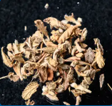
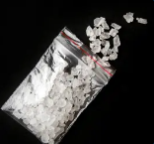
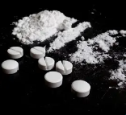
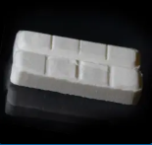
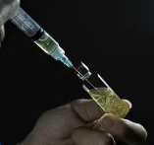
WHAT ARE NOVEL PSYCHOACTIVE SUBSTANCES (NPS)?
Open to some interpretation
A diverse group of modified, synthetic substances created to mimic prescription or illicit drugs
Synthetic cannabinoids
Synthetic stimulants
Designer opioids
Designer benzodiazepines
Hallucinogens
Dissociatives
Others (Xylazine, Medetomidine, Phenibut, Tianeptine)
However, some may be prescription drugs:
Approved in other countries, or
Veterinary use

Slide 12
HOW ARE NPS ACCESSED?
Intentional exposure
Purchase from local brick and mortar stores
Some synthetic cannabinoids, cathinones in the past
Internet with direct delivery to door
“Research chemical” suppliers
Dark Web
Traditional distribution networks (street dealers)
Unintentional exposure to a product ultimately from an initial source listed above
Jurásek B, Čmelo I, Svoboda J, Čejka J, Svozil D, Kuchař M. New psychoactive substances on dark web markets: From deal solicitation to forensic analysis of purchased substances. Drug Test Anal. 2021;13(1):156-168. doi:10.1002/dta.2901
https://www.cfsre.org/nps-discovery/drug-checking/drug-checking-q3-2022-philadelphia-pennsylvania-usa

Slide 13
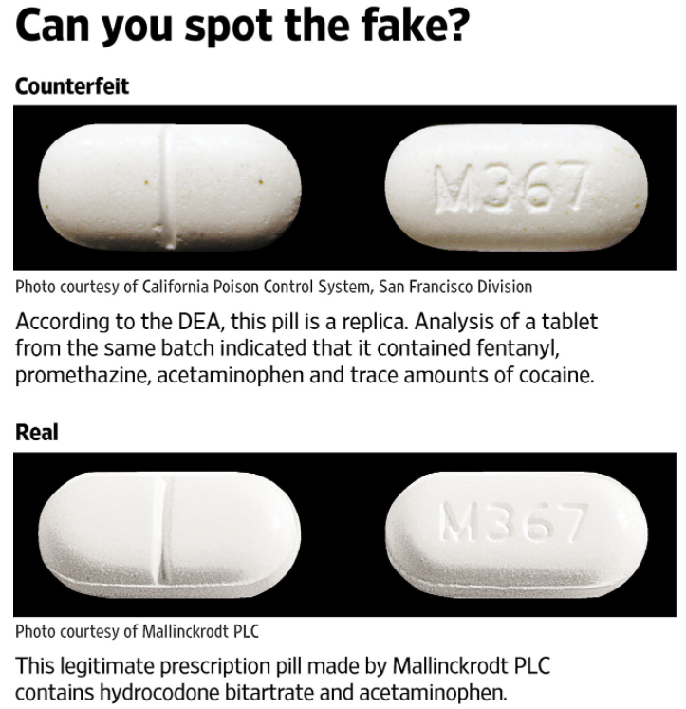
COUNTERFEIT TABLETS
US Drug Enforcement Administration. 2020 National Drug Threat Assessment. March 2021
Blumenberg A, Hughes A, Reckers A, et al. Flualprazolam: Report of an Outbreak of a New Psychoactive Substance in Adolescents. Pediatrics. 2019;146(1):e20192953
Arens A, et al. Adverse effects from counterfeit alprazolam tablets. JAMA Internal Medicine. October 2016; 176;10; 1554-55.
DEA. One Pill Can Kill. Accessed January 19, 2022. Available at: https://www.dea.gov/onepill

Slide 14
NPS OPIOIDS
Designer opioids are mistakenly thought of as “legal” replacements for controlled opioids
Utilized at times in counterfeit benzodiazepines and analgesic medication
Potency varies within these products and poses varying risks for poisoning, respiratory depression, and fatalities
In most cases, they are more potent than morphine
Many are more potent than fentanyl
Examples: fentanyl analogs, nitazene analogs, utopioids, others

Slide 15
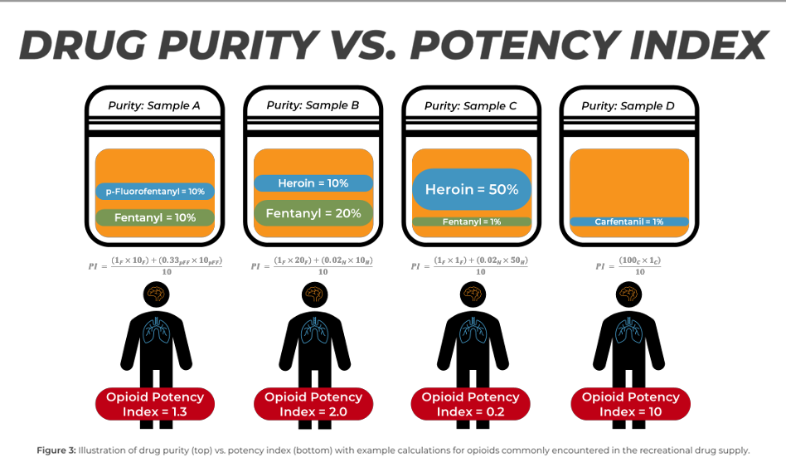
NPS POTENCY, IMPACT ON ADVERSE EVENTS
Variation in drug purity and potency can impact risk for adverse events and overdose
“…cyclopropylfentanyl is a full agonist (EC₅₀ = 8.6 nM, %Emax = 113%), with potency and efficacy similar to fentanyl (EC₅₀ = 10.3 nM, %Emax = 113%). By contrast, valerylfentanyl is a partial agonist at MOR (EC₅₀ = 179.8 nM, %Emax = 60%).”
“… cyclopropylfentanyl is 100-times more potent as an antinociceptive agent (ED₅₀ = 0.04 mg/kg, s. c.) than valerylfentanyl (ED₅₀ = 4.0 mg/kg, s.c.).”
“…cyclopropylfentanyl presents much greater risk of adverse effects when compared to valerylfentanyl.”
Xie B, Le Rouzic VP, Goldberg A, et al. Binding preference at the μ-opioid receptor underlies distinct pharmacology of cyclopropyl versus valeryl analogs of fentanyl. Neuropharmacology. 2023;227:109442. doi:10.1016/j.neuropharm.2023.109442
Krotulski, AH, Shinefeld, J, DeBord, J, Logan, BK (2022). Fentanyl Purity, Potency & Synthesis: Real-Time Testing of Opioid Drug Products in the United States. Center for Forensic Science Research and Education, United States of America.

Slide 16
“NITAZENE” DESIGNER OPIOIDS
“Alex Krotulski, associate director at the Center for Forensic Science Research and Education in Willow Grove, Pa., said protonitazene is three or four times more powerful than fentanyl — whose extreme potency has helped drive record-breaking overdose deaths in the United States — and isotonitazene is about 10 times more powerful. Krotulski, who has studied the nitazene substances closely in conjunction with forensic labs across the country, said they have been identified in the Midwest, South and Southwest, as well as on the Eastern Seaboard.”
https://www.washingtonpost.com/local/dc-politics/new-opioids-more-powerful-than-fentanyl-are-discovered-in-dc-amid-deadly-wave-of-overdoses/2021/11/29/680afb2c-4d43-11ec-94ad-bd85017d58dc_story.html

Slide 17
WHAT ARE NITAZENE ANALOGS?
Novel Psychoactive Substances in the subclass 2-benzylbenzimidazole
Structurally different from opioids
Attach to the same mu-opioid receptor
Limited information is available regarding the overall potency of nitazene analogs in comparison to illicitly-manufactured fentanyl (IMF) and other opioids
Assessment of 14 nitazene analogs via in vitro experiments demonstrated that drugs within the nitazene class often have greater potency than illicitly-manufactured fentanyl, prescription opioids, and other designer opioids
Benzimidazole-Opioids. Drug Enforcement Administration. Published January 2024. Accessed May 20, 2024. https://deadiversion.usdoj.gov/drug_chem_info/benzimidazole-opioids.pdf
Pergolizzi J Jr, Raffa R, LeQuang JAK, Breve F, Varrassi G. Old drugs and new challenges: a narrative review of nitazenes. Cureus. 2023;15(6):e40736. doi: 10.7759/cureus.40736
Vandeputte MM, Van Uytfanghe K, Layle NK, St Germaine DM, Iula DM, Stove CP. Synthesis, Chemical Characterization, and μ-Opioid Receptor Activity Assessment of the Emerging Group of "Nitazene" 2-Benzylbenzimidazole Synthetic Opioids. ACS Chem Neurosci. 2021 Apr 7;12(7):1241-1251. doi: 10.1021/acschemneuro
Krotulski AJ, Papsun DM, Kacinko SL, Logan BK. Isotonitazene quantitation and metabolite discovery in authentic forensic casework. J Anal Toxicol. 2020;44:521–530. doi: 10.1093/jat/bkaa016
National drug threat assessment 2024. Drug Enforcement Administration. Publlished May 2024. Accessed May 23, 2024. https://www.dea.gov/sites/default/files/2024-05/NDTA_2024.pdf

Slide 18
HISTORY & LEGAL STATUS
OF NITAZENE ANALOGS
Initial development began in the 1950s
Originally formulated by CIBA Aktiengesellschaft, a Swiss company
Numerous compounds in the benzimidazole class were formulated with the intention of creating an analgesic
The most potent derivative created was found to be 1000-fold more potent than morphine
Development of these compounds was stopped due to concern for addictive properties and high potency
No analogs have been clinically approved for therapeutic use
As of January 2024, 10 nitazene analogues are classified as Schedule I Controlled Substances in the United States
Nitazene analogs - Clinical Update. Aegis Sciences Corporation. Published October 18, 2023. Accessed May 20, 2024. https://www.aegislabs.com/clinical-update/oct23a/
Benzimidazole-Opioids. Drug Enforcement Administration. Published January 2024. Accessed May 20, 2024. https://deadiversion.usdoj.gov/drug_chem_info/benzimidazole-opioids.pdf
Vandeputte MM, Van Uytfanghe K, Layle NK, St Germaine DM, Iula DM, Stove CP. Synthesis, Chemical Characterization, and u-Opioid Receptor Activity Assessment of the Emerging Group of “Nitazene” 2-Benzylbenzimidazole Synthetic Opioids. ACS Chem Neurosci. 2021;12(7):1241-1251. doi:10.1021/acschemneuro.1c00064

Slide 19
INFORMATION ON NITAZENE DETECTION
Isotonitazene was among the first nitazene analogs discovered in the illicit market in 2019 with reports from Europe, Canada, and the United States
Metonitazene was discovered soon after in early 2020
Metonitazene surpassed Isotonitazene in prevalence in 2021 to become the most prevalent nitazene analogue detected through 2023
Protonitazene, first detected in 2021, became second most commonly detected in 2023
There have been over 4,300 reports since 2019 of nitazenes to the DEA
Pergolizzi J Jr, Raffa R, LeQuang JAK, Breve F, Varrassi G. Old drugs and new challenges: a narrative review of nitazenes. Cureus. 2023;15(6):e40736. doi: 10.7759/cureus.40736
Krotulski AJ, Papsun DM, Kacinko SL, Logan BK. Isotonitazene quantitation and metabolite discovery in authentic forensic casework. J Anal Toxicol. 2020;44:521–530. doi: 10.1093/jat/bkaa016
National drug threat assessment 2024. Drug Enforcement Administration. Publlished May 2024. Accessed May 23, 2024. https://www.dea.gov/sites/default/files/2024-05/NDTA_2024.pdf

Slide 20
INFORMATION ON NITAZENE DETECTION
Results of testing for more than 800,000 urine/oral fluid specimens collected from 1/1/23-3/31/24 that included medically necessary testing for fentanyl and designer opioids were analyzed
Samples received from >900 practice sites submitting specimens continuously throughout this timeframe
When comparing test results of Q1-2024 to those of Q1-2023 when fentanyl was detected (N: 41,323 samples)
17% increase in identification of nitazene analogs in specimens tested.
When nitazenes were identified, fentanyl was detected 99% of the time, indicating a significant co-positivity of these substances.
14% decrease in samples with only fentanyl identified
25% increase in samples with fentanyl + fentanyl analog identified
33% increase in samples with fentanyl + fentanyl analog + nitazene analog identified
63% decrease in samples with a fentanyl + nitazene analog identified
Schrecker, J. 2024. Unpublished data. Aegis Sciences Corporation.

Slide 21
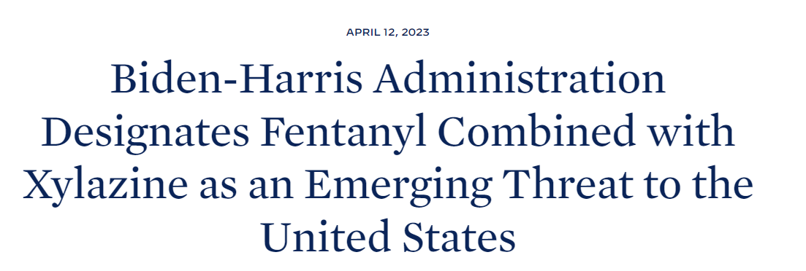
XYLAZINE
Veterinary sedative
Potent α₂-adrenergic agonist
Decreases the release of dopamine and norepinephrine in the CNS causing sedation, muscle relaxation, and decreased pain sensation
Never FDA-approved in humans due to side effects (CNS depression/hypotension)
Added as an adulterant to illicit drugs

Slide 22
XYLAZINE: RISKS
Not currently known to be reversed by naloxone
People often unaware of exposure
Repeated exposure may lead to severe, necrotic skin ulcerations requiring
Complicated wound care
Prolonged antibiotics
Amputation
The mechanism is thought to be due to direct vasoconstricting effect on local blood vessels and the resultant decreased skin perfusion
Prolonged use can lead to decreased perfusion and impaired wound healing, leading to higher chances of infection of these ulcers and topical effect of vasoconstriction
Repeated exposures to xylazine leads to dependence and severe withdrawal symptoms – unable to manage with standard treatment options
FDA warns about risk of xylazine exposure in humans. (2022). Food and Drug Administration. https://www.fda.gov/media/162981/download
Kariisa M, Patel, P, Smith H, Bitting J. MMWR Morb Mortal Wkly Rep. 2021;70(37):1300-1302.

Slide 23
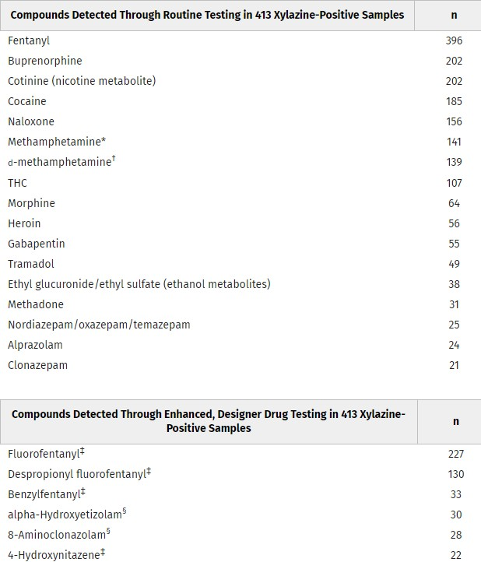
SUBSTANCES FOUND WITH XYLAZINE
Holt et al:
Provider ordered testing for xylazine analyzed using LC/MS/MS
Retrospective analysis was performed on xylazine-positive samples collected from April 2021 to March 2022
Xylazine was identified in 413 of 59,498 samples
Originated from 25 of the 39 states where testing was ordered
Holt AC, Schwope DM, Le K, Schrecker JP, Heltsley R. Widespread Distribution of Xylazine Detected Throughout the United States in Healthcare Patient Samples [published online ahead of print, 2023 Jan 6]. J Addict Med. 2023;10.1097/ADM.0000000000001132. doi:10.1097/ADM.0000000000001132

Slide 24
DESIGNER BENZODIAZEPINES
Benzodiazepines (BZD) are some of the most prescribed medications in the U.S. with a 67% increase between 1996 to 2013.
These are commonly abused for their euphoric, hypnotic, and other properties
Like designer opioids, there has been an increase in new designer benzodiazepines (DBZDs) over the past few years
May cause an immunoassay (IA) “false-false positive” if only using traditional BZD test for confirmation
IA tests may detect DBZD

Slide 25
DESIGNER BENZODIAZEPINES
‘ "If teens are not getting benzodiazepines from friends, surprisingly, these drugs can also be legally purchased online," says Dr. Weinstein. When teens purchase benzos online, they are often buying a counterfeit medication often known as "designer benzos," which are not necessarily labeled or monitored as a controlled substance. ’
https://www.yahoo.com/video/benzos-rising-popularity-among-teens-174946047.html?guccounter=1&guce_referrer=aHR0cHM6Ly93d3cuZ29vZ2xlLmNvbS8&guce_referrer_sig=AQAAAHQiE0Bwsws7QewWFtae9JPhgnATUnRoZ7ir0LdijlIY47x9KM-P0S7U0X7nat9Emjlh812vjFhMwMRGs-2lYjUc4DgeCTAJdICofpAGrYWbjKDqhjYt1tqLVSnpw7JfR0yt6Pt4_NbHk3n0aPhB9EapCkDXfsZbdoNgVU0bI74J

Slide 26
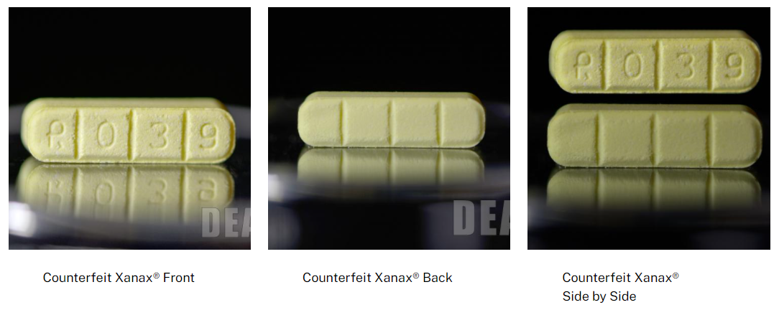
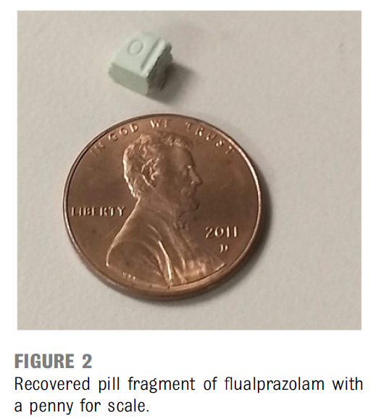
DESIGNER BENZODIAZEPINES
US Drug Enforcement Administration. 2020 National Drug Threat Assessment. March 2021
Blumenberg A, Hughes A, Reckers A, et al. Flualprazolam: Report of an Outbreak of a New Psychoactive Substance in Adolescents. Pediatrics. 2019;146(1):e20192953
Arens A, et al. Adverse effects from counterfeit alprazolam tablets. JAMA Internal Medicine. October 2016; 176;10; 1554-55.
DEA. One Pill Can Kill. Accessed January 19, 2022. Available at: https://www.dea.gov/onepill

Slide 27
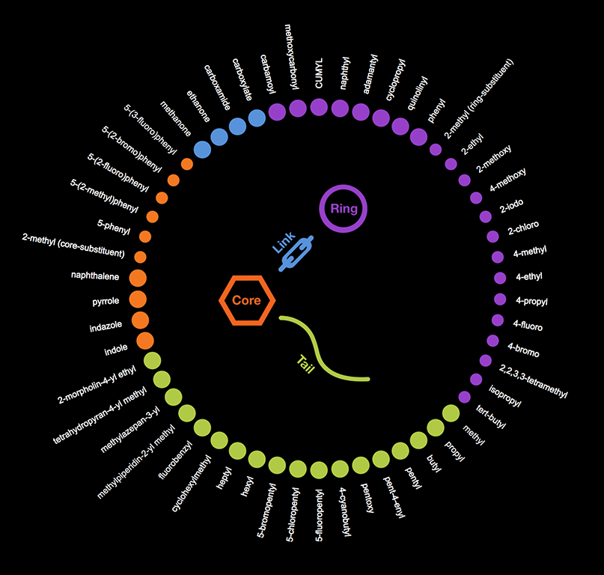
Chemistry of synthetic cannabinoids
SYNTHETIC CANNABINOIDS
Synthetic Cannabinoid Receptor Antagonists (SCRA)
Substances which mimic the effects of delta-9-tetrahydrocannbinol (THC), the psychoactive component of cannabis
Misleadingly called “synthetic marijuana”
Unregulated mind-altering substances
Potency frequently varies
Synthetic cannabinoids are added to plant material in one of two ways
Sprayed
Mixed
Common ways cannabinoids are ingested:
Smoked as dried plant material
Brewed as a tea
Vaporized in e-cigarettes
Psychotic effects range from:
Delusional or disordered thinking
Relaxation
Elevated mood
Anxiety
Paranoia
Very rare, isolated cases of bleeding disorders due to adulteration with anticoagulants (brodificoum).
Reported 2-3 times over the last 5 years.

Slide 28
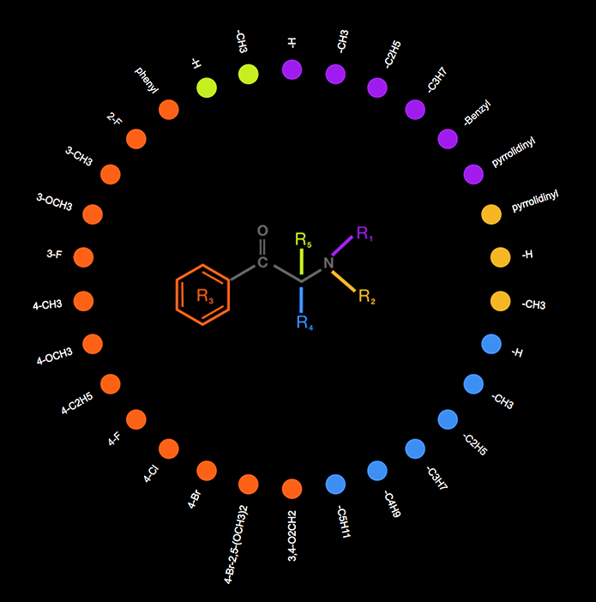
SYNTHETIC STIMULANTS
Cathinone is found in the khat plant, a shrub known for its mild stimulant effects
Synthetic cathinones contain one or more human engineered chemicals related to cathinone
Used by high-risk drug users but more commonly those who inject stimulants, heroin and other opioids
Broadly categorized as:
Methamphetamine-like synthetic cathinones
MDMA-like synthetic cathinones
Cocaine-MDMA mixed synthetic cathinones
Selective catecholamine uptake inhibitors
Other synthetic stimulants are abused which are structurally similar, but not technically cathinones
Piperazines
Others
Chemistry of synthetic cathinones

Slide 29
SYNTHETIC STIMULANTS
Commonly labeled as stimulants and known as:
Bath salts
Plant food
Jewelry cleaner
Phone screen cleaner
Side effects:
Paranoia
Hallucinations
Increased sex drive
Panic attacks
Increased friendliness
Excited delirium
They can be ingested in numerous ways:
Swallowed
Snorted
Smoked
Injected

Slide 30
HALLUCINOGENS/DISSOCIATIVES
Traditional
LSD
PCP
Ketamine
Psilocybin
Novel
LSD analogs
PCP analogs
Ketamine analogs

Slide 31
HALLUCINOGENS
Reported effects:
Emotional swings
Seeing images
Hearing sounds
Sensations that seem real, but are not
Long-term effects:
Persistent Psychosis
Visual disturbances, disorganized thinking, paranoia, mood disturbances

Slide 32
DISSOCIATIVES
Effects at low doses:
Numbness
Loss of coordination, disorientation, and confusion
Dizziness, nausea, vomiting
Elevated blood pressure, heart rate, respiratory rate and body temperature
Effects at high doses:
Hallucinations
Memory loss
Dangerous changes in blood pressure, heart rate, respiratory rate and temperature
Psychologic distress
Use with other CNS depressants can lead to respiratory arrest

Slide 33
DISSOCIATIVES
Long-term effects largely unknown, but long-term PCP use has resulted in:
Persistent speech difficulties
Memory loss
Depression
Suicidal thoughts
Anxiety
Social withdrawal

Slide 34
Discuss testing methodologies required for detection of novel psychoactive substances in healthcare specimens using an example case.

Slide 35
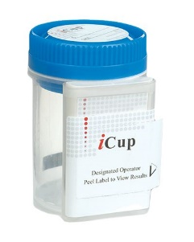
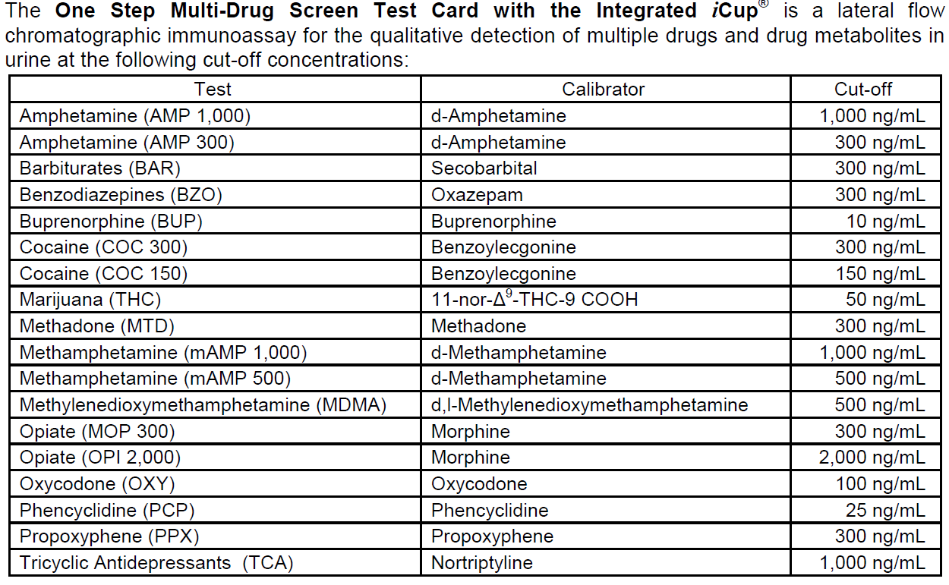
EXAMPLE CASE – PART 1
An individual is receiving treatment in an outpatient medication-assisted treatment (MAT) setting for opioid-use disorder. Individual also has a history of benzodiazepine misuse that required a significant inpatient stay for withdrawal management prior to initiation of outpatient MAT.
Based on medical history, medical provider is interested in assessing:
Adherence to prescribed buprenorphine/naloxone
Abstinence from non-prescription opioid use
Abstinence from non-prescription benzodiazepine use
Provider requests a urine sample which is tested using a point-of-care cup in the office.

Slide 36
EXAMPLE CASE – PART 2
Definitive Testing:
Negative for benzodiazepines;
Positive for Fentanyl, Buprenorphine, and Naloxone
Presumptive Testing: positive for benzodiazepines
Which test is correct?
What does this mean for this individual?
Is this a false positive on the immunoassay test?

Slide 37
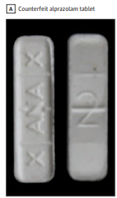
EXAMPLE CASE – PART 3
Next Steps:
Individual in treatment attested to using “Valium” that he was purchasing outside of a pharmaceutical setting
Stated that the definitive tests were “incorrect” because he was testing positive for benzodiazepines at the point of care, and he was not using fentanyl
Initially, testing ordered was only for definitive testing of prescription benzodiazepine
Designer benzodiazepine testing was added to the specimen
Results:
Definitive testing for benzodiazepine metabolites associated with diazepam use were negative
Bromazolam, a designer benzodiazepine, was detected through designer benzodiazepine testing
Indicative of purchase of counterfeit pill sold as “Valium” that was substituted with bromazolam and adulterated with fentanyl

Slide 38
What's next? Discuss the need for ongoing surveillance and updated methodology to identify use of illicitly-manufactured substances in the healthcare setting.

Slide 39
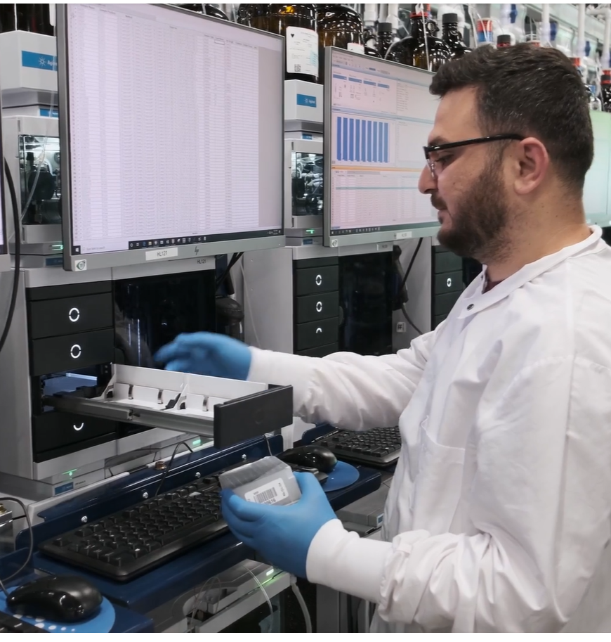
DETECTING HIGH-RISK SUBSTANCE USE
The NPS supply changes regularly.
Timely development of effective presumptive testing can be difficult
Development and validation of definitive laboratory developed tests (LDTs) is often required for evaluation of new to market substances
Laboratory test menus take time to research and develop, so they are a “snapshot in time.”
No high throughput lab is 100% in step with the changes in illicit supply.
When evaluating a laboratory test, it is important to not only understand methodologies employed in testing, but also the components of what is included in testing

Slide 40
AVAILABLE DATA SOURCES FOR HIGH-RISK SUBSTANCES
Who is the source reporting the data?
Forensic lab
Drug sample
Post-mortem sample
Drug Checking Service
Drug sample
Clinical lab
Urine
Oral fluid
Blood
Other
All show access to drugs in their own way, so they can all be useful

Slide 41
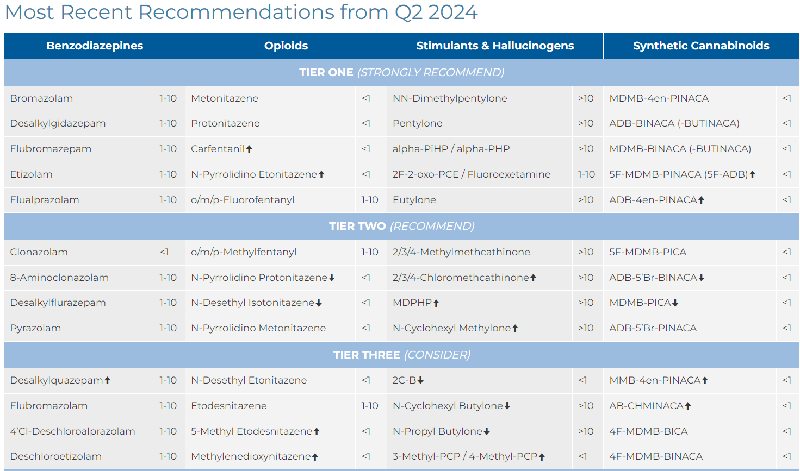
AVAILABLE DATA SOURCES FOR HIGH-RISK SUBSTANCES
Examples of leading resources for surveillance
Center for Forensic Research and Education (CFSRE)
Society of Forensic Toxicologist (SOFT) NPS Committee
DEA Tox Toxicology Testing Program
National Forensic Laboratory Information System
European Union Drugs Agency (EUDA)
https://www.cfsre.org/nps-discovery/scope-recommendations

Slide 42
WV ROLLING YEAR NPS FINDINGS
Designer Opioids
Fluoro Fentanyl
Despropionyl Fluorofentanyl
Fluoro Norfentanyl
Norcarfentanil
4-Hydroxy Nitazene
Despropionyl Bromofentanyl
N-desethyl Etonitazene
Metonitazene
N-desethyl Metonitazene
Acryl Fentanyl
N-Pyrrolidino 4-OH Nitazene
N-desethyl Isotonitazene
N-desethyl Protonitazene
Valeryl Fentanyl Carboxy Mtb
Benzyl Fentanyl
Designer Benzodiazepines
Bromazolam
alpha-Hydroxybromazolam
alpha-Hydroxyetizolam
Etizolam
3-OH-Flubromazepam
Flubromazolam
alpha-Hydroxyflubromazolam
8-Aminoclonazolam
High-level findings associated with medically necessary definitive tests
Dark blue portions of map demonstrate zip codes in which any NPS was detected in last 12 months; testing was performed in a single laboratory
Miscellaneous NPS
Xylazine
4-Hydroxyxylazine
Tianeptine MC5
Tianeptine
Phenibut
Medetomidine
3-OH-Medetomidine
Schrecker, J. 2024. Unpublished data. Aegis Sciences Corporation.

Slide 43
WV ROLLING YEAR NPS FINDINGS
Synthetic Stimulants
Pentylone
N,N-dimethyl Pentylone
Butylone
N-cyclohexyl Methylone
Alpha-D2PV
N-propyl Butylone
N-cyclohexyl Butylone
High-level findings associated with medically necessary definitive tests
Dark blue portions of map demonstrate zip codes in which any NPS was detected in last 12 months; testing was performed in a single laboratory
Synthetic Cannabinoids
MDMB-4en-PINACA BA
MDMB-INACA BA
ADB-BUTINACA NBA
4F-MDMB-BUTINACA N-BA
4F-MDMB-BUTINACA BA
MDMB-BUTINACA BA
Hallucinogens/Dissociatives
2F-2-oxo-PCE
2F-Deschloronorketamine
Schrecker, J. 2024. Unpublished data. Aegis Sciences Corporation.

Slide 44
WV ROLLING YEAR NPS FINDINGS
Primary classes of NPS compounds detected in WV in the past year were Miscellaneous NPS (predominantly xylazine) and Designer Opioids
These substances are most frequently identified alongside illicitly manufactured fentanyl
~1/3 of samples with positive NPS findings had positive results from multiple NPS classes
NPS Detected (Includes Combination by Class) | % of Total
NPS Other | 32.46%
Designer Opioids; NPS Other | 22.67%
Designer Opioids | 15.59%
Synthetic Stimulants | 8.61%
Designer Benzodiazepines | 5.26%
Synthetic Cannabinoids | 5.17%
Designer Benzodiazepines; NPS Other | 3.17%
Designer Benzodiazepines; Designer Opioids; NPS Other | 2.99%
Designer Benzodiazepines; Designer Opioids | 1.45%
NPS Other; Synthetic Stimulants | 0.73%
Schrecker, J. 2024. Unpublished data. Aegis Sciences Corporation.

Slide 45
EMERGENCE OF NEW SUBSTANCES
Since 2018, the Center for Forensic Science Research and Education has reported
“NPS Discovery has reported 154 newly discovered NPS in the United States”
“NPS Discovery has identified 240 NPS in forensic samples”
These substances
Contribute to risk for adverse events, including overdose
Rapidly evolve over time
https://www.cfsre.org/nps-discovery/trend-reports

Slide 46
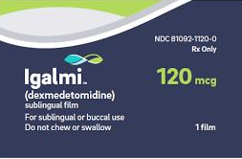
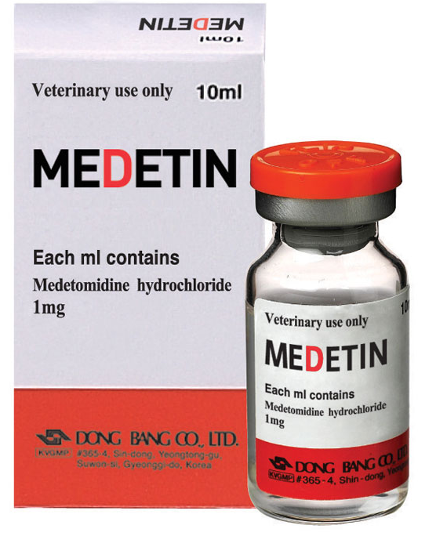
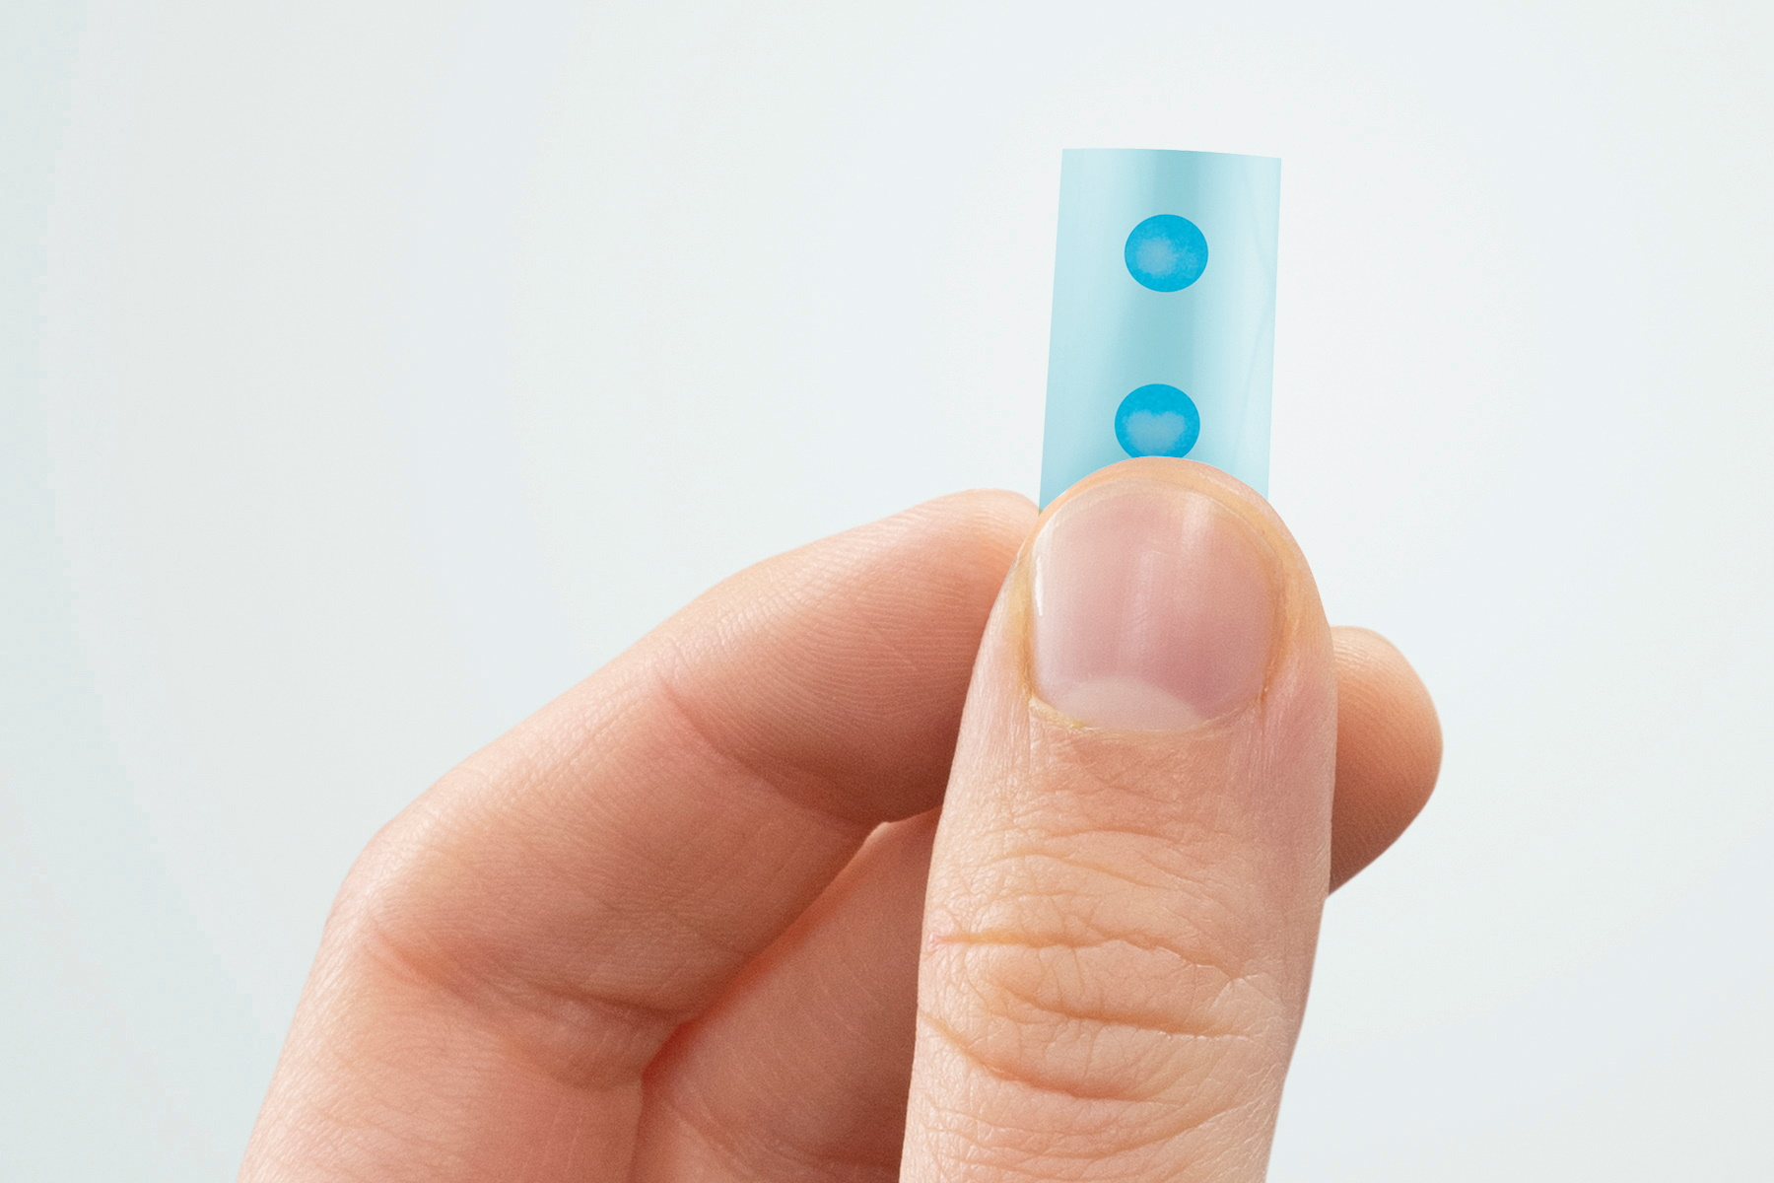
WHAT IS MEDETOMIDINE?
Potent α₂-adrenergic agonist
Sedative and analgesic
Available in both veterinary and human approved pharmaceutical
Can be used for agitation (bipolar and schizophrenia), procedural sedation and other off-label uses including alcohol withdrawal
Not a controlled substance so will not be recorded in a state prescription monitoring program
Added as an adulterant to illicit drugs
https://www.cfsre.org/images/content/reports/public_alerts/Public_Alert_Medetomidine_052024.pdf

Slide 47
SUMMARY
Illicitly-manufactured substances continue to enter the drug market in the United States
Those substances that are in circulation will likely continue to change over time requiring targeted methodology for identification
Leveraging data provided by surveillance organizations will be key in staying ahead of the curve in identification of high-risk, illicitly-manufactured drugs
Risks associated with these substances are often due to
Their inability to be consistently detected
Lack of available information regarding their effects when encountered
Their potency in comparison to pharmaceutical counterparts within the same drug class

Slide 48
EMERGING DESIGNER DRUGS
Detection of a Growing Threat to Public Health
Savannah R. Clary, Pharm.D., BCPS
For Aegis Internal Use Only – Do Not Distribute

