Slide 1






From Community Insights to Action: Bridging Gaps in Maternal Health Through Coordinated Care and Addressing Key Determinants in
Rural West Virginia
West Virginia Perinatal Summit, October 18, 2024
Jacquelyn E. Alvarado, DNP, APRN, CNM, C-EFM

Slide 2





OVERVIEW
  Provide an overview of the SWV Maternal Health Project.
ANALYSIS AND OBSERVATION
  To present observations from the regional Maternal Health Community Assessment. Local maternal health needs and existing support systems that were identified.
OBJECTIVES
MATERNAL HEALTH ACTION TASK GROUPS
  Development of the SWV Maternal Health Task Groups.
ACTION PLANNING & NEXT STEPS
  Planning, implementation, and timeline of the SWV Maternal Health Task Groups.

Slide 3
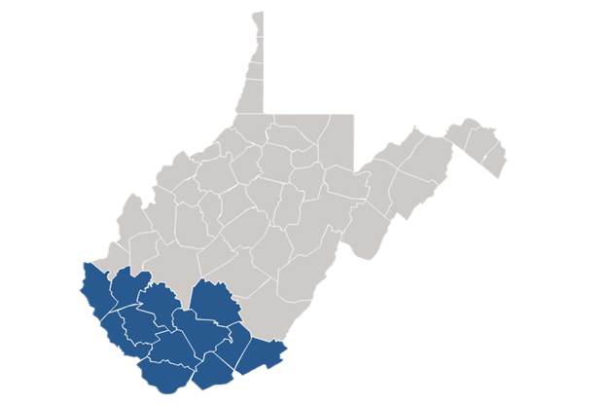
Project Overview
  Texas A&M Rural & Community Health Institute
  USDA Rural Development
  This project aims to work with SWV communities to give moms and babies the best chance to be healthy and thrive.
Counties:
Boone | Mingo
Fayette | Monroe
Lincoln | Raleigh
Logan | Summers
McDowell | Wayne
Mercer | Wyoming
Phase 1
Phase 2
Phase 3
Maternal Community Health Assessment
Create an
Action Plan
Implement
Action Plan
Project Duration - Through June 2025

Slide 4

Maternal Health Assessment Process
02.
04.
01.
03.
05.
Conduct Community Discussion Groups and Individual Interviews
Report Assessment Observations to Community
Visit project region and conduct interviews and discussion groups with a variety of stakeholders.
Hold Maternal Health Forum.
Collect Secondary Data
Review and Compile Assessment Findings
Launch Action Planning
Research publicly available demographic, maternal, and population health data.
Analyze both secondary and community discussion data.
Form task groups and develop Action Plan.

Slide 5

Maternal
Health Assessment

Slide 6
Data Collected
Secondary Data Sources
Focus Group and Interview Questions
1. How would you describe your community?
2. What maternal healthcare services are currently available in the local area?
3. What challenges or barriers do pregnant women face in accessing maternal healthcare services here?
4. What does your community need to provide high-quality maternal healthcare?
5. What has been done to address these challenges?
6. What advice do you have for people who are working on bringing more programs and services to your community?
  US Census Bureau
  American Community Survey
  March of Dimes Foundation Peristats
  America’s Health Rankings
  Robert Wood Johnson County Rankings and Roadmaps
  Healthy People 2030
  West Virginia Department of Health and Human Resources
  Feeding America
  Regional Community Health Assessments
  Centers for Disease Control and Management WONDER
  West Virginia Perinatal Partnership

Slide 7
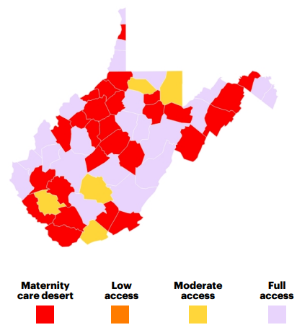
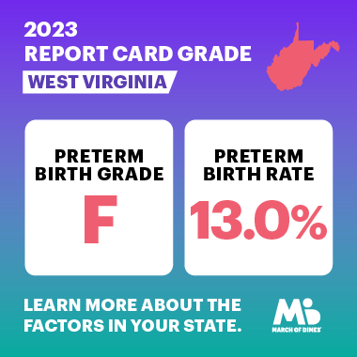

Maternal Health in WV Seconday Data Review
  49.1% of counties are maternity care deserts.
    20.1% of all births are in maternity care deserts.
    22.2% of women had no birthing hospital within 30 minutes.
  14.5% of birthing people received no or inadequate prenatal care.
  5.8% of maternity care providers practice in rural counties.
  1 in 8 babies (13.0% of live births) were preterm.
  Maternal mortality rate is 25.4 per 100,000 births.
  56.5% of women had one or more chronic health conditions.
  1 in 13 women of childbearing age (7.8%) was uninsured.
  8.1% Maternal drug use during pregnancy.
  10.3% Smoking.
  15.5% Binge drinking.
  22.8% Pre-pregnancy depression.
  11.5% Postpartum depression symptoms.
  39.4% experienced intimate partner physical violence, sexual violence, and/or stalking
  47.5% will experience rape or attempted rape by a current or intimate partner
March of Dimes (2023).
(March of Dimes, 2022).

Slide 8
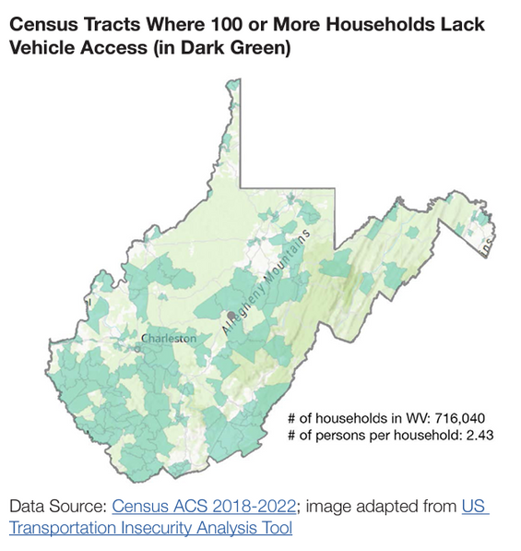
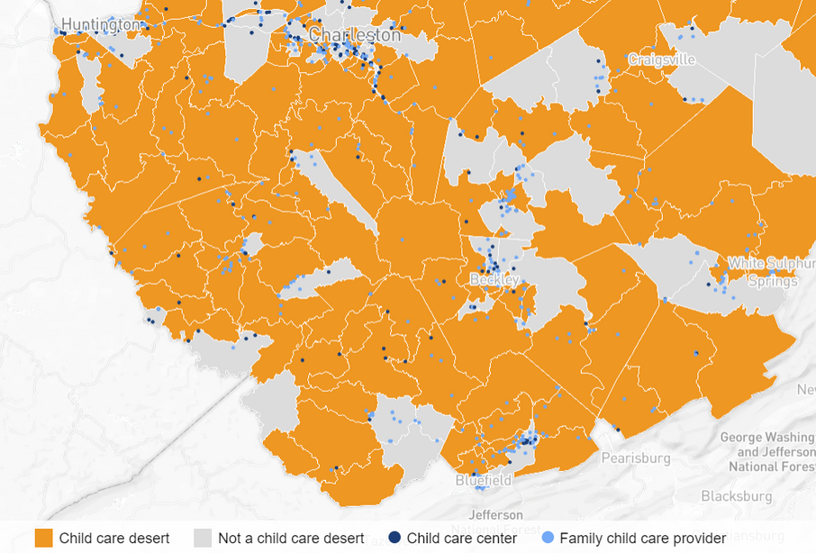
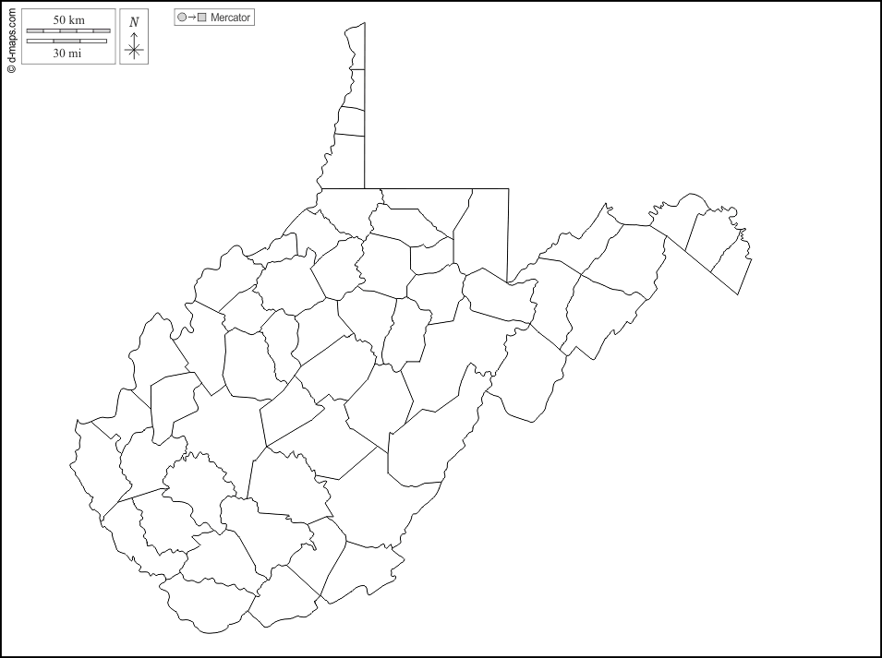
Seconday Data Review Continued
  Limited access to care via public transit.
  Three transit systems cover seven counties.
  Modivcare is available for Non-Emergency Medical Transportation.
  WIC serves 70% of all babies.
  Less than half of eligible expectant and post-partum moms participate in WIC.
  5.8% eat adequate amounts of fruits and vegetables every day.
  25% of children live in single-parent households.
  Childcare Desserts.
Prenatal and Birthing
Location Traffic Pattern
Ohio
Cabell
Kanawha
Wayne
Lincoln
Boone
Fayette
Greenbrier
Mingo
Logan
Raleigh
Wyoming
Summers
Monroe
Mercer
Virginia
Kentucky
McDowell

Slide 9





Priority Areas that Emerged from the Assessment
Factors Impacting Health
Clinical Coordination
Awareness of Clinical & Support Services
Behavioral Health and Substance Abuse Management
Coordination
Promotion
Engagement

Slide 10

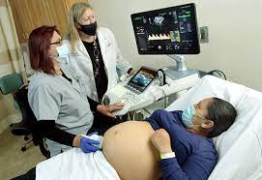



Clinical Care & Coordination Key Focus Areas
High-Risk Pregnancies
Prenatal & Postpartum
SUD, MH, and DV
  Limited MFM Providers
  Distance to MFM Providers
  Lack of resources
  Traveling for inpatient care and delivery services
  Lack of telehealth options
  Limited OB/GYN & CNM Providers
    OBs only in 3 counties
    Not enough Midwives or Doulas
    Low minority representation
  Limited education at prenatal appointments
  Postpartum Follow up
  Lack of Prenatal classes
  Breastfeeding support
  Quality of care
  Lack of provider collaboration between OB and Mental Health/SUD
  Insufficient DV screening
  Lack of PPD screenings
  Underutilization of available resources
  Stigma

Slide 11





Factors Impacting Health Key Focus Areas
Transportation
Childcare
Food Insecurity
  Limited public transportation options
  Missed appointments
  Missed work
  Delayed care
  Increased stress
  Childcare deserts
  Limited drop-in options
  Family dynamics
  Unable to bring children to prenatal visits
  Lack of social support
  Limited access to fresh fruits and vegetables
  Higher prevalence of chronic health conditions and anxiety
  Poor health outcomes
  Neural tube defects
  Low birth weight
  Preterm births
  Developmental issues

Slide 12

Task Group Goals
High-Risk Pregnancies
  Promote Interdisciplinary Collaboration with MFM providers
  Increase Access to OB Providers & MFM Care
  Improve Early Identification, Management, and Surveillance
  Utilize Evidence-Based Practice Recommendations
Prenatal Care & Postpartum Follow-up
  Expand Local Access to Prenatal Care
  Improve Initiation of Prenatal Care & Postpartum Follow-up
  Enhance Continuity and Frequency of Visit
  Implement Telehealth Services
  Enhance Care Coordination
  Encourage Health Insurance Enrollment
Mental Health, SUD, and DV
  Promote Interdisciplinary Collaboration
  Improve Early Detection and Treatment
  Reduce Stigma and Increase Support
  Strengthen Training and Education
  Improve Medication Management
Transportation
  Increase/Improve options for women to access services
Childcare
  Increase childcare services
Food Insecurity
  Increase WIC enrollment
  Expand access to fresh foods by partnering with local farmers' markets

Slide 13





Action Planning Examples
High-Risk Pregnancies
    Telehealth
    Remote Patient Monitoring
    Increase provider recruitment
Prenatal Care & Postpartum Support
    Increase OB provider recruitment
    Care coordinators
    Remote Centering
    Remote Patient Moniroting
    Incentives for care
MH, SUD, DV
    Find Help Expansion
    Collaborations (Southern Highlands)
    2 Week Postpartum Telehealth PPD Screening
    Utilize EBP guidelines
Transportation
    Local transportation coordination
    Volunteer Rideshare
Childcare
    Partner with health systems
    Local daycare-Drop-in care
    Create a local mom peer group
Food Insecurity
    WIC enrollment through Find Help Expansion
    Partner with local farmer's markets (Post 49 Market-Williamson)
    Home food and grocery delivery

Slide 14


  Action Items for the Next Meeting
    Gather information on current efforts to address. transportation, food security, and childcare needs.
    Develop overviews of potential best practice ideas that can be customized for SWV.
  Date and Time of Next Meetings
    Clinical Care: October 21, 2024, at 1 p.m
    Factors Impacting Health: October 21, 2024, at 2 p.m
    Task Group Communications
      archi@tamu.edu or Jacquelyn_Alvarado@tamu.edu
NEXT STEPS

Slide 15
References
Cabell Huntington Hospital. (2024). Maternal hypertension care. Perinatal Center. Retrieved July 21, 2024, from https://cabellhuntington.org/services/perinatal-center/maternal-hypertension-care/
Centers for Disease Control and Prevention. (2020). Pregnancy-related deaths: Data and statistics. Retrieved from https://www.cdc.gov/reproductivehealth/maternal-mortality/pregnancy-related-deaths-data.html
Dawley, D., Breyel, J., Lilly, C., & Umer, A. (2023). Prenatal care utilization among pregnant women with substance use disorder: A Drug-Free Moms and Babies Project study [ID: 1377131]. Obstetrics & Gynecology, 141(5S), 76S.
Driscoll, A. K., & Gregory, E. C. W. (2020, November). Increases in prepregnancy obesity: United States, 2016–2019. NCHS Data Brief, No. 392. U.S. Department of Health and Human Services, Centers for Disease Control and Prevention, National Center for Health Statistics.
Durr, A. J., Robinson, C. H., Seabury, R. A., Calkins, A. L., Pollard, C. R., Thygeson, N. M., Lindberg, C. C., McColley, J. M., & Baus, A. D. (2023). Evaluation of self-measured blood pressure monitoring in a southern rural West Virginia health system. Journal Name, Volume(Issue), pages.
eligibility guidelines for WIC. https://dhhr.wv.gov/News/2024/Pages/Department-of-Health-Informs-Residents-of-Increased-Eligibility-Guidelines-for-WIC.aspx
March of Dimes. (2022). West Virginia state summary. Retrieved July 21, 2024, from https://www.marchofdimes.org/peristats/state-summaries/west-virginia?top=3
March of Dimes. (2023). Maternity care report: West Virginia. March of Dimes. Retrieved July 21, 2024, from https://www.marchofdimes.org/peristats/assets/s3/reports/mcd/Maternity-Care-Report-WestVirginia.pdf
March of Dimes. (2024). Peristats: Preterm birth. Retrieved July 21, 2024, from https://www.marchofdimes.org/peristats/data?reg=99&top=21&stop=600&lev=1&slev=4&obj=35&sreg=54
Kipling, L., Bombard, J., Wang, X., & Cox, S. (2024). Cigarette smoking among pregnant women during the perinatal period: Prevalence and health care provider inquiries — Pregnancy Risk Assessment Monitoring System, United States, 2021. Morbidity and Mortality Weekly Report, 73(17), 393–398. Retrieved from https://www.cdc.gov/mmwr/volumes/73/wr/mm7317a2.htm
Koech, W. A., & Lilly, C. L. (2019). Association of county perinatal resources and gestational weight gain in West Virginia, United States. BMC Pregnancy and Childbirth, 19, 497. https://doi.org/10.1186/s12884-019-2650-7
National Coalition Against Domestic Violence. (2021). Domestic violence in West Virginia. https://assets.speakcdn.com/assets/2497/west_virginia-2021101912193555.pdf
West Virginia Perinatal Partnership. (n.d.). AIM patient safety bundles. Retrieved July 21, 2024, from https://wvperinatal.org/aim-patient-safety-bundles/
West Virginia Department of Health and Human Resources. (n.d.). Smoking and pregnancy. West Virginia Department of Health and Human Resources. Retrieved July 21, 2024, from https://dhhr.wv.gov/wvdtp/Cessation/Pages/Smoking-and-Pregnancy.aspx
West Virginia University. (2023, February 7). WVU study shows that the number of West Virginia infants exposed to drugs in the womb is 10 times higher than the national rate. WVU Today. https://wvutoday.wvu.edu/stories/2023/02/07/wvu-study-shows-number-of-west-virginia-infants-exposed-to-drugs-in-the-womb-is-10-times-higher-than-national-rate
West Virginia Department of Health and Human Resources. (2021). West Virginia vital statistics, 2021. https://dhhr.wv.gov/HSC/SS/Vital_Statistics/Documents/2021Vital.pdf
Society for Maternal-Fetal Medicine. (n.d.). Non-physician providers in maternal-fetal medicine. Retrieved from https://www.smfm.org/news/non-physician-providers-in-maternal-fetal-medicine#:~:text=Several%20practice%20models%20have%20been,care%20have%20also%20been%20increasing
West Virginia University. (2020, February 20). About 8 percent of West Virginia babies are exposed to alcohol shortly before birth. WVU Today. https://wvutoday.wvu.edu/stories/2020/02/20/about-8-percent-of-west-virginia-babies-are-exposed-to-alcohol-shortly-before-birth
West Virginia Department of Health and Human Resources. (2023). Drug-Free Mom and Babies. Retrieved July 21, 2024, from https://dhhr.wv.gov/office-of-drug-control-policy/newsletters/Pages/Drug-Free-Mom-and-Babies.aspx
West Virginia Department of Health and Human Resources. (2024, July 17). Department of Health informs residents of increased

Slide 16


Thank
You

