Slide 1
Congenital Syphilis
Stefan Maxwell MB,BS. FAAP
PEDIATRIX MEDICAL GROUP
Medical Director NICU, Women and Childrens' Hospital
Charleston WV

Slide 2
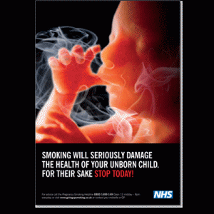
Disclosures
I am not discussing any commercial products or services
I have no financial interests herein
I am in compliance with HIPAA in this presentation

Slide 3


Slide 4
OBJECTIVES
History of Syphilis
Epidemiology
Clinical manifestations
Diagnosis
Treatment and management
Case presentation

Slide 5
Introduction
Before penicillin removed it's sting, congenital syphilis was frequent, dreaded and lethal.
Today it affects a million pregnancies annually
Plays a role in 20% of perinatal deaths in sub-Saharan Africa
Much speculation on the origin of the disease
Was named the French, Spanish, Italian and American disease and epidemics of 1493 and 1496 were extensively reviewed
The "scourge" coincided with the return of Columbus from Americas in 1493

Slide 6
HISTORY
Three hypotheses:
Columbian: Crew acquired from native Americans and took back to Europe in 1493
Pre-Columbian: syphilis present in Europe long before the voyage and was brought to New World by Columbus’ men
Unitarian theory: diseases such as syphilis, yaws, bejel and pinta are all caused by slightly different strains of one organism
T.pallidum, (syphilis) T.p.endemicum,(Bejel) T.p.pertenue,(yaws) T.p.carateum (pinta)

Slide 7


HISTORY
Neonatal syphilis described by Dr Gaspar Torella in 1497:
"In suckling infants, the first infection appears in mouth
or on face; results from infected breasts or nurse's face
or mouth. Nurses often kiss infants and the infected babies transmit
disease to other nurses
In 1532, Jacopo Cattaneo suggested maternal syphilis
transmitted in birth canal or by infected milk
In 1536, Paracelsus called it "the French matter" and was
transmitted a)during conception b)after conception in a
second infective coition or c)outside womb by poisoned
milk

Slide 8

HISTORY
PARACELSUS (1493-1541)
Philippus Aureolus Theophrastus Bombastus von Hohenheim
Swiss German physician, botanist, alchemist, astrologer & occultist Founded discipline of Toxicology “Some diseases are rooted in psychological conditions”

Slide 9

HISTORY
Dr Musa Brassavole (c.1500-1555)
Infection caused by:
Contact at birth
Suckling by an infected nurse
Being itself infected, transmitting to another
nurse
Maternofetal transmission was not thought of, as
the primary infection was not diagnosed in Mother

Slide 10

HISTORY
Augier Ferrier (1513-1588)
In 1564, thought that:
"The disease is acquired in utero inherited from
the father's seed.
When the Mother is infected at conception,
formation of fetal organs is severely disturbed"

Slide 11

HISTORY
“Morbus gallicus”: The French disease or ”Syphilis”. The name "syphilis" was coined by Hieronymus Fracastorius (Girolamo Fracastoro). Fracastorius was a true Renaissance man; he wrote on the temperature of wines, the rise of the Nile, poetry, the mind, and the soul;
He was an astronomer, geographer, botanist, mathematician philosopher and, last but not least ……
in the present context,
He was a physician. In 1530 he published :
"Syphilis sive morbus gallicus"
(Syphilis or the French Disease)
in which the name of the disease first appeared.

Slide 12
HISTORY
John Burns an obstetrician in Glasgow (1811)
"Babies who receive the venereal disease in utero may be born alive with no signs or symptoms at birth, but then develop a wrinkled countenance, (old age in the miniature) with copper-colored blotches which then develop into ulcers within a fortnight"
Michael Underwood (London) and Henry Maunsell (Dublin) named the coryza "snuffles"
Bertin in 1810 described painful bone diseases as "laminated periostitis"
Francois Valleix in 1835 thought this "paralysis" of limbs was a cerebral lesion and applied leeches behind each ear

Slide 13
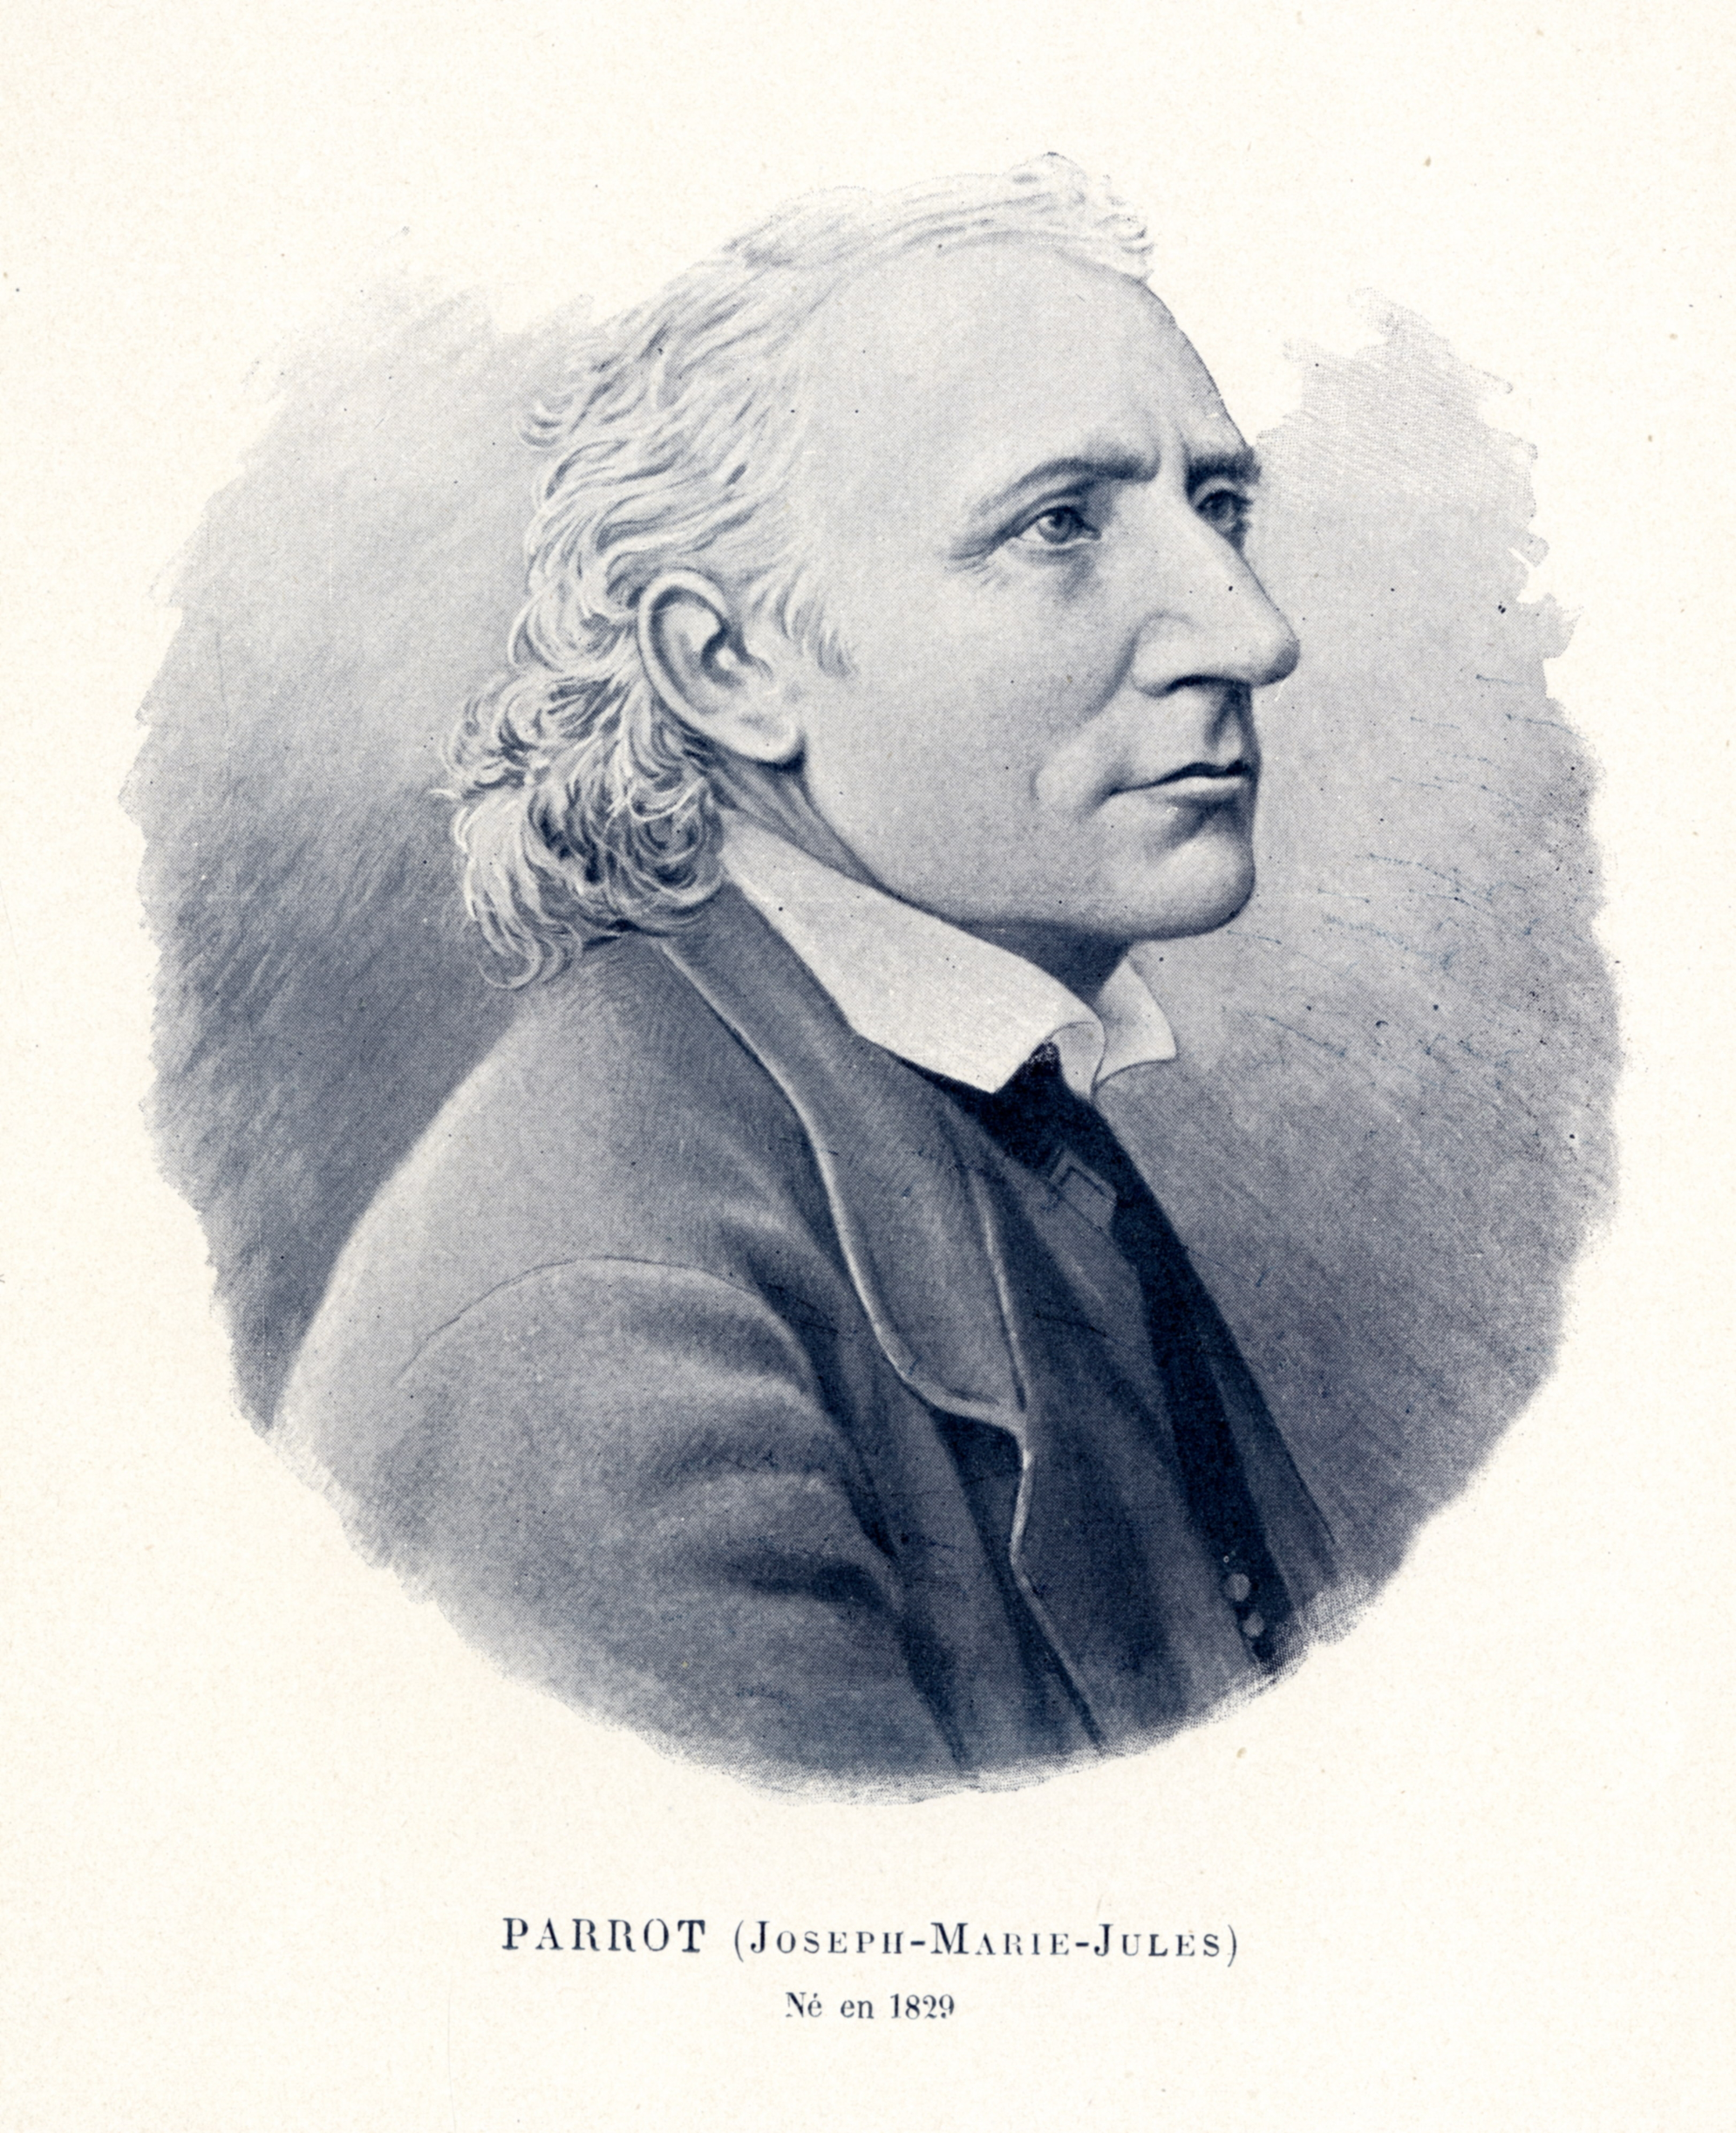
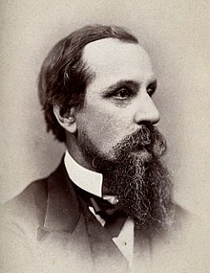
HISTORY
Jules Parrot (1829-1883) named this osteochondritis :
"Pseudo-paralysie" in 1872.
Tardive (delayed) congenital syphilis:
"Keratitis, deafness, and upper incisors which are
short, convergent and narrow with notches" was
described by Jonathan Hutchinson in 1863
He was a surgeon, opthalmologist, dermatologist
venereologist and pathologist (1823-1913)

Slide 14
HISTORY
The Infant Hospital in Vaugirard, Paris (1780-1793)
Opened by Jean Lenoir (Lt. General of Police) for infants with syphilis
Enclosed with a large orchard (vegetables and fodder) and walking areas for Mothers and stables for donkeys, goats and cows
71 beds for syphilitic women and 64 for babies. Women treated with oral mercury and friction. Infants breast-fed by nurses treated with mercury.
In 10 years, 1874 infants treated in the hospice, with 90% mortality.
In 1793 patients transferred to "Hopital des Veneriens" a Convent in Paris

Slide 15
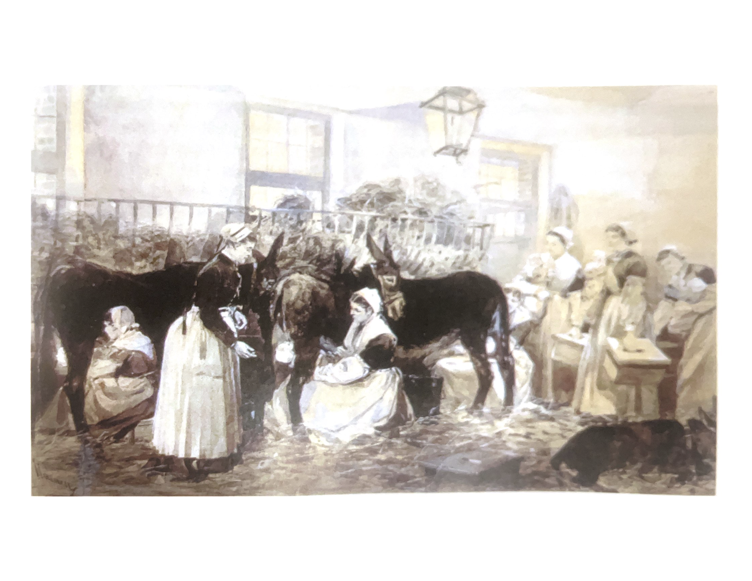
HISTORY
Feeding syphilitic infants was difficult. Artificial feeds were lethal and wet nurses transmitted the infection to nurses and other infants.
June 1881. Jules Parrot opened the "nourricerie". These were wards designed to treat "veneric foundlings" that were connected to stables where infants were fed with donkey milk.
Low in casein and high in sugar, it
resembles human milk more than cow's
milk

Slide 16
HISTORY
A decade long discussion ensued from 1786-1879
Contagionists (John Hunter, London) propagated that this was exclusively a maternal infection
Hereditists (Lamarck) thought it was inherited and there was germinal transmission via paternal sperm, bypassing the mother
Was also believed to be a major cause of prematurity
Finally, German zoologist Fritz Schaudin and dermatologist Erich Hoffmann identified "Spirochaeta pallida" in 1905

Slide 17
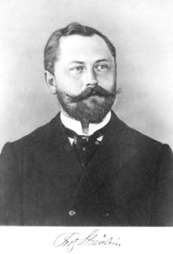
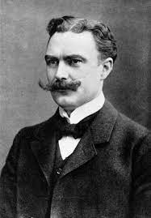
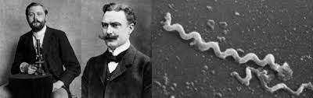
HISTORY: Fritz Schaudin and Erich Hoffmann

Slide 18
HISTORY
TREATMENT OF SYPHILIS
1798 (Francois Swediaur)
Mercury: "heal suckling infants by treating the nurse"
" If the nipples are ulcerated, rub mercury into a shaved area of a she - goat or ass, and
feed infant that milk"
Also mercury combined with rhubarb in soup and fed to infants
1910 (Paul Erlich, Nobel prize winner for detecting immune system)
He announced treatment with "Compound 606"

Slide 19
HISTORY OF TREATMENT
COMPOUND 606 also known as SALVARSAN or ARSPHENAMINE
Discovered by Professor Sahachiro Hata (Japanese man in Germany)
Used for also treating relapsing fever and African trypanosomiasis
Made from arsenic, was the first modern antimicrobial agent for syphilis
1943: PENICILLIN became available
Lentz and Ingraham in Philadelphia started treatment of mothers and babies
Highly effective in Moms but babies died of the Jarisch-Herxheimer
reaction (release of endotoxins by dead spirochaetes)

Slide 20

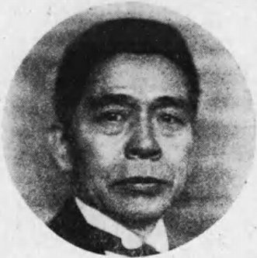
Sahachiro Hata and Paul Erlich

Slide 21
Introduction
Congenital syphilis:
Occurs when the spirochaete Treponema Pallidum is transmitted from a pregnant woman to the fetus
Infection can result in stillbirth, prematurity or a spectrum of clinical manifestations; only severe cases are clinically apparent at birth.
Most cases are because of no prenatal care or inadequate treatment
Risk factors also include homelessness, substance abuse and incarceration
Increased rates of infection in babies of mothers with HIV infection.

Slide 22
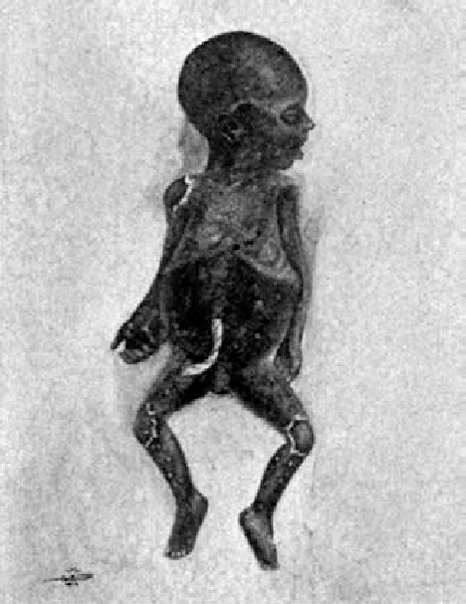
Syphilitic Stillbirth
All fetal deaths that occur after 20-weeks gestation and/or in a fetus weighing >500g should be evaluated for syphilitic stillbirth.
Mothers should be screened and tested for syphilis immediately.
Any pregnant person with untreated or inadequately treated syphilis is at-risk of delivering a baby with congenital syphilis (CS).
Adequate treatment : is stage-appropriate Bicillin initiated at least 30 days prior to delivery.
*Any suspected CS case (by lab and/or clinical criteria) must be reported to
the state health department within 24 hours.

Slide 23
Transmission
Humans are the only natural host of T pallidum. Congenital syphilis is acquired by transplacental transmission or occasionally by direct contact with an infectious lesion.
Transmission can occur at any time during pregnancy but increases as gestation advances
T. pallidum is not transferred in breast milk but may occur if the mother has an infectious lesion (chancre) on her breast.
Mothers with untreated primary or secondary syphilis are more likely to transmit the disease than women with latent or late latent disease

Slide 24
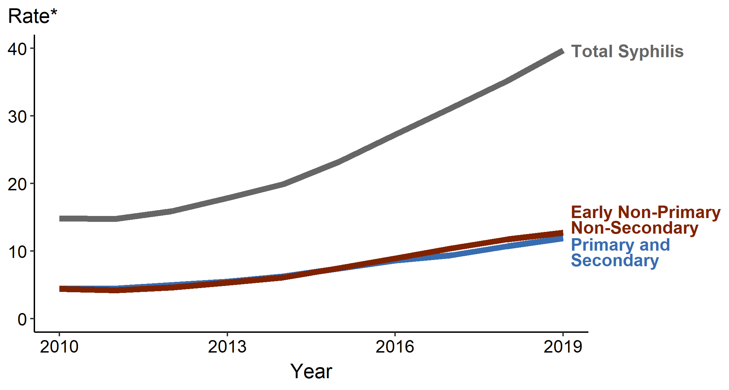
Rise of Syphilis in the United States
Syphilis - Rates of Reported Cases by Stage of Infection, United States, 2011–2020

Slide 25
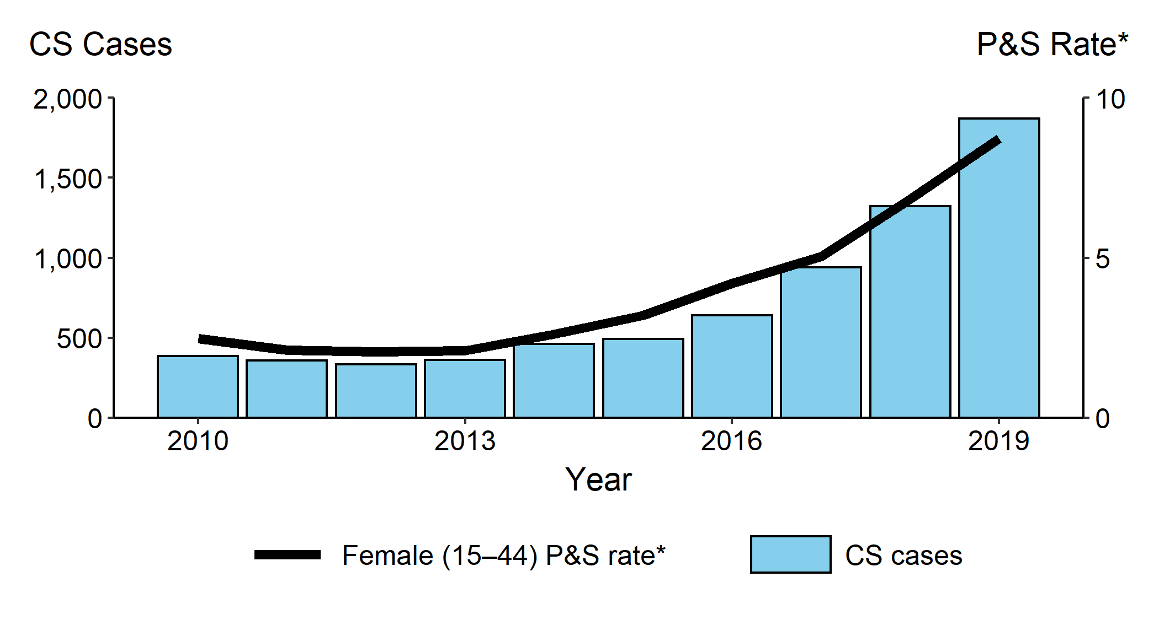
Rise of Congenital Syphilis in the United States
Congenital Syphilis (CS) — Reported Cases by Year of Birth and Rates of Reported Cases of Primary and Secondary Syphilis Among Women Aged 15–44 Years, United States, 2011–2020

Slide 26
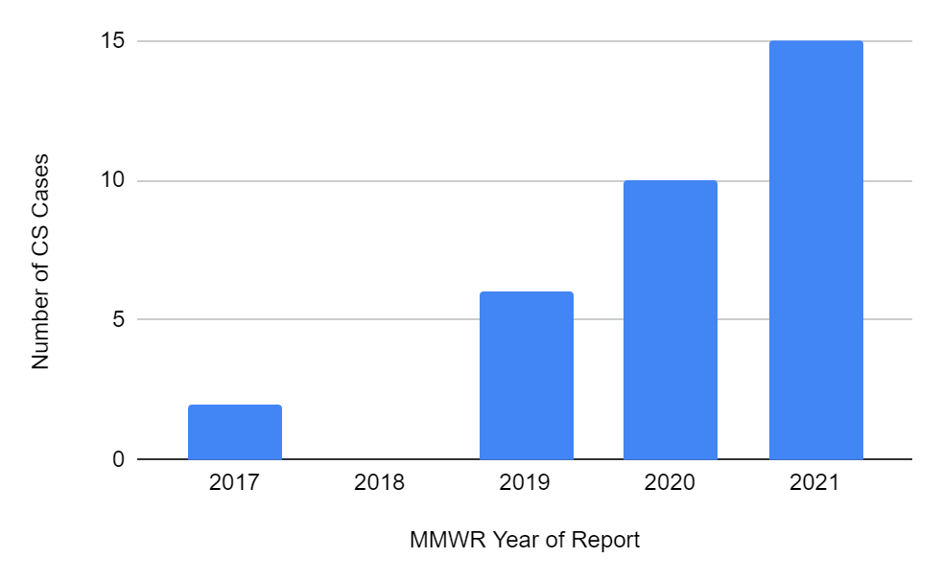
Rise of Congenital Syphilis in West Virginia
CS — Reported Probable Cases, West Virginia, 2017–2021
CS cases reported to West Virginia Department of Health and Human Resources increased 650% from 2017 to 2021.

Slide 27
Early Congenital Syphilis
Onset before 2 years of age. Clinical manifestations usually occur by 2-3 months of age if untreated. Most (60-90%) of babies are asymptomatic at birth, and depends on timing of infection or treatment
Common findings are:
Hepatomegaly, Jaundice, Nasal discharge (snuffles), Rash, generalized lymphadenopathy, skeletal abnormalities
Placenta is thick and pale and cord is edematous with spiral stripes of red and blue discoloration (barber’s pole). May have abscesses in Wharton’s jelly around the vessels (necrotizing funisitis)

Slide 28
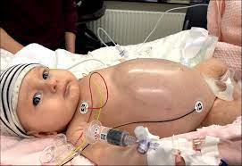
Hepatomegaly
Most common sign
May also have splenomegaly
Both jaundice and cholestasis
(Hepatitis)
Spirochaetes seen on biopsy

Slide 29
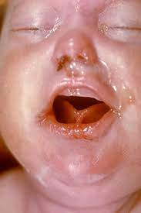
Rhinitis
Develops during first week
May be the first sign
Whitish, bloody or purulent
Contains spirochaetes, is contagious and can transmit infection by direct contact

Slide 30
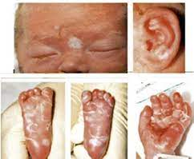
Rash
Occurs 1-2 weeks after rhinitis
Maculopapular initially
May be on back, buttocks, palms and soles or anywhere
Progresses to desquamation and crusting
May be present at birth as bullae (pemphigus syphiliticus)
Bullous fluid is contagious

Slide 31
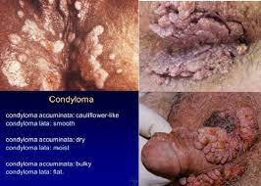
Rash
May also have fissures, mucous patches and condylomata lata
Fissures around lips, nares and anus and bleed easily
Condylomata lata are flat, wart-like lesions where there is friction (mouth, nose, anus)
Very infectious

Slide 32
Other clinical signs
Lymphadenopathy. Palpable epitrochlear lymph nodes in an infant is highly suggestive of congenital syphilis
Non-immune fetal hydrops
Myocarditis
Pneumonia (opacification both lungs, called ”pneumonia alba”)
Failure to move an extremity (pseudo-paralysis of Parrot)
Sepsis, due to other bacteria
Loss of eyebrows, chorioretinitis, cataracts, glaucoma etc
Rectal bleeding or NEC, nephrotic syndrome (treated with Penicillin)

Slide 33
Central nervous system
Asymptomatic: occurs in about 40% infants with clinical, lab or xray abnormalities. Infrequent otherwise
Symptomatic: rare, especially currently because of penicillin Rx, but may develop if not treated
Two types:
Acute leptomeningitis: Resembles aseptic meningitis around 6 months of age. Should suspect congenital syphilis in a febrile baby with CSF consistent with aseptic meningitis
Chronic meningovascular syphilis after a year of age. Presents with progressive hydrocephalus, seizures, optic atrophy, infarcts

Slide 34
Bony Abnormalities
Occurs in 60-80% of cases, and may be only manifestation
May be associated with fractures or pain, with limited movement which appears to be paralysis
Usually bilateral and symmetric
Femur, humerus, tibia are most frequently involved
May be lucent bands in metaphysis, or destruction of medial part of proximal tibial metaphysis (Wimberger’s sign) or serration (sawtooth)
Moth-eaten appearance of above bones

Slide 35
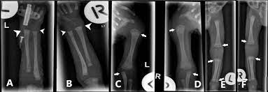
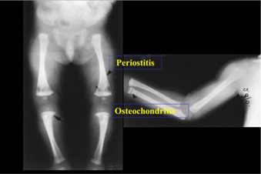
XRAY findings

Slide 36
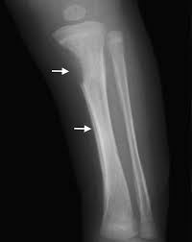
XRAY FINDINGS : WIMBERGER’S SIGN

Slide 37
Clinical Guidance for Baby At Delivery
A child born to a mother with a history of syphilis should automatically be tested at delivery.
A child born to a mother who was not adequately treated at least 30 days prior to delivery should be immediately treated regardless of symptoms and/or pending lab results.
      Please call the state health department for titer and treatment history.
Congenital Syphilis (CS) is often asymptomatic, and the newborn may appear normal…OR
There can be symptoms of Congenital Syphilis (CS) at or soon after birth.
      Immediately treat the newborn (do not wait for lab results).
      Document any possible signs or symptoms consistent with CS in patient chart.
*Any suspected CS case (by lab and/or clinical criteria) must be reported to the state health department within 24 hours.

Slide 38
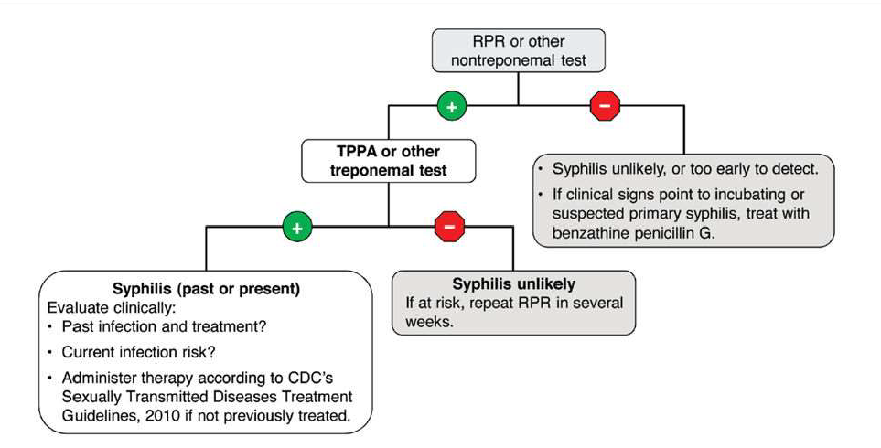
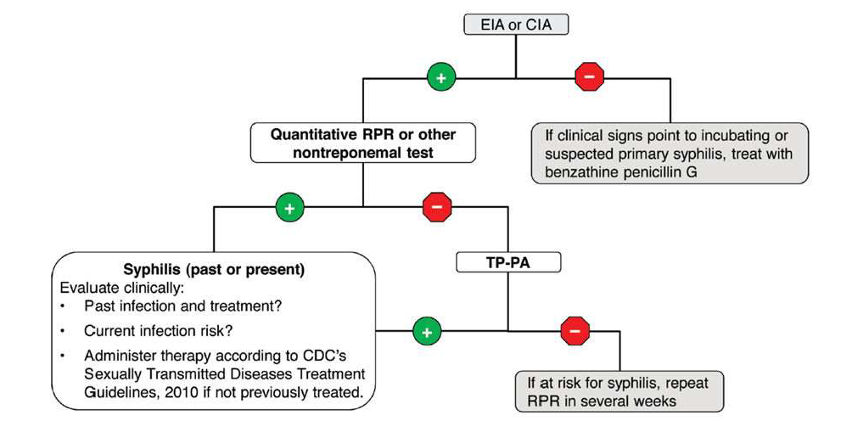
Syphilis Serology
Regardless of circumstance, if the birth mother has ever tested positive for syphilis, the child should have two types of serology labs ordered/run soon after delivery:
        Non-Treponemal (RPR with reflex to titer)
        Treponemal (TPPA, EIA, or other confirmatory treponema test) TPPA means particle-agglutination test for antibody
        EIA is an enzyme immunoassay test for IgG antibody
Traditional testing algorithm vs. reverse algorithm:

Slide 39
Laboratory tests
Anemia
Coombs negative hemolytic anemia
Thrombocytopenia, leukopenia or leukocytosis
Elevated liver function tests, (AST, ALT, Alk phos, direct bilirubin)
CSF pleocytosis (> 20 wbcs in term newborn, > 5wbcs one month old)
CSF protein >150 in newborns, >45 in a one month old
Reactive CSF VDRL (may get false positives from maternal antibody or blood)
CSF PCR more definitive

Slide 40
Treatment and Management Scenario #1
Scenario 1: Confirmed or Highly Probable CS
Any neonate with an abnormal physical exam that is consistent with CS, AND:
A quantitative nontreponemal titer that is fourfold (or greater) higher than the birth mother’s titer at delivery; OR
A positive darkfield test or PCR of placenta, cord, lesions, mucous or other body fluids
Recommended Evaluation:
CSF analysis for VDRL, cell count, and protein*
Complete blood count (CBC) and differential and platelet count
Long-bone radiographs
Other tests as clinically indicated (e.g., chest radiograph, liver function test, neuroimaging, ophthalmologic examination, and auditory brain stem response)
Recommended Regimens:
Aqueous crystalline penicillin G administered as 50,000 units/kg body weight/dose by IV q12 hours for first 7 days, then q8 hours thereafter for a total of 10 days; OR
Procaine penicillin G 50,000 units/kg of body weight/dose IM daily dose for 10 days
*If >1 day of therapy is missed, the entire course should be restarted. A full 10-day course of penicillin is preferred, even if ampicillin was initially provided.
If
Notes:
https://www.cdc.gov/std/treatment-guidelines/congenital-syphilis.htm

Slide 41
Treatment and Management Possible Syphilis
Any neonate with normal physical exam and nontreponemal titer equal to or less than fourfold of the maternal titer at delivery and has one of the following:
Birth mother was not treated, inadequately treated, or has no treatment documented
Birth mother was treated with erythromycin or a regimen other than those recommended in the current STI Treatment Guidelines (i.e., a non-penicillin G regimen)
Birth mother received the recommended regimen, but it was initiated <30 days prior to delivery
Recommended Evaluation:
CSF analysis for VDRL, cell count, and protein**
CBC, differential, and platelet count
Long-bone radiographs
*This evaluation is not necessary if a 10-day course of penicillin is administered, although such evaluations might be useful.
*Before using the single-dose IM regimen, the above recommended evaluation must be normal. If any part of the evaluation is abnormal or if follow-up is uncertain, a 10-day course of penicillin G is required.
Recommended Regimens:
Aqueous crystalline penicillin G administered as 50,000 units/kg body weight/dose by IV q12 hours for first 7 days, then q8 hours thereafter for a total of 10 days; OR
Procaine penicillin G 50,000 units/kg of body weight/dose IM daily dose for 10 days; OR
Benzathine penicillin G 50,000 units/kg body weight/dose IM in a single dose
Notes:
https://www.cdc.gov/std/treatment-guidelines/congenital-syphilis.htm

Slide 42
Treatment and Management Scenario #3
Scenario 3: CS Less Likely
Any neonate with normal physical exam and nontreponemal titer equal to or less than fourfold of the maternal titer at delivery and all three of the following are true:
Birth mother was treated appropriately during pregnancy for the stage of infection
Birth mother’s treatment was initiated 30 days or more prior to delivery
Birth mother has no evidence of reinfection or relapse
Recommended Evaluation:
No evaluation is recommended
*Another approach involves not treating the newborn if follow-up is certain but requires providing close serological lab evaluation every 2-3 months for 6 months for infants whose birth mother’s nontreponemal titers decreased at least fourfold after therapy for early syphilis or remained stable for low-titer, latent syphilis (e.g., VDRL <1:2 or RPR<1:4).
Recommended Regimens:
Benzathine penicillin G 50,000 units/kg body weight/dose IM in a single dose
Notes:
https://www.cdc.gov/std/treatment-guidelines/congenital-syphilis.htm

Slide 43
Treatment and Management Scenario #4
Scenario 4: CS Unlikely
Any neonate with normal physical exam and nontreponemal titer equal to or less than fourfold of the maternal titer at delivery and both of the following are true:
Birth mother’s treatment was adequate for pregnancy
Birth mother’s nontreponemal titer remained low and stable (i.e., serofast) before and during pregnancy and at delivery
Recommended Evaluation:
No evaluation is recommended
*Benzathine penicillin G 50,000 units/kg body weight as a single IM injection might be considered, particularly if follow-up is uncertain and the neonate has a reactive nontreponemal test.
*Any neonate with reactive nontreponemal tests should be followed serologically to ensure it returns to negative.
Recommended Regimens:
No treatment is required
Notes:
https://www.cdc.gov/std/treatment-guidelines/congenital-syphilis.htm

Slide 44
Treatment and Management Considerations
Exceptions and Special Circumstances to Consider for Treatment
Neonate’s nontreponemal test is nonreactive, and provider determines the birth mother’s risk for untreated syphilis is low, treatment of neonate with a single IM dose of benzathine penicillin G 50,000 units/kg body weight for possible incubating syphilis can be considered without further evaluation.
Neonates with birth mothers that had untreated early syphilis at time of delivery are at increased risk for CS, and the 10-day course of penicillin G should be considered regardless of neonate’s nontreponemal test and physical evaluation, even when follow-up is certain.
Neonates born to pregnant patients that had prenatal care and adequate treatment for their stage, but the nontreponemal titer has not fallen fourfold and reinfection is possible, can be treated with benzathine penicillin G 50,000 units/kg of body weight/dose IM in a single dose.
Notes:
https://www.cdc.gov/std/treatment-guidelines/congenital-syphilis.htm

Slide 46
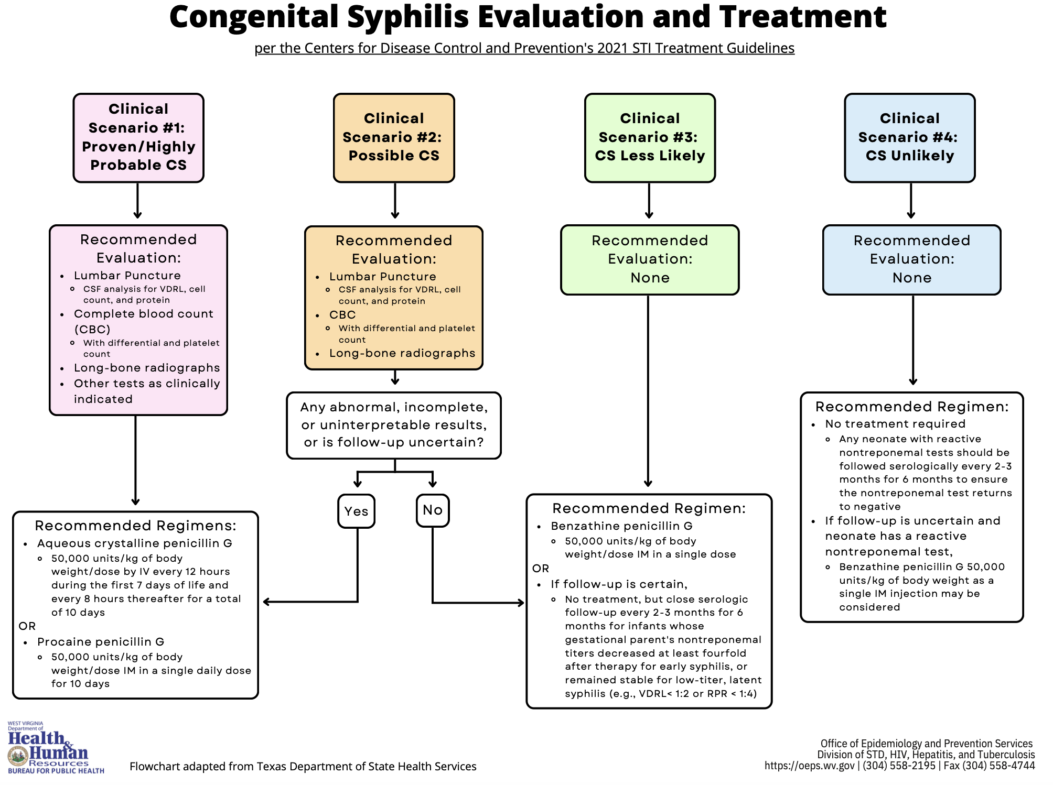

Slide 47
Case Presentation Baby C
Approached by OB re a 24 yo G2P1001 Mom at 29 weeks EGA with infant with poor BPP (4/8) and possible hydrops fetalis and hepatomegaly. Thought to have a liver tumor.
Mother RPR neg, Rubella immune, HBsAg neg, Hep C neg, GBS unknown GC/Chlamydia unknown. Given a course of steroids and wanted emergent c/section.
Infant Apgars 7, 8. BW 1600g, VS stable, Mild respiratory distress requiring nCPAP. CXR c/w RDS. Hepatomegaly ++ otherwise normal
No evidence of hydrops fetalis
US on admission showed enlarged liver with possible calcified mass

Slide 48
Baby C with hepatomegaly, possible tumor
On Day 2, Bilirubin levels increased T/D 16.1/2 and surgery consulted.
Treated with phototherapy. AFP (alpha-fetoprotein tumor marker) was elevated (> 30,000 suggesting a tumor ?hepatoblastoma)
Extensive lab investigations basically normal/negative for congenital infections , inborn errors, etc. called Cincinnati Childrens’ for transfer
After complying with their suggested investigations, since baby was essentially stable, they wanted to wait as our care was appropriate.
Weaned to room air, tolerating feeds, liver enzymes, bilirubin, AFP were all decreasing, and being treated expectantly

Slide 49
Baby C with hepatomegaly
On day of life 13, developed nasal stuffiness, respiratory distress requiring nCPAP. Viral cultures neg.
On day of life 17, examination of infant revealed a new finding:
Peeling and erythema of palms and soles!!
Immediately sent RPR : Positive. CSF VDRL : Positive
Long bone xrays: classic findings of congenital syphilis
Started recommended penicillin therapy for Neurosyphilis
On day of life 21 required intubation for obstructive apnea (?snuffles)

Slide 50
Baby C diagnosed with Congenital Syphilis
Mother questioned re her testing and suggested she get an RPR
Admitted to changing partners in second trimester
Mother had positive RPR. Suggested she seek treatment and inform partners to do the same
After intubation respiratory cultures positive for Klebsiella and treated with Meropenem. Extubated after 3 days and weaned to room air on day of life 26. Completed course of penicillin
Discharged home on day of life 44 (35 4/7 weeks CGA).
Repeat treponemal testing as outpatient at 6 months of age

Slide 52

…stronger, healthier babies.
Notes:
52

