Slide 1
Health Equity: What is it and How Do We Achieve It?
Veronica Gillispie-Bell, MD, MAS, FACOG
Senior Site Lead/Section Head, Women’s Services – Ochsner Kenner
Medical Director, Louisiana Perinatal Quality Collaborative and Pregnancy Associated Mortality Review

Slide 2
Objectives
Identify
Identify disparities in maternal health
Describe
Describe implicit bias and structural racism as root causes
Discuss
Discuss a pathway for change

Slide 3
You Cannot Have Quality Without Equity

Slide 4
Linking Quality to Equity
The Institute of Medicine defines quality as “the degree to which health services for individuals and populations increase the likelihood of desired health outcomes and are consistent with current professional knowledge”
Health disparities are the health outcome measure of progress toward health equity*
Equity
Safe
Effectiveness
Patient-Centered
Timely
Efficient
Notes:
The IOM has identified six domains to achieve quality. Initially, equity was a separate domain. They have since revised the domains as they understand equity has to be woven into all domains to achieve quality care

Slide 5
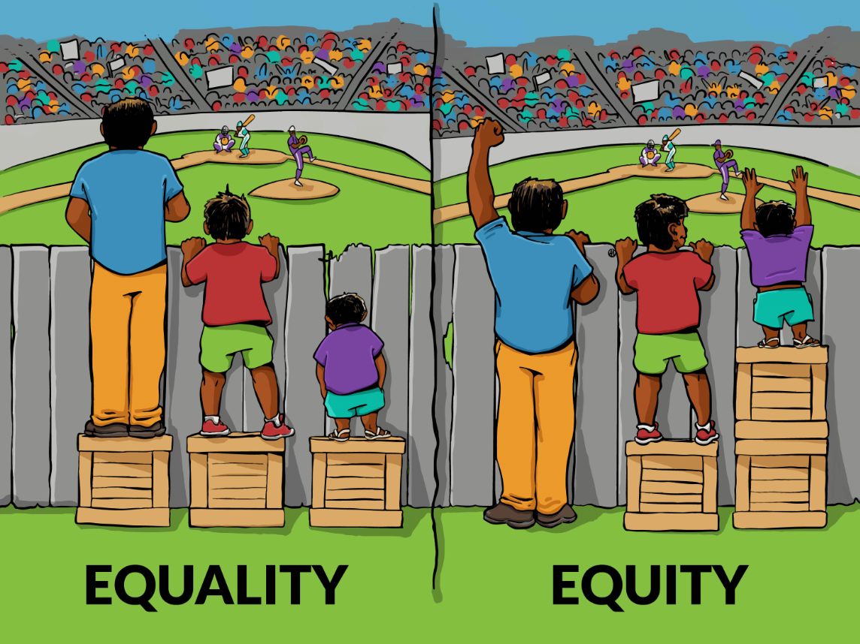
Ref “Interaction Institute for Social Change” Artist: Angus Maguire
Notes:
The American Public Health Association defines health equity as everyone having “the opportunity to attain their highest level of health.”
It is important to make a distinction between “Equality” and “Equity”.
Equality describes a situation where all individuals or groups of people receive the same amount of resources regardless of need.
“Equity” takes into consideration, advantage and disadvantage, involves a distribution of resources that enables all individuals and communities to have equal opportunity.
Racial health equity exists when racial identification is not a predictor of disease or of how society’s health-supporting resources and opportunities are distributed.

Slide 6
Why do health disparities occur?

Slide 7
Donabedian model for quality of care
Structure
Process
Outcome
Structural racism
Healthcare disparities
Health disparities
Notes:
Structure: Physical and organizational characteristics within health care
Process: How health care is delivered
Outcome: Effect of health care on patients or a population

Slide 8
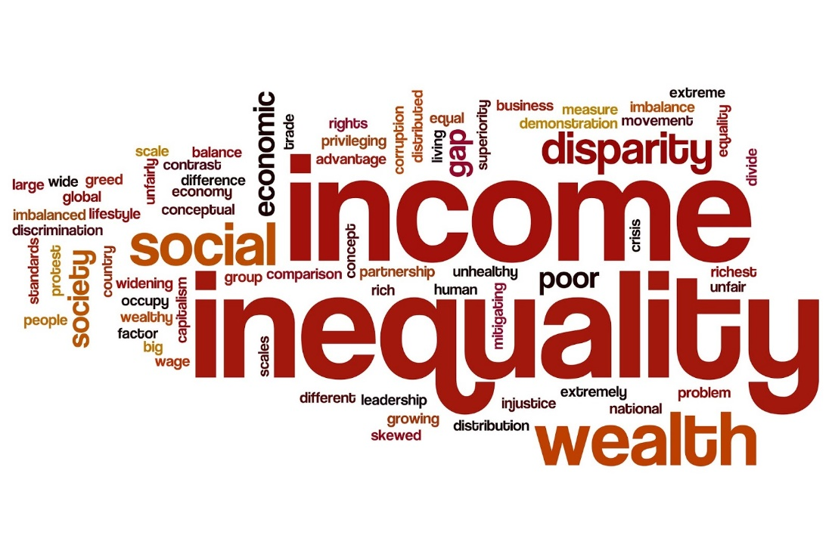
Structural Racism
Also known as Institutional or Systemic Racism is defined as “A system in which public policies, institutional practices, cultural representatives, and other norms work in various, often reinforcing ways to perpetuate racial group inequity”
- The Aspen Institute

Slide 9
Structural Racism Impacts SDoH
Social and community
Education
Neighborhood and the built environment
Health and health care
Economic stability

Slide 10
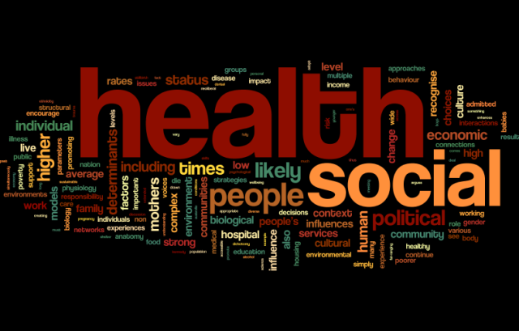
Where You Live Matters
Effect on Social Determinants of Health (SDoH)
Health and Health care: Decreased medical and social services in minority communities
Social and community: Targeted tobacco ads, higher levels of crime in minority communities
Education: Less funding for public schools
Built-environment: Food deserts, less green space, more factories

Slide 11
Why do health disparities occur?
After having health impacted by SDoH, our patient experiences health care disparities

Slide 12
Differences in how we deliver care
Black individuals are less likely to be offered preventive services such as cancer screening and influenza vaccine
Black individuals are less likely to have adequate treatment of pain
Blacks and Hispanics are less likely to receive bypass surgery even when medically indicated
Women are less likely to undergo appropriate cardiovascular testing
Implicit Bias

Slide 13
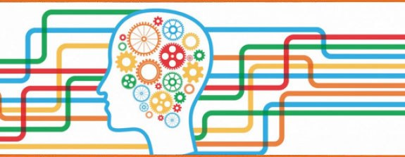
Implicit Bias Defined
Implicit bias, also known as unconscious bias, is defined as “the attitudes or stereotypes that affect our understanding, actions, and decisions in an unconscious manner”
- Kirwan Institute for the Study of Race and Ethnicity
This Photo by Unknown Author is licensed under CC BY-NC-ND

Slide 14
Moment of Reflection
Notes:
A boy and his father are driving down a road. They get into an accident. The father is killed. The son is taken to the hospital and it is determined that he needs surgery. The surgeon says, “I cannot operate on him. He is my son”. Who is the surgeon?

Slide 15
Causes of Implicit Bias
We tend to seek out patterns
We like to take shortcuts
Experience and social conditioning
Notes:
Our ability to store process and apply information about people in social situations ins dependent on our ability to look for patterns and associations
The brain is constantly inundated with more information than it can process, mental shortcuts are needed to make it through all of the data
Influenced by experience, whether that is direct personal experience or cultural conditioning , media portrayals, and upbringing

Slide 16
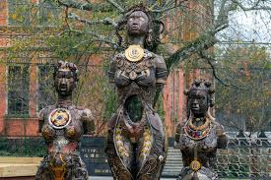
Bias Beliefs about Race and Pain
Dr. Marion Sims invented the speculum and the surgical procedure to repair vesicovaginal fistulas.
He performed thirty surgeries on a slave woman named Anarcha over approximately five years, finally successfully treating her vesicovaginal fistula with silver sutures.
In accord with the scientific racism of the time, she and the other slave women, Betsy and Lucy, were viewed as “medical super bodies” who could tolerate surgery without anesthesia.

Slide 17
Bias Beliefs about Race and Pain
In a study of 222 white medical students and residents, about 50% believed Black people were biologically different than white people, including having nerve endings that are less sensitive than whites and having thicker skin than whites

Slide 18
Bias Beliefs About Black Women Then and Now
In a study of 435 undergraduate students, ratings for Black women compared to White women as
More likely to have multiple sex partners in the last month
Less likely to use birth control
More likely to receive public assistance
Have less education
Earn less income
Less likely to follow the doctor’s instructions
Less likely for the father of the child to be involved

Slide 19
How health disparities happen
After having health impacted by SDoH, experiencing the effects of structural racism, our patient experiences health care disparities due to implicit bias, which all leads to a health disparity

Slide 20
Maternal and Infant Health Disparities
Nationally, Black women are 3 times and American Indian/Alaska 2 times, more likely to suffer a pregnancy-related death than a white woman
The rate of preterm birth among Black women is 50% higher than that of white women
The infant mortality rate for Black infants is 2.3 times higher than that of non-Hispanic white infants
The pregnancy-related death rate for a Black woman with a college degree is 2.2 times higher than that of a white woman with an eighth-grade education

Slide 21
Where do we go from here: Pathway to Change
Acknowledge your own bias and stance on equity
Identify structural racism in your institution toward your employees and patients
Have conversations about race
Develop short-term and long-term plans

Slide 22
WHO Framework for SDoH
Notes:
Health systems have the ability to improve the intermediary determinants SDH.

Slide 23
IHI Framework for Creating Health Equity
Make
Make health equity a strategic priority
Develop
Develop structure and processes to support health equity work
Deploy
Deploy specific strategies to address the multiple determinants of health which organizations can make an impact
Decrease
Decrease institutional racism within an organization
Develop
Develop partnerships with community organizations

Slide 24
The Roadmap to Reduce Disparities
Linking Quality to Equity
Creating a Culture of Equity
Diagnosing the Disparity
Designing the Activity
Securing
Buy-in
Implementing Change
Notes:
Advancing Health Equity was founded by Robert Wood Johnson in 2005 formerly known as “Finding Answers”. The organization strives to achieve equity by eliminating health and healthcare disparities. The Roadmap was developed in partnership with 33 healthcare organizations, the unique implementation challenges and successes experienced at each site, as well as the results of 11 systematic reviews of the disparities-reduction literature. While this can be done from a health systems standpoint, it can also be done through perinatal quality collaboratives.
This roadmap is a step-by-step pathway to implement support for equitable and respectful care. We will discuss in more detail during our second lecture in the series.

Slide 25
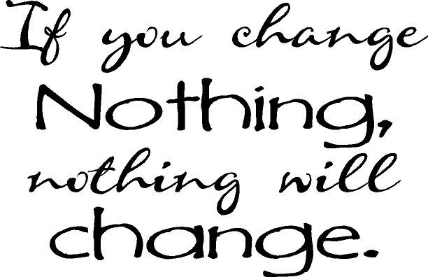
Your Role in Equity: Address Your Implicit Bias
Acknowledge your own bias
Implicit Association Test: https://implicit.harvard.edu/implicit/takeatest.html
Address your bias
See people as individuals
Recognize your belief as a stereotype
Increase opportunities to have contact with individuals from different groups
Empathy
Notes:
Because this is unconscious, you must think of addressing implicit bias like “breaking a habit”. Therefore, change must be intentional and longitudinal

Slide 26
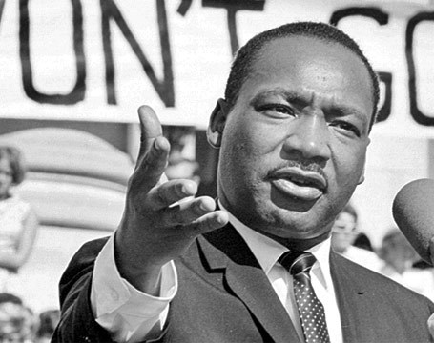
"The ultimate measure of a man is not where he stands in moments of comfort and convenience, but where he stands at times of challenge and controversy.“
- Dr. Martin Luther King, Jr.
Notes:
If you say nothing, you are still saying something. There is no such place as neutrality.

Slide 27
Summary
The cause of health disparities are complex in nature
We must examine ourselves as individuals and our workplace to see how we are propagating implicit bias and structural racism
There is a pathway to improvement…

Slide 28
Diversity and Inclusion Podcasts
NPR Code Switch
Dear White Women
Harvard Business Review Women at Work
Apple Podcasts All in: Workplace Diversity and Inclusion
The Guardian Antiracism and America

Slide 29
The Effects of Inequities

Slide 30
References
Widome R, Brock B. Noble P, Forster JL. (2013) The relationship of neighborhood demographic characteristics to point-of-sale tobacco advertising and marketing. Ethnicity & Health. 18(2):136-151. Doi: 10.1080/13557858.2012.701273.
Messer, L. C., Kaufman, J. S., Dole, N., Savitz, D. A., & Laraia, B. A. (2006). Neighborhood crime, deprivation, and preterm birth. Annals of epidemiology, 16(6), 455–462. https://doi.org/10.1016/j.annepidem.2005.08.006
Williams, D. R., & Collins, C. (2001). Racial residential segregation: a fundamental cause of racial disparities in health. Public health reports (Washington, D.C. : 1974), 116(5), 404–416. https://doi.org/10.1093/phr/116.5.404
Donabedian, A (2005) Evaluating the Quality of Medical Care, The Milbank Quarterly, 83(4):691-729.
Obermeyer Z, Powers B, Vogeli C, Mullainathan S. Dissecting racial bias in an algorithm used to manage the health of populations. Science. 2019;366(6464):447‐453. doi:10.1126/science.aax2342
Diversity and Inclusion in Leadership. An Official Position Statement of the Society of Maternal Fetal Medicine. January 2017. https://s3.amazonaws.com/cdn.smfm.org/media/1107/Leadership_-_January_2017.pdf.
Marrast, L. M., Zallman, L., Woolhandler, S., Bor, D. H., & McCormick, D. (2014). Minority physicians' role in the care of underserved patients: diversifying the physician workforce may be key in addressing health disparities. JAMA internal medicine, 174(2), 289–291. https://doi.org/10.1001/jamainternmed.2013.12756
Rothman P. (2016) Diversity in medicine has measurable benefits. News & Publications. Johns Hopkins Medicine. https://www.hopkinsmedicine.org/news/articles/diversity-in-medicine-has-measurable-benefits#:~:text=Studies%20show%20that%20students%20trained,by%202.2%20minutes%2C%20on%20average. Last accessed on July 13, 2020.
Smedley BD, Stith AY, Colburn L, et al.; Institute of Medicine (US). The Right Thing to Do, The Smart Thing to Do: Enhancing Diversity in the Health Professions: Summary of the Symposium on Diversity in Health Professions in Honor of Herbert W.Nickens, M.D.. Washington (DC): National Academies Press (US); 2001. Increasing Racial and Ethnic Diversity Among Physicians: An Intervention to Address Health Disparities? Available from: https://www.ncbi.nlm.nih.gov/books/NBK223632/
Cantor, J. C., Miles, E. L., Baker, L. C., & Barker, D. C. (1996). Physician service to the underserved: implications for affirmative action in medical education. Inquiry : a journal of medical care organization, provision and financing, 33(2), 167–180.
Snyder, J. E., Upton, R. D., Hassett, T. C., Lee, H., Nouri, Z., & Dill, M. (2023). Black Representation in the Primary Care Physician Workforce and Its Association With Population Life Expectancy and Mortality Rates in the US. JAMA network open, 6(4), e236687. https://doi.org/10.1001/jamanetworkopen.2023.6687

Slide 31
References
Hausmann, L. R., Jeong, K., Bost, J. E., & Ibrahim, S. A. (2008). Perceived discrimination in health care and use of preventive health services. Journal of general internal medicine, 23(10), 1679–1684. https://doi.org/10.1007/s11606-008-0730-x
Hoffman, K. M., Trawalter, S., Axt, J. R., & Oliver, M. N. (2016). Racial bias in pain assessment and treatment recommendations, and false beliefs about biological differences between blacks and whites. Proceedings of the National Academy of Sciences of the United States of America, 113(16), 4296–4301. https://doi.org/10.1073/pnas.1516047113
Cohen, J. J., Gabriel, B. A., & Terrell, C. (2002). The case for diversity in the health care workforce. Health affairs (Project Hope), 21(5), 90–102. https://doi.org/10.1377/hlthaff.21.5.90
Daugherty, S. L., Blair, I. V., Havranek, E. P., Furniss, A., Dickinson, L. M., Karimkhani, E., Main, D. S., & Masoudi, F. A. (2017). Implicit Gender Bias and the Use of Cardiovascular Tests Among Cardiologists. Journal of the American Heart Association, 6(12), e006872. https://doi.org/10.1161/JAHA.117.006872
Nadal K. A (2014). Guide to Responding to Microaggressions. CUNY FORUM 2:1 (2014) 71-76.
Sue, D. W., Capodilupo, C. M., Torino, G. C., Bucceri, J. M., Holder, A. M., Nadal, K. L., & Esquilin, M. (2007). Racial microaggressions in everyday life: implications for clinical practice. The American psychologist, 62(4), 271–286. https://doi.org/10.1037/0003-066X.62.4.271
Kim L, Whitaker M, O’Halloran A. Kambhampati A, Chai S, Reingold A, Armistead I, et al. (2020) Hospitalization Rates and Characteristics of Children Aged <18 Years Hospitalized with Laboratory-Confirmed COVID-19-COVID-NET, 14 States, March 1- July 25, 2020. MMWR Morb Mortal Wkly Rep. epPub https://www.cdc.gov/mmwr/volumes/69/wr/mm6932e3.htm?s#suggestedcitation
Peterson EE, Davis NL, Goodman D, Cox S, Syverson C, Seed K, Shapiro-Mendoz C, Callaghan W, Barfield W. (2019) Racial/Ethnic Disparities in Pregnancy-Related Deaths – United States, 2007-2016. MMR Morb Mortal Wkly Rep; 68:762765. DOI: http://dx.doi.org/10.15585/mmwr.mm6835a3
Bruce K, Trichilo R, Gillispie-Bell V, Hyde R, Outhuse A. (2021) Louisiana Pregnancy-Associated Mortality Review. https://www.partnersforfamilyhealth.org/wp-content/uploads/2021/09/2018_PAMR_Report_FINAL_MF.pdf. Last accessed on October 28, 2021.
MacDorman M. F. (2011). Race and ethnic disparities in fetal mortality, preterm birth, and infant mortality in the United States: an overview. Seminars in perinatology, 35(4), 200–208. https://doi.org/10.1053/j.semperi.2011.02.017
Infant Mortality and African Americans. U.S. Department of Health and Human Services. Office of Minority Health. https://minorityhealth.hhs.gov/omh/browse.aspx?lvl=4&lvlid=23. Last accessed on July 7, 2020.
Leonard, S. A., Main, E. K., Scott, K. A., Profit, J., & Carmichael, S. L. (2019). Racial and ethnic disparities in severe maternal morbidity prevalence and trends. Annals of epidemiology, 33, 30–36. https://doi.org/10.1016/j.annepidem.2019.02.007
Wyatt R, Laderman M, Botwinick L, Mate K, Whittington J. Achieving Health Equity: A Guide for Health Care Organizations. IHI White Paper. Cambridge, Massachusetts: Institute for Healthcare Improvement; 2016. (Available at ihi.org)

Slide 32
References
Braveman, P. A., Kumanyika, S., Fielding, J., Laveist, T., Borrell, L. N., Manderscheid, R., & Troutman, A. (2011). Health disparities and health equity: the issue is justice. American journal of public health, 101 Suppl 1(Suppl 1), S149–S155. https://doi.org/10.2105/AJPH.2010.300062
Devine, P. G., Forscher, P. S., Austin, A. J., & Cox, W. T. (2012). Long-term reduction in implicit race bias: A prejudice habit-breaking intervention. Journal of experimental social psychology, 48(6), 1267–1278. https://doi.org/10.1016/j.jesp.2012.06.00
FitzGerald C, Hurst S. Implicit bias in healthcare professionals: a systematic review. BMC Med Ethics. 2017;18(1):19. Published 2017 Mar 1. doi:10.1186/s12910-017-0179-8
Dovidio, J. F., & Fiske, S. T. (2012). Under the radar: how unexamined biases in decision-making processes in clinical interactions can contribute to health care disparities. American journal of public health, 102(5), 945–952. https://doi.org/10.2105/AJPH.2011.300601
Ly DP. Historical Trends in the Representativeness and Incomes of Black Physicians, 1900-2018. J Gen Intern Med. 2022;37(5):1310-1312. doi:10.1007/s11606-021-06745-1
Park J, Saha S, Chee B, Taylor J, Beach MC. Physician Use of Stigmatizing Language in Patient Medical Records. JAMA Netw Open. 2021;4(7):e2117052. Published 2021 Jul 1. doi:10.1001/jamanetworkopen.2021.17052

