Slide 1


Obstetric Hemorrhage
Brian M. Casey, M.D.
Notes:
Thank you Dr. Farry…and thank you to the organizing committee for allowing me to speak with you today on a topic that I know has been the subject of much work in the state and around the country…

Slide 2
Objectives
This presentation will discuss recognition and care of the patient experiencing obstetric hemorrhage. Elements of readiness and response to obstetrical hemorrhage will be reviewed as well as the impact on maternal morbidity/mortality.
Participants will be able to identify risk factors and common medical conditions that increase the possibility of obstetrical hemorrhage.
Participants will be able to list elements of readiness to provide rapid assessment and intervention for obstetric hemorrhage.
Participants will be able to describe methods for early recognition and intervention to reduce maternal morbidity related to hemorrhage.

Slide 3
Background

Slide 4
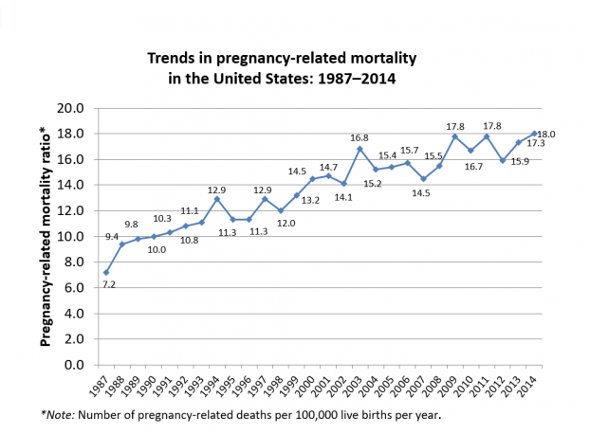
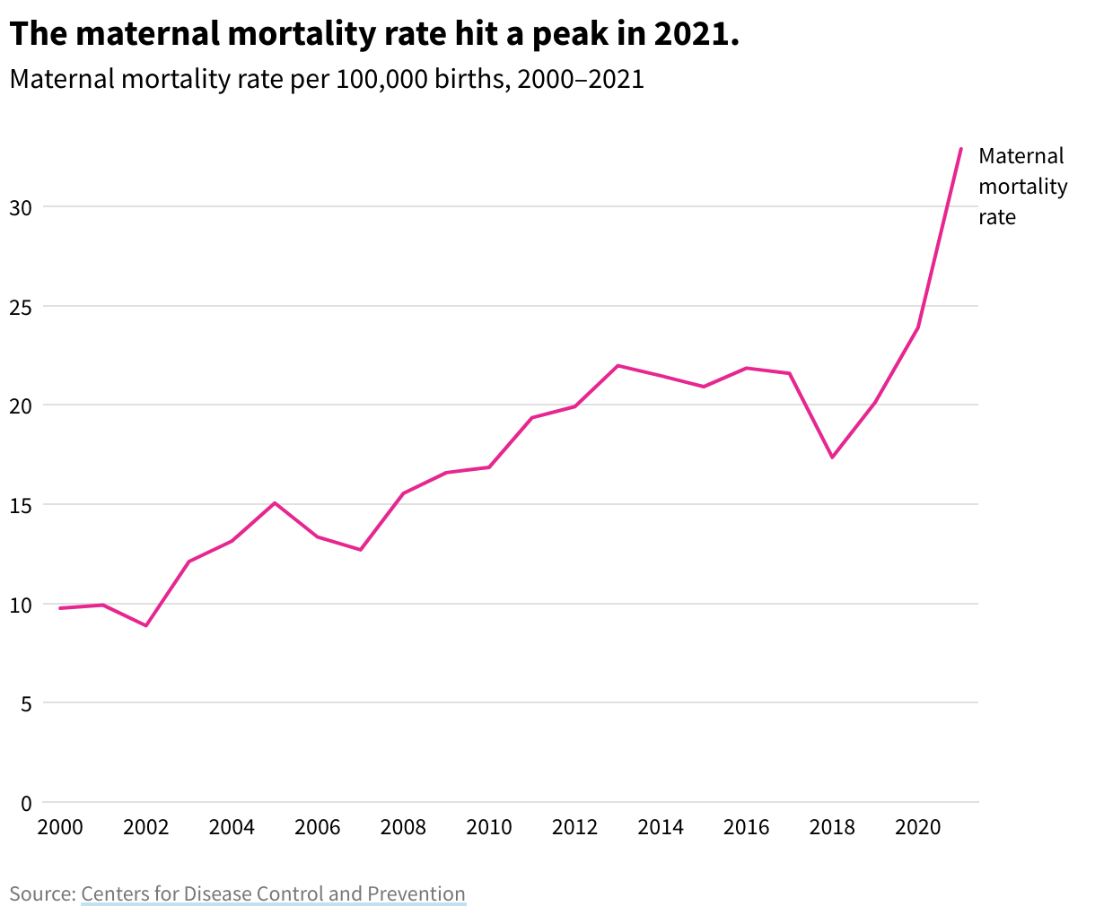
Trends in Pregnancy-related Mortality in the U.S.
Notes:
You have seen or heard about this…Maternal mortality is trending up with a whole lot of pontificating as to why that is.
Increased reporting…more awareness…more attention…more reporting
What is undeniable is this inexorable increase in maternal death despite increasing cost and expenditures in health care…

Slide 5
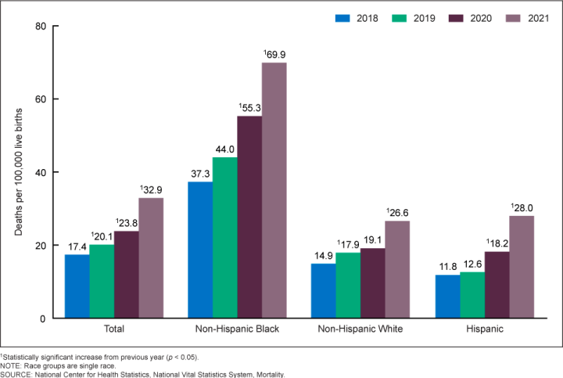
Recent Trends in U.S. Maternal Mortality according to Ethnicity
Notes:
Further complicating this picture is the obvious link between ethnicity and risk for maternal death and there is a lot of work being done to sort through SDOH and cause of maternal death

Slide 6
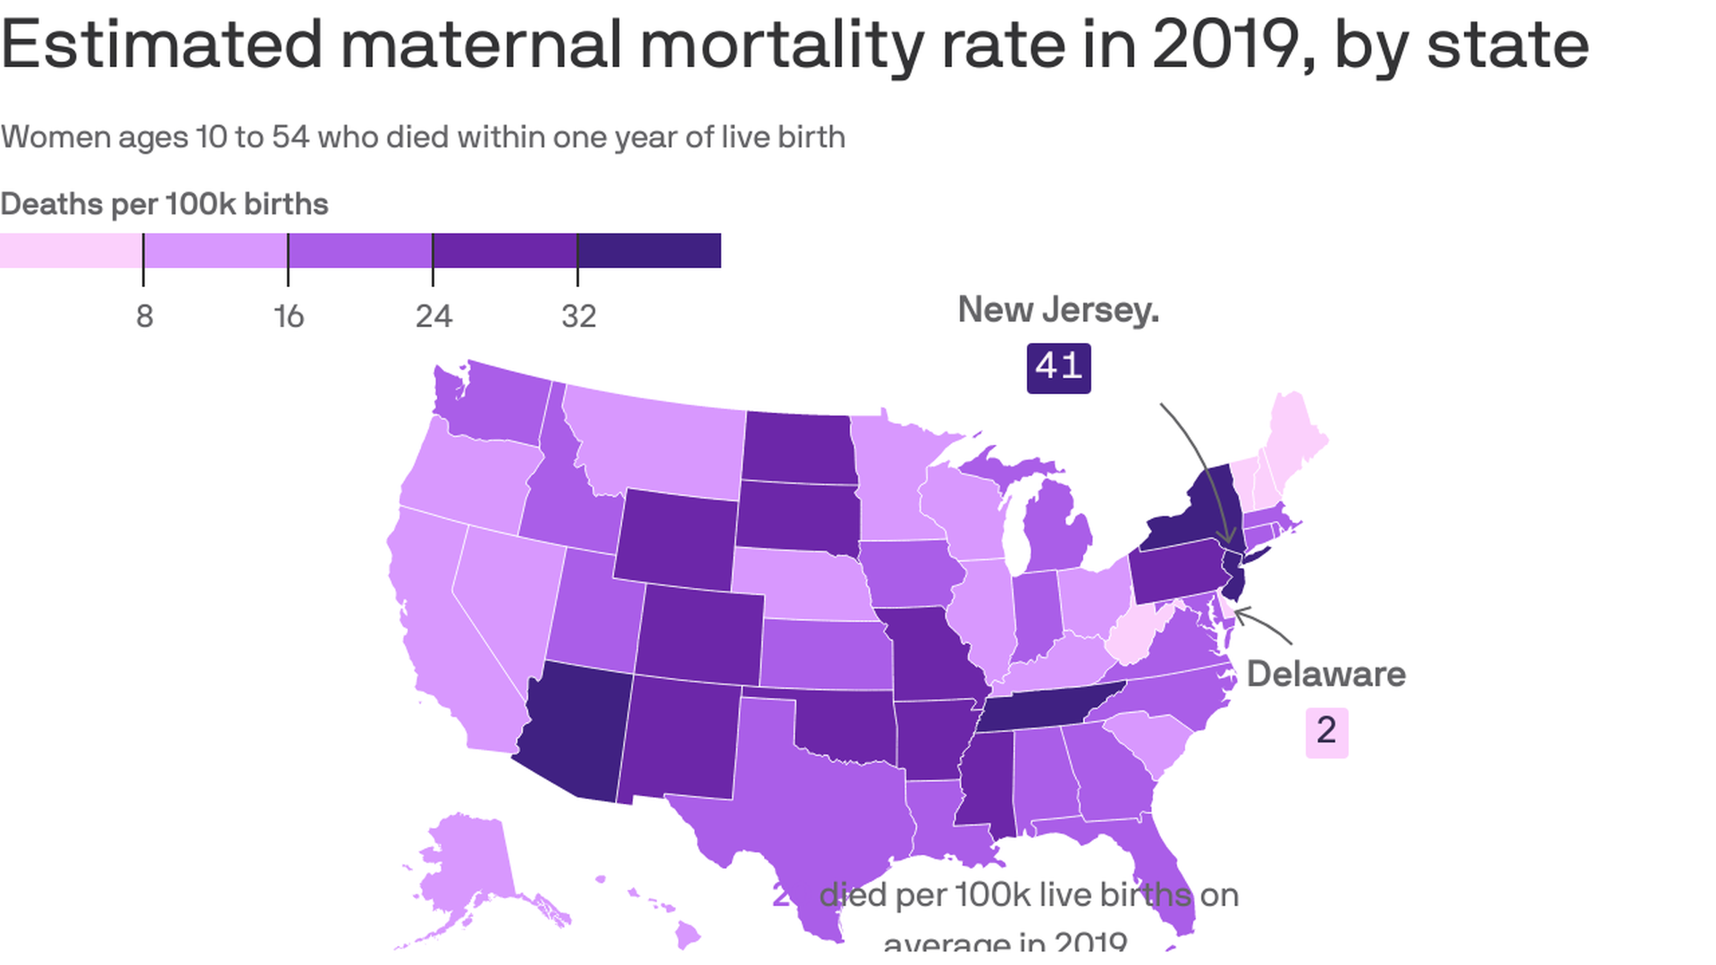
Notes:
That said, WV is looking pretty good at least with regard to 2019 maternal deaths within 1 year…according to this JAMA study in 2023…maybe partially related to the hard work done by many in this room

Slide 7
Mortality Causes
Notes:
So what are the causes of this crisis level increase in mortality…?

Slide 8
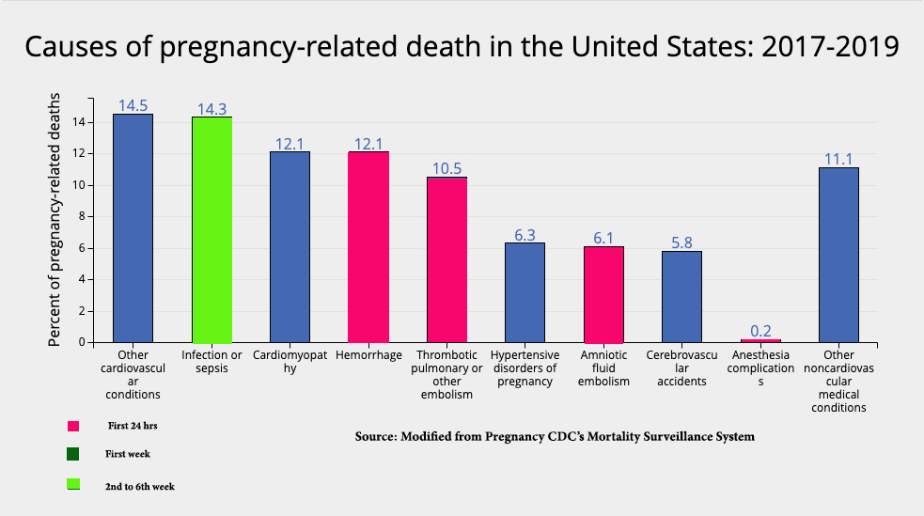
Hemorrhage – a leading cause…
Notes:
And hemorrhage remains a leading cause of maternal death in the U.S.

Slide 9
North Carolina: Mortality Mostly Preventable
Cause of Death (n=108) | % of All Deaths | % Preventable
Cardiomyopathy | 21% | 22%
Hemorrhage | 14 | 93
PIH | 10 | 60
CVA | 9 | 0
Chronic condition | 9 | 89
AFE | 7 | 0
Infection | 7 | 43
Pulmonary embolism | 6 | 17
Berg CJ, Harper MA, Atkinson SM, et al. Preventability of pregnancy-related deaths: results of a state-wide review. Obstet. Gynecol. Dec 2005;106(6):1228-1234.
Notes:
2005 Review of all maternal deaths N. Carolina
1995 – 1999…hemorrhage was #2 on the list of causes and 93% (more than any other cause!!!!) of those were felt to be preventable.
Berg CJ et al. Preventability of pregnancy-related deaths. Obstet Gynecol 106:1228-34, 2005.

Slide 10
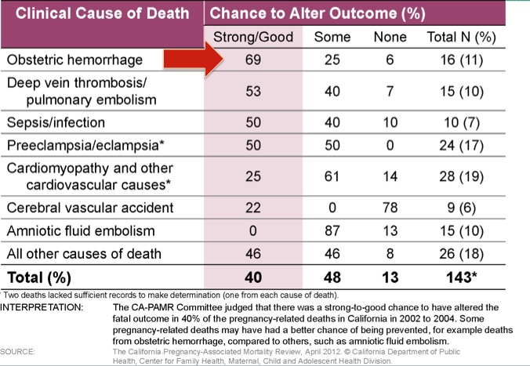
CA-PAMR Pregnancy-Related Deaths, Chance to Alter Outcome by Grouped Cause of Death; 2002-2004 (N=143)
Notes:
The California pregnancy associated mortality review did a similar analysis and found that
Only 6% of hemorrhage related deaths was there no chance to alter outcome. 2/3rds were felt to have a strong likelihood of altered outcome.
So hemorrhage in obstetrics is a problem for which most who look at it feel there is plenty of opportunity to prevent most….

Slide 11
Causes of Obstetric Hemorrhage
Notes:
Lets dig deeper into hemorrhage….lets look at causes of obstetric hemorrhage…

Slide 12
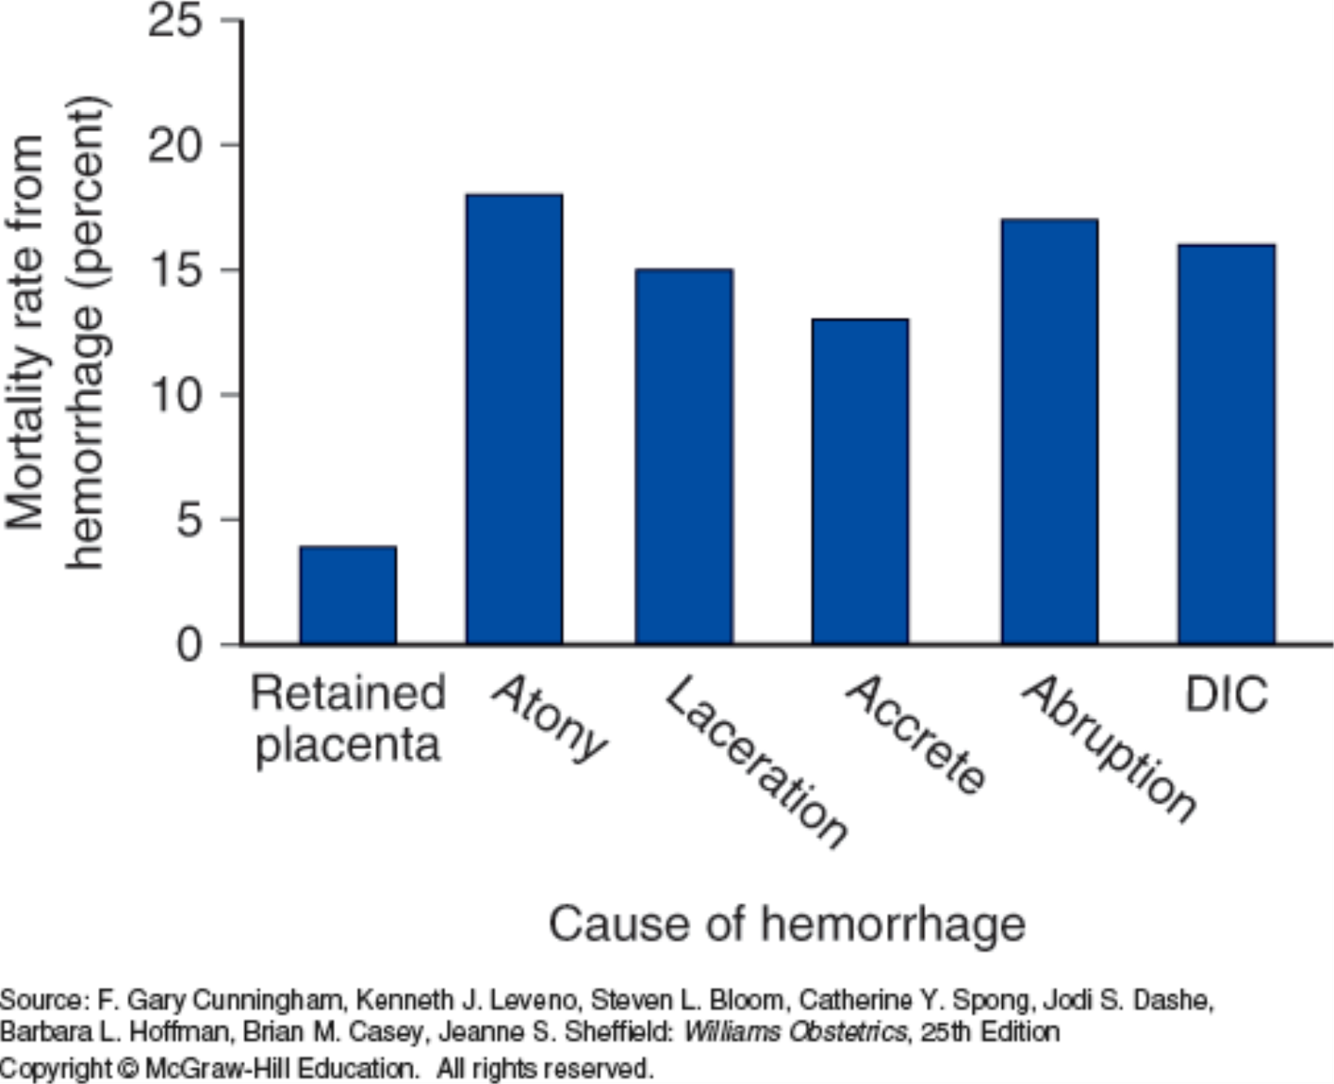
Cause Contribution to Hemorrhage-Related Maternal Death
Al-Zirqi, 2008; Berg, 2010; Creanga, 2015; Zwart, 2008
Notes:
The first step once you recognize increased bleeding is try to assess its cause so that you might adequately address it.
The players should not be a surprise…they are….READ…One of my mentors Gary Cunningham would often say that this list is accurate but the top 3 causes of hemorhage are atony….

Slide 13
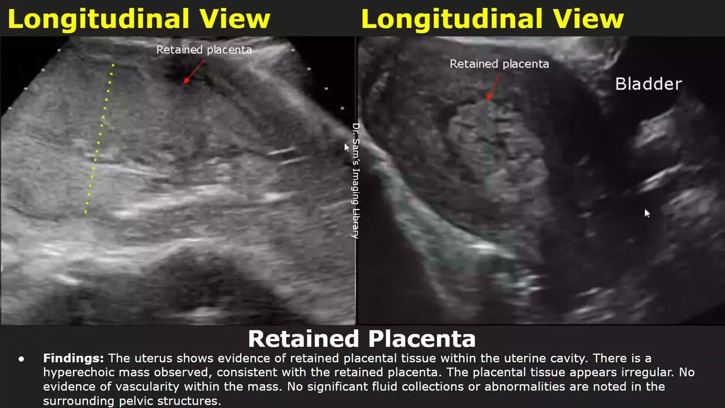
Retained Placental Tissue or Membranes
Notes:
Lets briefly talk about each cause and touch on treatment/management…first up retained palcenta…REVIEW IMAGES

Slide 14
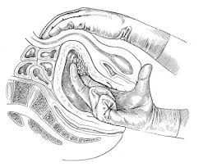
Manual Digital Curettage
Notes:
Retained tissue can be detected during manual evaluation after delivery of placenta or by routine evaluation of placenta for all cotyledons…I cannot stress enough the importance of looking at the placenta after every delivery and doing a bimanual examination of the uterine cavity in these cases…

Slide 15
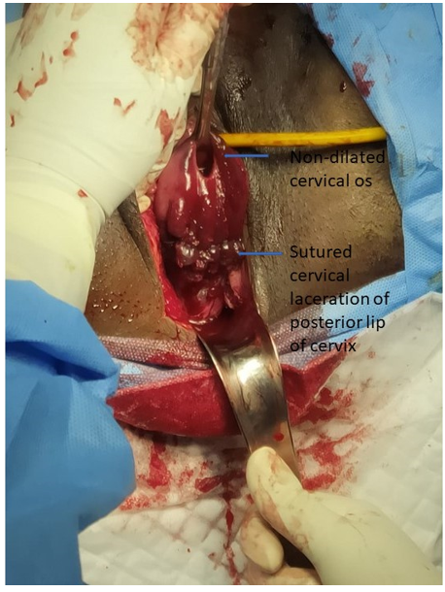
Lacerations
Notes:
Genital tract lacerations…depicted in this slide by a repaired posterior cervical laceration…

Slide 16
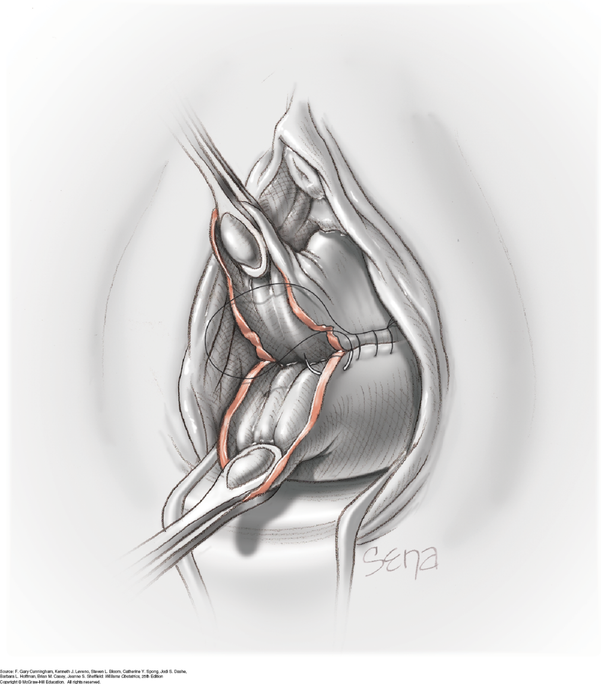
Repair of Cervical Laceration
Notes:
This slide depicts the repair of a cervical laceration after walking the cervix with ring forceps to see if a laceration is the cause of continued bleeding.

Slide 17
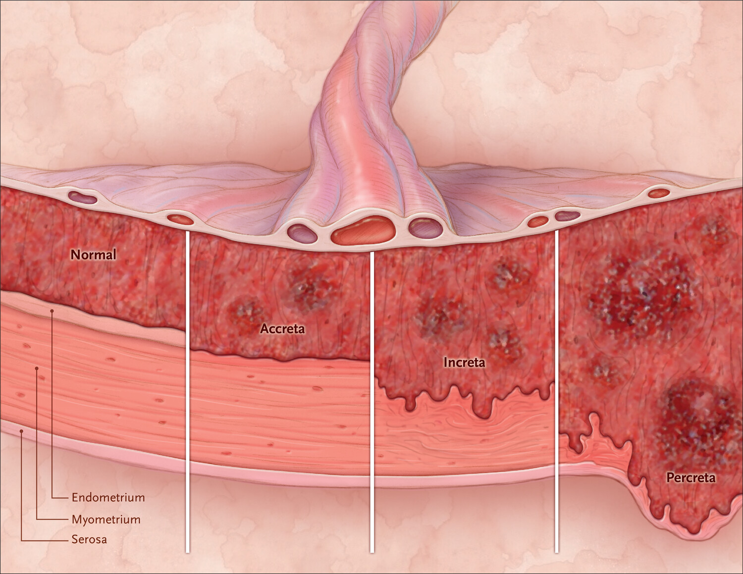
Placenta Accreta Spectrum
Notes:
PAS…or MAP
placenta accreta occurs when there is a defect of the decidua basalis, in conjunction with an imperfect development of the Nitabuch membrane ( a fibrinoid layer that separates the decidua basalis from the placental villi). resulting in abnormally invasive implantation of
the placenta
Accretta….incretta…percreta….

Slide 18
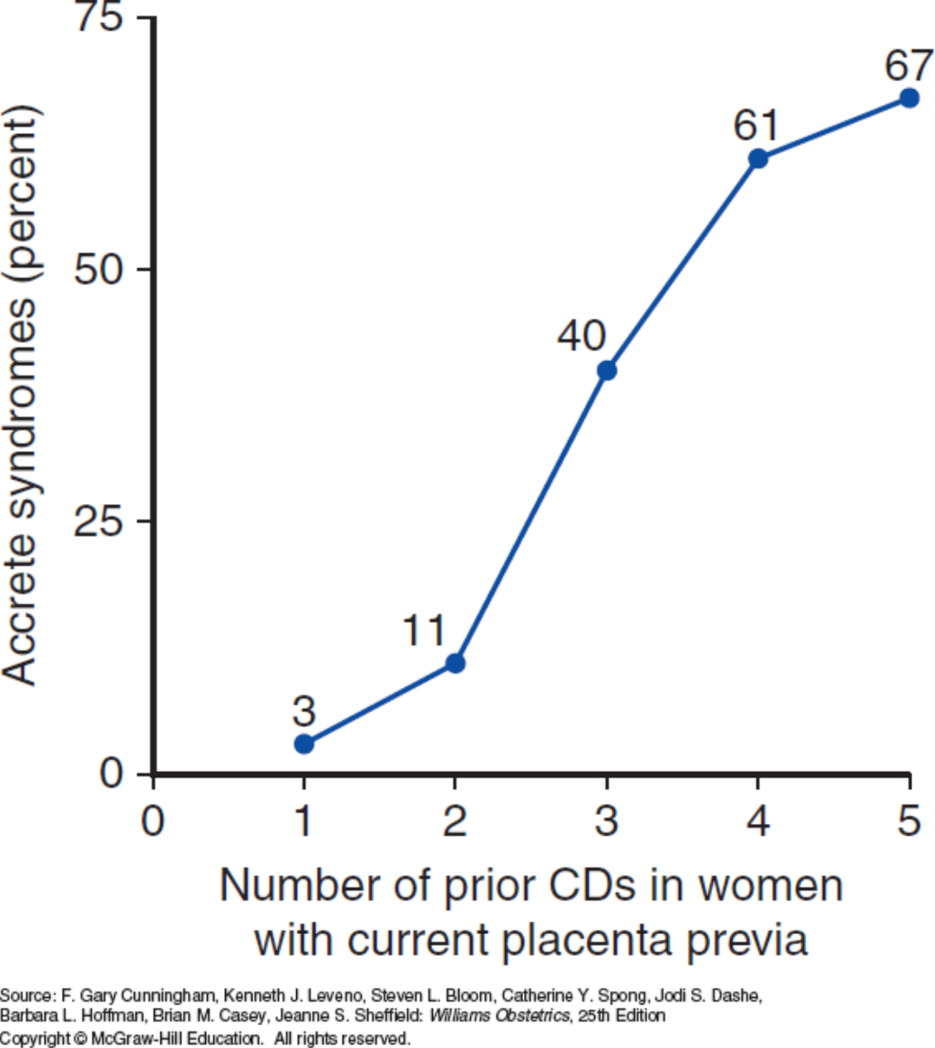
Frequency of morbidly adherent placenta in women with prior cesarean deliveries and placental previa
Silver, 2006
Notes:
incidence of placenta accreta has increased 10-fold in the past 50 years, to a current frequency of 1 per 2,500
deliveries. largely as a result of the increase in the number
of cesarean sections
…This graph indicates likelihood of placental invasion in women with previa and number of prior cesarean delivery…..
~ 50% at 3 and more than 2/3rds after 4 or 5

Slide 19
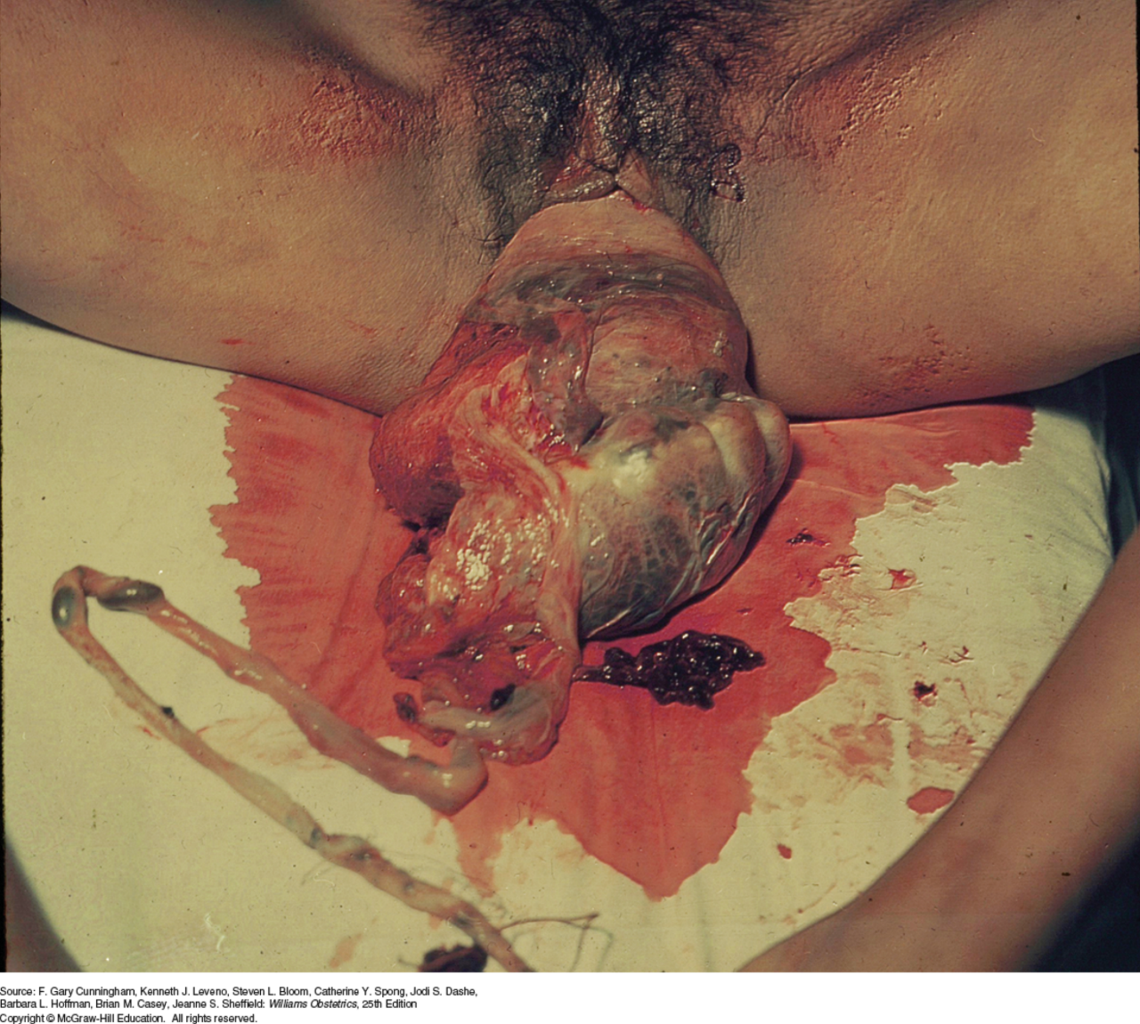
Uterine Inversion With Placenta Accreta
Notes:
This case was of an unfortunate woman who underwent a home delivery and was brought to Parkland Hospital dead on arrival. She was found to have a completely inverted uterus and adherent fundal placenta which led to her exsanguination and death.
Morbidly adherent placentas are something that we are seeing more and more of. I should mention that when we identify them up front, we are referring them all to Dr. Subramaniam and Dr. Bevis as they are the backbones of a morbidly adherent placenta group that is trying to wrap their arms around these situations to create some uniformity in management and improve communication among all members of the team.

Slide 20
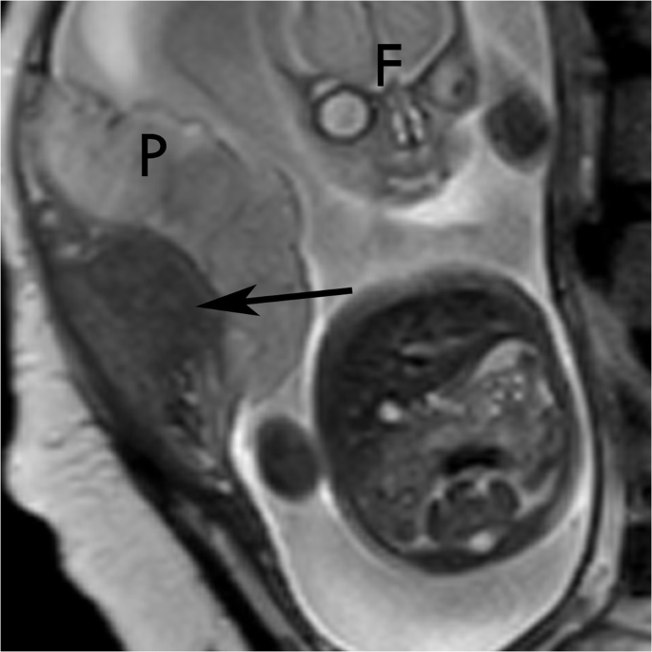
Placental Abruption
Notes:
Next is placental abruption 1-2% of deliveries…here this MRI indicates a placental separation or abruption

Slide 21
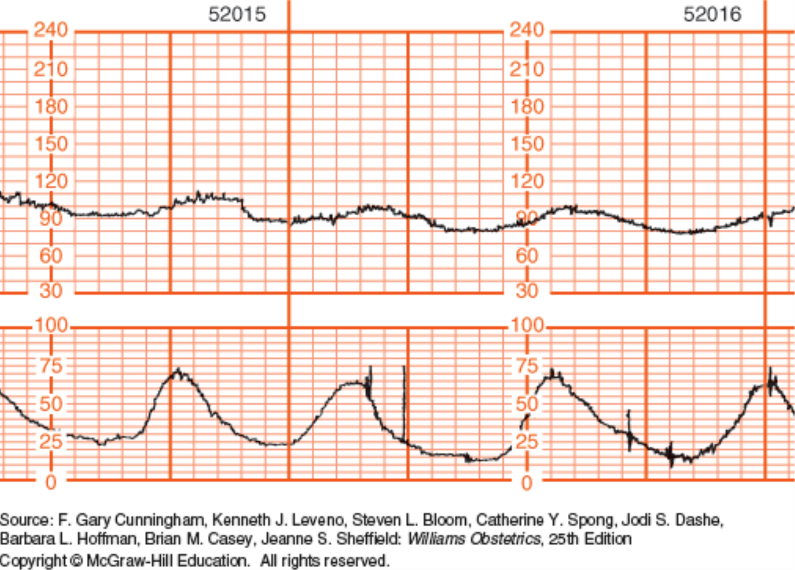
Vaginal Bleeding with Fetal Compromise
Notes:
Don’t have imaging this clear typically…but another signs of abruption (other than bleeding in 80%), is fetal heart rate trouble as shown here.

Slide 22
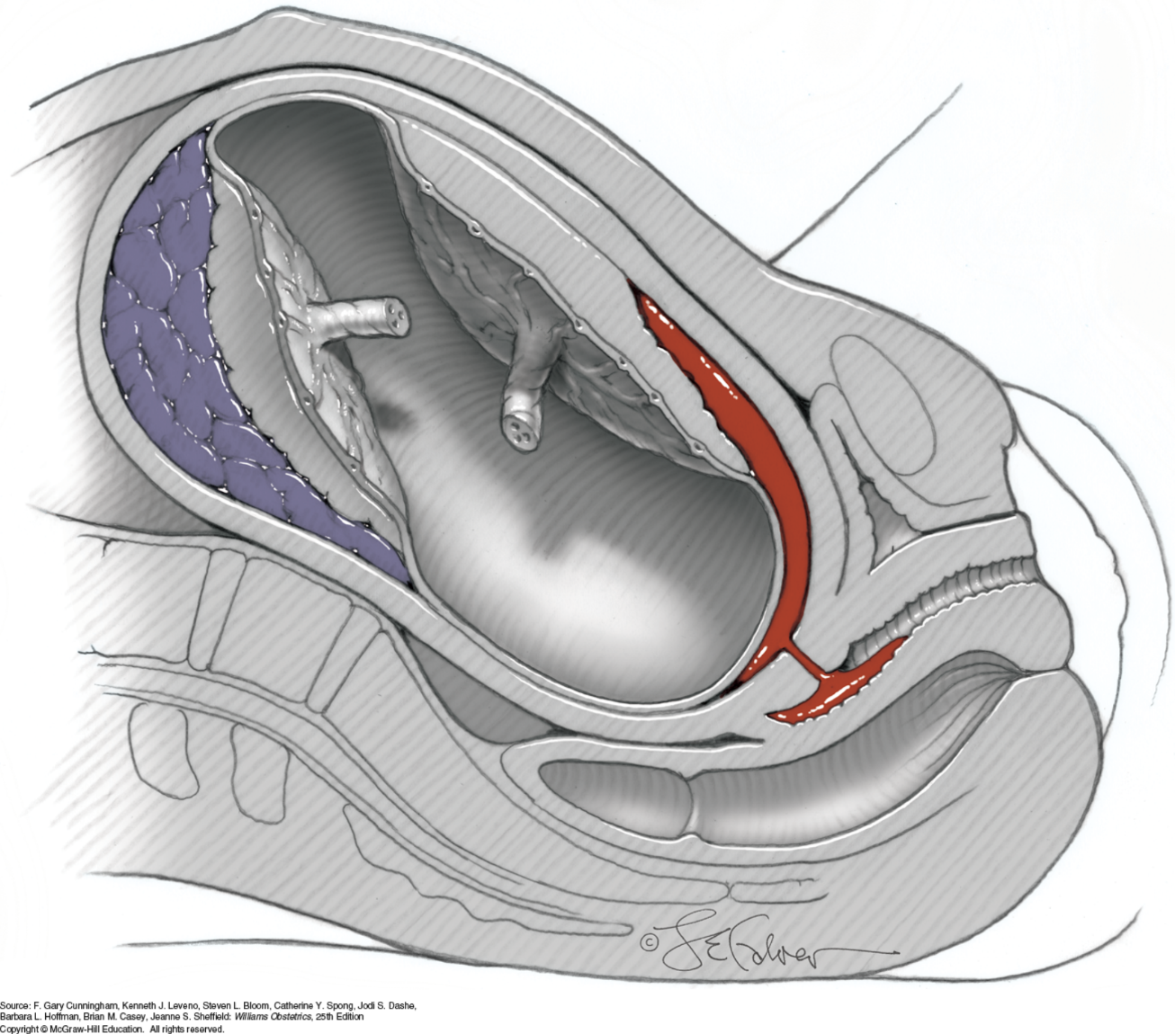
Placental Abruption: Partial and Concealed
Notes:
That said there can be total placental abruption with concealed hemorrhage and in that case the first sign might be fetal distress or even death.
In 1967, Dr. Pritchard and Dr. Brekken published their experience with 41 cases of abruption with fetal death:
Fibrinogen < 150 mg = 38%
Fibrinogen < 100 mg = 28%
Based off of that data, a good rule of thumb was to assume 4 units down and start transfusion with foley catheter monitoring of urine output immediately.
To the right is a partial abruption with blood and clots dissecting between membranes and decidua to the internal cervical os and then externally into the vagina.

Slide 23
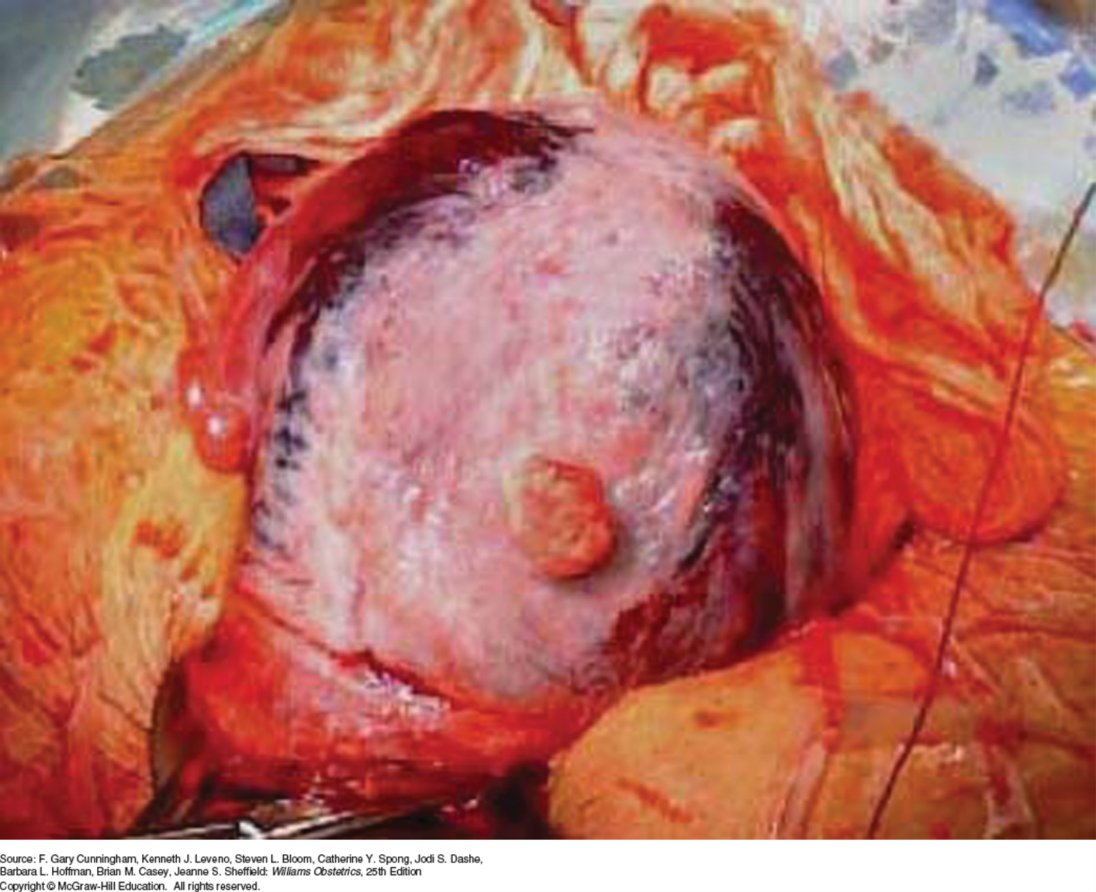
Couvelaire uterus
Notes:
And this is what you might find in an abruption during cesarean delivery. Blood markedly infiltrates the myometrium to reach the serosa, especially at the cornua.
The consequences of these are usually self-limited and related to speed of recognition and quality of resuscitation.
My only caveat is when confronted with unexplained fetal death, always consider abruption because to miss it could be fairly consequential with development of consumptive coagulopathy and death.

Slide 24
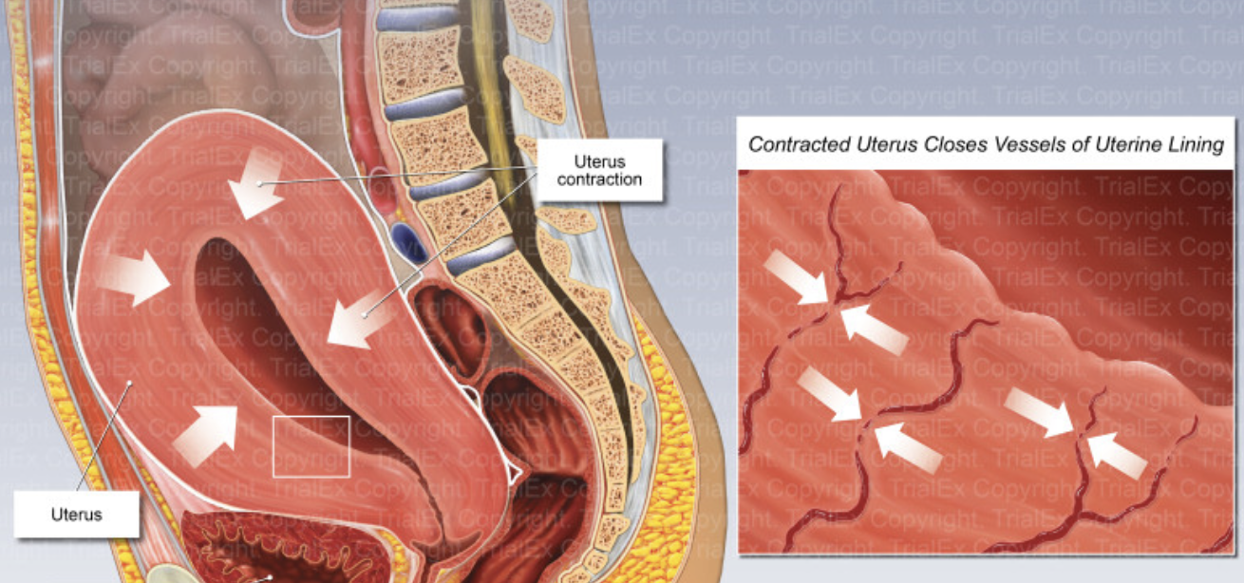
Uterine Atony
Notes:
Finally, lets talk about atony…Uterine atony is the most common cause of hemorrhage after delivery and there are several risk factors which include prolonged labor, use of oxytocin, infection, and over distended uterus.

Slide 25
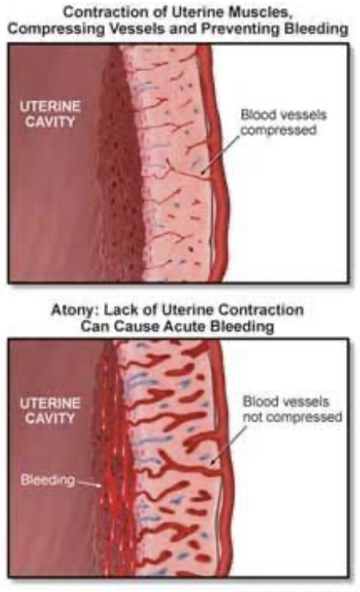
Atony: Risk Factor of PPH
  Uterine Tone
    Post-delivery uterine contraction
      Controls bleeding
      Constricts vasculature of uterus
    Uterine atony
      Lack of physiologic uterine tone
      → Excess bleeding
Notes:
Uterine contraction after delivery compresses the vessels woven through the myometrium
With incomplete or poor contraction of the uterus,

Slide 26
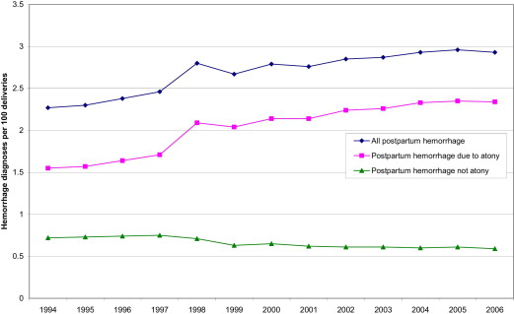
  Uterine Atony: Leading cause of hemorrhage and death
Etiologies and Risk Factors of PPH
Al-Zirqi, 2008; Berg, 2010; Creanga, 2015; Zwart, 2008
Notes:
Uterine atony is a big player in the development of hemorrhage is a big player in maternal death

Slide 27
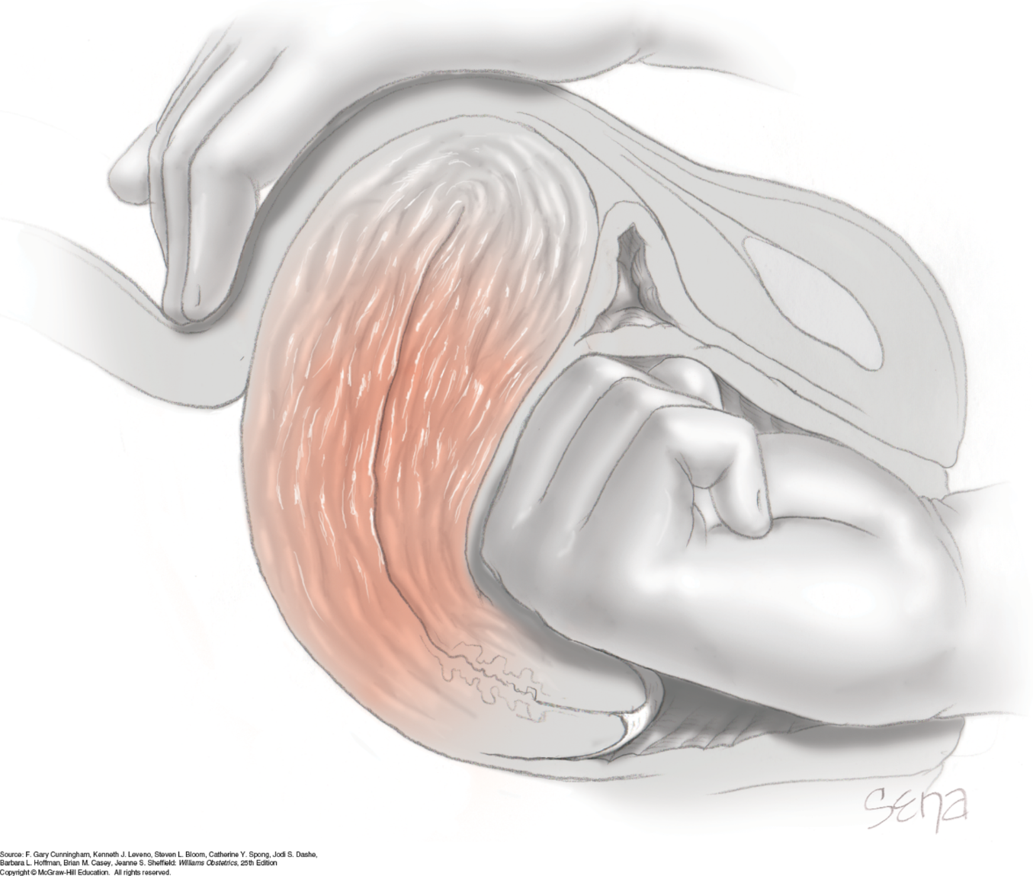
Bimanual Compression
Notes:
In the absence of identifiable retained tissue then uterine massage is typically necessary and should be aggressive and continuous.
This slide depicts uterine compression which can be employed while you are waiting for blood, help, or during resuscitation efforts.

Slide 28
Standard second-line uterotonic therapy (ergot derivatives, prostaglandins)
    Methylergonovine
      0.2mg, Inj, IM, Once, NOW
      *Note: Not first-line if patient is hypertensive.
    Carboprost
      250mcg, Inj, IM, Once, NOW
      *Note: Not first-line in asthmatic patients.
    Misoprostol
      800mcg, Tab, Rectal, Once, NOW
      *Note: Onset of action can be delayed.
  High “failure” rate → 30% require > 1 dose

Slide 29
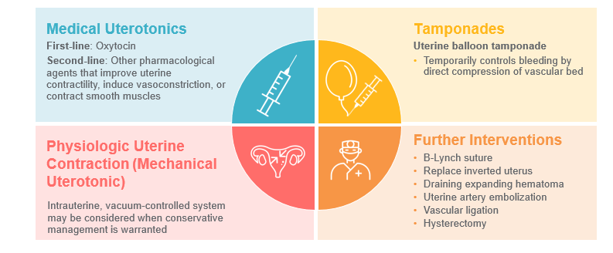
Third-line therapy (radiologic, devices, surgery)
  Tamponade Devices
    Bakri Balloon
    Foley
    Ebb Balloon
    Uterine Packing
  Vacuum Assisted Device
    Jada System
    Iris ?
  Uterine Artery Embolization
  Surgery
    O’Leary
    B-Lynch Compression
    Hysterectomy

Slide 30
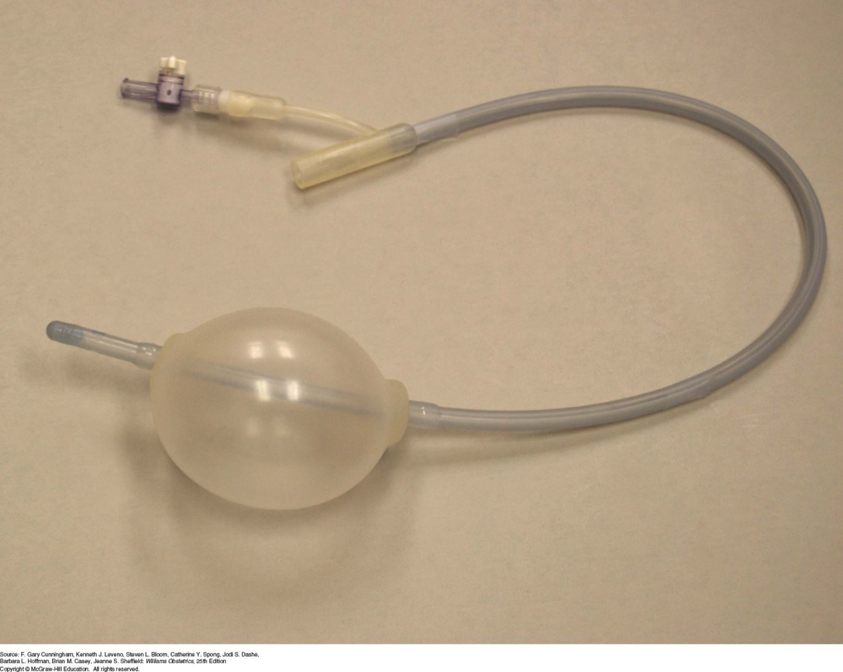
Bakri Balloon
Notes:
Use of Bakri balloons has become popularized as the last final step in medical management of uterine atony. Large Foley (30 F) catheter have been successfully used as well as intravaginal packing

Slide 31
  Bakri balloon (OLIVE, unpublished)
    Retrospective study of 3 centers (n=106)
    Device placed with median EBL 1625 mL
    89% treatment success (92% VD, 88% CD)
    Transfusion rate: 63%
    Indwelling time 17.1hrs (13.2-21)
    21% ICU admission rate
    9 SAEs

Slide 32
JADA Vacuum Device

Slide 33
JADA device - PEARLE Study
  Multi-center (12 US Sites) N= 107
  JADA System could be used if failed > 1 dose 2nd-line therapy
  Outcome – Control of bleeding without additional interventions
  Results
    94% control of PPH in 2.5 minutes
    Only 110mL of additional bleeding after device placement
    Total blood loss ~870 mL VD and 1300 mL CD
    Transfusion rate- 38% overall
    Indwelling time 3.2hrs
    No SAEs
Notes:
Knocks against JADA is expense and earlier use therefore less necessary

Slide 34
JADA Vacuum Device (RUBY)
    Observational post-market registry (US) of 16 centers with n=800
    96% (VD) and 88% (CD) success with atony
    ~50% had >2 uterotonic doses
    Total blood loss ~1400mL VD and 2300mL CD
    Transfusion rate- 29.2% VD and 60.7% CD
    Indwelling time 4.6hrs (VD) 6.3hrs (CD)
    Control in 5 minutes for majority of cases
    3 SAEs
In the real-world, JADA still shows a promising superior benefit for atony, but benefits not as robust given late use…
Notes:
Here is pragmatic real world observational study

Slide 35
Notes:
One study…another ongoing soon through MFMU …was a head to head but retrospective study…

Slide 36
Notes:
Look what they found…reduction in transfusion

Slide 37
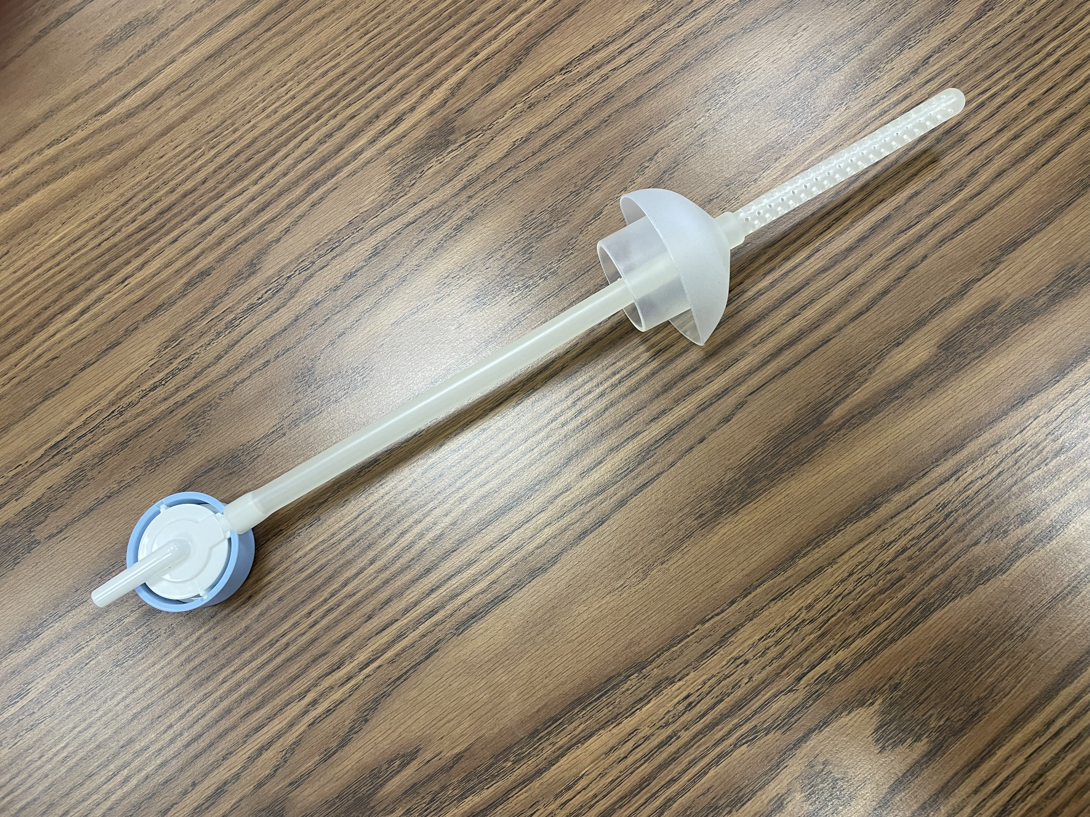
IRIS Vacuum Device

Slide 38
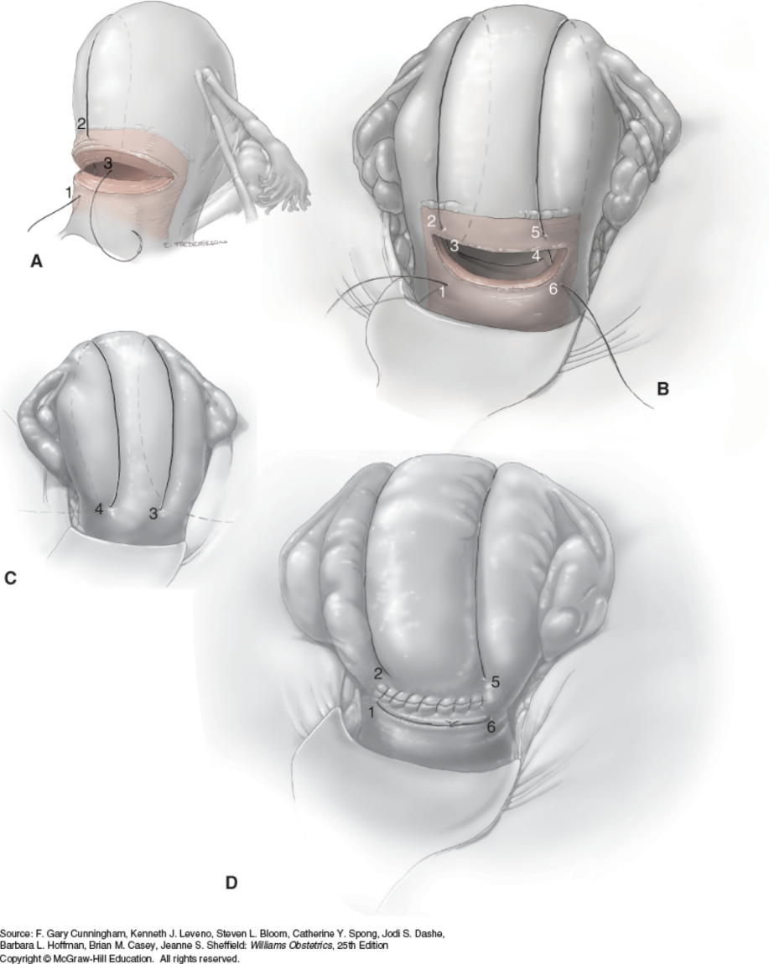
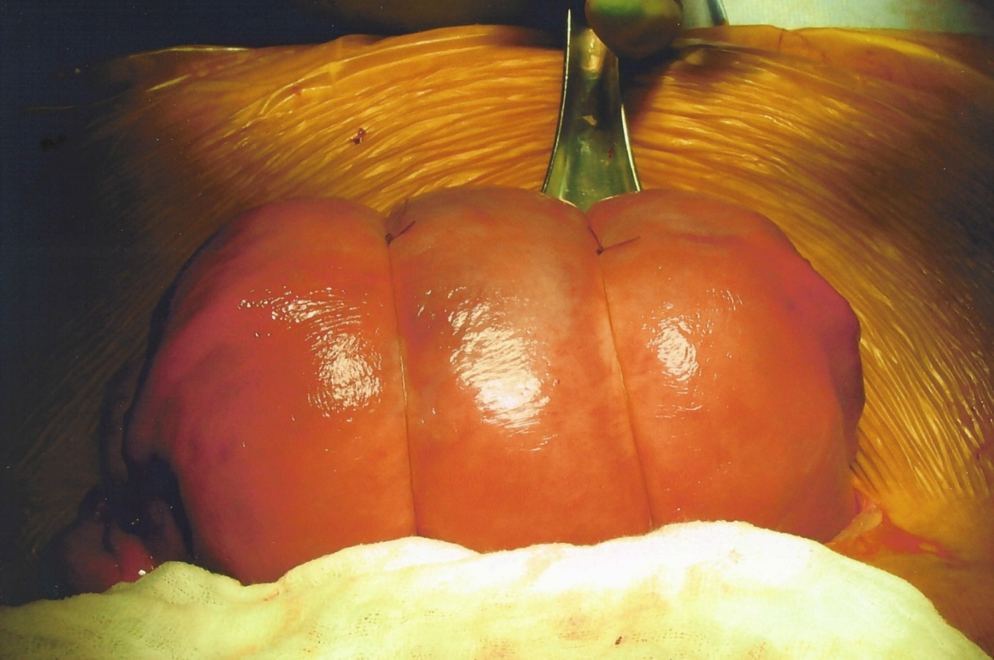
B-Lynch Suture
Notes:
In situations where you have the abdomen open for a cesarean, use of the B-Lynch suture has also been popularized. It has also been employed in heroic attempts to preserve the uterus after a vaginal delivery.
Uterine compression suture or “brace.” The B-Lynch suture technique is illustrated from an anterior view of the uterus in Figures A, B, and D and a posterior view in Figure C. The numbers denote the sequential path of the suture and are shown in more than one figure. Step 1. Beginning below the incision, the needle pierces the lower uterine segment to enter the uterine cavity. Step 2. The needle exits the cavity above the incision. The suture then loops up and around the fundus to the posterior uterine surface. Step 3. The needle pierces the posterior uterine wall to reenter the uterine cavity. The suture then traverses to the opposite side within the cavity. Step 4. The needle exits the uterine cavity through the posterior uterine wall. From the back of the uterus, the suture loops up and around the fundus to the front of the uterus. Step 5. The needle pierces the myometrium above the incision to reenter the uterine cavity. Step 6. The needle exits below the incision and the sutures at points 1 and 6 are tied below the incision. The hysterotomy incision is then closed in the usual fashion.

Slide 39
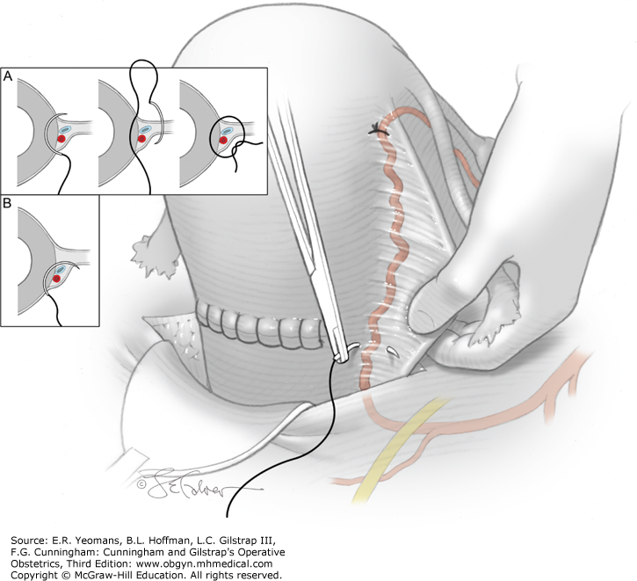
Uterine Artery Ligation
Notes:
At the time of cesarean, extension into the uterine artery is usually easily identifiable. Addressing it can be another matter, and knowing how to perform an O’Leary stitch or uterine artery ligation can be life-saving.
The suture goes through the lateral uterine wall anteriorly, curves around posteriorly, then re-enters anteriorly. When tied, it encompasses the uterine artery. Beware of the ureter…especially important that you have a well devoted bladder flap to be sure the ureter is down and out of the way.

Slide 40
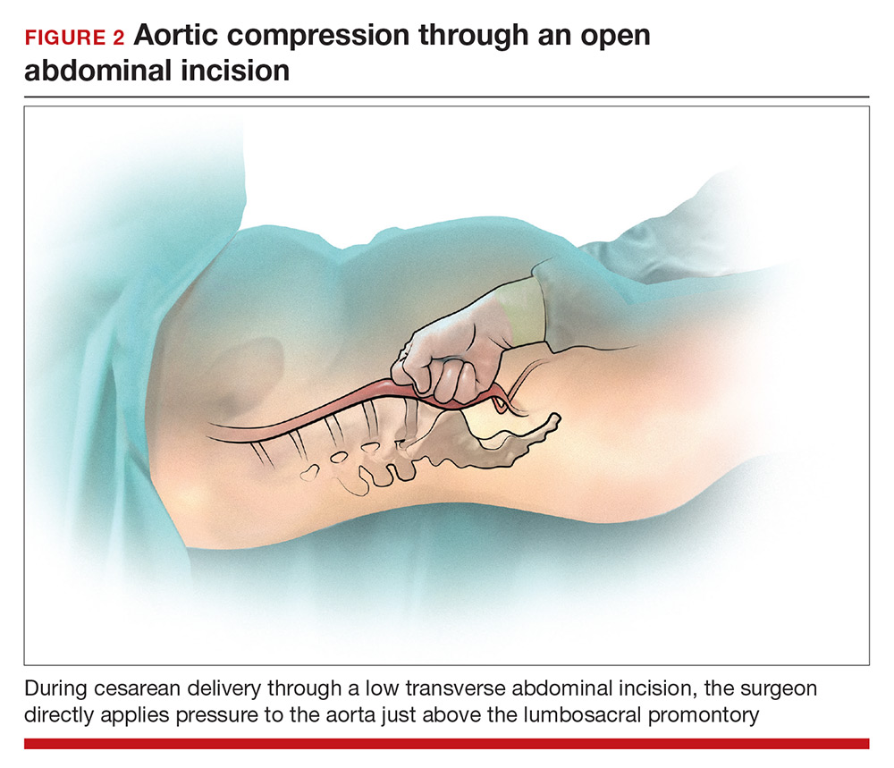
Aortic Compression
Notes:
Similar to the bimanual uterine compression, when blood loss is torrential and you need a minute to think, resuscitate, or wait for your friends…you can compress the aorta through an abdominal incision.

Slide 41
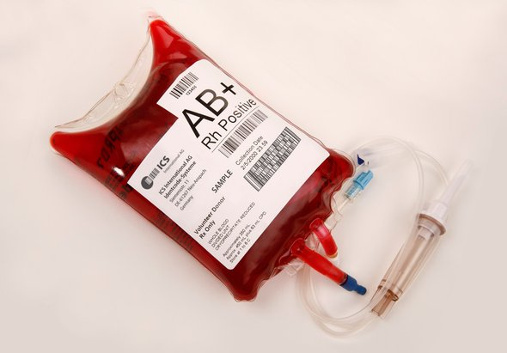
Transfusion = Perfusion
Notes:
Lastly, I put this up here to remind you that transfusion can be part of your treatment of atony rather than a response to it…a perfused uterus is more likely to behave the way you want it to than one of a woman who is under resuscitated.

Slide 42

Planning for and Responding to Obstetric Hemorrhage
California Maternal Quality Care Collaborative
Obstetric Hemorrhage Version 2.0 Task Force
This project was supported by Title V funds received from the California Department of Public Health; Maternal, Child and Adolescent Health Division
H
Notes:
Alright, now lets shift gears a bit…I have mentioned the California Collaborative several times and stolen some of their slides. They established a tsak force to look specifically at OB hemoorhage…

Slide 43
Key 2008 CMQCC Hemorrhage Task Force Survey Findings
40% of hospitals did not have a hemorrhage protocol
Inconsistent definitions of hemorrhage were used among responding hospitals
70% of hospitals were not performing drills
    MDs were not regularly participating in drills in hospitals that were doing them
Most had access to all 4 uterotonics
Many hospital reported they did not have access to alternative treatment methods, e.g., Balloons
Note: 173 hospitals responded to the first baseline survey. The response rate is 66.3% based on 173/261 hospitals (2008) with annual delivery volume > 50 births.
Notes:
Their findings in part were…

Slide 44
Obstetric Hemorrhage Safety Bundle
Readiness: (every unit)
Hemorrhage Cart / with Procedural Instructions (balloons, compression stiches)
Rapid access to hemorrhage medications (kit or equivalent)
Establish a response team: multiple partnerships // unit education, drills, debriefs
Establish MTP and 0-neg/uncrossmatched transfusion protocols
Recognition: (every patient)
Assessment of hemorrhage risk (prenatal, on admission, ongoing in labor & PP)
Measurement of CUMMULATIVE blood loss
Active Management of 3rd Stage (oxytocin after birth)*
Notes:
They took their findings and developed a safety bundle which had 4 parts
They stressed readiness and being cognizant of risk factors before the hemorrhage happened…
They suggested that there are problems with recognition of hemorrhage and recommended a quantitative and cumulative blood loss assessment.
They included regular use of uterotonics like oxytocin after delivery. There is some data from this institution regarding use of oxytocin and dose after delivery.

Slide 45
Obstetric Hemorrhage Safety Bundle
Response: (every hemorrhage)
Unit-standard, stage-based OB Hemorrhage Emergency Management Plan with checklist
Support program for patients, families and staff
Reporting / Systems Learning: (every unit)
Establish a culture of huddles for high-risk patients and post-event debriefings
Review all stage 3 hemorrhages for systems issues
Monitor outcome and process metrics in perinatal QI committee
Notes:
They recommended a standardized response with a checklist.
They acknowledged that we must remember there are patients and families who don’t understand and need constant explanation about what we are doing and why.
And finally stressed that we should be re-assessing our approaches constantly…so I would like to propose to you that what we are talking about today is not an ending but a beginning of an evolving process around one of the big killers of women on L&D in the U.S.

Slide 46


Slide 47
Food for thought…
Uterine Atony Prevention
Notes:
Ounce of prevention….
I was not a true believer in high dose oxytocin when I transferred from Dallas to Alabama

Slide 48
Notes:
But transfusion rate in birmingahm was very low…typically just less than 3 % of women in the US get transfused after delivery…these numbers were well below our established threshold of 3.5%

Slide 49
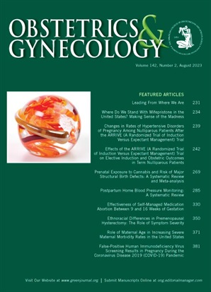
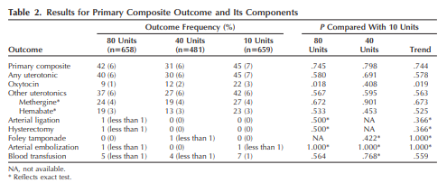
Oxytocin after birth:
80 vs. 40 vs. 10 Units
Tita et. al., Obstet Gynecol, 2012

Slide 50
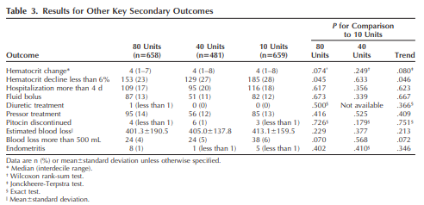
Oxytocin after birth:
80 vs. 40 vs. 10 Units
Tita et. al., Obstet Gynecol, 2012
Notes:
Easy to implement (it is cheap) and also straightforward to look at.impact on outcomes…
As we saw earlier, WV seems to be doing well in mortality rate overall, but this is low hanging fruit that could be reduced even further without tremendous cost to the system…

Slide 51
An Innovation…
Early Recognition

Slide 52
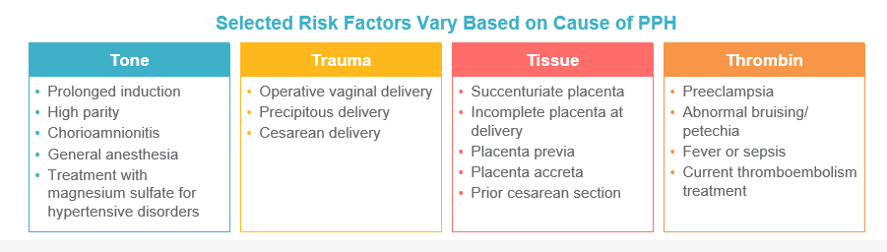
Etiologies and Risk Factors of PPH
Notes:
READ…

Slide 53
Hemorrhage: How Much is too Much?
> 500 mL for vaginal delivery and > 750 mL for C/S
  BUT 500 mL for NSVD is the average
  750 mL for C/S is average
  And for most women well tolerated
WHO defines
  EBL of > 500 mL an “alert line”
  > 1000 mL an “action line”
ACOG (reVITALize)
  Cumulative EBL > 1,000 mL for either vaginal or cesarean birth with enhanced surveillance and early interventions, as needed, for 500-1000 mL
4-5% of women > 1000 mL - A clinically significant amount!!
1/3 of women with > 1000 ml NO risk factors
Notes:
California wrestled with this issue of what normal was because you must agree what normal is in order to know what abnormal is…
They say >500 and greater than 750 is average…
WHO identifies 500 and 1000 cc as alert lines….
ACOG simply says 1000..

Slide 54
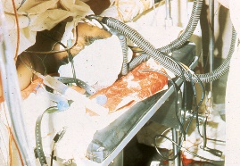
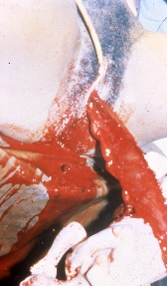
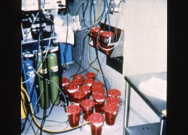
Recognition is sometimes not a problem…

Slide 55
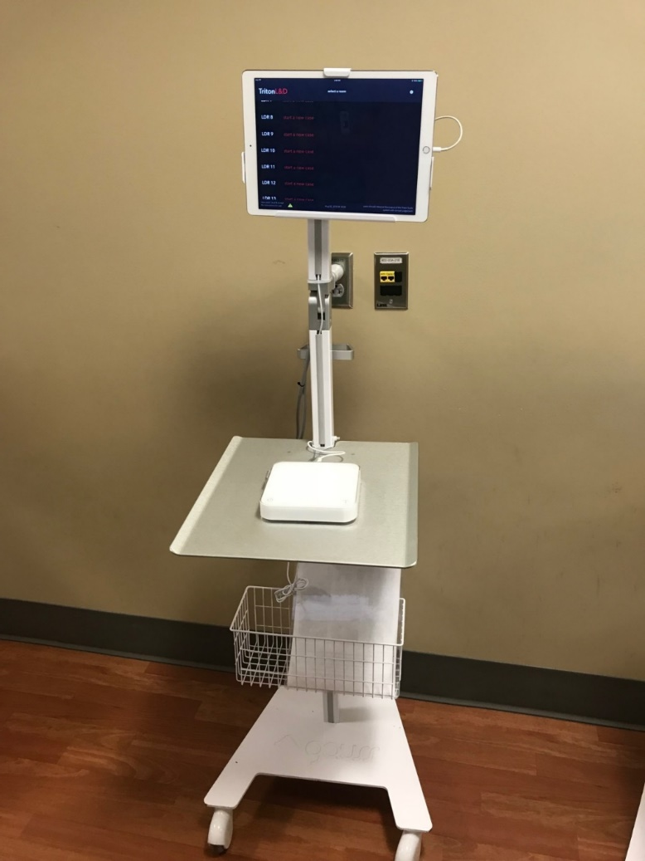
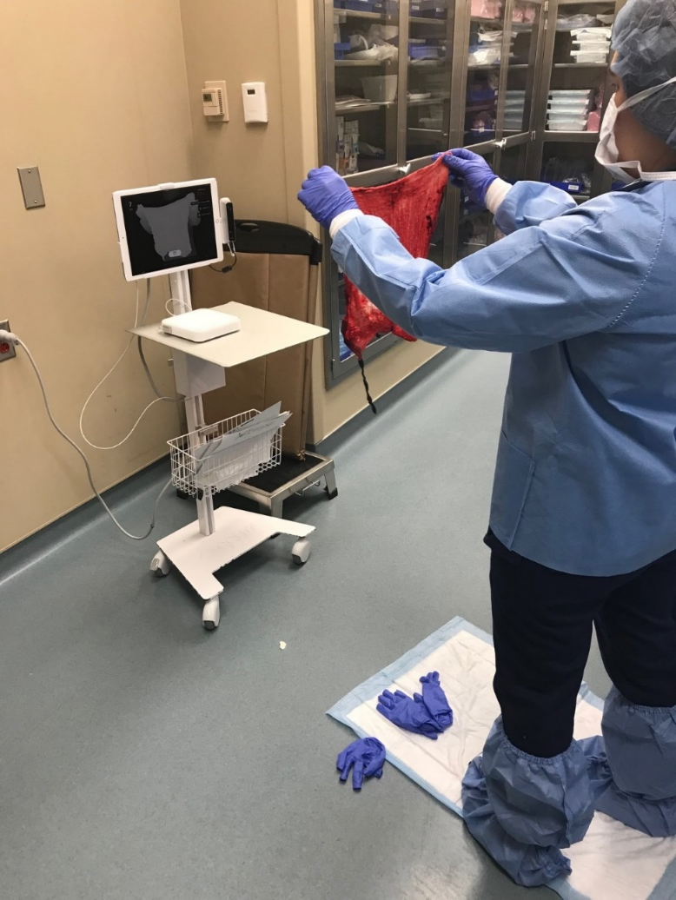
QBL: Device Estimation of Blood Loss
Pasko Data
Notes:
This is a sad picture…does anyone else get a lonely feeling when looking at this…I do.

Slide 56
Accuracy of Physician Estimates
All Deliveries
 | Pre-Triton | Post-Triton | P value
All Deliveries | N = 6378 | N = 2767
Mean | 524 ± 359 | 451 ± 307 | < .001
Hgb difference* | 0.3 ± 1.2 | 0.5 ± 1.2 | < .001
Any Delivery > 1000 cc | N = 212 | N = 74
Mean | 1578 ± 844 | 1573 ± 469 | .94
Hgb difference* | -1.2 ± 3.1 | -1.2 ± 2.1 | .80
Pasko et. al., SMFM, 2019
Notes:
We first analyzed accuracy of our EBL before versus after..
When we look at our estimate accuracy after Triton was initiated here, it significantly deteriorated I put those findings that did not favor Triton in red and those that favored triton in blue.
The number 0 would mean we were perfect. If the difference is positive, it means we underestimated the actual blood loss. If the difference was negative, we overestimated blood loss.
Interestingly, though no different before or after, we systematically overestimate blood loss in women who lost more than 1000 cc regardless of route of delivery

Slide 57
Accuracy of EBL vs. QBL
All Deliveries
 | EBL | QBL | P value
All Deliveries | N = 6378 | N = 1934
Mean | 524 ± 359 | 387 ± 296 | < .001
Hgb difference* | 0.3 ± 1.2 | 0.7 ± 1.0 | < .001
Any Delivery > 1000 cc | N = 212 | N = 74
Mean | 1578 ± 844 | 1354 ± 311 | .001
Hgb difference* | -1.2 ± 3.1 | -0.5 ± 1.7 | .03
Pasko et. al., SMFM, 2019
Notes:
Now for the interesting stuff. We compared head to head our qualitative estimates to Triton’s quantitative estimates
Triton, to its credit was more accurate when looking at all deliveries with blood loss greater than 1000 cc regardless of delivery route. Triton overestimated less….
This finding is in blue because it favors Triton.

Slide 58
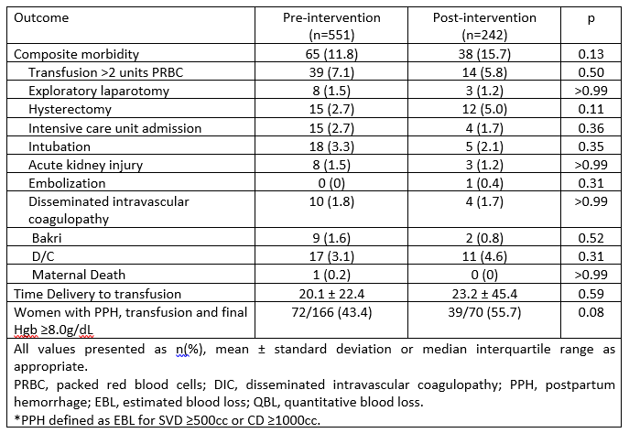
Clinical Outcomes With and Without Triton Among Women With PPH
Pasko et. al., SMFM, 2019
Notes:
Finally, we looked at several clinically relevant outcomes as a composite to see if Triton use resulted in better outcomes for our mothers..
There was no difference in the composite or any of the constituent outcomes. Time from delivery to transfusion and condition of those women with PPH and who were transfused were no different before or after Triton.
So:
Our estimates of blood loss in vaginal and cesarean deliveries were less accurate when Triton was on L&D.
In situations of OB hemorrhage (> 1000 cc), Triton was more accurate than physician estimates of blood loss. However, both physicians and Triton routinely overestimated blood loss.
In most vaginal and cesarean deliveries, physician qualitative estimates were more accurate than Triton quantitative estimates of blood loss.
There were no identified significant benefits associated with Triton use on L&D.

Slide 59
The innovation…
Notes:
What did we do with this data…we innovated…and I offer this to you as an fiscally responsible alternative to more elaborate or expensive methods to QUANTIFY BLOOD LOSS..

Slide 60
RECONGNITION C/S
C/S cases
92% of pt had 300mls or <, 8% had more than 300mls in the canister post placental delivery; so we set our C/S measures blood loss @ 300mls or >
82% of pts used 30 or < lap sponges in a C/S; meaning 18% used more. So we set our threshold for lap sponges in C/S pts @ 30
This is the 30/300 C/S plan

Slide 61
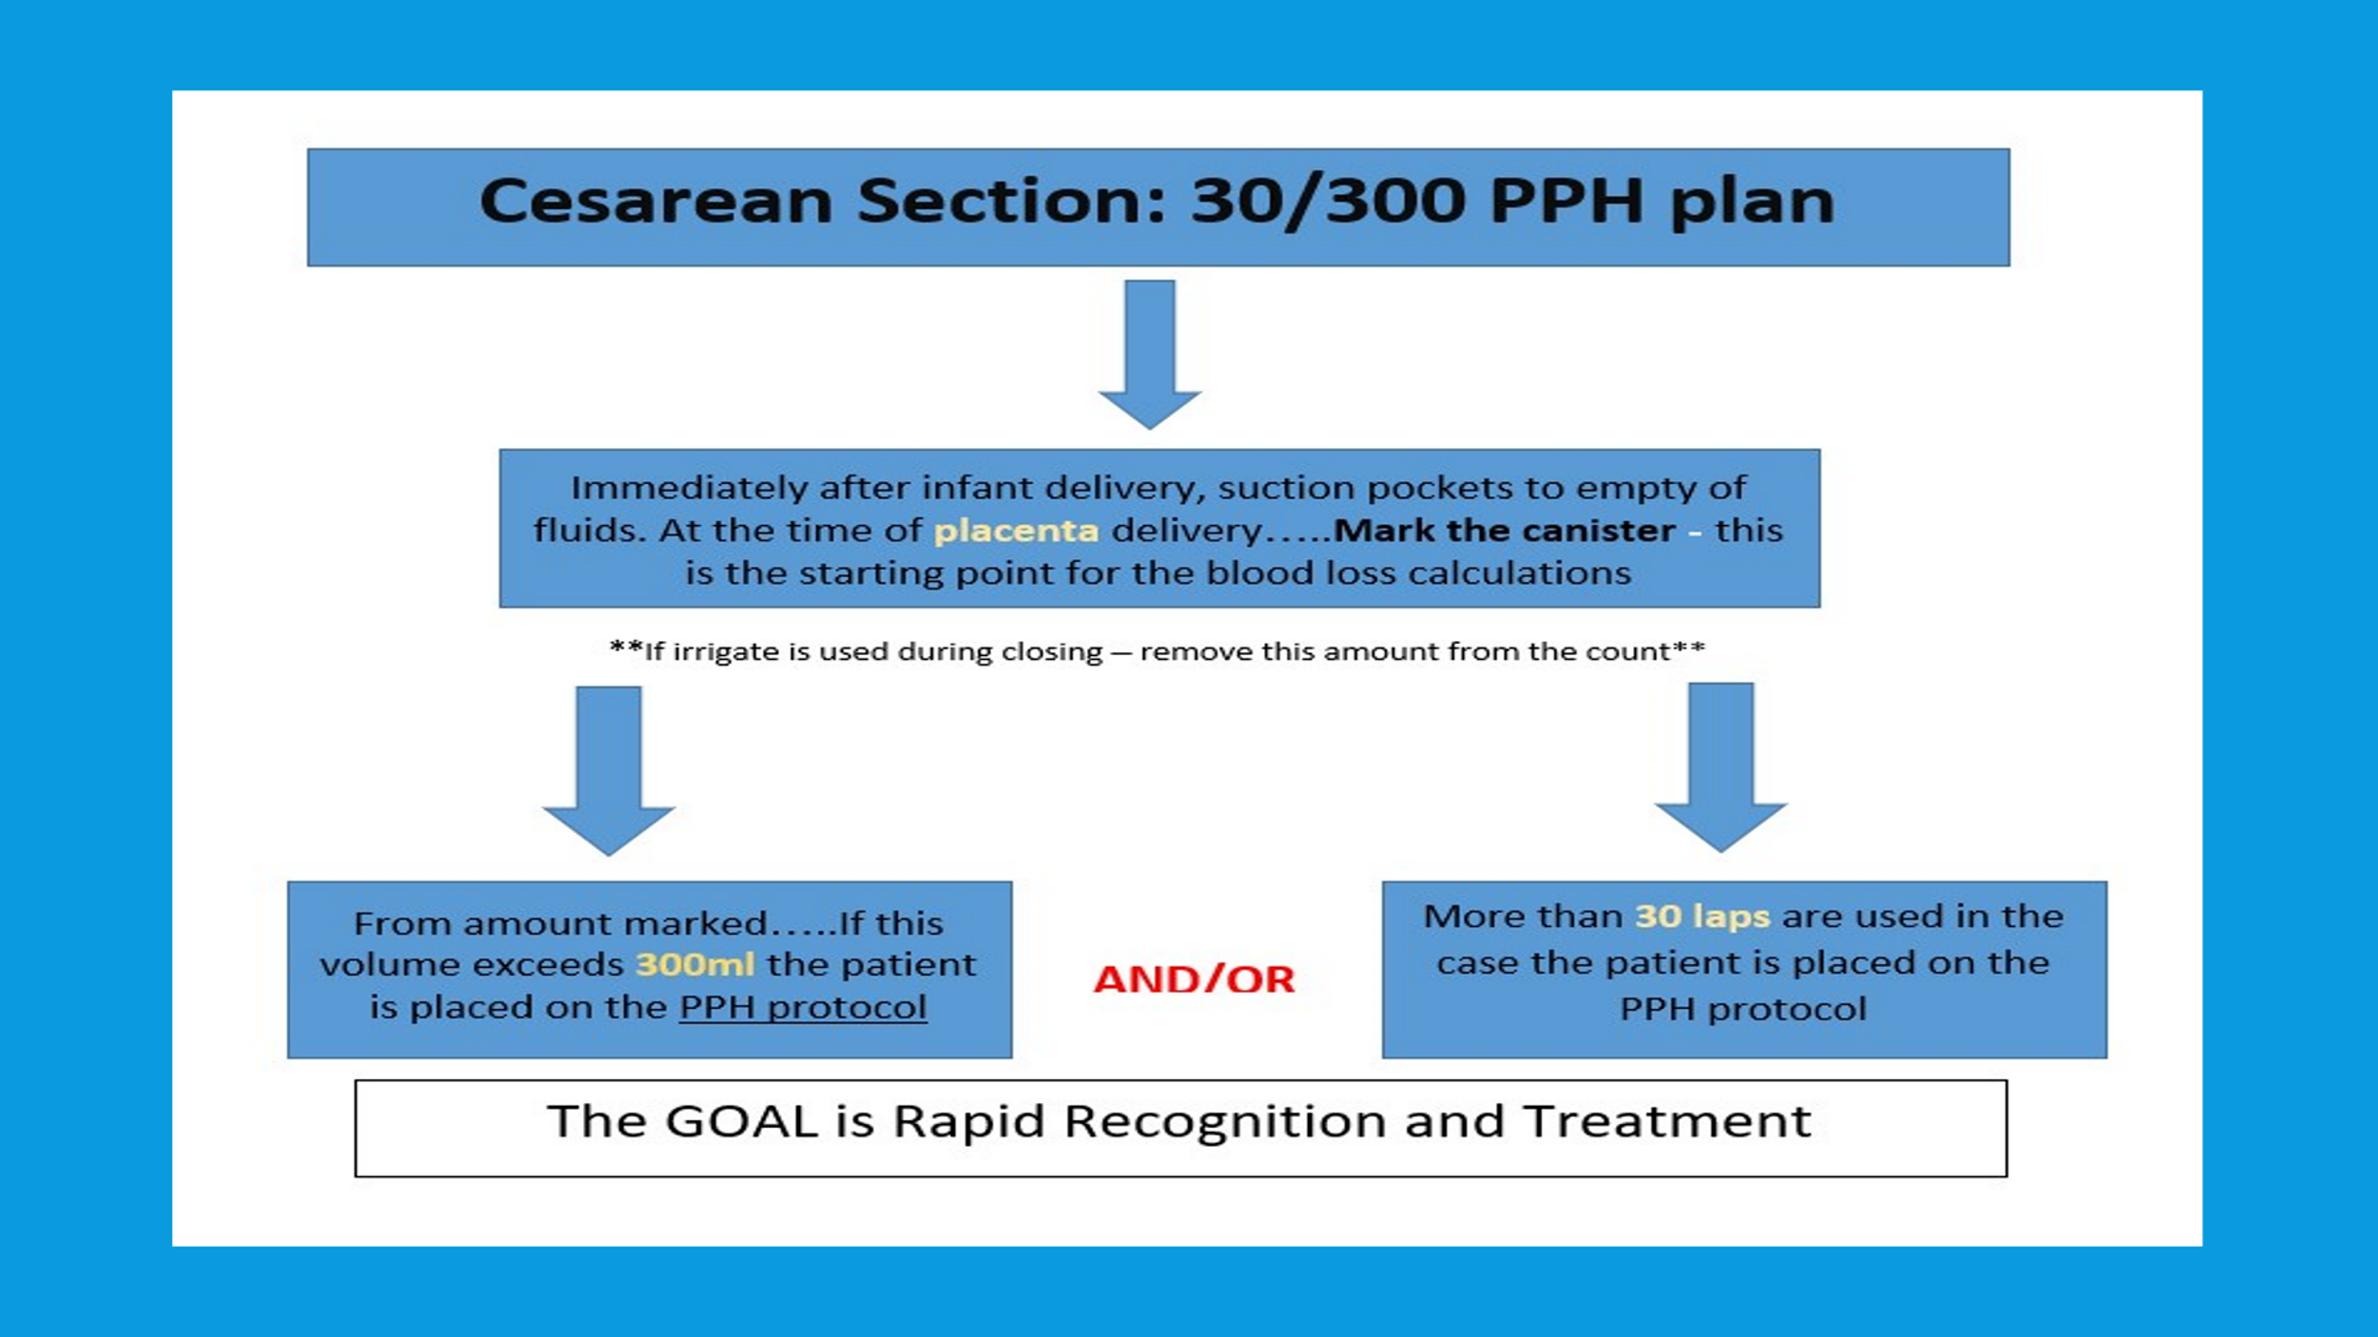

Slide 62
RECONGNITION Vaginal Delivery
Vaginal delivery
88% of pt had 500mls or <, 12% had more than 500 mls in the V-drape post delivery; so we set our Vaginal delivery measures blood loss @ 500mls or >
93% of pts used 5 or < lap sponges in a vaginal delivery; meaning 7% used more. So we set our threshold for lap sponges in vaginal delivery @ 5
This is the 5/500 vaginal delivery plan

Slide 63
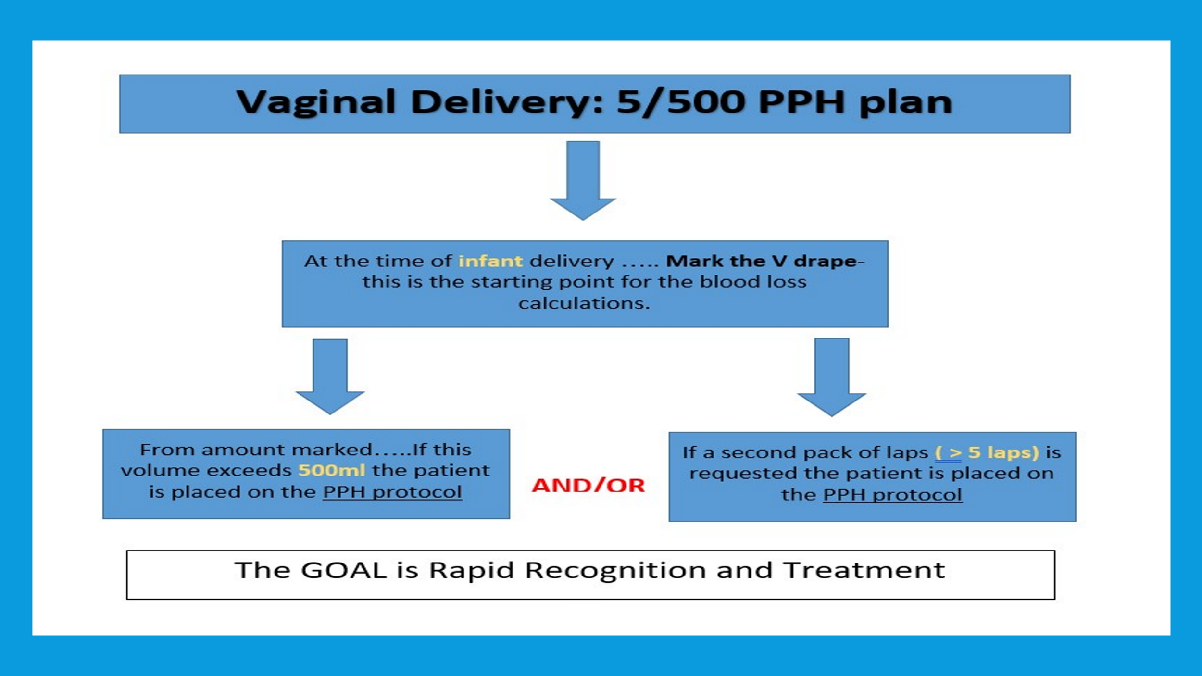

Slide 64
Quantitative Measurement
With this process:
Staff are not pulled away from the patient’s bedside to take pictures, collect chux, or weigh items
Staff are at the bedside engaged in the patient’s status using quantitative data to determine plans of care
The blood loss directly dictates a plan of care

Slide 65
Plan of Care PPH Protocol
PPH Protocol:
Remain in L&D minimum of 4 hours post delivery (reassessed Q1 hour until tx to MBU)
VS q 15 X 2hr, Q 30 min X2 hr, (reassessed @ 4 hours)
Repeat HCT Q2
Fluid management/ transfusion if ordered
PPH assessment Q15 X 2 hr Q30 min X2 hr

Slide 68
Questions?

