Slide 1
HCV and WVHAMP
Treating in our own backyard!

Slide 2
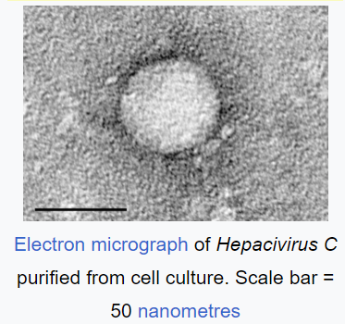
What is Hepatitis C
The hepatitis C virus (HCV) is a small (55–65 nm in size), enveloped, positive-sense single-stranded RNA virus of the family Flaviviridae. The hepatitis C virus is the cause of hepatitis C and some cancers such as liver cancer and lymphomas in humans.

Slide 6
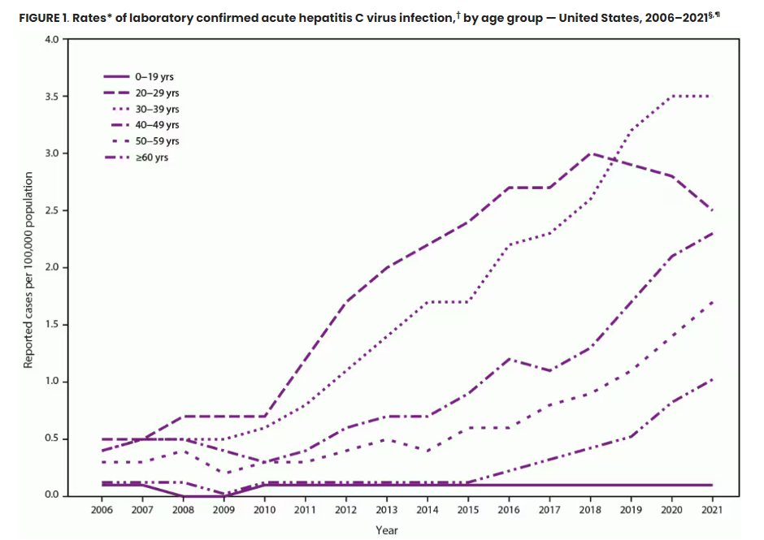

Slide 7
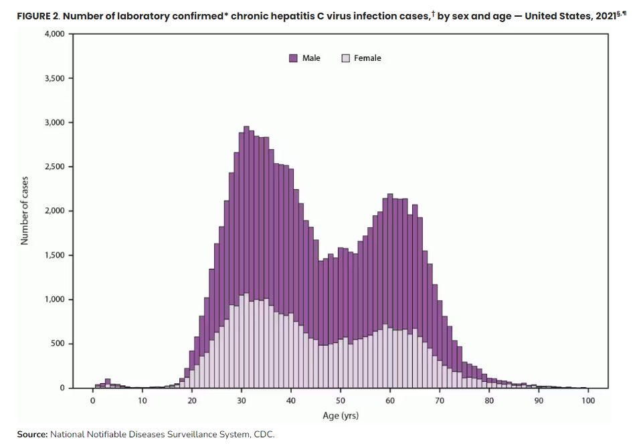

Slide 9
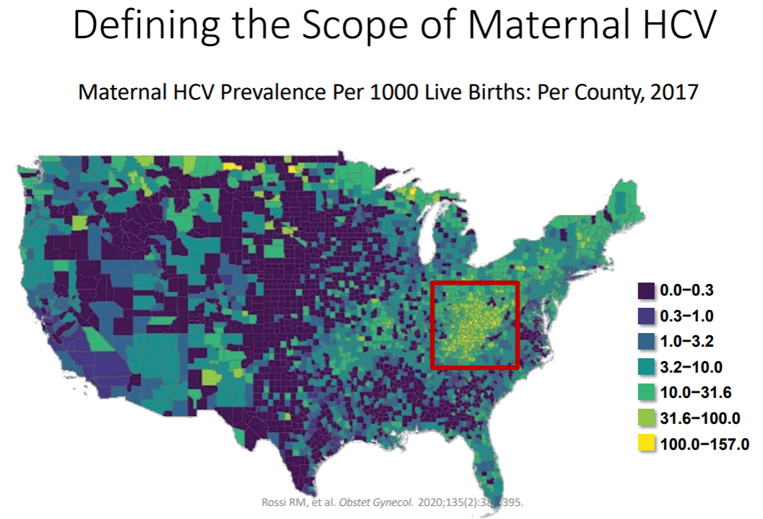

Slide 22
Towards Zero: Elimination of Hepatitis C in Mother-Infant Dyads
The West Virginia Chapter, American Academy of Pediatrics is collaborating with WV Perinatal Partnership and the WV BPH Office of Epidemiology and Prevention Services to offer education for healthcare providers of mothers and babies in West Virginia around Hep C screening recommendations, treatment and long-term follow up care.
A WVCTSI Project ECHO Series:
4 sessions beginning in February thru May during the lunch hour 12-1
Screening During Pregnancy - Including Epidemiology of Diseases
Labor & Delivery
Follow-Up Screening for Hepatitis C in Perinatally Exposed Infants
Management of Hepatitis C in Infants and Postpartum Patients

Slide 23
WVCTSI Project ECHO: Participation Form
Complete the form to register
Scroll down and select “Perinatal HCV ECHO: TBD 12-1 pm”
Submit- you will receive updated information with dates and reminders

