Slide 1
Prehospital Services for High-Risk Obstetric Patients
Challenges Across Central Appalachia
Clinton Burley President and CEO
HealthNet Aeromedical Services
Paul Seamann Director of Operations
Jan-Care Ambulance

Slide 2
Topics for Discussion
Primary 911 EMS Response
Community Hospital Accessibility
Interfacility Transfer: Access and Challenge
How Do We Move Forward?

Slide 3
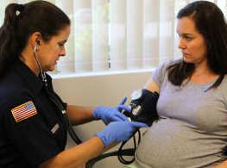
Primary 911 Response
Levels of EMS Care
Is the Ambulance Responding?
Comfort Level of Providers
Is the Community Hospital Ready?

Slide 4
Community Hospital Accessibility
Impact of Closures
Impact of Service Cuts
Do They Really Want Them?
Building Relationships for Care

Slide 5
InterfacilityTransfer: Access and Challenge
High-Risk OB Center

Slide 6
InterfacilityTransfer: Access and Challenge
Maternal Transport Team

Slide 7
InterfacilityTransfer: Access and Challenge
Critical Care Ground Transport

Slide 8
InterfacilityTransfer: Access and Challenge
HealthNet Base
Air Evac Base

Slide 9
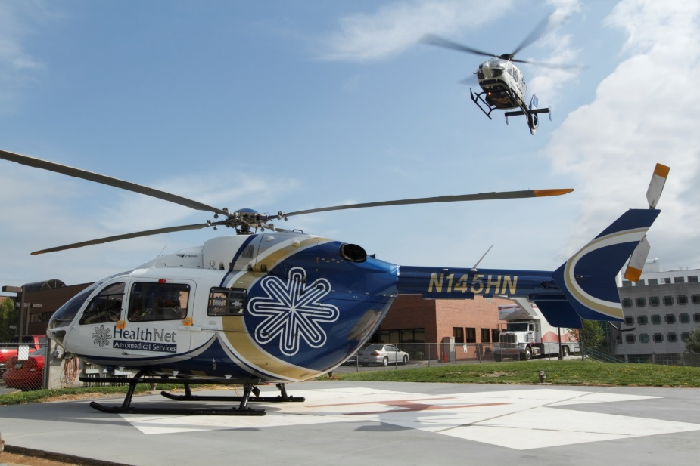
InterfacilityTransfer: Access and Challenge

Slide 10
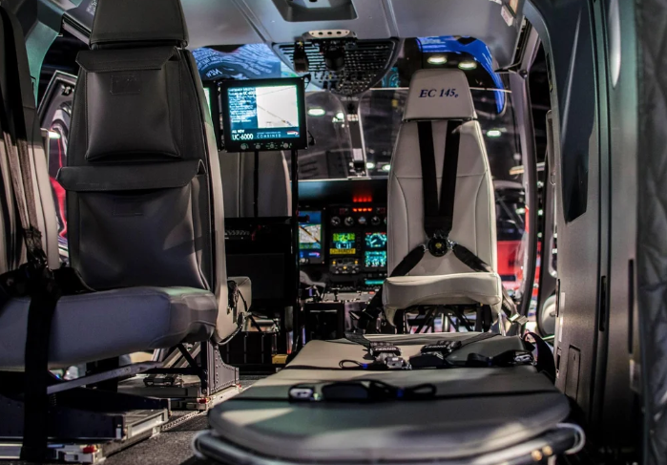
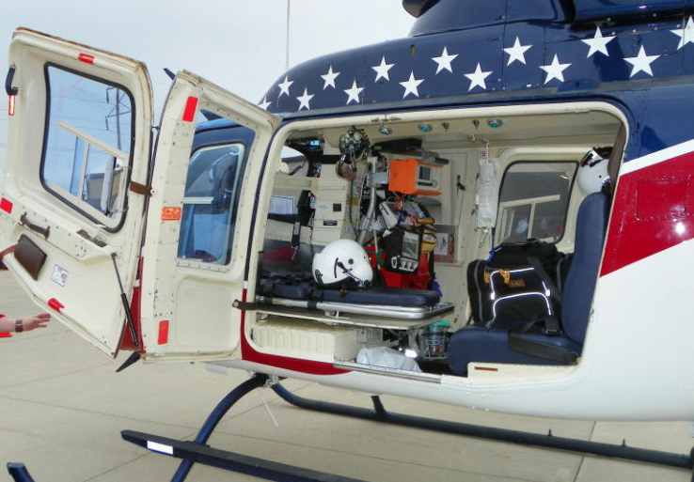
InterfacilityTransfer: Access and Challenge

Slide 11
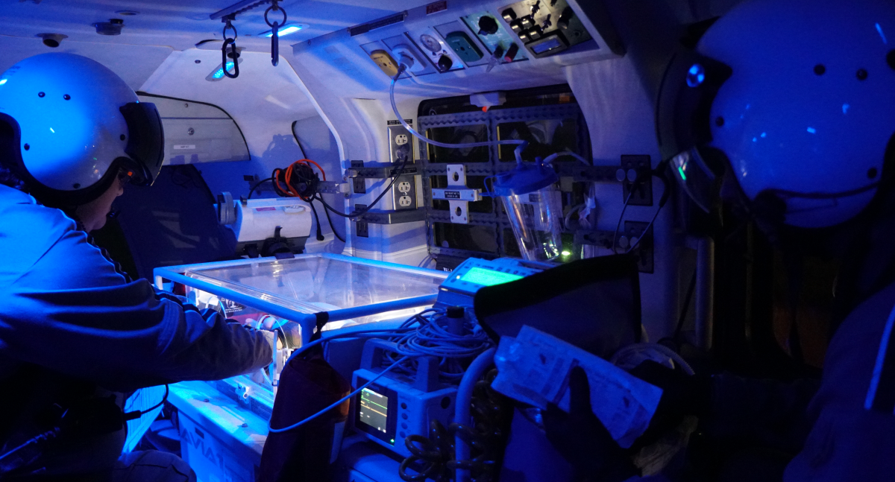
InterfacilityTransfer: Access and Challenge

Slide 12
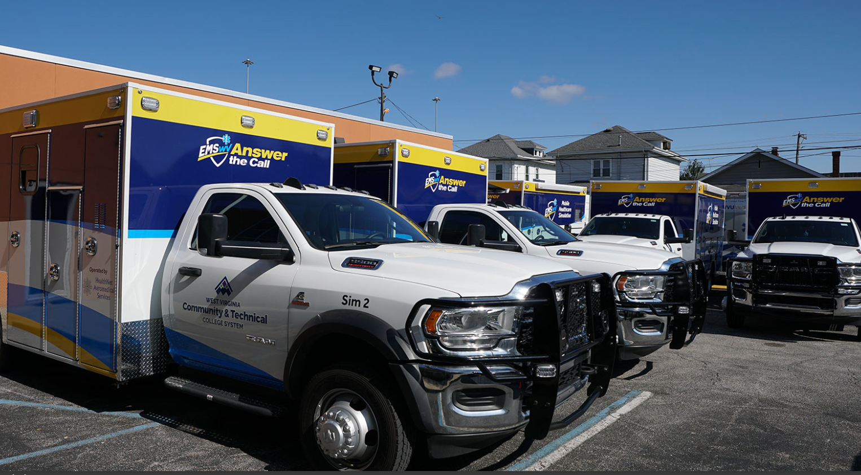
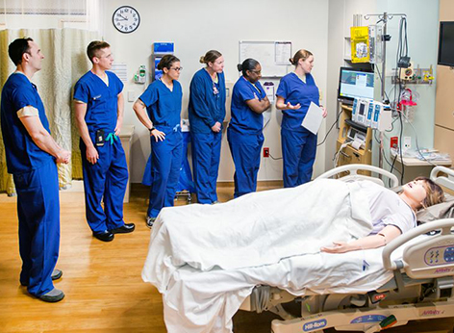
How Do We Move Forward?
Improve EMS OB Education
Bridge EMS to Hospital Relationships
Improve Hospital OB Education
Improve Connections Between Tertiary/Community Hospitals

Slide 13
Questions and Discussion

Slide 14
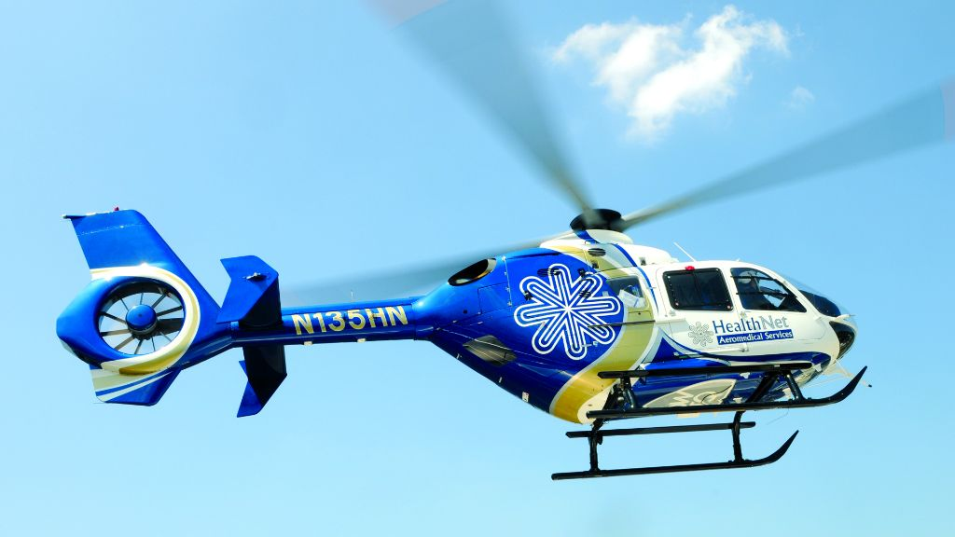
Questions and Discussion

Slide 15
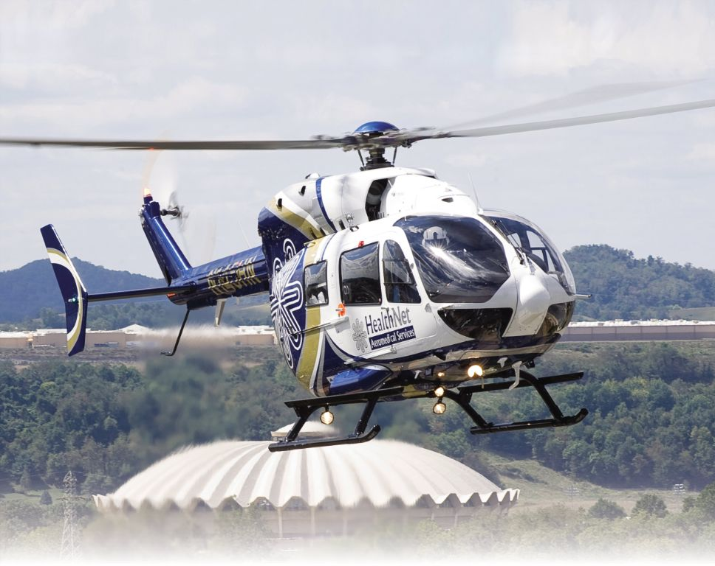
Questions and Discussion

Slide 16
Our team is honored to join you in serving patients through our region’s premier critical care transport system. Thank You!

Slide 17
EMSAC – Perinatal Review of EMS Protocol Committee
FLASH UPDATE
3 Current EMS Protocols
5 EMS Med Formularies
8 Appendix Reviews
9 EMS Protocol updates
READY TO CHANGE THE FUTURE ?
pseamann@jancare.com

Slide 18
EMSAC – Perinatal Review of EMS Protocol Committee
WVOEMS Protocols
246 pages:
Protocol – etc. cascade through:
EMT: Basic skills
AEMT: Intermediate
Paramedic: Advanced

Slide 19
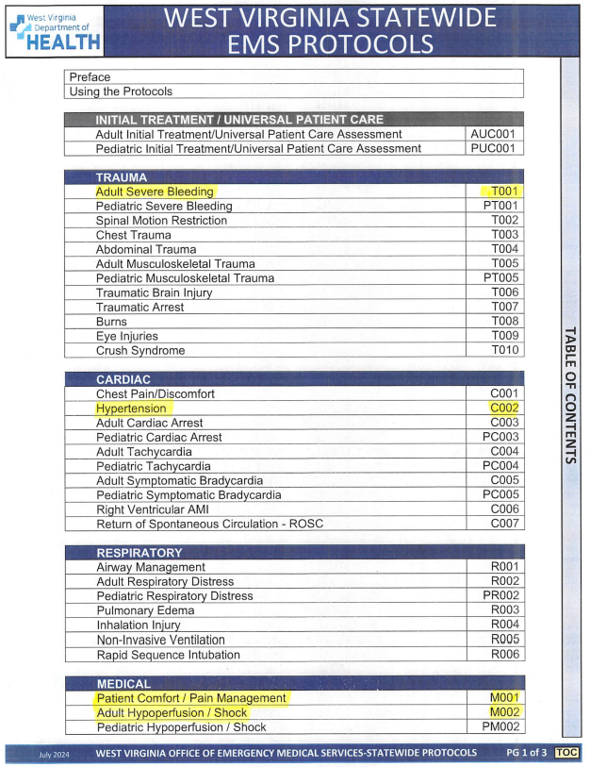
EMSAC – Perinatal Review of EMS Protocol Committee
WVOEMS Protocols
Possible: EMSAC – Perinatal Group
Group may review: 13 EMS Protocols - Appendices
for possible changes to meet specific Perinatal Needs

Slide 20
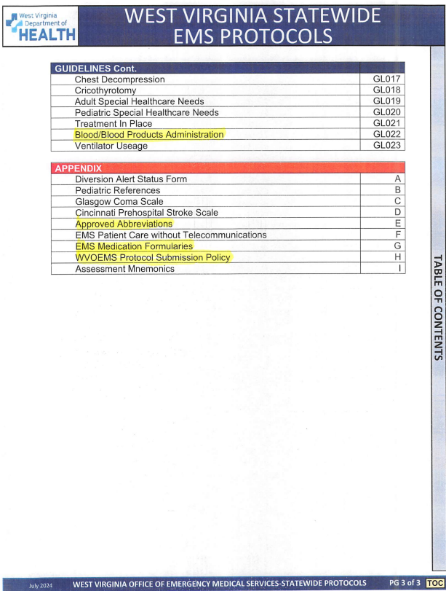
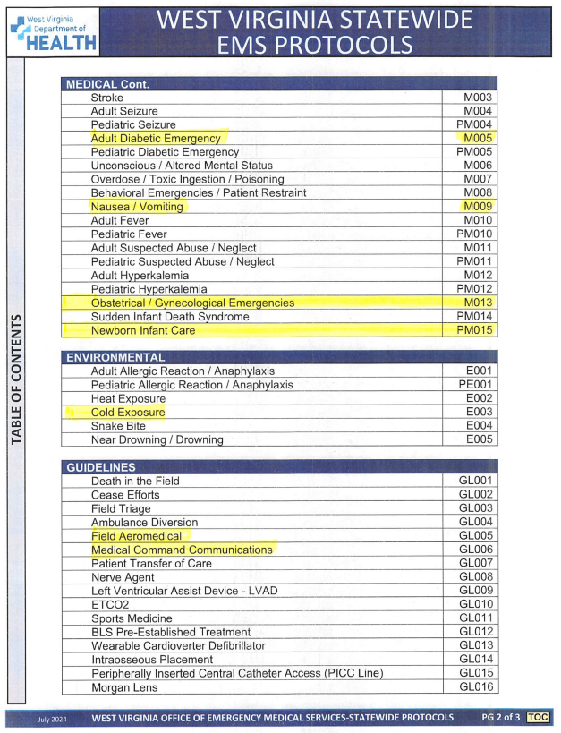
EMSAC – Perinatal Review of EMS Protocol Committee
1. Existing Protocols
2. Medication Formulary
3. Appendix – 4. Abbreviations
Adding Perinatal emphasis to existing Protocols, etc.

Slide 21
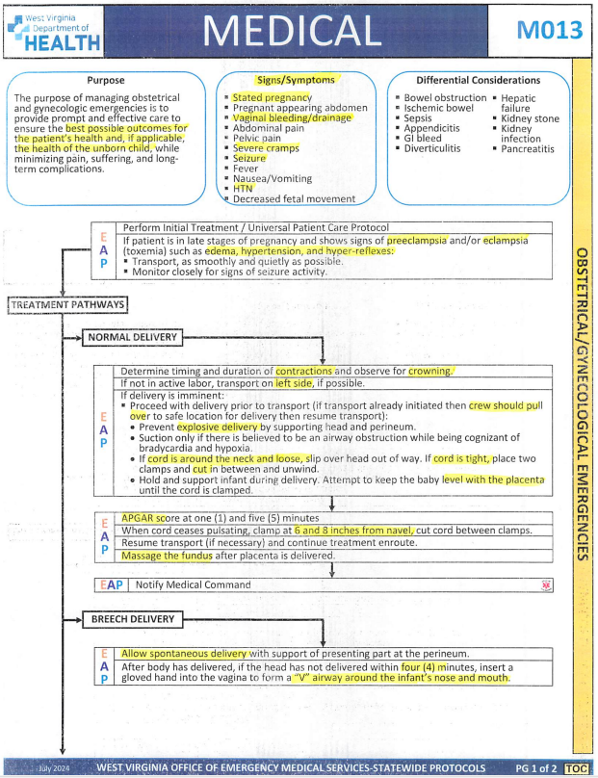
EMSAC – Perinatal Review of EMS Protocol Committee
OB – GYN Emergencies M013
Purpose: Pt & Unborn child
Preeclampsia – Eclampsia
Count Contractions
Crowning ?
Left side
Cord around neck…
Infant at level of placenta
APGAR – Cut Cord
Massage Fundus

Slide 22
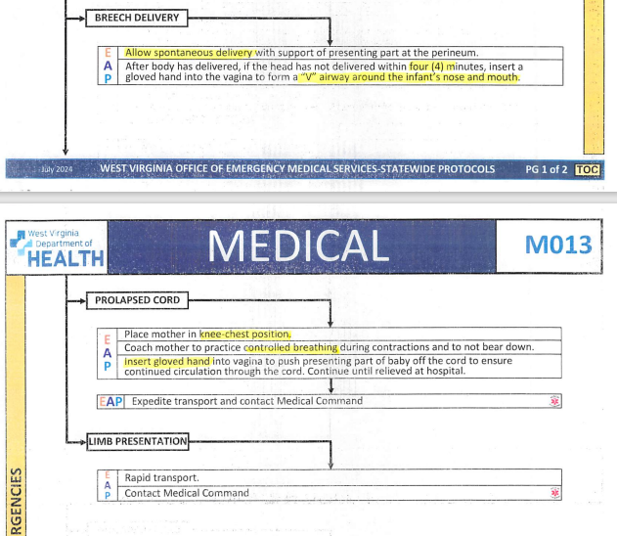
EMSAC – Perinatal Review of EMS Protocol Committee
OB – GYN M013
BREECH
Allow Spontaneous Delivery
If head not delivered 4 min
Gloved hand, “V” Airway
around ‘Nose and Mouth”
PROLAPSED CORD
Knee-Chest Position
Controlled Breathing
Push infant off cord
LIMB PRESENTATION *drive

Slide 23
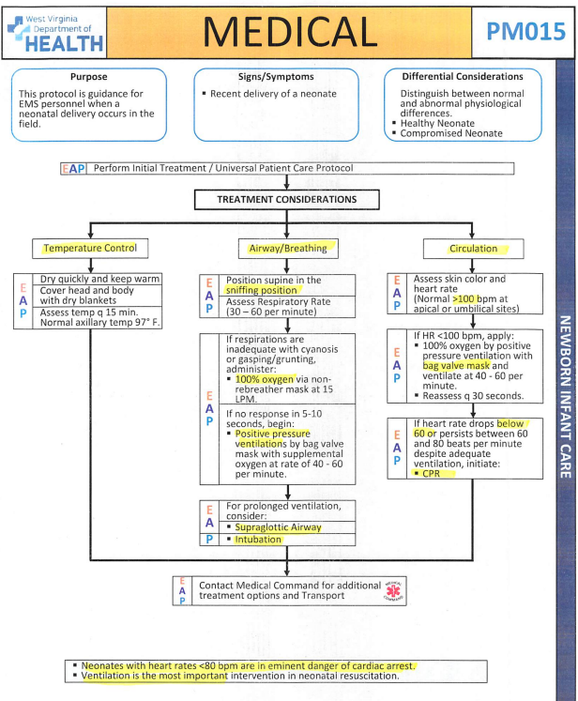
EMSAC – Perinatal Review of EMS Protocol Committee
NEWBORN CARE
TEMPERATURE CONTROL
Dry, Chest, Blankets, Heat
AIRWAY - BREATHING
Sniffing Position
Grunting = NRB, BVM
Supraglottic Airway, ET
CIRCULATION
HR <100 = BVM
HR < 60 = CPR

Slide 24
EMSAC – Perinatal Review of EMS Protocol Committee
SIDS
No CPR
If Rigor Mortis, Lividity
Note position, surroundings
INITIATE RESUSCITATION
Ped Cardiac Arrest Protocol
Contact Medical Command
NO RESUSCITATION
Medical Command Physician
Death in Field guidelines
Support family –
No prejudices - Judgements
Expect Different Reactions

Slide 25
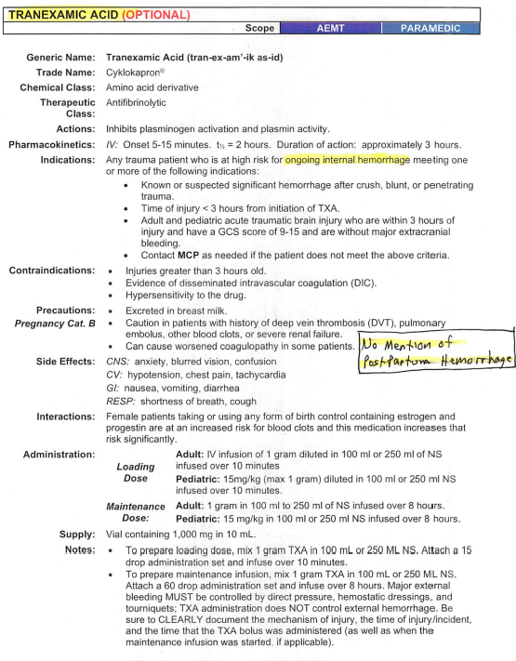
EMSAC – Perinatal Review of EMS Protocol Committee
Tranexamic Acid
TXA
“Treat on going
Internal Hemorrhage”
**No mention of:
Postpartum
Hemorrhage

Slide 26
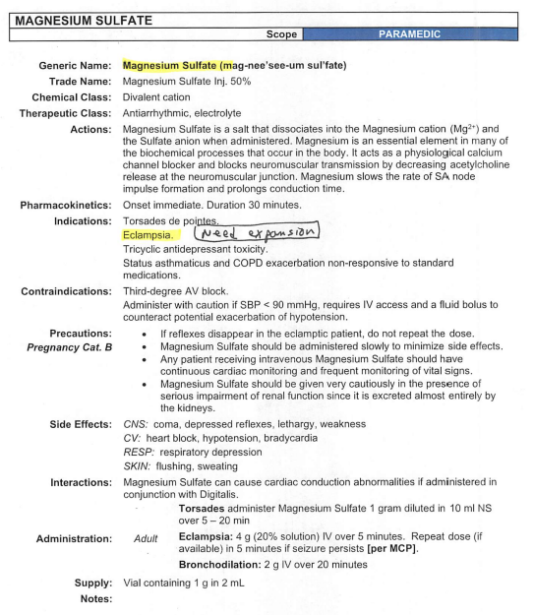
EMSAC – Perinatal Review of EMS Protocol Committee
MAGNESIUM SULFATE
* Treatment of:
Torsades de Pointes
Eclampsia
**Need Expansion and Clarification for Pregnancy Use

Slide 27
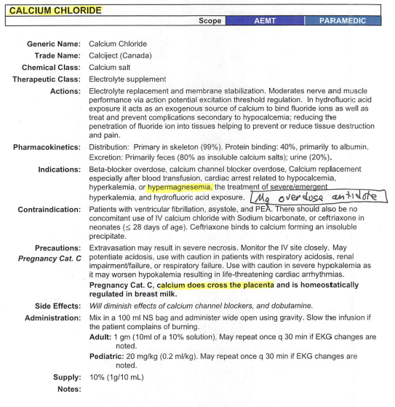
EMSAC – Perinatal Review of EMS Protocol Committee
CALCIUM CHLORIDE
* Treatment of:
Hypermagnesemia
No mention of Mg OD
**CaCl crosses placenta?
Use in Pregnancy~

Slide 28
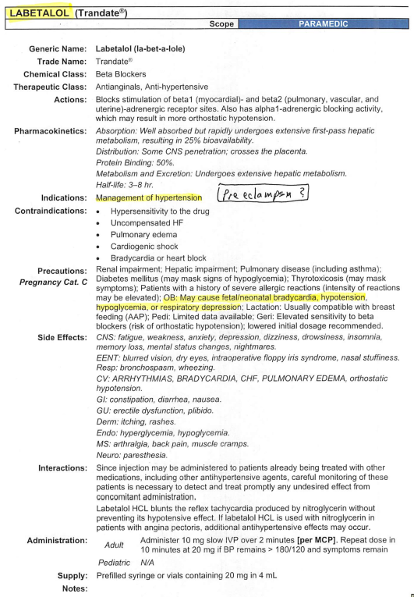
EMSAC – Perinatal Review of EMS Protocol Committee
LABETALOL Trandate
* Treatment of:
Hypertension
No direct mention of Preeclampsia
OB- ‘may cause fetal bradycardia, hypotension
**Pregnancy Update~

Slide 29
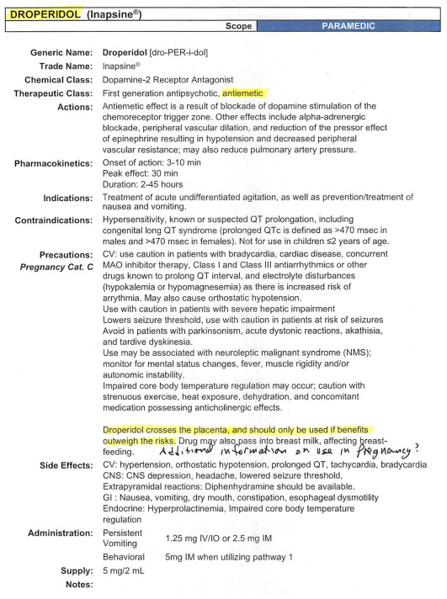
EMSAC – Perinatal Review of EMS Protocol Committee
DROPERIDOL Inapsine
* Treatment of:
Antiemetic -
Antipsychotic
OB- ‘crosses placenta
cautious use?
**Pregnancy Update~

Slide 30
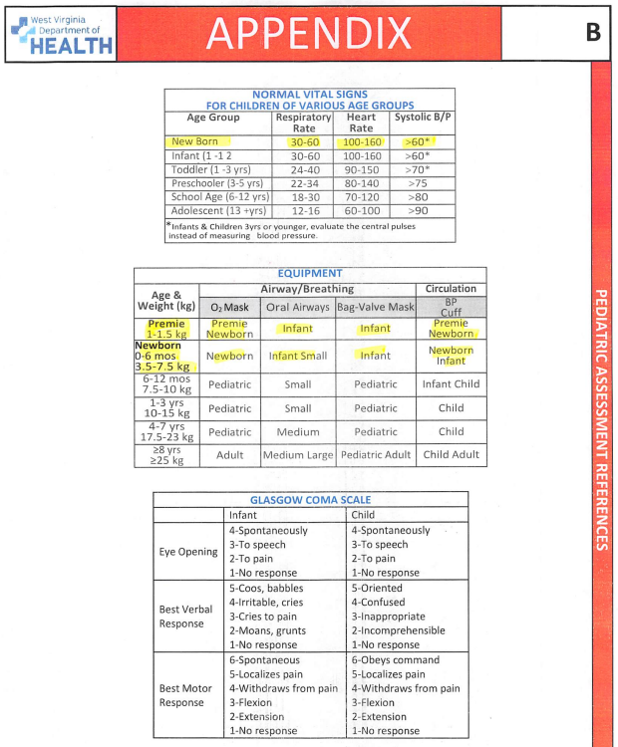
EMSAC – Perinatal Review of EMS Protocol Committee
APPENDIX -A
Newborn
Vital Signs Chart
Premie (1 – 1.5 kg)
Newborn (3.5 – 7.5 kg)
Equipment sizes:
O2 Mask
Oral Airways
BVM
BP Cuff

Slide 31
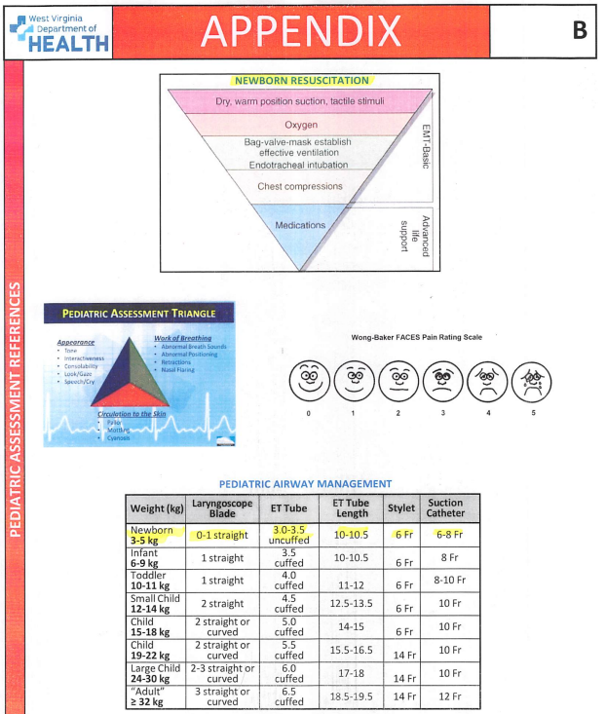
EMSAC – Perinatal Review of EMS Protocol Committee
APPENDIX -B
Newborn Resuscitation
Triangle Chart
Ped Assessment Chart
Wong-Baker Faces Pain
Newborn Airway Chart
0-1 Straight Laryngoscope
ET Tube: 3 to 3.5 uncuffed
ET Tube Length: 10- 10.5 cm

Slide 32
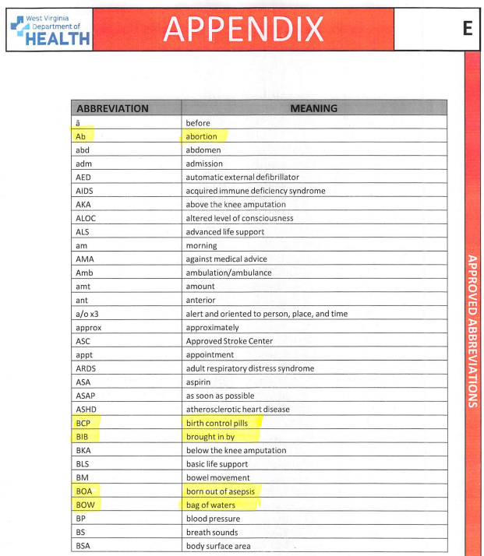
EMSAC – Perinatal Review of EMS Protocol Committee
ABBREVIATIONS
AB Abortion
BCP Birth Control Pills
BIB Brought in By
BOA Born out of Asepsis
Unplanned out of hosp birth
BOW Bag of Waters
G Gravida
IUD Intrauterine Device
IUP Intrauterine Preg.

Slide 33
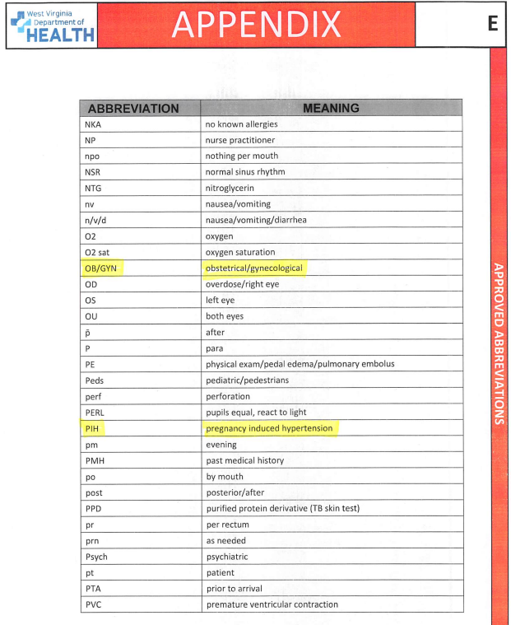
EMSAC – Perinatal Review of EMS Protocol Committee
ABBREVIATIONS
PIH Preg Induced HTN
D&C Dilat & Curettage
DOB Date of Birth
EBL Est Blood Loss

Slide 34
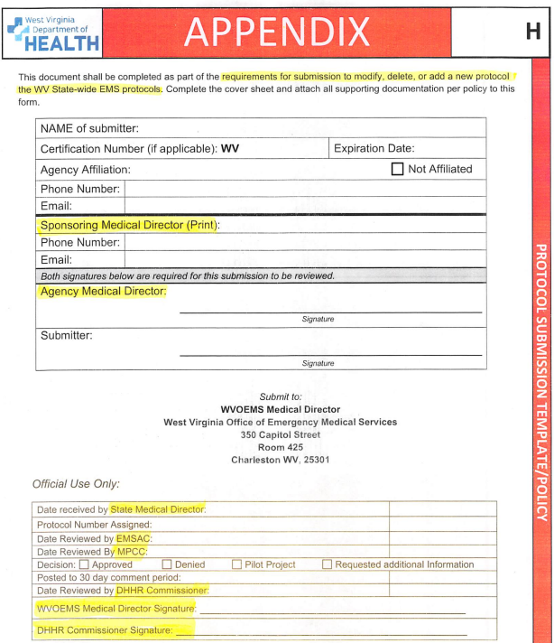
EMSAC – Perinatal Review of EMS Protocol Committee
APPENDIX -H
Requirements for submission to:
MODIFY, DELETE, or ADD a new PROTOCOL
*Sponsoring Med Director
*EMS Agency Med Director
EMSAC – MPCC
State EMS Med Director

Slide 35
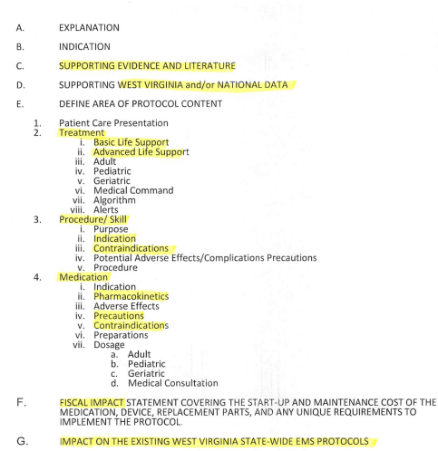
EMSAC – Perinatal Review of EMS Protocol Committee
APPENDIX -H
Explanation - Indication
Supporting Evidence
WV and Nat Data Literature
Define Area of
Protocol Content change
*Treatment
*Procedure or Skill
*Medication
*Fiscal Impact (Pitocin $299)
*Impact on Current Protocols

Slide 36
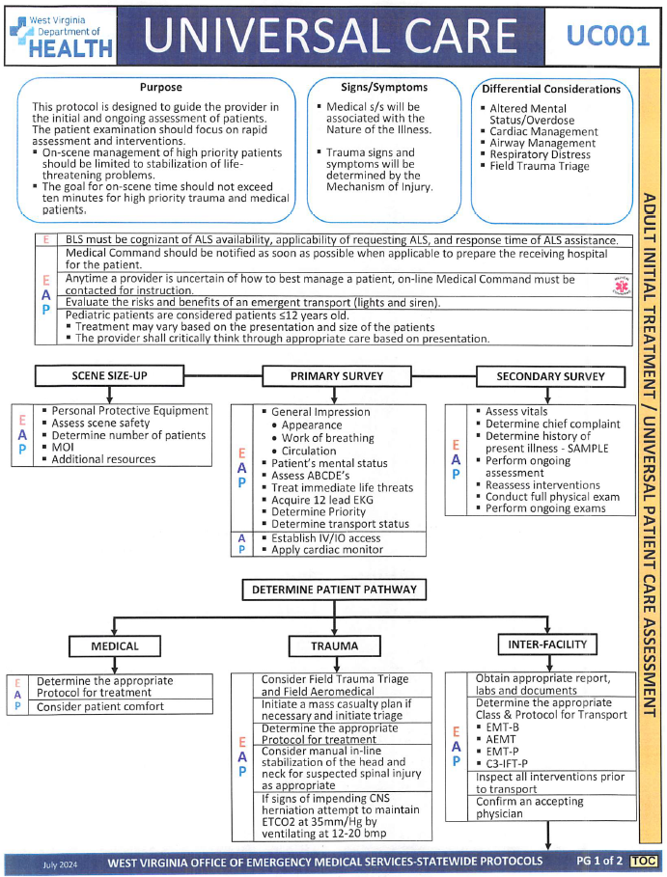
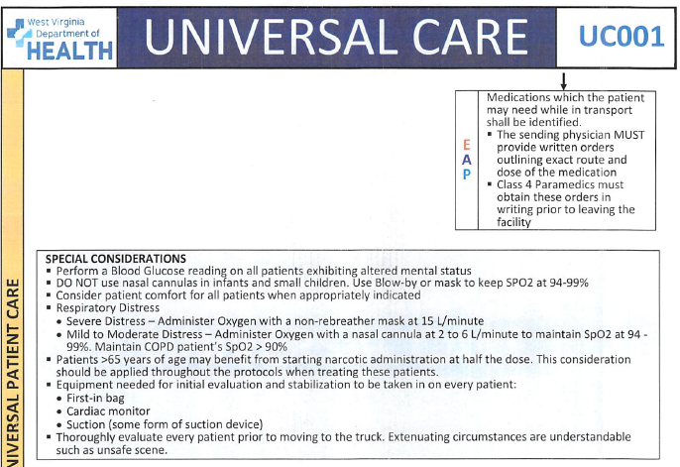
EMSAC – Perinatal Review of EMS Protocol Committee
Consider adding Perinatal Specific Language to:
“Universal Care EMS Protocol”

Slide 37
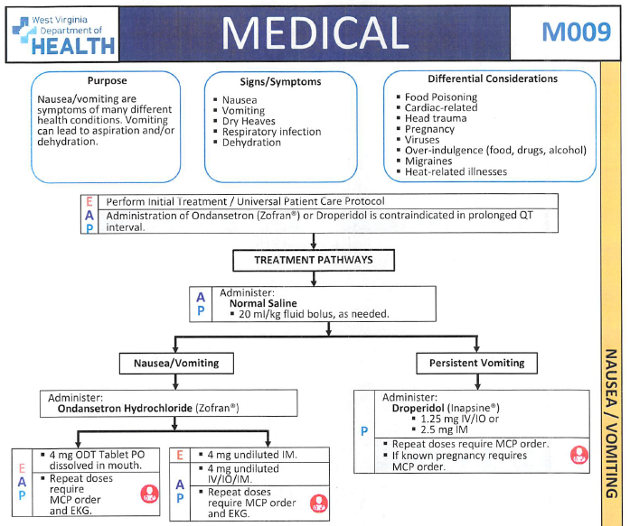
EMSAC – Perinatal Review of EMS Protocol Committee
Consider adding Perinatal
Specific Language to:
NAUSEA / VOMITING EMS Protocol
Oral Zofran
Zofran IV – IO - IM
Droperidol 1.25 mg IV-IO
2.5 mg IM
IV Bolus ?
Consider adding Perinatal
Specific Language to:
Patient Comfort
Fentanyl 100 mcg
Morphine 4 mg
Ketamine 25 mg (pregnancy?)

Slide 38
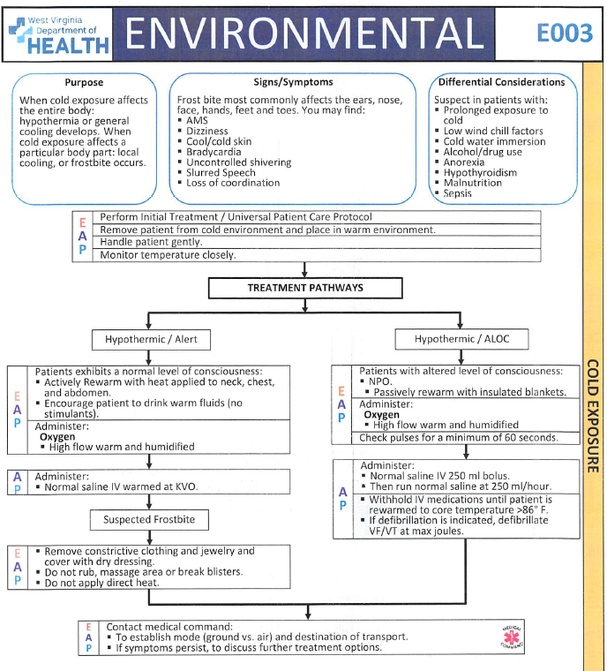
EMSAC – Perinatal Review of EMS Protocol Committee
Consider adding Perinatal Specific Language to:
“COLD EXPOSURE EMS Protocol”
Warm Ambulance
OB Kit – Towels~
Mylar Wrap
Infant to Mother Chest
Heat Packs? Too hot?

Slide 39
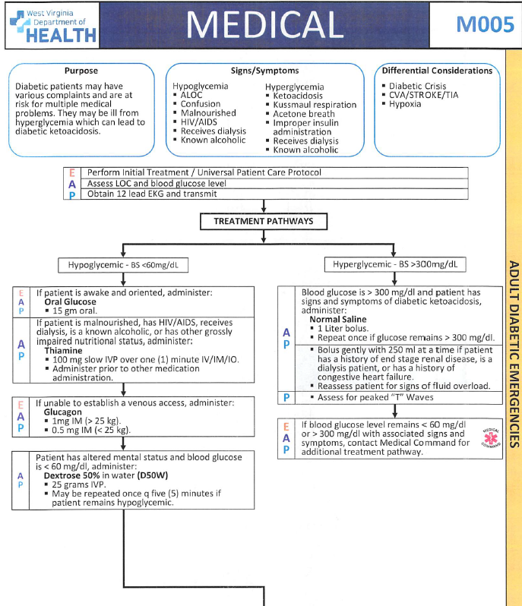
EMSAC – Perinatal Review of EMS Protocol Committee
Consider adding Perinatal Specific Language to:
DIABETIC EMERGENCIES EMS Protocol”
Gestational Hyperglycemia
IV Fluids, 12 Lead
Electrolytes
Insulin ?

Slide 40
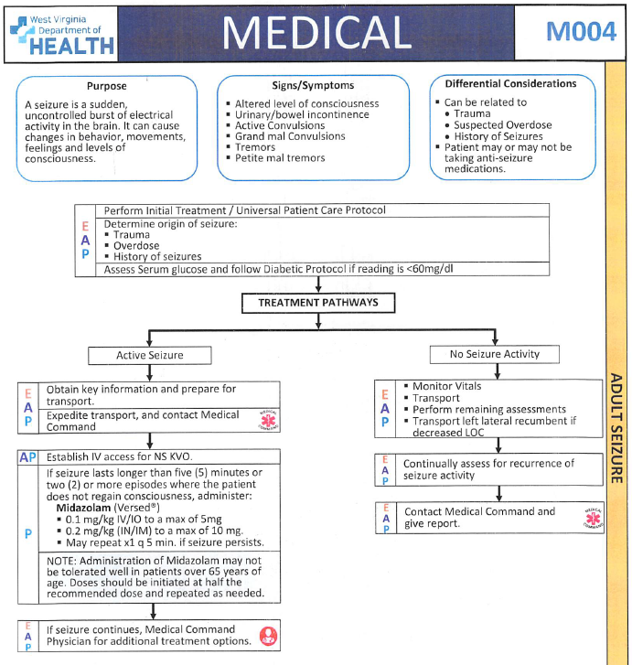
EMSAC – Perinatal Review of EMS Protocol Committee
Consider adding Perinatal
Specific Language to:
SEIZURES (Adult) EMS Protocol
Eclampsia (Seizures)
Magnesium Sulfate 4-6 gms
(EMS only carries 1-2 gms)
Labetalol ?
Oxygen and Delivery

Slide 41
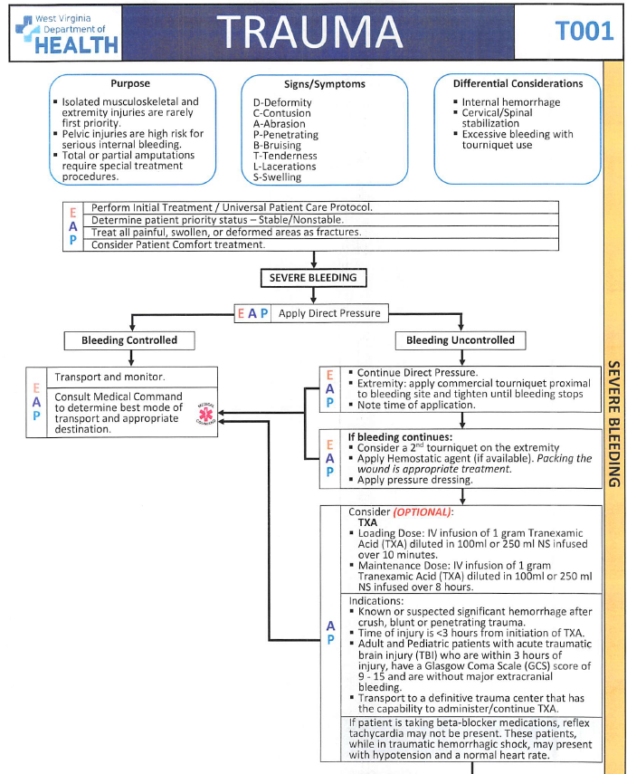
EMSAC – Perinatal Review of EMS Protocol Committee
Consider adding Perinatal
Specific Language to:
SEVERE BLEEDING EMS Protocol
TXA 1 gm, then 1 gm / 8 hrs
IV Fluid Bolus (20 ml / kg)
Fundal Massage, Baby to Breast
Placenta Removal ??
Oxytocin ?? (not on Amb now)
(No: Methergine, Hemabate)

Slide 42
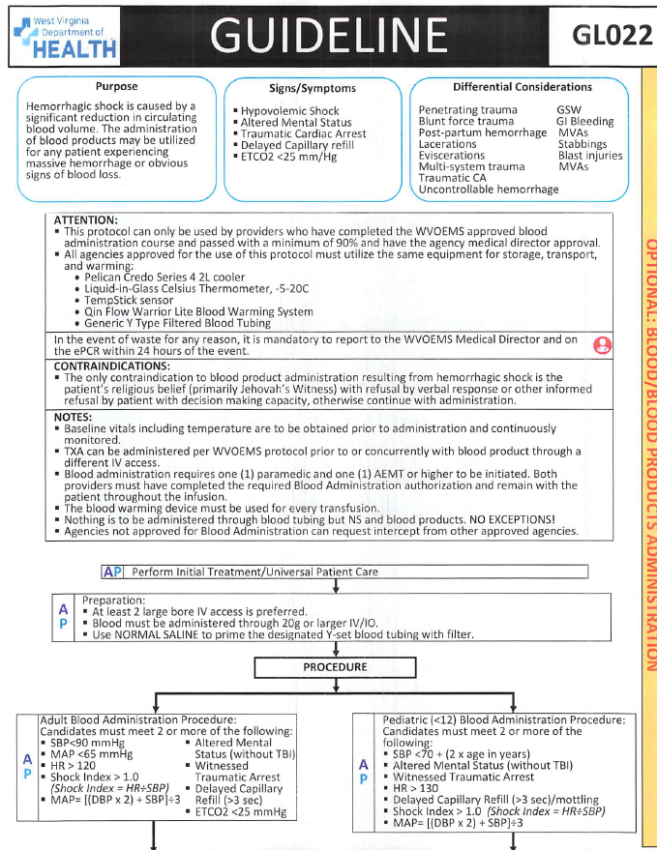
EMSAC – Perinatal Review of EMS Protocol Committee
Consider adding Perinatal
Specific Language to:
EMS Protocol
BLOOD Administration
O+ Whole Blood
Air Medical
Several Ground EMS
Differences in OB Use ?
Transfusion Exposure ?
CaCl: after 1st unit ? ?

Slide 43
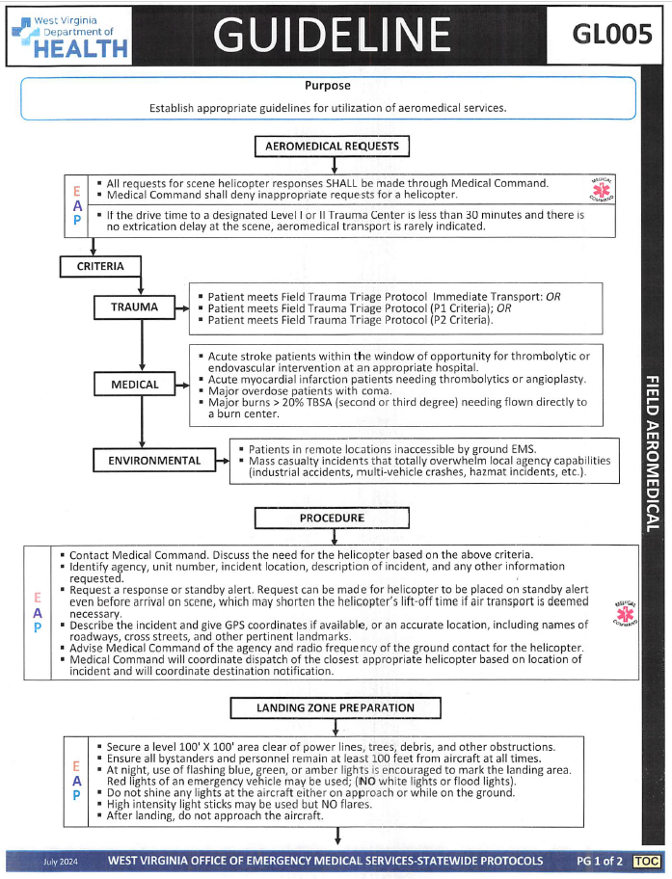
EMSAC – Perinatal Review of EMS Protocol Committee
Consider adding Perinatal
Specific Language to:
EMS Protocol
FIELD AEROMEDICAL
Land on Scene
Difficult to Delivery in flight
Transport time reduction
New Guidelines for when
to call for Scene Flight or “Hot Cot” turnover at Hosp.

Slide 44
EMSAC – Perinatal Review of EMS Protocol Committee
FLASH UPDATE
3 Current EMS Protocols
5 EMS Med Formularies
8 Appendix Reviews
9 EMS Protocol updates
READY TO CHANGE THE FUTURE ?
pseamann@jancare.com

Slide 45
Template
Template

Slide 46
Template
Template

