Slide 1
Lived Experience Integration
Forum
Presented to
West Virginia Perinatal Summit
October 17, 2024
Notes:
Thank you for having me here. I am so grateful to be here and share about the importance of the lived experience. On the next slide I’ll show you the mission of MV

Slide 2
The purpose of MoMMAs Voices is to amplify patient and family voices - especially those who have been historically marginalized - ensuring they are equipped and activated as partners to improve maternal health outcomes.
MoMMAs Voices is engaged as partners wherever maternal health improvements are needed.
Notes:
The next slide will show you about how MV came to be and about our coalition organizations

Slide 3
4th Trimester Arizona
Aaliyah in Action
AFE Foundation
Allo Hope Foundation
Angels Protection, Inc.
APS Foundation of America
Black Women’s Health Imperative
Cherished Mom
Dr. Shalon’s Maternal Action
Project
End Sepsis
Every Mother Counts
Healing our Hearts Foundation
HER Foundation (HG)
Let’s Talk PPCM
Maternal Near-Miss Support
Mom Congress
National Accreta Foundation
NICU Parent Network PCOS Challenge
PPROM Foundation
PUSH for Empowered Birth
PUSH Birth Partners
Save the Mommies (PPCM)
Shade of Blue Project
Sisters in Loss
Solace for Women
The Obstetrics Initiative
Urban Baby Beginnings
MoMMA’s Voices is a program of the Preeclampsia Foundation. Funding is provided by :
Merck for Mothers, as part of their worldwide 10-year initiative to assure no woman dies giving life
Alliance for Improvement in Maternal Health (AIM), a program of ACOG
Premier, Inc through the Premier Perinatal Improvement Collaborative
MEMBER ORGANIZATIONS
Notes:
Now we will move on to our objectives for the day!

Slide 4
1
DESCRIBE THE BENEFITS OF HAVING LIVED EXPERIENCE INTEGRATED IN QI ACTIVITIES
2
DESCRIBE VARIOUS WAYS TO BECOME A CHAMPION AT YOUR FACILITY AND BEYOND
WHAT WE WILL COVER
Notes:
First I want to start by telling you how I got here on the next slide.

Slide 5
Ways to Integrate Patients
Notes:
You can go to the next slide

Slide 6
Patient Engagement is not a new idea–”PFA”
Patient Family Partnership allows us to focus on the idea of working together
We started LEI Integration. We want to be a voice at the decision making table
OUR PATIENT ENGAGEMENT PHILOSOPHY
The ones closest to the pain need to be closest to the conversation
Notes:
Read the slide and then on the next slide we are going to think about some ways you can integrate patients, some might surprise you

Slide 7
Share personal stories, leading to a more focused commitment by improvement
teams
Identify pieces
of the process that are confusing or missing from a patient/family perspective (Ex: brochure)
WHAT TRAINED PATIENT FAMILY PARTNERS BRING TO THE WORK
Notes:
We know that when you hear a patient’s story, it allows your QI teams to be more committed and focused to the mission/work that you are doing. Patients can help identify pieces that are missing. I think about a friend of mine who was working with another state on a brochure that was to be disseminated in a hospital facility about preeclampsia. They asked her to review the brochure from her perspective, as a patient and what she would have modified, if anything. You’ll see opportunities for patients to get involved in this work through surveys, being a part of employee onboarding, leading support groups (talk about MH example and support group in antepartum unit). Simulations and integrating patients real live story to the end of the training. Next slide.

Slide 8
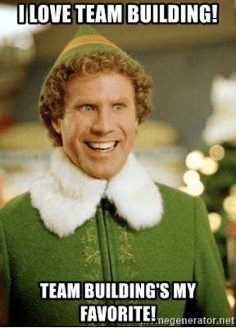
Game time!

Slide 9
Peanut Butter & Jelly
Describe how to make a peanut butter and jelly sandwich.
What steps are missing?
PEANUT BUTTER & JELLY
Notes:
If I were to ask you how to make a pb&j sandwich we can all agree it’s easy you might say something like xyz. But if you were to take a step back for a second and hear me share how to do it, you might recognize that you did miss some steps. This is what patients do. You might think “Oh we have a process for hypertension, for example, but what if by integrating a patient you recognize the steps you need to consider? On the next slide we are going to talk about some important considerations to have before you integrate that patient into your QI work.

Slide 10
Important Considerations Before Integrating
Notes:
Next slide.

Slide 11
01
02
03
04
05
Listen without judgement “Leave your baggage at the door”
Recognize the trauma and bravery they are bringing to you
Don’t focus on medical jargon
Possess an open mind to recognize that what a provider may see as a successful delivery, the
patient may view as trauma
Grief is the loss of all the things the PFP wanted it to be
IMPORTANT TIPS FOR INTEGRATING PATIENTS
Notes:
Next slide I’d like to give you some questions to consider as you go back into your places of work to implement.

Slide 12
Do you have a patient that can be apart of your next action plan?
Can you have a patient review your surveys?
How can you effectively communicate with your patient about what they’ve experienced?
JUST TAKE ONE STEP
Notes:
It’s so easy to think you have to wait until you have it all together, but you can take one step now. Read the questions. Talk about the importance of continuity within departments of the hospital. In talking with Megan I know you have worked on outlining process for those high risk patients, but are those the same across the board? Consider to pre-asses patients who migth be at risk. On the next slide, i”ll share more about what I mean.

Slide 13
MoMMA’s Voices Overview
Notes:
I’ve given you a lot of information and I want to show you know how we can help you as you begin to do this work.

Slide 14
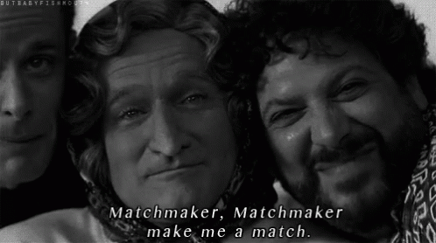
Matchmaker!
Our Impact
Find a Certified PFP
Feedback/
Data Collection
HOW DOES THE PROCESS WORK?
Notes:
Next slide, think about some tangible next steps

Slide 15
Train your patient family partners
Help match patient family partners
Get trained on Lived Experience Integration (Let us talk about the hard topics!)
Online Course
Workshops
Classes
Register your PQC program team or hospital system for Community of Learning (Fall 2024)
HOW CAN MOMMA’S VOICES HELP YOU?
Notes:
Next slide have you take a LEI scorecard assessment to just see where you are and ways to improve.

Slide 16
Q & A
QUESTIONS

Slide 17
www.mommasvoices.org
Bekah.Bischoff@mommasvoices.org
THANK YOU

Slide 18
‘7 Unique Active Listening Games, Exercises and Activities for Adults' by Andrew G. Ward, at www.goodlisteningskills.org © 2020.
Hersey, S. O. (2019, January 28). The Art of Listening. https://stateofformation.org/2019/01/the-art-of-listening/
Doyle, A. (2022, March 28). Active Listening Definition, Skills, and Examples. The Balance. https://www.thebalancemoney.com/active-listening-skills-with-examples-2059684
Rnt. (2016, December 17). Click on: CONFUSING: “HEAR” vs “LISTEN.” Click On. https://clickonenglish.blogspot.com/2016/12/confusing-hear-vs-listen.html
REFERENCES

