Slide 1
WEST VIRGINIA
PERINATAL
SUMMIT
State of the State in Perinatal Care
Kimberly M. Farry, MD, FACOG
October 17, 2024

Slide 2
West Virginia Occurrence Births 2013-2023
Total Number of Births In-state Resident Out-of-state Resident
Source: WV Health Statistics Center, Vital Statistics System, October 2024
Notes:
Between 2013-2023 we have had a decline in births that mirrors the decline in WV resident births. The number of out of state resident births has remained fairly stable. The number of total births has fallen by 17% and the total number of WV resident births in state have declined by 22%

Slide 3
WV Occurrence Births by Hospital, 2023
Notes:
Home births are more than 7 facilities- birth center and 6 hospitals

Slide 4
West Virginia Resident and West Virginia Occurrence Births 2013-2023
Total Number of Births In-state Resident Out-of-state Resident WV resident births out of state
Source: WV Health Statistics Center, Vital Statistics System, October 2024
Notes:
We have approximately the same number of WV women to deliver out of state as out of state residents who come into the sate to deliver
Out of state resident births in WV and WV resident births out of state have remained relatively constant

Slide 5
West Virginia Occurrence Births 2013 vs 2023
2013
2023
Out-of-state residents
In-state residents
Notes:
While the number of births to out of state residents has remained rather constant, the percentage of out of state resident births have increased

Slide 6
Number of Home Births, WV Occurrences, 2021-2023
Notes:
Home births is increasing, has not come back to pre-pandemic levels.
This number includes both panned and unplanned home births. Between 2014 and 2023, the percentage of unplanned home births ranged from 16.3%-25.0%, with an average of 20%.
ACOG put out a declaration that they didn’t agree with births. Medicaid expansion in WV in 20014.

Slide 7
Vanishing Maternity Care
2006
2024
Notes:
Click once and the hospitals will fade

Slide 8
WV Resident Births by Maternal Age, 2023
2.4%
40 and older
Source: WV Health Statistics Center, Vital Statistics System, October 2024

Slide 9
WV Resident Births by Race and Ethnicity, 2023
Unknown, 0.4%

Slide 10
WV Occurrence Births by Pay Source, 2023
Source: WV Health Statistics Center, Vital Statistics System, October 2024
Percent calculated excluding unknowns

Slide 11
Pre-Pregnancy BMI, Percentage of WV Occurrence Births, 2021-2023
Notes:
Our normal weight category is decreasing, our obese category is increasing.
Only a third of our births had a healthy BMI in 2023

Slide 12
Births at a Glance WV vs. US, 2022
Birth Outcome | WV | U.S. | WV Rank
Preterm Births | 13.0% | 10.4% | 3rd
Infant Mortality | 7.32 per 1,000 | 5.61 per 1,000 | 4th
Low Birth Weight | 10.0% | 8.6% | 6th
Teen Birth Rate (Age 15-19) | 19.8 per 1,000 | 13.6 per 1,000 | 9th
Cesarean Delivery | 34.1% | 32.1% | 11th
Very Low Birth Weight | 1.4% | 1.4% | 20th
Maternal Mortality | 23.9 per 100,000 (2018-2022) | 23.2 per 100,000 (2018-2022) | 20th
Source: Centers for Disease Control and Prevention, National Center for Health Statistics
Note: WV data may vary from locally reported data due to the national reporting period.
Source: NCHS, National Vital Statistics System, October 2024
CDC Wonder, 2024
Notes:
Year 2022 is latest year available for data across the board. The lower the number/ the higher the rank the worse it is.
Discuss how we have more work to do with preterm births and infant mortality.
Cesarean is for ALL births.

Slide 13
Births at a Glance WV vs. US, 2022
Birth Outcome | WV | U.S. | WV Rank
Preterm Births | 13.0% | 10.4% | 3rd
Infant Mortality | 7.32 per 1,000 | 5.61 per 1,000 | 4th
Low Birth Weight | 10.0% | 8.6% | 6th
Teen Birth Rate (Age 15-19) | 19.8 per 1,000 | 13.6 per 1,000 | 9th
Cesarean Delivery | 34.1% | 32.1% | 11th
Very Low Birth Weight | 1.4% | 1.4% | 20th
Maternal Mortality | 23.9 per 100,000 (2018-2022) | 23.2 per 100,000 (2018-2022) | 20th
Source: Centers for Disease Control and Prevention, National Center for Health Statistics
Note: WV data may vary from locally reported data due to the national reporting period.
Source: NCHS, National Vital Statistics System, October 2024
CDC Wonder, 2024
Notes:
Year 2022 is latest year available for data across the board. The lower the number/ the higher the rank the worse it is.
Discuss how we have more work to do with preterm births and infant mortality.
Cesarean is for ALL births.

Slide 14
WV vs US Prematurity rates 2011-2023
Notes:
WV is consistently above the national prematurity rates, and while both are trending upwards, WV’s is rising faster

Slide 15
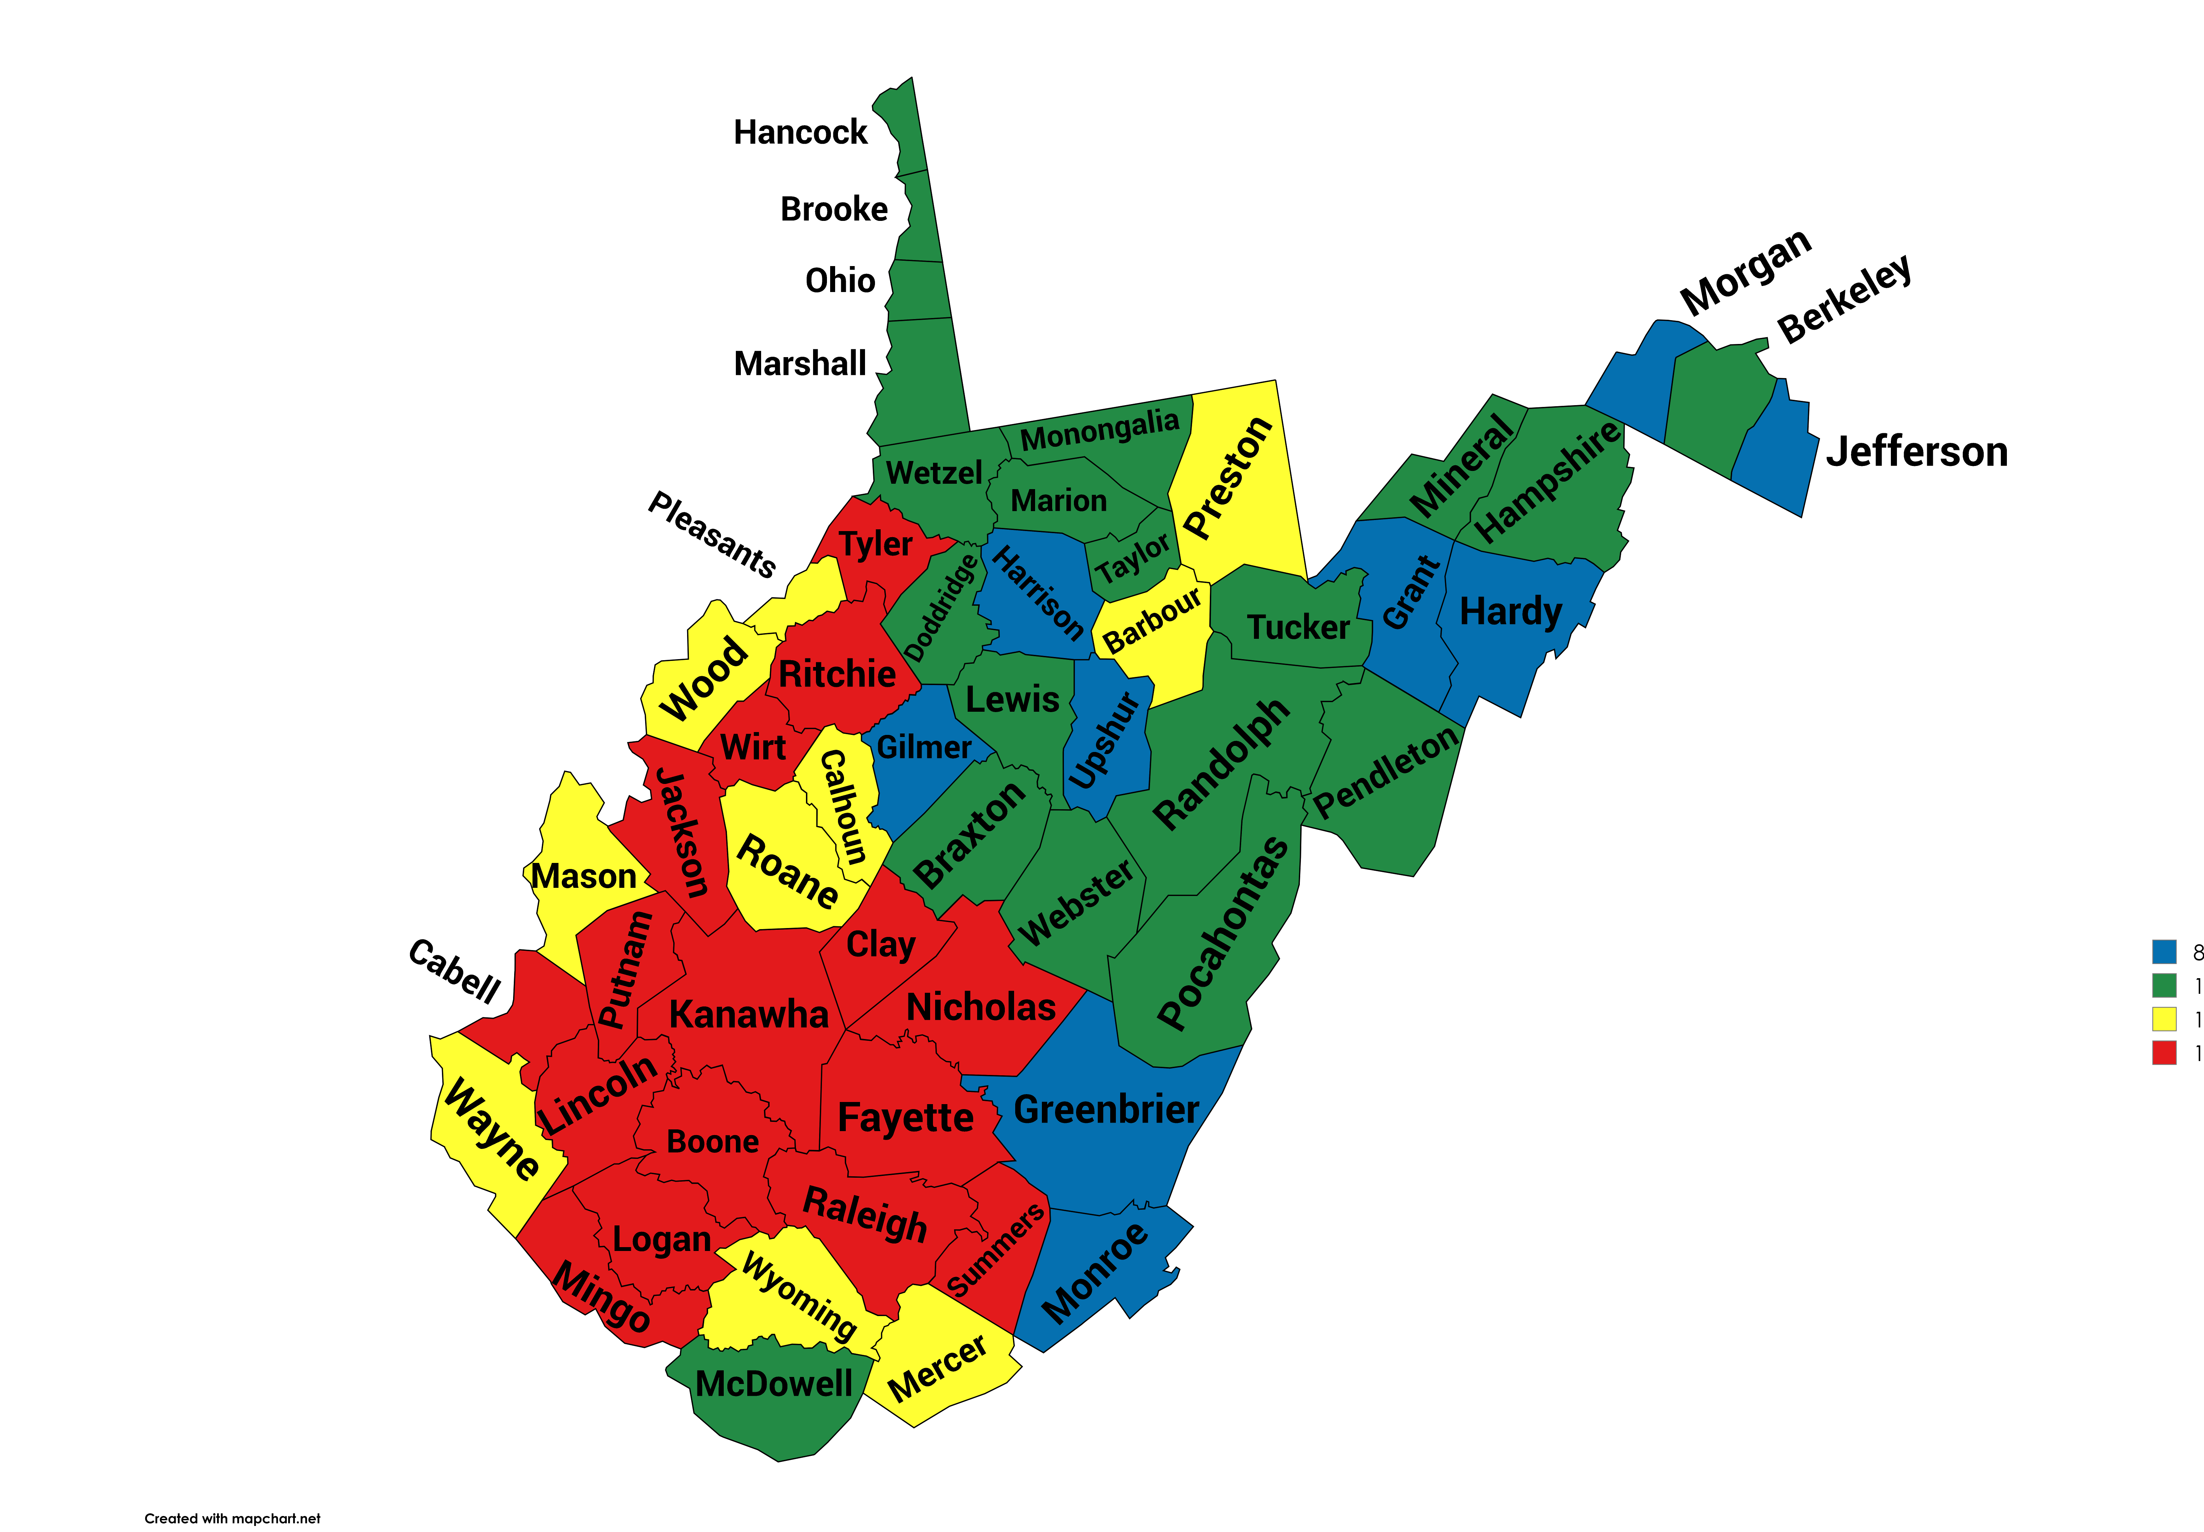
Premature WV Resident Births, 2019-2023
West Virginia: 12.7%
8.1% - 10.5%
10.6% - 12.6%
12.7% - 13.9%
14.0% - 19.4%

Slide 16
Births at a Glance WV vs. US, 2022
Birth Outcome | WV | U.S. | WV Rank
Preterm Births | 13.0% | 10.4% | 3rd
Infant Mortality | 7.32 per 1,000 | 5.61 per 1,000 | 4th
Low Birth Weight | 10.0% | 8.6% | 6th
Teen Birth Rate (Age 15-19) | 19.8 per 1,000 | 13.6 per 1,000 | 9th
Cesarean Delivery | 34.1% | 32.1% | 11th
Very Low Birth Weight | 1.4% | 1.4% | 20th
Maternal Mortality | 23.9 per 100,000 (2018-2022) | 23.2 per 100,000 (2018-2022) | 20th
Source: Centers for Disease Control and Prevention, National Center for Health Statistics
Note: WV data may vary from locally reported data due to the national reporting period.
Source: NCHS, National Vital Statistics System, October 2024
CDC Wonder, 2024
Notes:
Year 2022 is latest year available for data across the board. The lower the number/ the higher the rank the worse it is.
Discuss how we have more work to do with preterm births and infant mortality.
Cesarean is for ALL births.

Slide 17
Infant Mortality Rates, WV vs. U.S., 1970-2022
Note: WV 2022 and 2023 data are cumulative. U.S. 2023 data are provisional.
Rates calculated as deaths per 1,000 live births
Source: WV Health Statistics Center, Vital Statistics System, 2024
Centers for Disease Control and Prevention, NCHS, 2024
Notes:
WV ranking vs US. Some years WV was even below national average.
Death rate per 1,000 live births

Slide 18
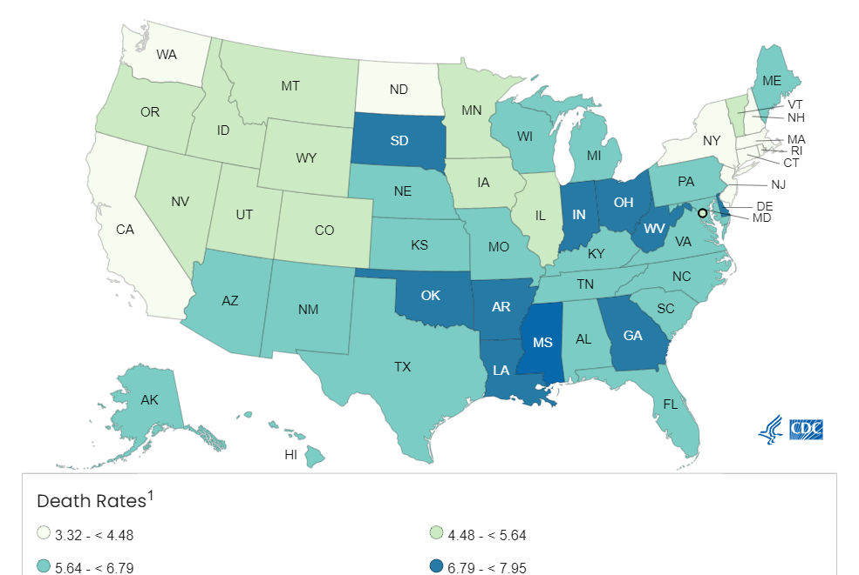
Infant Mortality Rate, 2022
¹Mortality/Death rate per 1,000 live births
Source: CDC , NCHS, National Vital Statistics System, October 2024

Slide 19
WV Resident Infant Mortality by Race/Ethnicity, 2018-2022
Notes:
This may explain why our mortality rate is comparable to the US- we have a much smaller black population.

Slide 20
Births at a Glance WV vs. US, 2022
Birth Outcome | WV | U.S. | WV Rank
Preterm Births | 13.0% | 10.4% | 3rd
Infant Mortality | 7.32 per 1,000 | 5.61 per 1,000 | 4th
Low Birth Weight | 10.0% | 8.6% | 6th
Teen Birth Rate (Age 15-19) | 19.8 per 1,000 | 13.6 per 1,000 | 9th
Cesarean Delivery | 34.1% | 32.1% | 11th
Very Low Birth Weight | 1.4% | 1.4% | 20th
Maternal Mortality | 23.9 per 100,000 (2018-2022) | 23.2 per 100,000 (2018-2022) | 20th
Source: Centers for Disease Control and Prevention, National Center for Health Statistics
Note: WV data may vary from locally reported data due to the national reporting period.
Source: NCHS, National Vital Statistics System, October 2024
CDC Wonder, 2024
Notes:
Year 2022 is latest year available for data across the board. The lower the number/ the higher the rank the worse it is.
Discuss how we have more work to do with preterm births and infant mortality.
Cesarean is for ALL births.

Slide 21
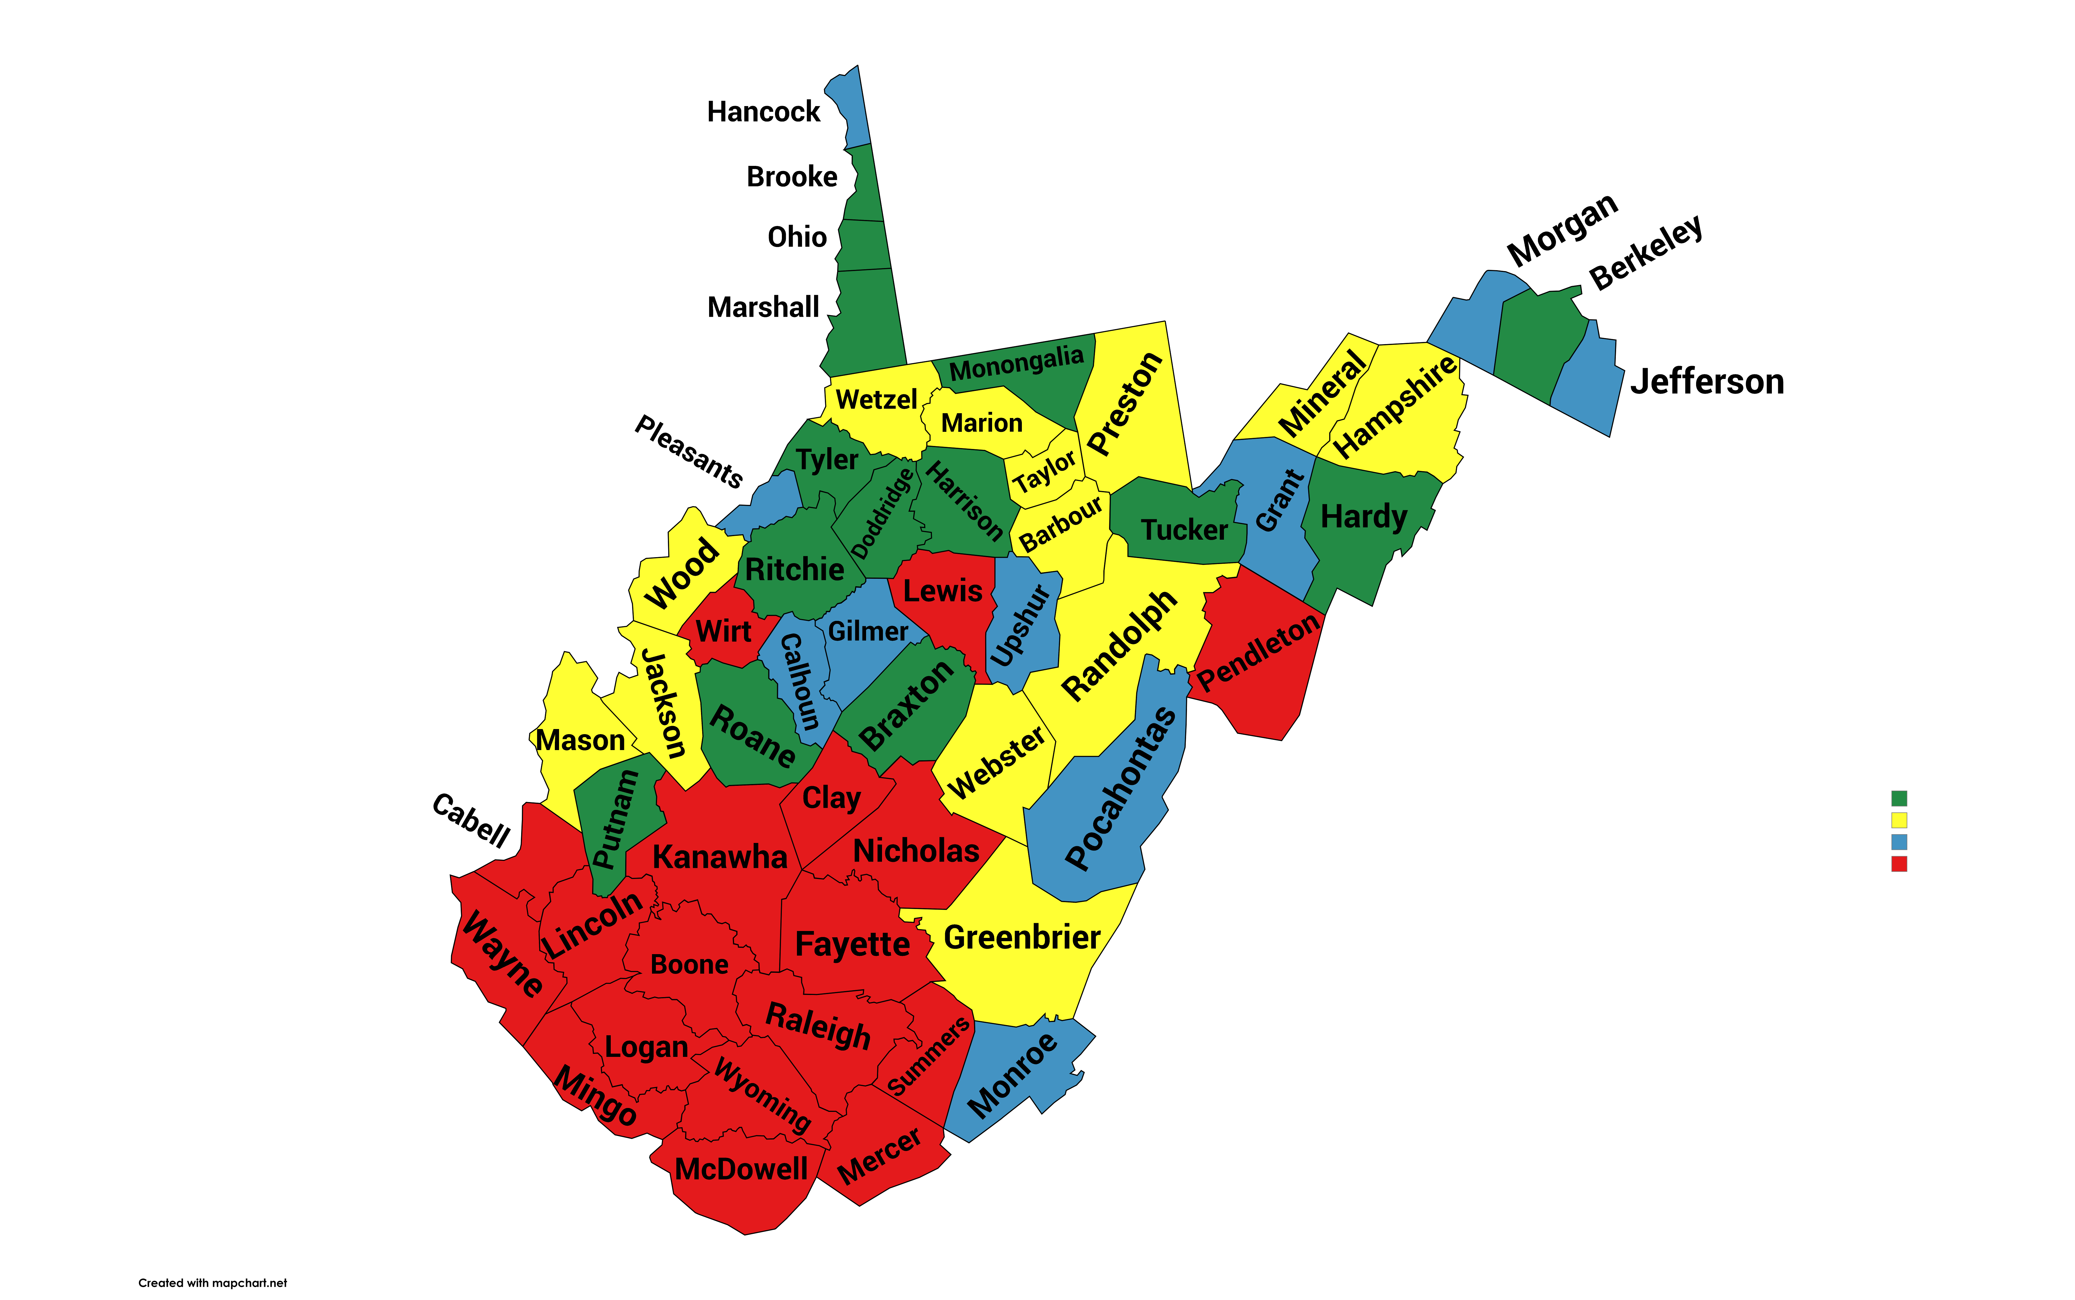
Low Birthweight WV Resident Births, 2019-2023
West Virginia: 9.7%
6.1 - 8.0
8.1 - 9.0
9.1 - 10.0
10.1 - 12.6

Slide 22
Low Birth Weight (LBW)
WV LBW
US LBW
Very Low Birth Weight (VLBW)
US VLBW
Sources: WV Health Statistics Center, Vital Statistics System
Centers for Disease Control and Prevention, NCHS, October 2024
Notes:
LBW = 5#8oz- 2,5000 grams
VLBW = 3#5oz, 1,500 grams
These rates are staying fairly steady, especially among the VLBW. Our rise in prematurity rates is in the late premature babies- 34-36 weeks. This is why out preterm birth project is focusing on late preterm births next.

Slide 23
WV Occurrence Very Low Birthweight Infants by Hospital, 2021-2023
Notes:
We will hear more about a new project we started last year to address very low birth weight babies being born in non tertiary care hospitals later this day.
CLICK
These 4 hospitals are tertiary care, where we want these babies to be born, where we want them to be born
CLICK
These 6 hospitals are a part of the preterm birth project that Dr. Smith- it look like 7, but one of those is the other hospitals and locations

Slide 24
Births at a Glance WV vs. US, 2022
Birth Outcome | WV | U.S. | WV Rank
Preterm Births | 13.0% | 10.4% | 3rd
Infant Mortality | 7.32 per 1,000 | 5.61 per 1,000 | 4th
Low Birth Weight | 10.0% | 8.6% | 6th
Teen Birth Rate (Age 15-19) | 19.8 per 1,000 | 13.6 per 1,000 | 9th
Cesarean Delivery | 34.1% | 32.1% | 11th
Very Low Birth Weight | 1.4% | 1.4% | 20th
Maternal Mortality | 23.9 per 100,000 (2018-2022) | 23.2 per 100,000 (2018-2022) | 20th
Source: Centers for Disease Control and Prevention, National Center for Health Statistics
Note: WV data may vary from locally reported data due to the national reporting period.
Source: NCHS, National Vital Statistics System, October 2024
CDC Wonder, 2024
Notes:
Year 2022 is latest year available for data across the board. The lower the number/ the higher the rank the worse it is.
Discuss how we have more work to do with preterm births and infant mortality.
Cesarean is for ALL births.

Slide 25
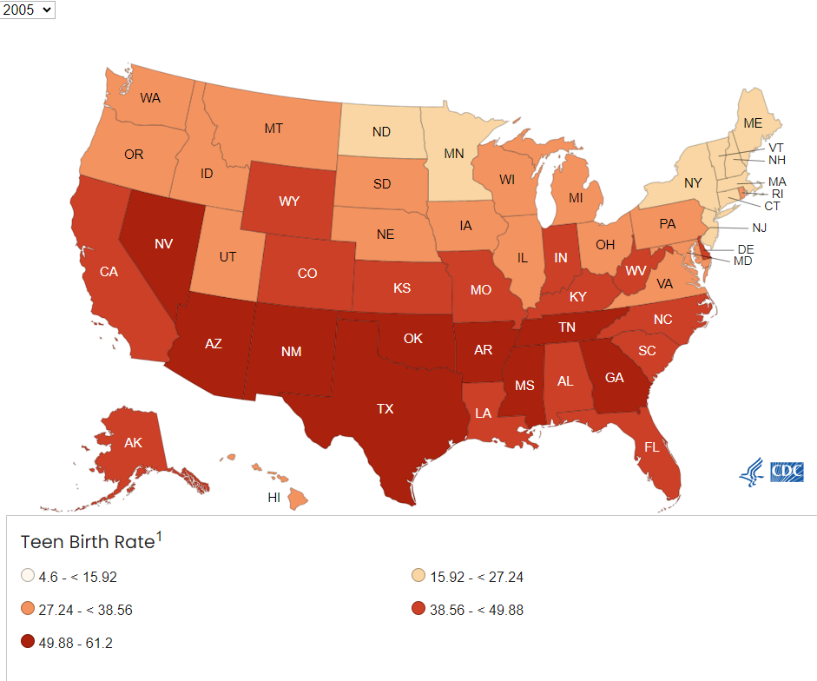
2005
Source: NCHS, National Vital Statistics System, October 2024
CDC Wonder, 2024
Notes:
Discuss: This is 2005, this is data we have, and at the beginning of the partnership.
Then we advance the slide to see a change 9 years later from 2014-2022.
Click once and it will take you through the years

Slide 26
2005
Source: NCHS, National Vital Statistics System, October 2024
CDC Wonder, 2024

Slide 27
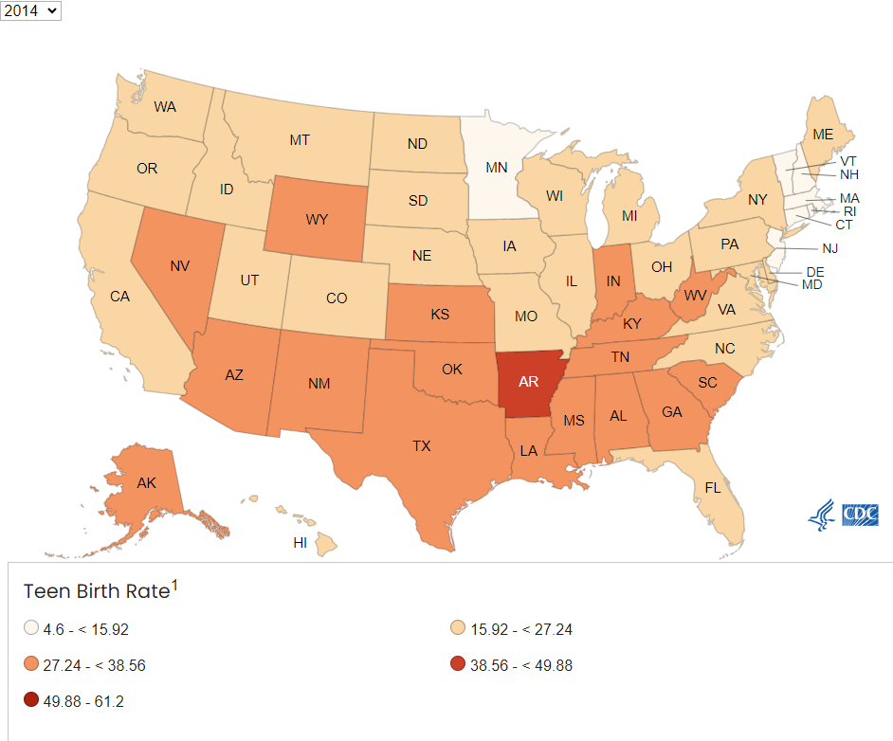
2014
Source: NCHS, National Vital Statistics System, October 2024
CDC Wonder, 2024

Slide 28
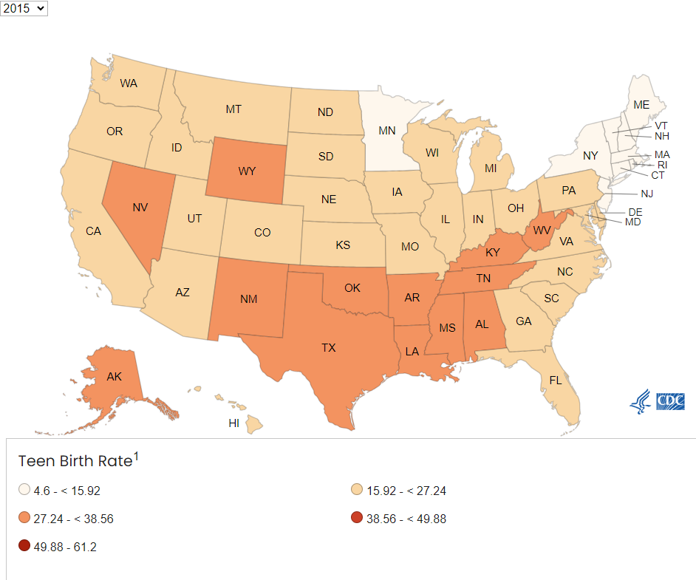
2015
Source: NCHS, National Vital Statistics System, October 2024
CDC Wonder, 2024

Slide 29
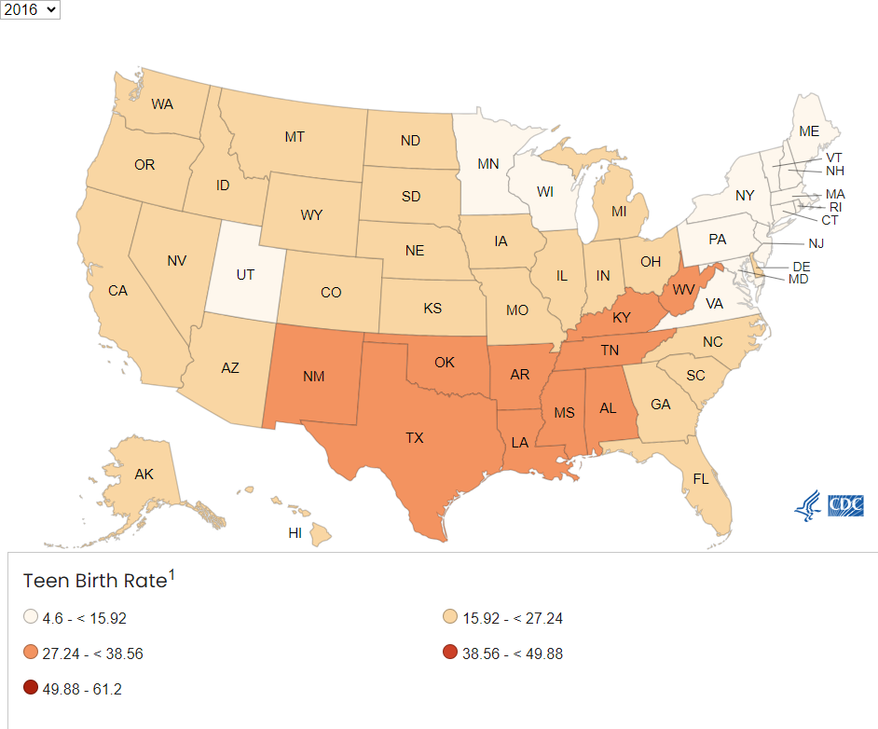
2016
Source: NCHS, National Vital Statistics System, October 2024
CDC Wonder, 2024

Slide 30
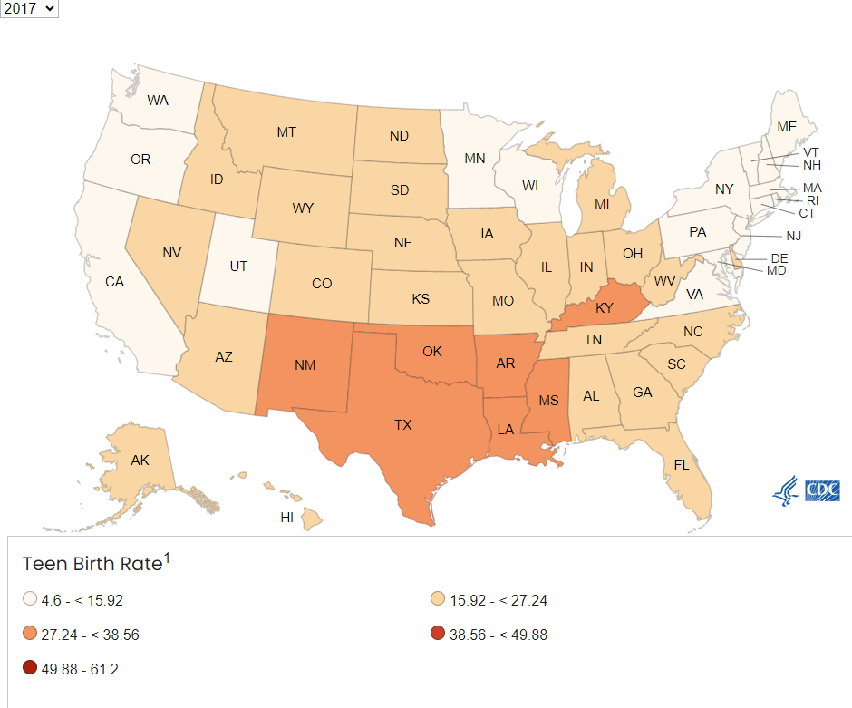
2017

Slide 31
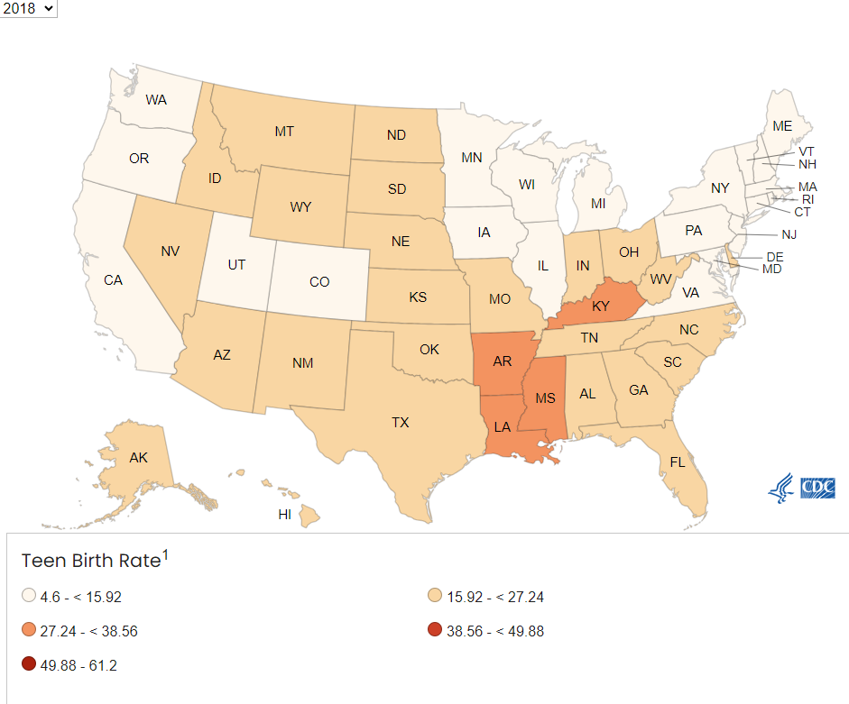
2018
Source: NCHS, National Vital Statistics System, October 2024
CDC Wonder, 2024

Slide 32
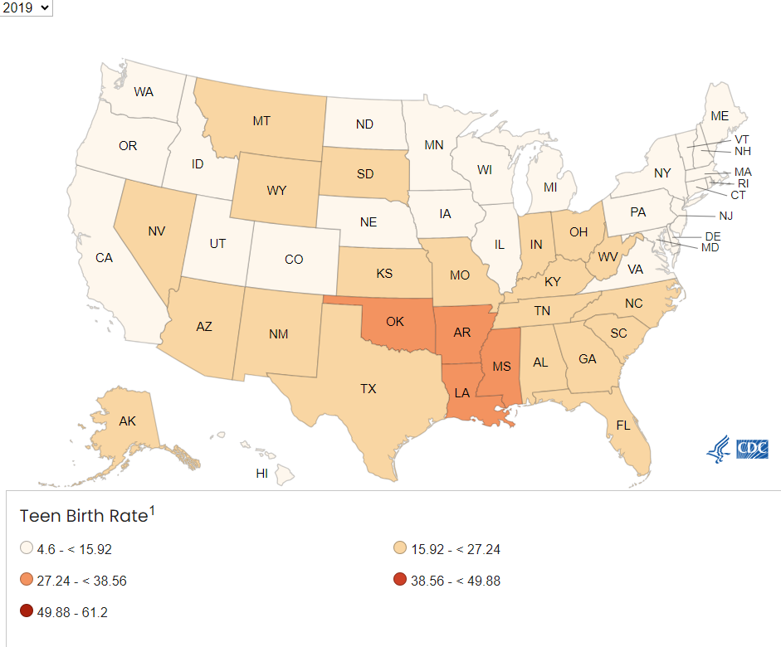
2019
Source: NCHS, National Vital Statistics System, October 2024
CDC Wonder, 2024

Slide 33
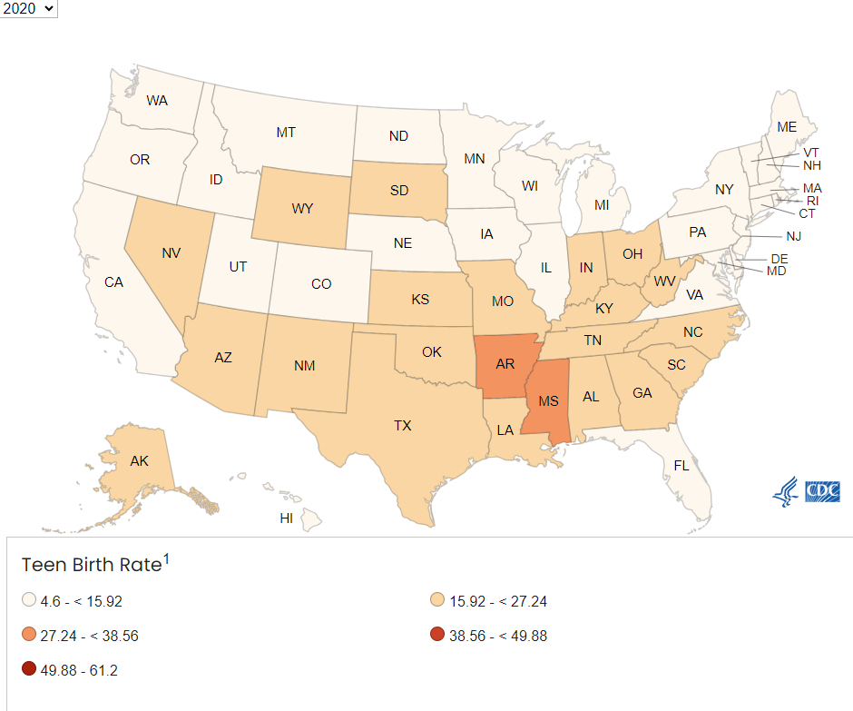
2020

Slide 34
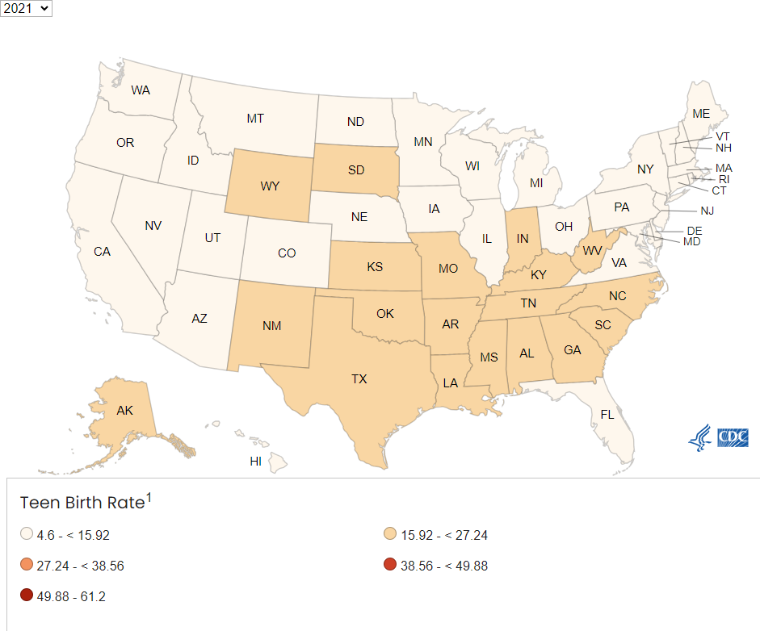
2021
Source: NCHS, National Vital Statistics System, October 2024
CDC Wonder, 2024

Slide 35
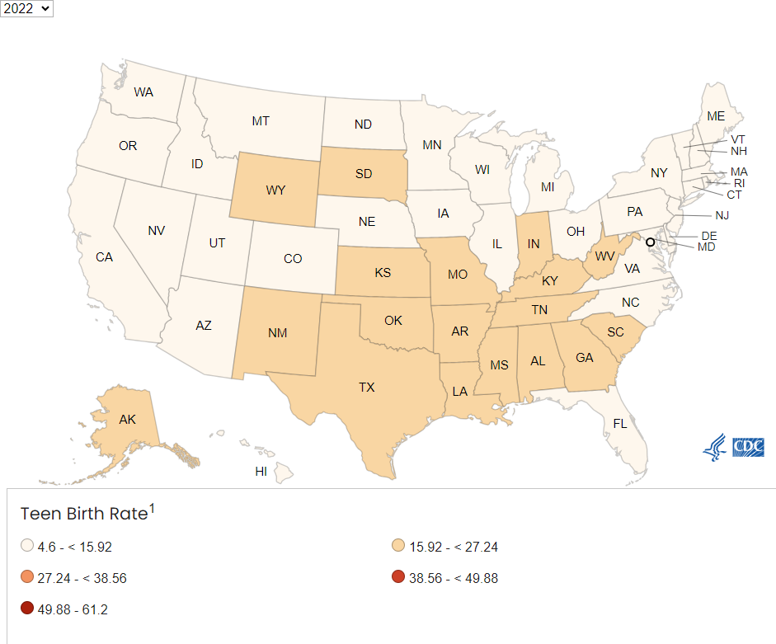
2022
Source: NCHS, National Vital Statistics System, October 2024
CDC Wonder, 2024

Slide 36
Teen Pregnancy rate by year 2005-2022
Source: Per 1,000 live births. 15-19 year old NCHS, National Vital Statistics System, October 2024
CDC Wonder, 2024

Slide 37
Births at a Glance WV vs. US, 2022
Birth Outcome | WV | U.S. | WV Rank
Preterm Births | 13.0% | 10.4% | 3rd
Infant Mortality | 7.32 per 1,000 | 5.61 per 1,000 | 4th
Low Birth Weight | 10.0% | 8.6% | 6th
Teen Birth Rate (Age 15-19) | 19.8 per 1,000 | 13.6 per 1,000 | 9th
Cesarean Delivery | 34.1% | 32.1% | 11th
Very Low Birth Weight | 1.4% | 1.4% | 20th
Maternal Mortality | 23.9 per 100,000 (2018-2022) | 23.2 per 100,000 (2018-2022) | 20th
Source: Centers for Disease Control and Prevention, National Center for Health Statistics
Note: WV data may vary from locally reported data due to the national reporting period.
Source: NCHS, National Vital Statistics System, October 2024
CDC Wonder, 2024
Notes:
Year 2022 is latest year available for data across the board. The lower the number/ the higher the rank the worse it is.
Discuss how we have more work to do with preterm births and infant mortality.
Cesarean is for ALL births.

Slide 38
Percent Cesarean Among WV Occurrence NTSV Births, 2013-2023
Target:23.6%
Notes:
Average 28.5%
CDC target is 23.6%

Slide 39
Births at a Glance WV vs. US, 2022
Birth Outcome | WV | U.S. | WV Rank
Preterm Births | 13.0% | 10.4% | 3rd
Infant Mortality | 7.32 per 1,000 | 5.61 per 1,000 | 4th
Low Birth Weight | 10.0% | 8.6% | 6th
Teen Birth Rate (Age 15-19) | 19.8 per 1,000 | 13.6 per 1,000 | 9th
Cesarean Delivery | 34.1% | 32.1% | 11th
Very Low Birth Weight | 1.4% | 1.4% | 20th
Maternal Mortality | 23.9 per 100,000 (2018-2022) | 23.2 per 100,000 (2018-2022) | 20th
Source: Centers for Disease Control and Prevention, National Center for Health Statistics
Note: WV data may vary from locally reported data due to the national reporting period.
Source: NCHS, National Vital Statistics System, October 2024
CDC Wonder, 2024
Notes:
Year 2022 is latest year available for data across the board. The lower the number/ the higher the rank the worse it is.
Discuss how we have more work to do with preterm births and infant mortality.
Cesarean is for ALL births.

Slide 40
WV Resident Maternal Mortality Causes, 2019-2023
Total: 102
Notes:
What is preventable and what is not?

Slide 41
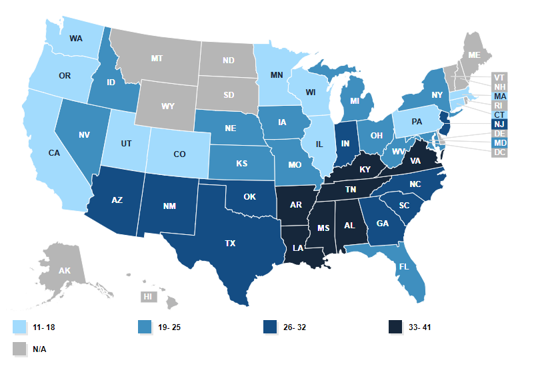
Maternal Mortality¹ Rate 2018-2022
¹Mortality rate per 100,000 live births
Source: KFF.org, National Vital Statistics System, Maternal deaths and mortality rates: Each state, the District of Columbia, United States, 2018‐2022, October 2024
Data suppressed due to reliability and confidentiality restrictions.
Notes:
Some data suppressed due to reliability and confidentiality reasons.
WV: 23.9 per 100,000
(2018-2022)
US: 23.2 per 100,000
(2018-2022)

Slide 42
Project WATCH Data, 2023
Birth score by infant count
High birth score by infant race
Source: Project WATCH, October 2024
Notes:
High vs low birth score by total infants. High = bad, generally a higher chance of death within the first 12 months of life
Percentage of each race’s births that had a high birth score

Slide 43
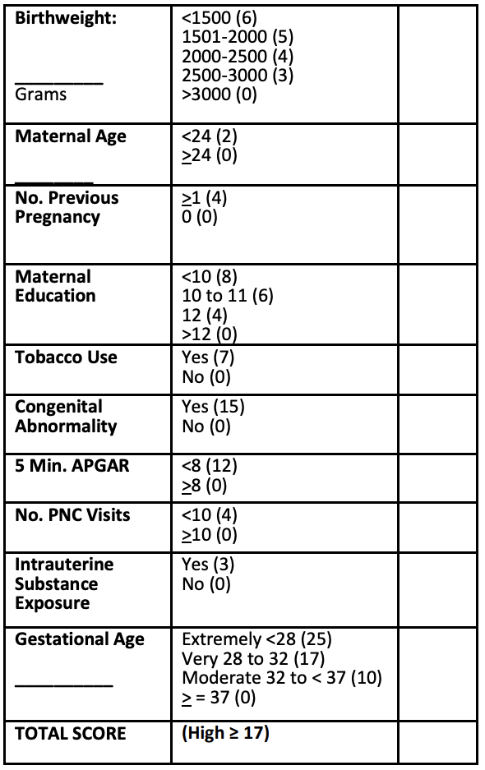
West Virginia Birth Score Calculations

Slide 44
WV Intrauterine Substance Exposure and Neonatal Abstinence Syndrome 2017-2023
Percentage (%)
Source: Project WATCH, October 2024

Slide 45
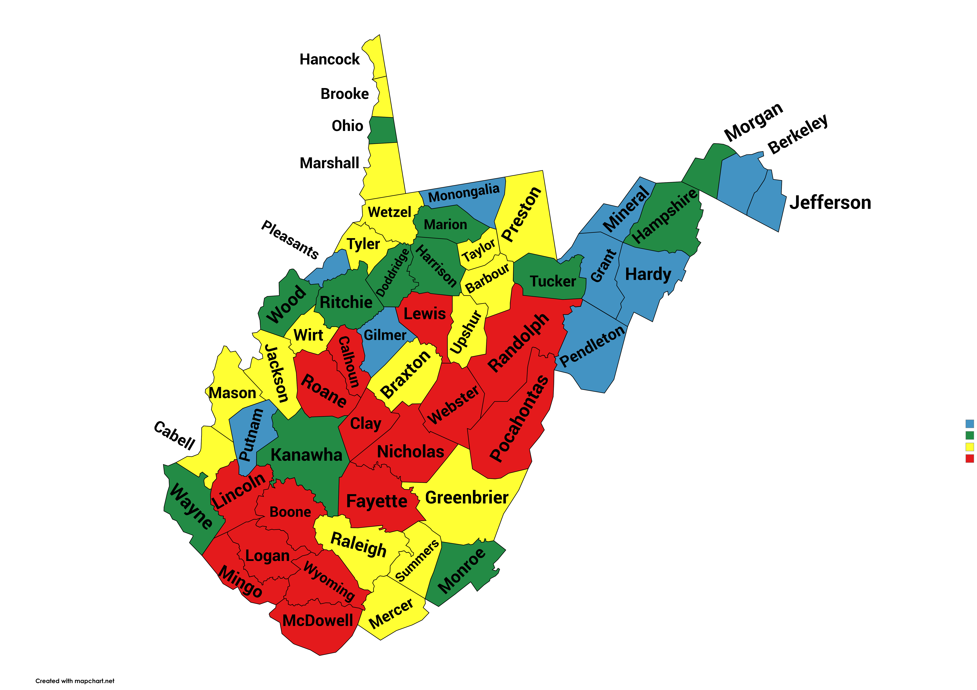
Smoking During Pregnancy, WV Resident Births by County, 2019-2023
9.5% - 16.0%
16.1% - 19.0%
19.3% - 23.0%
23.1% - 30.9%
Note: Percents are calculated excluding unknowns. 2022 and 2023 data are cumulative.
Source: WV Health Statistics Center, Vital Statistics System, 2024
Notes:
KITTY - Fix map rotation

Slide 46
WV Resident Maternal Smoking and Vaping During Pregnancy, 2013-2023
Note: Percents are calculated excluding unknowns. Smoking and vaping are not mutually exclusive. Vaping had 2,342 unknown/missing responses. Source: WV Health Statistics Center, Vital Statistics System, October 2024
Notes:
Smoking is falling, but vaping in increasing.

Slide 47
Premature and Maternal Smoking, WV Resident Births,2011-2023
Note: Percents are calculated excluding unknowns. 2022 and 2023 data are cumulative.
Source: WV Health Statistics Center, Vital Statistics System, 2024
Notes:
Our smoking rates are falling, but the premature rates are rising. And we know while smoking is falling, vaping is rising.

Slide 48
WV vs US Smoking rates 2011-2023
Notes:
Our smoking rates are much higher than the national rates

Slide 49
Trimester Prenatal Care Began
West Virginia Resident Births, 2010-2023
0.6%
2.8%
13.5%
83.1%
None
3rd
2nd
1st
1.9% 3.7%
12.8%
81.6%
77.2%
Source: WV Health Statistics Center, Vital Statistics System. October, 2024
Notes:
Dip around 2014 where less women entered into 1st trimester prenatal care to 77.2% but this has slowly been improving.
Unfortunately, our rate of no prenatal care and 3rd semester entry is rising. Rat

Slide 50
Selected Births Data by Mother's Race/Ethnicity, WV Residents, 2023
Notes:
Black mothers have higher rates of LBW, Preterm, and C-sections, yet lower rates of smoking compared to their white counterparts

Slide 51
Trimester Prenatal Care Began by Mother's Race/Ethnicity, WV Resident 2023
Notes:
More white mothers are entering first trimester care than the other races

Slide 52
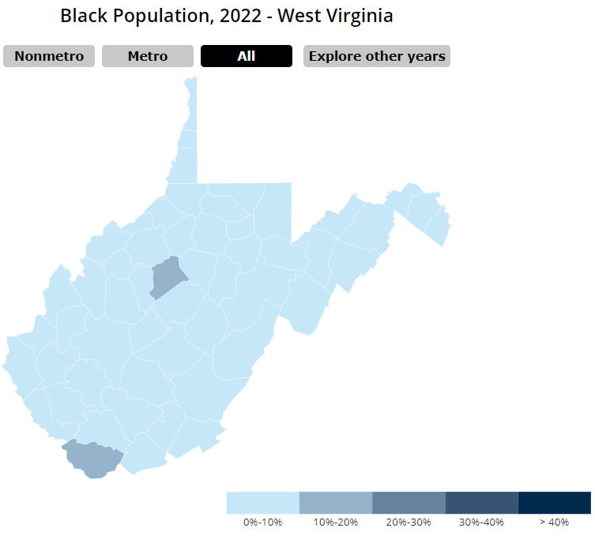
Notes:
Year 2022 is latest year available for data across the board. The lower the number/ the higher the rank the worse it is.
Discuss how we have more work to do with preterm births and infant mortality.
Cesarean is for ALL births.

Slide 53
WV Resident Breastfeeding 2014-2023
Source: CDC, NHSC for US rates,
WV Health Statistics Center, Vital Statistics System, 2024
Note: Percents are calculated excluding unknowns. 2023 data are cumulative.
Notes:
These are mother’s breastfeeding at the time of hospital discharge. Increase of 9 percentage points in 9 years, Still well below national average.
This data comes form the birth certificate that asks even attempted breast feeding in the hospital, which is not a great predictor of breastfeeding rates.
CDC had not released their 2023 numbers

Slide 54
Rates of Any and Exclusive Breastfeeding¹ among Children Born in 2021
¹Exclusive breastfeeding is ONLY breast milk- NO solids, water, or other liquids
Source: National Immunization Survey-Child, CCDC, Dept. of Heath and Human Services.
Notes:
This is more indicative of breastfeeding rates in WV: 68.1% said they ever breastfed, but by 6 months only 38.4% of WV mothers say they are doing ANY breastfeeding, compared to 59.8% of the US.
WV lags behind in all breast-feeding areas, although less so in exclusive breastfeeding.
Target is defined by health people 2030 for Any breastfeeding at 12 months and exclusive breastfeeding at 3 months.

Slide 56
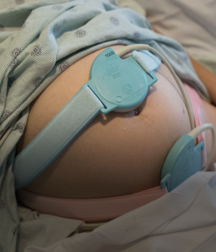
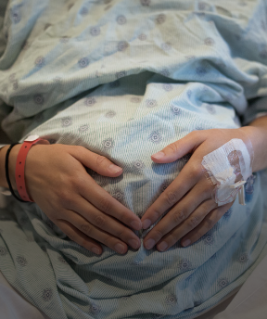
Maternal & Infant Safety
Outreach Education
Quality Improvement
Labor Support
Breastfeeding
Substance Exposure
Access to Care
Tobacco & Nicotine Cessation
Notes:
Put with Robin

Slide 57
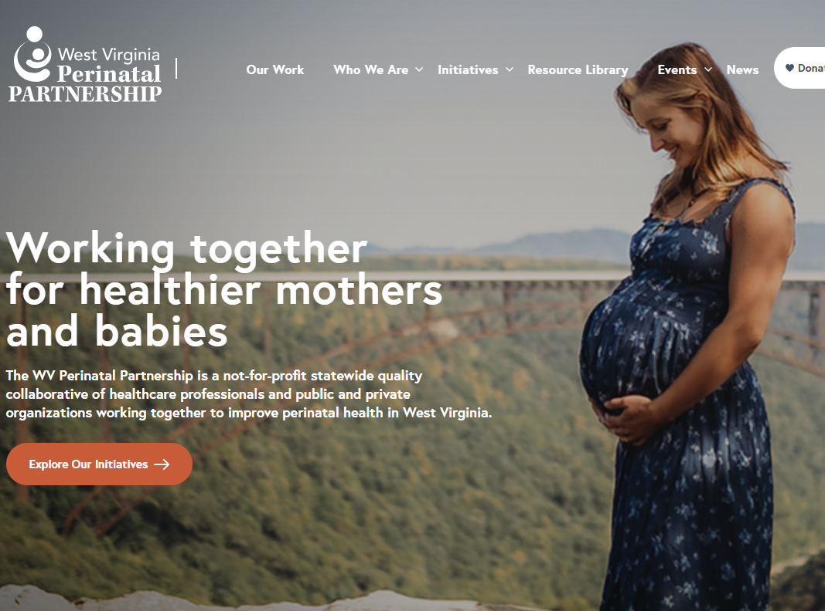
Check out our NEW website!
wvperinatal.org
Notes:
Put with Robin

