Slide 1
Creating an Inclusive and Affirming Health System for LGBTQIA+ Patients
Molly Fechter-Leggett, PsyD
Licensed Clinical Psychologist
LGBTQ+ Program Manager
Lou Teter, MLS
EEO Consultant

Slide 2
Disclosures for Activity Participants Non-Clinical Activity
West Virginia University Hospitals will provide 1 contact hours to those who participate and complete all learning activities.
Successful Completion Criteria:
Attendance and active participation throughout the entire event or session
Completion/submission of evaluation form

Slide 3
Introduction
Why are we here?
Ground rules
Further questions

Slide 5
Learning Objectives
Describe how creating an inclusive and affirming health system addresses WVU Medicine’s commitment to Health Equity
Recognize the impact of stigma and discrimination on LGBTQIA+ patients
Identify additional skills for respectful communication with LGBTQIA+ patients
Explain how EPIC can be used to affirm LGBTQIA+ patients
Recognize the role you play in ensuring our health system is welcoming to LGBTQIA+ patients

Slide 6
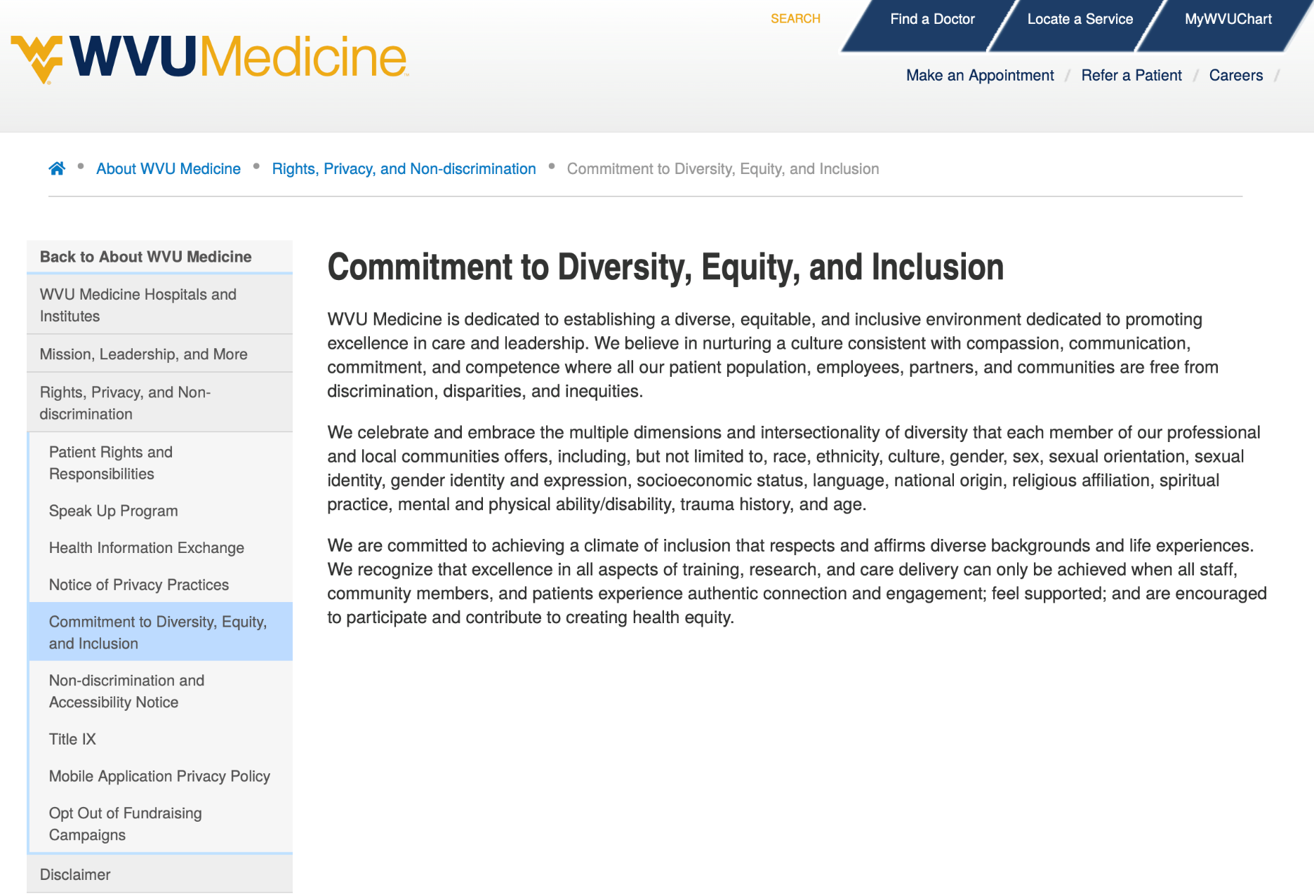
WVU Medicine’s Commitment to Health Equity

Slide 7
Foundational Review

Slide 8
+

Slide 9
What is transgender?
“Transgender” — umbrella term; describes people whose gender identity differs from their sex assigned at birth
“Cisgender” — umbrella term that describes people whose gender identity does not differ from the gender that society would expect of them given their sex assigned at birth
“Non-binary” — describes people who do not fit neatly into the gender identity categories of “man” or “woman”

Slide 10
Understanding Language
“Trans Man” – typically a person assigned female at birth whose gender identity is male/man
“Trans Woman” – typically a person assigned male at birth whose gender identity is female/woman
“Nonbinary” – may be assigned any sex at birth and identifies outside of binary gender categories

Slide 11
Gender Affirmation (Transitioning)
Social
names, pronouns, dress, coming out
Legal
identity documents
Medical
hormones, surgeries
Not all transgender people utilize all forms of gender affirmation
Each transgender person’s journey is unique
Not invited? Not your business.

Slide 12
How many LGBTQ+ patients are there?
Asking about identity
SOGI- Sexual Orientation and Gender Identity Data
Multiple opportunities to share
Most patients readily answer
Provides opportunity to offer relevant health screenings
Required by federal mandates

Slide 13
The Biggest Barrier to Safe Medical Care for Transgender Patients is Lack of Access
Lack of health care providers who are sensitive and knowledgeable about the needs of transgender patients
Discrimination and harassment by health care staff and providers
Systemic Barriers
Financial barriers to accessing care

Slide 14
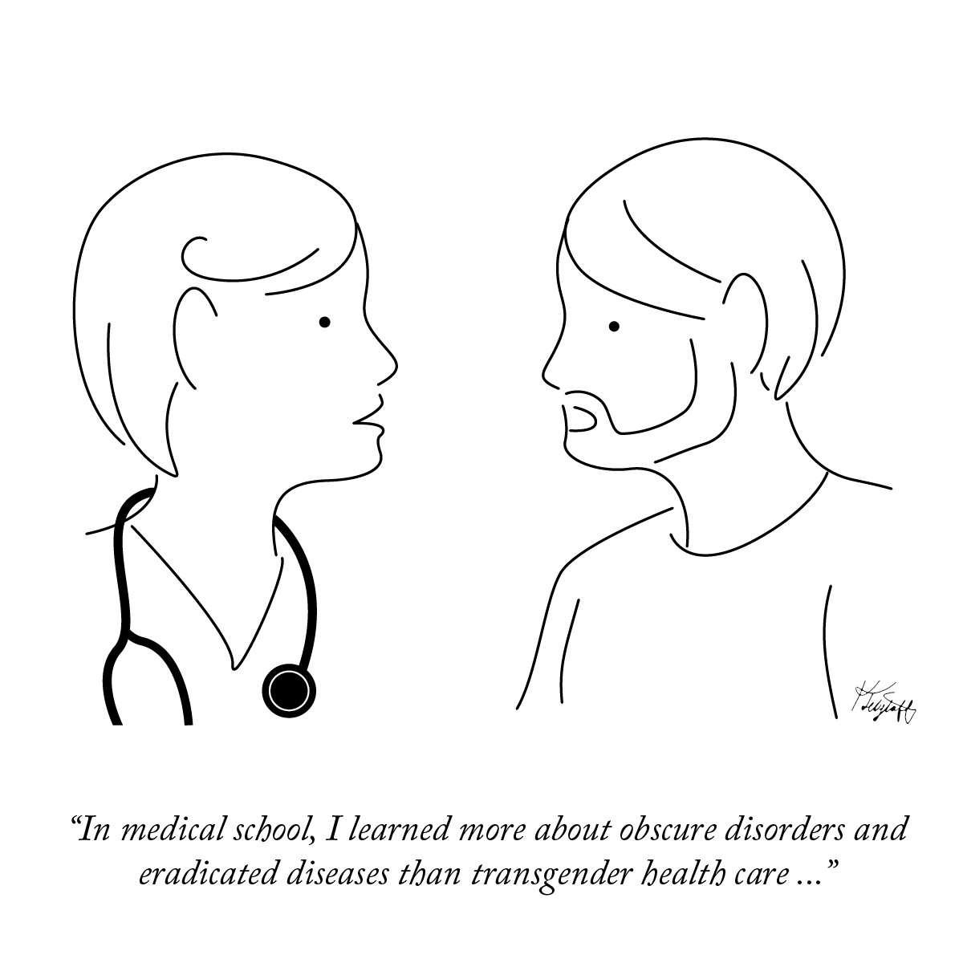

Slide 15
Baseline Expectations of Providers
Humility and awareness of limited knowledge
Use the language of the patient
Medically necessary care based on organs not on gender
Affirm all expressions of gender and sexual orientation
Nurture a supportive and welcoming environment

Slide 16
WVU Medicine Provider Survey (2018)
40%
23%
80%
1 in 10
said need more training
acknowledge significant barriers to care
acknowledge transgender patients have unique health risks and needs
endorsed questions indicating bias and active discrimination against transgender patients

Slide 17
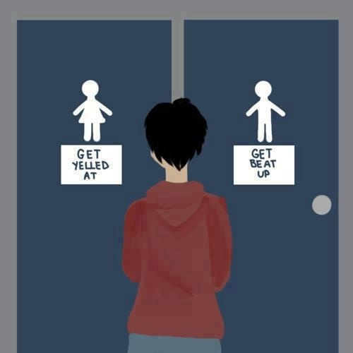
Discrimination Affects Health Care Access
70%
experienced serious discrimination in health care
19%
reported being refused health care due to their transgender or gender-nonconforming status
28%
postponed necessary health care when sick or injured
40%
delayed or did not seek preventive care because of experiences of health care discrimination based on their transgender status

Slide 18
Barriers to Care = Increase Health Disparities
High rates of mental health disorders and experiences of violence related to stigma and discrimination
Delayed care increases morbidity and mortality
Increased cancer risks
More likely to be the victims of violent crime; high victimization results in increased health disparities
Increased ACES lead to increases in chronic health conditions

Slide 19
Gender-affirming Care with Adolescents
What is Gender Affirming Care?
Puberty Blockers give everyone more time
Parental Consent and Involvement
Standard of Care by Every Major Medical Organization
These kids are here and at risk

Slide 20
Respectful Communication

Slide 21
Gender Affirmation in Action
“Hi. I’m [name]. I use [she/her] pronouns.
What name do you use? or
What name and pronouns do you use?”
Engaging the Families of Transgender and Gender Diverse Children. National LGBTQIA+ Health Education Center. Fenway Health. 2021. In Press.

Slide 22
Gender Inclusive Language Dos and Don’ts
Avoid saying… | Say instead… | Why? | Example
“Ladies and gentlemen” | “Everyone,” “Folks,” “Honored guests,” “Y’all” etc. | Moving away from binary language is more inclusive of people of all genders | “Good morning, everyone!”
“A gay” or “a transgender” (nouns) | “A gay person” or “a transgender person” (adjectives) | Gay and transgender are adjectives that describe people and groups | “We had a transgender athlete in our league this year.”
“Born female” “female-bodied or “born male” | “Assigned female/male at birth” | “born” and “-bodied” language is often interpreted as invalidation of someone’s gender identity | “Max was assigned female at birth, then he transitioned later in life.”
“Both genders” or “opposite sexes” | “All genders” | “Both” implies there are only two; “Opposite” reinforces antagonism among genders | “Video games aren’t just a boy thing — all genders play them.”

Slide 23
What should you do?
Respect a person’s right to self-identify. Use the pronouns or identities a person tells you to use.
Speak up when you hear microaggressions or derogatory slurs/jokes. Don’t tell them yourself.
Send gentle signals to people around you that you are welcoming and supportive.
Learn what makes a workplace safe and inclusive.
Expect to make mistakes but recover and repair.

Slide 24
EPIC can help!
(But is not perfect)

Slide 25
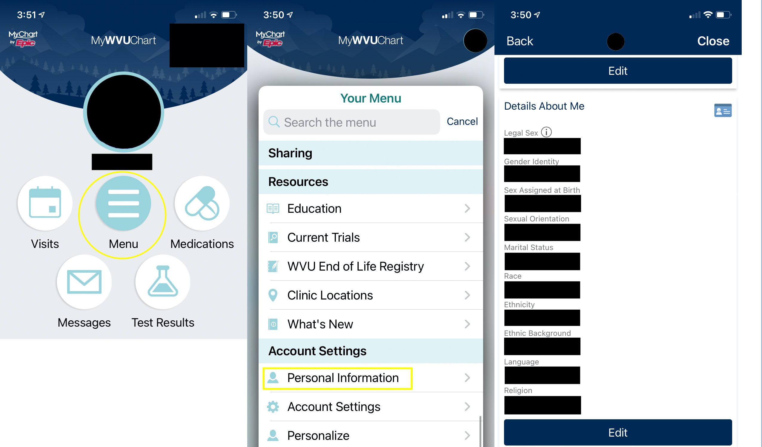

Slide 26
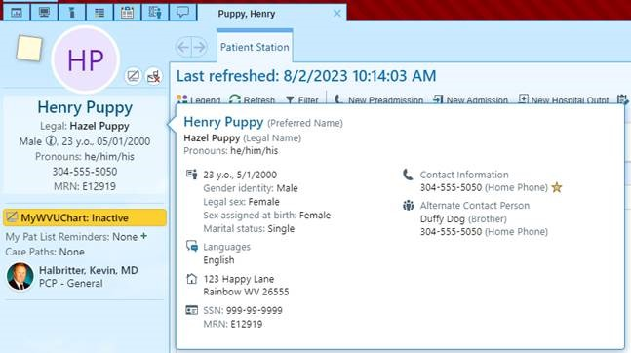

Slide 27
Questions?

Slide 28
CONTACT INFORMATION
Molly Fechter-Leggett, PsyD
Clinical Psychologist
LGBTQ+ Program Manager
transhealth@wvumedicine.org
Lou Teter, MLS
EEO Consultant
Department of Diversity, Equity,
And Inclusion
larel.teter@HROneSource.org

Slide 29
SUPPLEMENTAL INFORMATION

Slide 30
WV Laws Impacting Transgender People
Can change name legally with letter from a doctor and appearance in family court.
Can change sex marker on birth certificate in WV (Recent court ruling- cannot in other states, varies)
Can change sex marker on drivers license or photo ID (form from DMV signed by medical provider)
Can change sex marker on passport (including new X marker), self-attestation
Cannot be discriminated against in school- gender identity and sexual orientation fall under Title IX protections (includes bullying, bathroom use, participating in extra curricular activities, transcripts, etc- See Grimm v. Gloucester County School Board)
WV law passed (HB 3293) and was blocked in court regarding transgender girls’ participation in sports (see B.P.J. v. West Virginia State Board of Education)
No statewide non-discrimination bills (employment, housing, public accommodations). Individual jurisdictions have passed bills.
PEIA has a policy that denies coverage for Gender Affirming Care (class action lawsuit resulted on Medicaid ban and Health Plan managed PEIA being required to cover GAC, see Fain, Martell & Mcnemar vs WV DHHR, PEIA, The Health Plan)
2023 HB 2007 restricts adolescent gender-affirming care
Notes:
These are Athens, Beckley, Charles Town, Charleston, South Charleston,^{[21]} Fairmont,^{[22][23]} Harpers Ferry, Huntington, Lewisburg, Martinsburg, Morgantown, Shepherdstown, Sutton, Thurmond and Wheeling.^{[14]} In addition, Kanawha County,^{[24]} Buckhannon,^{[25]} and Elkins have policies banning discrimination based on sexual orientation and gender identity against county/city employees.^{[26]}
Bostock v Clayton County established employment discrimination against LGBTQ people is illegal on a federal level

Slide 31
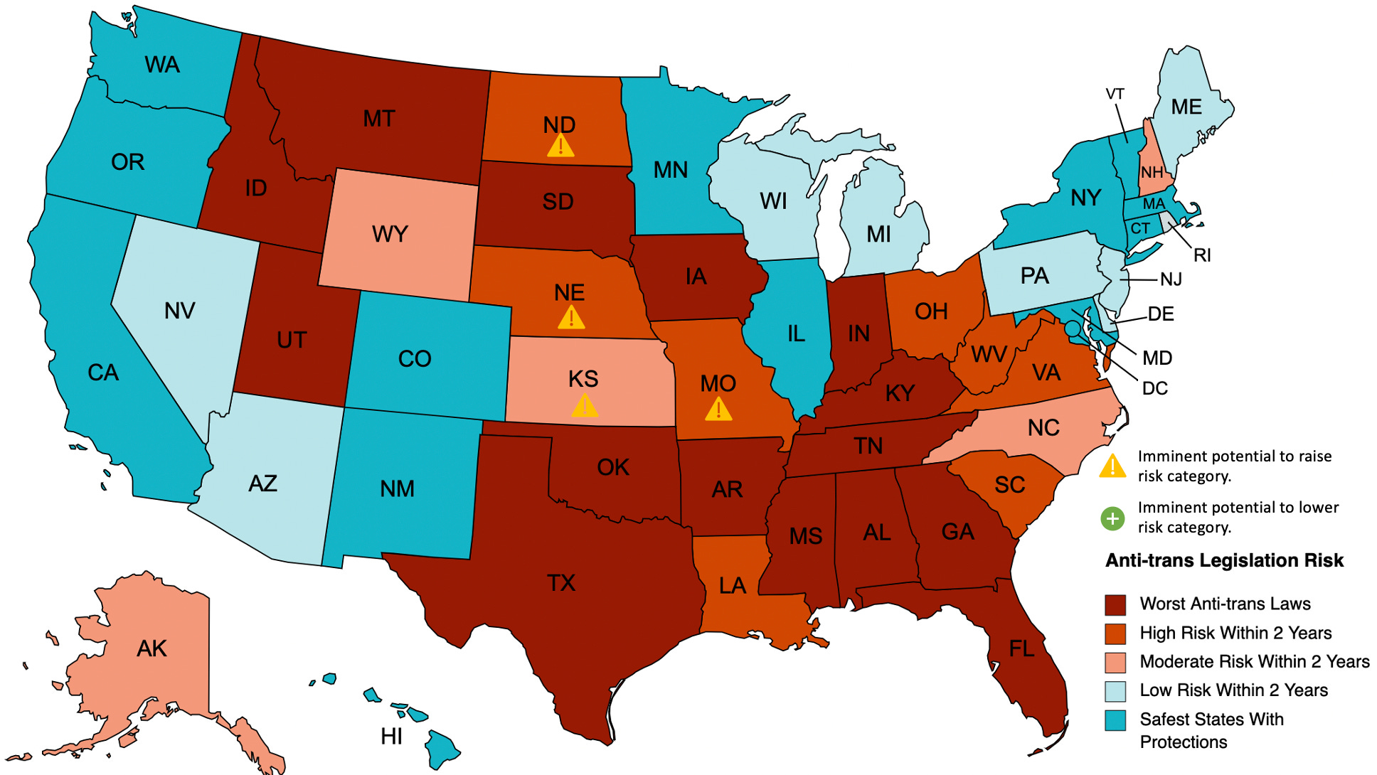
Anti-Trans Legislation

