Slide 1

AVOIDING POT HOLES: NAVIGATING THE CAUTIONARY TRAIL OF CANNABIS
jberry@hsc.wvu.edu
Notes:
2-2:45pm
Avoiding Pot Holes: Navigating the Cautionary Trail of Cannabis
Objectives:
Discuss the risks of cannabis on individuals and the general public
Describe the potential impact of cannabis on pregnant mothers and children
Recognize the inherent complications and potential dangers of “medicalizing” a heavily politically-lobbied recreational intoxicant.
Description:
Over the past two decades, most states have legalized marijuana for medical purposes either through legislative dictate or popular vote. This has occurred in the absence of solid scientific evidence demonstrating either efficacy or safety. The number of people using cannabis has skyrocketed, along with individual and public health harms such as addiction, psychosis, and suicide. Concerning parallels exist between today's industry driven cannabis market and the prescription opioid pain pill industry which fueled our nation's addiction epidemic. This talk will review the current evidence regarding potential harms, equip participants to consider the impact of these harms and to reasonably discuss risks with clients, courts, peers, and policy makers.
Dr. Berry,
I would like to invite you to speak at the 2023 WV Perinatal Summit on medical marijuana and its impact on pregnancy. The Summit will be held September 7-8, 2023, at Stonewall Resort. We are still drafting the agenda, so we can accommodate your schedule if one of the days works better for you to present.
Our Summit has over 200 participants, including physicians, nurses, state policymakers, behavioral health care providers, home visitors and community-based providers, as well as others working to improve health outcomes of mothers and babies in the state. I hope you will be able to join us.
I look forward to hearing from you. If you have any questions, please do not hesitate to contact me.
Janine
Janine Breyel
Deputy Director
West Virginia Perinatal Partnership
(304) 216-3437
wvperinatal.org

Slide 2




X
American Psychiatric Association
American Academy of Child and Adolescent Psychiatry
American Academy of Pediatrics
American Society of Addiction Medicine
American Academy of Addiction Psychiatry
American Academy of Neurology
American Academy of Ophthalmology
American College of Medical Toxicology
American College of Obstetricians and Gynecologists
cannabis for medicinal use should not be legalized through the state legislative, ballot initiative, or referendum process
Notes:
During the past 2 decades, while the use of alcohol and nicotine products in pregnancy has decreased, the potency of cannabis and prevalence of prenatal cannabis use have increased substantially, in part due to changing legalization patterns leading to greater availability and perceived safety.¹ Currently, 38 states and Washington, DC, have legalized medical cannabis and 23 states and Washington, DC, have legalized recreational cannabis.
Cannabis is now the most commonly used federally illegal drug in pregnancy, with an incidence of 7% among pregnant individuals in 2017, an increase from 3.4% in 2002.
What resources are available for individuals interested in stopping their cannabis use?
Cannabis use in Oncology care, misconceptions and best practice for treating anxiety/depression and pain
I am particularly interested in this subject and how it pertains to juveniles in the juvenile justice system.
Impact of cannabis on health and wellbeing of pregnancy
Effects of second hand on developing baby brains and exposure during pregnancy.
CBD/THC use in breast feeding and impact on babies/children
The effect of cannabis use during pregnancy

Slide 3
DISCLOSURES
I serve on the West Virginia Medical Cannabis Advisory Board
I serve on the WV Governor’s Council of Substance Abuse Prevention and Treatment
I have not received any financial renumeration from the multi-billion dollar cannabis industry
I AM biased

Slide 4

Notes:
Me circa 1990

Slide 5
OBJECTIVES
Discuss the risks of cannabis on individuals and the general public
Describe the potential impact of cannabis on pregnant mothers and children
Recognize the inherent complications and potential dangers of “medicalizing” a heavily politically-lobbied recreational intoxicant.
Notes:
Objectives:
Discuss the risks of cannabis on individuals and the general public
Describe the potential impact of cannabis on pregnant mothers and children
Recognize the inherent complications and potential dangers of “medicalizing” a heavily politically-lobbied recreational intoxicant.

Slide 6
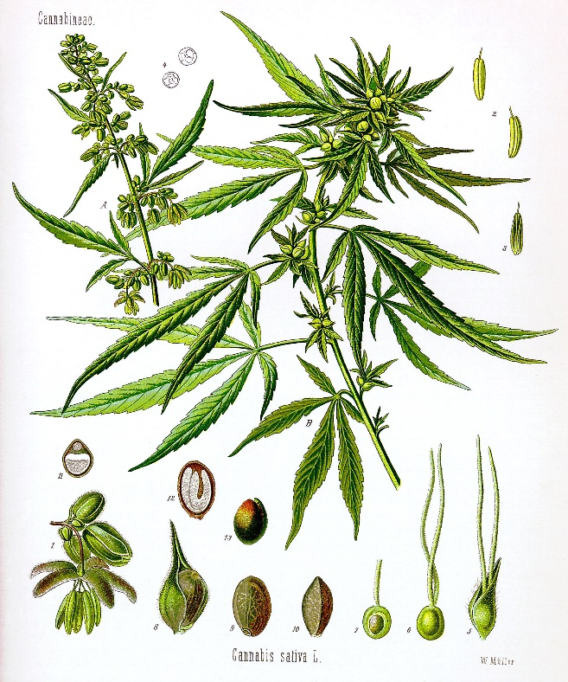
CANNABIS
> 400 compounds (60 pharmacologically active)
  Δ⁹-THC (tetrahydrocannabinol) + 120 other cannabinoids
  Each has individual, interactive and entourage effects
  Clinical trials w/ individual cannabinoids can’t be extrapolated to the “Cannabis plant”
  Composition varies among product
Elsohly MA, Slade D. Chemical constituents of marijuana. Life Sci. 2005;78(5):539-548
D'Souza D, Ranganathan M. Medical Marijuana: Is the Cart Before the Horse?. JAMA. 2015;313(24):2431-2432. doi:10.1001/jama.2015.6407.

Slide 7
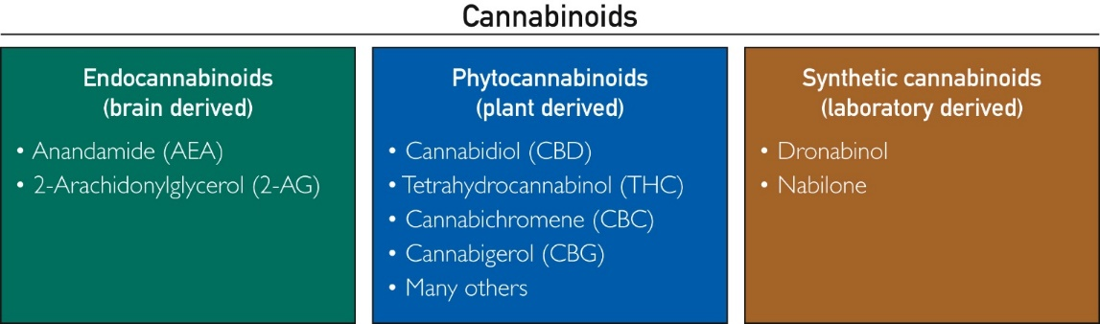
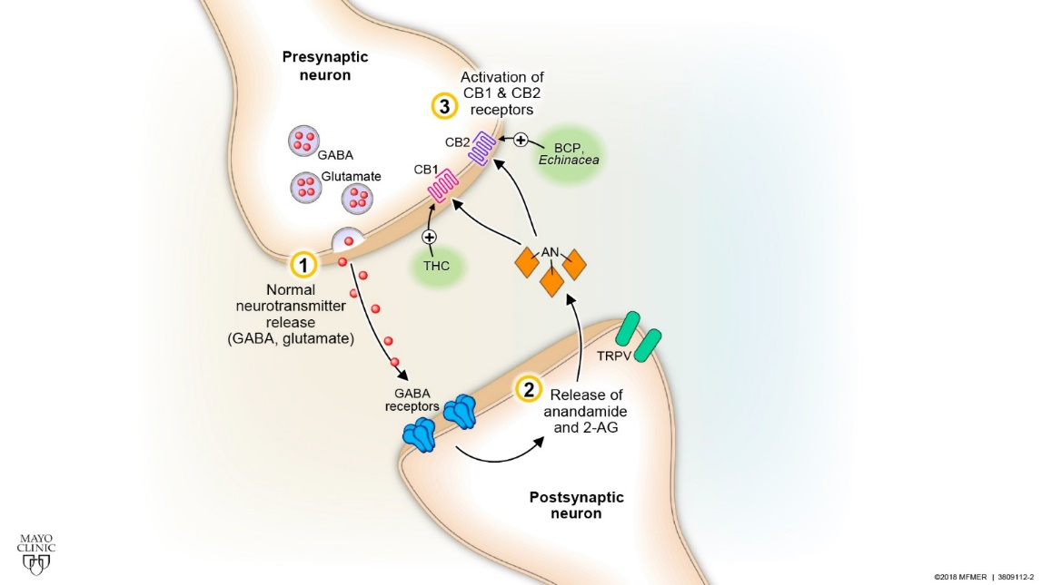
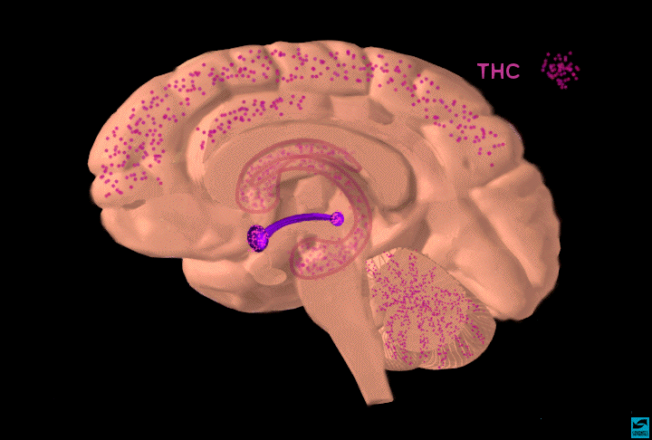
Mayo Clinic Proceedings 2019 94, 1840-1851DOI: (10.1016/j.mayocp.2019.01.003)
NIDA

Slide 8
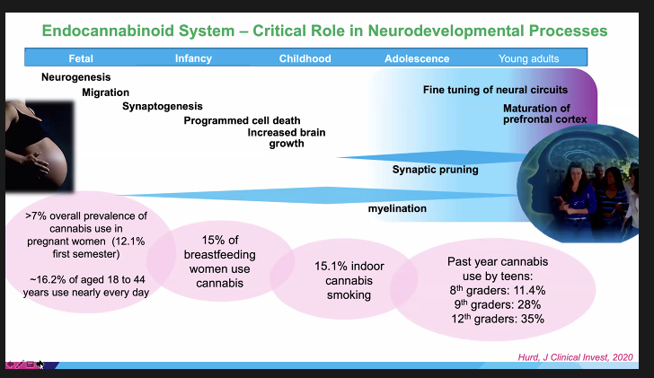
Institute of Cannabis Research – CSU-Pueblo Webinar Series – February 10, 2022
Cannabis Research Webinar Series | Monthly Webinars | CSU-Pueblo (csupueblo.edu)
Referenced from Libby Stuyt, IASIC Presentation 6/21/22
Notes:
The developing brain is characterized by two important neuronal processes for normal brain development
Axonal Myelination – insulating our neurons to form faster connections
Synaptic Pruning – getting rid of excess connections in our brain
Repeated exposure to exogenous THC disrupts normal endocannabinoid (Anandamide & 2-AG) signaling which in turn alters both processes
THC induces neurodegeneration at all developmental stages
This disruption process is heavily implicated in why there is such a strong association between cannabis and the development of thought disorders (i.e. Schizophrenia)
“Reefer madness” versus “Reefer Reality”

Slide 9
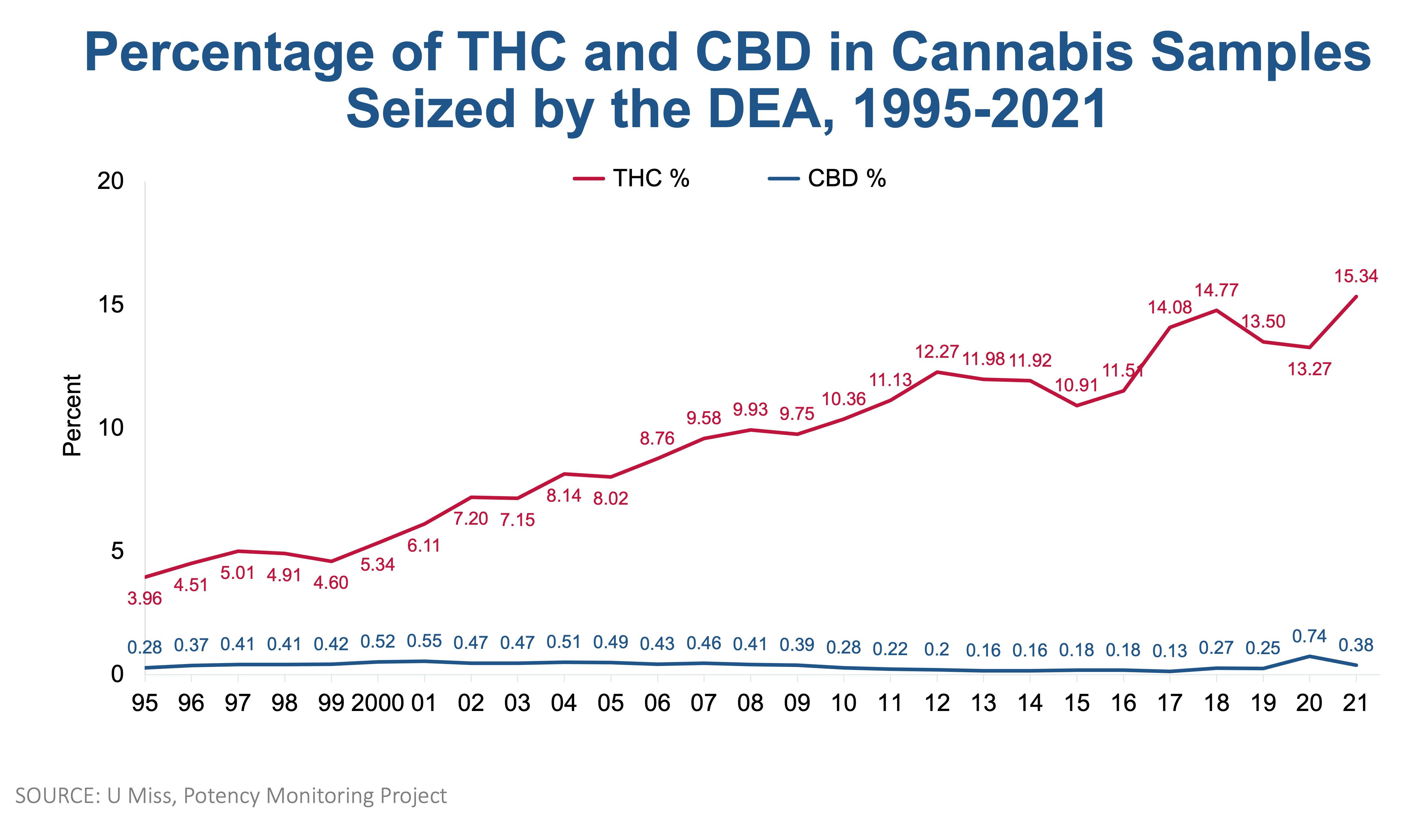
https://nida.nih.gov/research-topics/marijuana/cannabis-marijuana-potency
Notes:
Under contract with NIDA, the National Center for Natural Products Research (NCNPR) located at the University of Mississippi (UM), conducts analyses to monitor the potency of cannabis products distributed in the illegal marijuana marketplace in the United States. Samples are submitted for analysis by the Drug Enforcement Administration (DEA) and by state and local police agencies. Samples tested in the laboratory are classified into one of three categories: cannabis (plant material), hashish (dried resin), and hash oil (cannabis extract). Each sample is analyzed by gas chromatography for the major psychotropic component, delta-9-tetrahydrocannabinol (THC), as well various cannabinoids, including cannabidiol (CBD). The data below reflect the percentage of THC and CBD in the cannabis samples seized by the DEA from 1995-2021 and analyzed as of October 4, 2022. 'Year' indicates the year of seizure, not the date of receipt or analysis by NCNPR.

Slide 10
Higher Potency = Higher Risks
Ave THC content is 17-28% in today’s MJ plant (compared to 2% in 1960-80s)
THC content in concentrates up to 85-90%
FDA considering reducing nicotine concentration in tobacco
NO research that THC>10% is beneficial
Dutch concluded that >15% should be considered a hard drug
Notes:
Public believes that MJ obtained from a licensed dispensary is pure, natural, safe and effective for hundreds of conditions
Team of Dutch health experts concluded that THC potencies above 15% should be considered hard drugs after they observed negative impacts of rising levels
Ave. potency of MJ flowers/buds in CO is 17.1% THC while ave. potency for concentrates is 62.1%. Potency of up to 95% has been documented (Smartcolorado.org)
Ave. Potency in WA of flowers is over 20%

Slide 11

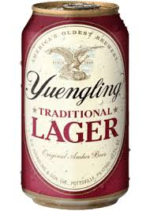
Higher Potency = Higher Risks
Notes:
12.5 oz Yeungling = 4.5% ABV
Wild Turkey – 50.5% ABV

Slide 12
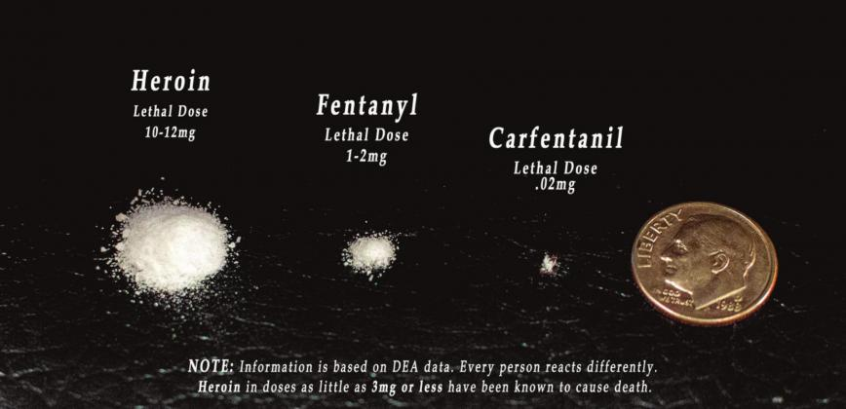
Higher Potency = Higher Risks
Notes:
1997 – 2007: avg dose of Opioid Rx increased from ~100 to 700 MMEs per person/per year

Slide 13
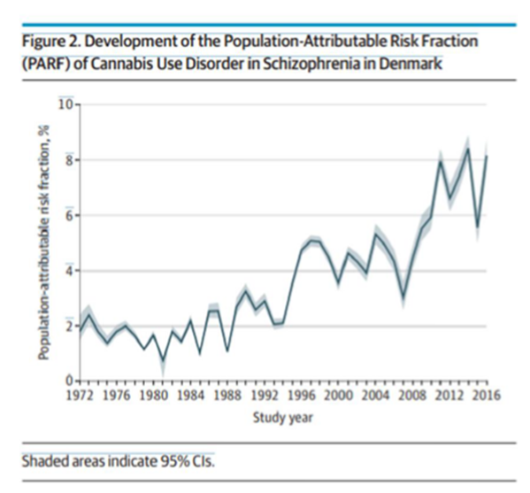
High Potency and Psychosis
Potency >10%
European Study
  1st Episode Psychosis
  3X Risk
  5X Risk with daily use
Denmark Study
  CUD and Schizophrenia
  4X Risk
DiForti et al. Lancet Psychiatry, 2019
Hjorthøj C, Development Over Time of the Population-Attributable Risk Fraction for Cannabis Use Disorder in Schizophrenia in Denmark. JAMA Psychiatry. 2021;78(9):1013–1019.

Slide 14
Daily or Near-Daily Use Has Grown Tenfold from 0.9 to 9 million
Source: National Household Survey on Drug Use and Health data analyzed by Jonathan Caulkins, Carnegie Mellon University
Slide adapted from Keith Humphrey

Slide 15



Increased Frequency and Potency
Pre-2000 avg user: 2 nights/wk
Today: Daily (frequency + potency = 70X THC!)
J Caulkins. Marijuana Legalization: What Everyone Needs to Know
Notes:
Daily 20 ounce Diet Coke for 35 Grande cappuccinos

Slide 16
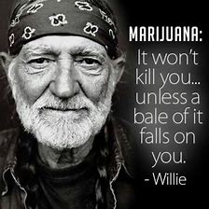
What’s the Big Deal?

Slide 17
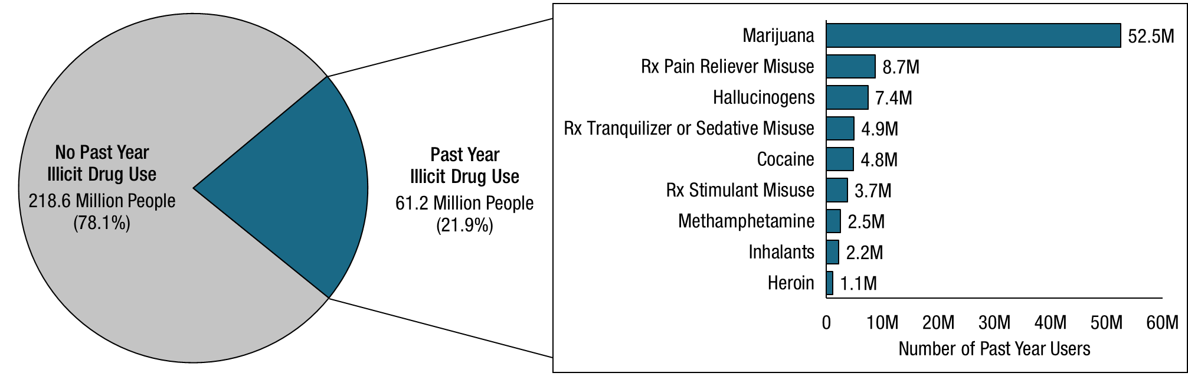
Past Year Illicit Drug Use: Among People Aged 12 or Older; 2021
FFR1.14
Rx = prescription.
Note: The estimated numbers of past year users of different illicit drugs are not mutually exclusive because people could have used more than one type of illicit drug in the past year.
Notes:
2018: 43.5M

Slide 18
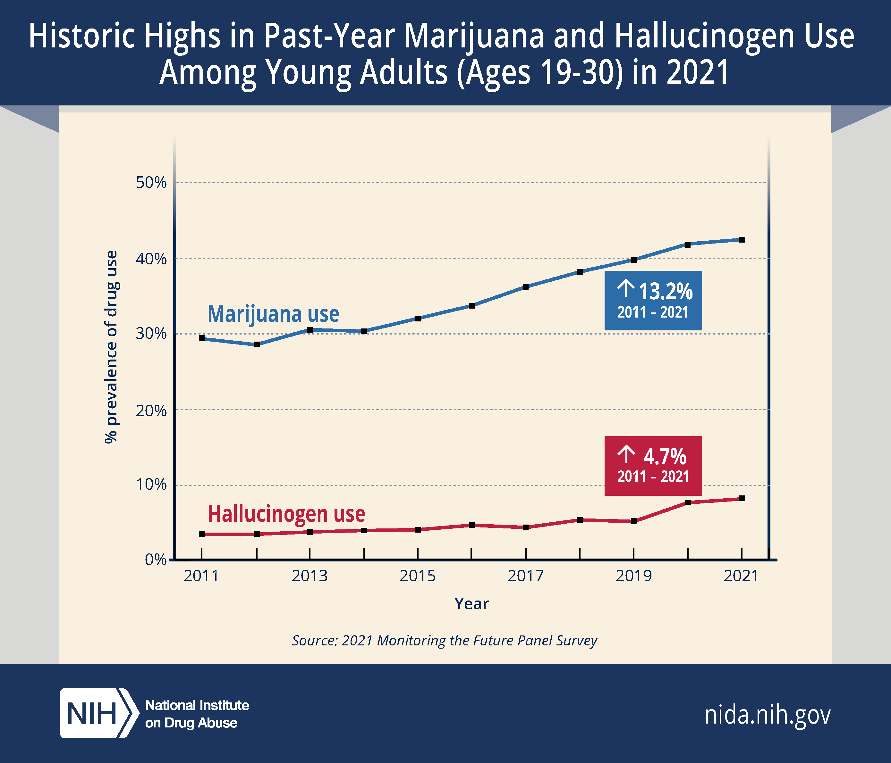
Record levels of year/month/daily use:
  43% Past Year
  29% Past Month
  11% Daily
Notes:
August 22, 2022
NIDA
Marijuana and hallucinogen use in the past year reported by young adults 19 to 30 years old increased significantly in 2021 compared to five and 10 years ago, reaching historic highs in this age group since 1988, according to the Monitoring the Future (MTF) panel study. Rates of past-month nicotine vaping, which have been gradually increasing in young adults for the past four years, also continued their general upward trend in 2021, despite leveling off in 2020. Past-month marijuana vaping, which had significantly decreased in 2020, rebounded to pre-pandemic levels in 2021.
Alcohol remains the most used substance among adults in the study, though past-year, past-month, and daily drinking have been decreasing over the past decade. Binge drinking (five or more drinks in a row in the past two weeks) rebounded in 2021 from a historic low in 2020, during the early stages of COVID-19 pandemic. On the other hand, high-intensity drinking (having 10 or more drinks in a row in the past two weeks) has been steadily increasing over the past decade and in 2021 reached its highest level ever recorded since first measured in 2005.
“As the drug landscape shifts over time, this data provides a window into the substances and patterns of use favored by young adults. We need to know more about how young adults are using drugs like marijuana and hallucinogens, and the health effects that result from consuming different potencies and forms of these substances,” said National Institute on Drug Abuse Director Nora Volkow, M.D. “Young adults are in a critical life stage and honing their ability to make informed choices. Understanding how substance use can impact the formative choices in young adulthood is critical to help position the new generations for success.”
Since 1975, the Monitoring the Future study has annually surveyed substance use behaviors and attitudes among a nationally representative sample of teens. A longitudinal panel study component of MTF conducts follow-up surveys on a subset of these participants to track their drug use through adulthood. Participants self-report their drug use behaviors across three primary time periods – lifetime, past year (12 months), and past month (30 days). The MTF study is conducted by scientists at the University of Michigan’s Institute for Social Research, Ann Arbor, and is funded by NIDA, part of the National Institutes of Health.
Data for the 2021 survey were collected online from April 2021 through October 2021. Key findings in the young adult group include:
Marijuana Use: Past-year, past-month, and daily marijuana use (use on 20 or more occasions in the past 30 days) reached the highest levels ever recorded since these trends were first monitored in 1988. The proportion of young adults who reported past-year marijuana use reached 43% in 2021, a significant increase from 34% five years ago (2016) and 29% 10 years ago (2011). Marijuana use in the past month was reported by 29% of young adults in 2021, compared to 21% in 2016 and 17% in 2011. Daily marijuana use also significantly increased during these time periods, reported by 11% of young adults in 2021, compared to 8% in 2016 and 6% in 2011.
Hallucinogen Use: Past-year hallucinogen use had been relatively stable over the past few decades until 2020, when reports of use started to increase dramatically. In 2021, 8% of young adults reported past-year hallucinogen use, representing an all-time high since the category was first surveyed in 1988. By comparison, in 2016, 5% of young adults reported past-year hallucinogen use, and in 2011, only 3% reported use. Types of hallucinogens reported by participants included LSD, MDMA, mescaline, peyote, “shrooms” or psilocybin, and PCP. The only hallucinogen measured that significantly decreased in use was MDMA (also called ecstasy or Molly), showing statistically significant decreases within one year as well as the past five years – from 5% in both 2016 and 2020 to 3% in 2021.
Vaping: Nicotine vaping in the past month increased significantly among young adults in 2021 despite leveling off in 2020 during the earlier part of the pandemic. The continued increase in 2021 reflects a general long-term upward trend: in 2021, nicotine vaping prevalence nearly tripled to 16% compared to 6% in 2017, when the behavior was first recorded.
Prevalence of marijuana vaping in the past month among young adults had significantly dipped in 2020 but returned to near pre-pandemic levels in 2021. Since 2017, when marijuana vaping was included in this study, past-month prevalence has doubled – from 6% in 2017 to 12% in 2021.
Alcohol Use: Reports of binge drinking by young adults – defined as having five or more drinks in a row in the past two weeks – returned to pre-pandemic levels in 2021 after significantly decreasing in 2020 (32% reported in 2021, versus 28% in 2020 and 32% in 2019). High-intensity drinking, defined as having 10 or more drinks in a row in the past two weeks, was at its highest level since it was first measured in 2005, reported by 13% of young adults in 2021, compared with 11% in 2005. However, past-month and past-year alcohol use, and daily drinking have been on a downward trend in young adults for the past 10 years. For example, in 2021, 66% of young adults reported alcohol use in the past 30 days, a significant decline from 70% recorded in 2016 and 69% in 2011.
The study also showed significant decreases in past-month cigarette smoking by young adults and non-medical use of opioid medications in the past year (surveyed as “narcotics other than heroin”) compared to 10 years ago. Both substances have been declining steadily in use for the past decade. Additional data from the 2021 MTF panel study include drug use reported by adults 35 to 50 years old, college/non-college young adults, and among various demographic subgroups.
“One of the best ways we can learn more about drug use and its impact on people is to observe which drugs are appearing, in which populations, for how long, and under which contexts,” said Megan Patrick, Ph.D., a research professor at the University of Michigan and principal investigator of the MTF panel study. “Monitoring the Future and similar large-scale surveys on a consistent sample population allow us to assess the effects of ‘natural experiments’ like the pandemic. We can examine how and why drugs are used and highlight critical areas to guide where the research should go next and to inform public health interventions.”

Slide 19
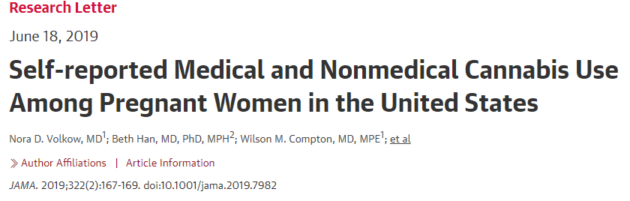
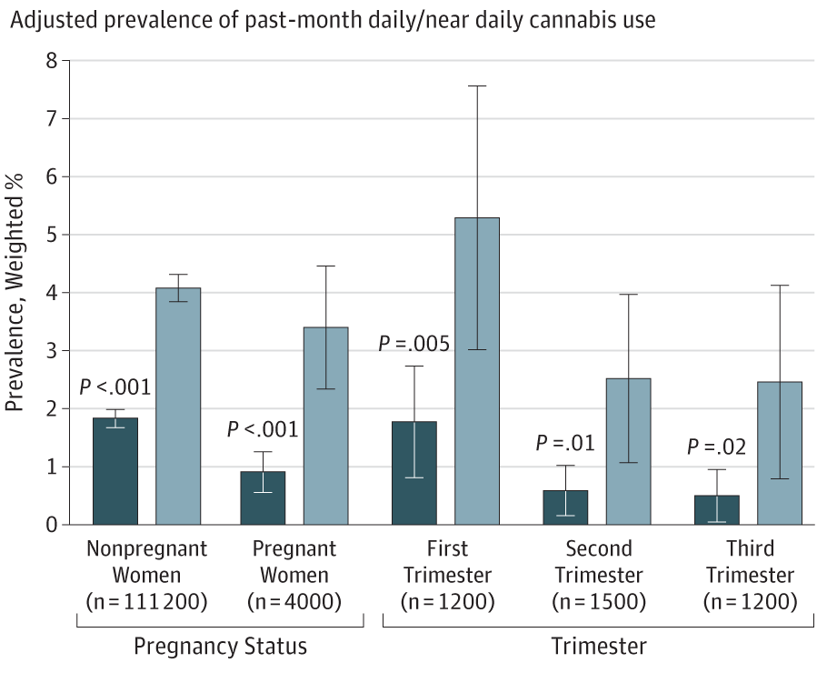
NSDUH 2002 to 2017 (n=467,100)
Past month, daily/near, # of days all increased
Past month increased 3.4% to 7%
  First Trimester: 5.7% to 12%
Between 2013 and 2017, past-month cannabis use was 0.5% for medical-only purposes
“Although many states have approved cannabis for nausea/vomiting (including in pregnancy), the results suggest that clinicians might not recommend it during pregnancy, perhaps reflecting the American College of Obstetricians and Gynecologists recommendation that pregnant women discontinue cannabis consumption.”
Notes:
Cannabis use increased among pregnant women in the United States from 2002 to 2014.¹ However, changes in cannabis use and frequency by trimester over time and national prevalence of medical cannabis use during pregnancy are unknown. Data from the National Survey on Drug Use and Health (NSDUH) were examined to address these knowledge gaps.
Methods
Data were from women aged 12 to 44 years who participated in the 2002-2017 NSDUH, a representative survey of the US civilian, noninstitutionalized population.² Collection of NSDUH data was approved by the institutional review board at RTI International.² Data were collected by interviewers during personal visits. Oral informed consent was received from respondents. The annual mean weighted response rate of the 2002-2017 NSDUH was 63.6%. Although methods to assess nonresponse bias vary, NSDUH trends have been comparable with trends from other population surveys.
The NSDUH collected sociodemographic characteristics, current pregnancy status, past-month cannabis use, past-month number of days of use, and daily/near daily use (≥20 days in the past month). Respondents who answered “yes” to “Are you currently pregnant?” were asked “How many months pregnant are you?”
Starting in 2013, respondents reporting past-year and past-month cannabis use were asked if any cannabis use was recommended by health care professionals. If answering “no,” respondents were classified as having past-month “nonmedical-only cannabis use.” If answering “yes,” they were asked if all cannabis use was recommended, and if answering “yes” to that question, they were classified as having past-month “medical-only cannabis use.”
Using logistic and linear regressions, we examined changes in adjusted (controlling for age, race/ethnicity, and family income) past-month cannabis use and use frequency and prevalence of past-month medical-only and nonmedical-only cannabis use by pregnancy status. Statistical significance was set at P < .05 by 2-sided t test. Analyses used SUDAAN software, release 11.0.1 (RTI International), to account for the NSDUH’s complex design and sampling weights.
Results
Based on 467 100 respondents overall between 2002 and 2017, prevalence of past-month cannabis use, daily/near daily cannabis use, and number of days of cannabis use all increased among pregnant (and nonpregnant) women aged 12 to 44 years from 2002 to 2017 and was higher for the first trimester than for the second and third trimesters. Between 2002-2003 and 2016-2017, adjusted prevalence of past-month cannabis use (Figure, A) increased from 3.4% to 7.0% among pregnant women overall (difference, 3.6%; 95% CI, 1.92%-5.29%) and from 5.7% to 12.1% during the first trimester (difference, 6.4%; 95% CI, 2.56%-10.29%). Adjusted prevalence of past-month daily/near daily cannabis use (Figure, B) increased from 0.9% to 3.4% among pregnant women overall (difference, 2.5%; 95% CI, 1.40%-3.59%), from 1.8% to 5.3% during the first trimester (difference, 3.5%; 95% CI, 1.08%-5.98%), from 0.6% to 2.5% during the second trimester (difference, 1.9%; 95% CI, 0.42%-3.44%), and from 0.5% to 2.5% during the third trimester (difference, 2.0%; 95% CI, 0.25%-3.66%). Adjusted past-month mean number of days of cannabis use (Figure, C) increased from 0.4 to 1.1 days among pregnant women overall (difference, 0.7; 95% CI, 0.38-0.99), from 0.8 to 2.0 days during the first trimester (difference, 1.2; 95% CI, 0.46-1.92), from 0.2 to 0.7 days during the second trimester (difference, 0.5; 95% CI, 0.08-0.81), and from 0.3 to 0.7 days during the third trimester (difference, 0.4; 95% CI, −0.06 to 0.92).
Among pregnant women between 2013 and 2017, past-month cannabis use was 0.5% for medical-only purposes (Table). Medical-only cannabis use did not differ by pregnancy status, but nonmedical-only cannabis use was higher among nonpregnant women (8.7%) than pregnant women (4.0%) (difference, 4.7%; 95% CI, 4.01%-5.38%).
Discussion
Prevalence and frequency of past-month cannabis use among pregnant women increased between 2002 and 2017 and were higher for the first trimester than later trimesters. Past-month clinician-recommended cannabis use was low among pregnant women, and nonmedical use was lower than among nonpregnant women. Although many states have approved cannabis for nausea/vomiting (including in pregnancy),³ the results suggest that clinicians might not recommend it during pregnancy, perhaps reflecting the American College of Obstetricians and Gynecologists recommendation that pregnant women discontinue cannabis consumption.⁴ Study limitations include likely underestimated cannabis use during pregnancy (eg, while unaware of being pregnant).⁵ Also, the NSDUH is subject to recall bias.
Cannabis effects on fetal growth (eg, low birth weight and length) may be more pronounced in women who consume marijuana frequently, especially in the first and second trimesters.⁴ This study highlights the importance of screening and interventions for cannabis use among all pregnant women.

Slide 20
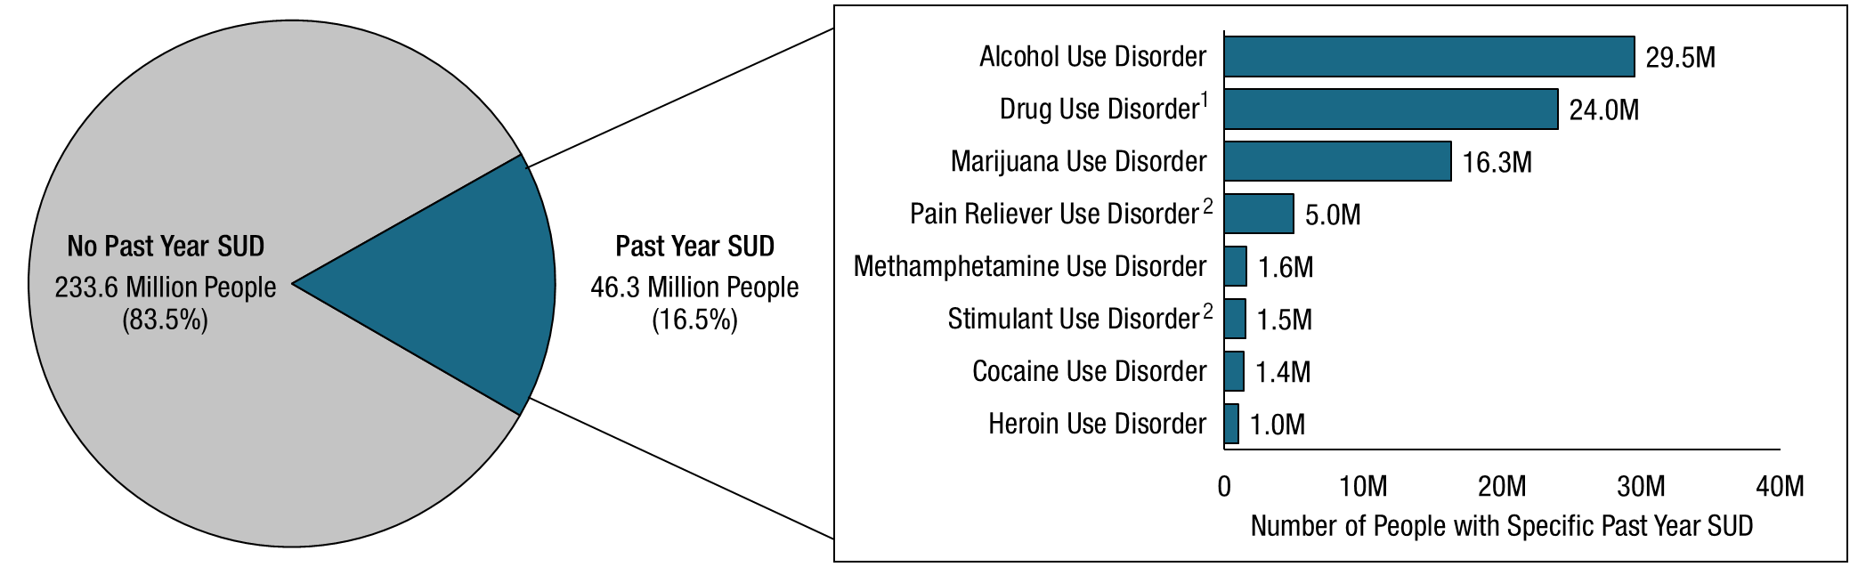
Past Year Substance Use Disorder (SUD): Among People Aged 12 or Older; 2021
FFR1.31
Note: The estimated numbers of people with substance use disorders are not mutually exclusive because people could have use disorders for more than one substance.
¹ Includes data from all past year users of marijuana, cocaine, heroin, hallucinogens, inhalants, methamphetamine, and prescription psychotherapeutic drugs (i.e., pain relievers, tranquilizers, stimulants, or sedatives).
² Includes data from all past year users of the specific prescription drug.
Notes:
MJ dwarfs opioid and stimulant USD combined!
CUD 2020 = 14.2M

Slide 21
ADDICTION
1 in 5 risk of CUD in all users
Risk increase if initiated early and used frequently: 22-44% (avg 33%)
26% of pregnant users
Janni Leung, et al. What is the prevalence and risk of cannabis use disorders among people who use cannabis? a systematic review and meta-analysis, Addictive Behaviors, Volume 109, 2020,106479
Ko JY﻿, et.al﻿. Prevalence and patterns of marijuana use among pregnant and nonpregnant women of reproductive age. ﻿ Am J Obstet Gynecol. 2015;213(2):201.e1-201.e10
Notes:
Background and Aims
We aim to quantify the prevalence and risk of having a cannabis use disorder (CUD), cannabis abuse (CA) or cannabis dependence (CD) among people in the general population who have used cannabis.
Method
We conducted a systematic review of epidemiological cross-sectional and longitudinal studies on the prevalence and risks of CUDs among cannabis users. We identified studies published between 2009 and 2019 through PubMed, the Global Burden Disease (GBD) Database, and supplementary searches up to 2020. The outcomes of interest were CUDs based on DSM or ICD criteria. Estimates were synthesized using random-effects meta-analyses, followed by meta-regression of study characteristics on effect sizes.
Results
From 1383 records identified, 21 studies were included. Meta-analyses showed that among people who used cannabis, 22% (18–26%) have CUD, 13% (8–18%) have CA, and 13% (10–15%) have CD. Estimates from cohort studies, showed that the risk of developing CD increased to 33% (22–44%) among young people who engaged in regular (weekly or daily) use of cannabis. There was a lack of data from cohort studies to estimate the risk of CUD or CA among regular cannabis users.
Conclusions
Cannabis users need to be informed about the risks of developing CUDs and the higher risks among those who initiate early and use frequently during adolescence. Future studies are needed to examine how changes in cannabis policies may affect the risks of CUDs in the population.

Slide 22
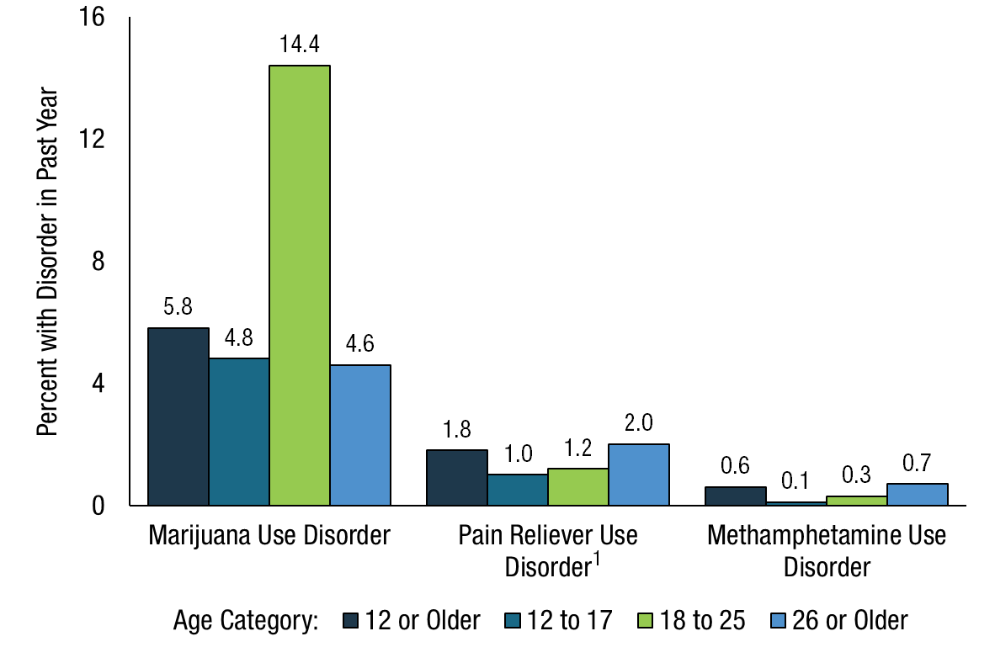
Marijuana Use Disorder, Pain Reliever Use Disorder, and Methamphetamine Use Disorder in the Past Year: Among People Aged 12 or Older; 2021
FFR1.35
¹ Includes data from all past year users of prescription pain relievers.
Notes:
Jonathan Haidt, Social Psychologist, Gen Z is most vulnerable demographic

Slide 23
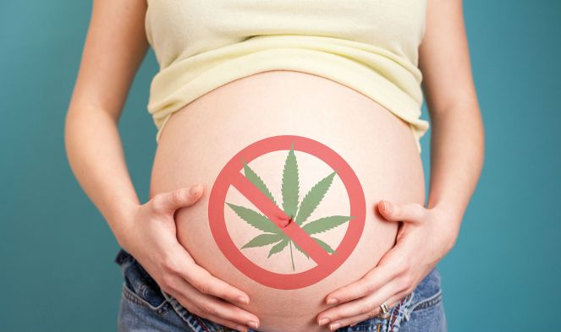
PREGNANCY
US Surgeon General issued advisory
CDC: 16% of pregnant women use illicit drugs
  MJ most common: 7%
Use for nausea, pain, insomnia, stress
THC is excreted in breast milk
~70% of dispensaries recommended
Dickson B1, Mansfield C, Guiahi M, et al. Recommendations From Cannabis Dispensaries About First-Trimester Cannabis Use. Obstet Gynecol. 2018;131:1031-1038.
Azofeifa A, Mattson ME, Schauer G, et al. National Estimates of Marijuana Use and Related Indicators - National Survey on Drug Use and Health, United States, 2002-2014. MMWR Surveill Summ. 2016;65:1-28. www.cdc.gov/mmwr/volumes/65/ss/ss6511a1.htm
Lo JO, Hedges JC, Metz TD. Cannabis Use and Perinatal Health Research. JAMA. Published online August 17, 2023.
Notes:
Medical dispensaries more likely to recommend (83%) than retail (60%)
Increase adiposity and impaired glucose metabolism in offspring.
ABCD is the largest long-term study of brain development and child health in the US.
Symptoms of psychopathology in children (ie, psychotic-like experiences [PLEs] and internalizing, externalizing, attention, thought, and social problems)
Paul SE. Associations Between Prenatal Cannabis Exposure and Childhood Outcomes: Results From the ABCD Study. JAMA Psychiatry. 2021 Jan 1;78(1):64-76. doi: 10.1001/jamapsychiatry.2020.2902. PMID: 32965490; PMCID: PMC7512132.
IMPORTANCE In light of increasing cannabis use among pregnant women, the US Surgeon
General recently issued an advisory against the use of marijuana during pregnancy.
OBJECTIVE To evaluate whether cannabis use during pregnancy is associated with adverse
outcomes among offspring.
DESIGN, SETTING, AND PARTICIPANTS In this cross-sectional study, datawere obtained from
the baseline session of the ongoing longitudinal Adolescent Brain and Cognitive Development
Study, which recruited 11 875 children aged 9 to 11 years, as well as a parent or caregiver, from
22 sites across the United States between June 1, 2016, and October 15, 2018.
EXPOSURE Prenatal cannabis exposure prior to and after maternal knowledge of pregnancy.
MAIN OUTCOMES AND MEASURES Symptoms of psychopathology in children (ie, psychotic-like
experiences [PLEs] and internalizing, externalizing, attention, thought, and social problems),
cognition, sleep, birth weight, gestational age at birth, body mass index, and brain structure
(ie, total intracranial volume, white matter volume, and gray matter volume). Covariates
included familial (eg, income and familial psychopathology), pregnancy (eg, prenatal
exposure to alcohol and tobacco), and child (eg, substance use) variables.
RESULTS Among 11 489 children (5997 boys [52.2%]; mean [SD] age, 9.9 [0.6] years) with
nonmissing prenatal cannabis exposure data, 655 (5.7%) were exposed to cannabis
prenatally. Relative to no exposure, cannabis exposure only before (413 [3.6%]) and after
(242 [2.1%]) maternal knowledge of pregnancy were associated with greater offspring
psychopathology characteristics (ie, PLEs and internalizing, externalizing, attention, thought
and, social problems), sleep problems, and body mass index, as well as lower cognition and
gray matter volume (all |β| > 0.02; all false discovery rate [FDR]–corrected P < .03). Only
exposure after knowledge of pregnancy was associated with lower birth weight as well as
total intracranial volume and white matter volumes relative to no exposure and exposure
only before knowledge (all |β| > 0.02; all FDR-corrected P < .04). When including potentially
confounding covariates, exposure after maternal knowledge of pregnancy remained
associated with greater PLEs and externalizing, attention, thought, and social problems
(all β > 0.02; FDR-corrected P < .02). Exposure only prior to maternal knowledge of
pregnancy did not differ from no exposure on any outcomes when considering potentially
confounding variables (all |β| < 0.02; FDR-corrected P > .70).
CONCLUSIONS AND RELEVANCE This study suggests that prenatal cannabis exposure and
its correlated factors are associated with greater risk for psychopathology during middle
childhood. Cannabis use during pregnancy should be discouraged.
JAMA Psychiatry. doi:10.1001/jamapsychiatry.2020.2902
Published online September 23, 2020.
Canada Birth registry (n=508,025)
Incidence of ASD
2.2% exposed
1.4% unexposed
Hazard ratio: 1.51 (controlled for confounders)
Incidence of intellectual disability and learning disorders higher, but less statistically robust
Likely underreporting of use
With significant findings seen in a large unexposed group and small exposed group, therefore, likely underestimates the potential risk

Slide 24
Cannabinoid Hyperemesis Syndrome
Intense and persistent (e.g. 5/hour) episodes of nausea, vomiting, dehydration and abdominal pain
Often take hot showers for relief for hours
1/3 of regular MJ smokers use hot shower/bath to relieve nausea and/or vomiting
~2.1 – 3.3 million in US annually
Up to 6% of ED visits for recurrent vomiting
  In CO, visits to ED for cyclic vomiting doubled after legalization
Discontinuing is only cure
Chocron Y, Zuber J, Vaucher J. Cannabinoid hyperemesis syndrome BMJ 2019; 366 :l4336
Notes:
Galli, J.A., Sawaya, R.A., Friedenberg, F.K. Cannabinoid Hyperemesis Syndrome. Curr Drug Abuse Rev. 2011 Dec; 4(4): 241–249.
What are the symptoms of CHS?
The primary symptoms of CHS are intense and persistent nausea and vomiting. People with this condition vomit extensively, often without warning, and can vomit up to five times per hour. They may also experience diffused abdominal pain, often report weight loss, and appear dehydrated.
People with CHS self-learn to take hot showers, which helps reduce or curb some nausea they experience. Many people with CHS will compulsively shower or bathe — often for hours every day — to relieve cannabis hyperemesis syndrome symptoms.
There are three phases of cannabis hyperemesis syndrome. Slightly different symptoms occur in each stage:
Prodromal phase: This phase is most common in adults who have used cannabis since they were teenagers. You may have abdominal pain or morning nausea. You may also fear throwing up but never actually vomit.
Hyperemetic phase: Usually lasting 24 to 48 hours, people in this phase have overwhelming, recurrent vomiting and nausea. You may start compulsively bathing, and avoid certain foods or purposefully restrict your food intake.
Recovery phase: During recovery, people stop using cannabis (even in small amounts). When you are in the recovery phase, symptoms lessen over a few days or months. Eventually, they completely disappear.
What causes cannabis hyperemesis syndrome?
Experts don’t know exactly what causes cannabis hyperemesis syndrome. Some researchers suspect genetics may play a role. Others believe CHS may occur due to overstimulation of your endocannabinoid system (ECS). The ECS is a network of receptors in your body that respond to compounds in cannabis.
How common is it?
Evidence from a US retrospective study including 1571 patients showed that CHS affects up to 6% of patients consulting for recurrent vomiting in emergency departments.3 Moreover, among regular cannabis smokers, about one third of them reports hot showers or baths as a means to relieve nausea and/or vomiting.10 Extrapolating those results to the population of the United States, it is estimated that 2.1-3.3 million people might suffer from CHS annually.10 In Colorado, which legalised cannabis in 2009, visits to emergency departments for cyclic vomiting doubled after legalisation.11 An estimated 182 million people worldwide were cannabis consumers in 2013, increasing to 192 million in 2016,1213 therefore CHS may represent an important diagnosis to consider in any patient consulting for recurrent vomiting.

Slide 25
Impact of Prenatal CUD on Perinatal Outcomes
N= 9144 births in CA identified as using MJ during pregnancy
Increased maternal risk
  Gestational Hypertension
  Preeclampsia
  Preterm delivery
  Severe maternal morbidity
Increased baby risk
  Respiratory distress syndrome
  Small for gestational age
  Neonatal ICU
  Infant death
Conclusions: “Our study suggests that prenatal cannabis use disorder is associated with increased maternal and neonatal morbidity and mortality. As cannabis use disorder in pregnancy is becoming more prevalent, our findings can help guide preconception and prenatal counseling.”
Prewitt KC, Hayer S, Garg B, Benson AE, Hedges MA, Caughey AB, Lo JO. Impact of Prenatal Cannabis Use Disorder on Perinatal Outcomes. J Addict Med. 2023 May-Jun 01;17(3):e192-e198
Notes:
Abstract
Objectives: With legislative changes to cannabis legalization and increasing prevalence of use, cannabis is the most commonly used federally illicit drug in pregnancy. Our study aims to assess the perinatal outcomes associated with prenatal cannabis use disorder.
Methods: We conducted a retrospective cohort study using California linked hospital discharge-vital statistics data and included singleton, nonanomalous births occurring between 23 and 42 weeks of gestational age. χ 2 Test and multivariable logistic regression were used for statistical analyses.
Results: A total of 2,380,446 patients were included, and 9144 (0.38%) were identified as using cannabis during pregnancy. There was a significantly increased risk for adverse birthing person outcomes, including gestational hypertension (adjusted odds ratio [AOR], 1.19; 95% confidence interval [CI], 1.06-1.34; P = 0.004), preeclampsia (AOR, 1.16; 95% CI, 1.0-1.28; P = 0.006), preterm delivery (AOR, 1.45; 95% CI, 1.35-1.55; P < 0.001), and severe maternal morbidity (AOR, 1.22; 95% CI, 1.02-1.47; P = 0.033). Prenatal cannabis use disorder was also associated with an increased risk of neonatal outcomes including respiratory distress syndrome (AOR, 1.16; 95% CI, 1.07-1.27; P < 0.001), small for gestational age (AOR, 1.47; 95% CI, 1.38-1.56; P < 0.001), neonatal intensive care unit admission (AOR, 1.24; 95% CI, 1.16-1.33; P < 0.001), and infant death (AOR, 1.86; 95% CI, 1.44-2.41; P < 0.001). There was no statistically significant difference in stillbirth (AOR, 0.96; 95% CI, 0.69-1.34; P = 0.80) and hypoglycemia (AOR, 1.22; 95% CI, 1.00-1.49; P = 0.045).
Conclusions: Our study suggests that prenatal cannabis use disorder is associated with increased maternal and neonatal morbidity and mortality. As cannabis use disorder in pregnancy is becoming more prevalent, our findings can help guide preconception and prenatal counseling.

Slide 26
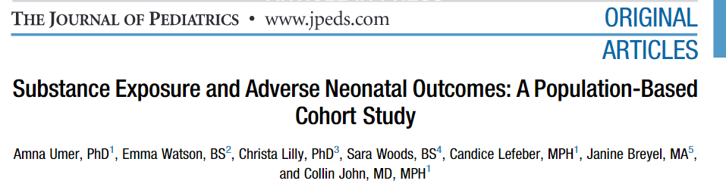
~1 in 8 WV births had exposure to substances (>4000 newborns 2020-2022)
10X higher than nation
Prevalence:
  Cannabis – 7.9%
  Opioids – 4.4%
  Stimulants – 2.1%
Cannabis = low birthweight and small for gestational age
70% increase in preterm birth with MJ + Stimulants (40% stimulants only)
Decreases placental blood flow, inhibits neurotransmitters and contributes to malnutrition
Anticipate neurodevelopmental and cognitive delays later in life
Amna Umer, Substance Exposure and Adverse Neonatal Outcomes: A Population-Based Cohort Study,The Journal of Pediatrics, Dec.2022
Notes:
Amna Umer, Substance Exposure and Adverse Neonatal Outcomes: A Population-Based Cohort Study,The Journal of Pediatrics,2022
Nearly one in eight infants born in West Virginia between 2020 and 2022 had in utero exposure to opioids, stimulants and/or cannabis, according to researchers at West Virginia University Health Sciences.
Amna Umer, a pediatric research associate professor in the School of Medicine, said her team’s new study showed West Virginia’s rates of prenatal exposure to opioids and stimulants were 10 times higher than national rates.
To estimate the effects of in utero exposure to substances, the study used data from Project WATCH, a state-mandated surveillance tool funded by the West Virginia Department of Health and Human Resources, which captures maternal and infant information on about 99% of all births in the state to identify at-risk infants.
Umer’s analysis of the WATCH data demonstrated that of the 34,412 live births of “singleton” babies, excluding twins, triplets or other multiples, that took place in West Virginia over the two-year span, 12.2% of newborns had in utero exposure to drugs such as oxycodone, methamphetamine or marijuana.
Umer said the most prevalent substance exposure was cannabis, with 7.9% of infants exposed to it in utero. Exposure to opioids occurred for 4.4% of the infants, and 2.1% had been exposed to stimulants while in the womb.
Slightly over 10% of the infants were exposed in utero to one of those substances, 1.7% had been exposed to two of the substances and 0.3% of infants had been exposed to all three.
The Journal of Pediatrics published Umer’s findings in a paper coauthored with Christa Lilly, associate professor at the School of Public Health; and experts from the School of Medicine: Candice Lefeber, project coordinator in the Department of Pediatrics, Collin John, associate professor and assistant program director for the divisions of internal medicine and pediatrics, and Janine Breyel from the West Virginia Perinatal Partnership.
“We showed substance exposure to stimulants alone was associated with preterm birth, whereas opioids alone and cannabis alone were associated with low birthweight and infants being small for their gestational age,” Umer said. “Infants exposed to both opioids and cannabis had greater risk than from either exposure individually.”
The study data showed a 40% increased risk of preterm birth among infants exposed to stimulants alone and a 70% increase with concurrent stimulant and cannabis exposures.
The risk of infants being small for their gestational age almost doubled with concurrent exposures to opioids and cannabis, and the mean birth weight of infants exposed to these substances fell by between 200 and 500 grams.
Use of neuroactive substances by pregnant women in the U.S., including the use of multiple different substances concurrently, increased from 5.8% in 2019 to 8.3% in 2020. Those substances can decrease placental blood flow, inhibit a fetus’ neurotransmitters and contribute to malnutrition.
That means more small, preterm babies, which in turn can mean neurodevelopmental and cognitive delays in later life, in addition to cardiovascular problems.
Umer emphasized that maternal substance use isn’t the only factor contributing to those adverse outcomes.
“Our results suggest a complex interplay between sociodemographic factors and lifestyle circumstances,” she said. “Substance use disorders can contribute to adverse neonatal outcomes, and so can many other factors we examined in the study, such as maternal age, race, being less educated, being insured through Medicaid which indicates a low income, not having been previously pregnant, inadequate prenatal care and, importantly, maternal smoking.
“One in five women in the study smoked during pregnancy, and 64.2% of the infants exposed to in utero substances were also exposed to maternal smoking.
“Then there are important factors that Project WATCH doesn’t capture, like the mother’s pre-pregnancy body mass index or whether she is a victim of physical abuse. The tool doesn’t track prenatal alcohol exposure either, although our previous work shows West Virginia’s rural population has a high prevalence of prenatal alcohol exposure.”
Umer focuses on neonatal health in West Virginia because rural communities experience significantly higher rates of substance use disorder in both the general and pregnant populations while bearing disproportionate socioeconomic burdens such as low incomes and high unemployment.
Umer’s research may not apply in places that also struggle with high rates of substance use but are more racially diverse and densely populated than West Virginia. However, Umer said her findings can be generalized to other predominantly rural and underserved populations with similar socioeconomic vulnerabilities and, consequently, similarly high rates of substance use disorder.
“Early identification and intervention reduce adverse outcomes of prenatal substance use like preterm birth and low birthweight, but stigma, shame and fear of legal ramifications deter women from seeking any or limited prenatal care,” Umer said. “During the two years of this study, more than 4,000 newborns were exposed to substances in utero. There is a critical need to address this crisis for the most vulnerable population in the state.”

Slide 27
PREGNANCY
Adolescent Brain Cognitive Development Study (ABCD)
  ~11,000 children 9-11y and follow into adulthood
  MJ exposure after maternal knowledge had greater psychopathology during middle childhood, even after controlling for confounders
Canadian Birth Registry
  ~500,000 births
  Greater risk of Autism Spectrum Disorder
  Hazard ratio: 1.51 (controlled for confounders)
  Relied on self-report, likely risk is under-estimated
Paul SE. Associations Between Prenatal Cannabis Exposure and Childhood Outcomes: Results From the ABCD Study. JAMA Psychiatry. 2021 Jan 1;78(1):64-76
Corsi DJ, Donelle J, Sucha E, Hawken S, Hsu H, El-Chaâr D, Bisnaire L, Fell D, Wen SW, Walker M. Maternal cannabis use in pregnancy and child neurodevelopmental outcomes. Nat Med. 2020 Oct;26(10):1536-1540

Slide 28
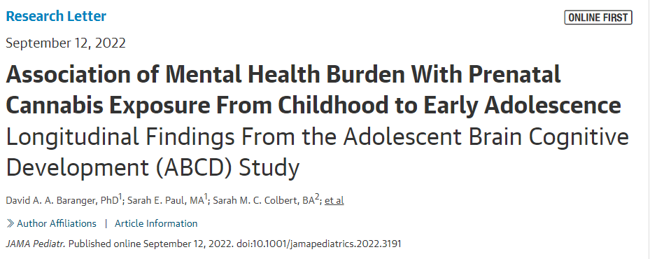
Adds longitudinal data to the baseline 2021 report
Persisting vulnerability as children progress through early adolescence
Increased psychopathology may lead to greater risk of psych d/o and substance use
“Evidence that the impact of PCE on psychopathology does not ameliorate as children enter adolescence further cautions against cannabis use during pregnancy.”
Notes:
PCE is associated with persisting vulnerability to broad-spectrum psychopathology as children progress through early adolescence. Increased psychopathology may lead to greater risk for psychiatric disorders and problematic substance use as children enter peak periods of vulnerability in later adolescence.⁵ Larger associations in the BAK-PCE group may be attributable to the timing of cannabinoid receptor neural expression, which onsets in rodents at the equivalent of 5 to 6 weeks.⁶ Limitations include the small sample of prenatal cannabis-exposed offspring, potential underreporting of use during pregnancy, imprecise data on the timing/frequency/potency of cannabis exposure, and the lack of data on some potential confounders (eg, maternal stress during pregnancy). Evidence that the impact of PCE on psychopathology does not ameliorate as children enter adolescence further cautions against cannabis use during pregnancy.

Slide 29

EPIGENTICS
THC alters placental genes and fetal DNA methylation of autism gene
Suppression of immune gene networks
Risk of anxiety in early childhood
Shorey-Kendrick LE﻿, et al. Prenatal delta-9-tetrahydrocannabinol exposure is associated with changes in rhesus macaque DNA methylation enriched for autism genes. ﻿ Clin Epigenetics. 2023;15(1):104.
Rompala G﻿, Nomura Y﻿, Hurd YL﻿. Maternal cannabis use is associated with suppression of immune gene networks in placenta and increased anxiety phenotypes in offspring. ﻿ Proc Natl Acad Sci U S A. 2021;118(47):e2106115118.
Notes:
Results
We designed this study to determine whether the use of edible cannabis during pregnancy is deleterious to the fetal and placental epigenome. Pregnant rhesus macaques consumed a daily edible containing either delta-9-tetrahydrocannabinol (THC) (2.5 mg/7 kg/day) or placebo. DNA methylation was measured in 5 tissues collected at cesarean delivery (placenta, lung, cerebellum, prefrontal cortex, and right ventricle of the heart) using the Illumina MethylationEPIC platform and filtering for probes previously validated in rhesus macaque. In utero exposure to THC was associated with differential methylation at 581 CpGs, with 573 (98%) identified in placenta. Loci differentially methylated with THC were enriched for candidate autism spectrum disorder (ASD) genes from the Simons Foundation Autism Research Initiative (SFARI) database in all tissues. The placenta demonstrated greatest SFARI gene enrichment, including genes differentially methylated in placentas from a prospective ASD study.
Conclusions
Overall, our findings reveal that prenatal THC exposure alters placental and fetal DNA methylation at genes involved in neurobehavioral development that may influence longer-term offspring outcomes. The data from this study add to the limited existing literature to help guide patient counseling and public health polices focused on prenatal cannabis use in the future.

Slide 30

WHAT ABOUT THE GUY!
Lower sperm count and abnormal sperm morphology, mobility and viability
Compared to nonusers, males using more than 1/wk increased the Hazard Ratio of spontaneous abortion by 2.0
Chandy M, Nishiga M, Wei TT, Hamburg NM, Nadeau K, Wu JC. Adverse Impact of Cannabis on Human Health. Annu Rev Med. 2023 Aug 15.
Payne KS, Mazur DJ, Hotaling JM, Pastuszak AW. 2019. Cannabis and male fertility: a systematic review.
J. Urol. 202:674–81
Harlow AF,Wesselink AK, Hatch EE, et al. 2021. Male preconception marijuana use and spontaneous
abortion: a prospective cohort study. Epidemiology 32:239–47
Notes:
Male preconception use associated

Slide 31
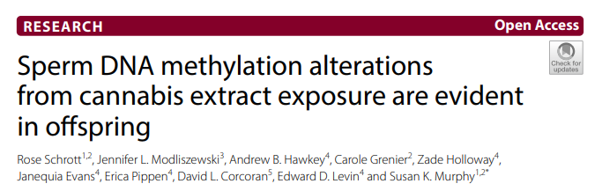
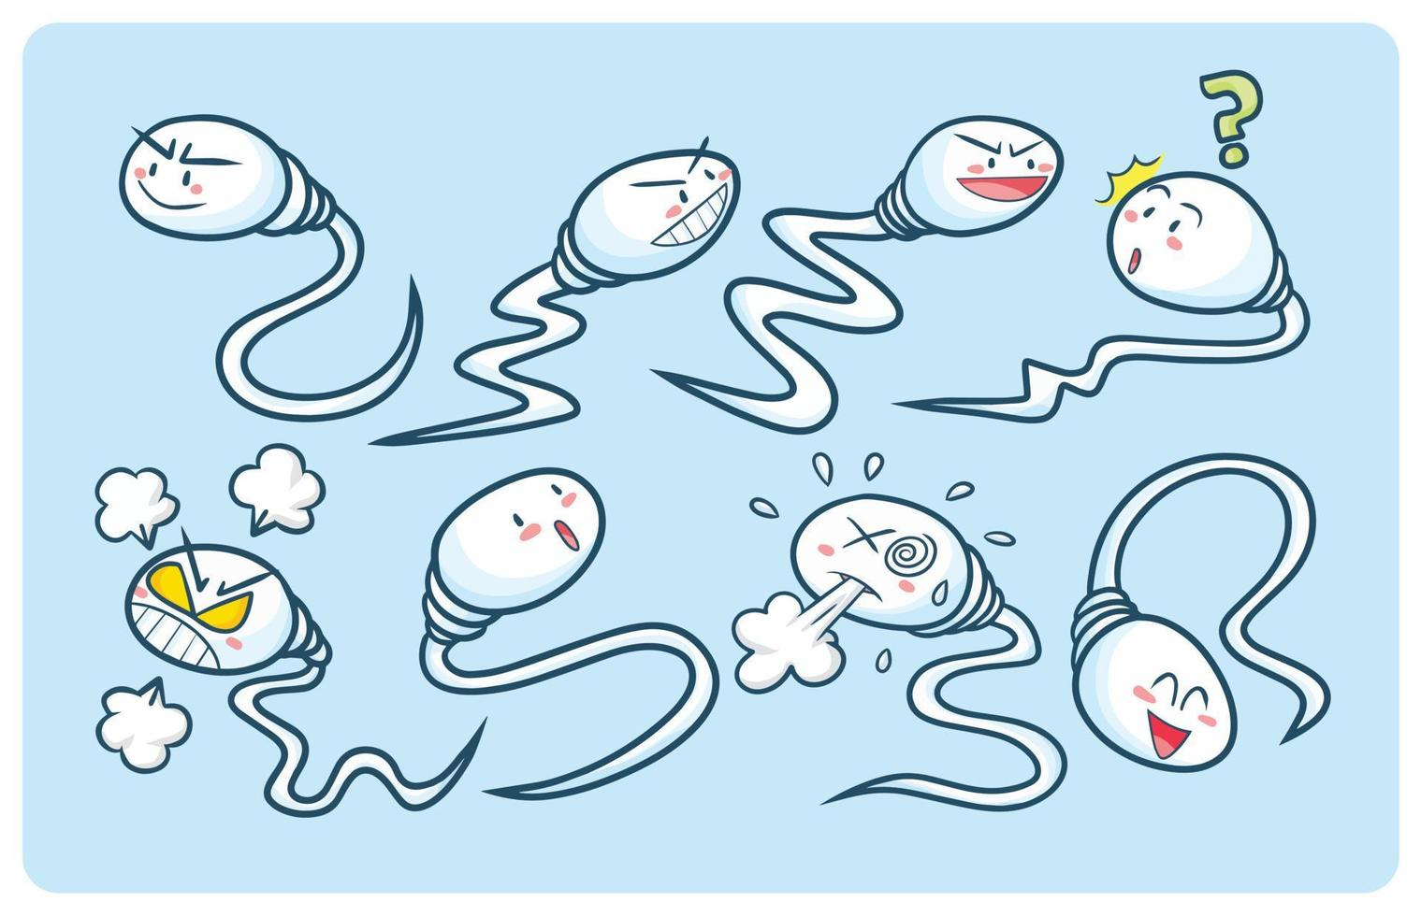
Schrott et al. Epigenetics & Chromatin (2022) 15:33
Changes were heritable in sperm and brain areas involved in development
Genes in hippocampus and NA
Cardiomegaly
As cannabis legalization expands and consumption increases, it is imperative that we improve understanding of how exposure in one generation can shape health and disease of future generations.”
Notes:
Taken together, these results demonstrate that paternal preconception exposure to cannabis affects intergenerational outcomes
A separate review article: Exposure to drugs of abuse induce effects that persist across generations
Baratta AM, Rathod RS, Plasil SL, Seth A, Homanics GE. Exposure to drugs of abuse induce effects that persist across generations. Int Rev Neurobiol. 2021;156:217-277.

Slide 32
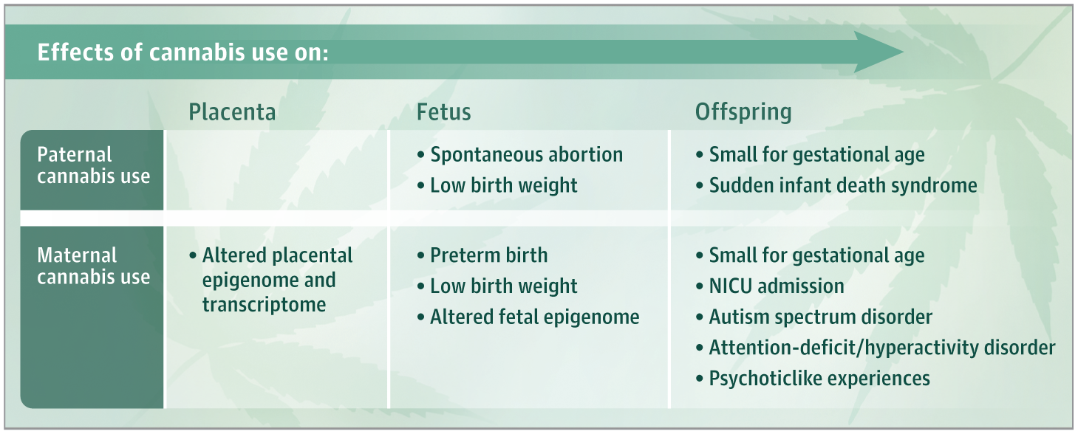
Lo JO, Hedges JC, Metz TD. Cannabis Use and Perinatal Health Research. JAMA. Published online August 17, 2023.
Notes:
Viewpoint
August 17, 2023
Cannabis Use and Perinatal Health Research
Jamie O. Lo, MD, MCR^{1,2}; Jason C. Hedges, MD, PhD^{1,2}; Torri D. Metz, MD, MS³
Author Affiliations Article Information
JAMA. Published online August 17, 2023. doi:10.1001/jama.2023.14697
related articles icon RelatedArticles
During the past 2 decades, while the use of alcohol and nicotine products in pregnancy has decreased, the potency of cannabis and prevalence of prenatal cannabis use have increased substantially, in part due to changing legalization patterns leading to greater availability and perceived safety.¹ Currently, 38 states and Washington, DC, have legalized medical cannabis and 23 states and Washington, DC, have legalized recreational cannabis.
Cannabis is now the most commonly used federally illegal drug in pregnancy, with an incidence of 7% among pregnant individuals in 2017, an increase from 3.4% in 2002. More recently, significantly increased rates of use by pregnant individuals have been reported, coinciding with the COVID-19 pandemic, with a prevalence of use up to 25% in some areas such as northern California. Prior studies report cannabis use rates as high as 30% in certain populations.¹ Perhaps more concerning, data from the National Survey on Drug Use and Health from 2007 to 2012 were notable for an 18.1% prevalence of cannabis use disorder among past-year pregnant cannabis users, with more recent studies reporting a prevalence of cannabis use disorders among pregnant individuals as high as 26.1%.²
Many individuals use cannabis to alleviate symptoms of nausea, insomnia, pain, and stress during pregnancy.³ Studies have shown that clinicians are not consistently counseling patients regarding cannabis use in pregnancy, in part because they are not comfortable with counseling on risks due to the limited and mixed available evidence.³ Despite research advances and changes in public health practices, there remains a significant gap in knowledge regarding the effects of cannabis use and perinatal health outcomes. The existing human literature is often limited by confounding, including from polysubstance use such as nicotine co-use, ascertainment of use through patient self-report, and inability to determine timing, dose, and frequency of cannabis use. Preclinical studies have uncovered potential underlying mechanisms for the observed adverse outcomes but have not always recapitulated typical human use (both mode of delivery and dose), thus reducing the translational strength of the findings.
There have been emerging data, including from the ongoing longitudinal Adolescent Brain and Cognitive Development study,⁴ suggesting that in utero cannabis exposure is linked to adverse outcomes among offspring, including small for gestational age, neonatal intensive care unit admissions, and preterm birth³ (Figure). In addition, prenatal cannabis exposure has also been associated with childhood outcomes such as autism spectrum disorder and attention-deficit/hyperactivity disorder, as well as symptoms of psychopathology, including psychoticlike experiences, internalizing, externalizing, attention problems, and thought and social problems.^{3,4} Maternal cannabis use disorder has also been linked to a greater risk of small for gestational age, preterm birth, low birth weight, and death within 1 year of birth.³
Recent findings of preclinical and human studies suggest that prenatal Δ⁹-tetrahydrocannabinol (THC, the main psychoactive component of cannabis) can affect the placental transcriptome and the placental and fetal epigenome^{5,6} (Figure). Rompala et al⁶ reported that maternal cannabis use was associated with changes in the placental transcriptome as a mediator of risk for anxiety-related problems in early childhood. In the nonhuman primate, Δ⁹-THC–induced changes in placental and fetal DNA methylation were in genes involved in neurodevelopment and autism spectrum disorder, which provides a potential underlying mechanism for reported altered gene expression and offspring neurobehavioral abnormalities observed with maternal cannabis use in pregnancy in the literature.⁵ This work highlights the need for additional mechanistic studies that can also inform the development of targeted therapeutics for individuals unable to abstain from cannabis use during pregnancy.
There are recent data showing that paternal cannabis use preconception may also adversely affect reproductive health and offspring outcomes, including lower infant birth weight, higher risk of spontaneous abortion, and sudden infant death syndrome³ (Figure). In addition, paternal cannabis exposure in humans, nonhuman primates, and rats is associated with altered sperm DNA methylation at genes involved in neurodevelopment and autism spectrum disorder, with the potential for transmissibility to future offspring.^{3,7} Although most of the existing literature focuses on the effects of maternal cannabis use, these findings highlight the urgent need to better understand contributions of paternal cannabis use preconception and during pregnancy.
Future research is also needed to study the impact of other emerging cannabinoid products on prenatal and offspring outcomes. Although Δ⁹-THC remains federally illegal, there are other analogues of THC, Δ⁸-THC and Δ¹⁰-THC, that are legal at the federal level yet not regulated by the Food and Drug Administration. They are molecularly different from Δ⁹-THC owing to the location of the double-bonded carbon chain and can still have psychoactive and intoxicating effects, including difficulty concentrating, short-term memory loss, and an altered sense of time. There also continue to be synthetic cannabinoids on the market that are similar to chemicals in the cannabis plant, but with more unpredictable and potentially life-threatening mind-altering effects, and an unknown effect on perinatal outcomes.
Unlike tobacco or alcohol use in pregnancy, because of the current lack of definitive evidence of harm with use, public health efforts to caution against use of cannabis while pregnant are lagging. As the evidence of deleterious effects from prenatal cannabis use continues to accumulate, physicians and researchers in reproductive health have a responsibility to mitigate adverse health outcomes from perinatal cannabis use. Fulfilling this responsibility requires actionable evidence from high-quality research to guide health care clinician counseling, inform developmental screening strategies for exposed offspring, direct health policies, and garner public awareness.
Back to topArticle Information
Corresponding Author: Jamie O. Lo, MD, MCR, Department of Obstetrics and Gynecology, Oregon Health & Science University, 3181 SW Sam Jackson Park Rd, Mail Code L458, Portland, OR 97239 (loj@ohsu.edu).
Published Online: August 17, 2023. doi:10.1001/jama.2023.14697
Conflict of Interest Disclosures: None reported.
References
1.Volkow ND﻿, Han B﻿, Compton WM﻿, McCance-Katz EF﻿. Self-reported medical and nonmedical cannabis use among pregnant women in the United States. ﻿ JAMA. 2019;322(2):167-169. doi:10.1001/jama.2019.7982
ArticlePubMedGoogle ScholarCrossref
2.Ko JY﻿, Farr SL﻿, Tong VT﻿, Creanga AA﻿, Callaghan WM﻿. Prevalence and patterns of marijuana use among pregnant and nonpregnant women of reproductive age. ﻿ Am J Obstet Gynecol. 2015;213(2):201.e1-201.e10. doi:10.1016/j.ajog.2015.03.021PubMedGoogle ScholarCrossref
3.Lo JO﻿, Hedges JC﻿, Girardi G﻿. Impact of cannabinoids on pregnancy, reproductive health, and offspring outcomes. ﻿ Am J Obstet Gynecol. 2022;227(4):571-581. doi:10.1016/j.ajog.2022.05.056PubMedGoogle ScholarCrossref
4.Paul SE﻿, Hatoum AS﻿, Fine JD﻿, et al. Associations between prenatal cannabis exposure and childhood outcomes: results from the ABCD study. ﻿ JAMA Psychiatry. 2021;78(1):64-76. doi:10.1001/jamapsychiatry.2020.2902
ArticlePubMedGoogle ScholarCrossref
5.Shorey-Kendrick LE﻿, Roberts VHJ﻿, D’Mello RJ﻿, et al. Prenatal delta-9-tetrahydrocannabinol exposure is associated with changes in rhesus macaque DNA methylation enriched for autism genes. ﻿ Clin Epigenetics. 2023;15(1):104. doi:10.1186/s13148-023-01519-4PubMedGoogle ScholarCrossref
6.Rompala G﻿, Nomura Y﻿, Hurd YL﻿. Maternal cannabis use is associated with suppression of immune gene networks in placenta and increased anxiety phenotypes in offspring. ﻿ Proc Natl Acad Sci U S A. 2021;118(47):e2106115118. doi:10.1073/pnas.2106115118PubMedGoogle ScholarCrossref
7.Lo JO﻿, D’Mello RJ﻿, Watch L﻿, Schust DJ﻿, Murphy SK﻿. An epigenetic synopsis of parental substance use. ﻿ Epigenomics. 2023;15(7):453-473. doi:10.2217/epi-2023-0064PubMedGoogle ScholarCrossref

Slide 33
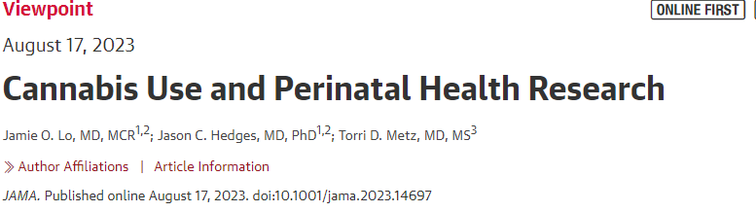
“As the evidence of deleterious effects from prenatal cannabis use continues to accumulate, physicians and researchers in reproductive health have a responsibility to mitigate adverse health outcomes from perinatal cannabis use. Fulfilling this responsibility requires actionable evidence from high-quality research to guide health care clinician counseling, inform developmental screening strategies for exposed offspring, direct health policies, and garner public awareness.”

Slide 34

WHAT CAN WE DO?
Have Compassion
  Understand patient’s perspective
Educate
  Peers, friends, legislators, media
Advocate for stricter regulations
  Potency caps, PDMP, Commercialization, pregnancy, youth
Study
  Efficacy/Harms, OD data, Suicide, ED, Hospitalizations, MVA
Screen
  Ask and document: product/route/frequency/potency/age of onset

Slide 35
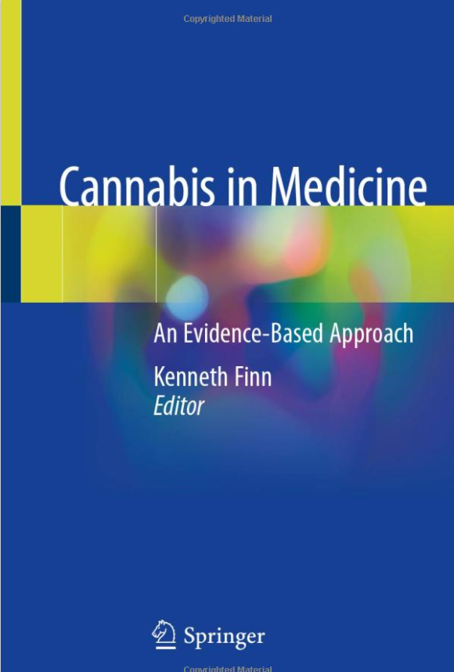
Resources/Thanks
International Academy on the Science and Impact of Cannabis (IASIC):https://iasic1.org/
Elizabeth Stuyt, MD
Keith Humphreys, PhD

Slide 36
