Slide 1

Health Consequences to Offspring due to Perinatal Exposure from Maternal Vaping during Pregnancy
Mark Olfert, PhD, FAHA, FAPS, RRT, CPFT
Director, Clinical & Translational Sciences PhD Program
West Virginia University School of Medicine
Center for Inhalation Toxicology
Division of Exercise Physiology / Dept. of Physiology, Pharmacology & Toxicology
West Virginia Clinical and Translational Science Institute (WVCTSI)

Slide 2
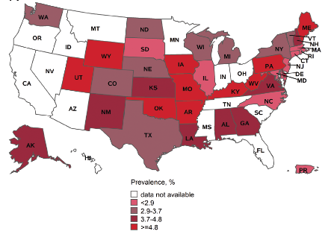
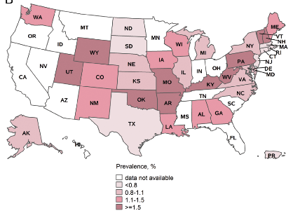
Prevalence of e-cigarette use in women
Before pregnancy
During pregnancy
Liu et al., Prevalence and Distribution of Electronic Cigarette Use Before and During Pregnancy Among Women in 38 States of the United States.
Nicotine & Tobacco Research, 2021, Vol. 23, No. 9
PRAMS = Pregnancy Risk Assessment Monitoring System 2016-2017

Slide 3

Maternal Smoking
2021 Rank: 1st
Note: 2021 data are preliminary. 2022 data are cumulative. Vaping data began collection in 2019. In 2019, 56.8% of vaping data is unknown.
Source: West Virginia Health Statistics Center, Vital Statistics System. August 2023.

Slide 4
Prevalence of e-cigarette use in women
Cigarette smoking is the strongest predictor of e-cigarette use
A quarter of women who used e-cigs before pregnancy continued to use e-cigs during pregnancy
Before pregnancy
During pregnancy
Liu et al., Prevalence and Distribution of Electronic Cigarette Use Before and During Pregnancy Among Women in 38 States of the United States.
Nicotine & Tobacco Research, 2021, Vol. 23, No. 9
PRAMS = Pregnancy Risk Assessment Monitoring System 2016-2017

Slide 5
Objectives
Understand the anatomy of electronic cigarettes and the e-liquid components used.
Describe the similarity that smoking and vaping has on blood vessel structure and function.
Describe the impact of maternal vaping during pregnancy on the vascular health of offspring in adolescent and adult life.

Slide 6
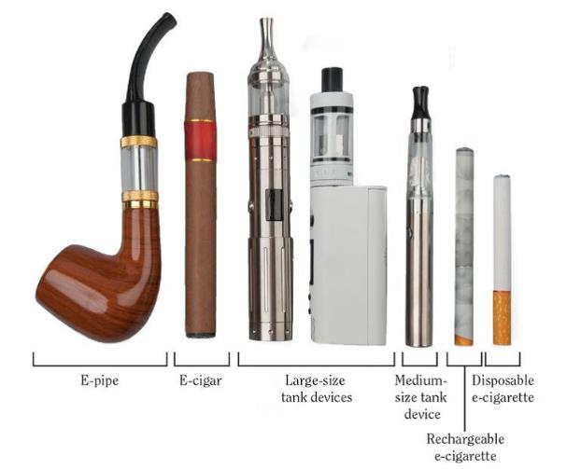
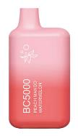
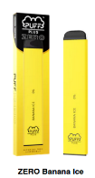
Electronic cigarettes (e-cigs)
Electronic Nicotine Delivery system (ENDs)
Elf bar
Pod-style
(JUUL)
Puff bar
https://e-cigarettes.surgeongeneral.gov/resources.html

Slide 7
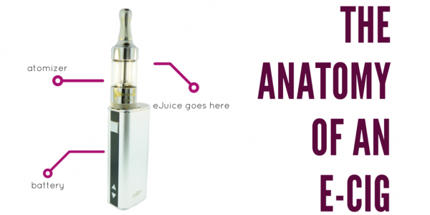
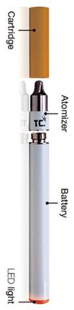
Anatomy of Electronic Cigarette
Anatomy of Electronic Cigarette
E-juice/liquid Cartridge
Atomizer
Battery
LED light

Slide 8
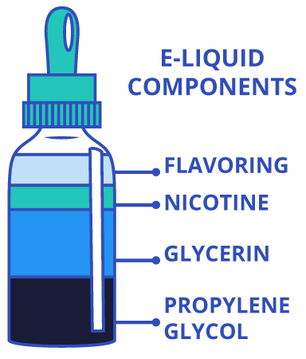
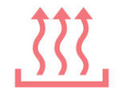
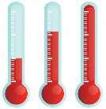
Anatomy of Electronic Cigarette
E-liquid
Diacetyl
2,3-pentanedione
Acetoin
Formaldehyde
Acetaldehyde
Acetone
Butanal
Acrolein
Benzaldehyde
Isovaleric aldehyde
m-Methylbenzaldehyde
(VG)
(PG)

Slide 9
Information about Vaping
Misleading Facts!
VG
PG
Nicotine
Flavors
4 ingredients and hundreds
of chemicals
Tobacco leaves
Paper
Nicotine
Flavors
4 ingredients and thousands of chemicals
Image source: https://veppocig.com/product_images/uploaded_images/is-vaping-worse-than-cigarettes-1024x1024.jpg

Slide 10
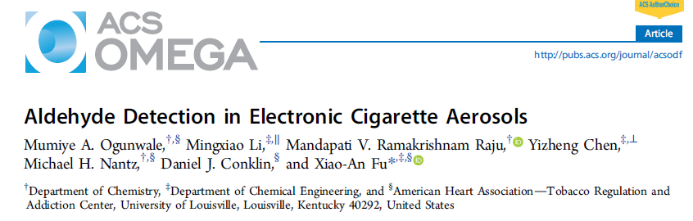
E-liquid aerosol
Red line =
traditional
cigarette
emission level
Adapted from Ogunwale et al. ACS Omega 2; 1207-1214, 2017

Slide 11
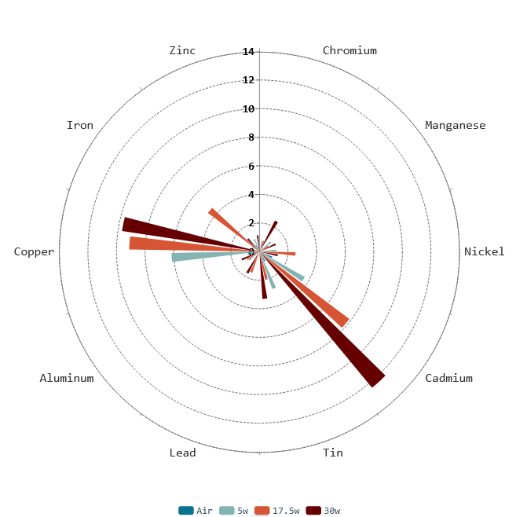
ICPMS Analysis
E-liquid aerosol – Heavy Metals
Shaded area =
OSHA Permissive Exposure Limit (PEL)
(Table Z-1)
Olfert, unpublished

Slide 12
Smoking vs. Vaping
If vaping is different than smoking,
we would expect that the blood vessels, tissues, and organs
would response differently to e-cig aerosol than cigarette smoke!
Acute exposure (10 puffs)
  Intravital (0-2 hours)
  Arterial myography (2-72 hrs)
Chronic exposure (4 weeks – 8 months)
  Artery Structure and Function
  Vascular reactivity (arterial myography)

Slide 13
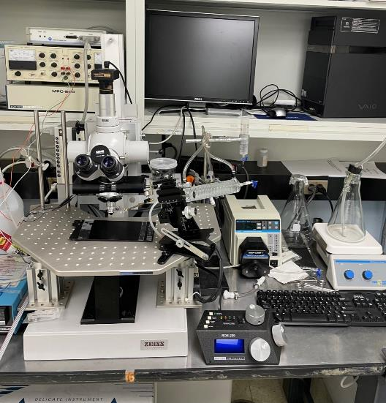
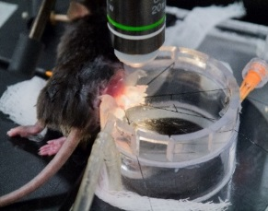

Intravital Microscopy

Slide 14
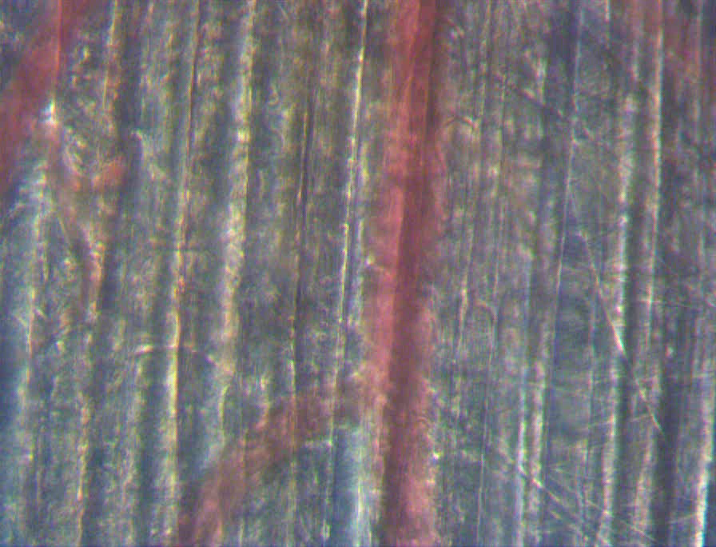
Intravital Microscopy
Intravital Microscopy
Notes:
5-24-18 pre.wmv file

Slide 15
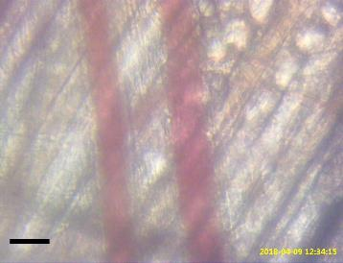
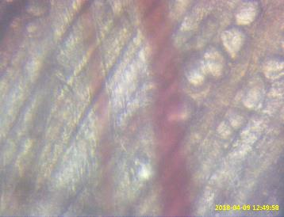
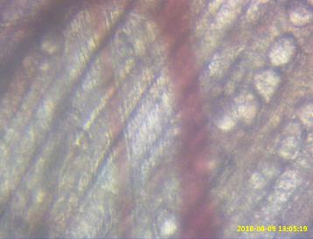
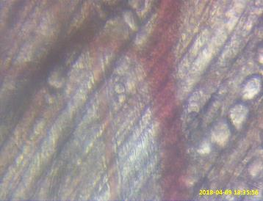
Intravital Microscopy
Baseline (Pre-exposure)
15 min Post Vape
arteriole
arteriole
vein
vein
50 um
50 um
30 min Post Vape
60 min Post Vape
arteriole
vein
arteriole
vein
50 um
50 um
Notes:
4-9-18 Pre exposure diameter ~31um

Slide 16


Intravital Microscopy
Intravital Microscopy
10 puffs/
5min
Puff = 5-second, 55-ml
Pitzer et al. IJMS Int. J. Mol. Sci. 2023, 24, 10208.

Slide 17

Intravital Microscopy
Intravital Microscopy
10 puffs/
5min
E-liquid = 50/50 VG:PG,
No flavor, 17.5 watts
Puff = 5-second, 55-ml
Pitzer et al. IJMS Int. J. Mol. Sci. 2023, 24, 10208.

Slide 18
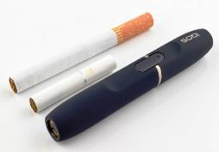
Intravital Microscopy
Intravital Microscopy
10 puffs/
5min
Puff = 5-second, 55-ml
Pitzer et al. IJMS Int. J. Mol. Sci. 2023, 24, 10208.

Slide 19
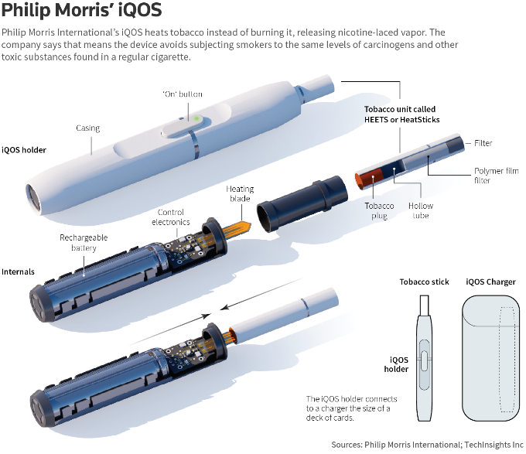
Heated Tobacco Product (HTP)

Slide 20
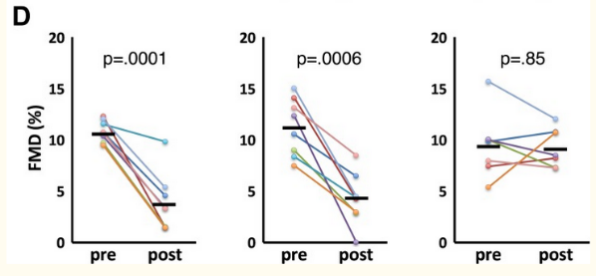
10 cycles of 5 s exposure +25 s break
Notes:
https://pubmed.ncbi.nlm.nih.gov/30206183/
Methods: We exposed anaesthetized rats (n=8/group) via nose cone to IQOS aerosol from single HeatSticks, mainstream smoke from single Marlboro Red cigarettes or clean air for a series of consecutive 30 s cycles over 1.5-5 min. Each cycle consisted of 15 or 5 s of exposure followed by removal from the nose cone. We measured pre-exposure and postexposure FMD, and postexposure serum nicotine and cotinine.

Slide 21
2016 Sep;150(3):606-12

Slide 22

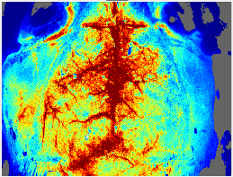
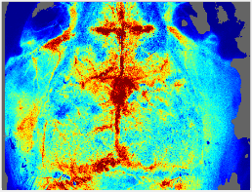
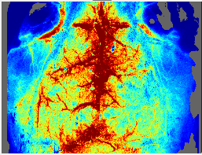
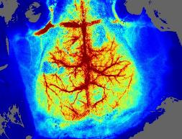
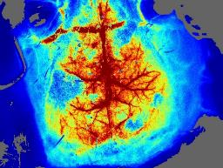
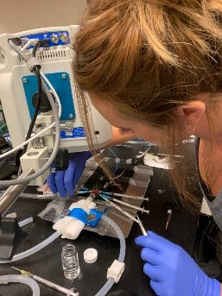
Laser Speckle Tracking
Baseline Post Vape (1 min) Post Vape (20 min)
1 Cigarette or E-cig (10 puffs / 5 min)
Moor Full Field Laser Perfusion Imager FLPI-2
C57BL/6 mice
Olfert, unpublished, 2019

Slide 23
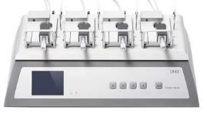
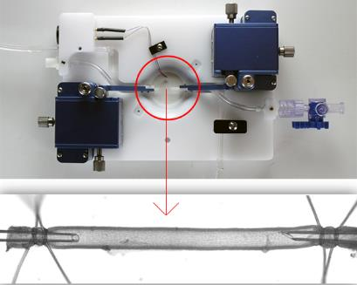

Arterial myography (arteriography)
Wire
measures tension
Pressure
measures vessel diameter
70 mmHg
Source: www.scintica.com/products/living-systems/pressure-arteriograph-systems/

Slide 24
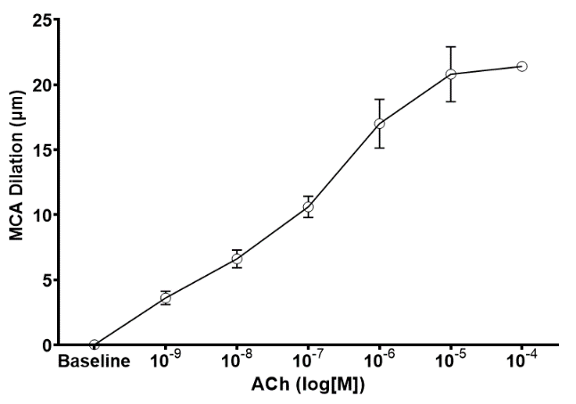
Endothelial-dependent dilation (EDD)
Vessel dilation response
Vasodilator Drug Dose ( log[M] )

Slide 25

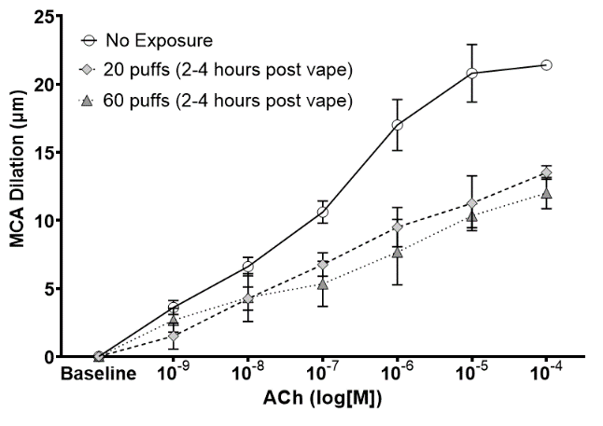

Time response to acute vape exposure
Middle Cerebral Artery
5-second puff
17.5 watts
50:50 VG:PG
No nicotine
No flavor
Sprague Dawley rat
Mills et al. Exp. Physiol. 107: 994-1006, 2022

Slide 26
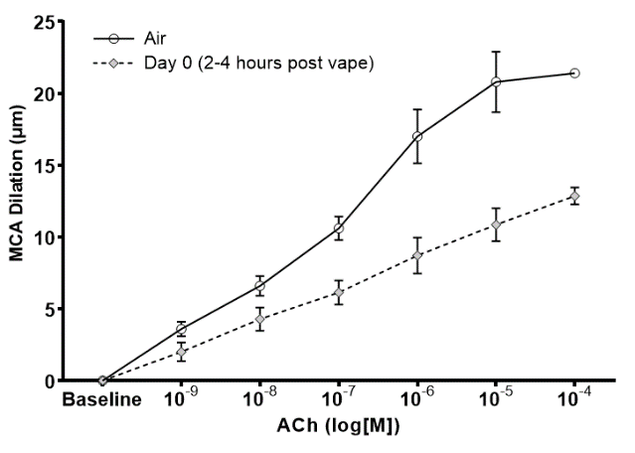
Time response to acute vape exposure
Middle Cerebral Artery
5-second puff
17.5 watts
50:50 VG:PG
No nicotine
No flavor
Sprague Dawley rat
Mills et al. Exp. Physiol. 107: 994-1006, 2022

Slide 27
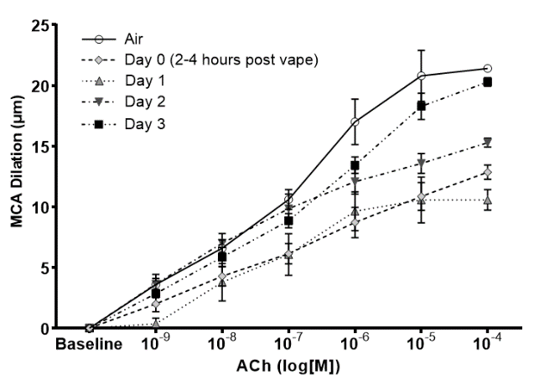
Time response to acute vape exposure
Middle Cerebral Artery
Sprague Dawley rat
Mills et al. Exp. Physiol. 107: 994-1006, 2022

Slide 28
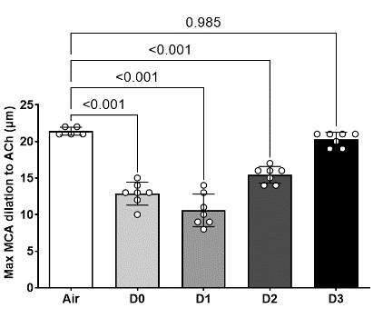
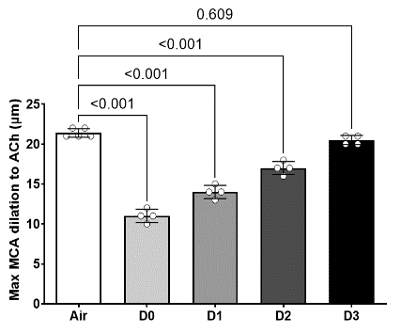
MCA dysfunction persists for 72 hours
E-cig
3R4F Cigarette
Number of (D)ays Post Exposure
Mills et al. Exp. Physiol. 107: 994-1006, 2022

Slide 29
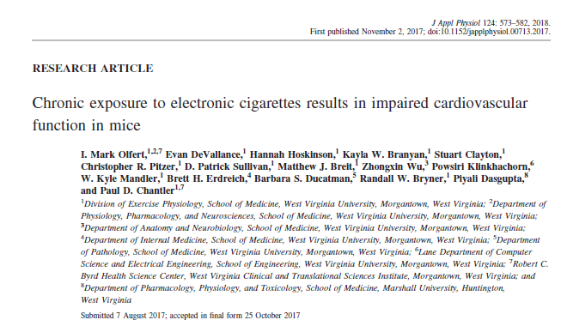
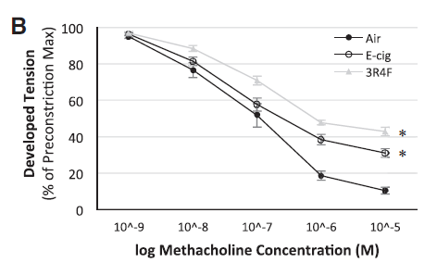
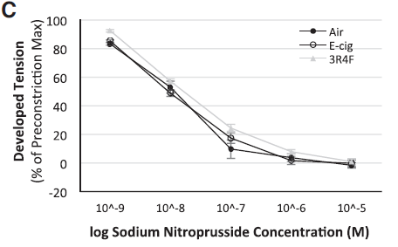
Chronic exposure (8-months)
  Intermittent 4 hrs/day (5d/wk)
  Puff = 55 ml
  3R4F: 1 cig/10 minutes
  (6/hr = 24 cigarettes/day)
  E-cig: 17.5W, 5-s puff/99-s
  (38-39 puffs/hr;
  ~154 puffs day)
Aorta
Aorta

Slide 30
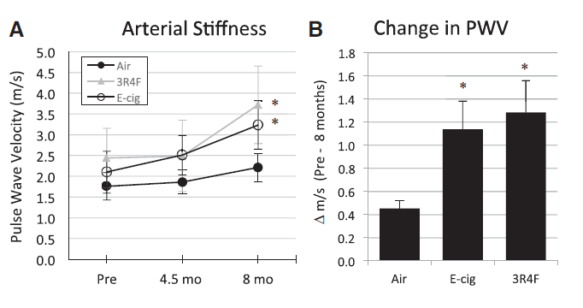
Chronic exposure (8-months)
  Intermittent 4 hrs/day (5d/wk)
  Puff = 55 ml
  3R4F: 1 cig/10 minutes
  (6/hr = 24 cigarettes/day)
  E-cig: 17.5W, 5-s puff/99-s
  (38-39 puffs/hr;
  ~154 puffs day)

Slide 31
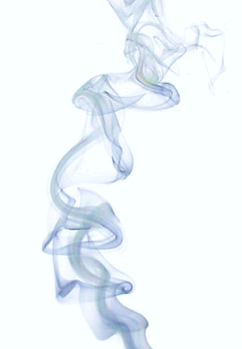
Take Home Message
E-cigarettes and Heated-Tobacco-Products produce….
Similar acute vascular responses as traditional tobacco cigarettes.
Chronic exposure results in vascular dysfunction in central and peripheral arteries…
but has a greater effect in peripheral (resistance) vessels.

Slide 32
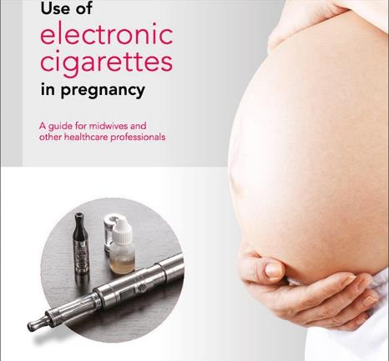
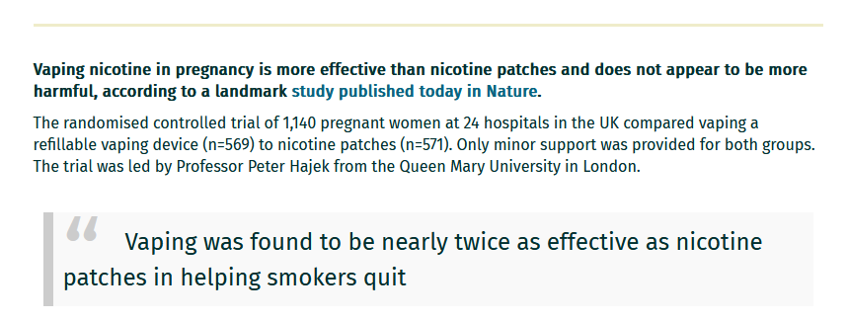
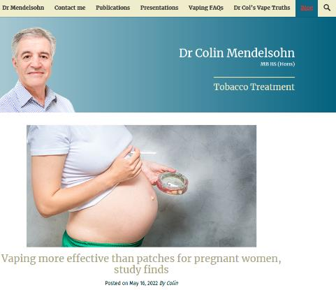
Vaping and Pregnancy

Slide 33

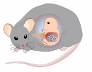
Pregnancy Exposure
Sprague Dawley (CD1) rat
Eiman Aboaziza, MD, PhD
GD2-4 Exposures Begin
PD21
Exposures End
Exposure
20 or 60 puffs/d, 5 d/wk
50:50 VG:PG,
French Vanilla
Birth
Wean
1- 3- 7-months
Time-mated Conception
(G0)
Endpoints
1 male/litter (myography)
1 female/litter (myography)

Slide 34
Pregnancy Exposure
Sprague Dawley (CD1) rat
Eiman Aboaziza, MD, PhD
GD2-4 Exposures Begin
PD21
Exposures End
Exposure
20 or 60 puffs/d, 5 d/wk
50:50 VG:PG,
French Vanilla
Birth
Wean
1- 3- 7-months
Time-mated Conception
(G0)
Endpoints
1 male/litter (myography)
1 female/litter (myography)
Pregnancy Dams
Cohort 1 (20 puffs/day, 5 d/wk) Cohort 2 (60 puffs/day, 5 d/wk)
Control (air exposed) Control (air exposed)
Ecig0 : 0 mg/ml nicotine Ecig0 : 0 mg/ml nicotine
Ecig18 : 18 mg/ml nicotine Ecig18 : 18 mg/ml nicotine

Slide 35
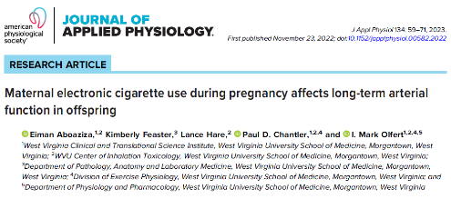
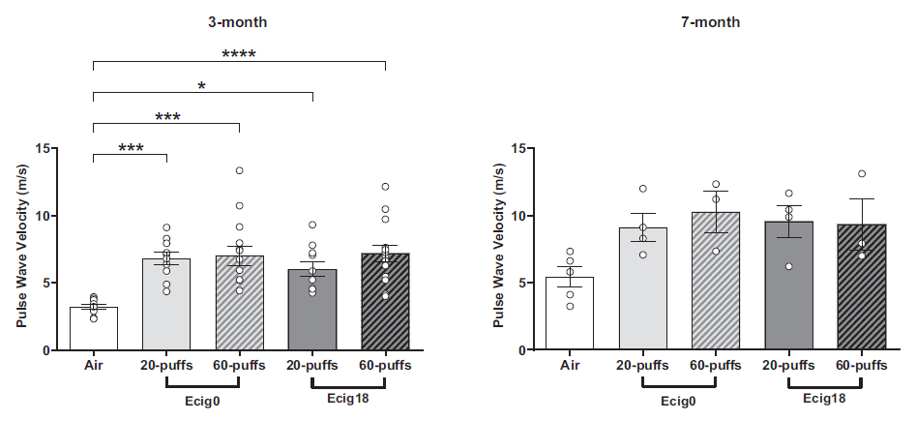
Pregnancy Exposure
Maternal exposure
GD2 → weaning (6 weeks)
20 puffs/d, 5d/wk
Puff: 5-second, 83 ml
17.5 watts
French Vanilla Flavor

Slide 36
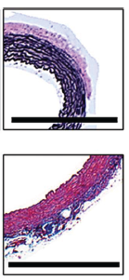
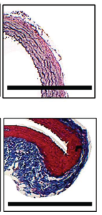
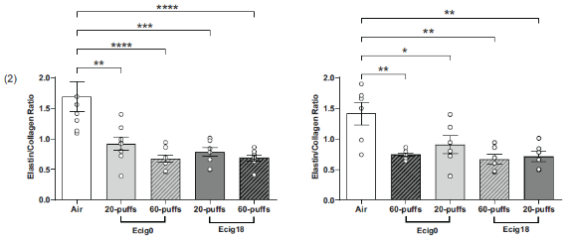
Pregnancy Exposure
Maternal exposure
GD2 → weaning (6 weeks)
20 puffs/d, 5d/wk
Puff: 5-second, 83 ml
17.5 watts
French Vanilla Flavor
Air
Ecig18
Offspring
3-month old
Offspring
7-month old
Elastin
Collagen
scale bar = 1 mm

Slide 37




Pregnancy Exposure
Maternal exposure
GD2 → weaning (6 weeks)
20 puffs/d, 5d/wk
Puff: 5-second, 83 ml
17.5 watts
French Vanilla Flavor

Slide 38

Pregnancy Exposure
Sprague Dawley (CD1) rat
GD2-4 Exposures Begin
GD21
Exposures End
Exposure
60 puffs/d, 5 d/wk
50:50 VG:PG, no flavor
Time-mated Conception
(G0)
Wean
1- 3- 6- 12-months
Endpoints
1 male/litter (myography)
1 female/litter (myography)
Dam exposure groups
Control (air) (n=5)
Ecig0, 5 watts (n=5), no nicotine
Ecig0, 30 watts (n=5), no nicotine
Ecig50, 5w (50 mg nicotine)
Ecig50, 30w (50 mg nicotine)

Slide 39
Litter Characteristics
 | Air | Ecig0 5 Watts | Ecig0 30 Watts | Ecig50 5 Watts | Ecig50 30 Watts
Dams (n=) | 7 | 5 | 6 | 7 | 5
Pups (n=) | 88 | 60 | 57 | 74 | 48
Litter size (range) | 14 ± 1 (9-13) | 13 ± 2 (11-14) | 10 ± 3* (4-14) | 9 ± 5 (2-14) | 8 ± 3* (1-13)
Litter size after 24 hrs | 11 ± 2 | 12 ± 2 | 10 ± 4 | 8 ± 5 | 7 ± 5
Male Pup Number | 5 ± 1 | 7 ± 1 | 5 ± 2 | 5 ± 3 | 4 ± 3
Female Pup Number | 6 ± 2 | 5 ± 1 | 5 ± 2 | 3 ± 3 | 3 ± 3
Female to Male ratio | 1.4 ± 0.5 | 0.8 ± 0.3 | 1.0 ± 0.5 | 0.8 ± 0.6 | 1.1 ± 0.7
Mean ± SD
Notes:
First going into Litter Characteristics we looked at litter sizes pre and post 24 hours and female to male pup ratio and saw no differences

Slide 40



Perinatal Complications
Mills, Olfert, unpublished 2023

Slide 41


Arterial Stiffness (carotid a.)
Mills, Olfert, unpublished 2023

Slide 42


Arterial Stiffness (carotid a.)
Male vs Female
Mills, Olfert, unpublished 2023

Slide 43


MCA Reactivity to ACh (EDD)
Middle Cerebral Artery reactivity
Exposure main effect p=<0.001
Age main effect p=<0.001
Mills, Olfert, unpublished 2023

Slide 44



Y-MAZE (8-Month Offspring)
Neurocognitive function
Mills, Olfert, unpublished 2023

Slide 45



Barnes Maze (8-Month Offspring)
Neurocognitive function
n=9-11/group
Path efficiency= speed / distance
Mills, Olfert, unpublished 2023
Notes:
No effect of sex

Slide 46


Neurocognitive function
Barnes Maze (8-Month Offspring)
n=9-11/group
No Nicotine
1
2
Nicotine
3
Escape
Hole
4
5
6
Nicotine
7
Escape
Hole
Mills, Olfert, unpublished 2023

Slide 47


Novel Object Recognition
Mills, Olfert, unpublished 2023

Slide 48




Novel Object Recognition (12-Month Offspring)
Neurocognitive function
n=9-11/group
Mills, Olfert, unpublished 2023
Notes:
No effect of sex

Slide 49

Take Home Message
Vaping during pregnancy:
Adolescent and Adult offspring shown…
  Impaired vascular function (not nicotine-dependent)
  Stiffer arteries (not nicotine-dependent)
    Changes in elastin an collagen
  Impaired cognitive function (nicotine-dependent)
  Altered epigenetic gene responses
  Greater obesity in adult life
  Intergenerational effects

Slide 50




Offspring Body Mass

Slide 51


Offspring Body Mass (in adult life)
6 Month
12 Month
6 Month
12 Month

Slide 52






MCA Reactivity to ACh (EDD)
Multigenerational effects
F0
♀
Maternal vape
exposure
F1
♀
×
♂
in-utero
exposure only
no
exposure
F2
Mills, Olfert, unpublished 2023

Slide 53

CONCLUSIONS
Blood vessels can not tell the difference between
smoking and vaping!
Vaping during pregnancy:
Altered (hostile) in-utero environment
Intergenerational effects
Adolescent and Adult offspring shown…
  Impaired vascular function
  Stiffer arteries
  Impaired cognitive function
  Altered epigenetic gene responses
  Greater obesity in adult life

Slide 54





Acknowledgments
Acknowledgements
Olfert Lab (*=past members)
  Amber Mills, PhDcandidate
  Madison Robinson
  *Eiman Aboaziza, MD, PhD
  *Sydney Nassabeh, MS
  *James Frazier, MS
  *Sarah Reppert
  *Juliana O’Reilly
  *Lance Hare
  *Joshua Moore, MS2
  *Chris Pitzer, MS
Collaborators
Duaa Dakhlallah, PhD
Paul Chantler, PhD
  Emily Burrage, PhD
  Tyler Coblentz, MS
Tim Nurkiewicz, PhD
Elizabeth Bowdridge, PhD
Jonathan Boyd, PhD
Weimin Gao, PhD
Eric Kelley, PhD
Barbara Ducatman, MD
iTOX Center
T. Goldsmith
K. Engler
A. Rapara
Transition Grant Support; WVU HSC Office of Research and Graduate Education
Philip R Dino Innovative Research Grant
WVU-MU Health Grant
Partnership
NIH/NIGMS U54GM104942

Slide 55


Cross-fostering during Lactation
Sprague Dawley (CD1) rat
GD2-4 Exposures Begin
GD21
Exposures End
Endpoints
1 male/litter (myography)
1 female/litter (myography)
Exposure
Wean
Lactation
60 puffs/d, 5 d/wk
50:50 VG:PG, no flavor
Time-mated Conception
(G0)
1-month
Air exposed
Dam exposure groups
Control (air) (n=6)
Air-Crossed (n=4)
Ecig0-30W (n=5)
Ecig0-30W-Crossed (n=4)
Ecig exposed
Fostered
by Ecig Dam
Fostered
by Air Dam
Mills, Olfert, unpublished 2023

Slide 56

Pre-conception Exposure
Sprague Dawley (CD1) rat
60 puffs/d, 5 d/wk
1.5 hr/d,
50:50 VG:PG,
No flavor
Endpoint
1 male/litter (myography)
1 female/litter (myography)
GD0
GD21
PD21
3-week exposure
3-weeks
3-weeks
Maternal only
Time-mated Conception
(no paternal exposure)
Birth
Wean
3-months
Dams
Control (air) (n=6)
Preconception Ecig0-5W (n=6)
Preconception Ecig0-30w (n=6)
Mills, Olfert, unpublished 2023

Slide 57

Trimester-based Pregnancy Exposure
60 puffs/d, 5 d/wk
1.5 hr/d,
50:50 VG:PG,
No flavor
Endpoints
1 male/litter (myography)
1 female/litter (myography)
Adolescent Adult
1st Trimester
GD2-7
2nd Trimester
GD8-14
3rd Trimester
GD15-21
GD0 Conception
Wean
3- 6-months
Dam Exposure Groups
Control (air) (n=6)
1st Trimester exposure (n=5)
2nd Trimester exposure (n=5)
3rd Trimester exposure (n=5)

Slide 58

Trimester-based Pregnancy Exposure
Mills, Olfert, unpublished 2023

Slide 59
Prevalence of e-cigarette use in women
Before pregnancy
During pregnancy
Liu et al., Prevalence and Distribution of Electronic Cigarette Use Before and During Pregnancy Among Women in 38 States of the United States.
Nicotine & Tobacco Research, 2021, Vol. 23, No. 9
PRAMS = Pregnancy Risk Assessment Monitoring System 2016-2017

Slide 60
Prevalence of e-cigarette use in women
Cigarette smoking is the strongest predictor of e-cigarette use
A quarter of women who used e-cigs before pregnancy continued to use e-cigs during pregnancy
Before pregnancy
During pregnancy
Liu et al., Prevalence and Distribution of Electronic Cigarette Use Before and During Pregnancy Among Women in 38 States of the United States.
Nicotine & Tobacco Research, 2021, Vol. 23, No. 9
PRAMS = Pregnancy Risk Assessment Monitoring System 2016-2017

Slide 61
Objectives
Understand the anatomy of electronic cigarettes and the e-liquid components used.
Describe the similarity that smoking and vaping has on blood vessel structure and function.
Describe the impact of maternal vaping during pregnancy on the vascular health of offspring in adolescent and adult life.

Slide 62
Electronic cigarettes (e-cigs)
Electronic Nicotine Delivery system (ENDs)
Elf bar
Pod-style
(JUUL)
Puff bar
https://e-cigarettes.surgeongeneral.gov/resources.html

Slide 63
Anatomy of Electronic Cigarette
Anatomy of Electronic Cigarette
E-juice/liquid Cartridge
Atomizer
Battery
LED light

Slide 64
Anatomy of Electronic Cigarette
E-liquid
Diacetyl
2,3-pentanedione
Acetoin
Formaldehyde
Acetaldehyde
Acetone
Butanal
Acrolein
Benzaldehyde
Isovaleric aldehyde
m-Methylbenzaldehyde
(VG)
(PG)

Slide 65
Information about Vaping
Misleading Facts!
VG
PG
Nicotine
Flavors
4 ingredients and hundreds
of chemicals
Tobacco leaves
Paper
Nicotine
Flavors
4 ingredients and thousands of chemicals
Image source: https://veppocig.com/product_images/uploaded_images/is-vaping-worse-than-cigarettes-1024x1024.jpg

Slide 66
E-liquid aerosol
Red line =
traditional
cigarette
emission level
Adapted from Ogunwale et al. ACS Omega 2; 1207-1214, 2017

Slide 67
ICPMS Analysis
E-liquid aerosol – Heavy Metals
Shaded area =
OSHA Permissive Exposure Limit (PEL)
(Table Z-1)
Olfert, unpublished

Slide 68
Smoking vs. Vaping
If vaping is different than smoking,
we would expect that the blood vessels, tissues, and organs
would response differently to e-cig aerosol than cigarette smoke!
Acute exposure (10 puffs)
  Intravital (0-2 hours)
  Arterial myography (2-72 hrs)
Chronic exposure (4 weeks – 8 months)
  Artery Structure and Function
  Vascular reactivity (arterial myography)

Slide 69
Intravital Microscopy

Slide 70
Intravital Microscopy
Intravital Microscopy
Notes:
5-24-18 pre.wmv file

Slide 71
Intravital Microscopy
Baseline (Pre-exposure)
15 min Post Vape
arteriole
arteriole
vein
vein
50 um
50 um
30 min Post Vape
60 min Post Vape
arteriole
vein
arteriole
vein
50 um
50 um
Notes:
4-9-18 Pre exposure diameter ~31um

Slide 72
Intravital Microscopy
Intravital Microscopy
10 puffs/
5min
Puff = 5-second, 55-ml
Pitzer et al. IJMS Int. J. Mol. Sci. 2023, 24, 10208.

Slide 73
Intravital Microscopy
Intravital Microscopy
10 puffs/
5min
E-liquid = 50/50 VG:PG,
No flavor, 17.5 watts
Puff = 5-second, 55-ml
Pitzer et al. IJMS Int. J. Mol. Sci. 2023, 24, 10208.

Slide 74
Intravital Microscopy
Intravital Microscopy
10 puffs/
5min
Puff = 5-second, 55-ml
Pitzer et al. IJMS Int. J. Mol. Sci. 2023, 24, 10208.

Slide 75
Heated Tobacco Product (HTP)

Slide 76
10 cycles of 5 s exposure +25 s break
Notes:
https://pubmed.ncbi.nlm.nih.gov/30206183/
Methods: We exposed anaesthetized rats (n=8/group) via nose cone to IQOS aerosol from single HeatSticks, mainstream smoke from single Marlboro Red cigarettes or clean air for a series of consecutive 30 s cycles over 1.5-5 min. Each cycle consisted of 15 or 5 s of exposure followed by removal from the nose cone. We measured pre-exposure and postexposure FMD, and postexposure serum nicotine and cotinine.

Slide 77
2016 Sep;150(3):606-12

Slide 78
Laser Speckle Tracking
Baseline Post Vape (1 min) Post Vape (20 min)
1 Cigarette or E-cig (10 puffs / 5 min)
Moor Full Field Laser Perfusion Imager FLPI-2
C57BL/6 mice
Olfert, unpublished, 2019

Slide 79
Arterial myography (arteriography)
Wire
measures tension
Pressure
measures vessel diameter
70 mmHg
Source: www.scintica.com/products/living-systems/pressure-arteriograph-systems/

Slide 80
Endothelial-dependent dilation (EDD)
Vessel dilation response
Vasodilator Drug Dose ( log[M] )

Slide 81
Time response to acute vape exposure
Middle Cerebral Artery
5-second puff
17.5 watts
50:50 VG:PG
No nicotine
No flavor
Sprague Dawley rat
Mills et al. Exp. Physiol. 107: 994-1006, 2022

Slide 82
Time response to acute vape exposure
Middle Cerebral Artery
5-second puff
17.5 watts
50:50 VG:PG
No nicotine
No flavor
Sprague Dawley rat
Mills et al. Exp. Physiol. 107: 994-1006, 2022

Slide 83
Time response to acute vape exposure
Middle Cerebral Artery
Sprague Dawley rat
Mills et al. Exp. Physiol. 107: 994-1006, 2022

Slide 84
MCA dysfunction persists for 72 hours
E-cig
3R4F Cigarette
Number of (D)ays Post Exposure
Mills et al. Exp. Physiol. 107: 994-1006, 2022

Slide 85
Chronic exposure (8-months)
  Intermittent 4 hrs/day (5d/wk)
  Puff = 55 ml
  3R4F: 1 cig/10 minutes
  (6/hr = 24 cigarettes/day)
  E-cig: 17.5W, 5-s puff/99-s
  (38-39 puffs/hr;
  ~154 puffs day)
Aorta
Aorta

Slide 86
Chronic exposure (8-months)

Slide 87
Take Home Message
E-cigarettes and Heated-Tobacco-Products produce….
Similar acute vascular responses as traditional tobacco cigarettes.
Chronic exposure results in vascular dysfunction in central and peripheral arteries…
but has a greater effect in peripheral (resistance) vessels.

Slide 88
Vaping and Pregnancy

Slide 89
Pregnancy Exposure
Sprague Dawley (CD1) rat
Eiman Aboaziza, MD, PhD
GD2-4 Exposures Begin
PD21
Exposures End
Exposure
20 or 60 puffs/d, 5 d/wk
50:50 VG:PG,
French Vanilla
Birth
Wean
1- 3- 7-months
Time-mated Conception
(G0)
Endpoints
1 male/litter (myography)
1 female/litter (myography)

Slide 90
Pregnancy Exposure
Sprague Dawley (CD1) rat
Eiman Aboaziza, MD, PhD
GD2-4 Exposures Begin
PD21
Exposures End
Exposure
20 or 60 puffs/d, 5 d/wk
50:50 VG:PG,
French Vanilla
Birth
Wean
1- 3- 7-months
Time-mated Conception
(G0)
Endpoints
1 male/litter (myography)
1 female/litter (myography)
Pregnancy Dams
Cohort 1 (20 puffs/day, 5 d/wk) Cohort 2 (60 puffs/day, 5 d/wk)
Control (air exposed) Control (air exposed)
Ecig0 : 0 mg/ml nicotine (GD2-PD21) Ecig0 : 0 mg/ml nicotine (GD2-PD21)
Ecig18 : 18 mg/ml nicotine (GD2-PD21) Ecig18 : 18 mg/ml nicotine (GD2-PD21)

Slide 91
Pregnancy Exposure
Maternal exposure
GD2 → weaning (6 weeks)
20 puffs/d, 5d/wk
Puff: 5-second, 83 ml
17.5 watts
French Vanilla Flavor

Slide 92
Pregnancy Exposure
Maternal exposure
GD2 → weaning (6 weeks)
20 puffs/d, 5d/wk
Puff: 5-second, 83 ml
17.5 watts
French Vanilla Flavor
Air
Ecig18
Offspring
3-month old
Offspring
7-month old
Elastin
Collagen
scale bar = 1 mm

Slide 93
Pregnancy Exposure
Maternal exposure
GD2 → weaning (6 weeks)
20 puffs/d, 5d/wk
Puff: 5-second, 83 ml
17.5 watts
French Vanilla Flavor

Slide 94
Pregnancy Exposure
Sprague Dawley (CD1) rat
GD2-4 Exposures Begin
GD21
Exposures End
Exposure
60 puffs/d, 5 d/wk
50:50 VG:PG, no flavor
Time-mated Conception
(G0)
Wean
1- 3- 6- 12-months
Endpoints
1 male/litter (myography)
1 female/litter (myography)
Dam exposure groups
Control (air) (n=5)
Ecig0, 5 watts (n=5), no nicotine
Ecig0, 30 watts (n=5), no nicotine
Ecig50, 5w (50 mg nicotine)
Ecig50, 30w (50 mg nicotine)

Slide 95
Litter Characteristics
 | Air | Ecig0 5 Watts | Ecig0 30 Watts | Ecig50 5 Watts | Ecig50 30 Watts
Dams (n=) | 7 | 5 | 6 | 7 | 5
Pups (n=) | 88 | 60 | 57 | 74 | 48
Litter size (range) | 14 ± 1 (9-13) | 13 ± 2 (11-14) | 10 ± 3* (4-14) | 9 ± 5 (2-14) | 8 ± 3* (1-13)
Litter size after 24 hrs | 11 ± 2 | 12 ± 2 | 10 ± 4 | 8 ± 5 | 7 ± 5
Male Pup Number | 5 ± 1 | 7 ± 1 | 5 ± 2 | 5 ± 3 | 4 ± 3
Female Pup Number | 6 ± 2 | 5 ± 1 | 5 ± 2 | 3 ± 3 | 3 ± 3
Female to Male ratio | 1.4 ± 0.5 | 0.8 ± 0.3 | 1.0 ± 0.5 | 0.8 ± 0.6 | 1.1 ± 0.7
Mean ± SD
Notes:
First going into Litter Characteristics we looked at litter sizes pre and post 24 hours and female to male pup ratio and saw no differences

Slide 96
Perinatal Complications
Mills, Olfert, unpublished 2023

Slide 97
Arterial Stiffness (carotid a.)
Mills, Olfert, unpublished 2023

Slide 98
Arterial Stiffness (carotid a.)
Male vs Female
Mills, Olfert, unpublished 2023

Slide 99
MCA Reactivity to ACh (EDD)
MCA reactivity
Exposure main effect p=<0.001
Age main effect p=<0.001
Mills, Olfert, unpublished 2023

Slide 100
Y-MAZE (8-Month Offspring)
Neurocognitive function
Mills, Olfert, unpublished 2023

Slide 101
Barnes Maze (8-Month Offspring)
Neurocognitive function
n=9-11/group
Path efficiency= speed / distance
Mills, Olfert, unpublished 2023
Notes:
No effect of sex

Slide 102
Neurocognitive function
Barnes Maze (8-Month Offspring)
n=9-11/group
No Nicotine
1
2
Nicotine
3
Escape
Hole
4
5
6
Nicotine
7
Escape
Hole
Mills, Olfert, unpublished 2023

Slide 103
Novel Object Recognition
Mills, Olfert, unpublished 2023

Slide 104
Novel Object Recognition (12-Month Offspring)
Neurocognitive function
n=9-11/group
Mills, Olfert, unpublished 2023
Notes:
No effect of sex

Slide 105
MCA Reactivity to ACh (EDD)
Multigenerational effects
F0
♀
Maternal vape
exposure
F1
♀
×
♂
in-utero
exposure only
no
exposure
F2
Mills, Olfert, unpublished 2023

Slide 106
Take Home Message
Blood vessels can tell the difference between
smoking and vaping!
Vaping during pregnancy:
Altered (hostile) in-utero environment
Adolescent and Adult offspring shown…
  Impaired vascular function (not nicotine-dependent)
  Stiffer arteries (not nicotine-dependent)
    Changes in elastin and collagen
  Impaired cognitive function (nicotine-dependent)
  Altered epigenetic gene responses
  Greater obesity in adult life

Slide 107
Acknowledgments
Acknowledgements
Olfert Lab (*=past members)
  Amber Mills, PhDcandidate
  Madison Robinson
  *Eiman Aboaziza, MD, PhD
  *Sydney Nassabeh, MS
  *James Frazier, MS
  *Sarah Reppert
  *Juliana O’Reilly
  *Lance Hare
  *Joshua Moore, MS2
  *Chris Pitzer, MS
Collaborators
Duaa Dakhlallah, PhD
Paul Chantler, PhD
  Emily Burrage, PhD
  Tyler Coblentz, MS
Tim Nurkiewicz, PhD
Elizabeth Bowdridge, PhD
Jonathan Boyd, PhD
Weimin Gao, PhD
Eric Kelley, PhD
Barbara Ducatman, MD
iTOX Center
T. Goldsmith
K. Engler
A. Rapara
Transition Grant Support; WVU HSC Office of Research and Graduate Education
Philip R Dino Innovative Research Grant
WVU-MU Health Grant
Partnership
NIH/NIGMS U54GM104942

Slide 108

Cross-fostering during Lactation
Sprague Dawley (CD1) rat
GD2-4 Exposures Begin
GD21
Exposures End
Endpoints
1 male/litter (myography)
1 female/litter (myography)
Exposure
Wean
60 puffs/d, 5 d/wk
50:50 VG:PG, no flavor
Time-mated Conception
(G0)
1-month
Dam exposure groups
Control (air) (n=6)
Air-Crossed (n=4)
Ecig0-30W (n=5)
Ecig0-30W-Crossed (n=4)
Fostered
by Ecig Dam
Fostered
by Air Dam
Mills, Olfert, unpublished 2023

Slide 109
Pre-conception Exposure
Sprague Dawley (CD1) rat
60 puffs/d, 5 d/wk
1.5 hr/d,
50:50 VG:PG,
No flavor
Endpoint
1 male/litter (myography)
1 female/litter (myography)
GD0
GD21
PD21
3-week exposure
3-weeks
3-weeks
Maternal only
Time-mated Conception
(no paternal exposure)
Birth
Wean
3-months
Dams
Control (air) (n=6)
Preconception Ecig0-5W (n=6)
Preconception Ecig0-30w (n=6)
Mills, Olfert, unpublished 2023

Slide 110
Trimester-based Pregnancy Exposure
60 puffs/d, 5 d/wk
1.5 hr/d,
50:50 VG:PG,
No flavor
Endpoints
1 male/litter (myography)
1 female/litter (myography)
Adolescent Adult
1st Trimester
GD2-7
2nd Trimester
GD8-14
3rd Trimester
GD15-21
GD0 Conception
Wean
3- 6-months
Dam Exposure Groups
Control (air) (n=6)
1st Trimester exposure (n=5)
2nd Trimester exposure (n=5)
3rd Trimester exposure (n=5)

Slide 111
Trimester-based Pregnancy Exposure
Mills, Olfert, unpublished 2023

