Slide 1
HRSA Resources for Advancing Maternal and Child Health 2023 West Virginia Perinatal Summit September 7, 2023
Christine Woolslayer
Public Health Analyst
Office of Intergovernmental Affairs (IEA) – Region 3 Philadelphia

Slide 2
Agenda
About HRSA
HRSA Office of Intergovernmental and External Affairs – Region 3
HRSA Resources

Slide 3
Health Resources and Services Administration (HRSA)
Mission: To improve health outcomes and achieve health equity through access to quality services, a skilled health workforce, and innovative, high-value programs
TENS OF MILLIONS of Americans receive quality, affordable health care, and other services through HRSA’s 90-PLUS PROGRAMS and more than 3,000 GRANTEES
Notes:
Source: https://www.hrsa.gov/about/organization/bureaus/index.html

Slide 4
HRSA Program Areas
Health Centers
Maternal & Child Health
Provider Relief
Ryan White HIV/AIDS Program
Telehealth
Health Workforce
National Health Service Corps
Rural Health
Organ Donation & Transplantation
More Programs: www.hrsa.gov/about/program-areas
Notes:
To view more program areas, click the hyperlink, “More Program Areas,” on the slide:
Health Centers
Provides quality primary and preventive care to millions of patients — regardless of their ability to pay.
Maternal & Child Health
Improves the health and well-being of America's mothers, children, and families.
Provider Relief Funding
Supports health care providers in the U.S. to prevent, prepare for, and respond to coronavirus.
Ryan White HIV/AIDS Program
Provides crucial HIV care, treatment, and support services to more than half a million people with diagnosed HIV.
Health Workforce
Strengthens the health workforce and connects skilled providers to communities in need.
National Health Service Corps
Connects health care clinicians to those with limited access to health care.
Rural Health Policy
Advises the HHS Secretary and increases access to high-quality health care in rural communities through innovative programs.
Telehealth
Improves access to quality health care services through the use of telehealth.
340B Drug Pricing
Enables covered entities to use federal resources to reach and serve eligible patients better.
American Indian/Alaska Native
Helps tribal organizations maximize the impact of government health care programs.
COVID-19 Coverage Assistance Fund
Gives every adult living in the United States free access to COVID-19 vaccines.
Data & Maps
Displays information on our public health programs and services.
Injury Compensation
Provides compensation to those with serious injuries from vaccines or countermeasures.
Organ Donation & Transplantation
Oversees the nation’s organ and blood stem cell transplant systems.
Poison Help
Connects people to their local poison help center via the Poison Help line, 1-800-222-1222.
Source: https://www.hrsa.gov/about/program-areas

Slide 5
HRSA FY 2023 Appropriation - $14.3 billion
Primary Health Care $5.8 billion for affordable, accessible, quality, and cost-effective primary health care services.
Ryan White HIV/AIDS Program $2.6 billion to fund city, state, county, and local community-based organizations to provide primary medical care, medication, and essential support services to people with HIV.
Health Workforce $1.8 billion to educate and train health care professionals and connect them to communities in need.
Maternal Child Health $1.7 billion to improve the health of all mothers, children, and their families.
Congressionally Directed Spending $1.5 billion for projects financing health-related activities.
Rural Health Policy $352 million to promote better health care services in rural America.
Family Planning* $286 million to expand family planning services for individuals in need.
Program Management $164 million to support HRSA’s program oversight and operations.
Health Systems $121 million to protect the public health and improve the health of individuals through programs that provide national leadership and direction in targeted areas.
Office for the Advancement of Telehealth $38 million to promote the use of telehealth technologies for health care delivery, education, and health information services.
340B Drug Pricing Program $12 million to provide oversight of drug discount programs.
*Administered by the HHS Office of the Assistant Secretary for Health Office of Population Affairs
Total: $14.3 billion
Source: Health Resources and Services Administration, Office of Budget and Finance (Feb 2023).
Notes:
HRSA FY 2023 Appropriation – Values
Primary Health Care
$5.8 billion for affordable, accessible, quality, and cost-effective primary health care services.
Ryan White HIV/AIDS Program
$2.6 billion to fund city, state, county, and local community-based organizations to provide primary medical care, medication, and essential support services to people with HIV.
Health Workforce
$1.8 billion to educate and train health care professionals and connect them to communities in need.
Maternal Child Health
$1.7 billion to improve the health of all mothers, children, and their families.
Congressionally Directed Spending
$1.5 billion for projects financing health-related activities.
Rural Health Policy
$352 million to promote better health care services in rural America.
Family Planning*
$286 million to expand family planning services for individuals in need.
*Administered by the HHS Office of the Assistant Secretary for Health Office of Population Affairs
Program Management
$164 million to support HRSA’s program oversight and operations.
Health Systems
$121 million to protect the public health and improve the health of individuals through programs that provide national leadership and direction in targeted areas.
Office for the Advancement of Telehealth
$38 million to promote the use of telehealth technologies for health care delivery, education, and health information services.
340B Drug Pricing Program
$12 million to provide oversight of drug discount programs.
HRSA FY 2023 Appropriation – Percentages
40% of total funding was appropriated for Primary Health Care
18% of total funding was appropriated for Ryan White HIV/AIDS Program
13% of total funding was appropriated for Health Workforce
12% of total funding was appropriated for Maternal & Child Health
11% of total funding was appropriated for Congressionally Directed Spending
2% of total funding was appropriated for Rural Health Policy
2% of total funding was appropriated for Family Planning
1% of total funding was appropriated for Program Management
1% of total funding was appropriated for Health Systems
<1% of total funding was appropriated to the Office for the Advancement of Telehealth
<1% of total funding was appropriated for 340B Drug Pricing Program

Slide 6
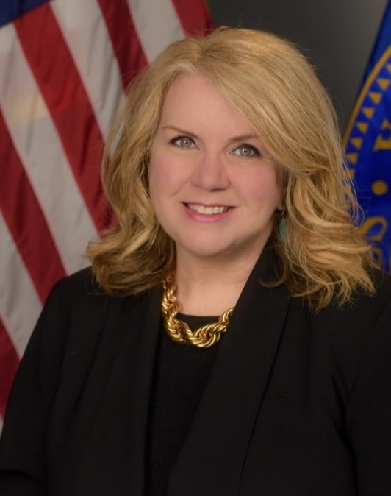
HRSA Priorities
Behavioral
Health
Health
Workforce
Maternal
Health
Carole Johnson,
HRSA Administrator
6
Notes:
Carole Johnson joined HRSA in January 2021 as our Administrator. She has outlined 3 priorities for the agency that aligns with Departmental priorities. These are Workforce, Maternal Health, and Behavioral Health.

Slide 7
Maternal and Child Health
The Maternal and Child Health Bureau’s mission is to improve the health and well-being of America’s mothers, children, and families.
Title V Maternal and Child Health Block Grant
Partnership between the federal government and states
Served 58 million pregnant people and children in 2021
Almost 3.7 million infants—nearly every newborn in the country—received newborn screening for genetic and metabolic conditions
Maternal, Infant, and Early Childhood Home Visiting Program
Voluntary, evidence-based home visiting services for pregnant people and parents with young children who live in communities that are at risk for poor maternal and child health outcomes
Served approximately 140,000 parents and children in 71,000 families and provided over 920,000 home visits in 2021
Healthy Start
Provides grants to communities with infant mortality rates > 1½ times the US average
Provides services and facilitates access to comprehensive health and social services
In FY 2021, Healthy Start served just over 77,000 people
Notes:
The Maternal and Child Health Bureau (MCHB) mission is to improve the health and well-being of America’s mothers, children, and families. One of the ways MCHB achieves this mission is through funding the Title V MCH Block Grant Program to provide health care and public health services for pregnant women, infants, children, children with special care needs, and their families.
Key Programs:
TITLE V BLOCK GRANT
Supports Federal/State partnerships to address the unique needs of MCH populations in all 59 states/jurisdictions
Plays a critical gap-filling role in funding services for uninsured or inadequately insured
In FY 2021
Served 58 million pregnant people and children
92% of pregnant people
98% of infants
58% of children nationwide, including children with special health care needs
MIECHV
The MIECHV Program is administered by the Health Resources and Services Administration (HRSA) in partnership with the Administration for Children and Families (ACF)
It’s voluntary evidence-based home visiting services for pregnant women and parents with young children living in at-risk communities
In FY 2021, the MIECHV Program among the 56 awardees, states, and territories, served approximately 140,000 parents and children in 71,000 families and provided over 920,000 home visits. Within the same fiscal year, MIECHV Program reached:
1,065 counties, which is 33 percent of all U.S. counties
45 percent of all urban counties, and 28 percent of all rural counties
60 percent of all counties served by the MIECHV Program were rural
140,000 parents and children living in higher risk communities received more than 920,000 home visits from nurses, social workers, and other trained counselors through HRSA’s administration of evidence-based programs to improve health, school readiness, and other outcomes for newborns to pre-kindergartners.
The MIECHV program in FY 2021 continues to serve families that disproportionately face barriers and challenges to health and well-being, including:
68% of participating families had household incomes at or below 100 percent of the Federal Poverty guidelines ($26,500 for a family four), and 40 percent were at or below 50 percent of those guidelines
60% of adult participants had a high school education or less
Of all households served:
20 percent reported a history of child abuse and maltreatment
14 percent reported substance misuse.
10 percent included enrollees who are pregnant teens.
Healthy Start
HRSA’s Healthy Start program provides grants to communities with infant mortality rates > 1½ times the US average and high rates of other adverse perinatal outcomes (e.g., low birthweight, preterm birth, maternal morbidity and mortality).
The program provides services and facilitates access to comprehensive health and social services for women, infants, and their families
The Healthy Start program aims to:
Improve access to quality health care and services for women, infants, children, and families through outreach, care coordination, health education, and linkage to health insurance;
Strengthen the health workforce, specifically those individuals responsible for providing direct services;
Build healthy communities and ensuring ongoing, coordinated, comprehensive services are provided in the most efficient manner through effective service delivery; and
Promote and improve health equity by connecting with appropriate organizations.
In FY 2021, Healthy Start served just over 77,000 people*
*Breakdown: 37,050 women, 35,202 infants and children, and 4,767 men.

Slide 8
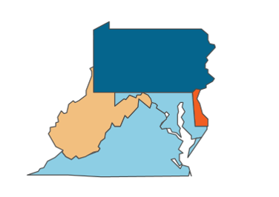
HRSA Office of Intergovernmental and External Affairs (HRSA IEA)
8

Slide 9
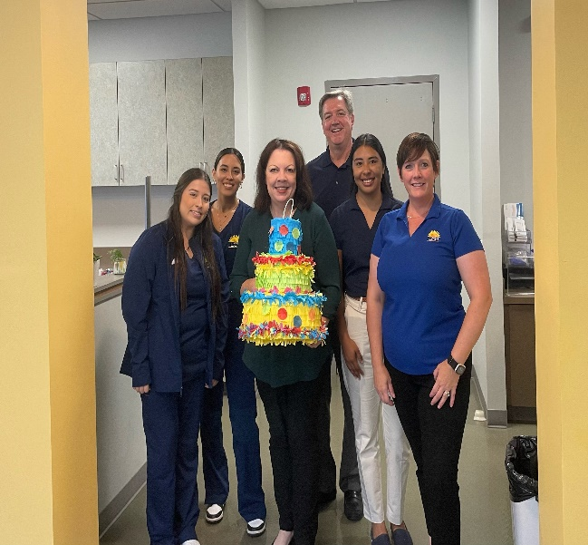
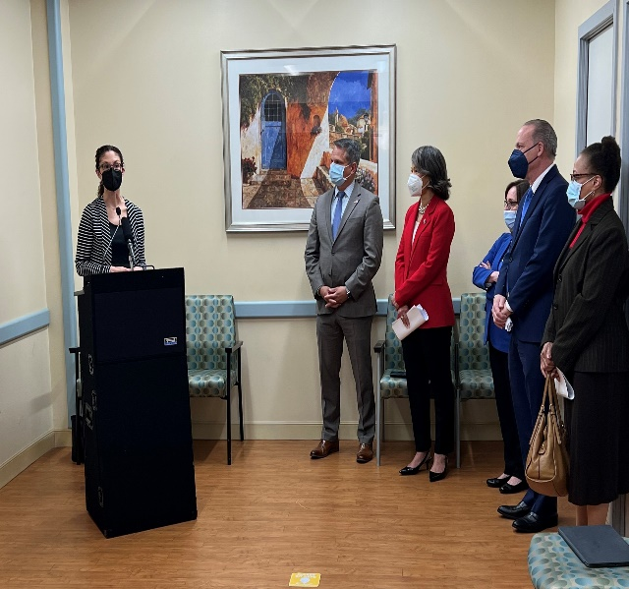
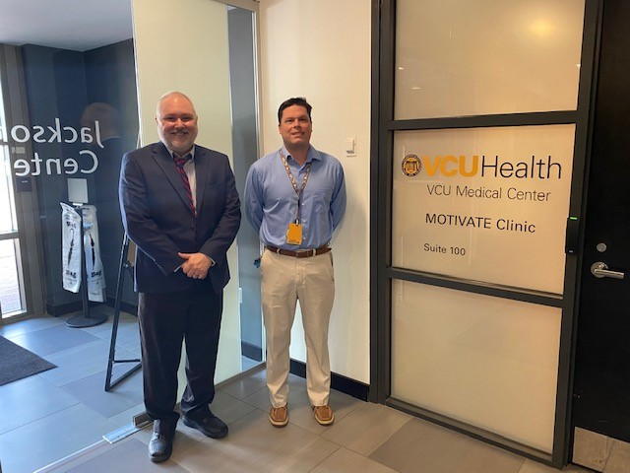
IEA Mission
To provide on-the-ground outreach to increase the reach, impact, and awareness of HRSA programs
Notes:
IEA serves as the principal Agency lead on intergovernmental and external affairs, regional operations, and tribal partnerships. We achieve this by leveraging the knowledge of the national and regional landscape, proximity, and networks of local contacts in states, tribes, and territories.

Slide 10
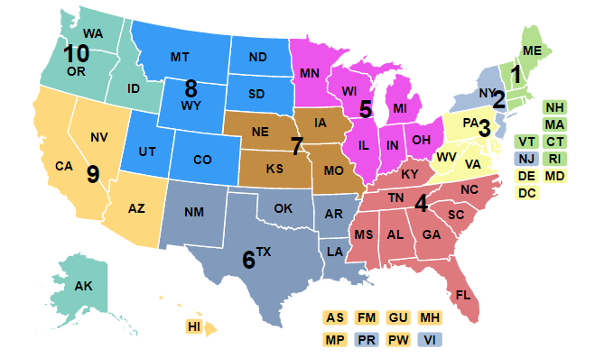
IEA Organization
10 Regional Offices
Tribal Affairs
External Affairs
Notes:
10 Regional Offices
Tribal Affairs:
Coordinate tribal public health activities across HRSA, including Urban Indian Health participation in the Health Center Program and Health Professional Shortage Area (HPSA) designation to tribal populations.
Serve as HRSA’s primary point of contact for tribal governments and tribal organizations, and HRSA liaison to and representative on tribal health-related committees and working groups.
External Affairs
The Office of External Affairs’ primary role is to facilitate HRSA’s interactions with intergovernmental agencies and stakeholder groups on cross-cutting public health issues.
Specifically, we partner with HHS IEA and HRSA colleagues to foster and strengthen relationships with key public health organizations.
Through these partnerships, HRSA IEA serves in different roles to convene stakeholders and share information that enhances HRSA’s work.
As an example, BHW and HRSA IEA are collaborating to facilitate four listening sessions with stakeholders that will help inform HRSA’s understanding of the most significant challenges facing our nation’s health workforce infrastructure with a focus on diversifying, expanding, and building capacity for the pipeline of healthcare professionals in the U.S. (The four listening sessions will cover 1) nursing; 2) medicine; 3) maternal health; 4) behavioral health.)
We also respond to inquiries from federal, state, and local governments and coordinate HRSA’s quarterly engagements with Regional Commissions. The commissions are federally funded by Congress and promote economic development in distressed areas of the United States related to various infrastructure issues including health care.
And finally, the External Affairs team administers HRSA’s cooperative agreements with National Organizations of State and Local Officials, also known as NOSLO.

Slide 11
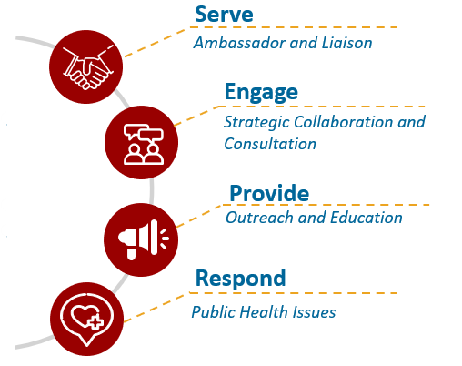
Core Functions
HRSA IEA serves as the principal Agency lead on intergovernmental and external affairs, regional operations, and tribal partnerships
Notes:
HRSA IEA serves as the principal Agency lead on intergovernmental and external affairs, regional operations, and tribal partnerships. We achieve this by leveraging knowledge of the national and regional landscape and established networks of local contacts in states, tribes, and territories.
Our work can be categorized by these Core Functions:
As Ambassadors and Liaisons, HRSA IEA serves as a central point of contact and representative for HRSA and facilitates connections to HRSA and federal, state, local, tribal, territorial, and community partners
HRSA IEA Strategically Collaborates and provides Consultation to broker relationships with and among partners addressing needs, facilitating problem resolution, advancing HRSA priorities, and leveraging HRSA resources
Outreach and Education: HRSA IEA promotes public health and health equity by expanding knowledge about HRSA’s programs, resources, priorities and related best practices.
Public Health Issues: HRSA IEA identifies critical ground-level public health information about national, regional, local, territorial, and tribal trends to inform HRSA’s operations, decision-making, and allocation of resources.

Slide 12
HRSA in your State FY 2022 – West Virginia
HRSA FISCAL YEAR 2022 INVESTMENT TOTALS: Last Updated: 08/15/2023
Program Area | Award Amount
Health Workforce | $7,811,113
Healthcare Systems | $44,462,321
HIV/AIDS | $5,236,669
Maternal and Child Health | $15,319,067
Primary Health Care | $74,498,920
Rural Health | $11,520,883
Telehealth | $299,437
FY 2022 Total | $159,148,410
Notes:
One of the ways HRSA fulfills its mission to improve health outcomes and health equity is through investments. In FY 2022, grants and cooperative agreements funding in WV totaled almost 160 million through As you can see, the total funding was dispersed through key program areas regarding health workforce, HIV/AIDS, maternal and child health, primary health care, and rural health.
Source:
https://data.hrsa.gov/tools/find-grants (Accessed: 03/01/2023)

Slide 13
HRSA Resources
13

Slide 14
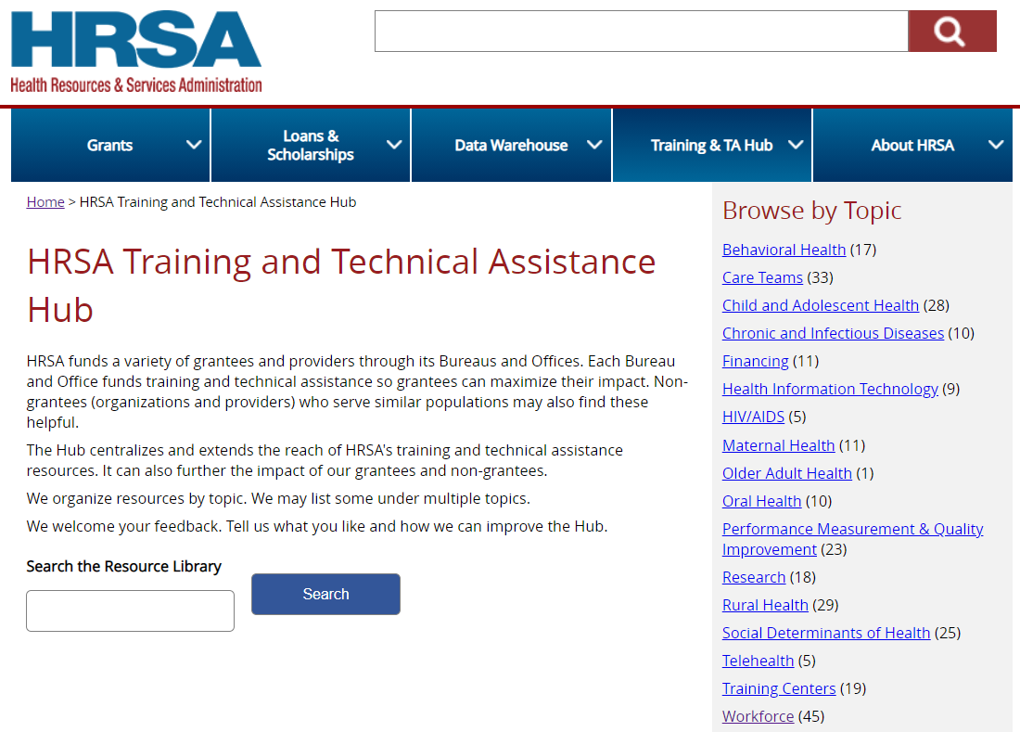
Training and Technical Assistance Hub
https://www.hrsa.gov/library/index.html/

Slide 15
Maternal Health Resources - HUB
Behavioral Health and Primary Care Integration
Data Resource Initiative for Child and Adolescent Health
Health Center Resource Clearinghouse
Maternal and Child Environmental Health Network: MotherToBaby
MCH Navigator
National Fetal, Infant, and Child Death Review Program
National MCH Workforce Development Center
Supporting Healthy Start Performance Project

Slide 16
MCH Navigator
The MCH Navigator is a centralized portal for pursuing continuous learning in maternal and child health (MCH)
It is designed to help emerging and established MCH professionals and students map professional growth pathways.
https://www.mchnavigator.org/

Slide 17
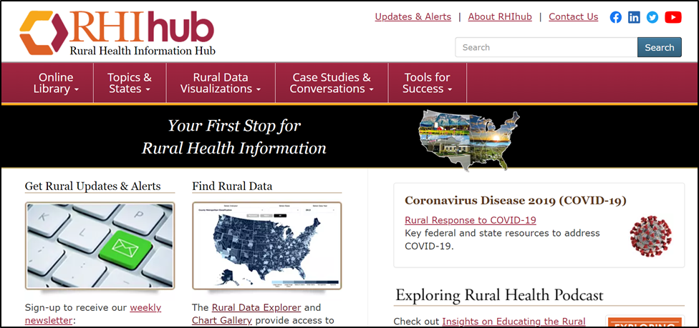
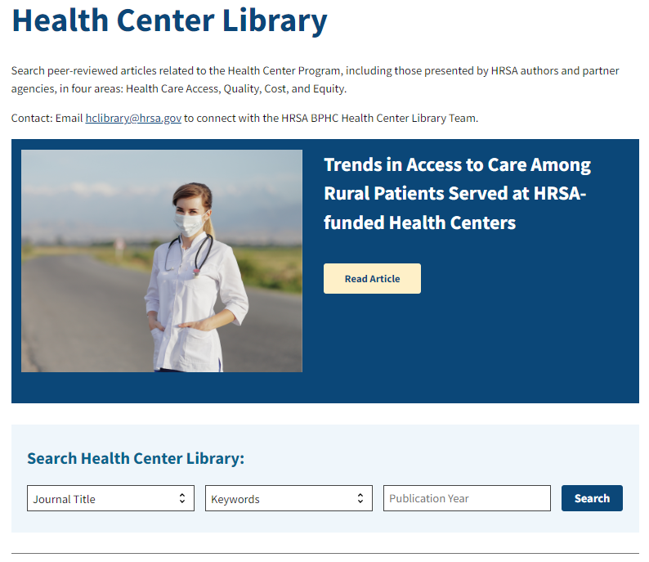
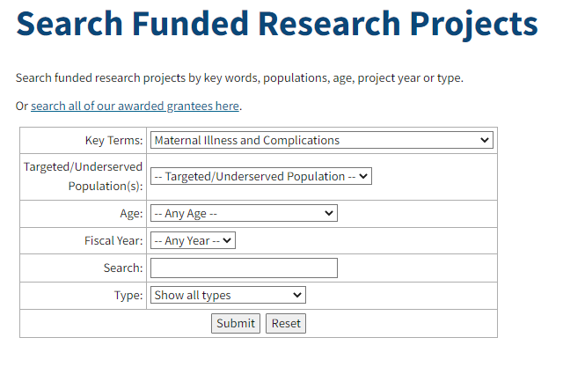
Research and Resource Hubs
https://bphc.hrsa.gov/data-reporting/health-center-research-evaluation/health-center-library
www.ruralhealthinfo.org
https://mchb.hrsa.gov/research/projects-search.asp
Notes:
https://www.ruralhealthinfo.org/toolkits/maternal-health
The toolkit compiles evidence-based and promising models and resources to support rural communities implementing maternal health programs across the United States.
https://www.ruralhealthresearch.org/topics/maternal-health
Rural Health Research Centers
Current Maternal Health Research Projects:
https://www.ruralhealthresearch.org/topics/maternal-health/current-projects
University of Minnesota Rural Health Research Center
Safe Obstetric Care Access for All Rural Residents: Minimum Standards for Clinical, Workforce, and Financial Viability of Rural Obstetric Units
Improving Racial Equity for Rural Mothers and Infants
Making It Work: Models of Success in Rural Maternity Care
Emergency Obstetrics in Communities Without Hospital-Based Maternity Care
Developing Rural-Relevant Strategies to Reduce Maternal Morbidity
Health Center Library:
Health Center Capacity in Rural Maternity Care Deserts
A new analysis explores the role of HRSA-funded health centers in helping to address rural access to maternity care.
MCHB Research
https://mchb.hrsa.gov/research/index.asp

Slide 18
Telehealth Resources
Mid-Atlantic Telehealth Resource Center
https://www.matrc.org/
Center for Connected Health Policy
https://www.cchpca.org/
ProviderBridge
https://www.providerbridge.org/
Multi-Discipline Licensure Resource Project https://licensureproject.org/
Rural Telehealth Research Center https://ruraltelehealth.org/

Slide 19
National Telehealth Conference – September 12th
Conference topics include:
The adoption of telehealth and expansion of broadband connectivity to improve health equity
Using tele-behavioral health as a successful model for integrating telehealth into the standard of care
Telehealth’s role in supporting the health care workforce and expanding services for patients
Implications of health policy to inform telehealth’s future in an evolving health care environment
Notes:
On September 12th, HRSA will host a virtual National Telehealth Conference that brings public and private sector leaders together to discuss telehealth best practices. The conference will examine the importance of integrating telehealth into standard care.

Slide 20
Mid-Atlantic Public Health Training Center
Provides specialized training for public health students and workers, focusing on technical, scientific, and leadership skills.
https://lms.marphtc.pitt.edu/

Slide 21
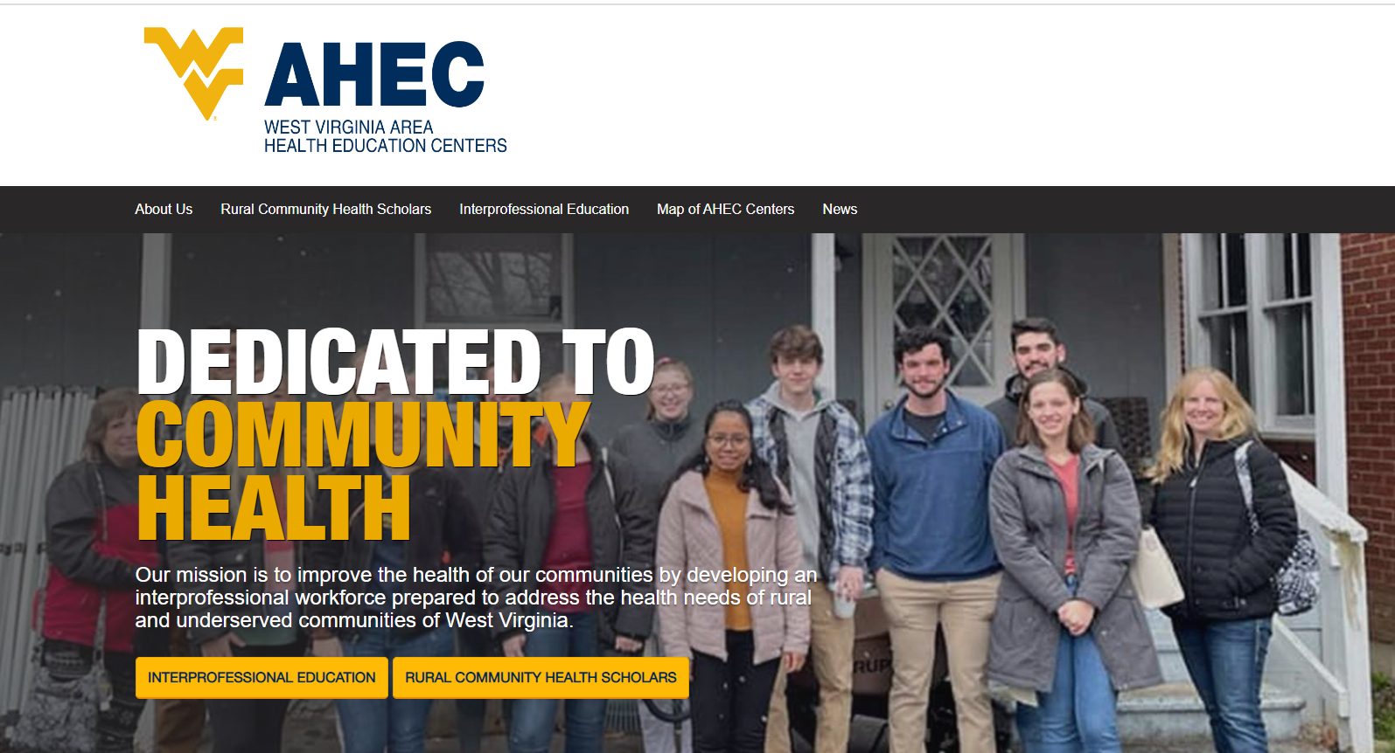
https://www.hsc.wvu.edu/west-virginia-area-health-education-center/

Slide 22
Loan Repayment & Scholarship Programs

Slide 23
Growth of BHW Participants in WV (2019 – 2022)
Provider Type | # of Participants 2019 | # of Participants 2022 | Growth %
Dental | 12 | 32 | 166%
Mental Health | 58 | 133 | 129%
Nurse Corp | 12 | 30 | 150%
Primary Care | 74 | 157 | 112%
Total: | 156 | 352 | 126%
https://data.hrsa.gov/topics/health-workforce/field-strength

Slide 24
Community Health Workers Training Program https://bhw.hrsa.gov/funding/community-health-worker-training-fy2022-awards

Slide 25
Health Workforce Connector
Connects clinicians to job and training opportunities at sites supported by select HRSA Health Workforce programs.
Show job vacancies at thousands of NHSC-approved sites nationwide
Use Google Maps technology to allow users to view the surrounding community (e.g., schools, restaurants, parks, places of worship, shops)
Narrow your job search by field of practice, specialty, HPSA score, site name, zip code, or sites with open positions
https://connector.hrsa.gov/connector/

Slide 26
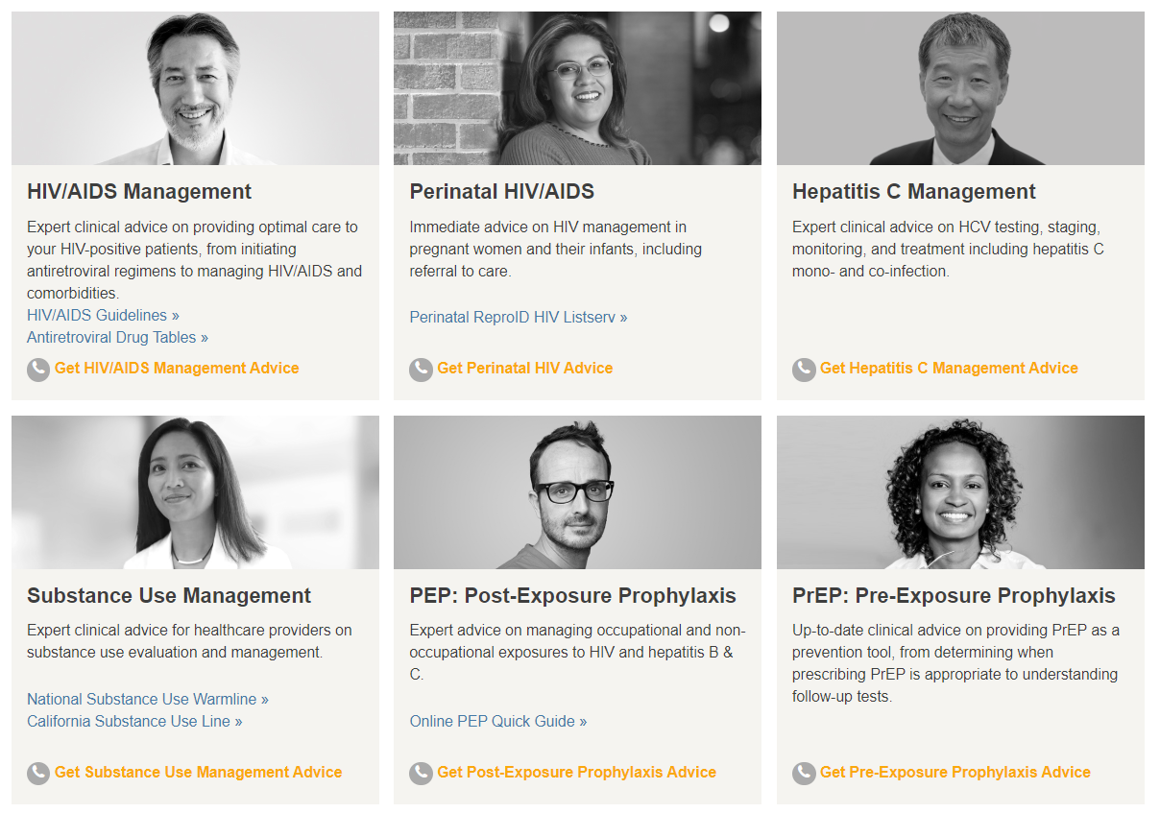
Clinician Consultation Center
https://nccc.ucsf.edu/

Slide 27
National Maternal Mental Health Hotline
Are you pregnant or a new parent and feeling sad, worried, overwhelmed or concerned that you aren’t good enough?
For support, understanding, and resources, CALL OR TEXT 1-833-TLC-MAMA (1-833-852-6262)
Free – Confidential – Available 24/7
Learn more at https://mchb.hrsa.gov/national-maternal-mental-health-hotline | Questions? hotline@postpartum.net

Slide 28
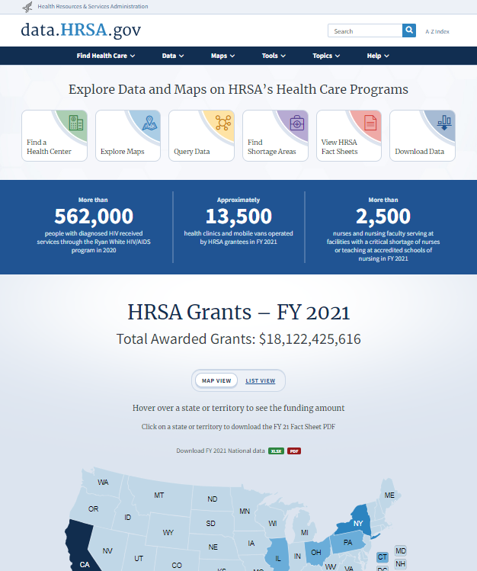
HRSA Data data.hrsa.gov
Quality Data Tools and Maps
HRSA Data Center
data.HRSA.gov
Title V MCH Block Grants
National and State Performance and Outcome Measures
https://mchb.tvisdata.hrsa.gov/
Health Center Data (Uniform Data System)
https://data.hrsa.gov/tools/data-reporting/program-data
April 2022: $90 Million Announced to Support New Data-Driven Approaches for Health Centers to Identify and Reduce Health Disparities

Slide 29
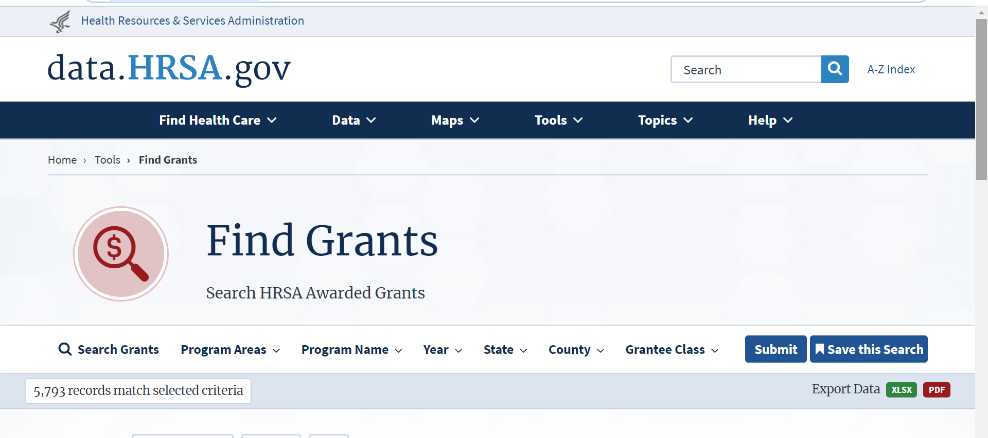
Who/Where are the Programs?
https://data.hrsa.gov/tools/find-grants

Slide 30
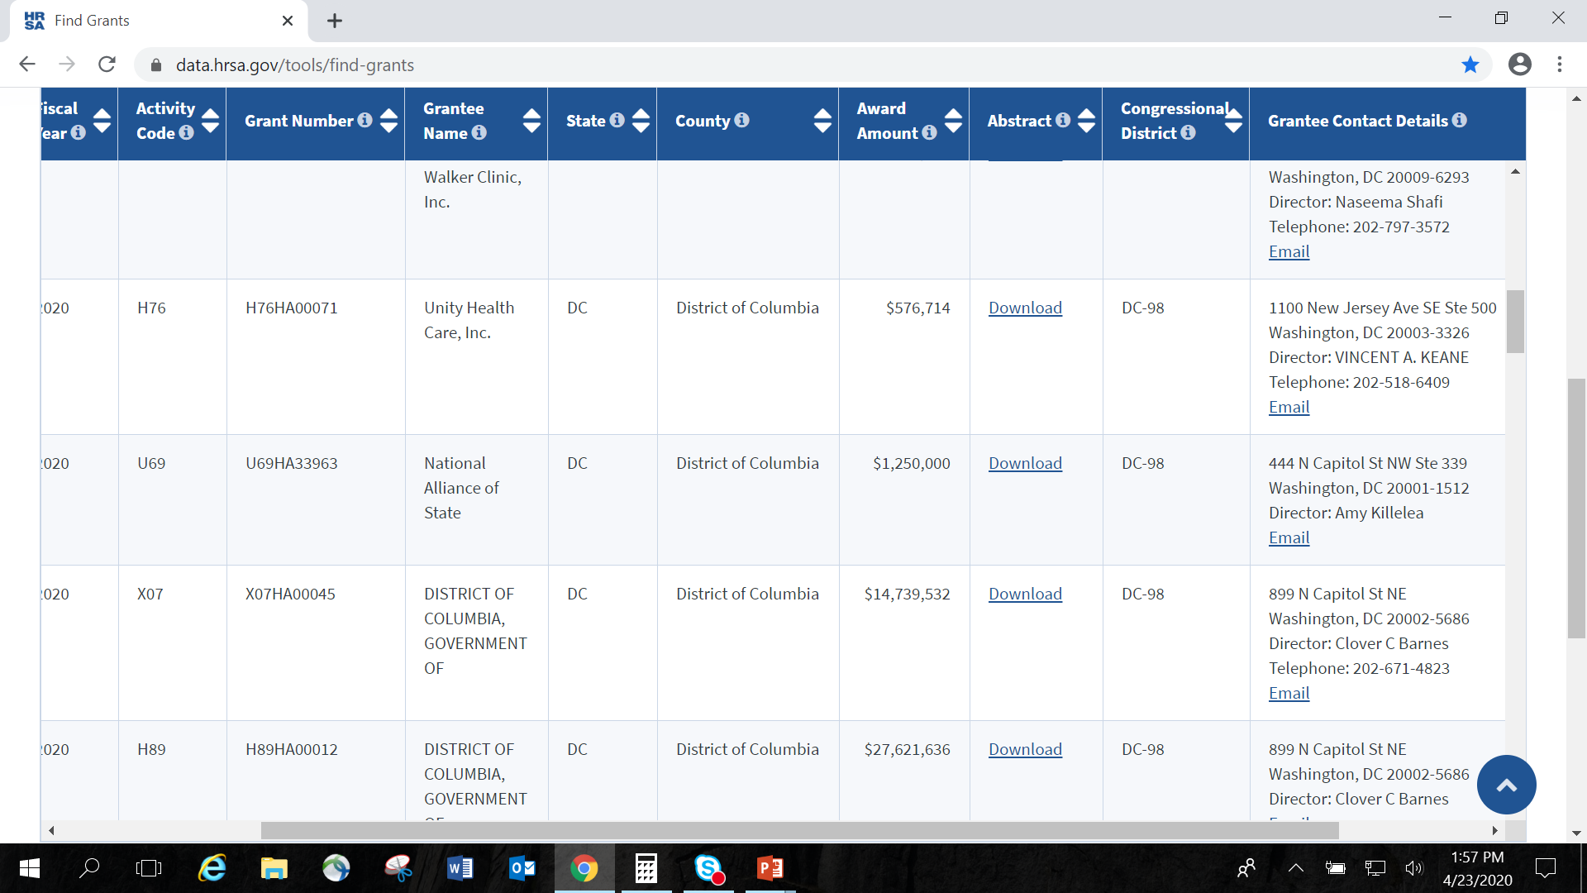
Who/Where are the Programs?
https://data.hrsa.gov/tools/find-grants

Slide 31
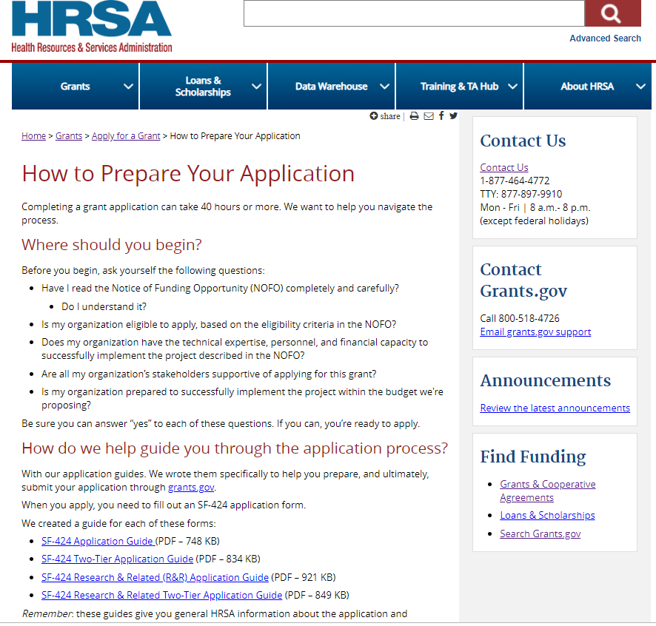
Grant Technical Assistance
HRSA Grants Technical Assistance (TA) Webpage http://www.hrsa.gov/grants/apply/.
One-stop-shop for potential applicants on how to apply for HRSA Federal assistance.
Applicants will find valuable information on how to apply for HRSA grants, including webcasts, videos, and other technical assistance guidance and a wealth of other relevant and useful information and links tailored to HRSA-specific process and requirements.

Slide 32
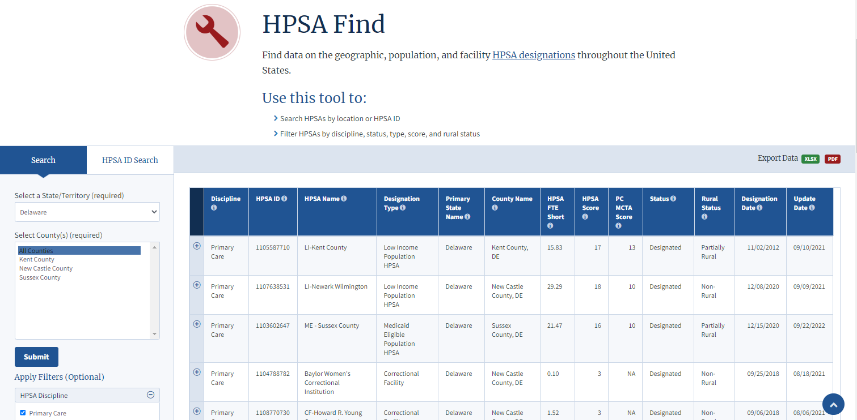
Health Professional Shortage Areas https://data.hrsa.gov/tools/shortage-area/hpsa-find
New: Maternity Care Target Areas (MCTA)

Slide 33
When should you contact HRSA IEA?
When you want to know more about HRSA programs or initiatives
When you need contextual information about the state, local, tribal, and regional landscape that may impact your stakeholders
When you are looking for technical assistance, resources, funding opportunities, or new partners
When you want to share new promising or best practices with us
Simply connect!

Slide 34
HRSA IEA Contact Information
Christine Woolslayer
Public Health Analyst
Office of Intergovernmental and External Affairs
Region 3 Philadelphia Regional Office
Health Resources and Services Administration (HRSA)
Phone: 267-243-1375
Email: cwoolslayer@hrsa.gov
Web: https://www.hrsa.gov/about/organization/offices/hrsa-iea

Slide 35
Connect with HRSA
Learn more about our agency at:
www.HRSA.gov
Sign up for the HRSA eNews
FOLLOW US:
Notes:
This is always the last slide HRSA is on four social media platforms. We encourage you to follow along and share our content on Twitter, Facebook, LinkedIn and Instagram to stay up-to-date on the latest HRSA news. Our account/handle on each platform is @HRSAgov.
Additionally, we also encourage you to sign up for HRSA’s e-News, a biweekly email of comprehensive HRSA news, and to sign up for HRSA press releases. You can also visit our website www.HRSA.gov for more detailed information about all of our programs.

