Slide 2
Brexanolone and New Frontiers:
Recent Innovations in Perinatal Psychiatry
Meredith Spada, MD, MEd
Assistant Professor of Psychiatry
University of Pittsburgh School of Medicine
Priya Gopalan, MD
Associate Professor of Psychiatry and Reproductive Sciences, Obstetrics, and Gynecology
University of Pittsburgh School of Medicine

Slide 3
Overview
Why Mental Health Matters
Brexanolone: Current State of Evidence
Clinical Conundrums
New Frontiers: Zuranolone

Slide 4

Why Mental Health Matters

Slide 5


Slide 6
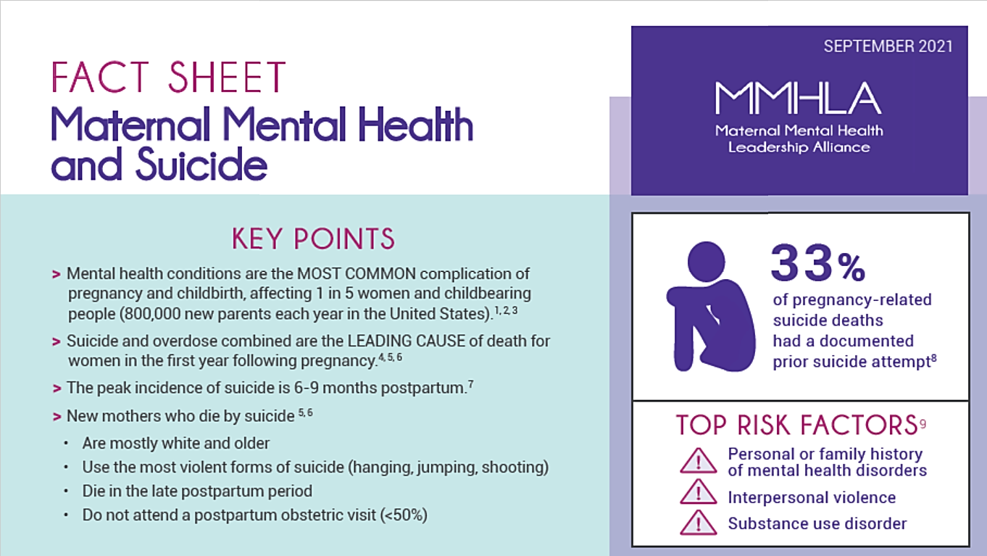

Slide 7
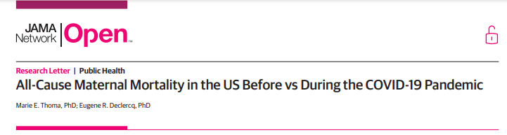
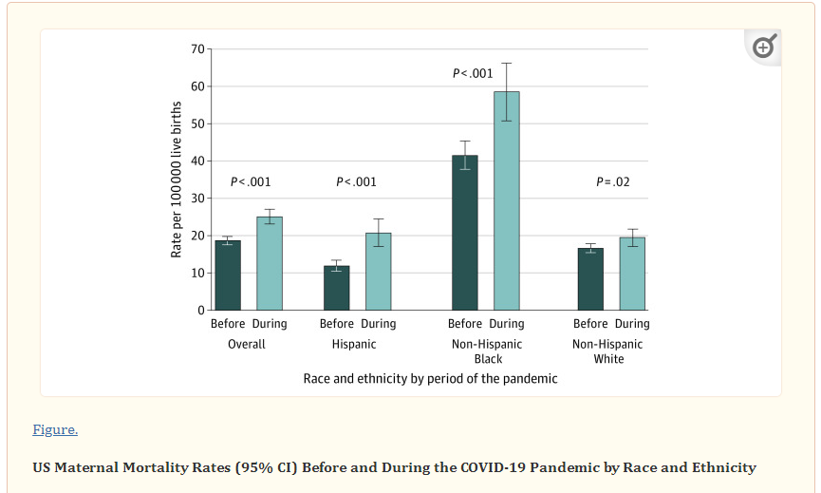
Thoma ME, Declercq ER. All-Cause Maternal Mortality in the US Before vs During the COVID-19 Pandemic. JAMA Netw Open. 2022;5(6):e2219133. doi:10.1001/jamanetworkopen.2022.19133

Slide 8
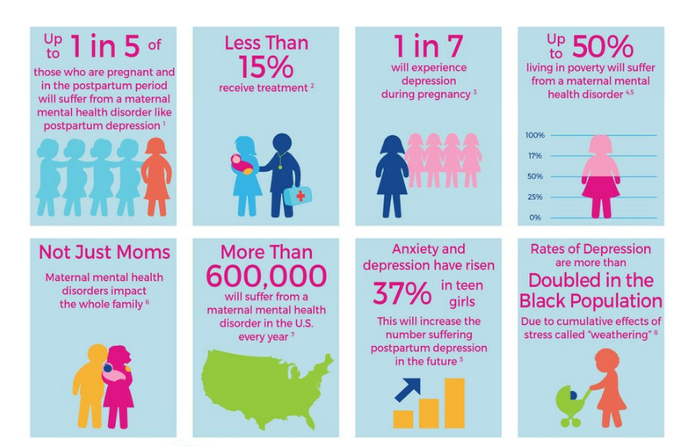
Notes:
About Maternal Mental Health Disorders — 2020 Mom

Slide 9
Maternal Mortality/Morbidity
https://www.cdcfoundation.org/sites/default/files/files/ReportfromNineMMRCs.pdf

Slide 10

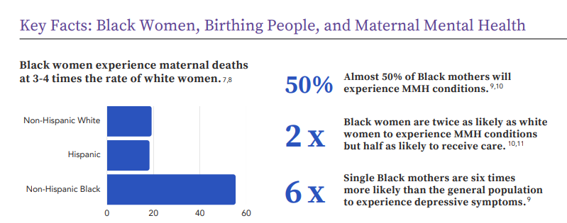

Slide 11
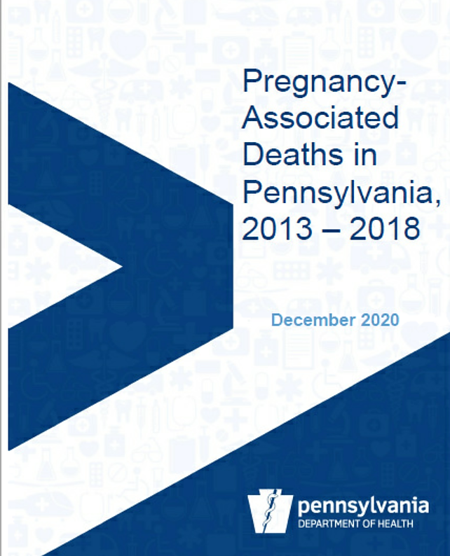

Slide 12
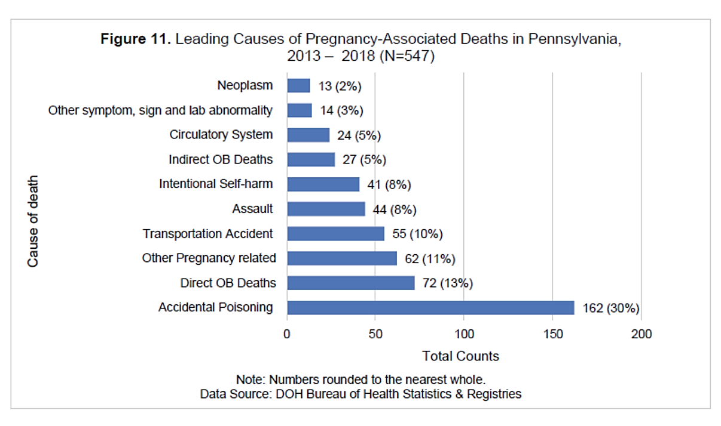

Slide 13
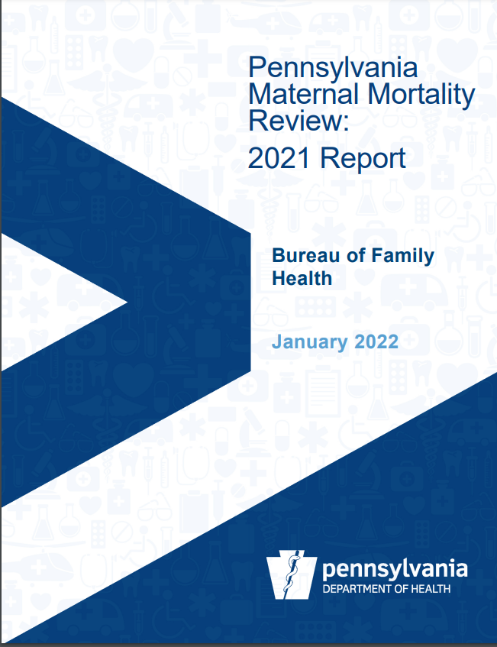

Slide 14
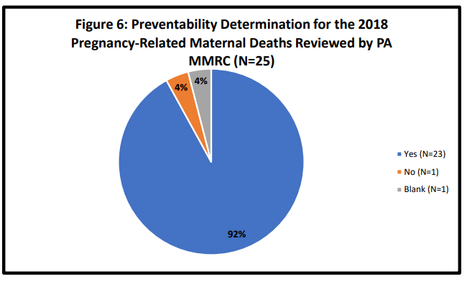
What % of PA pregnancy-related deaths are preventable?

Slide 15
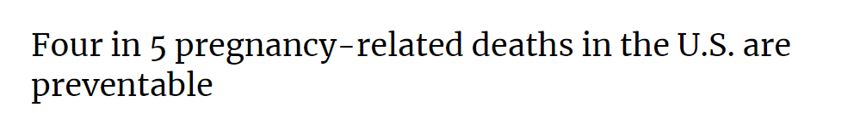
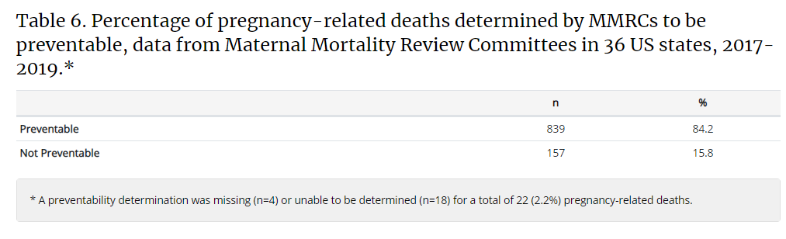
Source: https://www.cdc.gov/reproductivehealth/maternal-mortality/erase-mm/data-mmrc.html

Slide 16

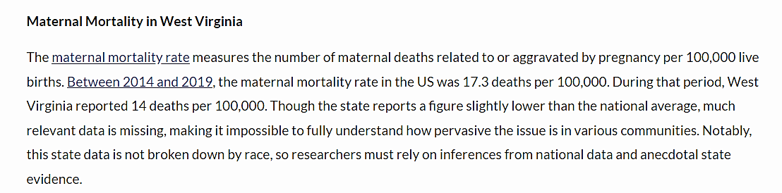
Black Infant and Maternal Mortality Needs to be Addressed in West Virginia - West Virginia Center on Budget & Policy (wvpolicy.org)

Slide 17
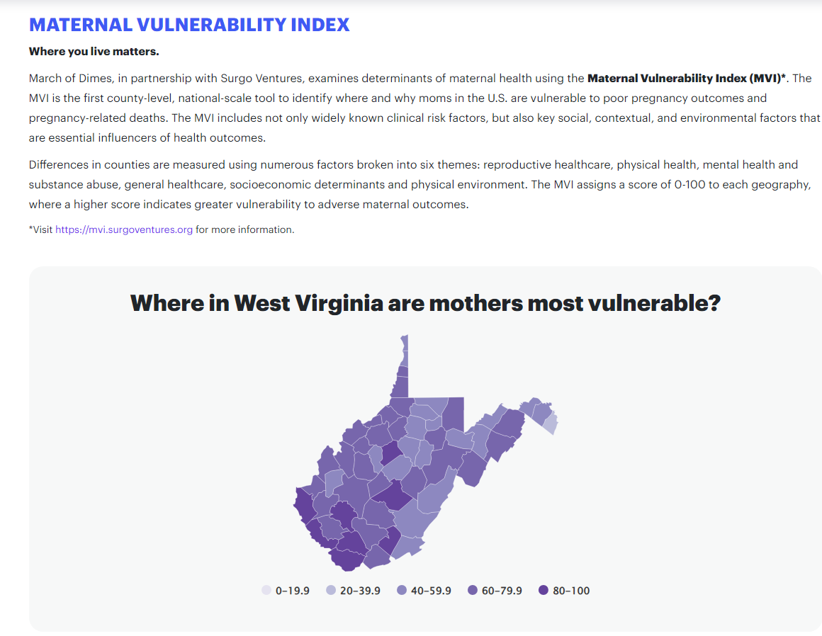

Slide 18
Brexanolone:
Current State of Evidence

Slide 19
Disclosures
No one involved with the development of the UPMC brexanolone program at Magee has any financial relationship with SAGE Therapeutics
*This includes UPMC Western Behavioral Health and UPMC Magee-Womens Hospital physicians and clinicians

Slide 20
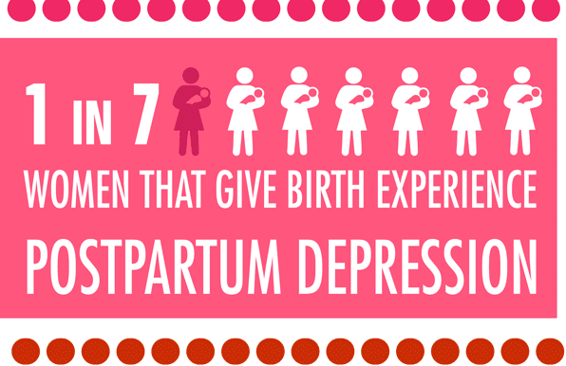

Slide 21
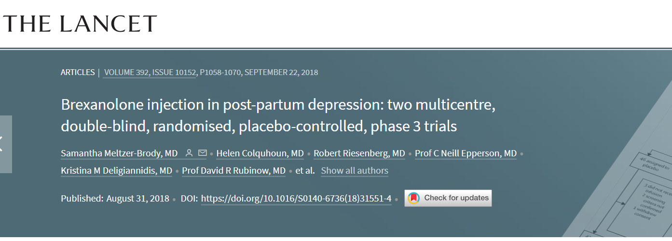
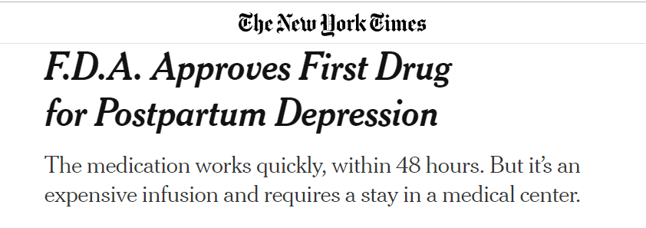
Notes:
Landmark lancet article came out in 2018 and demonstrated rapid onset and durable treatment response
First approved 3/19/2019

Slide 22

Ms. A has a spontaneous vaginal delivery with no complications. When you see her 6 weeks later in your office, she tells you that since her delivery, she has been having difficulty with low mood, anhedonia, hopelessness, worthlessness, and some difficulty with bonding with her baby. She has remained on her fluoxetine and continued psychotherapy. She asks you about this new medication she’s heard about: brexanolone.
What do you tell her?

Slide 23
Brexanolone - Neurobiology
Structurally identical to endogenous allopregnanolone
Positive allosteric modulator of synaptic and extrasynaptic GABAA receptors
Distinct binding site from GABA
Proposed Mechanism of PPD:
  Fluctuations in neuroactive steroids
  → Reduces GABA function
  → Postpartum depressive episode
Source: https://www.fda.gov/media/121351/download

Slide 24
Mechanistically driven neurosteroid treatment
Rapid ↓ symptoms in postpartum women with moderate to severe MDD
60-hour infusion
Phase 2 studies showed early 60-hour and sustained 30-day reduction in HAM-D scores (12 points)
Notes:
, for whom a hormonal etiology of depression is postulated. B

Slide 25
Hamilton Depression Rating Scale (HDRS)
Normal (0-7)
Mild depression (8-16)
Moderate depression (17-23)
Severe depression (≥24)
Notes:
Max score 52

Slide 26

Brexanolone - Pros
Quicker response than SSRIs
Treating the episodic depression
  May allow for engagement in longer-term psychiatric treatments
Novel treatment targeting pathophysiology
Quicker response = theoretical improvements in bonding/attachment, return to functioning
Notes:
Bonding-can have long lasting impacts

Slide 27
Screening and Evaluation
Depression onset third trimester through 6 months postpartum
HAMD17 > 20
No renal failure/dialysis
No imminent suicidality or homicidality
No psychosis or mania; no ECT
Substance use exclusion
Pregnancy exclusion
Notes:
Moderate to severe depression range

Slide 28
4% in Phase 3 trials with loss of consciousness
Potent GABA-A agonist
Requires hospitalization to monitor for excessive sedation and loss of consciousness
Requires enrollment in Risk Evaluation and Mitigation Strategies (REMS)

Slide 29

Safety Considerations
No increased risk of SI
Other potential side effects:
  Headache (14%)
  Dizziness (14%)
  Somnolence (11%)
  Dry mouth (10%)
14% of placebo group had sedation-related events

Slide 30
Dosing and Monitoring
Requirements = q2 hour checks
  While the requirement is a visual check, we check vital signs
Continuous pulse oximetry (required) and cardiac telemetry (not required by the FDA but need per hospital policy)
Riker SAS and Falls/Harm Assessment while in the hospital
Patient must be accompanied during interaction with baby/children
Hamilton Depression Score while in the hospital
Notes:
Riker Sedation-Agitation Scale (SAS)

Slide 31

Lactation
Relative Infant Dose (RID) < 1.3%
RID <10% considered compatible with breastfeeding
Low oral bioavailability (<5%)
Wald J, Henningsson A, Hanze E, Hoffmann E, Li H, Colquhoun H, Deligiannidis KM. Allopregnanolone Concentrations in Breast Milk and Plasma from Healthy Volunteers Receiving Brexanolone Injection, With Population Pharmacokinetic Modeling of Potential Relative Infant Dose. Clin Pharmacokinet. 2022 Sep;61(9):1307-1319. doi: 10.1007/s40262-022-01155-w. Epub 2022 Jul 23. PMID: 35869362; PMCID: PMC9439988.
Notes:
Given the potential infant exposure to antidepressants via excretion into breast milk, this study evaluated the concentrations of allopregnanolone in breast milk and maternal plasma from the start of a 60-h infusion of brexanolone injection through 7 days in 12 healthy volunteers.
A population pharmacokinetic model was constructed to successfully describe the variability and concentration versus time profile of allopregnanolone in plasma of brexanolone-treated patients with postpartum depression (PPD) and healthy volunteers, and the distribution into breast milk of healthy volunteers (total, 156 women). The maximum relative infant dose was estimated to be 1.3% of the maternal dose.
Together, these findings suggest the appropriateness of weight-based dosing and support other pharmacokinetic-related labeling recommendations of brexanolone in adult patients with PPD.
Drugs and Lactation Database notes that brexanolone is not likely to cause adverse outcomes given low oral bioavailability and low amounts detected in breastmilk

Slide 32

Brexanolone Referral Case
32 year old G2P1 with no significant past medical history delivered 8 weeks ago (normal SVD). She has a history of severe postpartum depression and presents to your outpatient clinic asking about brexanolone as a treatment option. She has had depressive symptoms for the last 6 weeks including low mood, anhedonia, hopelessness, and passive death wish. She is on citalopram 20 mg daily. She has no history of bipolar disorder.
What questions do you need to ask her?
How will you counsel her about the medication if you feel she is eligible?

Slide 33
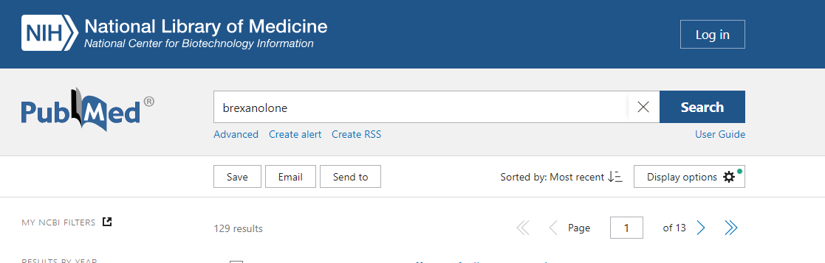
Notes:
129 since 2019; of these, 5 are original studies – the rest are reviews or position papers

Slide 34
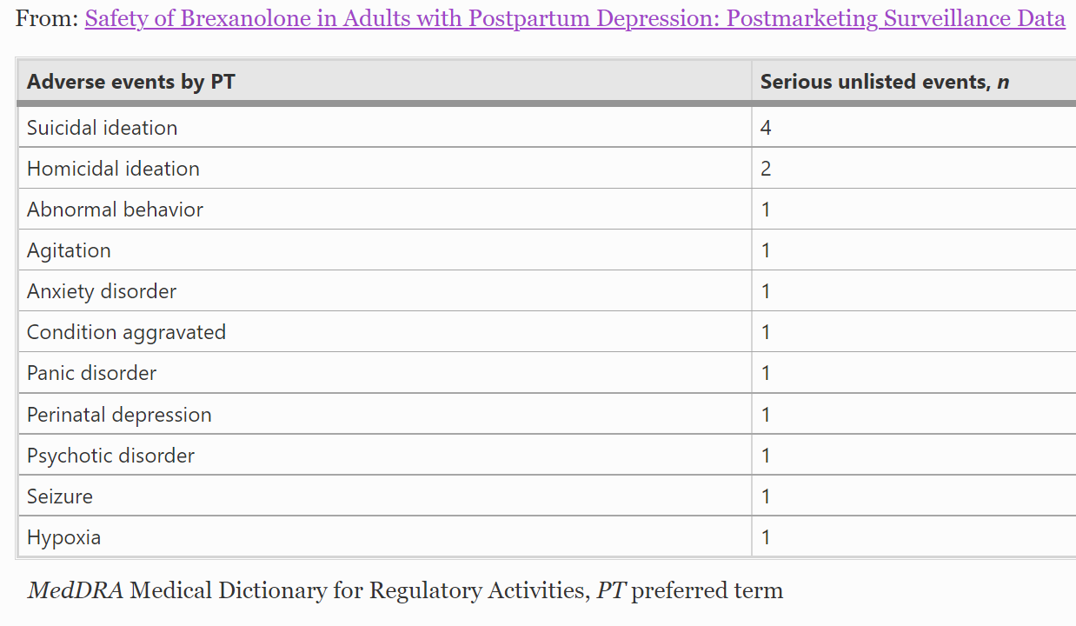
Table: Serious Unlisted Adverse Events
Take Aways:
N = 499
Sedation rates lower than expected
Garafola S, Shiferaw E, Dev V. Safety of Brexanolone in Adults with Postpartum Depression: Postmarketing Surveillance Data. Drugs Real World Outcomes. 2023 Jun 6. doi: 10.1007/s40801-023-00372-4
Notes:
Overall, there were 15 serious unlisted AEs; the majority (80%, 12/15) were in the psychiatric disorder SOC and represented symptoms of psychiatric disorders (n = 12), including suicidal ideation (n = 4), homicidal ideation (n = 2), and abnormal behavior, agitation, anxiety disorder, panic disorder, perinatal depression, and psychotic disorder (n = 1 each). The remaining three serious unlisted events were in SOCs of nervous system disorders (n = 1; seizure), respiratory disorders (n = 1; hypoxia), and general disorder/administration site conditions (n = 1; condition aggravated; Table 2).
Abstract
Background
Brexanolone is currently the only medication approved by the US FDA for the treatment of postpartum depression (PPD) in patients ≥15 years. Brexanolone is available commercially only through a restricted program (ZULRESSO® Risk Evaluation and Mitigation Strategy; REMS) due to risk of excessive sedation or sudden loss of consciousness during administration.
Objective
The aim of this analysis was to assess the postmarketing safety of brexanolone in adults with PPD.
Methods
The cumulative postmarketing adverse event (AE) listing from spontaneous and solicited individual case safety reports (ICSRs) received from March 19, 2019, through December 18, 2021, was analyzed. Clinical trial ICSRs were excluded. Reported AEs were classified as serious or nonserious as defined by FDA seriousness criteria and as listed or unlisted based on Table 2.0 within section 6 “Adverse Reactions” of the current brexanolone FDA-approved US Prescribing Information (PI).
Results
Overall, 499 patients received brexanolone in this postmarketing surveillance analysis between June 2019 and December 2021 (postmarketing setting). There were 137 ICSRs with 396 total AEs: 15 serious unlisted, 2 serious listed, 346 nonserious unlisted, and 33 nonserious listed. In total, two serious and one nonserious listed excessive sedation AEs were reported—all resolved by stopping infusion and did not require any treatment; no loss of consciousness AEs were received.
Conclusion
Results from postmarketing surveillance data analysis are consistent with the safety profile of brexanolone for the treatment of PPD as described in the FDA-approved PI. No new safety concerns or new aspects of known risks requiring an update to the FDA-approved PI were identified.
Key Points
Postpartum depression (PPD) is a common mood disorder affecting approximately 10%–15% of women in the US who give birth.
Brexanolone is the first and only medication approved by the US FDA for the treatment of PPD in patients 15 years and older.
In published brexanolone (60 and 90 μg/kg/h) clinical trials, the most common adverse reactions included sedation/somnolence (15% [21/140 total patients]), dizziness/presyncope/vertigo (12% [17/140]), dry mouth (5% [7/140]), loss of consciousness (3.6% [5/140]), and flushing/hot flush (2.9% [4/140]).
This postmarketing surveillance report evaluating brexanolone adverse events from March 19, 2019, through December 18, 2021, demonstrated that the rates of excessive sedation and loss of consciousness were lower than what was observed in clinical trials. Furthermore, the clinically observed severity was consistent with the events observed in completed clinical trials, with no new safety signals identified.

Slide 35
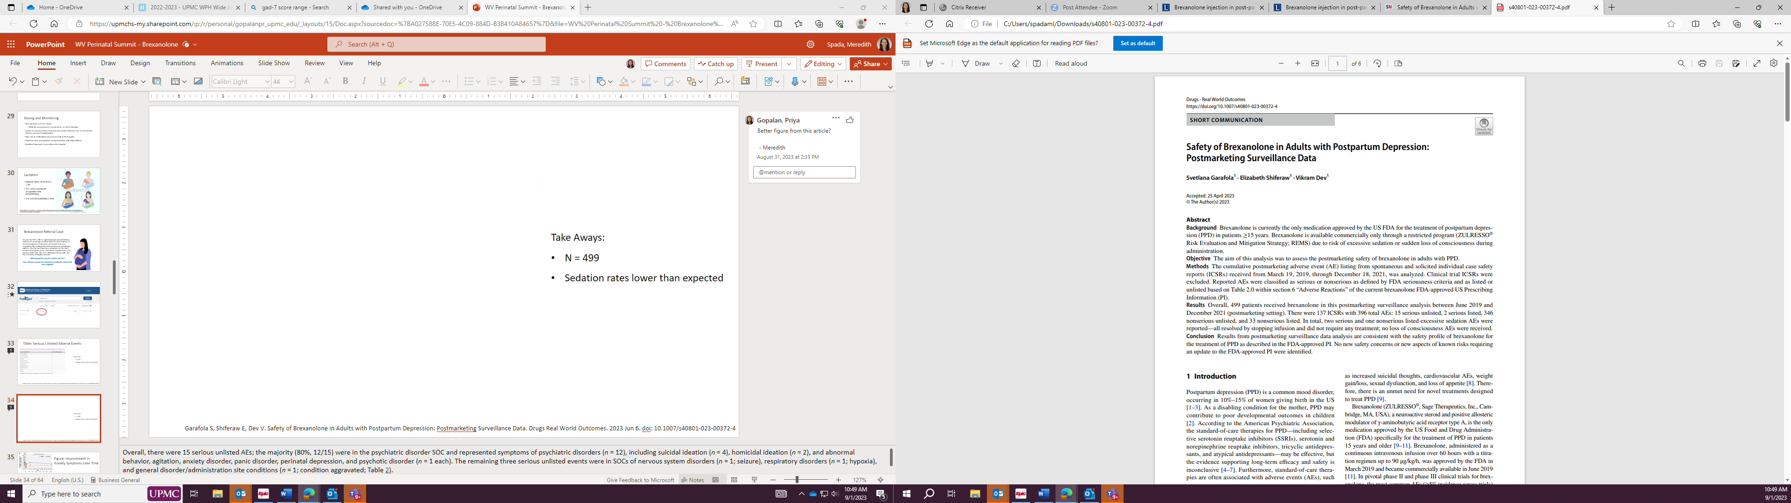
Take Aways:
Assessed postmarketing safety of brexanolone in adults with PPD
N = 499, analysis between June 2019 and December 2021
No loss of consciousness adverse events reported
Excessive sedation rates lower than expected
  2 serious and one nonserious listed excessive sedation adverse event
  All resolved by stopping infusion and did not require treatment
Garafola S, Shiferaw E, Dev V. Safety of Brexanolone in Adults with Postpartum Depression: Postmarketing Surveillance Data. Drugs Real World Outcomes. 2023 Jun 6. doi: 10.1007/s40801-023-00372-4
Notes:
Overall, there were 15 serious unlisted AEs; the majority (80%, 12/15) were in the psychiatric disorder SOC and represented symptoms of psychiatric disorders (n = 12), including suicidal ideation (n = 4), homicidal ideation (n = 2), and abnormal behavior, agitation, anxiety disorder, panic disorder, perinatal depression, and psychotic disorder (n = 1 each). The remaining three serious unlisted events were in SOCs of nervous system disorders (n = 1; seizure), respiratory disorders (n = 1; hypoxia), and general disorder/administration site conditions (n = 1; condition aggravated; Table 2).
Abstract
Background
Brexanolone is currently the only medication approved by the US FDA for the treatment of postpartum depression (PPD) in patients ≥15 years. Brexanolone is available commercially only through a restricted program (ZULRESSO® Risk Evaluation and Mitigation Strategy; REMS) due to risk of excessive sedation or sudden loss of consciousness during administration.
Objective
The aim of this analysis was to assess the postmarketing safety of brexanolone in adults with PPD.
Methods
The cumulative postmarketing adverse event (AE) listing from spontaneous and solicited individual case safety reports (ICSRs) received from March 19, 2019, through December 18, 2021, was analyzed. Clinical trial ICSRs were excluded. Reported AEs were classified as serious or nonserious as defined by FDA seriousness criteria and as listed or unlisted based on Table 2.0 within section 6 “Adverse Reactions” of the current brexanolone FDA-approved US Prescribing Information (PI).
Results
Overall, 499 patients received brexanolone in this postmarketing surveillance analysis between June 2019 and December 2021 (postmarketing setting). There were 137 ICSRs with 396 total AEs: 15 serious unlisted, 2 serious listed, 346 nonserious unlisted, and 33 nonserious listed. In total, two serious and one nonserious listed excessive sedation AEs were reported—all resolved by stopping infusion and did not require any treatment; no loss of consciousness AEs were received.
Conclusion
Results from postmarketing surveillance data analysis are consistent with the safety profile of brexanolone for the treatment of PPD as described in the FDA-approved PI. No new safety concerns or new aspects of known risks requiring an update to the FDA-approved PI were identified.
Key Points
Postpartum depression (PPD) is a common mood disorder affecting approximately 10%–15% of women in the US who give birth.
Brexanolone is the first and only medication approved by the US FDA for the treatment of PPD in patients 15 years and older.
In published brexanolone (60 and 90 μg/kg/h) clinical trials, the most common adverse reactions included sedation/somnolence (15% [21/140 total patients]), dizziness/presyncope/vertigo (12% [17/140]), dry mouth (5% [7/140]), loss of consciousness (3.6% [5/140]), and flushing/hot flush (2.9% [4/140]).
This postmarketing surveillance report evaluating brexanolone adverse events from March 19, 2019, through December 18, 2021, demonstrated that the rates of excessive sedation and loss of consciousness were lower than what was observed in clinical trials. Furthermore, the clinically observed severity was consistent with the events observed in completed clinical trials, with no new safety signals identified.

Slide 36
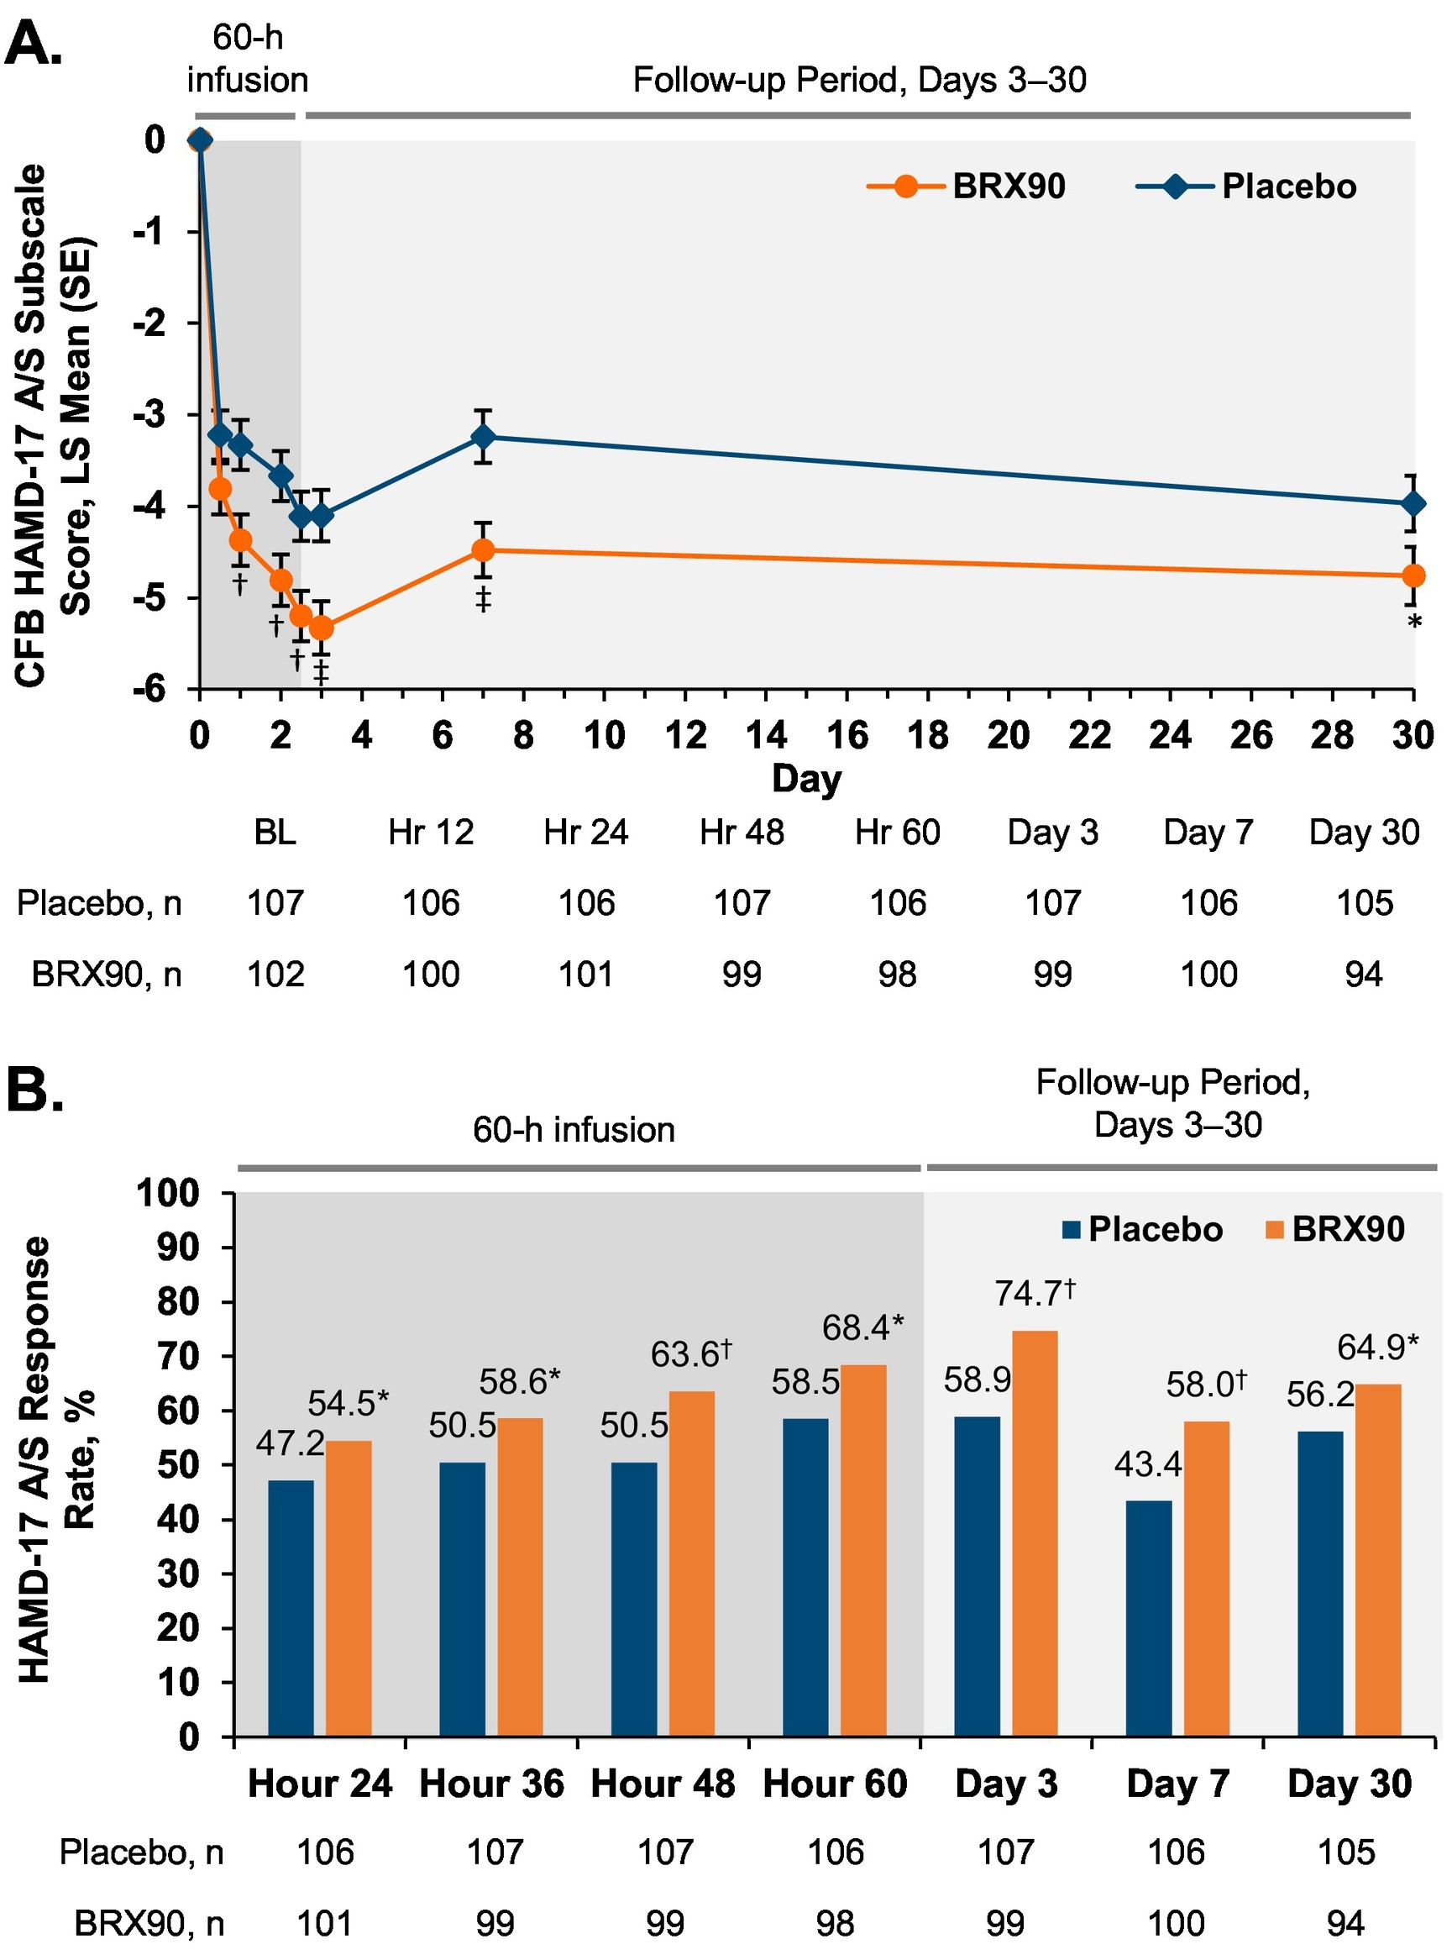
Figure: Improvement in Anxiety Symptoms Over Time
(A) Change from baseline (CFB) in HAMD-17 A/S subscale score through Day 30
(B) Proportion of patients achieving HAMD-17 A/S response through Day 30
Epperson CN, Rubinow DR, Meltzer-Brody S, Deligiannidis KM, Riesenberg R, Krystal AD, Bankole K, Huang MY, Li H, Brown C, Kanes SJ, Lasser R. Effect of brexanolone on depressive symptoms, anxiety, and insomnia in women with postpartum depression: Pooled analyses from 3 double-blind, randomized, placebo-controlled clinical trials in the HUMMINGBIRD clinical program. J Affect Disord. 2023 Jan 1;320:353-359. doi: 10.1016/j.jad.2022.09.143.
Notes:
Fig. 3. Improvement in anxiety-related symptoms over time. (A) Change from baseline (CFB) in HAMD-17 A/S subscale score through Day 30. (B) Proportion of patients achieving HAMD-17 A/S response through Day 30.
*p < 0.05; †p < 0.01; ‡p < 0.001 versus placebo. Abbreviations: BL = baseline; BRX90 = brexanolone 90 μg/kg/h; HAMD-17 A/S = 17-item Hamilton Rating Scale for Depression Anxiety/Somatization subscale; LS = least squares; SE = standard error.
Highlights
•Treatment with brexanolone was evaluated in adult women with postpartum depression.
•Brexanolone is associated with rapid improvement in depressive symptoms.
•Symptoms of anxiety and insomnia were rapidly reduced with brexanolone vs placebo.
•Treatment effects of brexanolone were sustained post infusion through Day 30.
Abstract
Background
Brexanolone is currently the only treatment specifically approved for postpartum depression (PPD) in the United States, based on the results from one Phase 2 and two Phase 3 double-blind, randomized, controlled trials in the HUMMINGBIRD program.
Methods
Adults with PPD randomized to a 60-h infusion of brexanolone 90 μg/kg/h (BRX90) or placebo from the 3 trials were included in these post hoc analyses. Data on change from baseline (CFB) in the 17-item Hamilton Rating Scale for Depression (HAMD-17) total score, HAMD-17 Anxiety/Somatization and Insomnia subscales, and Clinical Global Impression of Improvement (CGI-I) scale were pooled. Response rates for HAMD-17 (≥50 % reduction from baseline) and CGI-I (score of 1 or 2) scales and time to response were analyzed.
Results
Patients receiving BRX90 (n = 102) versus placebo (n = 107) achieved a more rapid HAMD-17 response (median, 24 vs 36 h; p = 0.0265), with an Hour-60 cumulative response rate of 81.4 % versus 67.3 %; results were similar for time to CGI-I response (median, 24 vs 36 h; p = 0.0058), with an Hour-60 cumulative response rate of 81.4 % versus 61.7 %. CFB in HAMD-17 Anxiety/Somatization and Insomnia subscales also favored BRX90 versus placebo, starting at Hour 24 through Day 30 (all p < 0.05), and response rates for both subscales were higher with BRX90.
Limitations
The study was not powered to assess exploratory outcomes.
Conclusions
Brexanolone was associated with rapid improvement in depressive symptoms and symptoms of anxiety and insomnia compared with placebo in women with PPD. These data continue to support the use of brexanolone to treat adults with PPD.

Slide 37
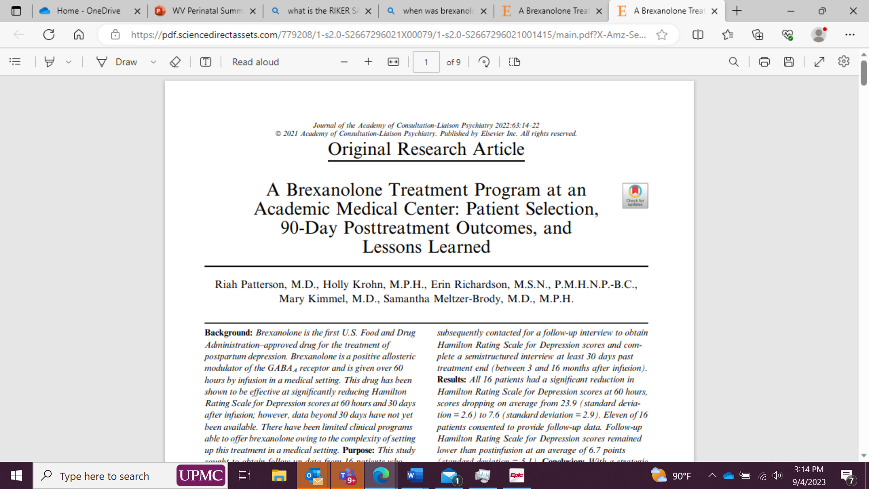
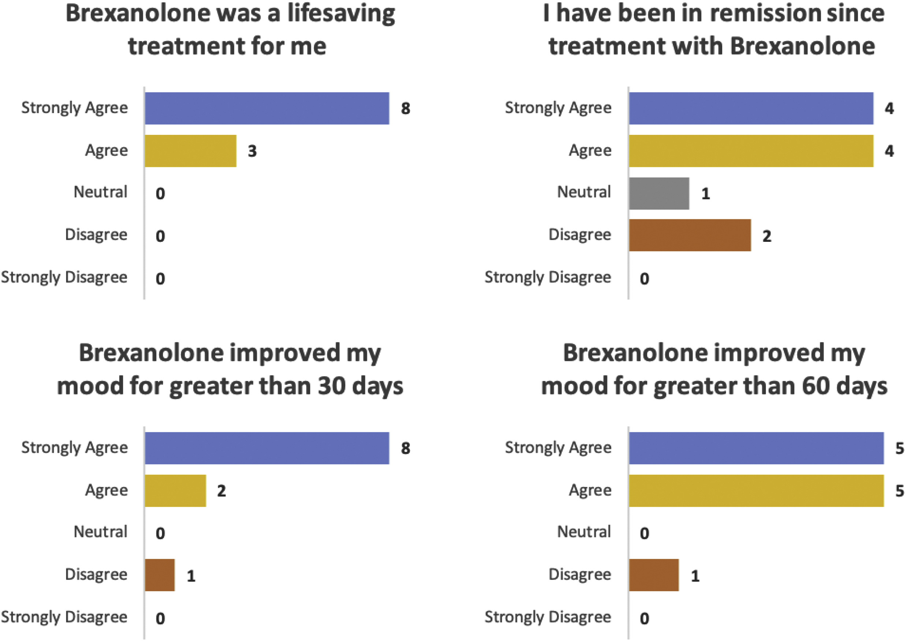
Take-aways:
11/16 participated in a semi-structured interview between 3-16 months after infusion
All 11 patients gave very positive feedback about their treatment
Followup HAM-D remained lower
"Brexanolone has been a useful clinical tool in treating women with significant symptoms of postpartum depression"
Patterson R, Krohn H, Richardson E, Kimmel M, Meltzer-Brody S. A Brexanolone Treatment Program at an Academic Medical Center: Patient Selection, 90-Day Posttreatment Outcomes, and Lessons Learned. J Acad Consult Liaison Psychiatry. 2022 Jan-Feb;63(1):14-22. doi: 10.1016/j.jaclp.2021.08.001. Epub 2021 Aug 24. PMID: 34438099.
Notes:
UNC Background
Brexanolone is the first U.S. Food and Drug Administration–approved drug for the treatment of postpartum depression. Brexanolone is a positive allosteric modulator of the GABAA receptor and is given over 60 hours by infusion in a medical setting. This drug has been shown to be effective at significantly reducing Hamilton Rating Scale for Depression scores at 60 hours and 30 days after infusion; however, data beyond 30 days have not yet been available. There have been limited clinical programs able to offer brexanolone owing to the complexity of setting up this treatment in a medical setting.
Purpose
This study sought to obtain follow-up data from 16 patients who received a brexanolone infusion at UNC Hospitals in Chapel Hill, NC, between October 2019 and December 2020 and were beyond the 30-day postinfusion time point. We describe the methods used to successfully implement this treatment program in an academic medical center and discuss associated challenges and lessons learned with patient selection and process improvements.
Methods
Hamilton Rating Scale for Depression scores were collected before and after infusion from 16 patients who received a brexanolone infusion at UNC. Patients were subsequently contacted for a follow-up interview to obtain Hamilton Rating Scale for Depression scores and complete a semistructured interview at least 30 days past treatment end (between 3 and 16 months after infusion).
Results
All 16 patients had a significant reduction in Hamilton Rating Scale for Depression scores at 60 hours, scores dropping on average from 23.9 (standard deviation = 2.6) to 7.6 (standard deviation = 2.9). Eleven of 16 patients consented to provide follow-up data. Follow-up Hamilton Rating Scale for Depression scores remained lower than postinfusion at an average of 6.7 points (standard deviation = 5.1).
Conclusion
With a strategic cross-disciplinary approach, a Clinical Brexanolone Treatment Program was established at UNC Hospitals in 2019. Sixteen patients have been treated in the program, and 11 participated in a follow-up interview. All 11 patients gave very positive feedback about their treatment. Our program has found brexanolone to be a useful clinical tool in treating women with significant symptoms of postpartum depression.

Slide 38
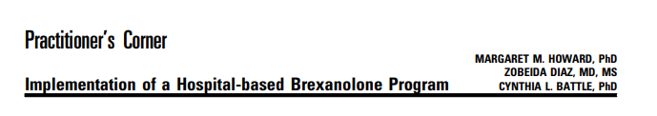
Take-Aways
Description of a program
26 patients infused
12 breastfed during the study
1 with sedation; no other adverse events
Howard MM, Diaz Z, Battle CL. Implementation of a Hospital-based Brexanolone Program. J Psychiatr Pract. 2022 Sep 1;28(5):404-408. doi:10.1097/PRA.0000000000000650.
Notes:
Women & Infants Hospital of Rhode Island (WIH)
Abstract
Postpartum depression (PPD) is a serious complication of childbearing affecting ∼1 in 7 mothers. Left unrecognized and untreated, it is associated with negative outcomes for mothers and their infants. Building upon research suggesting that, for some women, hormonal fluctuations after childbirth contribute to the onset of depression, clinical trials have found promise in a novel treatment approach, brexanolone infusion. In 2019, the Food and Drug Administration (FDA) approved brexanolone as the first medication with an indication specifically for PPD. Delivering brexanolone treatment to patients in need requires overcoming some logistical and clinical challenges that are unique to this approach. This brief report describes the process by which a university-affiliated obstetric-gynecologic hospital in the northeast United States successfully implemented a program to administer this novel treatment to women with PPD.

Slide 39
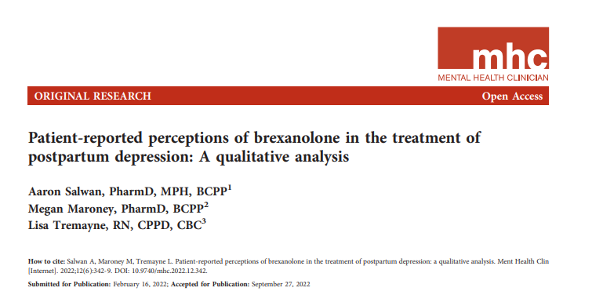
Take-Aways:
5/10 patients qualitatively interviewed at 16-20 months post-infusion
All had rapid improvement to brexanolone
Reported brexanolone helped return to usual selves, had positive influence on parent-child relationship, need for increased availability
Barriers included insurance approval, cost, required hospital stay
Salwan A, Maroney M, Tremayne L. Patient-reported perceptions of brexanolone in the treatment of postpartum depression: A qualitative analysis. Ment Health Clin. 2023 Jan 5;12(6):342-349. doi: 10.9740/mhc.2022.12.342. PMID: 36644587; PMCID: PMC9819138.
Notes:
Treatment center in New Jersey
Abstract
Introduction
Brexanolone demonstrates short-term efficacy for the treatment of postpartum depression (PPD). Postpartum depression is linked to infanticide and maternal suicide, and current treatment often fails to adequately control depressive symptoms. The purpose of this analysis is to further understand the experience(s) of women who have received brexanolone for the treatment of PPD.
Methods
Semistructured interviews modeled after the theory of planned behavior (TPB) were conducted to assess women's perceptions of treatment for PPD with brexanolone. Women who received treatment with brexanolone at this inpatient facility were eligible to participate in this study. The TPB is often used to predict intention to perform health-related behaviors. Semistructured interviews were recorded and transcribed, and thematic analysis was conducted to identify common ideas across all interviews. Follow-up assessment of depressive and anxious symptoms was also conducted using the Patient Health Questionnaire-9 (PHQ-9) and Generalized Anxiety Disorder-7 (GAD-7), respectively.
Results
Five of the 10 women who received treatment with brexanolone at this facility were interviewed, and common themes related to the TPB were analyzed. Attitudes toward brexanolone were favorable, and having a strong support system was a motivating factor in receiving treatment for PPD. Insurance approval, need for childcare, and poor understanding of symptoms of PPD were barriers to receiving treatment with brexanolone. Symptoms of depression and anxiety were rated as low at the time of the follow-up interview as measured by the PHQ-9 (mean 1.6, range 1 to 3) and GAD-7 (mean 2.8, range 2 to 4), respectively.
Discussion
Brexanolone rapidly and sustainably reduced symptoms of PPD and was well-received by patients. Despite significant barriers to use, women who received treatment with brexanolone advocated for its availability as well as increased awareness of PPD.

Slide 40
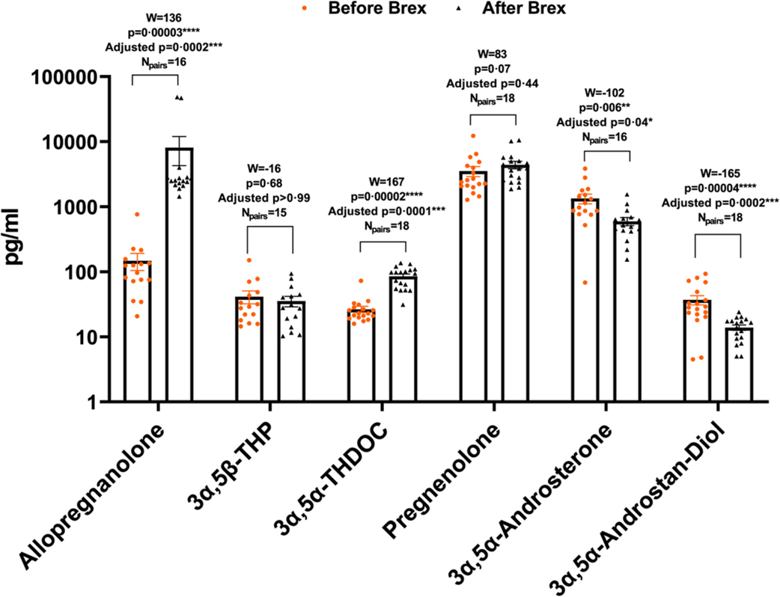
Brexanolone Infusion Alters Multiple Steroid Levels in PPD Patient Serum
Balan I, Patterson R, Boero G, Krohn H, O'Buckley TK, Meltzer-Brody S, Morrow AL. Brexanolone therapeutics in post-partum depression involves inhibition of systemic inflammatory pathways. EBioMedicine. 2023 Mar;89:104473. doi: 10.1016/j.ebiom.2023.104473. Epub 2023 Feb 16. PMID: 36801618; PMCID: PMC9984433.
Notes:
Study of 18 patietns who provided blood samples. Looked at steroids and inflammatory immune activators
Abstract
Background
Brexanolone has rapid, long-lasting, and remarkable efficacy in the treatment of post-partum depression (PPD). We test the hypothesis that brexanolone inhibits proinflammatory modulators and macrophage activation in PPD patients, which may promote clinical recovery.
Methods
PPD patients (N = 18) provided blood samples before and after brexanolone infusion according to the FDA-approved protocol. Patients were unresponsive to prior treatment before brexanolone therapy. Serum was collected to determine neurosteroid levels and whole blood cell lysates were examined for inflammatory markers and in vitro responses to the inflammatory activators lipopolysaccharide (LPS) and imiquimod (IMQ).
Findings
Brexanolone infusion altered multiple neuroactive steroid levels (N = 15–18), reduced levels of inflammatory mediators (N = 11) and inhibited their response to inflammatory immune activators (N = 9–11). Specifically, brexanolone infusion reduced whole blood cell tumor necrosis factor-α (TNF-α, p = 0.003), and interleukin-6 (IL-6, p = 0.04) and these effects were correlated with HAM-D score improvement (TNF-α, p = 0.049; IL-6, p = 0.02). Furthermore, brexanolone infusion prevented LPS and IMQ-induced elevation of TNF-α (LPS: p = 0.02; IMQ: p = 0.01), IL-1β (LPS: p = 0.006; IMQ: p = 0.02) and IL-6 (LPS: p = 0.009; IMQ: p = 0.01), indicating inhibition of toll-like receptor (TLR)4 and TLR7 responses. Finally, inhibition of TNF-α, IL-1β and IL-6 responses to both LPS and IMQ were correlated with HAM-D score improvements (p < 0.05).
Interpretation
Brexanolone actions involve inhibition of inflammatory mediator production and inhibition of inflammatory responses to TLR4 and TLR7 activators. The data suggest that inflammation plays a role in post-partum depression and that inhibition of inflammatory pathways contributes to the therapeutic efficacy of brexanolone.
Implications of all the available evidence
Together with previous studies showing that depression can be associated with elevations of pro-inflammatory modulators in blood, these results implicate the TLR4 and TLR7 inflammatory pathways along with TNF-α, IL-1β and IL-6 in the etiology of post-partum depression and suggest that other inhibitors of these pathways may have therapeutic efficacy in both post-partum and major depression.

Slide 41
Phone call or email for referrals
412-624-2000 OR email brexanolone@upmc.edu
Pre-screen phone call by Bellefield RN
Appropriate
Not Appropriate
Initiation of brexanolone process
Refer to outpatient psychiatric services at Magee Behavioral, Bellefield Towers, or CPCDS
Psychiatric evaluation by Magee BH
Initiation of prior authorization process
Deemed Appropriate
(Approximately 2-3 weeks)
Authorization Obtained
Pre-admission process initiated:*
Bed scheduled (Mondays)
Patient REMS registration
Psych CL, MFM, pharmacy, nursing management, SW notified
Admission to Magee for treatment administration

Slide 42
Brexanolone at UPMC
Multidisiciplinary Collaboration
First infusion in 8/2020
29 referrals; 15 admissions to date
Admitted to MFM service with psychiatry consult
Notes:
Recent suicidality

Slide 43
Clinical Conundrums

Slide 44

31 year old G1P1 at 8 months postpartum with worsening major depressive disorder despite sertraline, aripiprazole, and engagement in psychotherapy and support groups.
She has reached out to you inquiring about brexanolone as a treatment option, even though she is greater than 6 months postpartum.
WHAT WOULD YOU DO?
Notes:
-initial eval- deemed eligible-insurance approved-we infused her and she did well

Slide 45

32 year old G2P1 at 3 months postpartum with major depressive disorder admitted for brexanolone infusion.
Overnight, her IV infiltrates and nursing tries multiple times to replace the IV without success. She became increasingly upset and asked to stop the infusion so she could leave the hospital. A team member from the anesthesiology team comes to replace the IV.
The infusion had been paused for approximately 2 hours prior to the IV being replaced. She is still very upset when you see her in the morning and says that she really wants to go home to be with her baby.
WHAT WOULD YOU DO?
Notes:
Encouraged pt to stay; ran the infusion for 2 hours longer

Slide 46

29 year old G1P1 admitted for depression with anxious distress. Patient had recent cross-taper by PCP from escitalopram to sertraline as she reported inefficacy with escitalopram. She also was prescribed lorazepam 0.5 mg BID PRN anxiety, which was initially held for the infusion.
Two hours after start of infusion, the patient began reporting that she felt like she "needed to escape" and "did not want to be here." The psychiatry consult resident returned after initial evaluation and spoke with the patient at length at nursing request during which mindfulness and relaxation techniques were reinforced. Later the on-call consult psychiatrist spoke with her again at nursing request due to acute exacerbation of anxiety.
WHAT WOULD YOU DO?
Notes:
-sitter placed, in AM, denied any SI, noted this was an acute panic attack; said she had read on brex FB group that other women had reported experiencing similar reactions with the onset of infusion. Referred to IOP, safety planned extensively, spoke with mother.

Slide 47

37 year old G2P2 with major depressive disorder from a rural West Virginia drove herself to the hospital from several hours away for brexanolone infusion. The patient reported on admission not enjoying her baby or other child like she had in the past. Described the depression as making her life "colorless." She reported active suicidal ideation (SI) as recently as a week ago with thoughts to drive her car into traffic to end it all. She endorses ongoing passive death with but denies any active SI. She has access to guns.
WHAT WOULD YOU DO?
Notes:
-we infused her, safety planned extensively, called husband to remove guns; she reported in followup that brexanolone "saved her life."

Slide 48
New Frontiers: Zuranolone

Slide 49
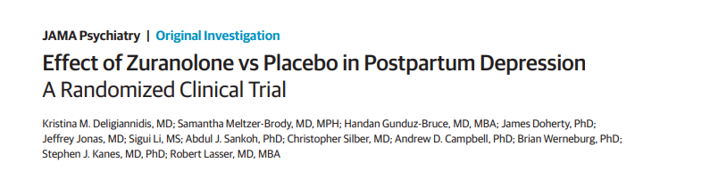
Multisite phase 3, double-blind, randomized, outpatient, placebo-controlled clinical trial
  153 randomized patients
Zuranolone 30 mg PO QHS x 2 weeks
Significant day 15 HAMD-17 score improvements from baseline vs placebo (−17.8 vs −13.6; 95% CI, −6.9 to −1.5; p = .003)
Differences in HAMD-17 scores observed day 3 (difference,−2.7; 95% CI, −5.1 to −0.3; p=.03)
  Sustained through day 45 (difference, −4.1; 95% CI, −6.7 to −1.4; p = .003)
- JAMA June 2021

Slide 50

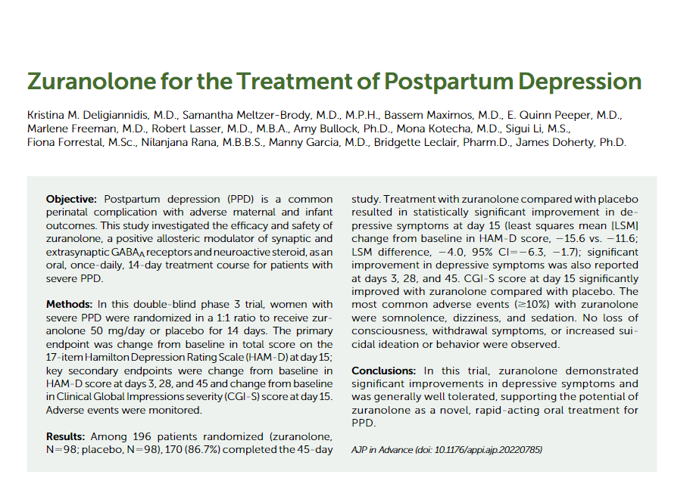
Deligiannidis KM, Meltzer-Brody S, Maximos B, Peeper EQ, Freeman M, Lasser R, Bullock A, Kotecha M, Li S, Forrestal F, Rana N, Garcia M, Leclair B, Doherty J. Zuranolone for the Treatment of Postpartum Depression. Am J Psychiatry. 2023 Jul 26:appiajp20220785. doi: 10.1176/appi.ajp.20220785. Epub ahead of print. PMID: 37491938.
Notes:
Most patients completed the study treatment (zuranolone group, 90.8%; placebo group, 92.9%), and the proportion of patients who prematurely discontinued study treatment was similar between treatment groups (zuranolone group, 9.2%; placebo group, 7.1%).
Overall, 21.9% of patients were Black/African American and 38.3% were Hispanic/Latina. The mean age was 30.0 years (SD=5.9) in the zuranolone group and 31.0 years (SD=6.0) in the placebo group.

Slide 51
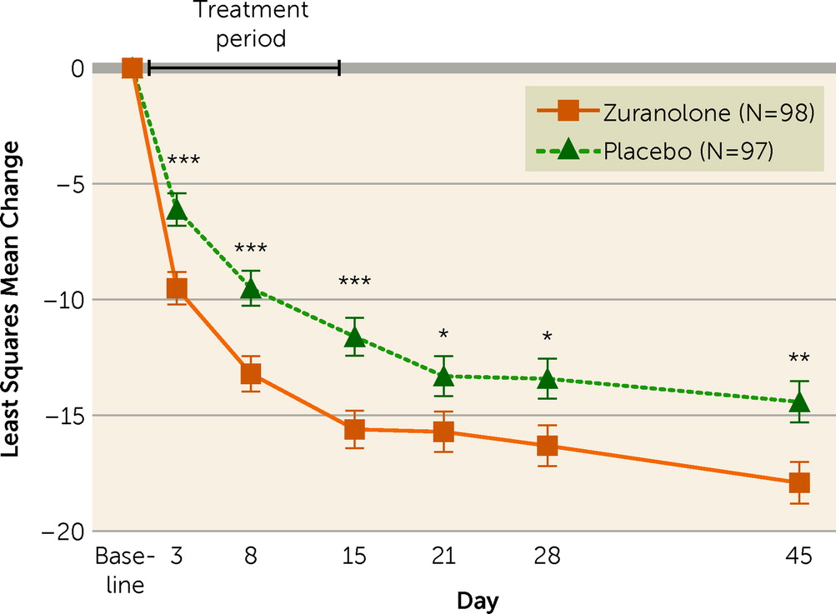
Multisite phase 3, double-blind, RCT
  196 randomized patients with severe depression
Zuranolone 50 mg PO QHS x 2 weeks versus placebo
Significant day 15 HAMD-17 score response (proportion of responders) (57.0% [N=53] vs. 38.9% [N=35]; odds ratio=2.02, 95% CI=1.11, 3.67; p=0.02)
HAM-D remission rate significantly greater at day 45 (44.0% [N=37] vs. 29.4% [N=25]; odds ratio=2.08, 95% CI=1.11, 3.92; p=0.02)
Deligiannidis KM, Meltzer-Brody S, Maximos B, Peeper EQ, Freeman M, Lasser R, Bullock A, Kotecha M, Li S, Forrestal F, Rana N, Garcia M, Leclair B, Doherty J. Zuranolone for the Treatment of Postpartum Depression. Am J Psychiatry. 2023 Jul 26:appiajp20220785. doi: 10.1176/appi.ajp.20220785. Epub ahead of print. PMID: 37491938.

Slide 52
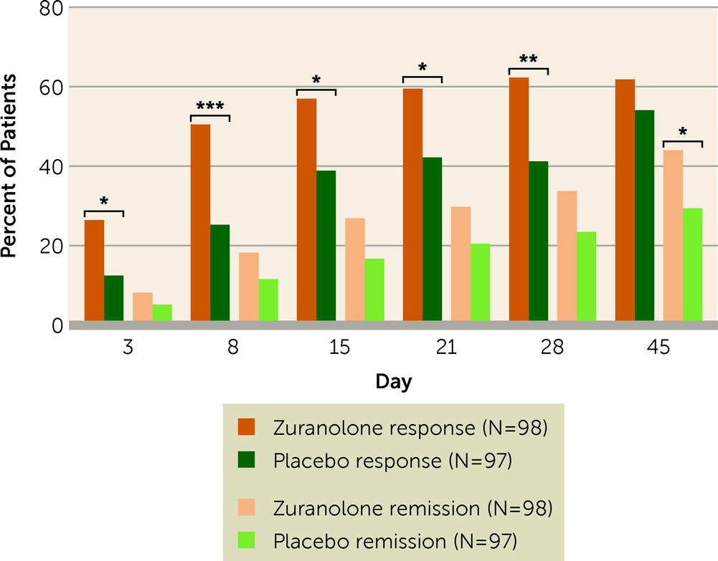
High placebo response (8 study visits in 45 days)
Rapid response to zuranolone
Median time to first HAM-D response
  9 days zuranolone versus 43 days in placebo
Deligiannidis KM, Meltzer-Brody S, Maximos B, Peeper EQ, Freeman M, Lasser R, Bullock A, Kotecha M, Li S, Forrestal F, Rana N, Garcia M, Leclair B, Doherty J. Zuranolone for the Treatment of Postpartum Depression. Am J Psychiatry. 2023 Jul 26:appiajp20220785. doi: 10.1176/appi.ajp.20220785. Epub ahead of print. PMID: 37491938.

Slide 53
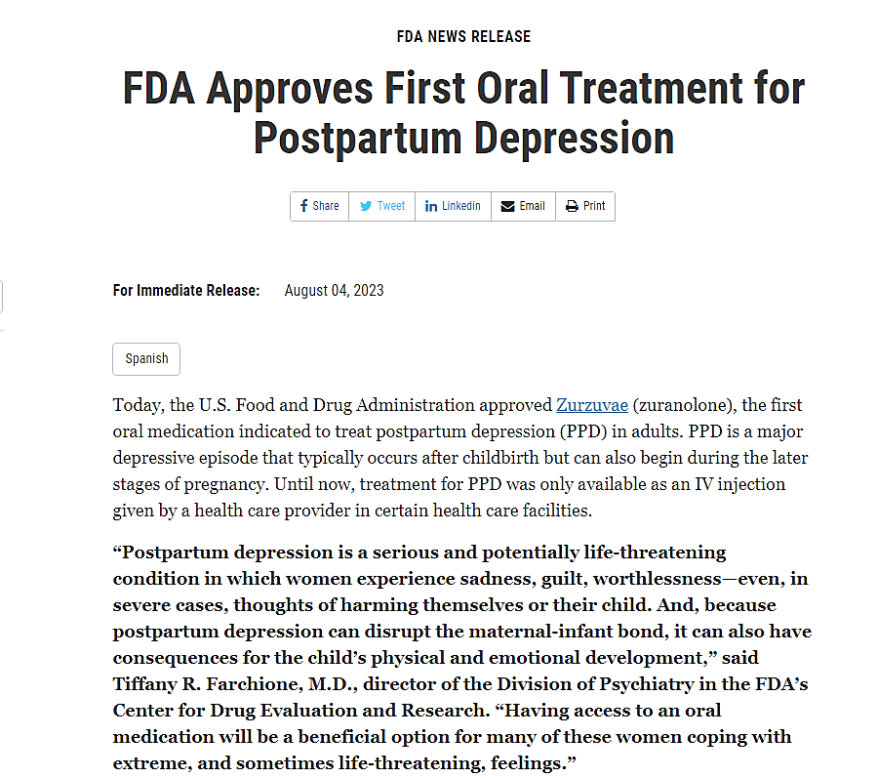

Slide 54
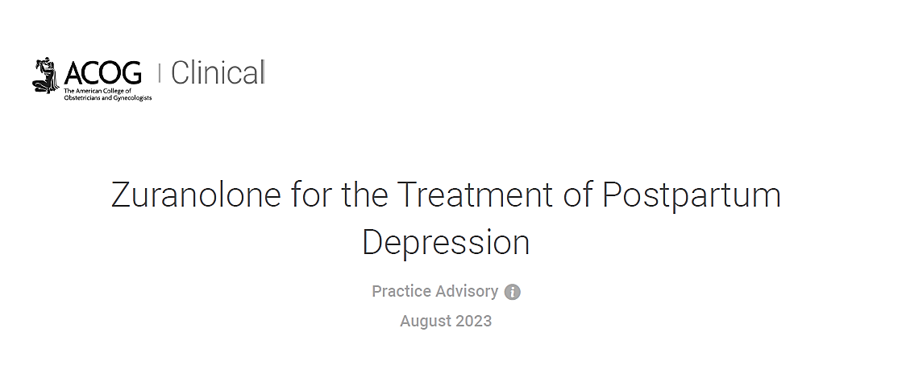
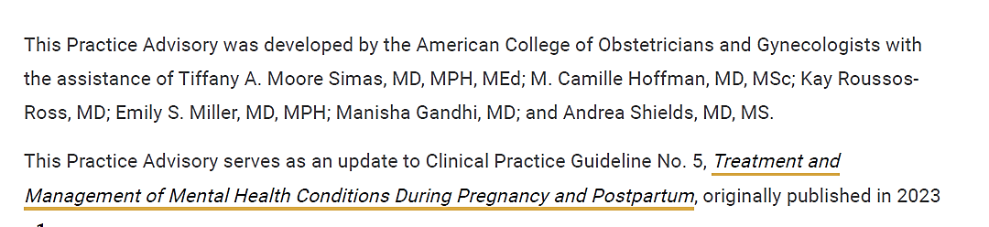

Slide 55
ACOG Practice Advisory
"ACOG recommends consideration of zuranolone in the postpartum period (ie, within 12 months postpartum) for depression that has onset in the third trimester or within 4 weeks postpartum. The decision to use zuranolone should balance the benefits (eg, significantly improved and rapidly resolved symptoms) with the risks and challenges (eg, potential suicidal thoughts or behavior, sedation that precludes performing some activities of daily living like driving, and lack of efficacy data beyond 42 days)."

Slide 56
ACOG Practice Advisory: Dosing
Recommended dose of 50 mg daily
  May be reduced to 40mg if CNS depressant effects occur
  Reduce to 30 mg for hepatic impairment
  Dose adjustments needed if taking strong CYP3A4 inhibitors
  Concomitant use with CYP3A4 inducers should be avoided
Take in the evenings with fatty meal
  400-1000 calories (25% to 50% fat) x 14 days

Slide 57
ACOG Practice Advisory: Other Considerations
If dose is missed, take next dose at regular time the next evening
  Do not take extra doses on the same day
  Complete 14 days of treatment total
Can be used alone or as an adjunct to other antidepressants (SSRIs, SNRIs)
Use effective contraception through treatment and for 1 week after

Slide 58
ACOG Practice Advisory: Common Side Effects
Most common side effects include dizziness, fatigue, drowsiness
  AJP Phase 3 study: >10%
Also common: diarrhea, common cold-like symptoms, UTIs

Slide 59
ACOG Practice Advisory: Risks
Impaired ability to drive or engage in other hazardous activities
CNS depressant effects (e.g., somnolence and confusion)
***Should not drive/engage in activities requiring complete mental alertness until at least 12 hours after each dose for the full treatment
  May not be able to accurately assess own degree of impairment
CNS depressants should be avoided (e.g., EtOH, BZDs, opioids, TCAs)
↑ suicidal thoughts and behaviors

Slide 60
ACOG Practice Advisory: Lactation
Passes into breast milk
RID lower than that of SSRIs
No data on effects on breastfed infants
Limited data on milk production
"Clinical need for zuranolone and the developmental and health benefits of breastfeeding should be balanced through a shared decision-making process that considers continuation, pumping and discarding milk through 1-week past treatment completion, and cessation."

Slide 61
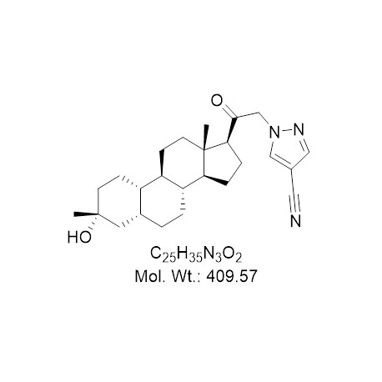
ACOG Practice Advisory: Monitoring
Recommend a validated screening tool be used to monitor for response to treatment or remission of depression symptoms

Slide 62
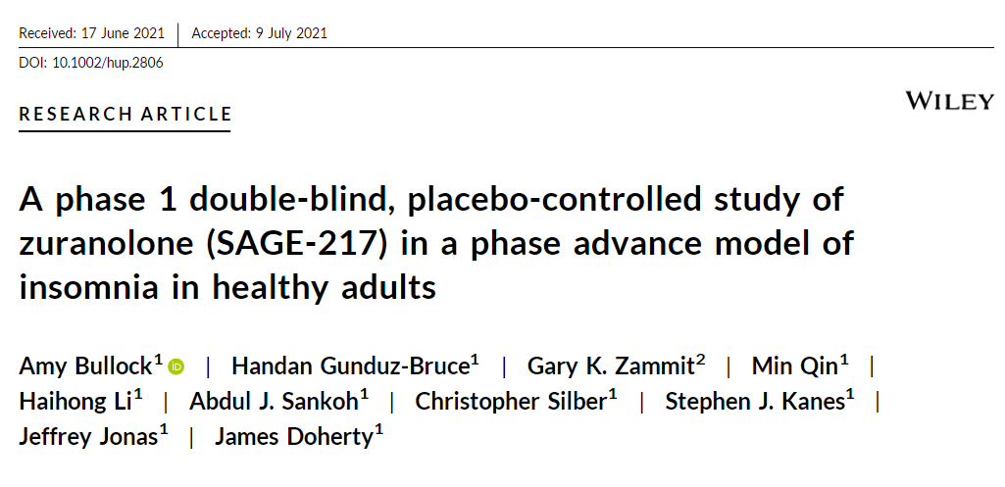
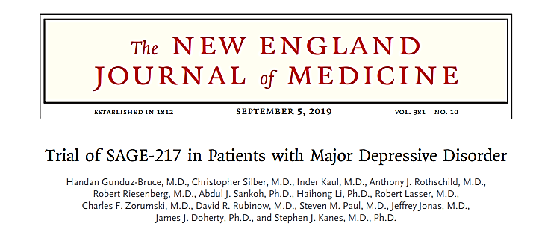
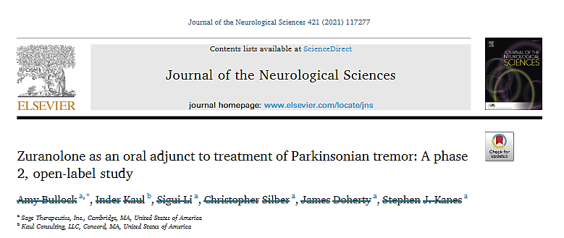

Slide 63


Slide 64
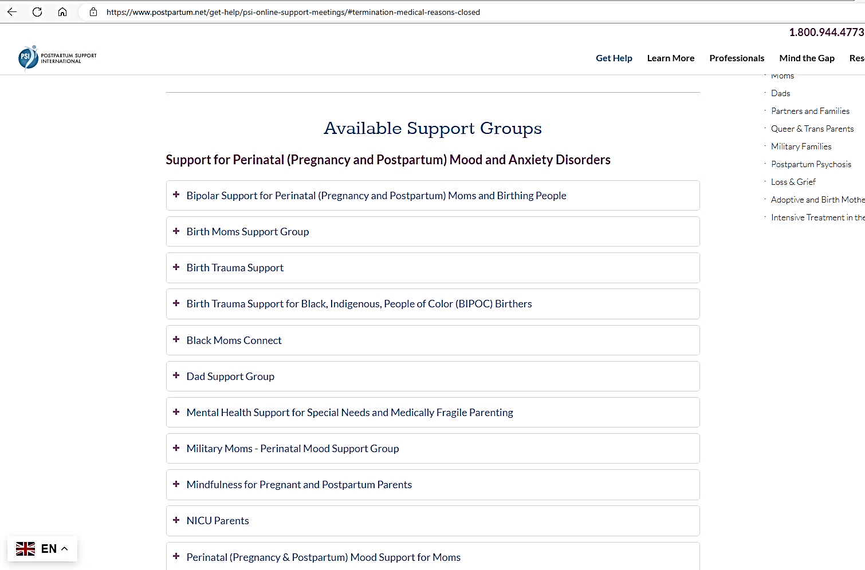

Slide 65

Questions?
Follow us on Instagram at @pgh_cl_psych

