Slide 1
Perinatal Hepatitis C Exposure A multidisciplinary approach to management in the mountain state West Virginia Perinatal Summit
September 2023

Slide 2
Jacob Kilgore, MD, MPH, FAAP Mariana Lanata Piazzon, MD FAAP
Perinatal Hepatitis C Exposure: A Multidisciplinary Approach to Management in the Mountain State

Slide 3
Infections Present
Note: * Indicates 1-4 deaths. 2013 data not available. 2021 data are preliminary. 2022 data are cumulative.
Source: West Virginia Health Statistics Center, Vital Statistics System. August 2023.

Slide 4
Perinatal Hepatitis C Exposure A multidisciplinary approach to management in the mountain state West Virginia Perinatal Summit
September 2023

Slide 5
Presenters
Jacob T. Kilgore, MD, MPH, FAAP
Assistant Professor, Dept. of Pediatrics, Division of Pediatric Infectious Diseases
Medical School: Marshall University JCESOM (M.D)
Residency: Marshall University JCESOM (Med-Peds)
Fellowship: Duke University SOM (Peds ID)
MPH: University of North Carolina (Epidemiology)
Mariana M. Lanata, MD, FAAP
Assistant Professor, Dept. of Pediatrics, Division of Pediatric Infectious Diseases
Director of Pediatric Antimicrobial Stewardship & Infection Control
Medical School: Universidad Peruana Cayetano Heredia (M.D.)
Residency: Miami (Nicklaus) Children’s (Peds)
Fellowship: Nationwide Children’s Hospital (Peds ID)

Slide 6
Disclosures
Neither speaker has any significant disclosures related to today’s presentation

Slide 7
Objectives
Review of West Virginia, Kentucky & Ohio incidence & prevalence data associated with perinatal hepatitis C exposure & hepatitis C infection in children & adults.
Overview of updated management recommendations for perinatal hepatitis C exposure & hepatitis C infections in children.
Discussion of a multidisciplinary care model for the management of perinatal hepatitis C exposure & pediatric hepatitis C infections in a high-prevalence area.

Slide 8
Content overview
Trends in hepatitis C virus (HCV) epidemiology
HCV screening recommendations
Our approach to perinatal HCV exposure
Future considerations
Brief clinical & microbiological review

Slide 9
Content overview
Trends in hepatitis C virus (HCV) epidemiology
HCV screening recommendations
Our approach to perinatal HCV exposure
Future considerations
Brief clinical & microbiological review

Slide 10
Trends in HCV epidemiology
Acute hepatitis C cases reported in the United States increased every year during 2012–2019
During 2019, a total of 4,136 acute cases were reported, corresponding to 57,500 estimated infections after adjusting for case underascertainment and underreporting
Perinatal exposure to hepatitis C virus (HCV) is increasingly common in the United States due to the ongoing opioid epidemic
Children born to viremic mothers face an approximate 5-7% risk of acquiring HCV infection
Although liver disease due to HCV progresses more slowly in children than adults, perinatally infected children face substantial risk for late complications with up to one-third developing cirrhosis by their mid-thirties
Reference: Centers for Disease Control & Prevention (CDC). Hepatitis C Questions and Answers for Health Professionals. Accessed online at https://www.cdc.gov/hepatitis/hcv/hcvfaq.htm#section.

Slide 11
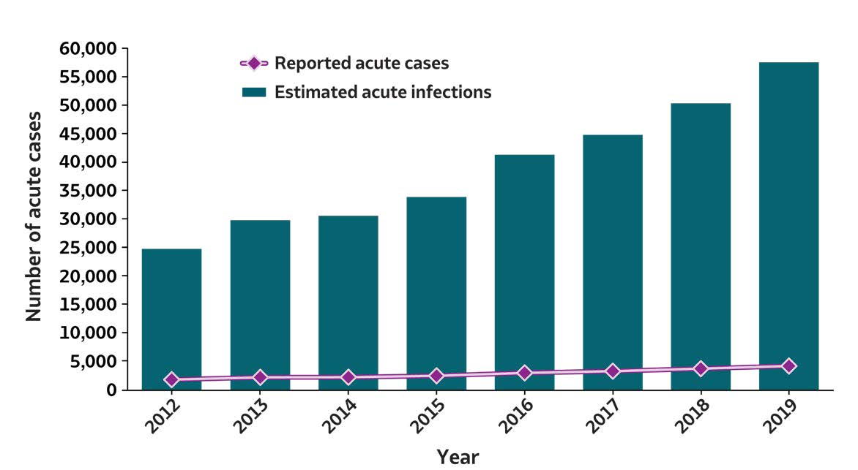
2019 VIRAL HEPATITIS
SURVEILLANCE REPORT
Figure 3.1. Number of reported acute hepatitis C virus infection cases and estimated infections* — United States, 2012–2019
Trends in HCV Epidemiology
Acute Hepatitis C | 2012 | 2013 | 2014 | 2015 | 2016 | 2017 | 2018 | 2019
Reported acute cases | 1,778 | 2,138 | 2,194 | 2,436 | 2,967 | 3,216 | 3,621 | 4,136
Estimated acute infections | 24,700 | 29,700 | 30,500 | 33,900 | 41,200 | 44,700 | 50,300 | 57,500
Source: CDC, National Notifiable Diseases Surveillance System.
*The number of estimated viral hepatitis infections was determined by multiplying the number of reported cases that met the classification criteria for a confirmed case by a factor that adjusted for underascertainment and underreporting. The 95% bootstrap confidence intervals for the estimated number of infections are displayed in the Appendix.

Slide 12
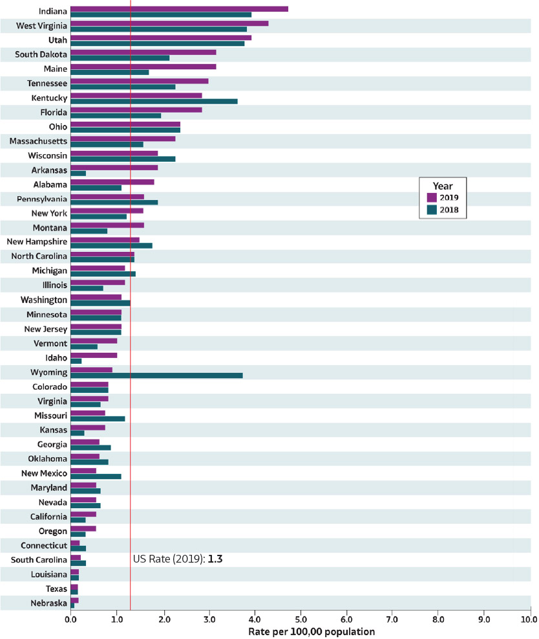
Figure 3.2. Rates* of reported acute hepatitis C† virus infections, by state — United States, 2018–2019
2019 VIRAL HEPATITIS
SURVEILLANCE REPORT
Trends in HCV Epidemiology
Source: CDC, National Notifiable Diseases Surveillance System.
* Rates per 100,000 population.
† Reported cases that met the classification criteria for a confirmed case. For the case definition, see https://ndc.services.cdc.gov/ conditions/hepatitis-c-acute/.
Only states with rates for 2018 and 2019 are shown. State/jurisdiction and year for no reported cases: North Dakota (2019), Hawaii (2018); for not reportable condition; Alaska (2018, 2019);
for unavailable data: Arizona (2018, 2019), Delaware (2018, 2019), District of Columbia
(2018, 2019), Iowa (2018, 2019),Mississippi (2018, 2019), Rhode Island (2018, 2019).

Slide 13
Figure 3.2. Rates* of reported acute hepatitis C† virus infections, by state — United States, 2018–2019
2019 VIRAL HEPATITIS
SURVEILLANCE REPORT
Trends in HCV Epidemiology
Source: CDC, National Notifiable Diseases Surveillance System.
* Rates per 100,000 population.
† Reported cases that met the classification criteria for a confirmed case. For the case definition, see https://ndc.services.cdc.gov/ conditions/hepatitis-c-acute/.
Only states with rates for 2018 and 2019 are shown. State/jurisdiction and year for no reported cases: North Dakota (2019), Hawaii (2018); for not reportable condition; Alaska (2018, 2019);
for unavailable data: Arizona (2018, 2019), Delaware (2018, 2019), District of Columbia
(2018, 2019), Iowa (2018, 2019),Mississippi (2018, 2019), Rhode Island (2018, 2019).

Slide 14
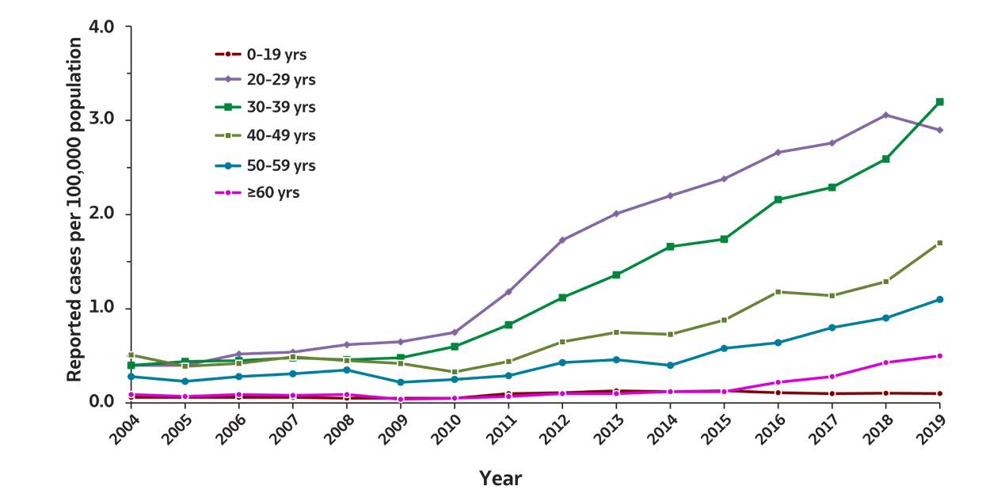
Figure 3.4. Rates of reported acute hepatitis C virus infection, by age group
— United States, 2004–2019
2019 VIRAL HEPATITIS
SURVEILLANCE REPORT
Trends in HCV Epidemiology
Age (years) | 2004 | 2005 | 2006 | 2007 | 2008 | 2009 | 2010 | 2011 | 2012 | 2013 | 2014 | 2015 | 2016 | 2017 | 2018 | 2019
0–19 | 0.1 | 0.1 | 0.1 | 0.1 | 0.0 | 0.0 | 0.1 | 0.1 | 0.1 | 0.1 | 0.1 | 0.1 | 0.1 | 0.1 | 0.1 | 0.1
20–29 | 0.4 | 0.4 | 0.5 | 0.5 | 0.7 | 0.7 | 0.7 | 1.2 | 1.7 | 2.0 | 2.2 | 2.4 | 2.7 | 2.7 | 3.0 | 2.9
30–39 | 0.4 | 0.4 | 0.4 | 0.5 | 0.5 | 0.5 | 0.6 | 0.8 | 1.1 | 1.4 | 1.7 | 1.7 | 2.2 | 2.3 | 2.6 | 3.2
40–49 | 0.5 | 0.4 | 0.4 | 0.5 | 0.5 | 0.4 | 0.3 | 0.4 | 0.6 | 0.7 | 0.7 | 0.9 | 1.2 | 1.1 | 1.3 | 1.7
50–59 | 0.3 | 0.2 | 0.3 | 0.3 | 0.4 | 0.2 | 0.3 | 0.3 | 0.4 | 0.5 | 0.4 | 0.6 | 0.6 | 0.8 | 0.9 | 1.1
≥60 | 0.1 | 0.1 | 0.1 | 0.1 | 0.1 | 0.0 | 0.1 | 0.1 | 0.1 | 0.1 | 0.1 | 0.1 | 0.2 | 0.3 | 0.4 | 0.5
Source: CDC, National Notifiable Diseases Surveillance System.

Slide 15
Figure 3.4. Rates of reported acute hepatitis C virus infection, by age group
— United States, 2004–2019
2019 VIRAL HEPATITIS
SURVEILLANCE REPORT
Trends in HCV Epidemiology
`
Age (years) | 2004 | 2005 | 2006 | 2007 | 2008 | 2009 | 2010 | 2011 | 2012 | 2013 | 2014 | 2015 | 2016 | 2017 | 2018 | 2019
0–19 | 0.1 | 0.1 | 0.1 | 0.1 | 0.0 | 0.0 | 0.1 | 0.1 | 0.1 | 0.1 | 0.1 | 0.1 | 0.1 | 0.1 | 0.1 | 0.1
20–29 | 0.4 | 0.4 | 0.5 | 0.5 | 0.7 | 0.7 | 0.7 | 1.2 | 1.7 | 2.0 | 2.2 | 2.4 | 2.7 | 2.7 | 3.0 | 2.9
30–39 | 0.4 | 0.4 | 0.4 | 0.5 | 0.5 | 0.5 | 0.6 | 0.8 | 1.1 | 1.4 | 1.7 | 1.7 | 2.2 | 2.3 | 2.6 | 3.2
40–49 | 0.5 | 0.4 | 0.4 | 0.5 | 0.5 | 0.4 | 0.3 | 0.4 | 0.6 | 0.7 | 0.7 | 0.9 | 1.2 | 1.1 | 1.3 | 1.7
50–59 | 0.3 | 0.2 | 0.3 | 0.3 | 0.4 | 0.2 | 0.3 | 0.3 | 0.4 | 0.5 | 0.4 | 0.6 | 0.6 | 0.8 | 0.9 | 1.1
≥60 | 0.1 | 0.1 | 0.1 | 0.1 | 0.1 | 0.0 | 0.1 | 0.1 | 0.1 | 0.1 | 0.1 | 0.1 | 0.2 | 0.3 | 0.4 | 0.5
Source: CDC, National Notifiable Diseases Surveillance System.

Slide 16
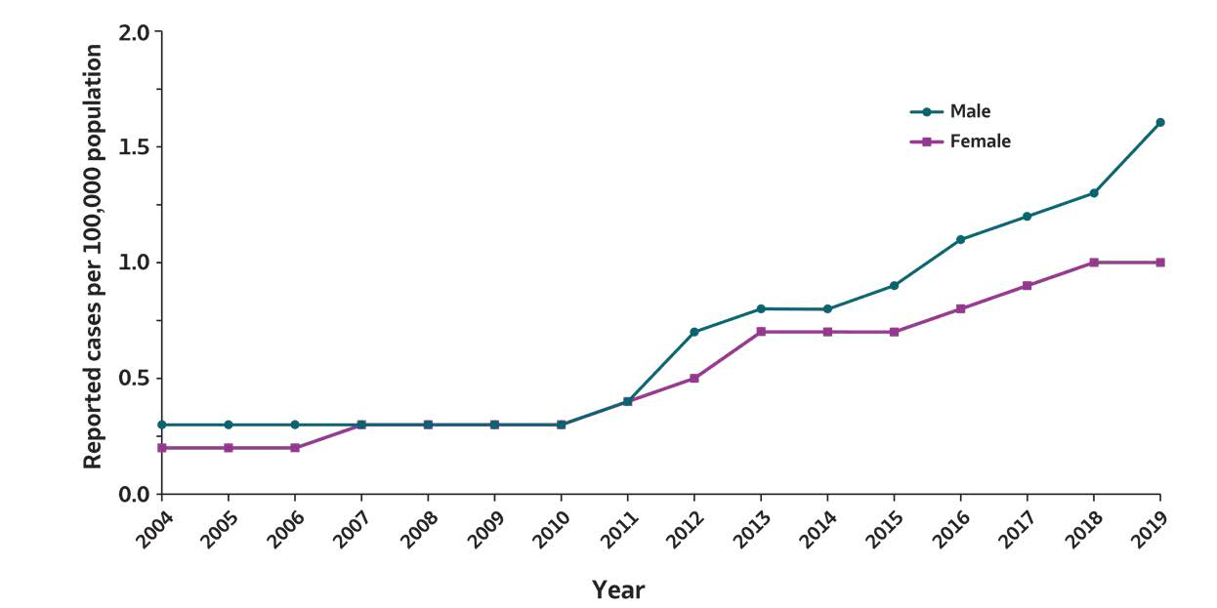
2019 VIRAL HEPATITIS
SURVEILLANCE REPORT
Figure 3.5. Rates of reported acute hepatitis C virus infection, by sex — United States, 2004–2019
Trends in HCV Epidemiology
Sex | 2004 | 2005 | 2006 | 2007 | 2008 | 2009 | 2010 | 2011 | 2012 | 2013 | 2014 | 2015 | 2016 | 2017 | 2018 | 2019
Male | 0.3 | 0.3 | 0.3 | 0.3 | 0.3 | 0.3 | 0.3 | 0.4 | 0.7 | 0.8 | 0.8 | 0.9 | 1.1 | 1.2 | 1.3 | 1.6
Female | 0.2 | 0.2 | 0.2 | 0.3 | 0.3 | 0.3 | 0.3 | 0.4 | 0.5 | 0.7 | 0.7 | 0.7 | 0.8 | 0.9 | 1.0 | 1.0
Source: CDC, National Notifiable Diseases Surveillance System.

Slide 17
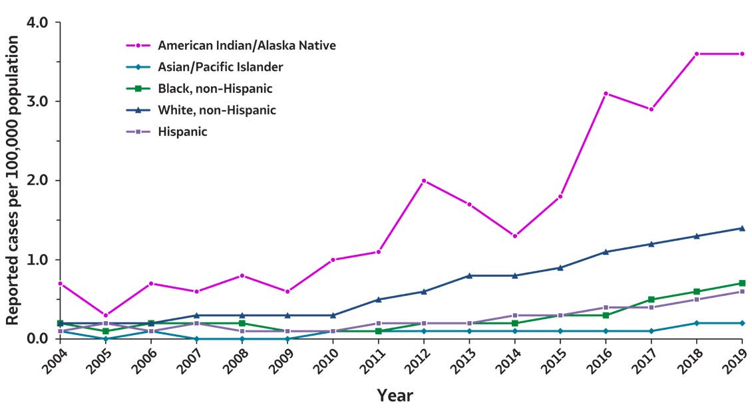
2019 VIRAL HEPATITIS
SURVEILLANCE REPORT
Figure 3.6. Rates of reported acute hepatitis C virus infection, by race/ethnicity — United States, 2004–2019
Trends in HCV Epidemiology
Race/Ethnicity | 2004 | 2005 | 2006 | 2007 | 2008 | 2009 | 2010 | 2011 | 2012 | 2013 | 2014 | 2015 | 2016 | 2017 | 2018 | 2019
American Indian/ Alaska Native | 0.7 | 0.3 | 0.7 | 0.6 | 0.8 | 0.6 | 1.0 | 1.1 | 2.0 | 1.7 | 1.3 | 1.8 | 3.1 | 2.9 | 3.6 | 3.6
Asian/ Pacific Islander | 0.1 | 0.0 | 0.1 | 0.0 | 0.0 | 0.0 | 0.1 | 0.1 | 0.1 | 0.1 | 0.1 | 0.1 | 0.1 | 0.1 | 0.1 | 0.2
Black, non-Hispanic | 0.2 | 0.1 | 0.2 | 0.2 | 0.2 | 0.1 | 0.1 | 0.1 | 0.1 | 0.2 | 0.2 | 0.3 | 0.3 | 0.5 | 0.6 | 0.7
White, non-Hispanic | 0.2 | 0.2 | 0.2 | 0.2 | 0.3 | 0.3 | 0.3 | 0.5 | 0.6 | 0.8 | 0.8 | 0.9 | 1.1 | 1.2 | 1.3 | 1.4
Hispanic | 0.1 | 0.2 | 0.1 | 0.1 | 0.1 | 0.1 | 0.1 | 0.2 | 0.2 | 0.2 | 0.2 | 0.3 | 0.3 | 0.4 | 0.5 | 0.6
Source: CDC, National Notifiable Diseases Surveillance System.

Slide 18
Trends in HCV epidemiology
Acute hepatitis C cases reported in the United States increased every year during 2012–2019
During 2019, a total of 4,136 acute cases were reported, corresponding to 57,500 estimated infections after adjusting for case underascertainment and underreporting
Perinatal exposure to hepatitis C virus (HCV) is increasingly common in the United States due to the ongoing opioid epidemic
Children born to viremic mothers face an approximate 5-7% risk of acquiring HCV infection
Although liver disease due to HCV progresses more slowly in children than adults, perinatally infected children face substantial risk for late complications with up to one-third developing cirrhosis by their mid-thirties
Reference: Centers for Disease Control & Prevention (CDC). Hepatitis C Questions and Answers for Health Professionals. Accessed online at https://www.cdc.gov/hepatitis/hcv/hcvfaq.htm#section.

Slide 19
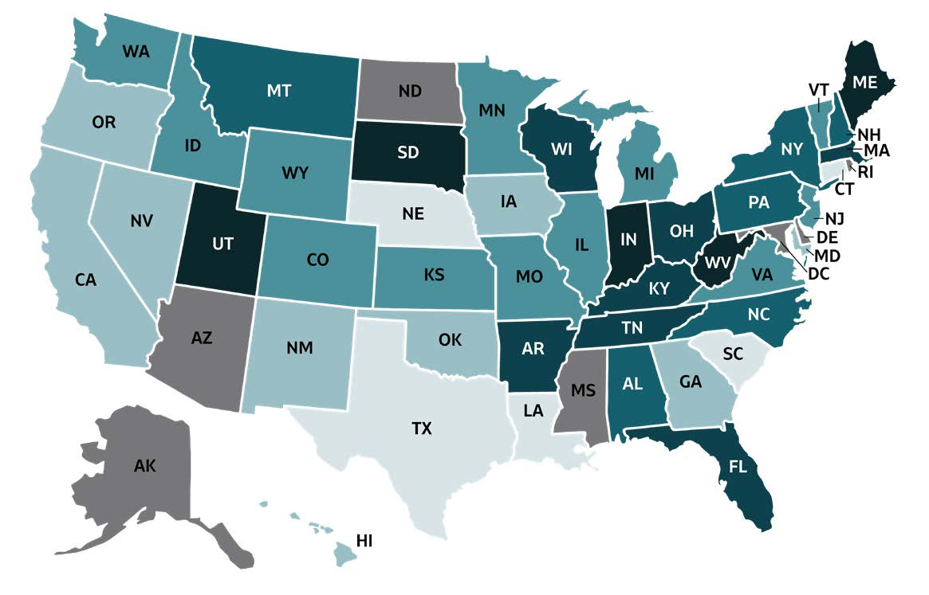
2019 VIRAL HEPATITIS
SURVEILLANCE REPORT
Figure 3.3. Rates of reported acute hepatitis C virus infection, by state or jurisdiction — United States, 2019
Trends in HCV Epidemiology
Color Key | Cases/100,000 Population | State or Jurisdiction
 | 0.0-0.2 | CT, LA, NE, SC, TX
 | 0.3-0.6 | CA, GA, HI, IA, MD, NM, NV, OK, OR
 | 0.7-1.2 | CO, ID, IL, KS, MI, MN, MO, NJ, VA, VT, WA, WY
 | 1.3-1.8 | AL, MT, NC, NH, NY, PA
 | 1.9-3.0 | AR, FL, KY, MA, OH, TN, WI
 | 3.1-4.8 | IN, ME, SD, UT, WV
 | Data not available | AK, AZ, DC, DE, MS, ND,RI

Slide 20
2019 VIRAL HEPATITIS
SURVEILLANCE REPORT
Figure 3.3. Rates of reported acute hepatitis C virus infection, by state or jurisdiction — United States, 2019
Trends in HCV Epidemiology
Color Key | Cases/100,000 Population | State or Jurisdiction
 | 0.0-0.2 | CT, LA, NE, SC, TX
 | 0.3-0.6 | CA, GA, HI, IA, MD, NM, NV, OK, OR
 | 0.7-1.2 | CO, ID, IL, KS, MI, MN, MO, NJ, VA, VT, WA, WY
 | 1.3-1.8 | AL, MT, NC, NH, NY, PA
 | 1.9-3.0 | AR, FL, KY, MA, OH, TN, WI
 | 3.1-4.8 | IN, ME, SD, UT, WV
 | Data not available | AK, AZ, DC, DE, MS, ND,RI

Slide 21
Trends in HCV epidemiology
Acute hepatitis C cases reported in the United States increased every year during 2012–2019
During 2019, a total of 4,136 acute cases were reported, corresponding to 57,500 estimated infections after adjusting for case underascertainment and underreporting
Perinatal exposure to hepatitis C virus (HCV) is increasingly common in the United States due to the ongoing opioid epidemic
Children born to viremic mothers face an approximate 5-7% risk of acquiring HCV infection
Although liver disease due to HCV progresses more slowly in children than adults, perinatally infected children face substantial risk for late complications with up to one-third developing cirrhosis by their mid-thirties
Reference: Centers for Disease Control & Prevention (CDC). Hepatitis C Questions and Answers for Health Professionals. Accessed online at https://www.cdc.gov/hepatitis/hcv/hcvfaq.htm#section.

Slide 22
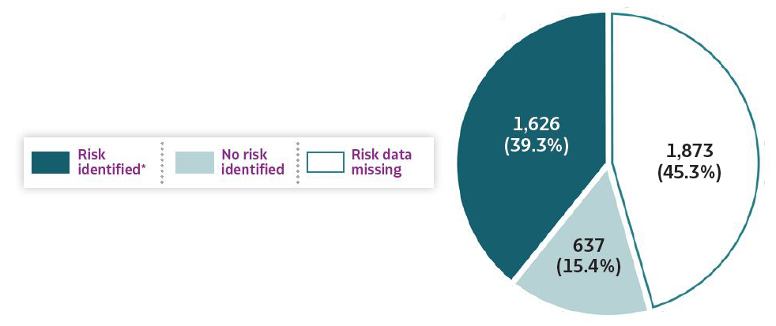
2019 VIRAL HEPATITIS
SURVEILLANCE REPORT
Figure 3.7. Availability of information regarding risk behaviors or exposures*† associated with reported cases of acute hepatitis C virus infection — United States, 2019
Trends in HCV Epidemiology
Source: CDC, Nationally Notifiable Diseases Surveillance System.
* Case reports with at least one of the following risk behaviors/exposures reported 6 weeks to 6 months prior to symptom onset or documented seroconversion if asymptomatic: 1) injection drug use; 2) multiple sexual partners; 3) underwent surgery; 4) men who have sex with men; 5) sexual contact with suspected/confirmed hepatitis C case; 6) sustained a percutaneous injury; 7) household contact with suspected/confirmed hepatitis C case; 8) occupational exposure to blood; 9) dialysis; and 10) transfusion. Reported cases may include more than one risk behavior/exposure.
† Risk behaviors/exposures data from one state was classified as ‘missing’ because of errors in reporting.

Slide 23
2019 VIRAL HEPATITIS
SURVEILLANCE REPORT
Table 3.3. Reported risk behaviors or exposures*† among reported cases of acute hepatitis C virus infection — United States, 2019
Risk behaviors/exposures | Risk identified* | No risk identified | Risk data missing
Injection drug use | 1,302 | 650 | 2,184
Multiple sexual partners | 223 | 594 | 3,319
Surgery | 179 | 888 | 3,069
Sexual contact § | 142 | 334 | 3,660
Needlestick | 91 | 886 | 3,159
Men who have sex with men ¶ | 42 | 315 | 2,114
Household contact (non-sexual) § | 36 | 440 | 3,660
Dialysis patient | 61 | 1,249 | 2,826
Occupational | 7 | 1,278 | 2,851
Transfusion | 3 | 1,105 | 3,028
Source: CDC, Nationally Notifiable Diseases Surveillance System.
* Case reports with at least one of the following risk behaviors/exposures reported 6 weeks to 6 months prior to symptom onset or documented seroconversion if asymptomatic: 1) injection drug use; 2) multiple sexual partners; 3) underwent surgery; 4) men who have sex with men; 5) sexual
contact with suspected/confirmed hepatitis C case;
6) sustained a percutaneous injury; 7) household contact with suspected/confirmed hepatitis C case;
8) occupational exposure to blood; 9) dialysis; and
10) transfusion. Reported cases may include more than one risk behavior/exposure.
† Risk behaviors/exposures data from one state was classified as ‘missing’ because of errors in reporting.
§ Cases with more than one type of contact reported were categorized according to a hierarchy: (1) sexual contact; (2) household contact (nonsexual).
¶ A total of 2,471 acute hepatitis C cases were reported among males in 2019.
Trends in HCV Epidemiology
Notes:
The number of reported acute hepatitis C cases by availability of specific risk behavior or exposure during 2019. The categories listed in the first column are injection drug use, multiple sexual partners, surgery, sexual contact, needlestick, men who have sex with men, household contact (nonsexual), dialysis patient, occupational, and transfusion. Column two displays the number of case reports for which a risk was identified. Column three lists the number of case reports for which no risk was identified. Column four provides the number of case reports for which risk information was missing.

Slide 24
2019 VIRAL HEPATITIS
SURVEILLANCE REPORT
Table 3.3. Reported risk behaviors or exposures*† among reported cases of acute hepatitis C virus infection — United States, 2019
Risk behaviors/exposures | Risk identified* | No risk identified | Risk data missing
Injection drug use | 1,302 | 650 | 2,184
Multiple sexual partners | 223 | 594 | 3,319
Surgery | 179 | 888 | 3,069
Sexual contact § | 142 | 334 | 3,660
Needlestick | 91 | 886 | 3,159
Men who have sex with men ¶ | 42 | 315 | 2,114
Household contact (non-sexual) § | 36 | 440 | 3,660
Dialysis patient | 61 | 1,249 | 2,826
Occupational | 7 | 1,278 | 2,851
Transfusion | 3 | 1,105 | 3,028
Source: CDC, Nationally Notifiable Diseases Surveillance System.
* Case reports with at least one of the following risk behaviors/exposures reported 6 weeks to 6 months prior to symptom onset or documented seroconversion if asymptomatic: 1) injection drug use; 2) multiple sexual partners; 3) underwent surgery; 4) men who have sex with men; 5) sexual
contact with suspected/confirmed hepatitis C case;
6) sustained a percutaneous injury; 7) household contact with suspected/confirmed hepatitis C case;
8) occupational exposure to blood; 9) dialysis; and
10) transfusion. Reported cases may include more than one risk behavior/exposure.
† Risk behaviors/exposures data from one state was classified as ‘missing’ because of errors in reporting.
§ Cases with more than one type of contact reported were categorized according to a hierarchy: (1) sexual contact; (2) household contact (nonsexual).
¶ A total of 2,471 acute hepatitis C cases were reported among males in 2019.
Trends in HCV Epidemiology
Notes:
The number of reported acute hepatitis C cases by availability of specific risk behavior or exposure during 2019. The categories listed in the first column are injection drug use, multiple sexual partners, surgery, sexual contact, needlestick, men who have sex with men, household contact (nonsexual), dialysis patient, occupational, and transfusion. Column two displays the number of case reports for which a risk was identified. Column three lists the number of case reports for which no risk was identified. Column four provides the number of case reports for which risk information was missing.

Slide 25
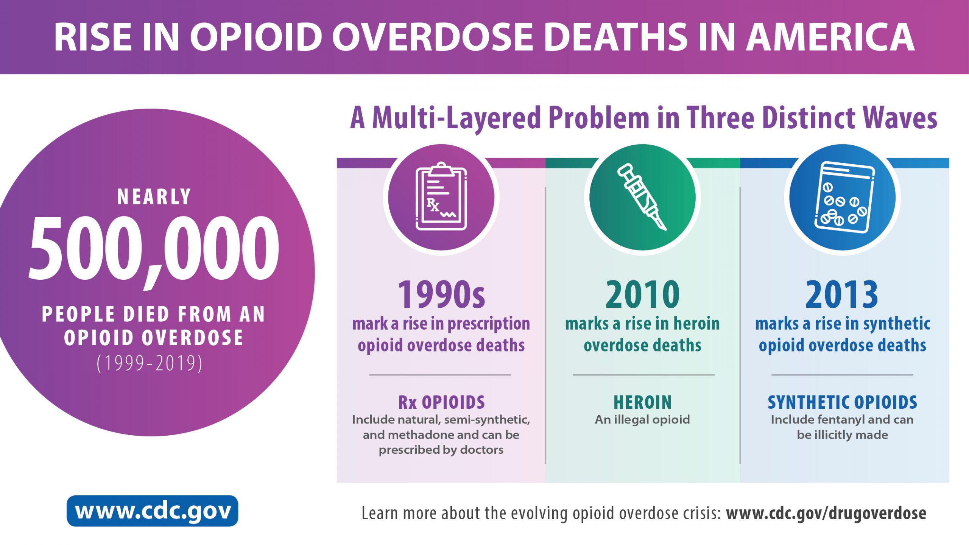
Trends in Opioid Epidemiology
Notes:
The number of reported acute hepatitis C cases by availability of specific risk behavior or exposure during 2019. The categories listed in the first column are injection drug use, multiple sexual partners, surgery, sexual contact, needlestick, men who have sex with men, household contact (nonsexual), dialysis patient, occupational, and transfusion. Column two displays the number of case reports for which a risk was identified. Column three lists the number of case reports for which no risk was identified. Column four provides the number of case reports for which risk information was missing.

Slide 26
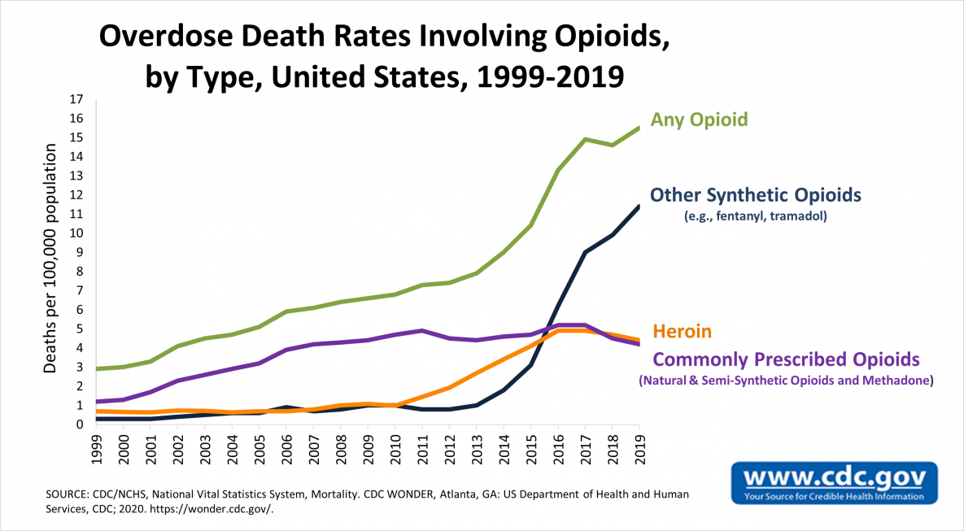
Trends in Opioid Epidemiology
Notes:
The number of reported acute hepatitis C cases by availability of specific risk behavior or exposure during 2019. The categories listed in the first column are injection drug use, multiple sexual partners, surgery, sexual contact, needlestick, men who have sex with men, household contact (nonsexual), dialysis patient, occupational, and transfusion. Column two displays the number of case reports for which a risk was identified. Column three lists the number of case reports for which no risk was identified. Column four provides the number of case reports for which risk information was missing.

Slide 27
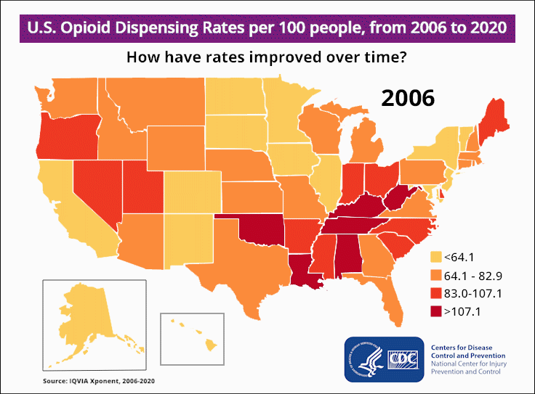
Trends in Opioid Epidemiology
Image reference https://www.cdc.gov/drugoverdose/images/2006-2020-map.gif?_=66070?noicon.
Notes:
The number of reported acute hepatitis C cases by availability of specific risk behavior or exposure during 2019. The categories listed in the first column are injection drug use, multiple sexual partners, surgery, sexual contact, needlestick, men who have sex with men, household contact (nonsexual), dialysis patient, occupational, and transfusion. Column two displays the number of case reports for which a risk was identified. Column three lists the number of case reports for which no risk was identified. Column four provides the number of case reports for which risk information was missing.

Slide 28
Trends in HCV epidemiology
Acute hepatitis C cases reported in the United States increased every year during 2012–2019
During 2019, a total of 4,136 acute cases were reported, corresponding to 57,500 estimated infections after adjusting for case underascertainment and underreporting
Perinatal exposure to hepatitis C virus (HCV) is increasingly common in the United States due to the ongoing opioid epidemic
Children born to viremic mothers face an approximate 5-7% risk of acquiring HCV infection
Although liver disease due to HCV progresses more slowly in children than adults, perinatally infected children face substantial risk for late complications with up to one-third developing cirrhosis by their mid-thirties
Reference: Centers for Disease Control & Prevention (CDC). Hepatitis C Questions and Answers for Health Professionals. Accessed online at https://www.cdc.gov/hepatitis/hcv/hcvfaq.htm#section.

Slide 29
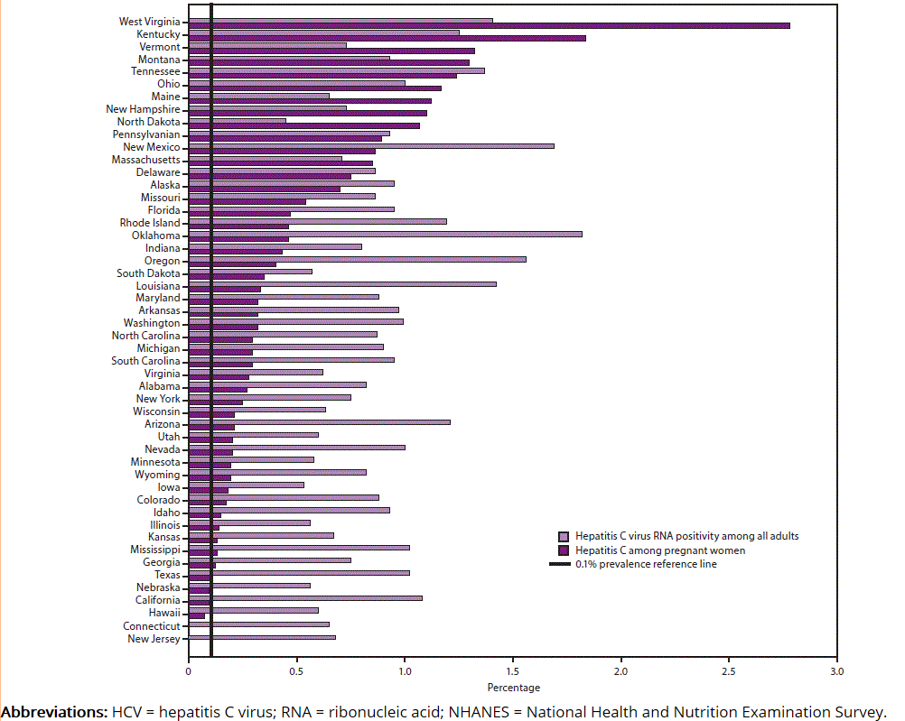
FIGURE 2. Estimated prevalence of hepatitis C virus RNA positivity among all adults* and hepatitis C among pregnant women,† by state§
Trends in HCV Epidemiology
Schillie et at MMWR 2020;69
Notes:
Light purple is Hep C positivity among all adults, Dark purple is hep C among pregnant women in percentage As we can see WV is the leading state with reported pregnant women with Hepatitis C infection

Slide 30
FIGURE 2. Estimated prevalence of hepatitis C virus RNA positivity among all adults* and hepatitis C among pregnant women,† by state§
Trends in HCV Epidemiology
Schillie et at MMWR 2020;69

Slide 31
WV Resident Births, Hepatitis C Maternal Infection, Number and Percent, 2014-2020
Year | HCV
 | Births (No.) | Percent (%)
2014 | 464 | 2.3
2015 | 552 | 2.8
2016 | 633 | 3.3
2017 | 663 | 3.5
2018 | 637 | 3.5
2019 | 616 | 3.4
2020 | 575 | 3.3
2021* | 495 | 2.9
2022* | 478 | 2.9
Total | 5,091 | 2.8
Trends in HCV Epidemiology
* Percentages are based on known values. 2021 data are preliminary. 2022 data are cumulative.
Source: WV Health Statistics Center, Vital Statistics System 2023

Slide 32
2019 VIRAL HEPATITIS
SURVEILLANCE REPORT
Table 3.4. Number of newly reported cases* of perinatal hepatitis C virus infection, by state or jurisdiction — United States, 2019
State or Jurisdiction | Perinatal Hepatitis C
Alabama | —
Alaska | 2
Arizona | —
Arkansas | 3
California | 15
Colorado | 1
Connecticut | —
Delaware | U
District of Columbia | —
Florida | 20
Georgia | 5
Hawaii | —
Idaho | —
Illinois | 10
Indiana | 14
Iowa | —
Kansas | 2
Kentucky | —
Louisiana | —
Maine | 4
Maryland | —
Massachusetts | 14
Michigan | 11
Minnesota | 5
Mississippi | —
Missouri | —
State or Jurisdiction | Perinatal Hepatitis C
Montana | —
Nebraska | —
Nevada | 1
New Hampshire | —
New Jersey | 11
New Mexico | —
New York | 1
North Carolina | —
North Dakota | —
Ohio | 41
Oklahoma | —
Oregon | —
Pennsylvania | 20
Rhode Island | U
South Carolina | 2
South Dakota | 2
Tennessee | 16
Texas | N
Utah | 2
Vermont | —
Virginia | 12
Washington | 3
West Virginia | —
Wisconsin | —
Wyoming | —
Total | 217
Trends in HCV Epidemiology
Source: CDC, National Notifiable Diseases Surveillance System.
* Reported cases that met the classification criteria for a confirmed case. For case definition, see https://ndc. services.cdc.gov/conditions/hepatitis-c- perinatal-infection/.
—: No reported cases. The reporting jurisdiction did not submit any cases to CDC.
N: Not reportable. The disease or condition was not reportable by law, statute, or regulation in the reporting jurisdiction.
U: Unavailable. The data were unavailable.
Notes:
The number of reported cases of perinatal hepatitis C, by state or jurisdiction during 2019. The first column lists the state or jurisdiction, and the second column provides the number of perinatal cases reported for each state or jurisdiction.

Slide 33
2019 VIRAL HEPATITIS
SURVEILLANCE REPORT
Table 3.4. Number of newly reported cases* of perinatal hepatitis C virus infection, by state or jurisdiction — United States, 2019
State or Jurisdiction | Perinatal Hepatitis C
Alabama | —
Alaska | 2
Arizona | —
Arkansas | 3
California | 15
Colorado | 1
Connecticut | —
Delaware | U
District of Columbia | —
Florida | 20
Georgia | 5
Hawaii | —
Idaho | —
Illinois | 10
Indiana | 14
Iowa | —
Kansas | 2
Kentucky | —
Louisiana | —
Maine | 4
Maryland | —
Massachusetts | 14
Michigan | 11
Minnesota | 5
Mississippi | —
Missouri | —
State or Jurisdiction | Perinatal Hepatitis C
Montana | —
Nebraska | —
Nevada | 1
New Hampshire | —
New Jersey | 11
New Mexico | —
New York | 1
North Carolina | —
North Dakota | —
Ohio | 41
Oklahoma | —
Oregon | —
Pennsylvania | 20
Rhode Island | U
South Carolina | 2
South Dakota | 2
Tennessee | 16
Texas | N
Utah | 2
Vermont | —
Virginia | 12
Washington | 3
West Virginia | —
Wisconsin | —
Wyoming | —
Total | 217
Trends in HCV Epidemiology
Source: CDC, National Notifiable Diseases Surveillance System.
* Reported cases that met the classification criteria for a confirmed case. For case definition, see https://ndc. services.cdc.gov/conditions/hepatitis-c- perinatal-infection/.
—: No reported cases. The reporting jurisdiction did not submit any cases to CDC.
N: Not reportable. The disease or condition was not reportable by law, statute, or regulation in the reporting jurisdiction.
U: Unavailable. The data were unavailable.
Notes:
The number of reported cases of perinatal hepatitis C, by state or jurisdiction during 2019. The first column lists the state or jurisdiction, and the second column provides the number of perinatal cases reported for each state or jurisdiction.
Are WV numbers really zero for 2019?

Slide 34
Trends in HCV epidemiology
Perinatal Hep C infection became reportable in the state of WV mid year in 2022
Unofficial data: in 2021 there were 13 infants identified with perinatal HCV infection.
Official Data for 2022: 11 confirmed cases of perinatal Hep C were reported.
Notes:
Bare in mind that number may potentially be very underestimated.

Slide 35
Trends in HCV epidemiology
Acute hepatitis C cases reported in the United States increased every year during 2012–2019
During 2019, a total of 4,136 acute cases were reported, corresponding to 57,500 estimated infections after adjusting for case underascertainment and underreporting
Perinatal exposure to hepatitis C virus (HCV) is increasingly common in the United States due to the ongoing opioid epidemic
Children born to viremic mothers face an approximate 5-7% risk of acquiring HCV infection
Although liver disease due to HCV progresses more slowly in children than adults, perinatally infected children face substantial risk for late complications with up to one-third developing cirrhosis by their mid-thirties
Reference: Centers for Disease Control & Prevention (CDC). Hepatitis C Questions and Answers for Health Professionals. Accessed online at https://www.cdc.gov/hepatitis/hcv/hcvfaq.htm#section.

Slide 36
Content overview
Trends in hepatitis C virus (HCV) epidemiology
HCV screening recommendations
Our approach to perinatal HCV exposure
Future considerations
Brief clinical & microbiological review

Slide 37
Brief Clinical review
Most common route of pediatric HCV infection is vertical transmission

Slide 38
Brief Clinical review
Most common route of pediatric HCV infection is vertical transmission
Risk factors for increased transmission:
Elevated maternal viral load prior to delivery (>600,000 IU/mL; ~log 5.8)
Prolonged rupture of membranes (ROM), generally considered ≥6 hours
Fetal scalp electrode
Maternal co-infection with HIV
References:
Indolfi G, Resti M. Perinatal Transmission of Hepatitis C. Journal of Medical Virology, 2009; 81(5):836-843.
Mack CL, et al. NASPGHAN Practice Guidelines: Diagnosis and management of hepatitis C infection in infants, children, and adolescents. J Pediatr Gastroenterol Nutr. 2012 Jun;54(6):838-55.
Roberts EA, Yeung L. Maternal –Infant Transmission of HCV infection. Hepatology, 2002;36(5 Supplement 1): S106-113.
Slowik M, Jhaveri R. Hepatitis B and Hepatitis C viruses in Infants and Young Children. Seminar in Pediatric Infectious Disease, 2005;16:296-305.

Slide 39
Brief Clinical review
Most common route of pediatric HCV infection is vertical transmission
Risk factors for increased transmission:
Elevated maternal viral load prior to delivery (>600,000 IU/mL; ~log 5.8)
Prolonged rupture of membranes (ROM), generally considered ≥6 hours
Fetal scalp electrode
Maternal co-infection with HIV
Transmission rates are similar for vaginal and cesarean deliveries
References:
Indolfi G, Resti M. Perinatal Transmission of Hepatitis C. Journal of Medical Virology, 2009; 81(5):836-843.
Mack CL, et al. NASPGHAN Practice Guidelines: Diagnosis and management of hepatitis C infection in infants, children, and adolescents. J Pediatr Gastroenterol Nutr. 2012 Jun;54(6):838-55.
Roberts EA, Yeung L. Maternal –Infant Transmission of HCV infection. Hepatology, 2002;36(5 Supplement 1): S106-113.
Slowik M, Jhaveri R. Hepatitis B and Hepatitis C viruses in Infants and Young Children. Seminar in Pediatric Infectious Disease, 2005;16:296-305.

Slide 40
Brief Clinical review
Most common route of pediatric HCV infection is vertical transmission.
Risk factors for increased transmission:
Elevated maternal viral load prior to delivery (>600,000 IU/mL; ~log 5.8)
Prolonged rupture of membranes (ROM), generally considered ≥6 hours
Fetal scalp electrode
Maternal co-infection with HIV
Transmission rates are similar for vaginal and cesarean deliveries
Breastfeeding is generally safe & not a common mode of HCV transmission
References:
Indolfi G, Resti M. Perinatal Transmission of Hepatitis C. Journal of Medical Virology, 2009; 81(5):836-843.
Mack CL, et al. NASPGHAN Practice Guidelines: Diagnosis and management of hepatitis C infection in infants, children, and adolescents. J Pediatr Gastroenterol Nutr. 2012 Jun;54(6):838-55.
Roberts EA, Yeung L. Maternal –Infant Transmission of HCV infection. Hepatology, 2002;36(5 Supplement 1): S106-113.
Slowik M, Jhaveri R. Hepatitis B and Hepatitis C viruses in Infants and Young Children. Seminar in Pediatric Infectious Disease, 2005;16:296-305.

Slide 41
Brief Clinical review
Most common route of pediatric HCV infection is vertical transmission.
Risk factors for increased transmission:
Elevated maternal viral load prior to delivery (>600,000 IU/mL; ~log 5.8)
Prolonged rupture of membranes (ROM), generally considered ≥6 hours
Fetal scalp electrode
Maternal co-infection with HIV
Transmission rates are similar for vaginal and cesarean deliveries
Breastfeeding is generally safe & not a common mode of HCV transmission
Postnatal HCV infection is possible, but not the focus of today’s presentation
References:
Indolfi G, Resti M. Perinatal Transmission of Hepatitis C. Journal of Medical Virology, 2009; 81(5):836-843.
Mack CL, et al. NASPGHAN Practice Guidelines: Diagnosis and management of hepatitis C infection in infants, children, and adolescents. J Pediatr Gastroenterol Nutr. 2012 Jun;54(6):838-55.
Roberts EA, Yeung L. Maternal –Infant Transmission of HCV infection. Hepatology, 2002;36(5 Supplement 1): S106-113.
Slowik M, Jhaveri R. Hepatitis B and Hepatitis C viruses in Infants and Young Children. Seminar in Pediatric Infectious Disease, 2005;16:296-305.

Slide 42
Brief Clinical review
Perinatal exposure
5-7%
83-85%
Perinatal infection
No perinatal infection
75%
25%
Chronic infection
Spontaneous clearance

Slide 43
Brief Clinical review
Perinatal exposure
5-7%
83-85%
Perinatal infection
No perinatal infection
75%
25%
Chronic infection
Spontaneous clearance
Notes:
Genotype 3 with highest rate of clearance

Slide 44
Brief Clinical review
HCV incubation period: 2 weeks to 6 months
If infected, usually asymptomatic (80%) in childhood
If symptomatic (20%):
5% develop significant liver disease in childhood
10% hepatomegaly
40-50% mildly elevated transaminases
5-10% subclinical thyroid disease, but rare for other extrahepatic manifestations
15% of infected children develop nonspecific symptoms
Fever
Lethargy
Anorexia
Abdominal pain
Nausea/vomiting
Diarrhea
Jaundice
Polyarthralgia

Slide 45
Brief Clinical review
Child growth is generally not affected
Progression to severe chronic liver disease and/or hepatocellular carcinoma (HCC) usually 20-30 years after infection
Other conditions (obesity, childhood cancer, alcohol, IV drug use, immunosuppression, iron overload, liver transplant) can increase the risk of severe disease
Liver pathology
Majority have minimal to no fibrosis on biopsy
Bridging fibrosis (4-44%)
~2% with cirrhosis (0-8%)
Mild inflammation (3-35%)
References:
Indolfi G, Resti M. Perinatal Transmission of Hepatitis C. Journal of Medical Virology, 2009; 81(5):836-843.
Mack CL, et al. NASPGHAN Practice Guidelines: Diagnosis and management of hepatitis C infection in infants, children, and adolescents. J Pediatr Gastroenterol Nutr. 2012 Jun;54(6):838-55.
Roberts EA, Yeung L. Maternal –Infant Transmission of HCV infection. Hepatology, 2002;36(5 Supplement 1): S106-113.
Slowik M, Jhaveri R. Hepatitis B and Hepatitis C viruses in Infants and Young Children. Seminar in Pediatric Infectious Disease, 2005;16:296-305.

Slide 46
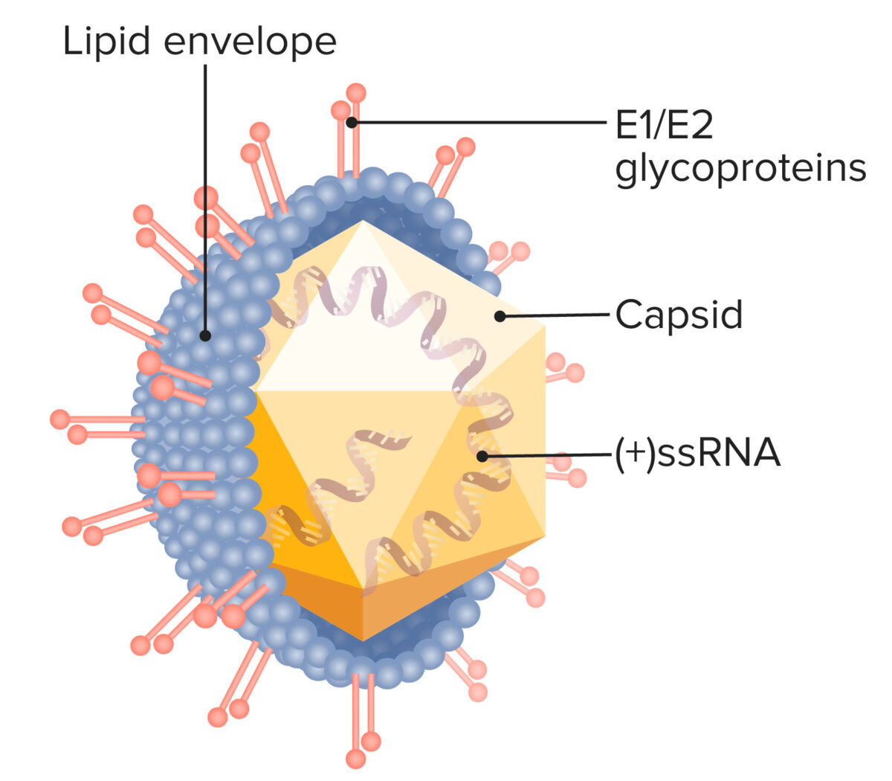
Brief microbiological review
Structure influences infectivity
Structure influences testing
Structure influences management
Image reference: https://www.lecturio.com/concepts/hepatitis-c-virus/.
Hepatitis C Virus
Notes:
Although HCV induces both antibody (Ab) and T cell responses, the virus evades them effectively in most cases, with 75% of those exposed becoming chronically infected. Evasion techniques are mostly targeted at the adaptive immune response, notably T-cell pathways and include everything from variations in lipoprotein structures to signaling interferences.
Genotypes 1a and 1b most prevalent

Slide 47
Content overview
Trends in hepatitis C virus (HCV) epidemiology
HCV screening recommendations
Our approach to perinatal HCV exposure
Future considerations
Brief clinical & microbiological review

Slide 48
HCV screening recommendations
All adults aged 18 years and older
(one-time vs. annual)
Persons < 18 years with high-risk activities
(one-time vs. annual)
People with a history of IVDA or sharing drug preparation equipment (annual)
People with HIV or MSM population on PrEP (annual)
People with persistently abnormal ALT levels
People who have ever received hemodialysis
People who received clotting factor concentrates produced before 1987
People who received a blood transfusion before July 1992
People who have received an organ transplantation before July 1992
Healthcare & public health personnel after non-accidental exposures
All pregnant women during each pregnancy
Children born to mothers with HCV infection
Updated CDC, WHO, IDSA, AASLD & USPSTF Guidelines
Notes:
For the purpose of our talk we want to focus on perinatal HCV exposure and infection. However we do want to briefly let you all know that there have been updated guidance in screening and testing in teenagers who would be considered at high risk of HCV infection.

Slide 49
HCV screening recommendations
All adults aged 18 years and older
(one-time vs. annual)
Persons < 18 years with high-risk activities
(one-time vs. annual)
People with a history of IVDA or sharing drug preparation equipment (annual)
People with HIV or MSM population on PrEP (annual)
People with persistently abnormal ALT levels
People who have ever received hemodialysis
People who received clotting factor concentrates produced before 1987
People who received a blood transfusion before July 1992
People who have received an organ transplantation before July 1992
Healthcare & public health personnel after non-accidental exposures
All pregnant women during each pregnancy
Children born to mothers with HCV infection
Updated CDC, WHO, IDSA, AASLD & USPSTF Guidelines
Notes:
Reference: https://www.cdc.gov/mmwr/volumes/69/rr/rr6902a1.htm
Reference. https://www.uspreventiveservicestaskforce.org/uspstf/recommendation/hepatitis-c-screening

Slide 50
HCV screening recommendations
Screening tests for antibody to HCV (anti-HCV)
Enzyme immunoassay (EIA)
Enhanced chemiluminescence immunoassay (CLIA)
Chemiluminescence microparticle immunoassay (CMIA)
Microparticle immunoassay (MEIA)
Electrochemiluminescence immunoassay (ECLIA)
Immunochromatographic assay (rapid test)
Nucleic acid tests to detect presence HCV RNA
Qualitative
Quantitative
Notes:
So how do we screen for HCV infection?
Two main categories

Slide 51
HCV screening recommendations
Screening tests for antibody to HCV (anti-HCV)
Enzyme immunoassay (EIA)
Enhanced chemiluminescence immunoassay (CLIA)
Chemiluminescence microparticle immunoassay (CMIA)
Microparticle immunoassay (MEIA)
Electrochemiluminescence immunoassay (ECLIA)
Immunochromatographic assay (rapid test)
Nucleic acid tests to detect presence HCV RNA
Qualitative
Quantitative

Slide 52
HCV screening recommendations
How soon after exposure to HCV can HCV antibodies be detected?
Anti-HCV seroconversion occurs an average of 8–11 weeks after exposure with ranges of 2 weeks to 6 months, with cases of delayed seroconversion more commonly having association with an immunosuppressed clinical status (e.g., HIV infection)

Slide 53
HCV screening recommendations
How soon after exposure to HCV can HCV antibodies be detected?
Anti-HCV seroconversion occurs an average of 8–11 weeks after exposure with ranges of 2 weeks to 6 months, with cases of delayed seroconversion more commonly having association with an immunosuppressed clinical status (e.g., HIV infection)
How soon after exposure to HCV can HCV RNA be detected?
People with recently acquired acute infection typically have detectable HCV RNA levels as early as 1–2 weeks after exposure to the virus

Slide 54
HCV screening recommendations
How soon after exposure to HCV can HCV antibodies be detected?
Anti-HCV seroconversion occurs an average of 8–11 weeks after exposure with ranges of 2 weeks to 6 months, with cases of delayed seroconversion more commonly having association with an immunosuppressed clinical status (e.g., HIV infection)
How soon after exposure to HCV can HCV RNA be detected?
People with recently acquired acute infection typically have detectable HCV RNA levels as early as 1–2 weeks after exposure to the virus
How long can maternal HCV antibodies be detected in children?
Most children would have cleared maternal antibodies by 18 months of age
Small percentage may still be positive – should be negative by 24 months of age

Slide 55
HCV screening recommendations
How do we test exposed neonates?
Standard of Care:
Hepatitis C antibodies done at 18 months of age.
Notes:
Is this enough? Is this the right approach? Can we do more???

Slide 56
Red Book Recommendations
Serology at 18 months of age
Liver enzyme testing can be performed at approximately 6-month intervals to detect the rare perinatally HCV-infected infant who has significant liver injury before 18 months of age.
Can Do NAAT for HCV RNA between 2-6 months of age when:
There is concern about follow-up
Family is not willing to wait
If antiviral therapy becomes available to younger infants,
Regardless of NAAT test result, serologic testing also should be performed at 18 months of age for more definitive diagnosis.

Slide 57
Debate about screening recommendations
Team Serology at 18 months
Early testing does not exclude repeat testing at 18 months
HCV RNA PCR is more expensive
No intervention/treatment available prior age 3
Team HCV RNA PCR 2-6 months of age
Highly sensitive and specific
Early capture of infected individuals before lost to follow up

Slide 58
Content overview
Trends in hepatitis C virus (HCV) epidemiology
Updated HCV screening recommendations
Our approach to perinatal HCV exposure
Future considerations
Brief clinical & microbiological review

Slide 59
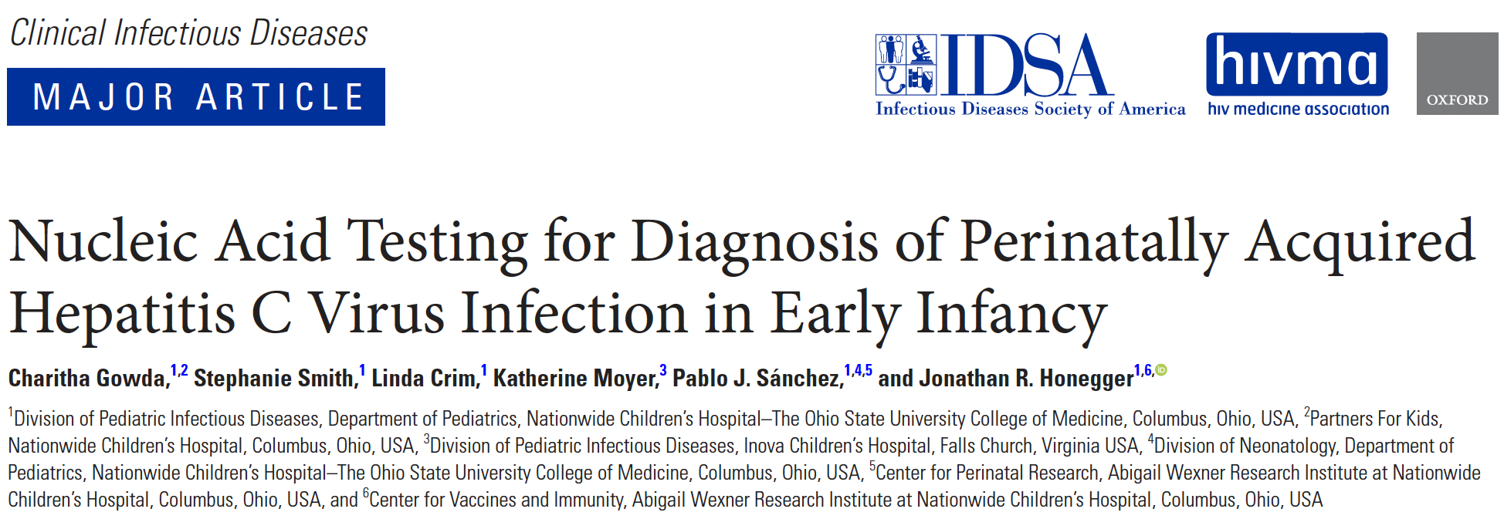
Our Approach to Perinatal HCV Exposure
Notes:
Include risk factors for increased acquisition

Slide 60
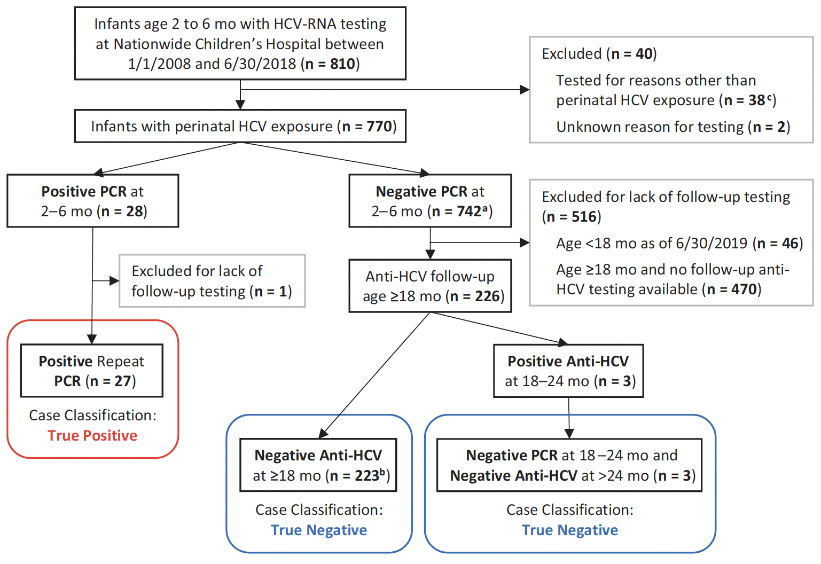
Our Approach to Perinatal HCV Exposure
Gowda et al CID 2021:73
Notes:
Include risk factors for increased acquisition

Slide 61
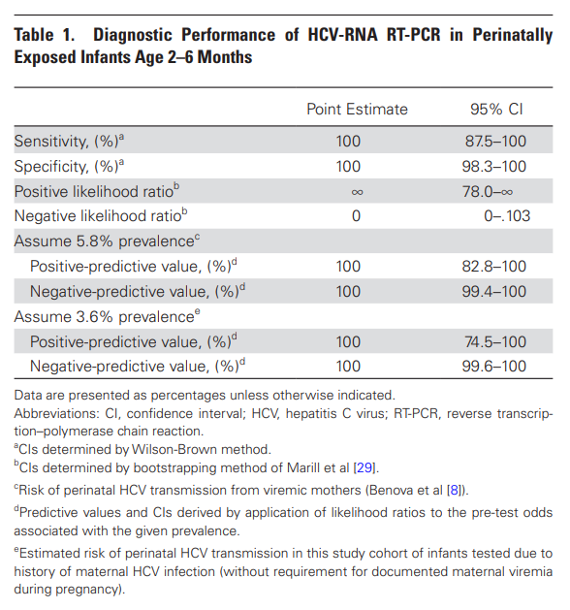
Our Approach to Perinatal HCV Exposure
Gowda et al CID 2021:73
Notes:
Prior studies had reported lower Thomas et al - sensitivity of 89% (90% CI, 80–95%) by age 3 months
Polywka et - a sensitivity of 75% (95% CI, 63–85%) at age 3 months - 85% (95% CI, 75–93%) at age 6 months
→ Newer tests/ more reliable – not related to viral load (all had high loads) test characteristics, such as improved reliability and reproducibility of modern real-time RT-PCR techniques that are less susceptible to human error than prior gel-based RT-PCR assays

Slide 62
OUR APPROACH TO PERINATAL HCV EXPOSURE
Why is this study so important? Why do we think it is important to implement HVC PCR testing in all perinatally exposed babies?
770 babies tested by PCR
517 patients lost to follow up
253 babies tested for Anti-HCV

Slide 63
Debate about screening recommendations
Team HCV RNA PCR

Slide 64
Our approach to perinatal hep C Exposure
All newborns with perinatal Hepatitis C exposure get ID referral and follow up
Initial Visit at 2 months Hepatitis C Quantitative PCR
Appropriate counseling given
Negative
Follow up at 18-24 months of age for Hep C Serology
Positive
Additional testing and follow up
Notes:
Include risk factors for increased acquisition

Slide 65
Our approach to perinatal hep C Exposure
Follow up for babies with positive Hepatitis C PCR
Initial Visit after positive test:
Other labs:
HCV genotype
LFTs
CBC with differential (mainly to look at platelets)
HIV 4th gen screen
Further counseling in natural history
Transmission and Prevention

Slide 66
Our approach to perinatal hep C Exposure
Initial Visit after positive test:
Transmission and Prevention
Universal precautions at school and at home
Avoid sharing toothbrushes, razors, nail clippers etc.
Use gloves and dilute bleach to clean up blood
Good time to address possibility of treatment with positive parent
Encourage appropriate vaccination including Hepatitis A and B

Slide 67
Our approach to perinatal hep C Exposure
Follow up visit at 18 months:
Labs:
Quantitative HCV RNA PCR
HCV Serology
CBC
LFTs
HBsAb
HBsAg
HBcAb
Notes:
Hepatitis B testing is important for several reasons:
1) Pts with Coinfection may warrant closer LFTs monitoring
2) May be helpful in the future as well : If patient develops chronic hep C infection and warrant therapy – if chronic Hep B infection – they can flaire up during HCV treatment

Slide 68
Our approach to perinatal hep C Exposure
3 year follow up:
Labs:
HCV RNA PCR
CBC
LFTs
Chem7
PT/PTT
If PCR is still positive or lab abnormalities → Liver ultrasound with acoustic radiation force impulse (to evaluate for liver fibrosis/staging)
Assess readiness for treatment
Notes:
Liver disease due to chronic HCV infection generally progresses slowly in children, and cirrhosis and liver cancer occur infrequently. Although elevated serum aminotransferase levels are often noted, HCV-infected children younger than 3 years virtually never develop advanced liver disease.

Slide 69
Our approach to perinatal hep C Exposure
Treatment is recommended for all children and adolescents with HCV infection aged ≥3 years
Regardless of disease severity.
Current available treatment options:
Ledipasvir/sofosbuvir (Harvoni)
Sofosbuvir/velpatasvir (Epclusa)
https://www.hcvguidelines.org/unique-populations/children

Slide 70
Our approach to perinatal hep C Exposure
Precautions:
Parents should be informed that hepatitis C is not transmitted by casual contact and, as such, children with HCV infection do not pose a risk to other children and can participate in school, sports, and athletic activities, and engage in all other regular childhood activities without restrictions.
Educate families and children about the risk and routes of HCV transmission, and the techniques for avoiding blood exposure, such as avoiding the sharing of toothbrushes, razors and nail clippers.
Household surfaces and implements contaminated with visible blood from an HCV-infected person should be cleaned using a dilution of 1 part household bleach to 9 parts water. Gloves should be worn when cleaning up blood spills.

Slide 71
Our approach to perinatal hep C Exposure
All newborns with perinatal Hepatitis C exposure get ID referral and follow up
Initial Visit at 2 months Hepatitis C Quantitative PCR
Appropriate counseling given
Negative
Follow up at 18-24 months of age for Hep C Serology
Positive
Additional testing and follow up
Notes:
Include risk factors for increased acquisition

Slide 72
Our approach to perinatal hep C Exposure
Follow up at 18-24 months of age with prev. negative PCR:
Obtain HCV antibodies
If negative: no further workup needed patient is not infected
If positive: obtain HCV RNA PCR – if negative – consider repeating HCV antibodies >24 months of age
If HCV RNA positive – follow up as infected

Slide 73
Content overview
Trends in hepatitis C virus (HCV) epidemiology
Updated HCV screening recommendations
Our approach to perinatal HCV exposure
Future considerations
Brief clinical & microbiological review

Slide 74
FUTURE CONSIDERATIONS
Our proposed model is not perfect. Despite earlier follow up, we still have a big percentage of no shows.
Many social challenges and barriers for care in this population.
Every initiative / effort helps.
Ultimate goal: Statewide Database
Notes:
Room for better policies
Unify registry of all exposed babies???
Better health records in CPS cases/foster systems?

Slide 75
Takeaway points
WV has the highest percentage of pregnant women with Hepatitis C infection
Risk of transmission to baby is low, yet high risk for chronic infection and liver failure in those infected
Many exposed children are lost to follow up and may very likely be unaware of their perinatal Hep C exposure
Earlier HCV PCR is a useful tool for early capture and assessment perinatally exposed babies to HCV

Slide 76
Thank you
Jacob T. Kilgore, MD, MPH, FAAP
kilgore14@marshall.edu
Mariana M. Lanata, MD, FAAP
lanatapiazzo@marshall.edu

Slide 77
References
Centers for Disease Control & Prevention (CDC). Hepatitis C Questions and Answers for Health Professionals. 2022, accessed online at https://www.cdc.gov/hepatitis/hcv/hcvfaq.htm#section.
Indolfi G, Resti M. “Perinatal Transmission of Hepatitis C.” Journal of Medical Virology, 2009; 81(5):836-843.
Mack CL, Gonzalez-Peralta RP, Gupta N, Leung D, Narkewicz MR, et al. NASPGHAN Practice Guidelines: Diagnosis and management of hepatitis C infection in infants, children, and adolescents. J Pediatr Gastroenterol Nutr. 2012 Jun;54(6):838-55. PubMed PMID: 22487950.
Roberts EA, Yeung L. Maternal –Infant Transmission of HCV infection. Hepatology, 2002;36(5 Supplement 1): S106-113.
Slowik M, Jhaveri R. Hepatitis B and Hepatitis C viruses in Infants and Young Children. Seminar in Pediatric Infectious Disease, 2005;16:296-305.
Schillie S, Wester C, Osborne M, Wesolowski L, Ryerson AB. CDC Recommendations for Hepatitis C Screening Among Adults — United States, 2020. MMWR Recomm Rep 2020;69(No. RR-2):1–17. DOI: http://dx.doi.org/10.15585/mmwr.rr6902a1external icon.
United States Preventative Services Task Force (USPSTF). “Hepatitis C Virus Infection in Adolescents and Adults: Screening.” 2022, accessed online at https://www.uspreventiveservicestaskforce.org/uspstf/recommendation/hepatitis-c-screening.
World Health Organization (WHO). ”Hepatitis C.” 2016, accessed online at https://www.who.int/news-room/fact-sheets/detail/hepatitis-c.
American Association for the Study of Liver Diseases (AASLD) & Infectious Diseases Society of American (IDSA). “CV Guidance: Recommendations for Testing, Managing, and Treating Hepatitis C.” 2022, accessed online at https://www.hcvguidelines.org.
Kimberlin DW, Barnett ED, Lynfield R, Sawyer MH. American Academy of Pediatrics Redbook 2021-2024: Report of the Committee on Infectious Diseases. “Hepatitis C.” Accessed online at https://publications.aap.org/redbook/book/347/chapter/5752660/Hepatitis-C?searchresult=1.
Notes:
Include risk factors for increased acquisition

