Slide 1
Intimate Partner Violence, Substance Use, Substance Use Coercion: Implications for Perinatal Providers
WVPP Perinatal Summit 2023
Carole Warshaw MD, Director, National Center on Domestic Violence, Trauma, and Mental Health
September 19, 2023

Slide 2
Overview
Weave West Virginia Project
Mental health, substance use, and pregnancy in the context of intimate partner violence (IPV)
Concepts of mental health and substance use coercion
Addressing substance use coercion in clinical practice
Policy implications
1

Slide 4
Weave WV Project Overview
Weaving Together Communities of Support for People Experiencing Substance Use and Domestic Violence.
Three-year project funded by the U.S. Department of Health and Human Services, Office of Women’s Health to:
Improve health and safety outcomes for people impacted by intimate partner violence (IPV) and substance use (SU) across the state of West Virginia, and particularly for pregnant and parenting people and their families

Slide 5
Weave WV Project Goals
Create and maintain a statewide partnership
Identify and develop best practices that address needs and disparities and advance health equity
Improve outcomes and service effectiveness for people experiencing IPV and substance use through cross-training and implementation of best practices in SUD, IPV, and health care settings including SBIRT+ Pilot
Build and maintain regional networks to improve cross-system partnerships and collaboration
Evaluate project impact
Notes:
Think about how SU Coercion/IPV could be better integrated
Need: There is a high level of need for coordinated intimate partner violence (IPV) and substance use disorder (SUD) services in West Virginia, particularly for pregnant and parenting women (PPW), as evidenced by high rates of substance use, poor infant and maternal health outcomes, and racial disparities in health, healthcare access and IPV.
The purpose of this project is to create a statewide pilot initiative to train substance use disorder (SUD) treatment providers on intimate partner violence (IPV) and IPV providers on substance use and to address the intersection of IPV and SUD during the pregnancy and postpartum period.
State-Level Partnerships. The Project Team will engage and mobilize a statewide response that addresses unmet needs of PPW experiencing IPV/SU and disparities impacting racial, ethnic, sexual, and gender minorities, and people living with disabilities. This statewide response will build on local strengths and opportunities, involving community stakeholders in a Stakeholder Advisory and HC-TF
Project goals are to:
engage state agencies, IPV programs, treatment providers, and other key stakeholders from diverse communities in increasing the use of EB and promising practices in service delivery;
create and deliver training for SUD, IPV, and healthcare providers; and
a collaborative statewide network of regional teams to promote service implementation at the local level and address access and outcome disparities and unmet needs
In order to accomplish these goals we will build on existing state-wide partnerships and engage key stakeholders in 6 core activities
Incentivize SUD providers treating PPW to receive training on identifying IPV
Crosstrain SUD treatment providers to address IPV and train IPV staff on SUD.
Identify research-based services for screening, assessment, brief intervention, and referral.
Integrate IPV and SUD protocols into medical practice.
Integrate perinatal and postpartum programs into existing substance use programs.
Evaluation to determine changes in providers' knowledge, skill, and comfort in addressing IPV/SU, document changes in referrals and collaboration among state partners, and assess improvement in IPV-SUD health outcomes among pregnant and postpartum women.
Our approach builds on WV’a existing statewide partnerships & networks, incorporates the PP of reducing SU coercion, and responds to the high overdose and drug-related death rate for women in WV.

Slide 6
Overview and Framework
Thinking About Trauma, Substance Use, and Mental Health in the Context of Intimate Partner Violence and the Implications for Perinatal Care
8

Slide 7
Trauma, Mental Health, Substance Use, and IPV: What Are the Connections?
IPV has significant health, mental health (MH), and substance use-related effects
There are high rates of IPV and other trauma among people accessing MH and substance use disorder (SUD) treatment and among people accessing perinatal care
People who abuse their partners actively use MH and SU issues against their partners as a tactic of control, particularly in relation to custody and credibility.
IPV impacts survivors’ ability to access and engage in health, MH, and SUD treatment.
Integrated approaches to IPV, trauma, MH, and SU are critical to the safety and recovery of survivors and their children
10

Slide 8
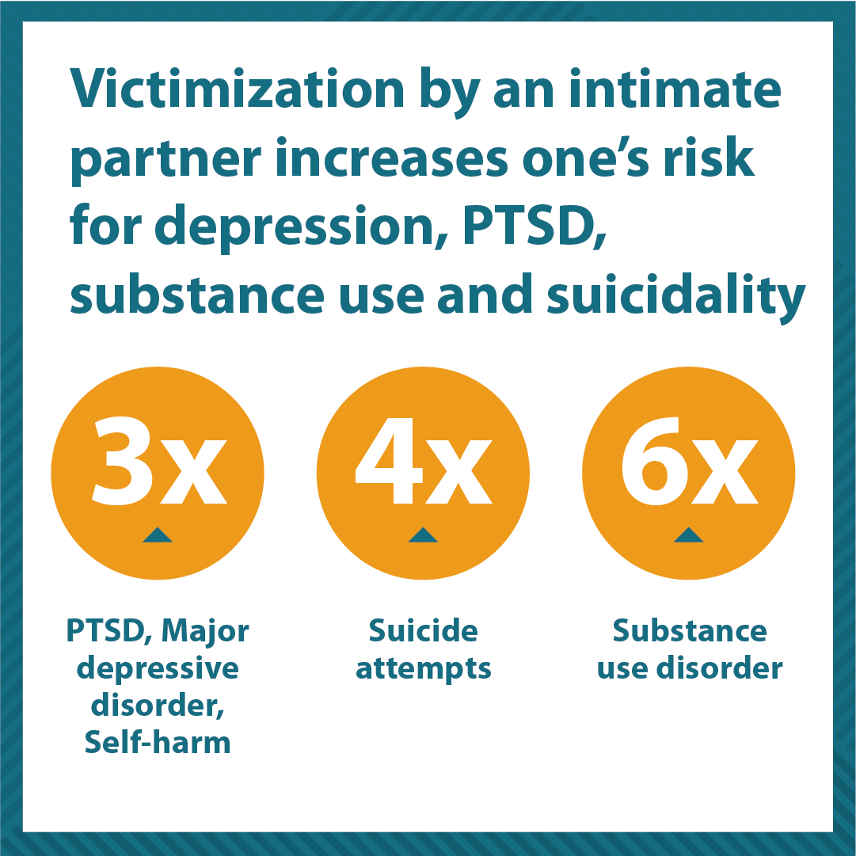
IPV Has Significant Mental Health and Substance Use Effects
Women: Increased PTSD, depression, suicidality, chronic pain, insomnia, and substance/opioid use; High rates of IPV among women dx with a psychiatric disability
IPV increases the risk for post-partum depression and substance use during pregnancy
LGBTQ+ individuals: Higher rates of depression and substance use among gay men; Increased SU associated with gender abuse of transgender women
11
NCSC, 2022; Wagner et al., 2009; Bennett et al.,1994; Hemsing et al., 2015; Smith et. al., 2012; Ogle et al.,2003; Eby, 2004; LaFlair, et al., 2012; Bueller et al., 2014; Nuttrock et al., 2014; Nathanson et al., 2012; Lipsky et al., 2008; Breiding et al., 2014; Bonomi et al., 2009; Gonzalez, et al., 2014; Khalifeh, et al., 2015; Friedman et al., 2007
Notes:
Need: There is a high level of need for coordinated intimate partner violence (IPV) and substance use disorder (SUD) services in West Virginia, particularly for pregnant and parenting women (PPW), as evidenced by high rates of substance use, poor infant and maternal health outcomes, and racial disparities in health, healthcare access and IPV.
Isolation (suicide)
Research has consistently documented that exposure to abuse is a significant factor in the development and exacerbation of psychiatric conditions and influences the course of recovery (Walsh et al., 2015).
Both random population studies and studies conducted in clinical settings indicate that IPV places individuals at significantly higher risk for depression, anxiety, PSTD, eating disorders, chronic pain, insomnia, substance use disorders, suicide attempts, and experiencing greater unmet mental health needs.
Depression, PTSD, Chronic Pain also increased risk for SU and opioid use
Metanalysis (Bedouyn et al., 1.5-2 fold increase in Post-Partum Depression - A sizable proportion (9%–28%) of major depressive disorder, elevated depressive symptoms, and postpartum depression can be attributed to lifetime exposure to IPV.
SU – 6x higher among people who experience IPV: Experiencing multiple forms of IPV significantly increases this risk. Among women accessing SUD treatment, 45% reported pregnancy-related IPV – (Velez et al., 2006)
PTSD/Depression- Risks – Frequency, recency severity, cumulative burden, isolation, lack of social support: Increase risk for suicide
People living with Psychiatric Disabilities, cumulative burden, associations of homelessness (IPV major risk factor)
Suicide: Risk factors PTSD/Depression/Multiple types of abuse, homelessness, chronic health conditions, ALSO risk for potentially lethal assault; Entrapment/solation, worse during COVID
Increases suicide risk among adolescents and adults, with rates of suicidal ideation and attempts found to be three and four times higher among women who have experienced IPV (Dillon et al. 2013).
In community samples,
23% of women experiencing IPV reported a past suicide attempt vs 3% without a history of IPV, and 36.8% of IPV survivors seriously considered suicide
In another study, over 90% of women hospitalized with suicidal ideation reported current and severe IPV (Heru et al. 2006). Likewise, higher rates of IPV have been found among women with suicidal ideation or attempts. All impact ability to access resources; Increase risk for abuser control. What Helps: Safety, access to resources, social support; IPV-informed treatment

Slide 9
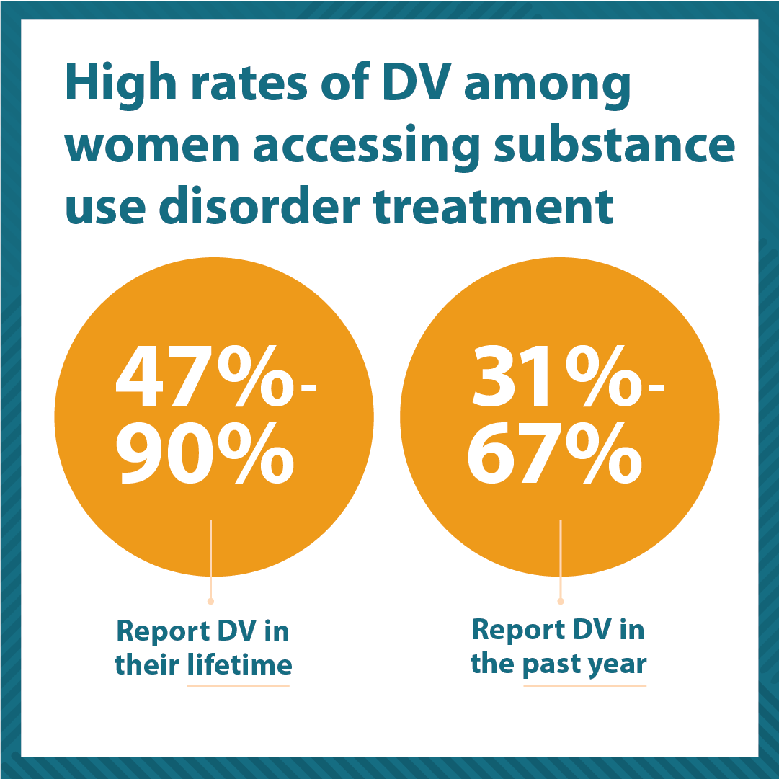
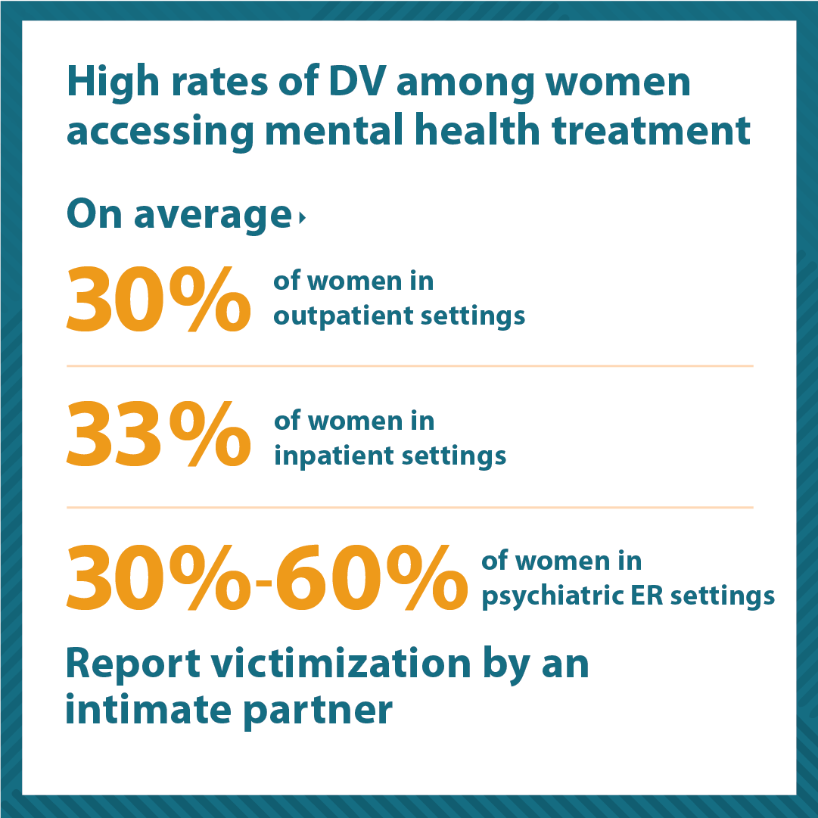
IPV is prevalent among people accessing mental health and substance use disorder treatment
Rivera et al. 2015 (NCDVTMH); Phillips et al. 2014 (NCDVTMH)
12
Notes:
Methadone clinic – 90%

Slide 10
IPV and Pregnancy
Prevalence of IPV during pregnancy among rural Appalachian women:
81% reported some type of IPV: 28% physical violence, 20% sexual violence: 75% reported past year IPV. National average is 3-13%.
IPV during pregnancy increases the risk of:
STIs, unintended pregnancy
Preterm birth, low birth weight, fetal injury
Physical injuries, pregnancy loss, and maternal mortality
Maternal depression, anxiety, PTSD, and substance use
Women experiencing IPV are 7.5x more likely to have partner interfere with HC
Agarwal et al., 2023; Bailey & Daugherty, 2007; Morrison et al., 2022; Pallatino et al., 2021; Phillips et al., 2021
13
Notes:
. Nationally, 47-90% of reproductive-aged women with a SUD report IPV compared to 1-20% of non-SUD populations; 32-75% of women opioid users report IPV in the past year;⁶ and 75% of pregnant Appalachian women report IPV in the last year,³ vs. the national average of 3-13%.⁸
PPW’s increased risk for IPV is, in turn, a primary risk factor for substance use, late prenatal care, low birth weight, preterm labor, injury, maternal homicide, and mental health concerns.⁸
Partner abuse is an explicit barrier to healthcare, IPV, and SU services for PPW. Women experiencing IPV are 7.5 times as likely to have a partner who interferes with their healthcare.¹⁰
The prevalence of IPV during pregnancy varies across different countries and cultures, with rates ranging from 2% to 35%. It is important to note that IPV during pregnancy often goes unreported and undetected, so the actual prevalence may be higher than reported [3,4].
IPV during pregnancy has been associated with a range of adverse health outcomes for both the mother and the developing fetus. Physical violence during pregnancy can result in injuries such as bruises, fractures, and head trauma. Psychological abuse during pregnancy can cause depression, anxiety, and post-traumatic stress disorder (PTSD). Additionally, pregnant women who experience IPV are more likely to experience reproductive health complications, such as sexually transmitted infections (STIs), unintended pregnancy, and induced abortion [5-7].
Adverse effects of IPV during pregnancy on fetal health can include low birth weight (LBW), preterm birth, fetal injury, and even fetal death. Children born to mothers who experience IPV during pregnancy may also have long-term health consequences, such as developmental delays, behavioral problems, and chronic health conditions [8,9].
Agarwal S, Prasad R, Mantri S, et al. (May 20, 2023) A Comprehensive Review of Intimate Partner Violence During Pregnancy and Its Adverse Effects on Maternal and Fetal Health. Cureus 15(5): e39262. doi:10.7759/cureus.39262
Physical violence during pregnancy can result in serious injuries such as fractures, internal bleeding, and head trauma, which can lead to complications and, in some cases, death. Additionally, pregnant women who experience severe physical violence may be at risk of developing pregnancy-related complications such as preeclampsia, premature rupture of membranes, and preterm labor, which can also increase the risk of maternal mortality
Pregnancy mortality surveillance system. (2023). Accessed: May 4, 2023: https://www.cdc.gov/reproductivehealth/maternal-mortality/pregnancy-mortality-surveillance-system.htm.
Bailey and Daugherty – Intimate Partner Violence During Pregnancy: Incidence and Associated Health Behaviors in a Rural Population
Medical records were also reviewed. Results: 81% of participants reported some type of IPV during the current pregnancy, with 28% reporting physical IPV, and 20% reporting sexual violence. More than half were current smokers.
Physical IPV during pregnancy was associated with significantly increased rates of pregnancy smoking (including decreased rates of quitting and reducing), increased rates of alcohol, marijuana, and harder illicit drug use around the time of conception, and later entry into prenatal care.
The experience of psychological IPV during pregnancy was associated with a significantly decreased likelihood of quitting or reducing smoking during pregnancy, an increased rate of alcohol use around the time of conception, and an increased rate of pre-pregnancy obesity.
Morrison et al., 2022
Reproductive-aged women are at a heightened risk for IPV in general and pregnancy and the immediate post-partum period can be particularly vulnerable time for women already experiencing IPV (Agrawal et al., 2014; Chisholm et al., 2017; Román-Gálvez et al., 2021).
A recent study by Román-Galvez et al.(2021) found that IPV during pregnancy ranges in prevalence from 1.6 to 78% for physical violence, and 1.8 to 67.4% for psychological violence.
Furthermore, IPV during pregnancy has become a leading cause of maternal mortality(Campbell et al., 2017, 2021). Pregnant victims of IPV are more likely to report their pregnancy was unintended and a lack of prenatal care, as well as experience poorer infant outcomes, such as low birth weight; they also have a higher risk depression and other mental health issues, death as a result of homicide, and substance abuse (Alhusen et al., 2015; Campbell et al., 2017; Hill et al., 2016). In fact, regardless of pregnancy status, IPV is associated with substance use in victims, who report engaging in drug use to cope with abuse-related trauma (Pallatino et al., 2021; Phillips et al., 2021; Warshaw et al., 2014).
Substance use within the context of a violent relationship can also heighten the severity of IPV, potentially increasing the risk for homicide (Kraanen et al., 2014; Salom et al., 2015). However, research has shown that an estimated 47–90% of pregnant women with SUDs experience IPV, surpassing general population rates (Campbell et al., 2017; Engstrom et al., 2012; Schneider et al., 2009; Velez et al., 2006). Additionally, studies of women in treatment for substance use disorders have found that lifetime physical and emotional abuse surpasses 70%, with 45% reporting pregnancy-related IPV (Velez et al., 2006). Thus, suggesting that pregnant women are at a particularly high risk for IPV-related substance abuse.
Despite the recognition that women may have unique needs in relationship to co-occurring IPV and substance use during pregnancy or the immediate post-partum period, several gaps in the literature remain. First, although there is a burgeoning set of research – derived from studies with both patients and providers – on co-occurring IPV and substance use, such studies have not traditionally included pregnant or immediately post-partum women (e.g., Afifi et al., 2012; Bennett & O’Brien, 2007; Cafferky et al., 2018; Kraanen et al., 2014; McHugo et al., 2005). Thus, it remains unclear as to what is needed to optimize outcomes for pregnant or post-partum women specifically.
Second, research suggests that opioid use disorder (OUD) among reproductive aged women, including those who are currently pregnant or immediately post-partum, has risen in the last fifteen years (Haight et al., 2018). However, relatively few studies of IPV and substance use have included OUD (Stone & Rothman, 2019) or sought to understand the intersection of co-occurring IPV and OUD with women who are pregnant or immediately post-partum (Dewey, 2020; Pallatino et al.,2021; Phillips et al., 2021). Studies that seek to understand

Slide 11
Less well recognized are the ways people who abuse their partners engage in coercive tactics targeted toward a partner’s mental health or use of substances...
14

Slide 12
Mental Health Coercion Survey National Domestic Violence Hotline and NCDVTMH Survey
N=2,456
86% | Ever called “crazy” or accused of being crazy
74% | Deliberately did things to make you feel like you are going “crazy” or losing your mind
53% | Ever sought help for feeling upset or depressed
49% | If “yes” Has your partner or ex- tried to prevent or discourage from getting that help or taking prescribed meds for those feelings
50% | Partner or ex- ever threatened to report to authorities that you are “crazy” to keep you from getting something you want or need (e.g., custody of children, medication, a PO)
15
Warshaw C., Lyon E., Bland P., Phillips H., Hooper M., NCDVTMH/The Hotline, 2014

Slide 13
Mental Health Coercion Survey: Qualitative Findings
Undermine Sanity: Call pathologizing names; “diagnose” partner; attempt to convince others that partner is unstable/mentally ill; gaslighting; blaming the abuse on partner’s mental health
Treatment Interference: Attempt to influence diagnosis; coerce partner to overdose and then try to have partner committed
Control of Medications: Prevent from taking, force to take (wrong dose/overdose), steal meds, call partner an addict for taking meds
Threats to Report or Discredit: Report meds/treatment to influence custody; Use MH diagnoses to make false allegations and obtain protective order
Warshaw C., Lyon E., Bland P., Phillips H., Hooper M., NCDVTMH/The Hotline, 2014
16
Notes:
Undermine Sanity: Call pathologizing names; “diagnose” partner; attempt to convince others that partner is unstable/mentally ill; gaslighting; blaming the abuse on partner’s mental health
Treatment Interference: Attempt to influence diagnosis; coerce partner to overdose and then call crisis line and try to have partner committed
Control of Medications: Prevent from taking, force to take (wrong dose/overdose), steal meds, call partner an addict for taking meds
Threats to Report or Discredit: Report meds/treatment to influence custody; Use MH diagnoses to make false allegations and obtain protective order
Participants reported their abusive partners:
Told friends/family that they were unstable
Would “diagnose” them
Called them pathologizing names
Attempted to convince police/doctors that they were mentally ill
Engaged in “gaslighting”: Twisting situations around to make them look or feel “crazy”
Abusive partner would go to survivor’s doctor and tell him that she needed medication, doctor would tell survivor she didn’t, and then partner would return to ‘convince’ doctor that she did.
One caller reported that she has bipolar disorder. During a depressive episode, while she was highly medicated, her abusive partner maxed out credit cards in her name, threw her out of the house, and divorced her.
Sometimes abusive partner encourage medication to further her purposes other times she would not allow her to take medication (for anxiety). It depended on the situation.
One caller shared that her ex-partner prevented her from calling authorities many times because he told her she was crazy & no one would believe her. She tried calling the police several times and he manipulated the police and they didn’t listen to her or protect her.
One caller shared that her abusive partner was in charge of taking her to her doctor’s appointments and picking up her medications, and she (the abuser) stopped doing that. The abusive partner then used that to file a protective order against the survivor saying she stopped taking her medication and was dangerous.
“That’s like hitting the nail on the head of all the things he was doing to me. He told me that if I tried to leave he was going to take the kids and I would be in the psych ward.”

Slide 14
Substance Use Coercion Survey National Domestic Violence Hotline and NCDVTMH Survey
N=3,224
26% | Ever used substances to reduce pain of partner abuse?
27% | Pressured or forced to use alcohol or other drugs, or made to use more than wanted?
15.2% | Tried to get help for substance use?
60.1% | If yes, partner or ex-partner tried to prevent or discourage you from getting that help?
37.5% | Partner or ex-partner threatened to report alcohol or other drug use to someone in authority to keep you from getting something you wanted or needed?
24.4% | Afraid to call the police for help because partner said they wouldn’t believe you because of using, or you would be arrested for being under the influence?
17
Warshaw C., Lyon E., Bland P., Phillips H., Hooper M., NCDVTM/The Hotline, 2014
Notes:
Many survivors of IPV experience substance use coercion – tactics specifically targeted towards a partner’s use – or alleged use - of substances -

Slide 15
Introduction to Substances, Coerced Use, and Escalation of Substance Use
Survivors often introduced to substances by an intimate partner
Abusive partners play major role in initiation of substance use and escalation of SU problems
Coercive tactics range from being pressured to use with partner and unable to refuse; being manipulated, threatened or forced into using; being drugged
Roberson, 2017; Amaro et al., 1995; Macy et al., 2013; Rothman et al., 2018; O’Brien et al., 2016, Warshaw et al., 2014
©ncdvtmh
18
Notes:
Some specific examples of tactics associated with SUC include:
Introducing, pressuring, coercing, or forcing survivors into using substances, including new or more addictive ones;
Controlling survivors’ access to substances as a way to maintain power and control within the relationship;
Coercion into using so would “calm down” instead of being angry about being beaten (VT)

Slide 16
Substance Use Coercion Survey: Treatment Interference and Sabotage
Not allowing partner to attend mutual aid meetings (such as AA) or seek treatment; harassing into leaving
Withholding transportation, childcare, and/or financial resources for treatment
Keeping substances in the home
Controlling medications, stealing medications, using medications to coerce or control
Escalating violence if partner tries to stop using
19

Slide 17
Substance Use Coercion Survey: Additional Qualitative Findings
Blaming Abuse on Partner’s Substance Use and benefiting from stigma and lack of access to services
Substance Use-Related Sexual Coercion: Coerced or forced substance use tied to coerced or forced sex
Threats to Report or Discredit: Reported to judges, police, probation and parole officers, CPS, employers; False allegations; Videotaping
20
Notes:
Substance Facilitated Sexual Coercion
Pressure to use connected to coerced sex
Using a partner’s substance use to justify sexually abusive or violent behavior
Coercion into exchanging sex of drugs or money; coercion into trafficking
Deliberate Incapacitation
Sexual violence when passed out
Leveraging stigma associated with substance use to isolate survivors from social networks and supports; and to manipulate and mobilize systems (e.g., child welfare, criminal justice) against them.

Slide 18
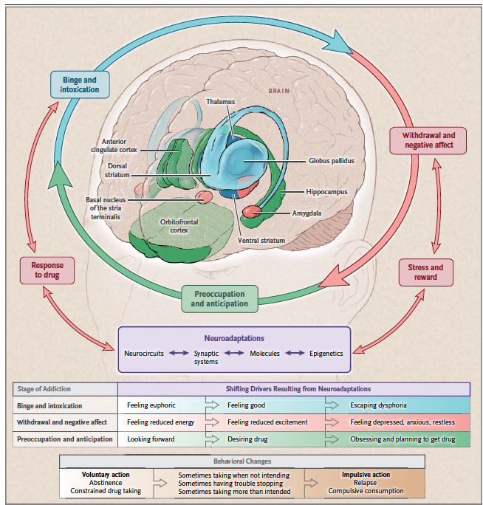
Considering the Neurobiology of Relapse Cues in the Context of Substance Use Coercion
Provoking relapse as a tactic of abuse:
Exposure to addictive/rewarding drugs
Conditioned cues from the environment
Exposure to stressful experiences
Involves activation of neural circuitry (e.g., reward, incentive, salience, and glutaminergic pathways, including pathways involved in the stress response).
These can be “deliberately” activated by an abusive partner who engages in substance use coercion
ASAM (Hajela et al., 2011); Warshaw et al, 2014
21

Slide 19
What are the Implications of Substance Use Coercion for the Opioid Epidemic?
30

Slide 20
IPV and Opioids
IPV increases a person’s risk for opioid use.
High rates of IPV among people accessing OUD treatment:
90% of women accessing services in a methadone clinic had experienced IPV
Women who experience IPV are at increased risk for relapse and for opioid OD
IPV and opioid ODs have increased during COVID-19
IPV and substance use coercion create unique risks that directly threaten safety and well-being.
Engstrom, et al., 2012, Rivera et al., 2015; Gilbert, 2019
31
Notes:
Study of 352 women in community corrections: if reported IPV (61%) more likely drug overdose (Gilbert, 2019)

Slide 21
Substance Use Coercion and Opioids
Introducing partner to opioids/controlling supply
Threatening to put a partner into withdrawal
Coercing partner to engage in illegal activities
Forcing partner to use unsafely
Injuring partner to obtain pain meds
Sabotaging treatment: Stalking at regular MAT appointments; Keeping a partner from meeting Tx requirements; Controlling or diverting meds
Using opioid history as threat and tactic of control: Custody, CPS, LE, housing, jobs, probation/parole; planting drugs
Bland 2013, Warshaw & Tinnon, 2018
32
Notes:
Study of 352 women in community corrections: if reported IPV (61%) more likely drug overdose (Gilbert, 2019)
Forcing, pressuring, or coercing survivors into engaging in illegal or unwanted activities to obtain substances or money for substances- this marks an under-explored trajectory into human trafficking;
Relationship Entrapment
Exploiting partner for financial or personal (including addiction-related) gain

Slide 22
Substance Use Coercion and the Opioid Epidemic
Consider the Impact of Substance Use Coercion on:
Initiation into use and OUD; relationship entrapment
Ability to engage in treatment; relapse and recovery
Medical complications; OD and OD-related death; maternal mortality
Neonatal Abstinence Syndrome/NOWS
Involvement in child protective services and criminal legal system; ability to comply with court-ordered treatment requirements or meet conditions of probation, parole or reunification plan
Housing, employment, and access to public benefits
Underscoring the need for coordinated IPV-informed responses to support safety, recovery, resilience, parenting, and prevention
33

Slide 23
In addition, people who abuse their partners actively try to undermine their partners’ relationships with their children, creating risks for their children’s health, mental health and well-being.
Yet, research consistently shows that attachment to the non-abusive caregiver is what is most protective of children’s resilience and development.
22
Notes:
Most well aware that threats related to loss of custody and child removal are such a prominent form of abuse, even more so in the context of mental health and substance use coercion
We know that people who perpetrate IPV often actively try to undermine their partners’ relationships with their children, creating risks for a child’s development and their physical and mental health.
While exposure to IPV can impact children’s physical, psychological, and emotional well-being, research consistently shows that attachment to the non-abusive primary caregiver is what is most protective of children’s resilience and development.
Research has also shown that prevention and early intervention efforts are effective in reducing child abuse and IPV.
Understanding the dynamics of IPV – including abusive behavior targeted at a partner’s substance use, mental health, or parenting – is critical to supporting children and families- particularly in the face of abusive behavior targeted at a partner’s substance use, mental health or parenting.
Particular relevance for Family Court and re: policies related to SU and pregnancy/SU and parenting
25 states and the District of Columbia consider substance use during pregnancy to be child abuse under civil child-welfare statutes, and 3 consider it grounds for civil commitment.
26 states and the District of Columbia require health care professionals to report suspected prenatal drug use, and 8 states require them to test for prenatal drug exposure if they suspect drug use. including MAT, yet research has shown that best outcomes for both mothers and children are maintaining the child-parent bond
NY State – not consider child abuse and DOES NOT require reporting
Does have targeted programming but doesn’t prioritize access for PPP or
Also has implications for “test and report” policies re: testing for substances during pregnancy and post-partum without informed consent, leading to removal unrelated to evidence of abuse and neglect – and too often applied in discriminatory ways (testing and removal rates much higher in BIPOC communities.
Amplified in context of SU coercion, where this can include coercing a partner to use and then reporting them to CPS or using their SU against them in custody battles or as a way to discredit them with their children.

Slide 24
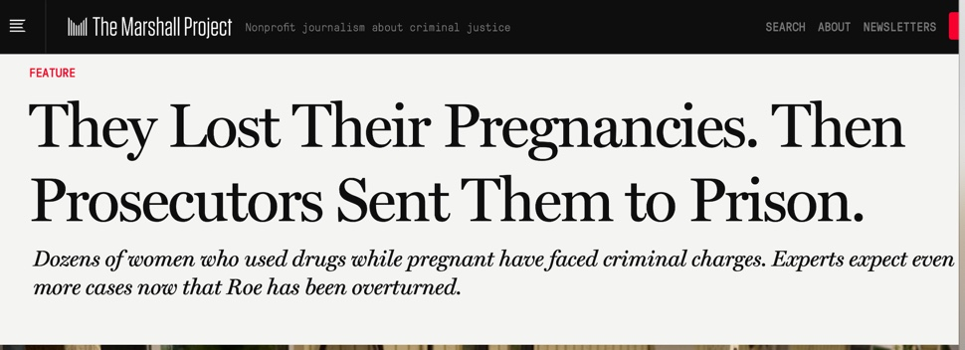
Substance Use During Pregnancy and State Policies
25 states and the District of Columbia consider substance use during pregnancy to be child abuse under civil child-welfare statutes, and 3 consider it grounds for civil commitment.
26 states and the District of Columbia require health care professionals to report suspected prenatal drug use, and 8 states require them to test for prenatal drug exposure if they suspect drug use.
https://www.guttmacher.org/state-policy/explore/substance-use-during-pregnancy
23
Notes:
Particular relevance for Family Court and re: policies related to SU and pregnancy/SU and parenting
25 states and the District of Columbia consider substance use during pregnancy to be child abuse under civil child-welfare statutes, and 3 consider it grounds for civil commitment.
26 states and the District of Columbia require health care professionals to report suspected prenatal drug use, and 8 states require them to test for prenatal drug exposure if they suspect drug use. including MAT, yet research has shown that best outcomes for both mothers and children are maintaining the child-parent bond
Also has implications for “test and report” policies re: testing for substances during pregnancy and post-partum without informed consent, leading to removal unrelated to evidence of abuse and neglect – and too often applied in discriminatory ways (testing and removal rates much higher in BIPOC communities.
Recent data from UPMC found higher rates of drug testing for Black vs. White women but higher rates of SU among W vs. Black women
Amplified in context of SU coercion, where this can include coercing a partner to use and then reporting them to CPS or using their SU against them in custody battles or as a way to discredit them with their children.
Dozens of women who used drugs while pregnant have faced criminal charges. Experts expect even more cases now that Roe has been overturned.
Meron Menghistab for The Marshall Project
Some were already mothers, excited about having another baby. Others were upset or frightened to find themselves pregnant. All tested positive for drugs. And when these women lost their pregnancies, each ended up in jail.
More than 50 women have been prosecuted for child neglect or manslaughter in the United States since 1999 because they tested positive for drug use after a miscarriage or stillbirth, according to an investigation by The Marshall Project, The Frontier and AL.com that was co-edited and published in partnership with The Washington Post.
The medical community calls this legal approach harmful and counterproductive. But it’s a strategy many legal experts say is likely to become more common now that Roe v. Wade has been overturned, making it easier for states to pass laws that give fetuses and embryos the same rights as children or their mothers.
An analysis of court records and medical examiner data over the last 23 years found at least 20 felony cases in Alabama, 14 in South Carolina and 10 in Oklahoma, as well as nine in other states where prosecutors have embraced some form of “fetal personhood” in bringing criminal charges after miscarriage or stillbirth. Many of the prosecutions resulted in lengthy prison sentences and life-altering consequences for mostly poor women who were struggling with addiction.
In 20 additional cases, women in Alabama, Oklahoma and South Carolina were prosecuted after positive drug tests because their babies died shortly after birth.
Seven of the Oklahoma stillbirth and miscarriage cases were filed in the last two years. In many instances, the fetuses were not developed enough to be viable outside the womb. Sentences have ranged from probation to 20 years in prison. Women sent to prison after pregnancy loss are among the few Americans serving time for drug consumption; most laws criminalize drug possession and sales, not use.
25 states and the District of Columbia consider substance use during pregnancy to be child abuse under civil child-welfare statutes, and 5 consider it grounds for civil commitment.
26 states and the District of Columbia require health care professionals to report suspected prenatal drug use, and 8 states require them to test for prenatal drug exposure if they suspect drug use.
19 states have either created or funded drug treatment programs specifically targeted to those who are pregnant, and 16 states and the District of Columbia provide pregnant people with priority access to state-funded drug treatment programs.
9 states prohibit publicly funded drug treatment programs from discriminating against pregnant people.
A and C
B and D
All of the above
Since the late 1980s, policymakers have debated the question of how society should deal with the problem of substance use during pregnancy. Prosecutors have attempted to rely on a host of criminal laws already on the books to attack prenatal substance use. The Supreme Courts in Alabama and South Carolina have upheld convictions ruling that an individual’s substance use in pregnancy constitutes criminal child abuse. Meanwhile, several states have expanded their civil child-welfare requirements to include prenatal substance use, so that prenatal drug exposure can provide grounds for terminating parental rights because of child abuse or neglect. Further, some states, under the rubric of protecting the fetus, authorize civil commitment (such as forced admission to an inpatient treatment program) of pregnant people who use drugs; these policies sometimes also apply to alcohol use or other behaviors. A number of states require health care professionals to report or test for prenatal drug exposure, which can be used as evidence in child-welfare proceedings. And in order to receive federal child abuse prevention funds, states must require health care providers to notify child protective services when the provider cares for an infant affected by illegal substance use. Finally, a number of states have placed a priority on making drug treatment more readily available to pregnant individuals, which is bolstered by federal funds that require prioritized access to treatment programs for anyone who is pregnant.
Guttmacher Institute. Substance Use During Pregnancy: State Laws. 8.31.23.
https://www.guttmacher.org/state-policy/explore/substance-use-during-pregnancy

Slide 25
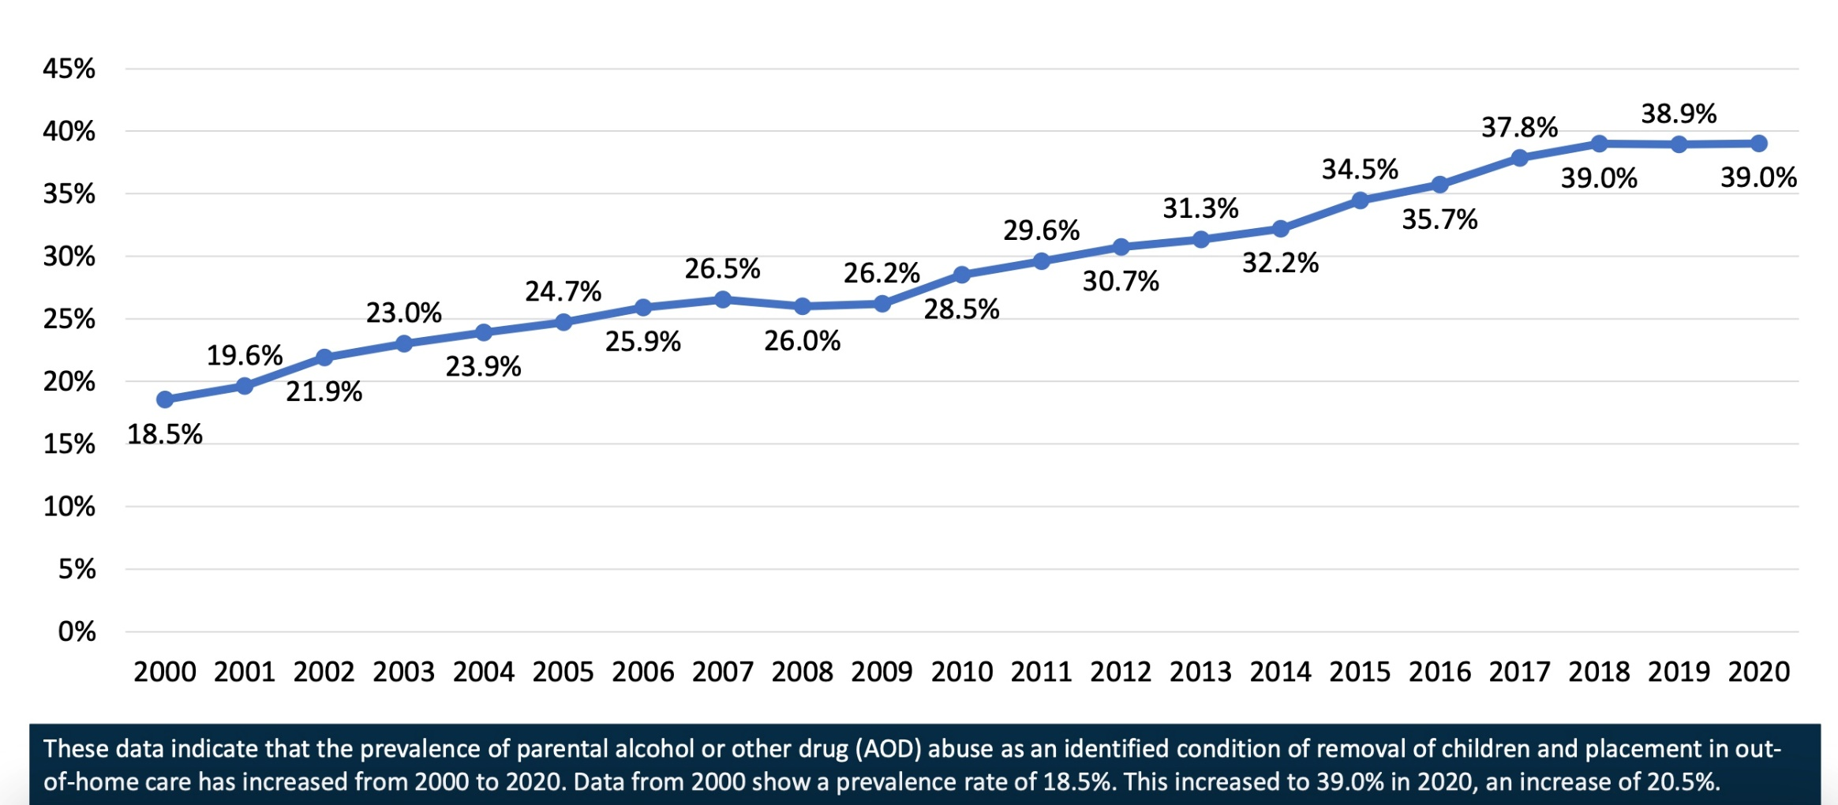
Prevalence of Parental Substance Use as an Identified Factor for Child Removal in the U.S. 2000-2020
25

Slide 26
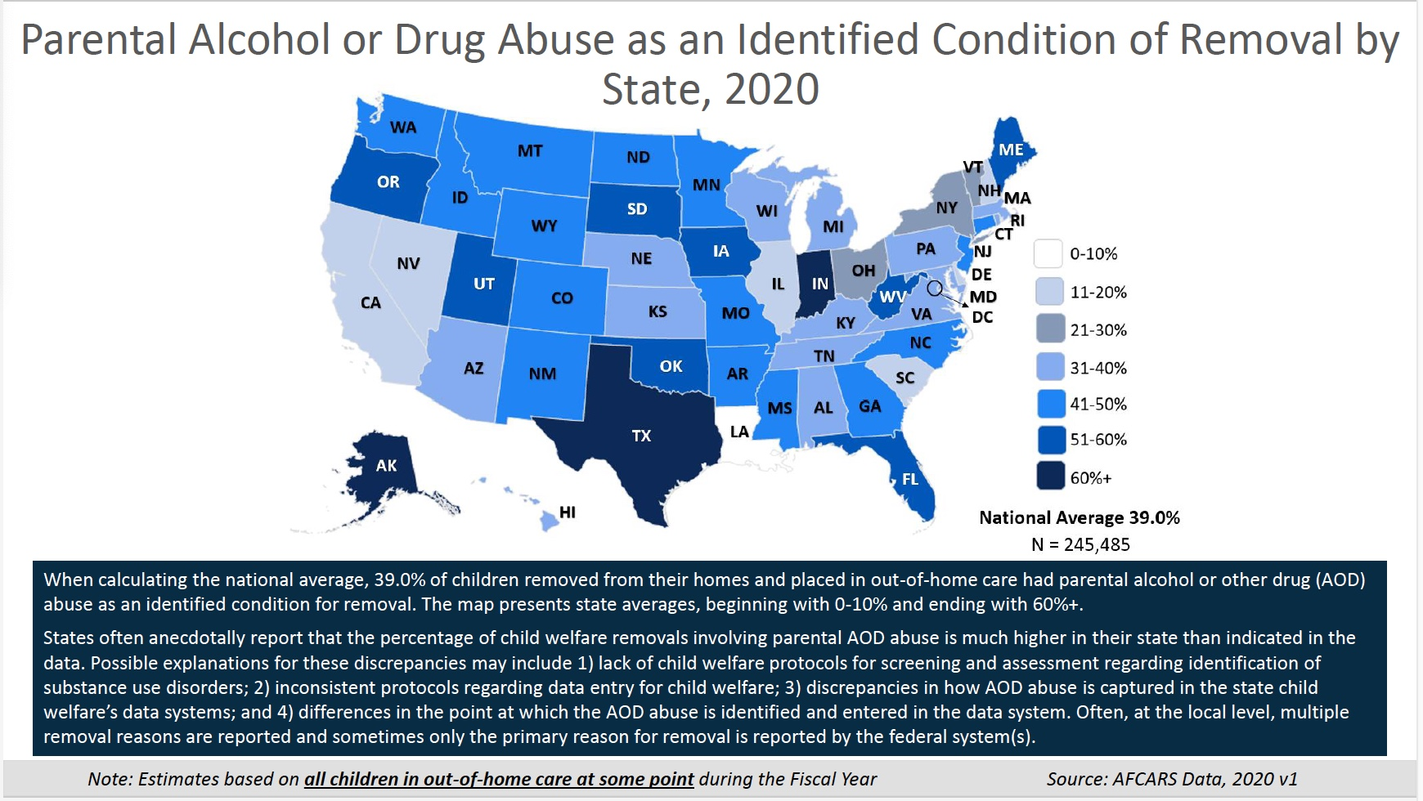
26

Slide 27
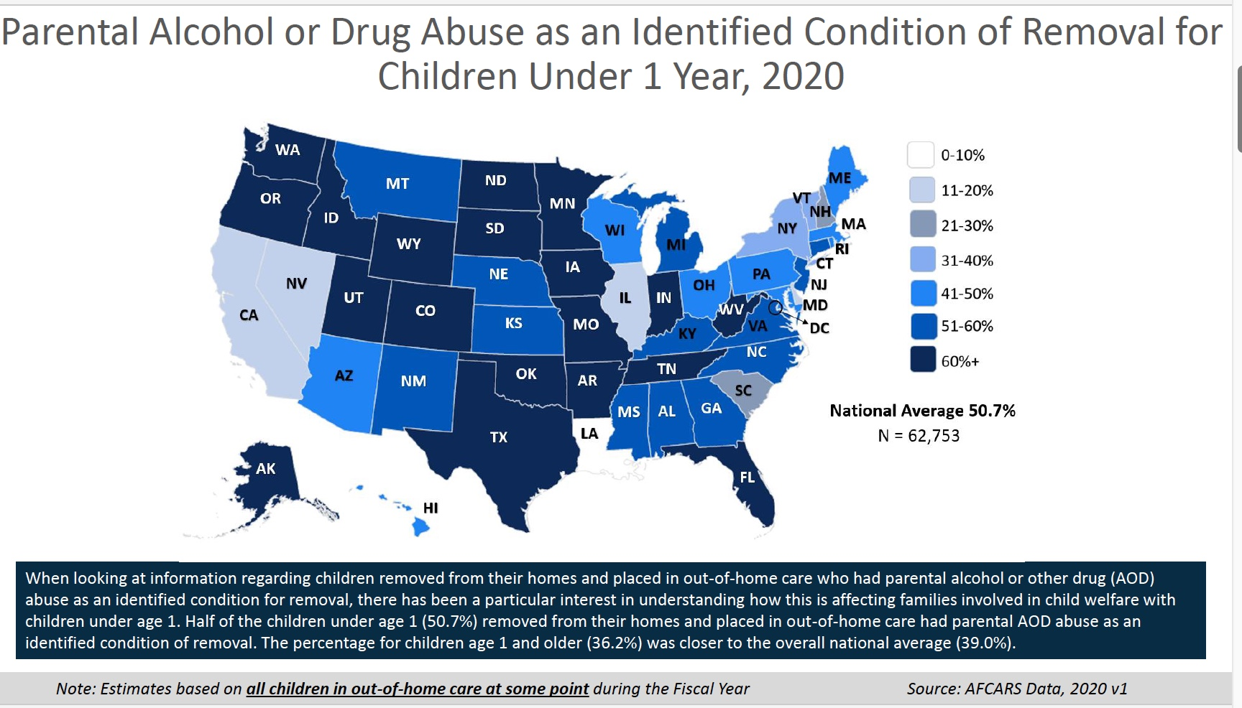
27

Slide 28
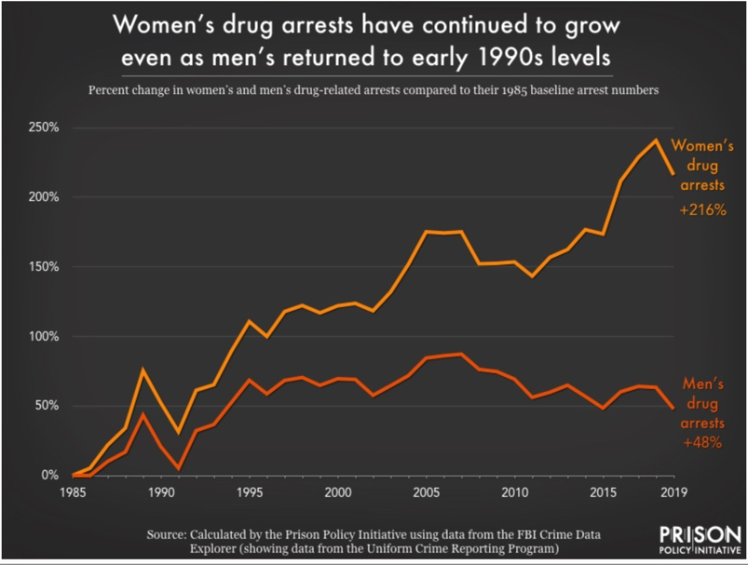
Substance Use is a Major Factor in Women’s Incarceration
https://www.prisonpolicy.org/blog/2020/11/10/women-drug-enforcement/
28
Notes:
Since you asked: What role does drug enforcement play in the rising incarceration of women?
Women are being jailed at higher rates than ever. We explore whether drug arrests and substance abuse could be having an impact.
by Tiana Herring, November 10, 2020
Increased drug arrests for women
Over the past 35 years, total arrests have risen 25% for women, while decreasing 33% for men. The increase among women is largely driven by drugs: During that period, drug related arrests increased nearly 216% for women, compared to 48% for men.
Changes in policing in the 1990s contributed to this rise. The shift toward “broken windows” policing — or arresting people for minor offenses to supposedly prevent major crime — resulted in increased arrests for both men and women. But these policies particularly affected women, who are more likely to be involved in relatively minor drug crimes like simple possession than higher-level drug offenses.
More than a quarter of women in jail are held for drug crimes, which holds true for both convicted and un-convicted women. (Another 32 percent are held for property offenses, which are often linked to drug dependence and abuse.) In state prisons as well, the share of women incarcerated for drug and property crimes is greater than for their male counterparts.
2019 Data
At fiscal year-end 2019, about 59% (6,500) of all females sentenced to federal prison were serving time for drug offenses, compared to 45% (66,700) of all males.
A larger percentage of female state prisoners were serving sentences for drug (26%) or property (24%) offenses than males (13% drugs, 16% property) at yearend 2018.
More than a quarter of women in state prison were incarcerated for drug offenses at the end of 2015, compared to 15 percent of men.4 More than 61 percent of women in federal prison are incarcerated for drug offenses, compared to approximately 50 percent of men. Currently, there are 8,500 women in federal prisons on drug charges, 24,700 in state prisons and 27,000 in local jails. Of the 27,000 women in local jails on drug charges, a staggering 63 percent have not been convicted. Female Drug Arrests, 1980-2012 Source: Bureau of Justice Statistics.
Rate Per 100,000 ––State and Federal Prison: U.S. Female Incarceration Rates, December 31, 2015
Drug use and drug selling occur at similar rates across racial and ethnic groups, yet black and Latina women are far more likely to be criminalized for drug law violations than white women.
Black women are almost twice as likely – and Latinas are more than 20 percent more likely – to be incarcerated than white women.9
Even though black women are no more likely than white women to use illicit drugs during pregnancy, they are far more likely to be reported to child welfare services for drug use.10 In fact, a seminal study published in the New England Journal of Medicine found that black women were 10 times more likely than white women to be reported to child welfare.11

Slide 29
How People Who Engage in IPV Leverage Punitive Systems and Policies Against Their Partners
Arrest and incarceration for substance use-related crimes +/or child removal
Cannot seek help for fear of arrest (or losing children to CPS)
Theft, sex work, dealing compelled by induced physiological dependence and/or coerced by abusive partner
Abusive partner interferes with treatment required by probation, sentencing agreement, or reunification plan; Program requirements do not take into account DV or SU coercion and may be difficult-to-impossible to comply with
Court mandated Tx providers are not trained on how to provide safe effective treatment for people experiencing DV or SU coercion
Judges and custody evaluators are not trained to factor in MH/SU Coercion
Perinatal providers can play a critical role in supporting survivors in these contexts
29

Slide 30
Trauma, DV, and MH/SU Coercion: Complex Picture
Abusers control treatment and medication and sabotage recovery
Abusers actively undermine their partners’ sanity, sobriety, and parenting
Abusers use these issues to control their partners and discredit them with sources of support
Impact on DV Survivors and Their Children
DV and other trauma associated with increased risk for range of MH/SU conditions
Stigma compounds risks. Concerns re: custody and system involvement impact help-seeking
Warshaw-NCDVTMH 2013
34

Slide 31
Experiencing a mental health or substance use disorder places individuals at greater risk for being controlled by an abusive partner
Stigma associated with mental health and substance use conditions contributes to the effectiveness of abusive tactics and can create barriers for survivors when they seek help. This is further exacerbated by structural violence.
35
Notes:
As you can see, experiencing a MH or SUD increases risk for being controlled by an abusive partner – we talk about risk rather than vulnerability to make clear not inherent to person being victimized but stigma associated with MH and SUD that reinforces ability of abusive partners to get away with using these tactics-
Leveraging systems – critical aspect and why so important to bring awareness to this
Judges – custody hearing – consider potential red flag if partner brings this up – Abusive partner appears better put together than person they have been abusing for years

Slide 32
Trauma, Substance Use, Mental Health, and IPV in a Broader Social Context
Health
Mental Health/Suicide
Substance Use
Intergenerational
Interpersonal
Economic
Undermining Sanity and Sobriety
Jeopardizing health and wellbeing
Controlling Access to Resources
Traumatic Effects of Abuse
Ongoing Coercive Control
Health and MH
Economic
Social
Cultural and Spiritual
Environmental
Transgenerational
Traumatic Legacies of Historical Trauma
Ongoing Structural Violence
Policies that
perpetuate
structural
violence and
discrimination
Warshaw, 2015
36

Slide 33
What are some things we can do?

Slide 34
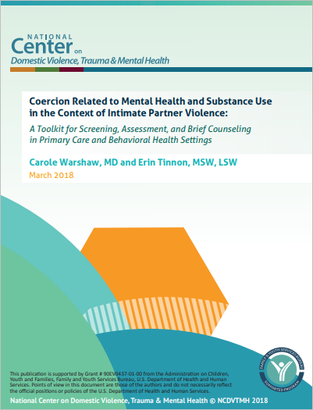
Strategies for Addressing Mental Health and Substance Use Coercion in Clinical Practice
NCDVTMH Toolkit on Coercion Related to Mental Health and Substance Use in the Context of Intimate Partner Violence
www.nationalcenterdvtraumamh.org/publications-products/coercion-related-to-mental-health-and-substance-use-in-the-context-of-intimate-partner-violence-a-toolkit/
37

Slide 35
Coercion Toolkit: Initial Steps for Addressing Substance Use Coercion
Recognizing the role coercion may be playing
Development/exacerbation of MH and SU conditions; Ability to access treatment; Relapse, OD, and NOWS; Recovery efforts
Preparing your practice
Trauma-informed, culture- and gender-responsive services
Training for staff; Information and resources on IPV
Attention to safety, confidentiality, and documentation, including Telehealth and EHR safety and onsite safety
Partnerships with DV programs; Onsite IPV counseling
Warshaw & Tinnon, 2018
38
Notes:
How can symptoms and needs be understood as threat responses and survival strategies
Services are both IPV- and trauma-informed
Offer culturally responsive, linguistically accessible, 2-generation, TI services
Offer flexible appointment times for survivors receiving MAT
Reduce unnecessary restrictions/requirements that prevent those most in need from accessing services; employ a harm-reduction approach
Provide transportation, childcare, extended stays, intakes at DV programs
Train staff: Address philosophical barriers for survivors of IPV (e.g. responsibility for their use of substances; non-empowerment-based approach)
Have information, resources on IPV available (and safe to take home or read in clinic)
Address issues of safety, confidentiality and information sharing
Develop safety protocols to ensure survivors do not have to attend treatment in the same setting as their abusive partner or ex-partner or with others who might not be safe
Develop collaborative relationships with DV programs; Have referral system in place; Consider onsite DV counseling and/or groups

Slide 36
Coercion Toolkit: Responding to Substance Use Coercion in Clinical Practice
Determine best strategies for addressing substance use coercion in your clinical setting
Clinical workflow; staff roles
Incorporate conversations about substance use coercion into routine assessments
Discuss as part of substance use histories and conversations about IPV
Discuss relationship of SU to IPV, coercion, and other trauma
Discuss how partner responds to person’s use of substances,
Discuss how partner might respond to medication and Tx plans
Know what to listen for
Warshaw & Tinnon, 2018
39
Notes:
Talk with patients/clients privately
Recognize ways an abusive partner may try to control the assessment process
Be careful not to make assumptions about sexual orientation or gender identity of patients/clients or their partnersWhat is Substance Use Coercion? Coercive tactics targeted toward a partner’s use of substances as part of a broader pattern of abuse and control
Common Forms of Substance Use Coercion
Introduction to or escalation of substance use
Coerced use or forced withdrawal
Use of violence or threats of violence to reinforce tactics
Sabotaging treatment access or recovery efforts
Controlling, stealing, or diverting medications
Using substance use-related stigma to isolate, discredit, or threaten
Blaming abuse on partner’s substance use
Threatening or reporting partner to law enforcement, child welfare, family court, or other systems because of their substance use
Open a Conversation About Substance Use Coercion:
“Many people have told us that their partner or ex-partner pressured them to use substances, use in ways that they didn’t want to, or used their substance use as a way to control them. People have also told us that their partners try to prevent them from accessing treatment and support, control their medications, and/or sabotage their recovery. We also know that using substances is a common way to deal with physical and emotional pain. If any of this is part of your experience or ever comes up in the future, know that we’re here to support you.”
Validate and Affirm the Person’s Experience and Offer Perspective
“It is never your fault when someone harms you – regardless of what your partner or society tells you. You deserve to be treated with dignity and respect.” “Your partner may try to find other people to agree that your mental health needs/your use of substances give them a right to control or abuse you. This is a tactic to make you feel isolated and further their control over you. By undermining your credibility with other people, your partner makes it much more difficult for you to get support, be believed, and trust yourself. I believe you - you are not alone.”

Slide 37
Coercion Toolkit: Responding When Someone Discloses Experiences of Substance Use Coercion
Things to keep in mind that impact access
Brief counseling
Offer perspective
Discuss coping strategies and emotional support
Incorporate into treatment planning, relapse and overdose prevention, recovery support, and harm reduction practices
Safety Planning: Strategize about ways to access treatment and services
Documentation and EHRs
Warm referral to DV services; onsite DV services
Warshaw & Tinnon, 2018
40
Notes:
Telehealth services are critical to ensuring that people who experience intimate partner violence (IPV) have access to needed mental health and substance use care.
At the same time, accessing services from home when an abusive partner is present can pose safety, security, and privacy risks to survivors of IPV and other household members.
IPV survivors report consistent challenges to accessing care due to interference by abusive partners (e.g., monitoring or listening-in to sessions, trying to prevent or disrupt participation, threatening the treatment provider).
Behaviors such as tracking access to technology, monitoring phone and internet usage, attempting to access electronic health records, impersonation, and location surveillance are common.

Slide 38
Beyond “Screening”
Building Safe Opportunities to Discuss IPV and Substance Use Coercion
42

Slide 39
Confidentiality is a Safety Need
Confidentiality and the limits of confidentiality
Privacy practices
Options to protect sensitive information (EHRs, Open Notes, EOBs, billing, referrals, etc.)
Private communications and offering safer contact options
Telehealth safety (secure location and technology; tech safety)
Flexibility in service times and locations
Recognize ways abusive partner may try to control or sabotage services
Warshaw & Tinnon, 2018
43
Notes:
An abusive partner may seem very concerned but may actually be trying to manipulate your perceptions and control their partner’s treatment. Be wary of involving a partner or family member in treatment without previously (and privately) ascertaining that the person is safe, and that the client wants that person involved.
Talk with patients/clients privately
Recognize ways an abusive partner may try to control the assessment process
Be careful not to make assumptions about sexual orientation or gender identity of patients/clients or their partners

Slide 40
Discuss Substance Use Coercion as Part of Substance Use Histories and Conversations About IPV
If it is safe for someone to talk about IPV, here are some ways to open a conversation:
“Many people have shared with us that their partner or ex-partner pressured them to use substances, or use in ways that they didn’t want to.
People have also told us that their partners try to prevent them from accessing treatment and support, control their medications and/or sabotage their recovery. I wonder if this is something you’ve experienced?”
“Sometimes people who have been hurt by a partner find themselves using substances to deal with the pain. This is a pretty common reaction. If this is something you can relate to, know that we’re here to support you.”
Warshaw & Tinnon, 2018
44
Notes:
Asking in the Context of IPV Inquiry and Assessment:
Clinicians can ask about mental health and substance use coercion in the context of inquiry about IPV. If a person indicates that they are being (or have been) abused by an intimate partner, it is appropriate to ask about how the abuse may be affecting their mental health and/or use of substances.
Open a Conversation About Substance Use Coercion:
“Many people have told us that their partner or ex-partner pressured them to use substances, use in ways that they didn’t want to, or used their substance use as a way to control them. People have also told us that their partners try to prevent them from accessing treatment and support, control their medications, and/or sabotage their recovery. We also know that using substances is a common way to deal with physical and emotional pain. If any of this is part of your experience or ever comes up in the future, know that we’re here to support you.”
Preparing for inquiry: Before asking about IPV, providers should gain familiarity with the dynamics of IPV and with how to respond when abuse is disclosed. Knowing how to respond in a trauma-informed and culturally-sensitive manner can be critical for survivors’ safety and well-being, and can make it easier to proceed with inquiry about mental health and substance use coercion.
Domestic violence is not just physical abuse. Many people say that their partners abuse them emotionally or call them ‘crazy’ or other demeaning names related to their mental health status. Many people say that their abusive partners do or say things to make them feel like they might be ‘going crazy,’ interfere with their treatment or medication, or do things to undermine them with their friends and family or with other people they might turn to for help. Have you ever experienced anything like that?”
If a person does indicate that they are being abused by an intimate partner, also ask about how the abuse has affected their use of substances or mental health
Does your partner force you to use when they use? Have they ever spent all of your money on drugs or alcohol without your consent? Does your partner’s use affect your use?”
“Has your partner ever forced or coerced you into doing something illegal (e.g., dealing, stealing, trading sex for drugs) or other things you felt uncomfortable with in order to obtain alcohol or other drugs?”
Things to listen for and Questions to weave in
Has your partner ever forced you to use substances, take an overdose, or kept you from routines that are healthy for you?
Has your partner ever tried to control your medication, or access to treatment? Have they actively done things to undermine your recovery?
Has your partner blamed you for their abusive behavior by saying you’re the one who is “crazy” or an “addict?”
Has your partner used your substance use or mental health condition as a way to discredit you with other people?
Has your partner threatened to take your children away because you are “receiving” substance use disorder treatment?
Has your partner ever coerced you into doing things you didn’t want to do by threatening to put you into withdrawal?

Slide 41
Discuss as Substance Use Coercion as Part of a Substance Use History
Relationship of substance use to current abuse, previous trauma, and coercion
How the person’s partner responds when they are using or not using substances
How they think their partner might respond to medication and treatment plans and any concerns they may have
Warshaw & Tinnon, 2018
46
Notes:
about the relationship of substance use to experiences of IPV and other trauma and how those experiences have affected the person’s substance use and/or recovery efforts.
How their experiences of overdose or withdrawal, stigma related to their substance use, using when they would rather not, and/or their struggles with recovery or relapse…
Might be related to living with fear, isolation and entrapment; experiencing economic control, physical violence, and/or sexual coercion; being stalked, and/or dealing with injury-related disability, chronic pain, interpersonal betrayal, or trauma-related mental health symptoms
How partner responds when they are using
Is their partner supportive? Does their partner criticize and demean them? Use their substance use or mental health condition to justify abuse? Try to control their medication or treatment or threaten them with loss of custody because of their mental health condition or SUD? Is their partner only “nice” when they’re not okay?
How partner might respond to medication and Tx plans
Ask whether they have any concerns about their safety, including if their partner knows they are receiving treatment. Consider whether potential medication side effects will place them at greater risk.

Slide 42
Asking as Part of a Substance Use History Cont.
Have you ever felt like you ought to cut down on your drinking or drug use or tried to cut down on your drinking or drug use? Has your partner ever tried to stop you from cutting down on your drinking or drug use?
Have you ever been annoyed by someone criticizing your drinking or drug use? Have you ever been made to feel afraid by someone’s criticizing your drinking or drug use? Has your partner used your drinking or drug use as a way to threaten you?
Have you ever felt guilty about your drinking or drug use? Have you ever felt coerced into drinking or using drugs or engaging in illegal activities or other behaviors you weren’t okay with or that compromised your integrity, and then felt guilty about it?
Have you ever had an eye-opener first thing in the morning because drinking or using drugs felt like the only way you could survive or get through the day, steady your nerves, or relieve a hangover? Have you had an eye-opener first thing in the morning because you were forced to drink or use drugs right away?
Ewing, 1984; Warshaw 2009; Warshaw & Tinnon 2017
48

Slide 43
Incorporate Conversations About Substance Use Coercion Into Your Assessments
Has your partner ever forced you to use substances, take an overdose, or kept you from routines that are healthy for you?
Has your partner ever tried to control your medication, or access to treatment? Have they actively undermined your recovery?
Has your partner blamed you for their abusive behavior by saying you’re the one who is “crazy” or an “addict?”
Has your partner used your substance use or mental health condition as a way to discredit you with other people?
Has your partner threatened to take your children away because you are receiving substance use disorder treatment?
Has your partner ever coerced you into doing things you didn’t want to do by threatening to put you into withdrawal?
49
Notes:
Just highlight so people have this but don’t read through

Slide 44
Offer Perspective: Validate and Affirm
“It is never your fault when someone harms you – regardless of what your partner or society tells you. You always deserve to be treated with dignity and respect.”
“Your partner might find other people to agree that mental health or substance use gives them a right to control or abuse you. Undermining your credibility with other people is a way to strengthen their control because it makes it difficult for you to get support, be believed, and trust what you know to be true.”
“I believe you, you are not alone.”
Warshaw & Tinnon, 2018
55
Notes:
“It is never your fault when someone harms you – regardless of what your partner or society tells you. You deserve to be treated with dignity and respect.”
“Your partner may try to find other people to agree that your mental health needs/your use of substances give them a right to control or abuse you. This is a tactic to make you feel isolated and further their control over you. By undermining your credibility with other people, your partner makes it much more difficult for you to get support, be believed, and trust yourself. I believe you - you are not alone.”
You mentioned that your partner regularly tries to get you to use when you don’t want to or to use more than you’re comfortable with. Is there someone you could call if this is happening to support you or offer some perspective?”
You mentioned that your partner regularly tries to get you to use when you don’t want to or to use more than you’re comfortable with. Is there someone you could call if this is happening to support you or offer some perspective?”

Slide 45
Ask About the Children
The person’s perception of the impact of IPV and SU on their children and any potential concerns they may have around their children’s wellbeing
Their efforts to protect and care for their children
Any things their partner does to undermine their relationship with their children
Are there threats to leverage child protective systems or child custody proceedings against them?
Are there threats of disclosing MH/SU concerns to their children or other trusted supports?
50
Notes:
And, of course:
Create safe environment to talk with survivors about their relationships, what they want, what they’ve tried, what their concerns are, what obstacles they face, and what might be most helpful to them and their children.
If they are a parent, it will be important to consider their children in any meaningful treatment options.
Coordinating care with other trusted professionals in your patient’s life can make a significant difference in people getting the support they need.

Slide 46
Things to Keep in Mind
In addition to threats and physically preventing a partner from accessing treatment:
Survivors may be reluctant to seek assistance: Fear of arrest, deportation, CPS involvement; concerns about child custody; stigma and credibility
Coerced use/withdrawal may make it harder to keep appointments
Pressure from abusive partner may make it harder to participate in residential treatment
Abusive partner may try to control or divert medication
Keeping regular appointments may increase danger (re: stalking)
Consider role of IPV in relapse/OD
52
Notes:
An abusive partner may try to sabotage abstinence, recovery, and/or other efforts to reduce use.
Survivors might be reluctant to engage in treatment knowing their partner might use this against them in a custody battle.
Stigma associated with substance abuse makes it less likely that survivors will be believed or seen as capable of parenting.
Accessing residential treatment for substance abuse can be difficult and is more challenging in the context of IPV. Abusers may accuse their partners of “abandoning their children” if they seek inpatient or residential treatment.
Substance use and withdrawal may make it more difficult to keep scheduled appointments.
An abusive partner might interfere with treatment by controlling a survivor’s medication use, including MAT.
Keeping regularly scheduled appointments (e.g. methadone or court ordered treatment) makes it harder to avoid the person who is stalking them.
Substance use-related coercion can cause a person to relapse or use more than they want and can compromise their ability to safety plan.
The stress and trauma associated with leaving an abusive relationship or managing safety while still being exposed to harm can also lead a person to relapse, or use more than they want.
Our attitudes and expectations can create barriers (sobriety requirements vs. harm reduction). Shame can lead to relapse. Invest in OD prevention

Slide 47
Notice Red Flags
Missing or coming late to appointments
Losing prescriptions or unable to fill scripts; Misplacing medication or running out early
Negative drug screens for prescribed medications; positive screens for non-prescribed substances
Partner is overbearing and makes it difficult to see the patient alone
53

Slide 48
Collaboratively Strategize Ways to Safely Access Treatment and Services
Discuss:
Safe communication: Safe times/places to receive calls, texts, and mail; Telehealth safety
Safe strategies for keeping appointments; Stalking risk, flexible appointment schedules
Staying connected to services if pressured to leave
Options for maintaining control of medications, including treatment alternatives
Legal documents that enable the abusive partner to have control over the person’s benefits or care
Threats to subpoena records, coerce into using, or report SU
Informed consent and choice re: drug testing
Warshaw & Tinnon, 2018
59
Notes:
Collaboratively Strategize About Safety:
Safe communication: Telehealth (safe time/location; encryption; spyware), EMRs (ROI/Open Notes); other preferred forms of communication (phone, email, mail, EOBs]
Flexible appointment scheduling to reduce risk of treatment interference or stalking
Staying connected to services if pressured by an (ex-)partner to discontinue them
Maintaining control of medication(s) (e.g., safe storage options; alternative forms of medication or shorter scripts)
Safe ways to access recovery support
Changing medical or legal documents that enable an (ex-)partner to exert control over the individual
Mark EMR as confidential; Block Open Notes access
What is getting in the way, brain storming things that might help, ensuring we aren’t contributing, altering our practice to accommodate
Discuss whether there are there safe times or places to receive phone calls, bills, statements
Discuss safe strategies for keeping appointments and for staying in treatment if pressured to leave
Discuss options for managing medication safely, including if receiving MAT
Discuss whether keeping regular appointments (e.g. methadone treatment) raises concerns about being stalked. Discuss ways to stagger appointment times or try switching to another form of treatment
Discuss any legal documents that enable the abuser to have control over the person’s care
ACOG
What in support of or people with LE – what support – the way this policy has been implemented, challenges and difficulties – What policies support newborn mothers who have positive – issue, impact and solutions – not talk about something counter
ACOG Statement:
“Before performing any test on the pregnant individual or neonate, including screening for the presence of illicit substances, informed consent should be obtained from the pregnant person or parent. This consent should include the medical indication for the test, information regarding the right to refusal and the possibility of associated consequences for refusal, and discussion of the possible outcome of positive test results.”

Slide 49
Documentation with MH and SU Coercion in Mind
Any information that becomes available to an abusive partner can increase that person’s danger, including their location, the fact that they are seeking treatment, and/or that they disclosed the abuse.
Records can be subpoenaed to support an abuser’s case against your client.
Thoughtful documentation of IPV and its effects can benefit survivors who want to use records to prove that the abuse occurred, bolster their credibility, or provide evidence of their ability to be a good parent.
62
Notes:
While confidentiality generally well protected within MH and SUD Tx fields, there are particular issues to be aware of when working with survivors of IPV
Records can be subpoenaed to support an abuser’s case against your client.
Any information that becomes available to an abusive partner can increase that person’s danger, including their location, the fact that they are seeking treatment, and/or that they disclosed the abuse.
Thoughtful documentation of IPV and its effects can benefit survivors who want to use records to prove that the abuse occurred, bolster their credibility, or provide evidence of their ability to be a good parent

Slide 50
Documentation with Substance Use Coercion in Mind, Cont.
Documentation can help survivors to prove the abuse occurred, bolster their credibility, and provide evidence of their ability to be a good parent.
Documentation should include:
The connections between symptoms and abuse, including coercion
Efforts of abusive partner to control your perceptions
How abuse creates barriers to participation in services
The person’s strengths, coping strategies, and efforts to protect and care for children
Warshaw & Tinnon, 2018
63
Notes:
Document relationship of symptoms to abuse
Discuss potential to subside when safe
Document attempts by abusive partner to control your perceptions, medication or treatment
Carefully frame diagnoses and medication
Describe strengths, coping strategies, & observations of ability to care for and protect children
Describe engagement in treatment; Make sure treatment plan is acceptable and doable
Describe observations about abusive partner
Be alert to abuser who seems “healthier” than victim
Recognize appropriateness of a survivor’s anger toward abusive partner and reluctance to expose their children to a violent abusive parent.
Survivors are often penalized for being the “less cooperative” parent.
Conversely, in states with Failure to Protect laws, survivors are often unjustly penalized for failure to limit contact with their abusive partner.
Abusers frequently use custody battles and visitation as ways to control a partner who is attempting to leave.
Prolonged custody battles are particularly devastating to survivors and their children. Abusers often continue to drag their partners to court, depleting their legal funds and threatening the safety and well-being of their children
Identify mechanisms for keeping MH or SUD Tx info private and ensure that patients have a choice about who can access that information, except in cases of emergency.
Discuss possible risks of disclosure (e.g., data accessed by abusive partner working in HC setting or who coerces their partner to access their records online, or by providers who are not sensitive to these issues).
Discuss whether there is any risk that an abuser’s legal team may try to subpoena the information in the context of a custody proceeding.
Good documentation and informed consent can help mitigate issues when records are subpoenaed
However, ensuring that sensitive information is protected, is critical

Slide 51
Partnering With DV Service Providers
66

Slide 52
WV Coalition Against Domestic Violence (WVCADV)
Licensed Domestic Violence Programs
Statewide Coalition Office
Public Policy
Training and Education
Public Awareness
Community Organizing
Technical Assistance
Statewide & National Partnerships
Prevention Programs
Network Coordination for 14 DV Programs
Other
14 Local Programs
Cover all 55 counties
Autonomous
Crisis Counseling
Emergency Shelter
Information & Referrals
Legal Advocacy
Adult & Children’s Services
Community Education
Housing
Other
67

Slide 53
Implications for Policy and Practice
Identifying gaps and barriers
Supporting sustainable workforce development
Building regional and statewide networks
Working with state partners
Identifying additional sources of funding
Addressing stigma and threats of child removal as a barrier to treatment
Building on existing relationships and partnerships
Notes:
Statewide partnership – heard today also partnerships among people (peers, clinicians, DV advocates, medical educators, public health officials and state agencies, disability and LGBTQ rights, home visitors) passionate about improving the lives of PPP who use substances in WV (creative programming and funding, access to resources (Telehealth)
Identifying gaps and barriers
Equity, SDOH, lack of services, transportation, child removal (Courts/Brian legal aid, CPS, providers themselves); SUD covered by ADA (what would accommodation look like), meeting people where they are
Work force- burned out, leave, not prepared, partner with peers, peers in supervisory positions/Medicaid - paperwork, lose magic
Networks – who, (state – share innovative practices, creative sources of funding, resources and referrals (telehealth)
Antt

Slide 54
Thank you!
WVPP Perinatal Summit 2023
Carole Warshaw MD, Director cwarshaw@ncdvtmh.org
Hadley Mowe, Project Specialist hmowe@ncdvtmh.org
Notes:
Final slide with contact information for presenters and NCDVTMH; always end with this.

Slide 56
Safety Plan: Access and Recovery
www.nationalcenterdvtraumamh.org
Collaboratively Strategize:
Safe communication (telehealth, phone, mail, etc.)
Stalking risk and appointment schedule
Staying connected to services if pressured by a (ex-)partner to leave
Maintaining control of medication(s), including MAR/MAT
Threats to disclose or subpoena protected health information
Legal documents that enable a (ex-)partner or social contact to exert control over the person
National Domestic Violence Hotline: 1 (800) 799-SAFE and 1 (800) 787-3224 (TTY)
RAINN National Sexual Assault Hotline: 1 (800) 656-HOPE
StrongHearts Native Helpline: 1 (844) 7NATIVE
Love is Respect (for teenagers): 1 (866) 331-9474 and 1 (866) 331-8453 (TTY)
Connect

Slide 57
NCDVTMH Resources on Substance Use Coercion
Resources on Substance Use Coercion: http://www.nationalcenterdvtraumamh.org/publications-products/su-coercion-reports/
Toolkit on Coercion Related to Mental Health and Substance Use in the Context of Intimate Partner Violence: www.nationalcenterdvtraumamh.org/publications-products/coercion-related-to-mental-health-and-substance-use-in-the-context-of-intimate-partner-violence-a-toolkit/
7 Common Practices that in Substance Use Disorder Care That Can Hurt Survivors and What You Can Do Instead: http://www.nationalcenterdvtraumamh.org/wp-content/uploads/2019/09/7-Common-Practices-Final.pdf
Committed to Safety for ALL Survivors: Guidance for Domestic Violence Programs on Supporting Survivors Who Use Substances: http://www.nationalcenterdvtraumamh.org/publications-products/committed-to-safety

Slide 58
Supporting Survivors Who Experience Mental Health or Substance Use Coercion
NCDVTMH Toolkit on Coercion Related to Mental Health and Substance Use in the Context of Intimate Partner Violence
www.nationalcenterdvtraumamh.org/publications-products/coercion-related-to-mental-health-and-substance-use-in-the-context-of-intimate-partner-violence-a-toolkit/

Slide 59
Palm Card on Substance Use Coercion
Notes:
Many people have told us that their partner or ex partner pressurex them

Slide 60
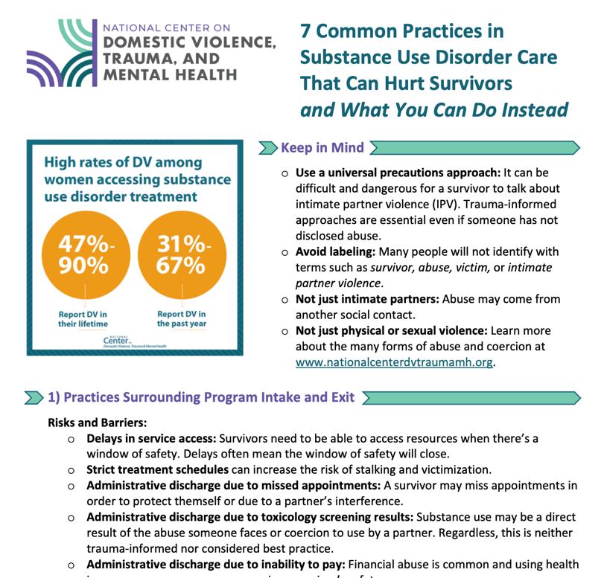
7 Common Practices in Substance Use Disorder Care That Can Hurt Survivors and What You Can Do Instead

Slide 61
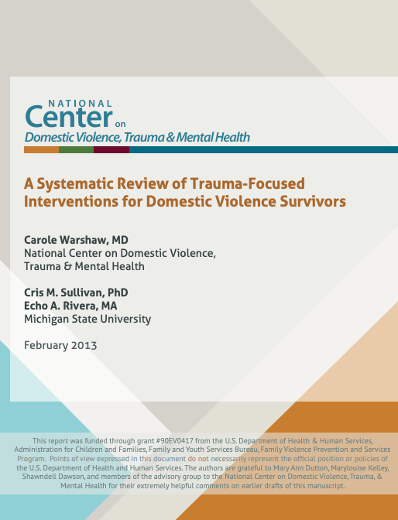
Systematic Review of Trauma-Focused Interventions for Domestic Violence Survivors: Warshaw, Sullivan, and Rivera, 2013
Resources to Support Mental Health Treatment for Survivors of Intimate Partner Violence
Mental Health Treatment in the Context of Intimate Partner Violence: Warshaw & Zapata-Alma, 2021
Notes:
Greenfield, 2016; Gilbert et. al, 2006, 2016, Myers et. al, 2015; Kubany et. al, 2004; Collins, 2015

Slide 62
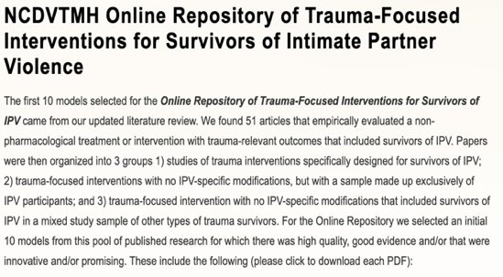
NCDVTMH’s Online Repository of IPV-Specific Interventions www.nationalcenterdvtraumamh.org/publications-products/ncdvtmh-online-repository-of-trauma-focused-interventions-for-survivors-of-intimate-partner-violence/
Notes:
https://pixabay.com/illustrations/laptop-computer-screen-blank-3164876/

Slide 63
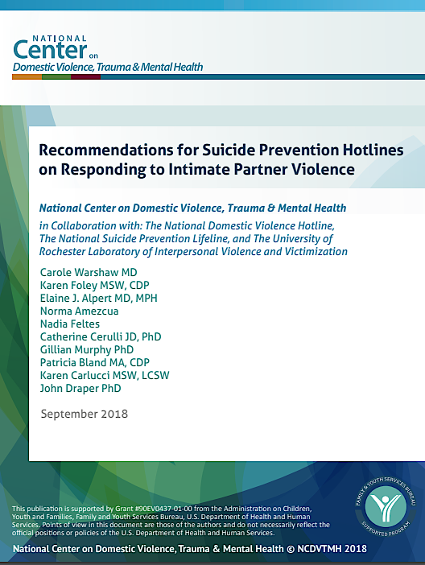
Resources to Support Collaboration with Suicide Prevention Hotlines and Crisis Services and to Promote Telehealth Safety
Recommendations for Suicide Prevention Hotlines on Responding to Intimate Partner Violence
Telehealth Recommendations to Support Survivors of Domestic Violence

