Slide 1
ERAS for Postoperative Cesarean Delivery Pain: Current Trends
Manny Vallejo, MD
Associate Dean and Designated Institutional Official
Professor of Medical Education, Anesthesiology, Obstetrics & Gynecology
Co-Director, Obstetric Anesthesiology
WVUMedicine Childrens Hospital
No financial disclosures

Slide 2
Objectives
Discuss the consequences of untreated postoperative pain following cesarean delivery (CD)
Discuss components of multimodal analgesia techniques for the treatment of postoperative CD pain
Describe multimodal adjuvants that can used to treat postoperative CD pain
Describe and discuss the importance of having an ERAS protocol for CD pain
Discuss the treatment of a parturient with Maternal Opioid Use Disorder (MOUD)

Slide 3
Postoperative Cesarean Delivery (CD) Pain
Cesarean delivery (CD) is the most common surgery done in the world (21% worldwide; 5% in sub-Saharan Africa + 43% in Latin America and Caribbean)
In United States > than 32% of live births were delivered by C/D (~ 1.2 million)
CD results in moderate to severe pain and most women report pain and require opioid analgesia
Severe untreated post-operative pain following CD results in an ↑ consumption of opioids, ↓ mobility, ↑ incidence of postpartum depression, and persistent post-surgical pain
Early mobilization is also particularly important in this obstetric population because of an ↑ risk of thrombo-embolic complications
Alemu 2021; Cavalho 2019; Hernandez 2020; CDC: National Center for Health Statistics; Betran 2021

Slide 4
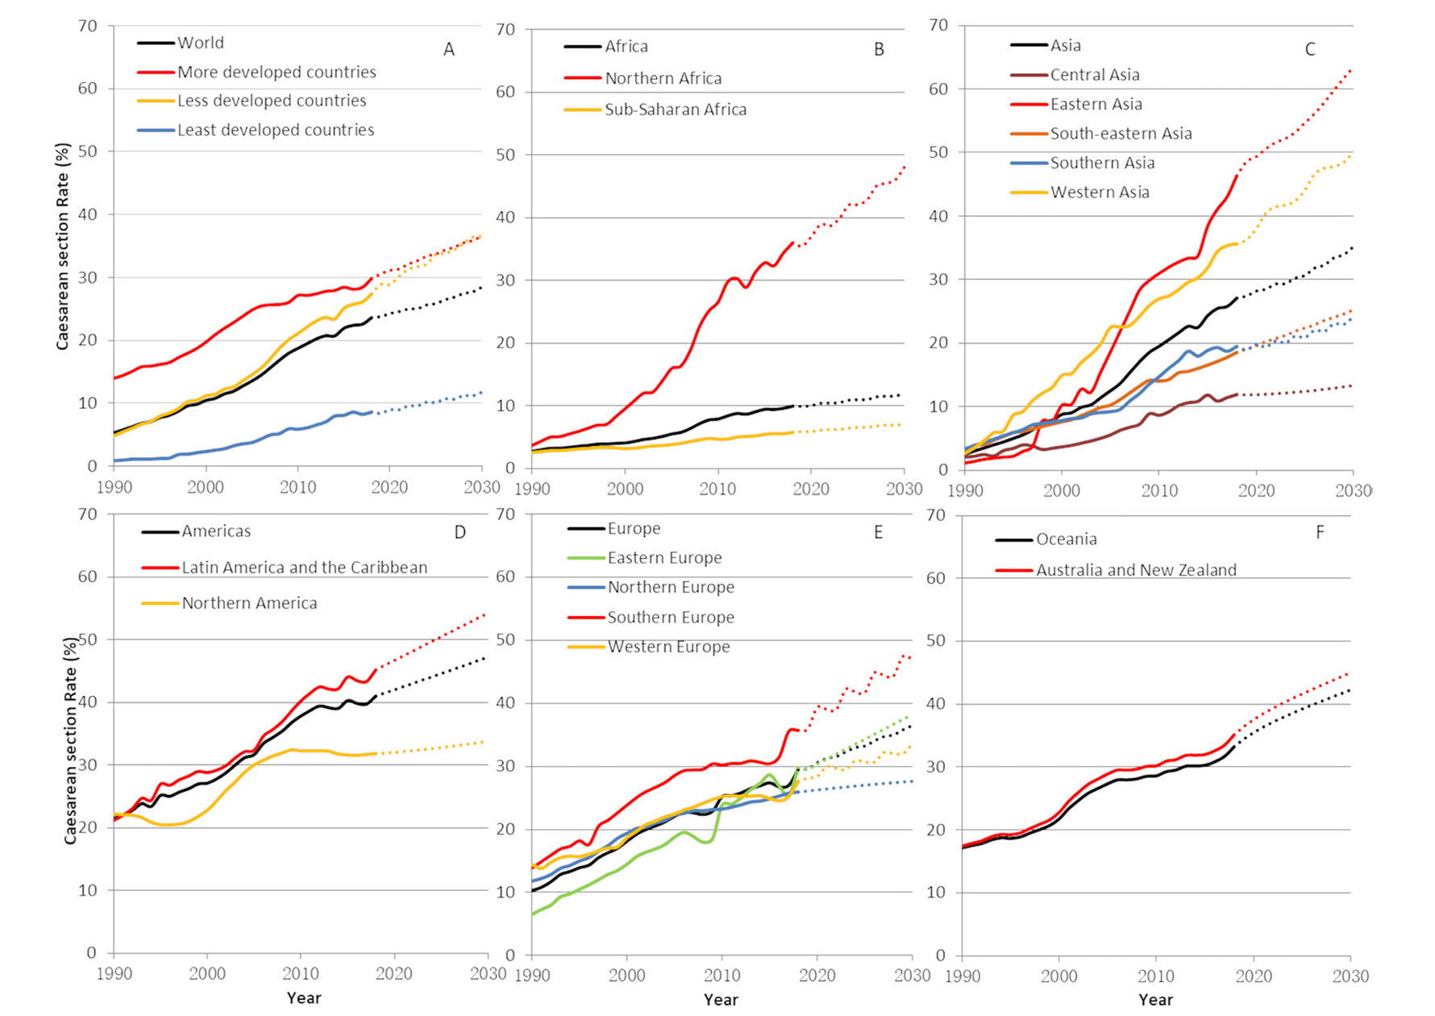

Slide 5
Postoperative CD Pain
Untreated pain interrupts the mother’s ability to care for her baby and may lead to the development of chronic pain
Chronic pain after CD is estimated to occur in 9–18% of women
Women undergoing CD rank avoidance of pain during and after surgery as their highest anesthetic priority
Non-steroidal anti-inflammatory drugs (NSAIDs) and paracetamol can only supplement other modes of analgesia and are not sufficient on their own
Carvalho 20119; Jadon 2018

Slide 6
Regional Analgesic Blocks
The gold standard for pain control following CD is neuraxial (intrathecal/epidural) morphine
Can supplement analgesia but cannot be used as the sole analgesic agent
Systematic reviews and meta-analyses also report that regional blocks (wound infiltration, II-IH, TAP, QL) produce superior analgesia and ↓ supplemental opioid consumption and ↑ time to first analgesia request when compared to placebo
However, no benefits if neuraxial morphine is given
Regional blocks could be considered as an alternative when neuraxial morphine is contraindicated or produces undesirable side effects
Jadon 2018, Alemu 2021; Hernandez 2020

Slide 7
Regional Anesthesia Blocks
Wound/skin infiltration < IH-IL Block < TAP Block < QL Block < neuraxial morphine
Covers visceral and somatic pain (morphine) > some visceral + somatic (QL) > only somatic pain (TAP, II-IH) > wound/skin infiltration (somatic only)
QL Blocks - local anesthetic has been shown to spread to the paravertebral space, resulting in both visceral and somatic analgesia
Therefore, can ↓ opioid consumption but not eliminate narcotic consumption
Alemu 2021; Hernandez 2020

Slide 8
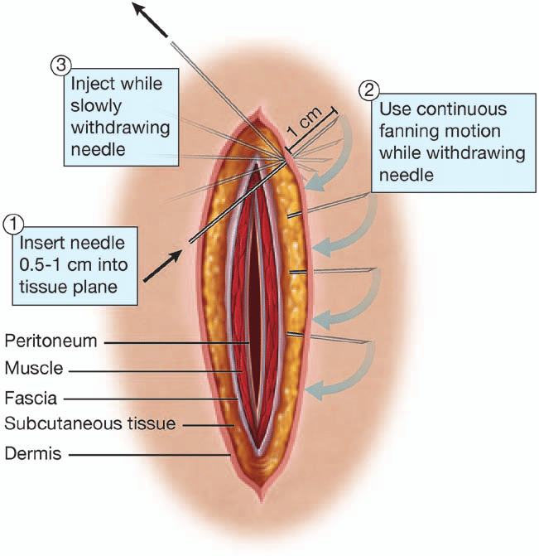
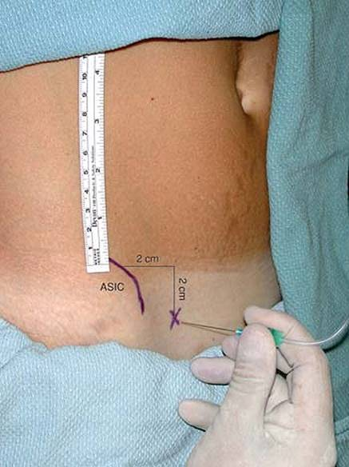
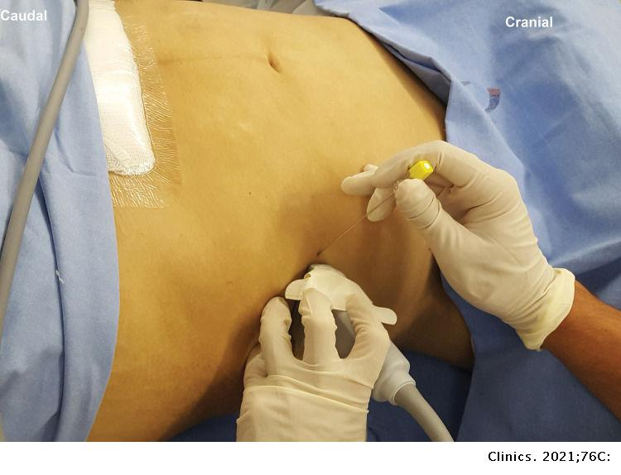
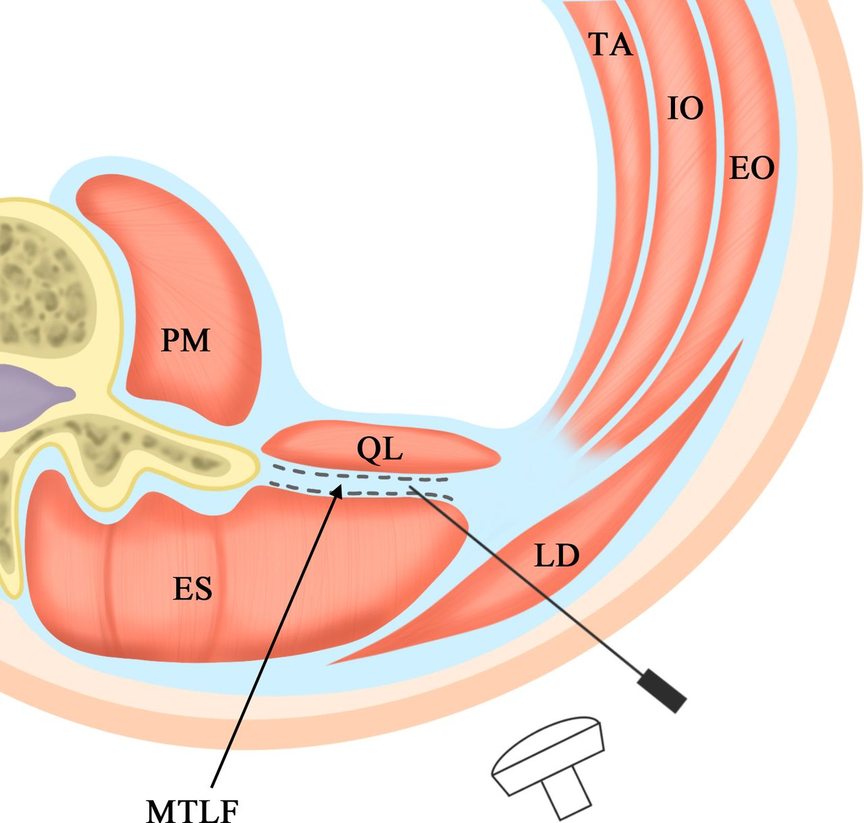
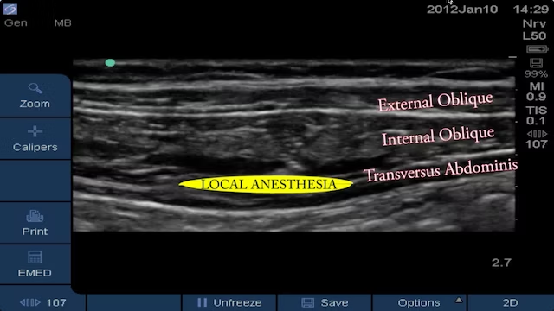
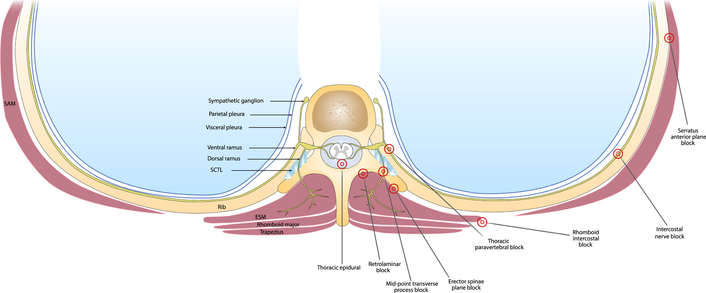

Slide 9
Regional Analgesia Block Contraindications
Disseminated intravascular coagulation disorder (DIC), infection, coagulation disorders, sepsis, and patient refusal
Other contraindications to regional anaesthesia (bleeding diathesis, infection at the site of block and peripheral neuropathy), severe medical conditions such as severe pre-eclampsia and eclampsia and patients who had intra-operative complications like post-partum hemorrhage
The risks of local anesthetic toxicity and bleeding from needle insertion sites should also be taken into consideration
Hernandez 2020; Jadon 2018;

Slide 10
Breast Feeding and Medications
Consideration must be placed on the medications given to the mother as they may transfer to the breast-fed infant
A relative-infant dose (RID) is expressed as a percentage and is weight-adjusted for the neonate
RIDs quantifies the amount of neonatal drug exposure relative to the mother’s dose
A RID > 10% is considered high
Acetaminophen provides effective analgesia with minimal side effects. It has an opioid-sparing effect and has a RID = 1.3%
Hernandez 2020

Slide 11
Breast Feeding and Medications
Ketorolac (NSAID) has a low RID of 0.2 to 0.4%
Ibuprofen (NSAID) - short half-life, RID = 0.6% in colostrum and < 0.38% in mature breast milk
Hydrocodone = 3.7%, Oxycodone = 8%, Morphine = 10.7%
Central nervous system (CNS) depression rates, defined as feeding infants whose mothers were taking oxycodone or codeine have been reported as 20% and 16%, whereas the rate of CNS depression in infants whose mothers were only taking acetaminophen = 0.5%
Hernandez 2020

Slide 12
ERAS Protocols
Goal is to optimize postoperative analgesia
Pain management protocols have moved towards a standardized approach that has become embedded in enhanced recovery after surgery pathways
Evidence based multimodal analgesic protocols are intended to ↓ variability in care, improve pain management, ↓ opioid utilization and accelerate recovery to normal presurgical function
In principle, this is the optimal approach to managing surgical pain
However, postoperative pain management protocols standardized one-size-fits-all protocols treats all patients the same and assume all women will have similar pain experiences after delivery
Carvalho 2019

Slide 13
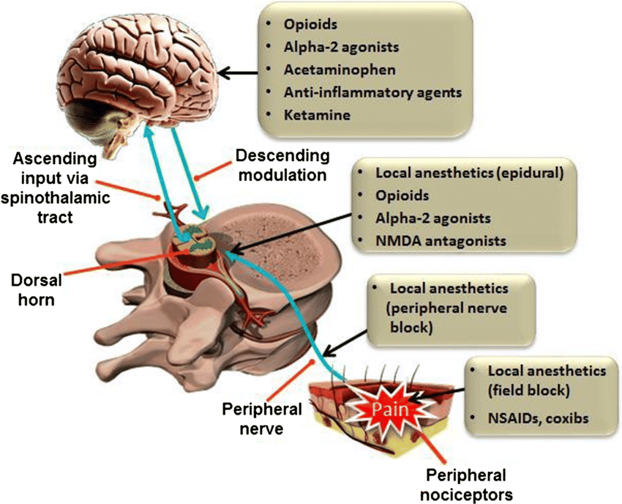

Slide 14
Disadvantages of a Standardized ERAS Approach
Several studies from the United States report that standardized (individual physician or institutional) opioid prescription practices result in significantly more opioids being prescribed to women after cesarean delivery than are required or consumed
The postoperative pain experience is a complex psychophysical response to a noxious stimulus that involves a cognitive evaluation and an emotional response
Women who receive good peripartum pain relief are not necessarily satisfied with their care and maternal satisfaction may be related more to coping with pain
Satisfaction is multidimensional and is largely related to the assessed difference between actual and expected care
Carvalho 2019

Slide 15
Standardized ERAS Protocols
Standardized protocols may lead to under-treatment in patients with high analgesic needs and overtreatment in women with low analgesic needs with ↑ side effects
Pre-operative identification of patients at-risk of developing severe pain might allow clinicians to optimize care by offering personalized, stratified or targeted analgesic treatment protocols
Preoperative pain prediction tools are only of moderate value
Pain reporting during local anesthetic infiltration and answering simple rating questions about anticipated pain and analgesic needs are the easiest tools to apply and show some promise for post-CD delivery pain prediction
Carvalho 2019

Slide 16
Pre-Operative Post-op Pain Questionnaires
Available pre-operative pain questionnaires for predicting post-cesarean pain and analgesic use include:
State Trait Anxiety Inventory (STAI), Anxiety Sensitivity Index (ASI), Hospital Anxiety and Depression Scale (HADS), Pain Catastrophizing Scale (PCS), Fear of Pain Score (FPQ III), Eysenck Personality Questionnaire Revised-Short Scale (EPQR-S), Pittsburgh Sleep Quality Index (PSQI) and Patient-Reported Outcomes Measurement Information System (PROMIS) Anxiety Scale, Depression Scale and Posttraumatic Stress Disorder Checklist
Unfortunately, these detailed questionnaires appear to explain only a small percentage of postoperative pain variance, with weak to moderate correlations reported amongst the studies

Slide 17
Tailored ERAS Protocols
Individual preferences for pain relief and for avoidance of side effects after cesarean delivery may optimally balance individual pain needs and side effect concerns compared to standardized postoperative pain treatment protocols
Individualized or stratified post-discharge opioid prescribing practices have been shown to ↓ unnecessary opioid analgesic prescriptions and consumption => should be routinely implemented
Outcomes other than pain and analgesic use, including recovery measures and maternal satisfaction metrics, should be considered when evaluating personalized or patient-selected pain treatment protocols

Slide 18
Simple Patient-Selected Analgesic Protocol with Script and Table to Guide Dose and Protocol Selection Based on Preference for Pain and Side Effect Avoidance
Select the desired CESAREAN ANALGESIC PROTOCOL: Lower, Medium or Higher (please circle) for Spinal Anesthesia
PROPOSED PATIENT-SELECTED ANALGESIC PROTOCOL OPTIONS:
Low Dose Protocol: 50 mcg intrathecal morphine + scheduled acetaminophen + scheduled NSAIDs
Medium Dose Protocol: 100 mcg intrathecal morphine + scheduled acetaminophen + scheduled NSAIDs
High Dose and Drug Protocol: 200 mcg intrathecal morphine + scheduled acetaminophen + scheduled NSAIDs + gabapentin + local anesthetic wound infiltration/instillation or regional block (transversus abdominis plane/quadratus lumborum block)
Carvalho 2019

Slide 19
Maternal Opioid Use Disorder (MOUD)
During labor and delivery, a multimodal analgesic approach is key and non-opioid strategies should be maximized
For labor and vaginal delivery, the use of epidural analgesia should be offered to all patients with a history of opioid use disorder, unless contraindicated
Substance use disorders pose unique challenges during pregnancy, including associated psychosocial and physical health problems
The antenatal consult provides the anesthesiologist with an opportunity to create a trusting nonjudgmental environment, where the patient can be open about her opioid use history
Patients with opioid use disorder are often anxious about pain management in the hospital. They often fear that their pain won’t be taken seriously and that they will have restricted access to pain medication
Soens 2019

Slide 20
MOUD and the Healthcare Provider
Tendency to under medicate patients for fear of addiction relapse and prescription drug diversion
Problematic because these patients often have ↑ analgesic requirements due to problems with opioid tolerance or opioid induced hyperalgesia
In addition, patients with opioid use disorder frequently have psychiatric co-morbidities such as depression and anxiety which are independent predictors for more severe postoperative pain
Goal of pain management is to effectively control postoperative pain, ↑ patient satisfaction, and improve outcomes, while minimizing risks
Soens 2019

Slide 21
Opioid Use Disorder Treatment
Challenges of providing anesthesia and analgesia for patients with chronic opioid exposure include the potential for withdrawal, opioid tolerance and opioid-induced hyperalgesia (OIH)
As a result of these phenomena, opioid-dependent women generally require higher doses of opioid than non-opioid dependent women to control pain associated with delivery
Opioid induced hyperalgesia (OIH) manifest as increased baseline sensitivity to pain, hyperesthesia and allodynia
In patients with OIH, escalating doses of opioids may aggravate pain
Soens 2019

Slide 22
MOUD for Vaginal Delivery
Avoid use of mixed agonist-antagonist medications, such as nalbuphine, butorphanol and pentazocine as these can precipitate withdrawal
Epidural analgesia should be offered unless contraindications
Intravenous patient-controlled analgesia (e.g., fentanyl, remifentanil) can be used if neuraxial analgesia is contraindicated
For complicated vaginal deliveries (third or fourth degree perineal or deep sulcal tears, vaginal hematoma), consider long acting neuraxial opioids such as morphine or hydromorphone
Scheduled acetaminophen and NSAIDS should be prescribed
Soens 2019

Slide 23
MOUD for Cesarean Delivery
Administer iv acetaminophen pre-operatively
Neuraxial anesthesia + intrathecal/epidural morphine is preferred unless contraindicated
Consider other non-opioid strategies, (e.g., dexamethasone, ketamine)
Scheduled acetaminophen and NSAIDS should be prescribed for postpartum analgesia when possible
Consider regional block techniques such as patient controlled epidural analgesia (PCEA) or TAP blocks
Do not withhold medications from opioid-dependent patients, but instead use medications needed to treat the pain effectively, while also being cognizant of potential behavioral issues involved
Soens 2019

Slide 24
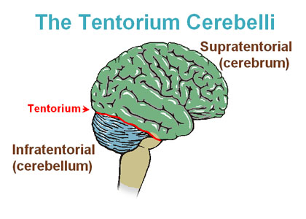
Supratentorial (consciousness) vs Infratentorial
The importance of treating perceived pain and patient satisfaction
Satisfaction is multidimensional and is largely related to the assessed difference between actual and expected care

Slide 25
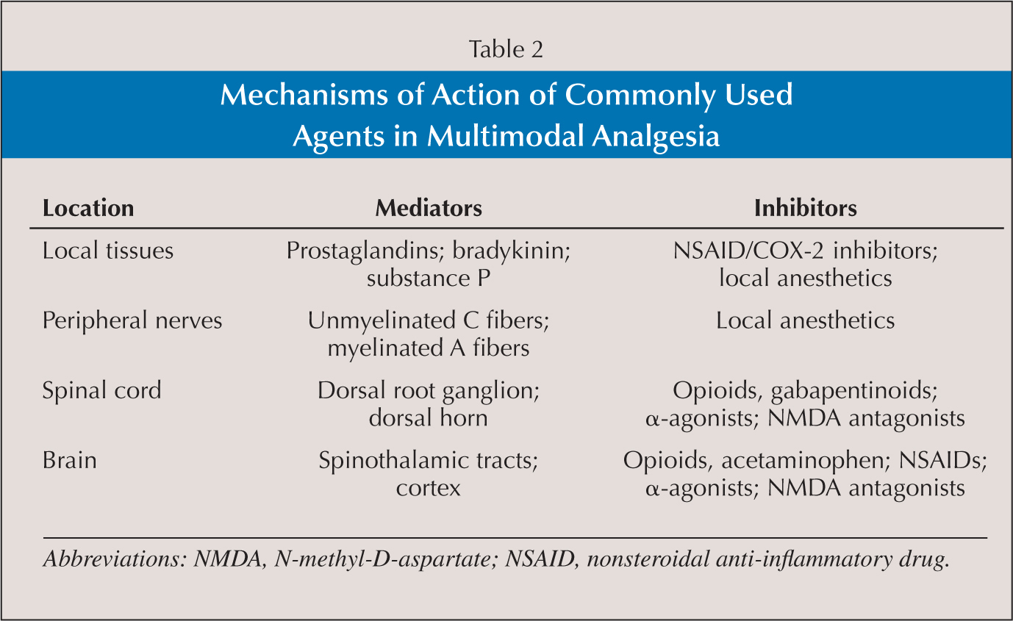
Adjunct Supplemental Medications

Slide 26
Buprenorphine
The Drug Addiction Treatment act of 2000, provides for greater flexibility in prescribing buprenorphine which can be done in an office-based setting
Allows for treatment as outpatients without the need for visits to a treatment program on a daily basis
Buprenorphine is a partial mu-opioid receptor agonist and antagonist at the k and d receptor
Buprenorphine is displaced by other opioids only with very high doses of opioids
Soens 2019

Slide 27
Buprenorphine
Additional beneficial antidepressant effect
Respiratory depression with buprenorphine is significantly less due to its partial agonist effects resulting in a ceiling effect
For optimal analgesia => divide treatment dose in three or four doses every 6-8 h, as this dosing regimen takes advantage of the analgesic properties of buprenorphine
Soens 2019

Slide 28
Naltrexone
Naltrexone is a nonselective opioid receptor antagonist that competitively binds to mu-, k- and d- opioid receptors, and blocks the analgesic and euphoric effects of opioids
Used in some patients recovering from substance use disorder to help them in their effort to maintain abstinence
When possible, naltrexone should be stopped well in advance (48-72 hours); however, this may not be possible – although can be used safely in pregnancy
Some patients may be on the long-acting form (Vivitrol®) which is administered once monthly
Soens 2019

Slide 29
Outcomes compared among 3 treatment options: buprenorphine-naloxone, buprenorphine, and methadone treatment strategies
Illicit drug use is common in patients requiring MOUD treatment and should be considered for all patients with OUD
Women on methadone OMT tend to have a more severe substance abuse problem with a marked overall increased risk profile, requiring particularly close medical attention
Buprenorphine-naloxone is a safe treatment option for MOUD, but larger studies are needed before changing official recommendations

Slide 30
Non-opioid Strategies for Peripartum Analgesia
Acetaminophen – multiple studies report ↓ pain scores and ↓ opioid consumption after CD => low risk, low cost with benefit => indicated for multimodal analgesia
Nonsteroidal anti-inflammatory drugs (NSAIDs) – ↓ opioid requirements by approximately 20-30% => indicated for multimodal analgesia unless contraindicated
Ketamine
Well known for its anesthetic qualities, but also has strong analgesic properties, mostly because of its actions as an NMDA receptor antagonist
Administration of subanesthetic doses of ketamine ( < 0.5 mg/kg) can ↓ opioid requirements and ↑ analgesia in the first 24 h after surgery
Human data on the transfer of ketamine to breast milk are lacking and given this, ketamine administration during breastfeeding requires careful monitoring of the neonate
Soens 2019

Slide 31
Non-opioid strategies for peripartum analgesia
Clonidine
α2- adrenoreceptor agonist that has been shown to be useful in ↓ postoperative pain
Common side effects: include feeling sleepy, tired and weak, feeling dizzy or fainting when getting out of bed, headaches, depression, difficulty sleeping and bradycardia
Gabapentin and Pregabalin
300 mg (but not 150 mg) ↓ postoperative opioid consumption and immediate postoperative pain
↑ the risk of respiratory depression – among patients taking illicit opioids or prescription opioids, use of gabapentin has been associated with an ↑ risk of opioid-related death => should be used with caution
Soens 2019

Slide 32
Non-opioid strategies for peripartum analgesia
Magnesium
NMDA receptor antagonist
In the obstetric population, Rezae et al. found that an IV bolus of 50 mg/kg magnesium sulfate significantly ↓ pain scores and analgesic consumption in the first 24 h after surgery
In contrast, Paech et al. found that IV magnesium sulfate had no effect on pain severity after CD - magnesium sulfate was associated with ↑ blood loss after surgery
Already used in our pre-eclamptic and eclamptic patients
Given the contradictory findings regarding analgesic benefits and potential side effects, more clinical studies are needed to assess the risk benefit in this population

Slide 33
Non-opioid Strategies for Peripartum Analgesia
Dexamethasone
Is a glucocorticoid and a strong anti-inflammatory agent that has been used as an adjunct for post-operative analgesia
Analgesic and opioid sparing effect - single bolus of 8 mg intravenous, given immediately after umbilical cord clamping
More effective than placebo in ↓ postoperative pain scores + analgesic requirements during the first 24 h after surgery
↓ the incidence of nausea and vomiting and ↓ pain scores on the first postoperative day

Slide 34
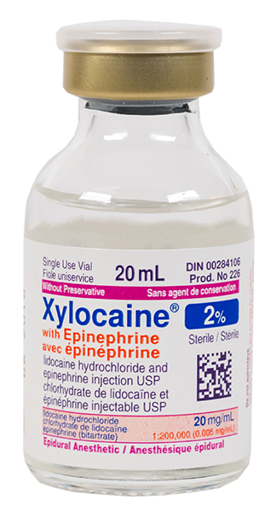
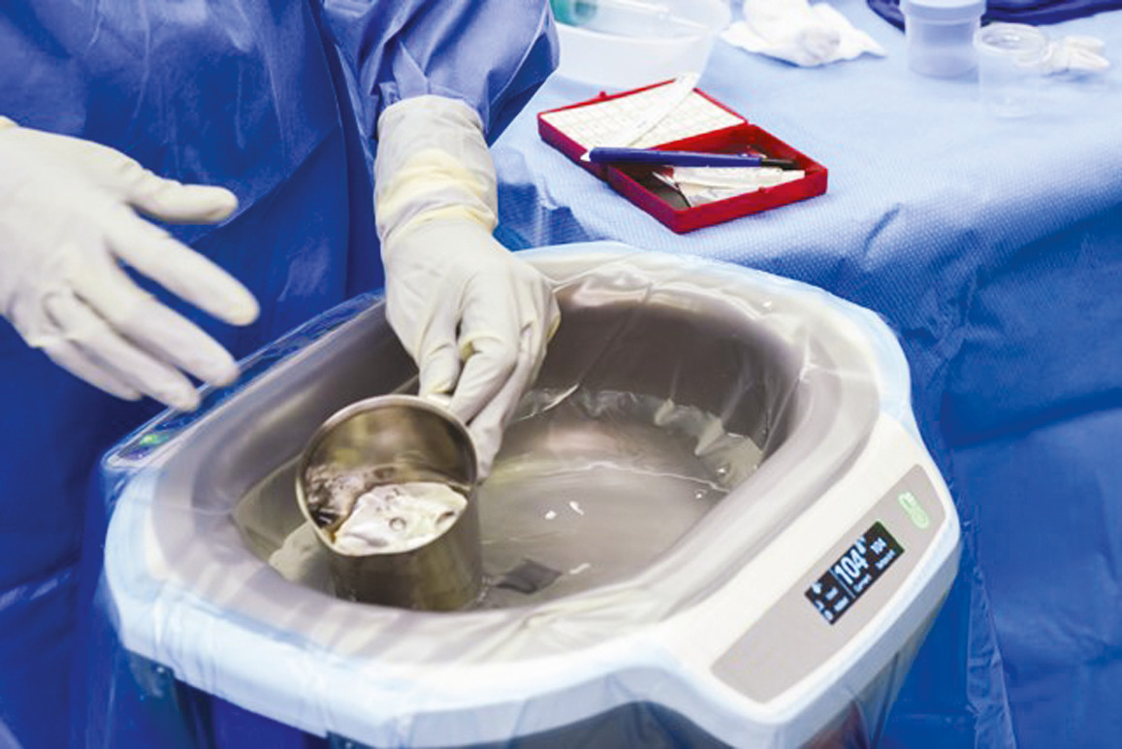
Non-opioid Multimodal Regional Block Strategies for Peripartum Analgesia
Epidural analgesia – consider neuraxial morphine, post-op MOUD CD analgesia
Abdominal nerve blocks and wound site infiltration decreases post cesarean delivery NRS score, total analgesic consumption and prolong time to first analgesic request compared to the non-exposed group
Wound site infiltration
Ilioinguinal-Iliohypogastric nerve blocks
TAP blocks
Quadratus Laborum nerve blocks
Abdominal wash-out
Soens 2019; Zemedkun 2020

Slide 35
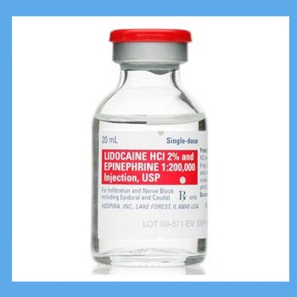
40 patients randomly assigned with equal number in two groups; lidocaine (N = 20) and normal saline (N = 20)
Lidocaine group received 50 mL of 0.8% lidocaine with epinephrine, placebo group received 50 ml of saline 0.9%
Syringe for the lidocaine group containing 50 mL of 0.8% lidocaine with epinephrine (1:50,0000 dilution, prepared by adding 30 mL of normal saline to 20 mL of 2% lidocaine containing epinephrine 1:200000) and in the placebo group syringe containing 50 mL of normal saline 0.9%
Conclusion => intraperitoneal instillation of 50 mL of 0.8% lidocaine with epinephrine is an effective and safe technique for postoperative pain relief over 24 h at rest and at 48 h on movement after TAH
Does not ↓ opioid consumption over 24 h after TAH

Slide 36
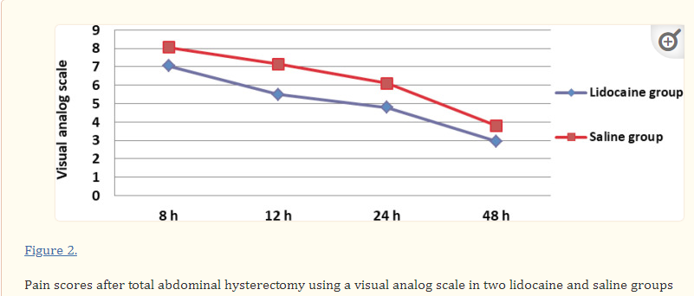

Slide 37
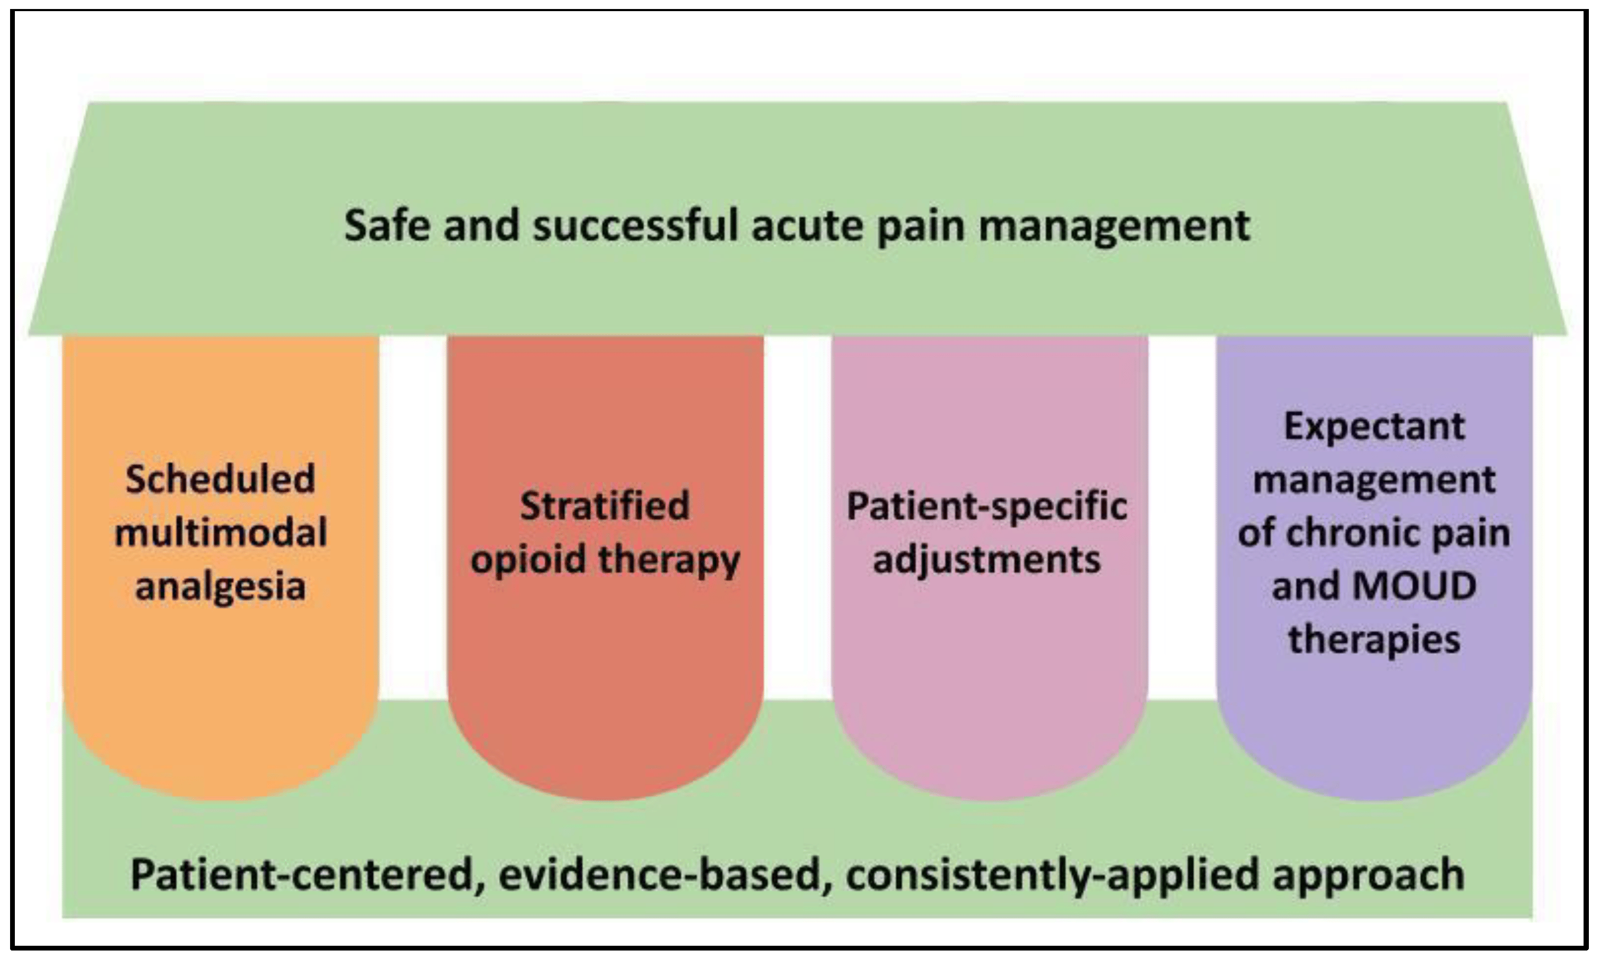
ERAS Protocol Component Summary

Slide 38
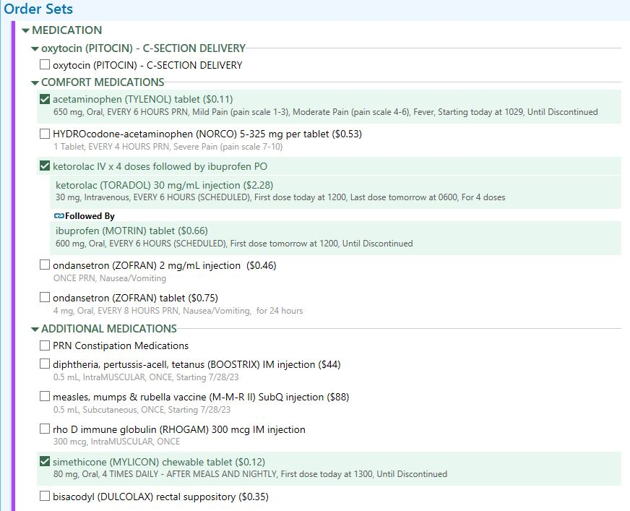
OB Post Cesarean Delivery
order set

Slide 39
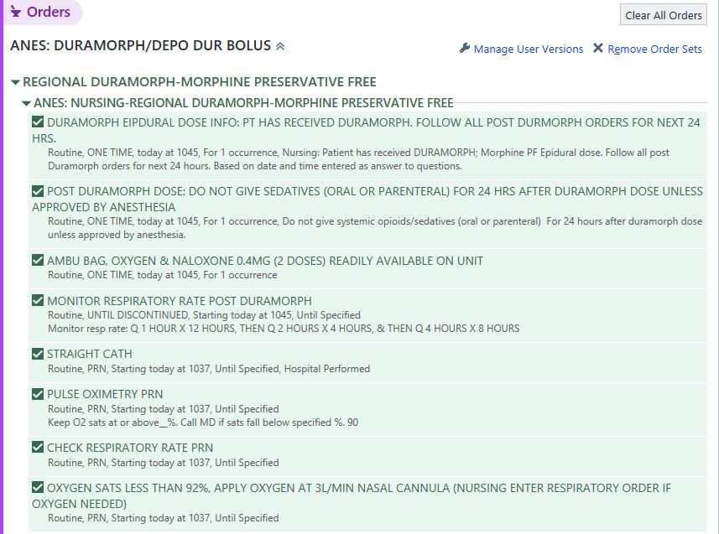
OB Anesthesia Preservative free morphine order set

Slide 40
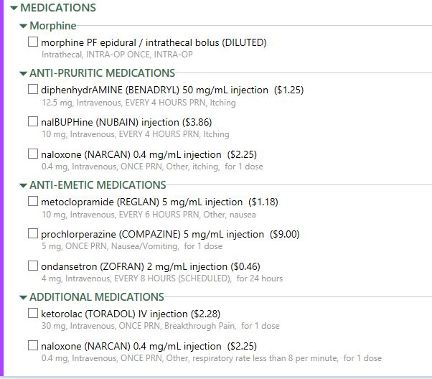
OB Anesthesia Preservative free morphine order set

Slide 41
Recommended Anesthesia OR CD Adjuvants
Given intravenously by anesthesia in the OR as they have shown to provide better analgesia and less PONV
Glycopyrrolate (0.2 mg) – avoid if patient is tachycardic (HR > 100 bpm)
Reglan (10 mg)
Dexamethasone (8 mg)
Zofran (4 mg)

Slide 42
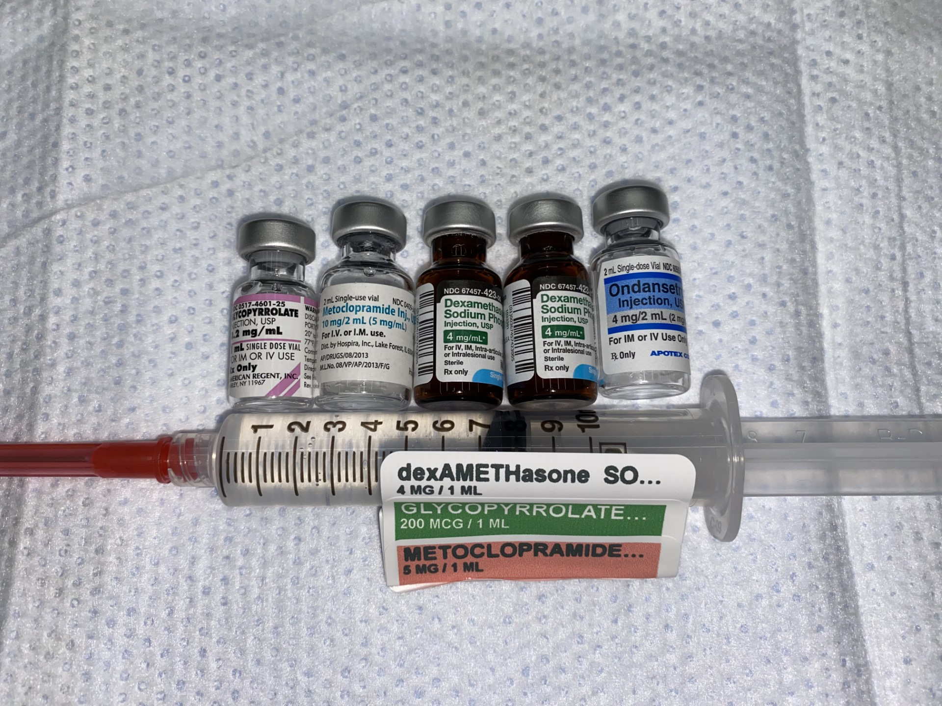
Vallejo ERAS C/S Analgesia Elixir ….. Of Life!

Slide 43
Thank You
Questions

