Slide 1
What can psi-wv do for you?
Kayla Mullin, MA, LPC, AADC, PMH-C
Heather marshall, ma, lpc, pmh-c

Slide 2
Objectives
Identify mother’s needs in relation of Maslow’s Hierarchy of Needs
Increase awareness of the signs of PMADs in partners and special populations
Identify the resources of Postpartum Support International and the local chapter, PSI-WV.

Slide 3
Psi-wv representatives
Kayla Mullin, MA, LPC, AADC, PMH-C
Heather Marshall, MA, LPC, PMH-C

Slide 4
Perinatal Mood and anxiety disorders (pmads)
Postpartum Depression
Postpartum Anxiety
Postpartum OCD
Postpartum Psychosis
Birth trauma/PTSD

Slide 5
pmads
In the United States alone:
Approximately 70% to 80% of women will experience, at a minimum, the ‘baby blues’. Many of these women will experience the more severe condition of postpartum depression or a related condition.
The reported rate of clinical postpartum depression among new mothers is between 10% to 20%.
One recent study found that 1 in 7 women may experience PPD in the year after giving birth. With approximately 4 million live births occurring each year in the United States, this equates to almost 600,000 postpartum depression diagnoses.

Slide 6
If we don’t treat…
Poor care for mother and baby—prenatal and postnatal
Preterm labor
Preeclampsia
Low birth weight
Babies whose mothers were depressed or anxious during pregnancy are more likely to have eating and sleeping challenges and are more likely to be difficult to soothe.
Notes:
Research published in 2014 by Dubber et al. examined the influence of maternal-fetal bonding and perinatal symptoms of anxiety and depression on postpartum mother-infant bonding.
Results support the hypothesized negative relationship between maternal-fetal bonding and postpartum maternal bonding impairment as well as the role of post-partum depressive symptoms. Early identification of bonding impairment during pregnancy and postpartum depression in mothers plays an important role for the prevention of potential bonding impairment in the early postpartum period.

Slide 7
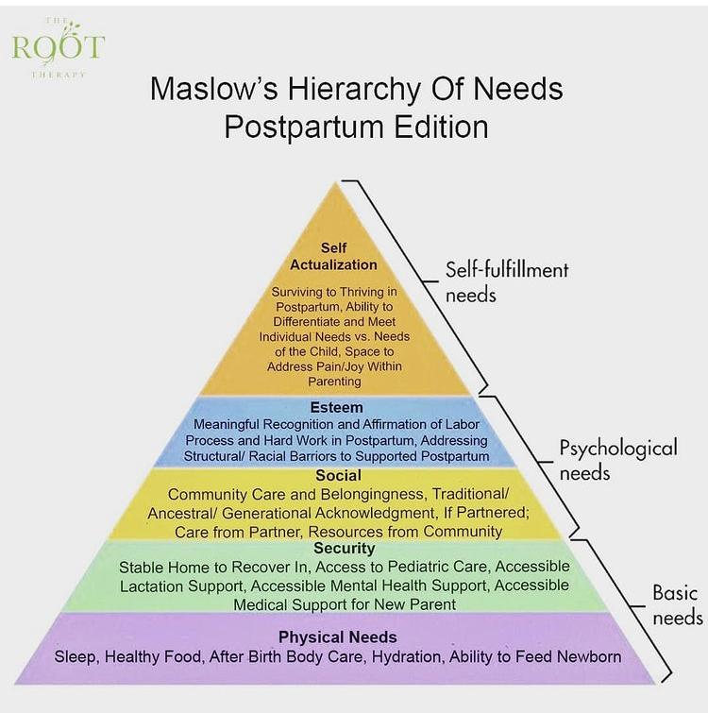
Treatment for pmads focuses on..
What does the mother need?
&
How can we help?

Slide 8
Issues for partners
Approximately 10% of new fathers experience symptoms of depression during the postpartum period. 18% will go on to develop a clinically significant anxiety disorder.
Half of men who have partners with postpartum depression will go on to develop depression themselves.
Because we do not yet have an official set of diagnostic criteria for paternal postpartum depression, we most often assess by using measures developed for maternal PPD.

Slide 9
LGBTQIA+ families
Queer & trans families are at higher risk for perinatal mood struggles for a variety of reasons including discrimination, stigma, personal mental health history, possible issues with their family of origin, conception or adoption complications, denial of parental rights, and more.
Recent study suggests that systemic inequities still exist regarding mental health and well-being of LGBTQIA+ individuals, including in the postpartum period.
Notes:
A literature review completed in February 2022 found that LGBTQIA+ families struggle with a lack of knowledge from healthcare providers and lack of access to mental health services. It also identified gaps in the system, including lack of education, gendered language, not using correct pronouns, and lacking trauma-informed practices.

Slide 10
Postpartum support international
Crisis line in English and Spanish, 8am-11pm—can call or text
English 1-800-944-4773
Spanish 1-971-203-7773
Specialized coordinators for Dads, LGBTQIA+, and other special populations
Dad/partner support group monthly
Online support groups for anything and everything
Online provider directory
Resources for professionals
Perinatal Psychiatric Consult Line
Training and certification

Slide 11
PSI Coordinators
Both local and national
Able to expedite referrals
Sorts by area, needs, and insurance

Slide 12
What is psi-wv?
Our Mission is to increase awareness, education, prevention, and treatment of perinatal mental health issues affecting individuals, their families, and support systems in all areas of West Virginia.
Our Vision is that all pregnant and postpartum individuals and their families, including those from underserved communities, will have access to perinatal support, mental health/healthcare providers, education, and resources to improve overall well-being through advocacy, training, and increased awareness of perinatal mental health.

Slide 15
What can psi-wv do for clients?
Offer trainings to staff
Help with referrals to certified providers
Offer consultation on a local basis
Develop trainings and resources that meet our specific needs in WV
Aid in advocacy for the mothers in our state

Slide 16
Lunch and learn
The EPDS and how to address a high score
How to address comments regarding suicide
Signs of PMADS
Treatment Options for PMADs
Case Consultation
And other topics not listed here… just contact us!

Slide 17
Membership in psi-wv
Discounts on trainings/annual conference/educational resources
Online forum/listserv for providers and psychiatry
Peer consultation & web-conferencing groups
Perinatal Mental Health Alliance for People of Color membership for our BIPOC members
Connection with local PSI chapter for resources and consultation with peers

Slide 18
Contact us/get involved
Heather Marshall, Liaison/Membership
psiwvliaison@gmail.com
Lora McDonald, Secretary/General Questions
psiwvsecretary@gmail.com
Follow us on Facebook at Psi-WV
Visit our website West Virginia Chapter of Postpartum Support International (psichapters.com)

