Slide 1
Human Trafficking 101: Victim Centered Response
Katie Spriggs, MSW
Executive Director
Eastern Panhandle Empowerment Center

Slide 2
Human Trafficking: Defined
Sex Trafficking:
the recruitment, harboring, transportation, providing, or obtaining of a person for a commercial sex act, in which a commercial sex act is induced by force, fraud, or coercion,
OR in which the person induced to perform such an act has not yet attained 18 years of age.
(via Trafficking Victims Protection Act (TVPA)

Slide 3
Human Trafficking: Defined
Labor Trafficking:
the recruitment, harboring, transportation, provision, or obtaining of a person for labor or services, using force, fraud or coercion for the purpose of subjection to involuntary servitude, debt bondage, or slavery.
(TVPA)

Slide 4
Using Force, Fraud or Coercion…
Beatings, burnings, sexual assault, starvation
Psychological abuses
Document withholding
Debt bondage
Threats of deportation
Threats against family or friends
Drug/alcohol dependency
US vs Mendez
Isolation
Allowing one call home per week, with trafficking right beside of them

Slide 5
Similarities between DV/SA/HT
Domestic Violence, Sexual Assault and Human trafficking are all involuntary
All violate a person’s freedom
Perp’s use a relationship of trust to their advantage
Similar elements of power and control in all three voluntary or involuntary service or labor of any persons . . . in liquidation of any debt or obligation.

Slide 6
The Many Faces of Coercion
Any plan, scheme, or pattern
Beatings, burnings, sexual assault, starvation
Psychological abuses
Document withholding
Debt bondage
Threats of deportation
Threats against family or friends
Drug/alcohol dependency
Isolation
Allowing one call home per week, with trafficker right beside of them

Slide 7
Coercion: WV Definition
WV state law definition:
“Coercion” means:
(A) The use or threat of force against, abduction of, serious harm to or physical restraint of an individual;
(B) The use of a plan, pattern or statement with intent to cause an individual to believe that failure to perform an act will result in the use of force against, abduction of, serious harm to, physical restraint of or deportation of an individual;
(C) The abuse or threatened abuse of law or legal process;
(D) The destruction or taking of, or the threatened destruction or taking of, an individual’s identification document or other property; or
(E) The use of an individual’s physical or mental impairment when the impairment has a substantial adverse effect on the individual’s cognitive or volitional function.

Slide 8
Grooming
Gathering information
Gaining trust
Filling a need or want
Isolation
Integrating abuse
Maintain control

Slide 9
Types of Trafficking
Pimp controlled
Gang controlled
Familial trafficking
Survival Trafficking
Intimate partner trafficking

Slide 10
Trafficking vs. Smuggling
• Trafficking –
An offense against a person
Trafficked persons are victims
Does not require movement
Involves compelled labor or service through force, fraud, coercion
Traffickers may use smuggling debt as a means to control victims
Traffickers maintain ongoing control over victims, even after the border is crossed
Trafficking is exploitation based
Smuggling –
An offense against the integrity of the U.S. borders; requires illegal crossing of the U.S. border
The person being smuggled is cooperating;
Smugglers typically make their money once the person being smuggled has reached the U.S. border; their “business relationship” with the immigrant then terminates
Can become trafficking once a person is forced to provide labor or services
Smuggling is transportation based

Slide 11
HT- here?

Slide 12
Prevalence
Around 1 in 5 homeless youth stated that they were victims of human trafficking (85% experiencing sex trafficking, 10% experiencing labor trafficking and around 5% experiencing both)
91% of respondents were approached by strangers or acquaintances who offered fraudulent job opportunities
19% of all youth interviewed had engaged in survival sex solely so that they could access housing or food
29% of LGBTQ youth were identified as human trafficking survivors, compared to 17% of straight youth
Youth with a history of involvement in the foster system accounted for...
27% of all youth engaged in the sex trade 26% of all youth who were labor trafficked

Slide 13
Prevalence
In 2014, the Urban Institute studied the underground commercial sex economy in eight U.S. cities
estimated that this activity generated between $39.9 million and $290 million in revenue depending on the city.
According to the study, pimps in one city earned an average of $32,833 per week.
It is within this economy that sex trafficking thrives, and with this potential for earnings, sex trafficking is considered a lowrisk, high-reward endeavor.

Slide 14
Who is most vulnerable?
Significant risk factors include:
recent migration or relocation
substance use
mental health concerns
involvement with the child welfare system
being a runaway or homeless youth
It can happen to anyone right?
But the real story is that while it can happen to anyone available evidence suggests that
people of color and LGBTQ+ people are more likely to be trafficked than other demographic groups.
That’s not a coincidence. Generational trauma, historic oppression, discrimination and other societal factors and inequities create community-wide vulnerabilities.
Traffickers recognize and take advantage of people who are vulnerable in certain ways.

Slide 15
Human Trafficking as a traumatic event
Limited availability of responsive services
Know what services are available and what their limitations are
Providers difficulty establishing trust with survivors
Meet them where they are
Understand that ‘coping’ looks vastly different for each person
Mandated treatment programs may be counter productive
Giving back choice is paramount
Secrecy is a trademark of victims involved in sex trafficking; victims may not define their experience as abusive, or attempt to escape
Foreign-born trafficking victims face additional barriers related to language, culture, and isolation

Slide 16
Responding to Human Trafficking as a trauma event
Trauma is a defining life event with a complex course which can profoundly shape a victim's sense of self and others;
The victims' complaints, behaviors and symptoms are coping mechanisms (their original sources of strength may no longer be effective)
The primary goals of services are empowerment and recovery- not justice system success
The service relationship is collaborative, with victim and provider having equally valuable knowledge, the victim can be an active planner and participant in services, his/her safety ensured, a priority placed on choice and self control, and trust developed over time (Harris & Fallot, 2001).

Slide 17
Trauma Bonding
The same person who causes the trauma, is also the only one helping them heal from it

Slide 18
Activity: Logic vs. Impulse

Slide 19
Human Trafficking Response

Slide 20
WV Human Trafficking Task Force
Established in 2015
Housed within the US Attorney’s office
Meetings twice per year, with committees meeting more often
Worked to develop a model process for victim services in the state

Slide 21
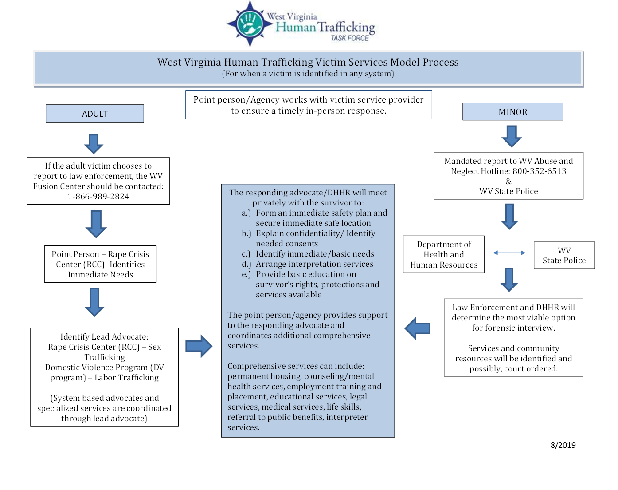

Slide 22
Sooooo Many Advocates
Community Based Advocates
That’s us!
Rape Crisis Centers: Sex Trafficking
DV Programs: Labor Trafficking
System Based Advocates
Within the court systems, guiding survivors through the prosecutorial process at a state and federal level
LE Based Advocates
Walking with survivors through the LE investigation process
CASA’s
Court Appointed Special Advocates
CAC’s
Family support services

Slide 23
Trauma Informed Care
Use that advocate!
Relay information regularly
Give reasonable time if needing follow up
Understand the effects of on-going trauma and incorporate those approaches into your work

Slide 24
Critical Aspects of a HT Safety Plan
Proactive plan: prevent crisis
Reactive plan: when crisis occurs
Batterer generated risks
Life generated risks

Slide 25
The elephant in the room
The survivors who don’t want to report
The survivors who recant
The survivors who fight you when you’re arresting the bad guy

Slide 26
Down with the elephant
With respect to LE advocate involvement:
Victim’s were more likely to have a police report taken (59%-41%)
The case was more likely to be investigated further (24%-8%)
Expert testimony
Know your peeps
SART TEAMS/DV Task Force!

Slide 27
Some things to note..
Trafficking does not require transportation
Human trafficking is different from human smuggling
Physical force or physical bondage is not always required
Human trafficking can occur in legitimate businesses
Initial consent or voluntary migration is irrelevant
Human trafficking is likened to forced labor, involuntary servitude, and modern-day slavery

Slide 28
Questions/thoughts/comments
Katie Spriggs, MSW
Kspriggs@swcinc.org

