Slide 1
West Virginia Perinatal Partnership Update
Highlights of Nursing Leadership Survey and WVPP Initiatives
Notes:
WE are going to be going over the Perinatal Nursing Leadership survey.
This survey was done this summer- beginning in June 2023 with the last replies in August 2023. It was to the 20 birthing hospitals in WV to be completed by the nursing leadership.

Slide 2
West Virginia Perinatal Partnership
Maternal & Infant Safety
Breastfeeding
Substance Use Disorder
Quality Improvement
Access to Care
Outreach and Education
Contraception
Tobacco Cessation
Labor Support

Slide 3
Maternal Infant Safety
Notes:
The Partnership recognizes the importance of Maternal and Infant Safety.
The United States has higher infant mortality rates than other developed county and is higher still. WV‘s infant mortality rate in 2020 was above the national average with a rate of 7.33 per 1,000 live births compared to a rate of 5.4 in the nation. Norway, for comparison, has an infant mortality rate of 1.6.
Sources: CDC- https://www.cdc.gov/nchs/pressroom/sosmap/infant_mortality_rates/infant_mortality.htm
Sources: AMJC- https://www.ajmc.com/view/us-has-highest-infant-maternal-mortality-rates-despite-the-most-health-care-spending

Slide 4
Survey Results – Maternal Infant Safety
Notes:
The survey asked about different significant events and if there is a debrief for the PATIENT after such an event. Most hospitals do not routinely include the patient in the debrief, particularly with severe hypertension and difficult deliveries.
The gold bar here is at 100%- this would be where we would want all the facilities to be in debriefing patients after a significant event

Slide 5
Survey Results – Maternal Infant Safety
Does your facility have a Perinatal Risk team?
Notes:
A Perinatal Risk team is a multi-disciplinary team that meets regularly to implement AIM initiatives and look at outstanding cases for the facility. Over half the hospitals reported they do not have this team. This is an area of opportunity.

Slide 6
Survey Results – Maternal Infant Safety
Types of shaken baby syndrome / abusive head trauma prevention education to new and expectant parents / caregivers
Notes:
Most hospitals- 19 out of 20- do provide education on shaken baby, with Period of PURPLE Crying being the most common. There is an opportunity to update the resources for the facilities.
Talk about Keep your Cool When Baby Cries- This is a resource from Our Baby Safe and Sound that comes from TEAM for WV Children.

Slide 7
Maternal Infant Safety Projects
Safe Sleep
Fetal Monitoring
Infant Mortality
Infectious Diseases
Emergency Department Education
Notes:
As you can see, we have some opportunities to help increase Maternal Infant Safety throughout the state. The Partnership has 5 different projects ongoing that addresses maternal infant safety.
Safe Sleep: The annual training for Say Yes to Safe Sleep was held this summer by webinar over 2 half days by our partner Our Babies Safe and Sound. The focus was on safe sleep, maternal mental health and prevention of shaken baby syndrome.
Fetal Monitoring: Three AWHONN Intermediate Fetal Monitoring teach-back courses have been completed. Four new Intermediate Instructors were approved to teach independently through those courses. Fourteen RNs and one MD completed and passed the course. These courses took place in Princeton, Huntington and Glendale, WV.
Infant Mortality: The Partnership has contracted with Anne Williams to provide staff support and professional guidance to the WV DHHR Bureau for Public Health, Office of Maternal, Child, and Family Health Office with the Infant and Maternal Mortality Review Panel (IMMRP) process. Based on recommendations and guidance from the Nurse Consultant, OMCFH recently added new members to the Panel and developed timelines/procedures to improve timeliness of case reviews to within 6 months of the date to enable identification of appropriate interventions/actions to address preventable factors in infant and maternal deaths in WV.
Emergency Department Education: The Partnership has engaged in an education program targeted to emergency departments in hospitals without obstetrical services. This program, aided by an obstetrician from WVU Children’s Hospital, has provided didactic and hands on training to eight units across the state. In addition, we are currently forming an emergency department work team to include improving screening for pregnant and postpartum women, additional simulation trainings, and identification of resources to support rural facilities by linking with larger hospitals and obstetrical teams. A review of maternal transport issues will be included in this project, exploring barriers to timely transport, consultation, and ease of the process. This examination of transport issues will coincide with the work of the Born in the Right Place project as we investigate deliveries of preterm infants outside of tertiary care centers.

Slide 8
Access to Care
Notes:
West Virginia faces significant access to care challenges, particularly with our rural populations.
The survey questions specifically focused on the postnatal period, but our projects look at access to care for women in all areas related to childbirth, particularly for those in underserved areas.

Slide 9
Access to Care
Notes:
Put your hand in the middle of the state and there are shockingly few delivery facilities. We have had 8 maternity units close in the past 10 years. The closure of Summersville Regional Medical Center’s Maternity Unit had the effect of lengthening the drive time to a delivering hospitals by 2 hours. The red stars are our Level 3 NICUs. Our state has 7 Maternal Fetal Medicine specialists for about 18,0000 pregnant people.

Slide 10
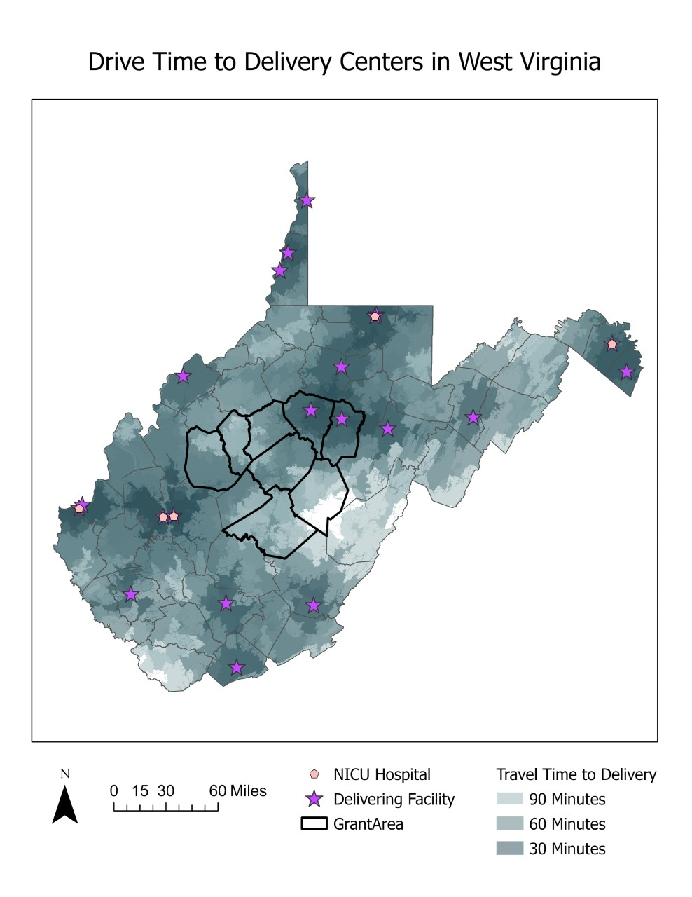
Access to Care
Notes:
This drive time map tells us that some WV mothers and their families have to drive 2 hours to get to a maternity care provider or to a delivering hospital. Within the past few months there have been 3 deliveries in Summersville Regional Medical Center and 1 in Braxton Hospital
Right now, WVU is working on reopening a Maternity Care Unit at Summersville Regional Medical Center. New building plans are on the architect's desk.

Slide 11
Access to Care Projects
Rural Maternity and Obstetric Management Strategies
Improving Mother & Infant Outcomes
Project Director: Shauna Lively
Project Coordinator: Denise Smith
Notes:
The RMOMS project is a 4 year, 4 million dollar HRSA grant whose goal it is to expand access to care and provider capacity building. The Partnership was one of only 3 RMOMS grants awarded in 2021. The WV RMOMS program is working towards increasing patient navigation and care coordination to help tailor services to local needs. The program is developing a telehealth strategy to improve access to care, particularly for women with high-risk pregnancies and/or transportation barriers.
Additional funding from UniCare Health Plan and OMCFH has allowed the Partnership to provide robust education for wrap-around services such as childbirth education, lactation support, and doula training courses thus expanding the capacity of each clinic and hospital that care for mothers and babies.

Slide 12
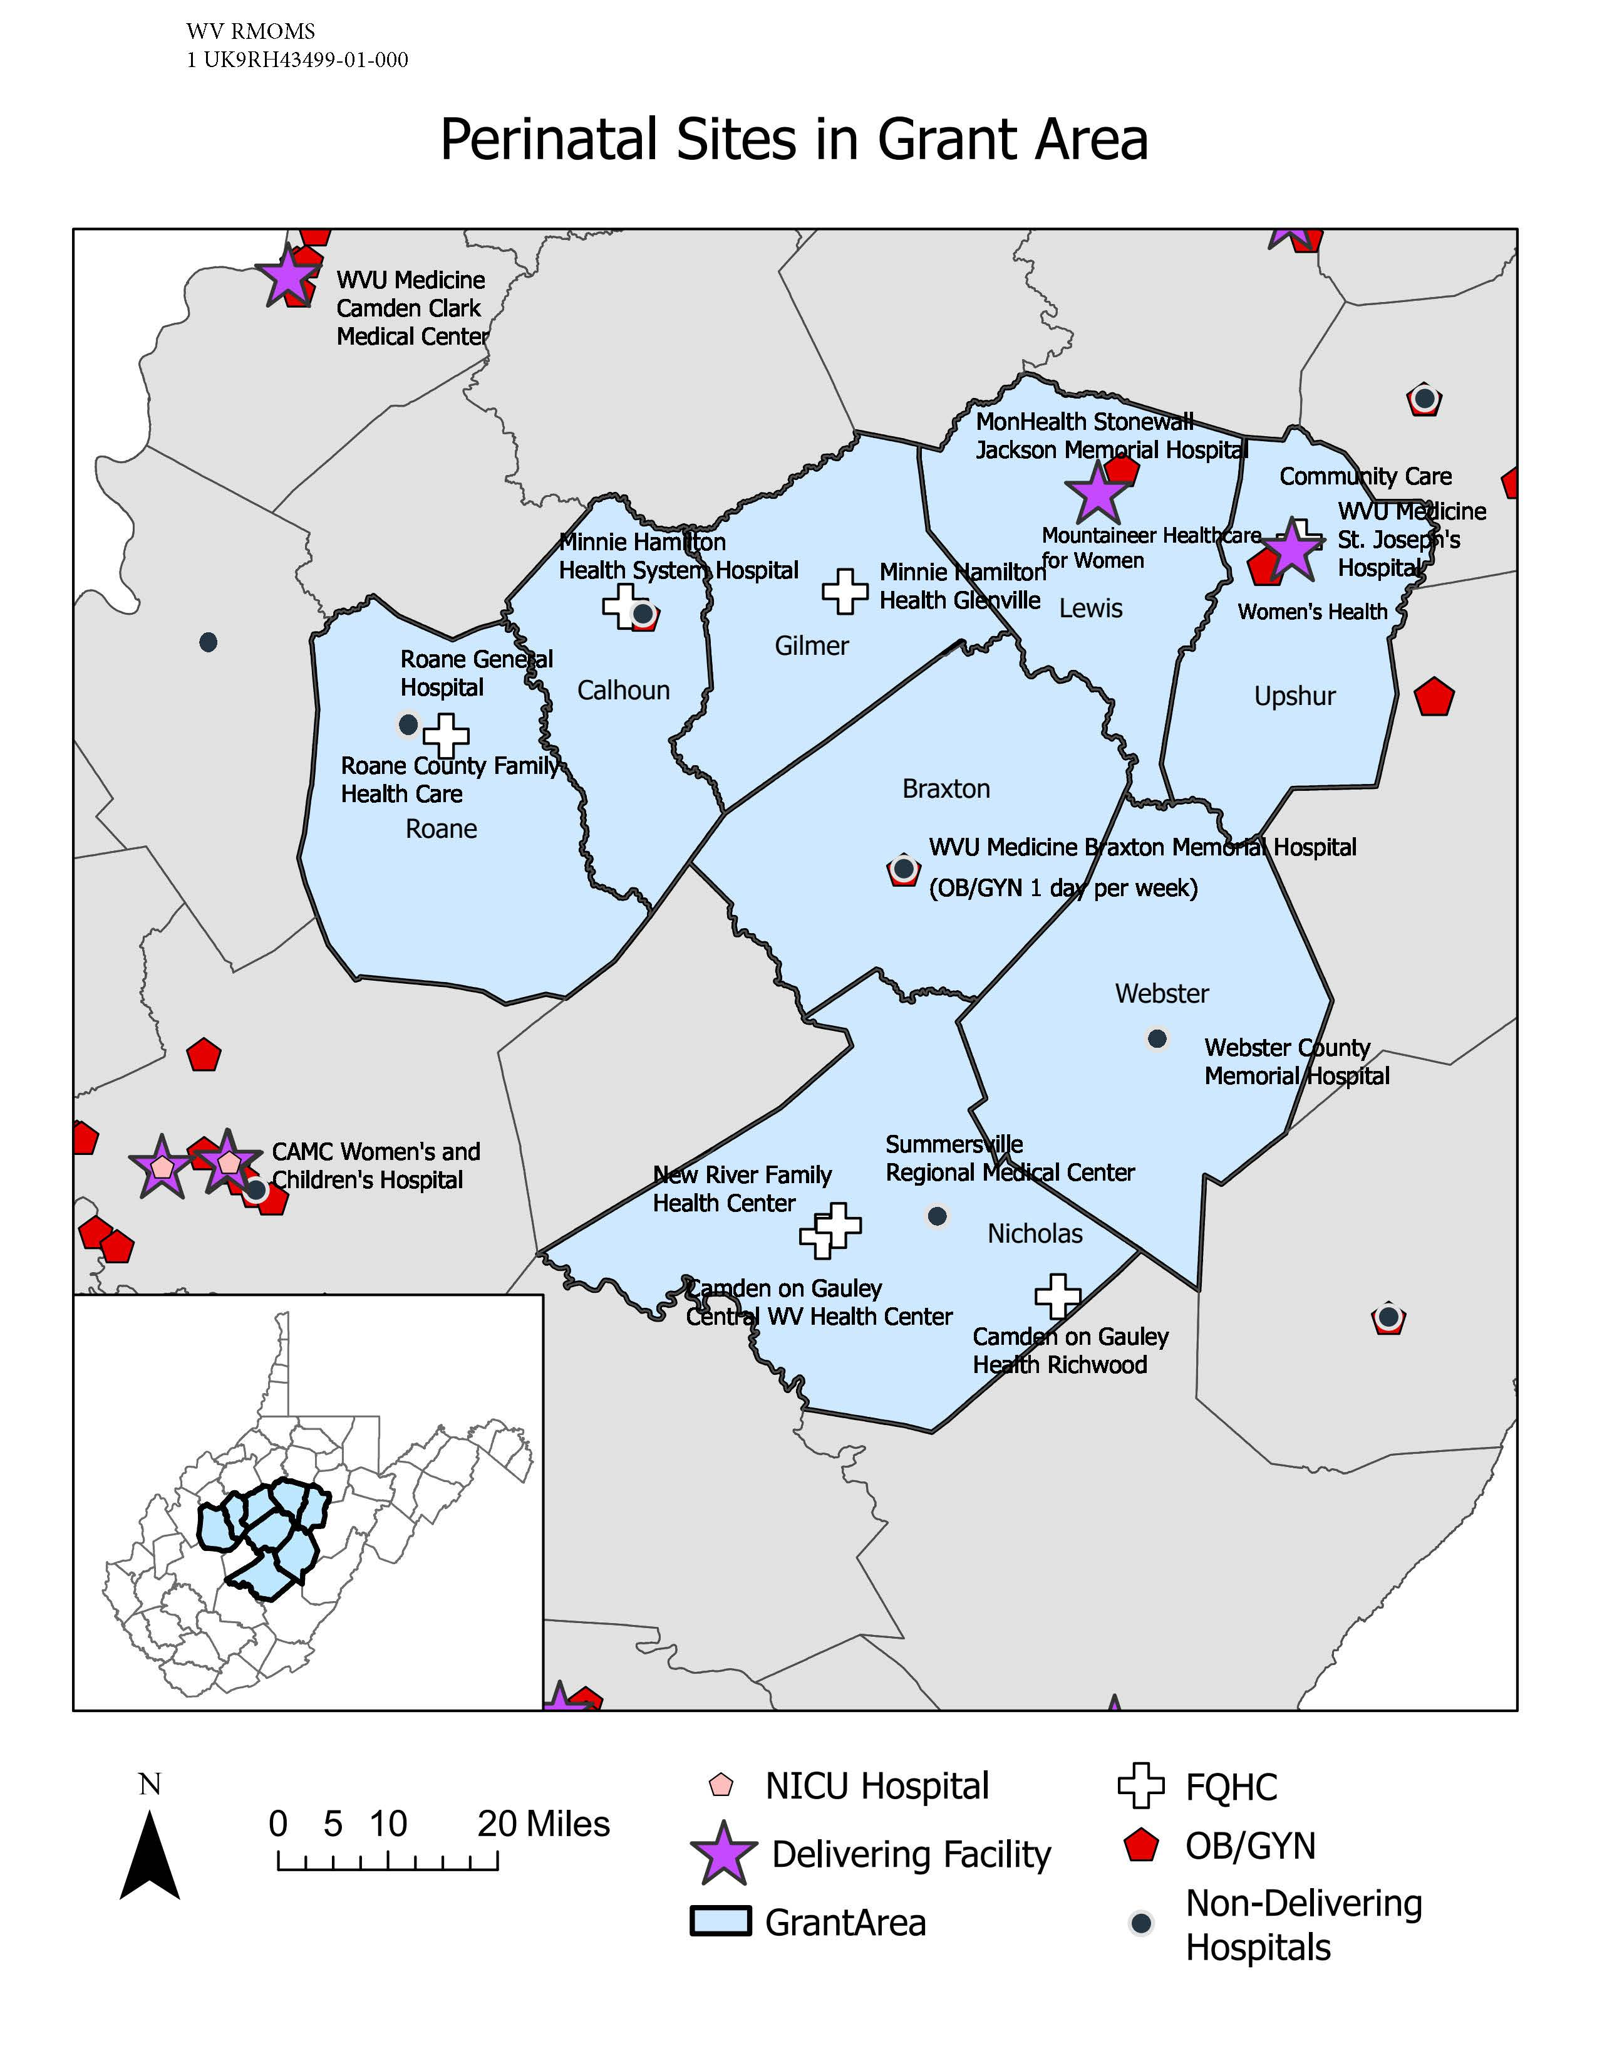
WV RMOMS Project Area
Braxton County
Calhoun County
Gilmer County
Lewis County
Nicholas County
Roane County
Upshur County
Webster County
Notes:
There are 2 delivering hospitals and four hospitals that do not deliver in our region as well as four federally qualified health centers as partners.

Slide 13
Access to Care

Slide 14
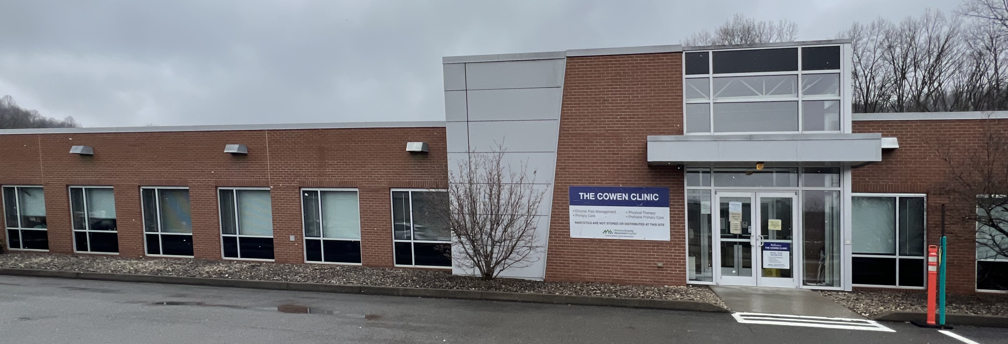
Year 2: Workforce Expansion
Delivering Hospitals in RMOMS Target Area
St Joseph’s Hospital, Upshur County –Navigator + Skills mannequin for regional drills
Stonewall Jackson Memorial, Lewis County—Materials for Small Clinic Staff & Mother Navigator/Clinic Nurse
Non-Delivering Hospitals Providing Maternity Care Services
Webster Memorial Hospital—Cowen Clinic CNM 1 day/week and plans to hire RFTS home visitor
Braxton Memorial Hospital—OB/GYN 1 day/week; Childbirth Education by the WIC nurse; Sonography equipment
FQHCs providing maternity services
New River Health Care in Summersville has 2 Nurse Practitioners; Family Med Physician 2 days/wk and 1 new OB/GYN beginning October 2023 and expansion into Smithers with NP.
Minnie Hamilton 1 WHNP + Navigator and equipment at new Glenville clinic
Camden on Gauley CNM 3 days Summersville and 1 day in Webster County
Notes:
This slide shows what we have done in the first year of enhancing and developing services. Providing medical care is essential and we are working on telehealth for years 3 and 4. The Support Services are also essential—doula care, home visitation, childbirth education, & lactation consultation.

Slide 15
Substance Use Disorder
Notes:
Substance Use disorder is a major issue in WV and for the Partnership.

Slide 16
Survey Results – Substance Use Disorder
If a woman is identified as having OUD, what percentage of facilities...
Always ask if she would like a referral to medication-assisted treatment (MAT Program)
Prescribe Naloxone (Narcan) before discharge
Notes:
About 50% of mothers who die in the first year after childbirth in WV do so because of an overdose. Prescribing Narcan is a low hanging fruit and can help save lives, yet most facilities are not doing this. This is an important are of focus.
Again, the gold bar is showing the gold standard- how we would ideally like all the facilities to get to.

Slide 17
Substance Use Disorder Projects
Drug Free Moms and Babies Program
Weave WV, Weaving Together Communities of Support for People Experiencing Substance Use and Domestic Violence
Substance Exposure and Neonatal Abstinence Syndrome Education & Outreach
RCORP - NAS WV Rural Community Opioid Response Program – Neonatal Abstinence Syndrome
Substance Use During Pregnancy Committee
Notes:
Drug Free Moms and Babies Program
Drug Free Moms and Babies has expanded to 20 sites in 18 counties. Our newest programs are located at Reynolds Memorial Hospital (Glen Dale), Berkeley Medical Center (Martinsburg), and Jefferson Medical Center (Ranson). The program at Thomas Memorial Hospital closed in 2022. We are in discussions with stakeholders to explore how DFMB services can be reinstated.
The Partnership coordinates a monthly meeting of the DFMB providers to discuss challenges and barriers, provide resources and other support, and share information. DFMB is funded through grants from WV DHHR BBH (State Opioid Response, State Pilot Program for Pregnant and Postpartum Women, block grant), OMCFH, and the federal RCORP NAS grant.
WEAVE WV: Weaving Together Communities of Support for People Experiencing Substance Use and Domestic Violence
The Partnership is a subrecipient of a grant awarded to the National Center for Domestic Violence, Trauma, and Mental Health in October 2022 from the U.S. Office of Women’s Health. Other partners are the WV DHHR Bureau for Behavioral Health, WV Coalition Against Domestic Violence, and Marshall University Center of Excellence for Recovery. Robin Young, who started April 3, 2023, was hired as the project manager for the Partnership.
Our responsibilities under the project are to lead a Health Care Task Force, implement new screening protocols in two pilot sites, expand protocols to DFMB sites, facilitate regional partnerships in collaboration with WV Coalition Against Domestic Violence, and assist with evaluation of the project.
We participate in monthly meetings of the Project Team, as well as other meetings (e.g., evaluation) as needed.
The Partnership identified representatives for the Health Care Task Force and invited them to be a member. Members include Ob-Gyns, pediatrician, family medicine, psychiatrist, certified nurse midwife, DFMB providers, and substance use treatment providers. The first meeting of the Task Force was held on March 2, 2023.
The two pilot sites have been identified and engaged: WVU Ob-Gyn in Morgantown and AccessHealth in Beckley.
Substance Exposure and NAS Outreach and Education Project
In late 2022, a task force was created to identify training needs and develop educational materials. Task force includes neonatologists, community-based pediatricians, and family practice providers.
The need for two trainings was identified:
One for hospital-based providers to ensure proper screening, diagnosing, coding, and documentation of infants with intrauterine substance exposure. The curriculum is currently being developed. Dr. Stefan Maxwell, Dr. Cody Smith, and Candice Lefeber will record the training in early May.
Another targeted to community-based pediatric providers on Birth Score notification process for babies diagnosed with NAS and those exposed to Hepatitis C. The training will address the needs and resources for families affected by substance use disorder. We are in the beginning stages of developing this program, including what materials to include and how to deliver the trainings.
The project has uncovered several problems, including inconsistencies in how/if newborn information is communicated to community-based providers from hospitals, Birth Score processes, and barriers associated with faxing. Most of these problems have been addressed. For example, it was discovered that because of a coding error, NAS notifications were only being sent to pediatric providers if the infant had also received a High Birth score. This has been resolved. To address problems with faxing, it was recommended that phone calls to provider offices be made when a baby in their care was diagnosed with NAS. The Birth Score office will be provided funding so that they can hire someone to make calls to providers.
Rural Communities Opioid Response Program for NAS
A Consortium made up of the Partnership, Greenbrier Physicians, Women’s HealthCare at Davis Medical Center, and the WV School of Osteopathic Medicine was established to guide the project. In addition to supporting DFMB programs at Greenbrier Physicians and Davis Medical Center, the project provides training on Love Your Birth Control to health care providers in the 3-county area. Additionally, Time Out for Me, an assertiveness and sexuality workshop for women with (or at-risk for) substance use disorder, has been delivered in Pocahontas County in collaboration with the Day Report Center and other partners. In May, this 6-week curriculum will be delivered to women in Randolph County.
The 3-year project ends September 2023, however the Partnership submitted a proposal in March under the same federal program. The new opportunity tripled the funding available for projects problems with faxing, it was recommended that phone calls to provider offices be made when a baby in their care was diagnosed with NAS. The Birth Score office will be provided funding so that they can hire someone to make calls to providers.
Substance Use During Pregnancy Committee
The Partnership continues to hold quarterly meetings of the Substance Use During Pregnancy Committee. The Committee makes policy recommendations, shares information, and helps guide the multiple initiatives and projects undertaken by the Partnership to improve services for this population.

Slide 18
Tobacco Cessation
Notes:
West Virginia has just under 20% of smoking of pregnant women, number 1 in the nation. This is an area of concern for the Partnership.

Slide 19
Survey Results - Tobacco Cessation
If a patient uses tobacco / nicotine / vape products, are they offered nicotine replacement therapy (NRT) such as patches, gum, or lozenges, etc.?
Notes:
Most facilities are engaged with nicotine replacement therapy, although there is an opportunity for improvement for always offering.

Slide 20
Tobacco Cessation Projects
Tobacco Free Families Advisory Council
Help2Quit
Provider trainings and education
BABY & ME - Tobacco Free Program
Help2Quit Toolkit for Pediatric Providers
Notes:
The Partnership continues to partner with the Tobacco Baby & Me Tobacco Free Program (BMTFP), a national telehealth tobacco cessation incentive-based program for pregnant and postpartum women and their families. From July 2022-March 2023, 151 pregnant women were referred to the program from 26 different providers. Of those referred almost 50% (74) were enrolled in the program. Only 7.9% of the WV participants have given birth to a low birthweight baby (compared to the WV average of over 9% for general population and 16% for smoking moms). 91% of the BMTFP participants have given birth to a term infant.
Newly developed promotional materials, including video testimonial from Valley Health, WV patient stories and an updated flyer have been developed.
The Division of Tobacco Prevention recently finalized their FY24 budget and has allocated $35,000 for the Partnership to help pay for BMTFP.
The Partnership continues to coordinate quarterly meetings of the Tobacco Free Families Advisory Council. The West Virginia State Medical Association and the West Virginia Hospital Association recently joined the Advisory Council.
Dr. Tim Lefeber, WVU Associate Professor of Pediatrics & WVPP Tobacco Champion, provided updated recommendations from the Tobacco Cessation and Prevention Task Force to the Joint Health Committee in the WV Legislature during the December Interim meetings at the Capitol.
The Partnership participated in the Tobacco-Free and Prevention Awareness Days at the Capitol during the 2023 Legislative Session.

Slide 21
Labor Support
Notes:
Labor Support has been a foundation of the Partnership's work, to help hospitals have the best outcomes for their patients.

Slide 22
Survey Results - Labor Support
Notes:
The survey asked about doulas in the hospitals. Only three facilities report a fully positive experience with doula, most found a mix of positive and negative. Acceptance of doulas was split evenly, with slightly more hospitals reporting their staff acceptances doulas and less providers accept them. The survey also found that half the hospitals treat doulas as a visitor, and not a labor-support professional. This is an area of opportunity for the Partnership to help support the doula profession.

Slide 23
Labor Support Projects
Doula Care
Evidence-based Labor Support (EBLS)
Lamaze childbirth Educators Seminar
Spinning Babies
Notes:
The Partnership was awarded an additional $32,000 from the UniCare Health Plan of West Virginia to continue the Pilot Doula Project in 2023. This Phase II grant aims to build on and scale up the reach of doula services offered to pregnant and postpartum women in underserved and vulnerable communities in West Virginia throughout 2023. A total of 56 participants have completed either labor support or postpartum doula training. We have contracted with Family Care in Charleston and St. Joseph’s Hospital in Buckhannon ($10,000 each) to provide payment for doula services over the next few months. We hope to encourage doulas and to collect data as part of a UniCare QI project. We will be contracting with a few other hospitals in the next month. Part of the work will entail providing an online directory of doulas for the convenience of providers and those who are pregnant.

Slide 24
Breastfeeding
Notes:
The Partnership works to promote breastfeeding in WV because of its benefits to mommas and babies.

Slide 25
Survey Results - Breastfeeding
Notes:
In WV, nurses take on much of the lactation support. Just over half the facilities have dedicated lactation staff, this means nearly half the hospitals provide rely on their nursing staff to provide lactation support in addition to other duties. International Board-Certified Lactation Consultant and Certified Lactation Counselor is the most common lactation certificate here in WV.

Slide 26
Survey Results - Breastfeeding
Notes:
We are a “bag free” state. This has been a successful initiative from our Partnership.
Most facilities are not providing formula samples on discharge. The question was open to interpretation, so the four hospitals that reported they are provided formula samples could meant they are giving the extra formula to the mothers that are exclusively formula feeding.

Slide 27
Survey Results – Breastfeeding
Does your facility offer outpatient lactation care / support?
Notes:
About 70% of our facilities provided outpatient lactation support. Increasing outpatient lactation support is an opportunity to help increase WV’s breastfeeding rate.

Slide 28
Survey Results – Breastfeeding
Notes:
Takeaway- skin to skin is often done.
Most facilities are initiating skin-to-skin with vaginal/uncomplicated deliveries, but there is the opportunity for improvement for skin to skin with cesareans. Another area would be initiating skin-to-skin sooner rather than later.
We would like all these bars to be at 100%- again, the gold standard.

Slide 29
Breastfeeding Projects
WV Breastfeeding Institute
Improving Maternity Practices in Infant Nutrition and Care (mPINC)
Zipmilk lactation support directory
Breastfeeding Education and Lactation Training for all levels of experience
Breastfeeding Friendly Communities
Continuity of Care
Notes:
The WV Breastfeeding Institute (WVBI) has worked to expand lactation support for WV mothers, offering a variety of trainings for all levels of education and experience. Since July 1, 2022 70 people have enrolled in the Certified Breastfeeding Specialist training; 35 participated in the Outpatient Breastfeeding Champion Training in September 2022. These are the two largest and most popular trainings, but several more are offered for both hospital and outpatient/community lactation support.
To connect mothers and providers with trained lactation support, “ZipMilk” an online directory that mothers can enter their zip code to find help near them was launched. WVBI is in the process of collecting submissions and vetting them, with the goal of having a robust network of lactation support providers available for WV mothers.
A pilot project to integrate Lactation Care into the primary care setting is underway. This is collaborative effort with the WV School of Osteopathic Medicine and includes a Quality Improvement component. A Primary Care Breastfeeding Support workshop for students and residents (those who are in OB, Peds and Family Practice specialties) and other local providers will be conducted.
Strategic Planning for the West Virginia Breastfeeding Institute is underway with a group of stakeholders. The Partnership has applied for funding for two more projects (one to expand postpartum care, including lactation support and one for a public awareness campaign to educate mothers, employers and communities about federal protections passed for working mothers).

Slide 30
Contraception
Notes:
In WV, over 50% of pregnancies are unplanned. The Partnership sees contraception as a priority.

Slide 31
Survey Results - Contraception
Immediate post-partum LARC device insertion
Notes:
IUD insertion and nexplanon after delivery is a growing area of opportunity for our facilities to help decrease unplanned pregnancies. Over 50% of our facilities do not provide these services.

Slide 32
Contraception Projects
Love your Birth Control
Shared-decision making training with WV FREE
Notes:
The Love Your Birth Control Project, a shared decision-making, client led approach to counseling individuals about contraception, is a collaboration between WVPP and WV Free.
This free training has been conducted since 2018 in obstetrical units, physician’s offices, health departments, harm reduction clinics, family practice centers, nursing schools, school nurses, home visitor agencies, domestic violence organizations, and to residents of both schools of medicine in West Virginia. Hundreds of healthcare providers and community support workers have been trained. Materials have been distributed at health fairs, community events and billboards have been erected around the state advertising the website for more information.

Slide 33
Quality Improvement
Notes:
Building the capacity to use Quality Improvement (QI) throughout out initiatives is a new focus for the Partnership. The CDC awarded a 5-year grant to assist the Partnership to increase its QI capacity. This includes increasing the ability to collect and analyze data, and to use the evidence for informed decision making. This grant was awarded less than a year ago, so activities are just getting underway.

Slide 34
Survey Results – Quality Improvement
Number of VLBW (>1500 grams) born per hospital in the past year
Notes:
In WV, about 18% of our VLBW babies are born in non-tertiary care facilities. This is the focus of a new QI project.
Source- WV Health Stats center, part of the next speech with Tonya Cheney.

Slide 35
Quality Improvement Projects
Born in the Right Place-Very Low Birth Weight
Severe Hypertension AIM bundle
Hemorrhage Patient Safety AIM Bundle
Improving Outcomes for the Substance Exposed Mother-Infant Dyad
Notes:
The Partnership created and hired a new position, Director of Quality Improvement to lead this QI capacity building, and one new project is underway.
Born in the Right Place
The Born in the Right Place project aims to decrease the number of Very Low Birthweight Babies (VLWB) being born in non-tertiary care hospitals. This project is well underway with the formation of both the advisory and workgroups. The Partnership has two doctors on board as leaders for the advisory council and has been meeting monthly with the workgroup. Data has been collected of VLBW babies for the last three years and preliminary analysis has started to identify risk factors. The data has been used to identify the critical hospitals and invite them to collaborate on this project.
Two of our QI projects are specifically AIM bundles. The Alliance for Innovation on Maternal Health (AIM) is the national, cross-sector commitment designed to lead in the development and implementation of patient safety bundles for the promotion of safe care for every U.S. birth.
Since 2018 when West Virginia was accepted as an AIM state, we have implemented the OB Hemorrhage patient safety bundle and the Severe Hypertension in Pregnancy bundle. We have seen a continuation of a low maternal morbidity rate of 1% or less, and improved processes in birthing facilities with new policies, protocols, education, and simulation training. West Virginia is one of only a few states that have achieved 100% participation from their birthing facilities. Representatives from every obstetrical unit engages in education, data collection, data review, and their own team work to accomplish the bundle implementation.
Through a grant from AIM, the WVPP has been able to provide home blood pressure kits to provider offices for distribution to high-risk patients.
Another project that falls under the QI banner is Improving Outcomes for Mother-Baby Dyad with Substance Exposure Quality Improvement Project.
In collaboration with the WV Children’s Hospital Collaborative, this quality improvement initiative is implemented in 4 hospitals: WVU Children’s Hospital, Hoops Family Children’s Hospital at CHH, CAMC Women and Children’s Hospital, and Berkeley Medical Center. The project began in the fall 2020 and we are still collecting and analyzing data.
In 2022, one of the project’s leads, Dr. Richard Brant (WVU Children’s Hospital), applied to the American Board of Pediatrics (ABP) for approval of the quality improvement initiative for credit for the Improving Professional Practice (Part 4) component of Maintenance of Certification (MOC). On December 12, 2022, ABP approved the West Virginia Perinatal Partnership’s project. Pediatricians participating in the project can receive MOC Part 4 credit.

Slide 36
Survey Results - Quality Improvement
Do you complete a postpartum depression screen before discharge?
Notes:
There is a large discrepancy in this question about postpartum depression screens. ACOG recommendations are the everyone should be receiving a postpartum depression screen.
Every hospital should be doing a depression screen, but this could be being done at admission rather than also at discharge. This is an area that needs to be examined further about what screens are being done and when so that we can identify areas of improvement. Perinatal Mental health has also been highlighted as a concern with other hospitals… segue into next slide

Slide 37
Survey Results- Quality Improvement
Top three results of the patient safety bundles you would like to see implemented in WV…
Perinatal Mental Health Conditions
Care for Pregnant & Postpartum People with Substance Use Disorder
Safe Reduction of Primary Cesarean Section
Notes:
Talk about how Perinatal mental health has been highlighted as a topic concern by the hospitals. And this is why Perinatal Mental Health is going to be out next AIM bundle
The partnership also does a lot of SUD work.

Slide 38
Outreach Education
Notes:
Much of the Partnership’s time and resources are devoted to outreach and education. Many of the projects that we have mentioned before would also fall under Outreach & Education, but we are going to highlight a few other projects and areas of improvement for the state.

Slide 39
Survey Results - Outreach Education
What education needs do you think are important for your hospital?
OB Simulation / drill training
S.T.A.B.L.E.
Spinning Babies
Breastfeeding topics
POST-BIRTH Warning Signs
Notes:
You can talk about how these needs are all areas the Partnership can help with

Slide 40
WVPP Outreach Education
Fetal Monitoring
S.T.A.B.L.E.
Spinning Babies
Evidence Based Labor Support
Lamaze Childbirth Educator Certification
Love Your Birth Control
Obstetric Patient Safety (OPS)
Substance Use during Pregnancy
Escape Womb
OB Complications in the Emergency Departments Education
OB Simulation Drill Training
Advanced Life Support in Obstetrics
Help2Quit Tobacco/Nicotine Cessation
POST-BIRTH Warning Signs Education Program
Bereavement
Notes:
New Outreach Education Director- Mary Beth Stewart
Here is a list of outreach and education projects, we have spoken about many of these under other initiatives.
Additionally, another project the Partnership is supporting is helping with bereavement,
Bereavement Project
The Perinatal Bereavement Committee has been meeting on a regular basis and will have a table at the Spring Perinatal Conference on April 25th with bereavement materials including the miscarriage booklet for hospital representatives to take back to their hospital. The Bereavement Toolkit is currently being revised.
The Partnership also recognizes that bereavement comes in many forms, not just from infant loss but also from losing custody. specifically bereaved motherhood. The Partnership contracted with Jerica Wesley, PhD, an assistant professor at Marshall and a counselor with an interest in maternal mental health, to develop the toolkit and curriculum. The initiative focuses on providing resources and training to hospital providers to give them the skills needed to successfully intervene with these patients to help them access treatment and other needed services prior to discharge. The toolkit will include information on helping with reunification when possible if a mother is discharged without custody of her infant.

Slide 41
Outreach Education Resources
Safe Sleep
Count the Kicks
BABY & ME - Tobacco Free Program
March of Dimes- Birth Equity
AWHONN

Slide 42
Kimberly Farry, MD, FACOG Board President, West Virginia Perinatal Partnership Chair, Central Advisory Council Medical Director, OBGYN Outpatient Clinical Services WVU Medicine, St. Joseph's Hospital Buckhannon, WV
www.wvperinatal.org
Coordinated by the West Virginia Higher Education Policy Commission, Division of Health Sciences

