Slide 1
Maternal Mortality
Annelee Boyle MD, FACOG
Associate Professor of Obstetrics and Gynecology
Division of Maternal Fetal Medicine
aboyle@hsc.wvu.edu

Slide 2
Disclosures
I have no financial conflicts of interest to disclose
I am a practicing Catholic who will be discussing abortion

Slide 3
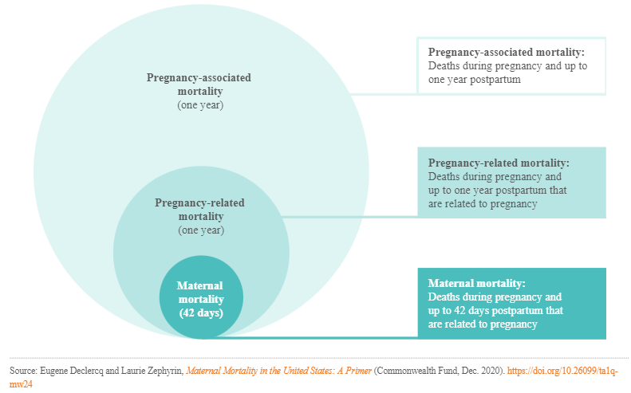
Definitions
Notes:
Pregnancy-associated mortality: Death while pregnant or within one year of the end of the pregnancy, irrespective of cause. This is the starting point for analyses of maternal deaths.
Pregnancy-related mortality: Death during pregnancy or within one year of the end of pregnancy from: a pregnancy complication, a chain of events initiated by pregnancy, or the aggravation of an unrelated condition by the physiologic effects of pregnancy. Used by the Centers for Disease Control and Prevention (CDC) to report U.S. trends, this measure is typically reported as a ratio per 100,000 live births. In this brief, when we discuss causes of maternal deaths and current rates, we will generally be using pregnancy-related mortality as our index.
Maternal mortality ratio: Death while pregnant or within 42 days of the end of pregnancy, irrespective of the duration and site of the pregnancy, from any cause related to or aggravated by the pregnancy or its management, but not from accidental or incidental causes. Used by the World Health Organization in international comparisons, this measure is reported as a ratio per 100,000 live births. When we examine historical trends, we will be using maternal mortality as our index.

Slide 4
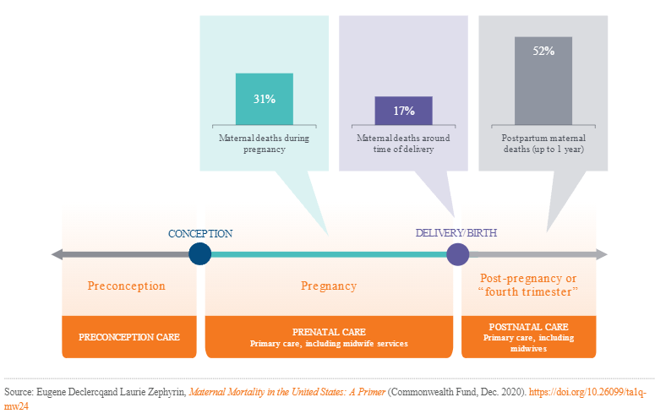
Timing of Death
Notes:
Pregnancy-associated mortality: Death while pregnant or within one year of the end of the pregnancy, irrespective of cause. This is the starting point for analyses of maternal deaths.
Pregnancy-related mortality: Death during pregnancy or within one year of the end of pregnancy from: a pregnancy complication, a chain of events initiated by pregnancy, or the aggravation of an unrelated condition by the physiologic effects of pregnancy. Used by the Centers for Disease Control and Prevention (CDC) to report U.S. trends, this measure is typically reported as a ratio per 100,000 live births. In this brief, when we discuss causes of maternal deaths and current rates, we will generally be using pregnancy-related mortality as our index.
Maternal mortality ratio: Death while pregnant or within 42 days of the end of pregnancy, irrespective of the duration and site of the pregnancy, from any cause related to or aggravated by the pregnancy or its management, but not from accidental or incidental causes. Used by the World Health Organization in international comparisons, this measure is reported as a ratio per 100,000 live births. When we examine historical trends, we will be using maternal mortality as our index.

Slide 5
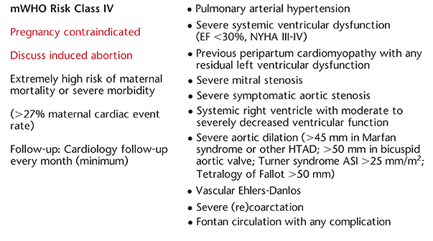
ACOG BP 212 Pregnancy in Heart Disease May 2019

Slide 6
Timing of Death
Notes:
Pregnancy-associated mortality: Death while pregnant or within one year of the end of the pregnancy, irrespective of cause. This is the starting point for analyses of maternal deaths.
Pregnancy-related mortality: Death during pregnancy or within one year of the end of pregnancy from: a pregnancy complication, a chain of events initiated by pregnancy, or the aggravation of an unrelated condition by the physiologic effects of pregnancy. Used by the Centers for Disease Control and Prevention (CDC) to report U.S. trends, this measure is typically reported as a ratio per 100,000 live births. In this brief, when we discuss causes of maternal deaths and current rates, we will generally be using pregnancy-related mortality as our index.
Maternal mortality ratio: Death while pregnant or within 42 days of the end of pregnancy, irrespective of the duration and site of the pregnancy, from any cause related to or aggravated by the pregnancy or its management, but not from accidental or incidental causes. Used by the World Health Organization in international comparisons, this measure is reported as a ratio per 100,000 live births. When we examine historical trends, we will be using maternal mortality as our index.

Slide 9
Timing of Death
Notes:
Pregnancy-associated mortality: Death while pregnant or within one year of the end of the pregnancy, irrespective of cause. This is the starting point for analyses of maternal deaths.
Pregnancy-related mortality: Death during pregnancy or within one year of the end of pregnancy from: a pregnancy complication, a chain of events initiated by pregnancy, or the aggravation of an unrelated condition by the physiologic effects of pregnancy. Used by the Centers for Disease Control and Prevention (CDC) to report U.S. trends, this measure is typically reported as a ratio per 100,000 live births. In this brief, when we discuss causes of maternal deaths and current rates, we will generally be using pregnancy-related mortality as our index.
Maternal mortality ratio: Death while pregnant or within 42 days of the end of pregnancy, irrespective of the duration and site of the pregnancy, from any cause related to or aggravated by the pregnancy or its management, but not from accidental or incidental causes. Used by the World Health Organization in international comparisons, this measure is reported as a ratio per 100,000 live births. When we examine historical trends, we will be using maternal mortality as our index.

