Slide 1
Implementing an Obstetric Hemorrhage Initiative: Tales from the Field
Judette M. Louis, MD, MPH
Associate Professor
Department of OB/GYN
Morsani College of Medicine and College of Public Health
University of South Florida

Slide 2
Disclosure
I have no financial conflicts of interest to disclose

Slide 3
Learning Objectives
Explain the components of a quality improvement initiative related to obstetric hemorrhage
Describe the factors that contribute to improved practice and related challenges.

Slide 5
The Four R’s of Obstetrical Hemorrhage
Readiness – Ob Hemorrhage Protocol
Recognition – Risk Assessment
Response – Active Management & Treatment
Reporting – Debriefing & Root Cause Analysis

Slide 6
Florida OHI Hospitals 2013 Readiness Survey
13% of hospitals do not perform drills
32% of hospitals do not have access to all procedure options (e.g. B-lynch suture, etc)
33% of hospitals do not have a written general hemorrhage policy
35% do not have a massive transfusion protocol
42% do not utilize techniques to quantify blood loss for both vaginal and cesarean births
60% do not perform debriefs after events
Notes:
Some findings from our application/baseline questionnaire of hospitals participating in the OHI.
The findings from our survey of Florida hospitals recruited to participate in the pilot phase of the OHI indicated that 1/3 of hospitals do not have a written general hemorrhage policy and 35% do not have MTP.
The majority of hospitals define hemorrhage as >500 cc for a vaginal birth and >1000 cc for a C/S
More than half of Florida hospitals surveyed report that they do not perform debriefs after hemorrhage events.
Only 13% do not perform simulation drills. Of those hospitals that do perform drills, a third of them do not have physicians participating.
100% of hospitals have access to oxytocin, methergine, high dose misoprostol, and hemabate, but a third of hospitals report they do not have access to all procedural options (e.g. B-Lynch suture)
58% of Florida hospitals who participated in this interest questionnaire reported that they utilize techniques to quantify blood loss for both vaginal and cesarean births. (but some of these hospitals also sometimes used estimation of blood loss. Only 26% of hospitals never estimated and only quantified blood loss).

Slide 7
Improve Readiness
Implement standardized protocols
Hemorrhage Cart
Procedural Instructions (balloons, stitches)
Partnership with the blood bank
Regular unit-based drills (with debriefs)
Ensure rapid availability of medications
Special case resources (previa, Jehovah’s Witness)
Unit Education to protocols
Notes:
RECOMMENDATIONS FOR BIRTH FACILITIES: The 4 R’s
Improve readiness to address hemorrhage by implementing standardized protocols (general and massive).
Among the components related to readiness is the availability of a well stocked hemorrhage cart. Having a multidisciplinary approach to include a partnership with the blood bank. Assuring professional staff are educated on and practice use of procedures and protocols. Special care must be taken to assure appropriate recognition of special conditions such as placenta previa and for patients who have beliefs that may require different actions or products. Medications must be available and staff have authority to implement protocols at the first recognition of need.

Slide 8
Improve Recognition
On-going assessment of hemorrhage risk
Prenatally
On Admission
Prior to delivery
Postpartum
Early Warning Tools for vital signs and symptoms
Quantitative CUMMULATIVE blood loss assessment
Notes:
RECOMMENDATIONS FOR BIRTH FACILITIES: The 4 R’s
Improve recognition of OB hemorrhage by performing on-going objective quantification of actual blood loss during and after all births.
Recognition of signs of hemorrhage at the earliest possible moment requires ongoing assessment and tools to support staff in their assessment. Quantitative measurement of blood loss and assurance of continued assessment in the postpartum period are essential.

Slide 9
Improve Response
Perform regular hemorrhage drills
Unit-standard OB Hemorrhage Protocol with checklists
Massive transfusion protocols
Notes:
RECOMMENDATIONS FOR BIRTH FACILITIES: The 4 R’s
Improve response to hemorrhage by performing regular on-site multi-professional hemorrhage drills.
Timely response to hemorrhage can mean the difference between life and death, loss of fertility, and other adverse sequelae. Having a standard protocol that is used for every woman every time with cues and checklists for providers helps to assure that responses are correct and safe. Having simulation drills and debriefs after all hemorrhage events also helps to improve response.

Slide 10
Issues with Hemorrhage Response
Denial
Delay
Lack of practice with rare occurrences
Imperfect estimation/quantification of blood loss
Poor utilization of blood products
Insufficient communication
Notes:
The California Maternity Quality Care Collaborative found that there are some factors that play a role in the management of obstetric hemorrhage—they include, denial, delay, lack of practice with rare occurrences, challenges with estimation of blood loss, poor utilization of blood products in early stages, and insufficient communication among the delivery team. There are evidence-based mechanisms to address all of these factors and we will be implementing them into our practice.
Because only about 2.9% of births result in hemorrhage, it is a relatively rare phenomenon (Callaghan et al 2010). As a result, many hospitals do not have a hemorrhage protocol in place and do not perform drills (Bingham and Jones, 2012). Obstetric teams have “consistently failed to recognize, be ready, and respond” to hemorrhage situations that often end in maternal morbidity and mortality (Bingham, 2012, p 541). Hospitals who do have protocols in place may not include all evidence-based strategies or consistently apply them.
Common errors include both active clinician errors and latent system errors. Bingham (2012) examined types of errors in response to postpartum hemorrhage such as skill-based, rule-based and knowledge-based errors. Skill-based errors often occur when clinicians fail to recognize that a woman is hemorrhaging. This can occur as a result of performing routine actions in a familiar environment and not recognizing the impending issue (Bingham 2012, p 542). A possible solution to these types of errors is improvement in the routine quantification of blood loss so that hemorrhage is more rapidly recognized. Rule-based errors, Bingham notes, are errors in how a plan is executed, and may be solved by improving readiness through drills. Additionally, knowledge-based errors can be improved through debriefings after hemorrhage incidents, which could improve clinician, nursing, and other team member response (Bingham, 2012).

Slide 11
Improve Reporting
Standardize definitions and consistency in coding and reporting.
Accomplished by standardizing our definitions, following protocols, quantifying blood loss, practicing our responses, and consistent coding and reporting.
Notes:
RECOMMENDATIONS FOR BIRTH FACILITIES
Improve reporting of OB hemorrhage by standardizing definitions and consistency in coding and reporting.
This is accomplished by standardizing our definitions, following protocols, quantifying blood loss, practicing our responses, and consistent coding and reporting.

Slide 12
Key Elements of the OHI
Develop an Obstetric Hemorrhage Protocol
Develop a Massive Transfusion Protocol
Antepartum Risk Assessment
Active Management of the Third Stage of Labor
Quantification of Blood Loss
Construct an OB Hemorrhage Cart
Ensure Availability of Medications and Equipment
Perform Interdisciplinary Hemorrhage Drills
Debrief after OB Hemorrhage Events
Notes:
Hospitals need to review current protocols and pay careful attention to assure all of these elements are included:
Clear definition
Risk factors and assessment
Clear steps to initiate intervention
Medical and surgical treatment
Clear roles and responses to clearly defined stages of hemorrhage
The use of checklists and other tools such as standing order will improve our response
Transfusion policy will need to be updated in conjunction with the blood bank
Practice using simulation drills on a regular basis
Hospitals should individualize their protocols based on an assessment of their own resources

Slide 13
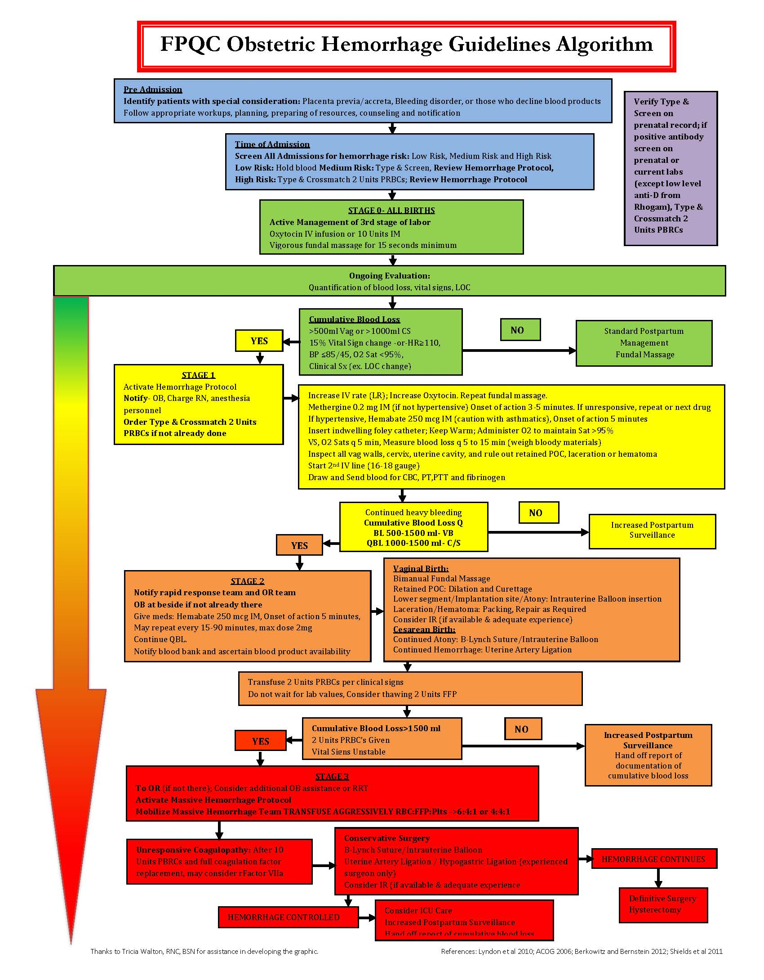
FPQC OB Hemorrhage Care Guidelines Algorithm
Available as part of the OHI Toolkit

Slide 14
1. Develop an Obstetric Hemorrhage Policy
Notes:
One of the first steps will be to create a general obstetric hemorrhage policy and procedures - a written protocol for your hospital. Core principal #1 – READINESS.

Slide 15
Why a Protocol for Obstetric Hemorrhage?
Now a complex series of steps that involve many staff members and departments
Communications!
PPH seems to always happens at night or weekends…(when people may be tired or there are less resources)
We can improve…
Notes:
Because of the complexity of response to hemorrhage and the diversity of staff who need to be involved it is essential to develop a policy that assures communication and knowledge of roles and skills required. Having a set policy and practicing it makes it easier for staff to respond and focus on individual patient needs—when roles are clear and the team works together there is less chance of mis-steps.

Slide 16
Core Elements of Any Protocol
Develop an effective written document for responding to maternal hemorrhage
Rapid response to hemorrhage emergency
Coordination among:
physicians
nurses
anesthesiologists
blood bank
Complete set of prewritten orders to instantly execute
Escalation through stages
Notes:
These are some of the keys to developing a strong protocol—involve key staff, define the response, assure coordination, have prewritten orders and authority to implement the orders, provide for an escalation of intervention as stages of hemorrhage increase.

Slide 17
2. Massive Transfusion Protocol
Notes:
Massive Transfusion Protocols are important components of response to hemorrhages of all types. OB is no exception.

Slide 18
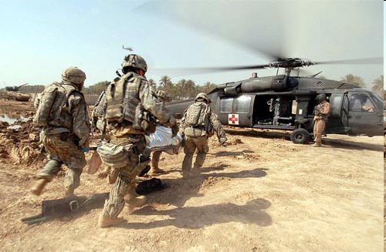
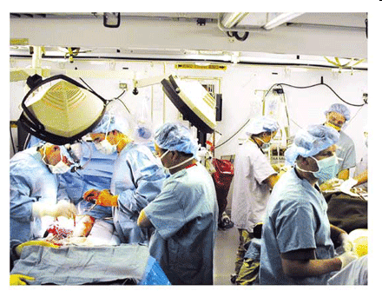
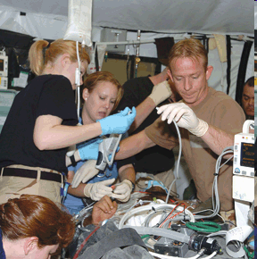
Lessons from Combat in Iraq
Lowest losses ever from hemorrhage
Key: increased FFP:RBC ratio
18
Notes:
We have often learned from military action about trauma response, this is the case in responding to hemorrhage. In the Iraqi War, there were the lowest losses ever in war time from hemorrhage. A key factor in this change was paying attention to the ratios of Fresh Frozen Plasma and Red Blood Cell infusions.

Slide 19
“Whole blood” is good for OB hemorrhage
After 2u PRBCs, start FFP
Massive transfusion protocol: 1:1 ratio FFP/RBC
6 RBC + 4 FFP + 1Plt pack (Stanford+)
4 RBC + 4 FFP, plts and cryo on request (CPMC)--think ahead!
Keep up!
Two Stages: Resuscitation and Treatment
Resuscitation, transfuse per clinical signs
DIC treatment, transfuse per lab parameters
Supportive measures are critical
Warm patient (Bair Hugger®, fluid warmer)
Correct metabolic acidosis
19
Notes:
Having a massive transfusion protocol is very important in responding to OB hemorrhage. In the protocol, it is important to specify the steps needed to anticipate need—coordination with the blood bank to have needed products readily available and standing orders that allow you to keep up with the blood loss by starting infusions as soon as indicated.
There are recommended ratios of infusions of RBCs to FFP as indicated on this slide.
There are 2 stages in hemorrhage response—resusciation with transfusion according to the clinical indications, and treatment for DIC using laboratory parameters.
It is also important to not forget other needed supportive measures when the patient is in this critical state—things to consider are any metabolic acidosis and changes in body temperature that may need correction.

Slide 20
Recommendations: Massive Transfusion Protocol
Every OB unit needs one!
Coordinated with Blood Bank, Anesthesia, and ER/ICU
Ability to deliver large volumes of RBCs and coagulation products
Principle: Whole blood out = whole blood in
Guidelines for coagulation product usage
Notes:
Often massive transfusion protocols have been the realm of the trauma world. It is now recognized that a specific mass transfusion protocol is necessary for the obstetric unit. It requires that there be careful coordination with the hospital team—blood bank, anesthesia, ER, ICU, L&D, surgery, postpartum units, pharmacy.
There are tools to deliver appropriate large volumes of blood replacement and coagulation products and you need to review your current policies and update them as needed.

Slide 21
3. Antepartum Risk Assessment
Notes:
Core Principal – Recognition of risk

Slide 22
Risk Assessment
Risk factor identification
A prewritten order set for admission to L&D includes “risk scoring” for obstetric hemorrhage
Definition checklist
Risk assessment can also occur intrapartum
22
Notes:
Recognition of hemorrhage begins with admission and identification of risk factors. Prewritten order sets based on risk scores will assist in keeping the team aware of the potential for hemorrhage. Other tools and checklists will be used as indicated.

Slide 23
Ongoing Hemorrhage Risk Assessment
 | Low | Medium | High
Antepartum | No previous uterine incision Singleton pregnancy ≤ 4 previous vaginal births No known bleeding disorder No history of PPH | Prior cesarean birth(s) Prior uterine surgery Multiple gestation >4 previous vaginal births Hypertension-associated Conditions History of previous PPH Large uterine fibroids Estimated fetal weight greater than 4 kg Morbid obesity (BMI > 35 kgm²⁾ Polyhydramnios | Placenta previa Low-lying placenta Suspected placenta accreta Hematocrit <30 Platelets <100,000 Active bleeding at admission Known coagulopathy Abruptio Placenta
Intrapartum |  | Induction or augmentation of labor Protracted labor or arrest disorder Chorioamnionitis
23
Notes:
This table is a tool that has been revised from the California Maternal Quality Care Collaborative Toolkit. As you see in this table various risk factors are listed based on the degree of hemorrhage risk. This tool can be used to identify women at risk both during the antepartum and intrapartum period.

Slide 24
4. Active Management of the Third Stage of Labor
Notes:
Core Principal – RESPONSE.
Active Management of the Third Stage of Labor or AMTSL is an evolving concept.

Slide 25
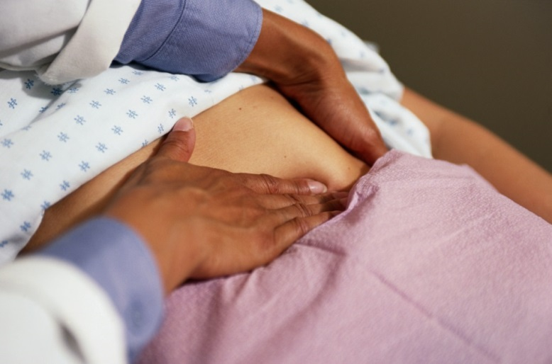
Active Management of the Third Stage
Oxytocin (10u) IV or IM with delivery of infant or placenta
Vigorous fundal massage (at least 15 sec) after placenta delivery
Controlled cord traction is an optional component to be applied only by a skilled care provider
25
Notes:
Various studies showing different combinations of components, dosing, timing and technique were studied and reported in the literature. Current research most strongly supports the use of uterotonics in the third stage for reduction in severe blood loss, blood transfusions and the use of additional uterotonics. A meta analysis of active v. expectant management demonstrated 62% fewer PPH in Active Management group versus Expectant Management (Postpartum estimated blood loss of ≥ 500 ml for vaginal birth)
We recommend that women receive oxytocin at delivery of the baby and fundal massage. Gentle, controlled cord traction by a skilled care provider is an optional component of AMSTL.
Physiologic management of the third stage which requires a different skill set may be a viable alternative for low risk women who received no interventions that increase PPH risk and who have been counseled on risks, benefits and the alternative of AMSTL.

Slide 26
5. Quantification of Blood Loss
Notes:
Quantification of blood loss rather than estimations of blood loss can improve the early recognition and response to hemorrhage. We are going to discuss this practice and some of the tools that make it easier to implement.

Slide 27
Quantification
EBL method used most often is visual estimation
Visual estimation is unreliable and inaccurate
Underestimated as much as 50 % of time Institute most accurate methods: Quantification of Blood Loss
Accurate QBL prompts the Nurse on critical actions such as mobilizing the team
Critical decisions are made based on QBL
QBL leads to earlier interventions & improved outcomes
27
Notes:
Accurate estimation of blood loss is critical in planning interventions for the patient experiencing PPH. Studies have consistently demonstrated an underestimation of blood loss by providers. Given this data, several professional societies recommend quantification of blood loss after every birth. AWHONN recommends QBL also after noting the success of the California Maternal Quality Care Collaborative results initiated in 2010.
Maternal morbidity and mortality is associated with delay in diagnosis and delay in interventions with PPH. QBL may result in earlier interventions and improved outcomes.

Slide 28
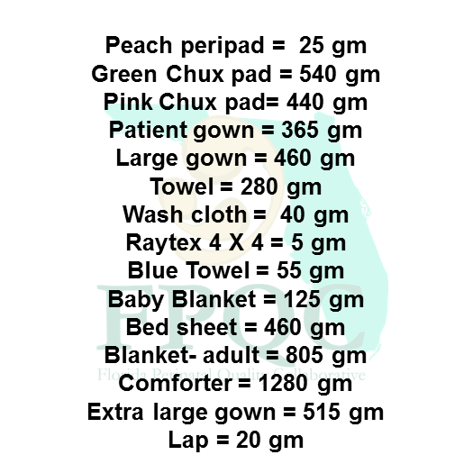
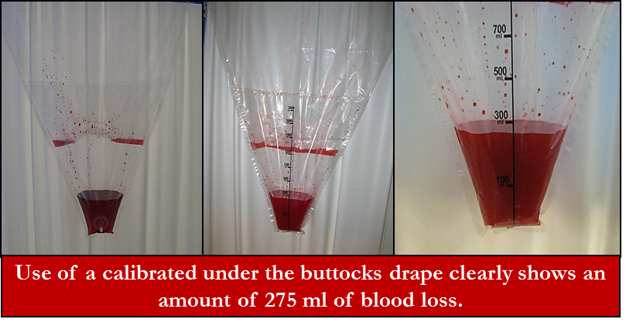
Dry Weights
Photos: Tricia Walton and Hedy Edmund
Notes:
This figure is an example of an educational tool that can be used for blood loss quantification. These pictures can be posted in all delivery areas including the operating room and the delivery room.

Slide 29
Recommendations
Many centers will customize their approach to quantification using a combination of approaches for different settings
Vaginal deliveries
Cesarean sections
Minimal loss
Greater than usual loss
Massive loss
The process is intentional—a formal effort!
No more vague “Guesstimates”
Continues and is cumulative
Denial
Delay
29
Notes:
The intent is to be consistent, measure over time, assure the postpartum unit is alert to potential for hemorrhage and that measurement is looked at in a cumulative way so that trigger levels are recognized and response initiated. It is also important that these measures be reported off to the postpartum floor in all cases where blood loss is 500 cc or greater so that the cumulative amount can continue to be monitored and the trigger recognized if blood loss resumes or continues.

Slide 30
Who should determine QBL?
Anesthesia is at the head of the table and often does not see it all
OB’s aren’t looking at the suction bottles or at the collective sponges
No one is doing it in a standardized manner— obstetricians need help! Collaboratively!
We should be able to answer:
How much blood is in the suction bottle (after amniotic fluid)?
How much blood is on sponges?
How much blood is on the floor/on the table?
In a big case, hourly and cumulatively
30
Notes:
Each member of the obstetric is vital to assuring a complete assessment, information must be accurately and clearly communicated to the team.

Slide 31
6. Construct an Obstetric Hemorrhage Cart
Notes:
One of the most important response tools is the Obstetric Hemorrhage Cart.

Slide 32
Hemorrhage Carts, Kits and Trays
Checklist of medications and procedures
Diagrams depicting various procedures
B-Lynch
Uterine artery ligation
Balloon placement
Set of vaginal retractors
Sponge Forceps
B-Lynch sutures
Vaginal Packs
Uterine Balloons
Banjo curettes
Uterine forceps
Long needle holder
32
Notes:
This is a sample checklist for items to include in an obstetric hemorrhage cart. Each site can customize their carts to reflect their local practice.

Slide 33
7. Ensure Availability of Medications and Equipment
Notes:
Include in OB Hemorrhage Protocols the needed medications and equipment needed to adequately respond. Assure that there are tools to facilitate the use of these important medications and equipment so that it is clear what intervention to take, when to activate the team response, and when to escalate to the next stage. Algorithms are one such tool that can assist the OB team to recognize and respond to hemorrhage.

Slide 34
OB Hemorrhage Medication Kit PYXIS/refrigerator
Pitocin 20 units per liter NS 1 bag
Hemabate 250 mcg/ml 1 ampule
Methergine 0.2 mg/ml 2 ampule
Cytotec* 200mg tablets 5 tabs
* There is no strong evidence that misoprostol is useful as primary or adjunctive therapy of postpartum hemorrhage in addition to standard injectable uterotonics.
34
Notes:
These are the 4 main medications that need to be available to respond to an OB hemorrhage.
*There is no strong evidence that misoprostol is useful as primary or adjunctive therapy of postpartum hemorrhage in addition to standard injectable uterotonics.

Slide 35
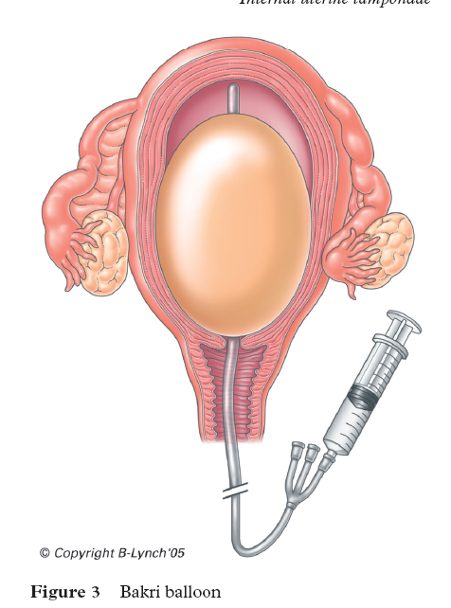
B-Lynch suture
Bakri Balloon
Notes:
Among the other tools that need to be available are the intrauterine balloon. The most widely available is the Cook “Bakri” but there are others available for use. They are specifically designed to fit the uterus, are filled with saline readily, are relatively easy to use and include a double lumen to facilitate drainage. The costs for these are low. They are sometimes placed prophylactically but not inflated unless necessary.
The B-Lynch Compression Suture is an excellent intervention for uterine atony when medical intervention does not result in good response. They are most often placed at the time of C-section or after failed medical management in vaginal deliveries. B-Lynch sutures are quick and easy to place, they can be combined with the intrauterine balloon for a “sandwiching technique” – in short every obstetrician should have this skill and there should be reminder posters available in all delivery suites or operating rooms

Slide 36
8. Perform Hemorrhage Drills
Notes:
Simulation is used in training where it would be unsafe to rehearse in clinical practice. Drills using simulated real life situations, have the benefit of offering learning opportunities without causing harm to the patient, allow for skills and competence acquision and the development of clinical reasoning. Medical simulation drills in the OB setting can help to assess for system weaknesses and strengths, test policies and procedures relative to hemorrhage and improve teamwork and communication among staff. The drills should be multi-disciplinary and include the care team of nurses, physicians, anesthesia, and other ancillary staff.

Slide 37
Importance of Drills / Simulations Safety and QI Leader: Paul Preston, MD
“Medicine is the last high-risk industry that expects people to perform perfectly in complex, rare emergencies but does not support them with high-quality training and practice throughout their careers.”
“Certain individual and team skills require regular practice that cannot ethically occur in routine care.”
37
Notes:
We recommend that all hospitals adopt regularly scheduled simulation drills for practicing response to obstetric hemorrhage. The drills should occur onsite with all disciplines available and occur on all shifts—at least annually. When the occasion arises, unscheduled drills may provide additional insights into preparedness for the unexpected.

Slide 38
Simulation Drills
Hospitals should run drills at different times of the day to ensure that appropriate hemorrhage team members are available at all times.
All members of the health care team should participate, including nurses, physicians and ancillary staff, as appropriate.
Debriefings should occur after every drill and after every actual OB hemorrhage emergency.
This allows for continuous quality improvement
38
Notes:
We know obstetric hemorrhage is rare, but despite this we must be prepared. Much like we prepare for the advent of a fire, we must use simulation drills to prepare our teams for appropriate hemorrhage response. All team members must participate in the drills and we have them on all shifts and days of the week. Following the drills a debrief and to determine areas that require modification or that should be added allows for discovery of areas of strength and that need improvement. The debrief tool is one that is also used after the occurrence of an actual hemorrhage at the level of greater than 3 units of transfusion, for any hemorrhage related death, and any hemorrhage related hysterectomy.

Slide 39
9. Debrief after OB Hemorrhage Event
Notes:
Core Principal – REPORTING
Debriefing is a process of information exchange and feedback conducted after an event and designed to improve teamwork, skills, and outcomes. It is one of the most crucial components of the initiative in order to improve preparedness and response.

Slide 40
Debriefs
After major OB hemorrhage event or simulation drill, provides opportunity to:
Decompress
Discover areas for improvement
Benefit from immediate feedback
Enhances retention of information
Increases learner engagement
Leads to higher staff confidence
Is a learning opportunity, not punitive
40
Notes:
Following an obstetric hemorrhage or any major obstetric event, conducting a debriefing will provide the opportunity to decompress and identify areas for improvement. Participants benefit from the immediate feedback, have increased engagement and enhanced retention of information.

Slide 41
Debriefing
Led by facilitator (primary RN and primary MD)
Includes:
Recap of the situation
Key events that occurred
What worked
What did not work
E.g. communication, lack of necessary equipment
Discussion of what can be done differently
Completion of a debrief form
41
Notes:
The debrief is facilitated by one of the team members: a recap is provided, key events are described, and the team reconstructs the events and performs an analysis of why the event occurred, what worked and what did not work—this leads to discussion of lessons learned and what needs to be done differently in the future.

Slide 42
Systems Approach to Obstetric Hemorrhage
Department: OB Hemorrhage Protocol with stages
Hospital: Massive Transfusion Protocol
Summary Flow algorithm: graphic or tabular
Nursing checklist by stages
Documentation forms: OB Hemorrhage Report
Worksheets to assist with assessment of blood loss
Hemorrhage cart/kit
Instruction cards for new procedures in cart or
Drills
Notes:
In summary, a systems approach to OB hemorrhage includes these components.

Slide 43
How did it go?

Slide 44
Active Management of Third Stage Percent of women (chart audit) who received documented vaginal deliveries received active management of the third stage of labor

Slide 45
Quantification of Blood Loss Percent of All Reporting Hospitals at which each quantification method was used for VAGINAL deliveries

Slide 46
Quantification of Blood Loss Percent of All Reporting Hospitals at which each quantification methods was used for CESAREAN deliveries

Slide 47
Total Units of Each Type of Blood Product Transfused per 100 births

Slide 48
Percent of women transfused with any blood product during the birth admission

Slide 49
Percent of women transfused with >3 units of any product during the birth admission

Slide 50
What did we learn?

Slide 51
Needs change over time
Initial visits
Beneficial for the initiative
Who are the players?
What is the setting?
What are the resources?
Opportunities
Introduced concepts
Provide the basis and rationale
Help formulate an action plan

Slide 52
Later in the initiative
Visits were more directed
No longer low hanging fruit
What are the barriers?
What interventions have been tried?
Perspectives may differ

Slide 53
Approaches
Needs assessment
Address criticism head on
Different approaches may be appropriate
Science
Vignettes
Data on progress

Slide 54
Common findings
Passionate staff and participants
Champion make a difference
Administrative support is crucial
Carrot vs stick: both can be effective

Slide 55
Surprising findings
Size does not matter
Readiness and support matter
Innovation and sharing seems to come easily to some hospitals

Slide 57
Cookbook Medicine?
It works!!!!

Slide 58
Suggestions for Other Hospitals
Engage leadership at all levels
Building relationships is important for collaboration
People need to want to change
Engaging people depends on how you present the changes
Give the staff explanations for changes
Get education department involved
Learn from other hospitals
Assure resources available
Evolving process, be flexible!

Slide 59
Questions or Comments

