Slide 1
PROJECT W.A.T.C.H: Intrauterine substance exposure & nas surveillance data update
Collin John, MD MPH FAAP
Associate Professor of Internal Medicine and Pediatrics
Director, Project WATCH
West Virginia University

Slide 2
Objectives
To revisit the data gathered from the Centers for Disease Control and Prevention regarding Neonatal Abstinence Syndrome (NAS) in WV
To discuss the data related to Intrauterine substance exposure (IUSE) and NAS gathered from Project WATCH over the last 10 months
To discuss future needs that are needed in WV with regards to IUSE and NAS surveillance

Slide 3
The NAS crisis
Reportedly...
National Data for WV in 2013*
Substance Use Exposure 5.9%
60 per 1,000 births
NAS 3.3%
33.4 infants per 1,000 births
Anecdotally, most people would agree this is an underestimate
Beginning in October 2016, the WV Perinatal Partnership and Project WATCH collaborated to develop a better way to capture the rates of IUSE and NAS in West Virginia.
*Ko JY, Patrick SW, Tong VT, Patel R, Lind JN, Barfield WD. Incidence of Neonatal Abstinence Syndrome - 28 States, 1999-2013. MMWR Morb Mortal Wkly Rep. 2016 Aug 12;65(31):799-802.

Slide 4
Questions asked on Project WATCH
Intrauterine Substance Exposure (includes any medication prescribed by a physician during pregnancy).
Yes/No (if No, questions below will not be available)
If yes, then check all that apply
Self-reported
Documented in prenatal record
Positive maternal drug test
Unknown
Other
Infant with clinical signs consistent with NAS diagnosis*?
Yes/No
*NAS is diagnosed when a baby has intrauterine exposure to a neuroactive substance and exhibits clinical signs/symptoms of withdrawal, regardless of whether or not pharmacological treatment is required.

Slide 5
Surveillance Data- Oct 1 2016 -Aug 1 2017
10 months, N= 16,014
IUSE = 13.95%
Recall the earlier report which said 5.9 in 2013 %
NAS = 5.31%
Recall the earlier report which said 3.3 in 2013%
Among those babies with IUSE, 38% developed NAS
This data would suggest that in only 3 years, the rate doubled

Slide 6
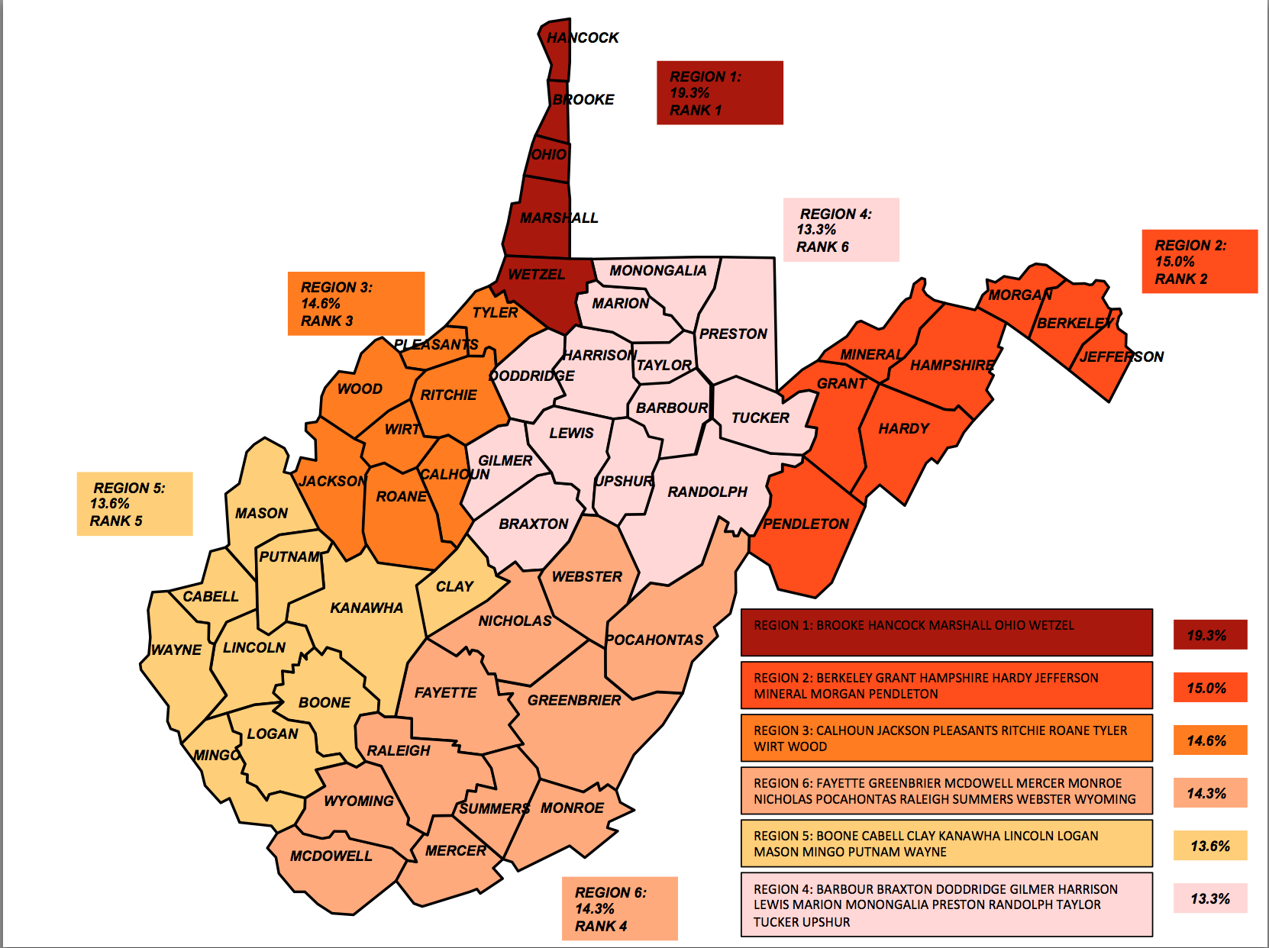
Rates of IUSE by
GRASTF* Regions
*Governors Regional Substance Abuse Task Force

Slide 7
Rates of NAS by
GRASTF* Regions
*Governors Regional Substance
Abuse Task Force

Slide 8
SO WHY THE POTENTIAL DISCONNECT BETWEEN DATA REPORTED BY THE CENTERS FOR DISEASE CONTROL AND PROJECT WATCH?

Slide 9
Audit- January 2017
N= 789 (52% of 1,521 births in Birth Score database during January)
Six hospitals completed chart review for all births during the month of January 2017
Ruby
UHC
Wheeling
CAMC
Cabell
Thomas

Slide 10
Audit data- Overall Prevalence (N= 789)
Data Source | Frequency | Percent
Intrauterine Substance Exposure (IUSE)
Hospital- IUSE | 134 | 17.07%
Birth Score- IUSE | 111 | 14.14%
ICD 10 code in chart – Intrauterine Exposure codes (newborn affected by…) | 57 | 7.23%
NAS
Hospital- NAS | 79 | 10.1%
Birth Score- NAS | 67 | 8.55%
ICD 10 code in chart – NAS | 43 | 5.46%

Slide 11
Audit Data- Overall Intrauterine Substance Exposure
Hospital | Birth Score | ICD 10 code (P04.x) in chart | Frequency
NO | NO | NO | 642
NO | NO | YES | 1
NO | YES | NO | 3
NO | YES | YES | 1
YES | NO | NO | 20
YES | NO | YES | 6
YES | YES | NO | 59
YES | YES | YES | 48

Slide 12
Audit Data- Overall NAS
Hospital | Birth Score | ICD 10 code P96.1 in chart | Frequency
NO | NO | NO | 687
NO | NO | YES | 1
NO | YES | NO | 18
NO | YES | YES | 5
YES | NO | NO | 10
YES | NO | YES | 1
YES | YES | NO | 20
YES | YES | YES | 36

Slide 13
Intrauterine Substance Exposure Hospital vs. Birth Score (N= 789)
 |  | BIRTH SCORE DATA
 |  | NO | YES | TOTAL
HOSPITAL DATA | NO | 644 | 4 | 648
 | YES | 26 | 107 (81%) | 133
 | TOTAL | 670 | 111 | 781
Out of a total of 133 cases identified in the hospital record, 107 were identified by Birth Score
Out of 648 non-cases identified by the hospital record, 4 were identified by the Birth Score
Kappa statistic (measure of agreement) in this scenario is 85%. This is considered “Very Good”

Slide 14
NAS - Hospital vs. Birth Score (N= 789)
 |  | BIRTH SCORE DATA
 |  | NO | YES | TOTAL
HOSPITAL DATA | NO | 689 | 11 | 700
 | YES | 23 | 56 (71%) | 79
 | TOTAL | 712 | 67 | 779
Out of a total of 79 cases identified in the hospital record, 56 were identified by the Birth Score
Out of a total of 700 non-cases identified by the hospital record, 11 were identified by the Birth Score
Kappa statistic (measure of agreement) between the 2 datasets is 74%. This is considered “Good”

Slide 15
Moving forward…
Screening
Survey how hospitals screen for IUSE
QI- Birth Score data entry/EMR data pull
New QI Coordinator to work with hospitals
Education
Additional training for hospital staff/coders
CME, CEU, MOC opportunities
Policy Development
Maternal Drug Screening mandate?
Research
Identify questions of interest with the data
APHA 2017- November

Slide 16
Conclusion
IUSE and NAS rates in WV have been determined to be far greater based on Project WATCH data vs. CDC data
Some of the disconnect may be related to diagnosis, coding issues, etc.
We are just at the tip of the iceberg with regards to IUSE and NAS surveillance

Slide 17
New QI position for Project watch
Goal- to complete our research team (teamwork makes the dream work!)
Epidemiologist
Biostatistician
Pediatrician
Program Coordinator/MPH
Opportunity- To add a Quality Improvement Nurse Specialist
QI Nurse will assist Project WATCH to improve the quality of data collected at WV birth facilities

