Slide 1
Screening for Congenital Heart Disease in the Newborn and Connecting to Care
John R. Phillips, M.D.
Associate Professor of Pediatrics
Division of Pediatric Cardiology
WVU Children’s Hospital

Slide 2
Objectives
Outline the issue of congenital heart disease
Discuss normal cardiac anatomy
Explain critical congenital heart diseases (CCHD)
Discuss evaluation of neonates with positive screening in West Virginia including the use of telemedicine

Slide 3
Congenital Heart Disease
Congenital heart disease occurs in 8 of every 1000 live births
25% have critical congenital heart disease (CCHD)
Most CCHD require a patent ductus arteriosus (PDA) for survival
Congenital heart disease accounts for 6-10% of all infant deaths
Congenital heart disease accounts for 20-40% of deaths caused by congenital malformations

Slide 4
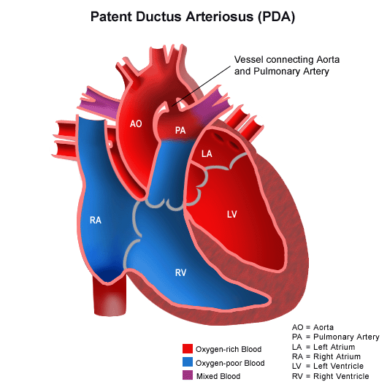
Normal cardiac anatomy

Slide 5
Critical congenital heart disease
Defined as those defects that requiring surgical, cardiac catheterization or pharmacologic intervention to avoid death or end-organ damage
Characterized by:
Too little blood flow to the lungs
Too little blood flow to the body
Mixing of oxygenated and deoxygenated blood causing hypoxia (low blood oxygen to the body)

Slide 6
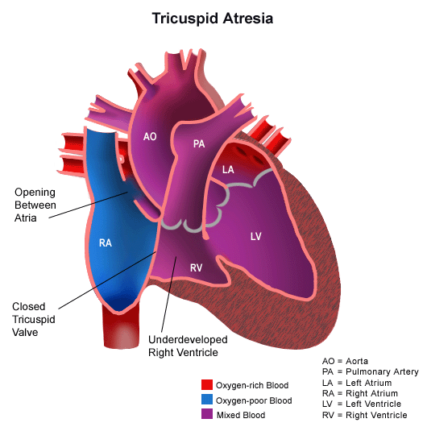
CCHD: Too little blood flow to the lungs
Right arm 75%
100%
60%
75%
Right/left leg 75%

Slide 7
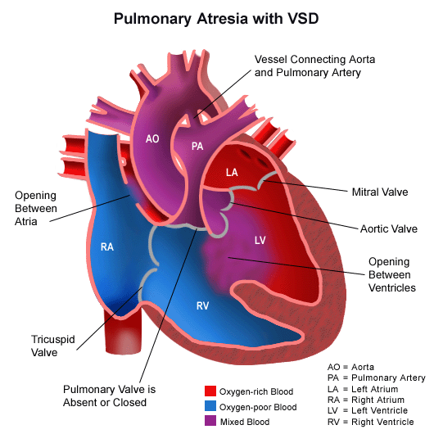
CCHD: Too little blood flow to the lungs
Right arm 75%
100%
60%
75%
Right/left leg 75%

Slide 8
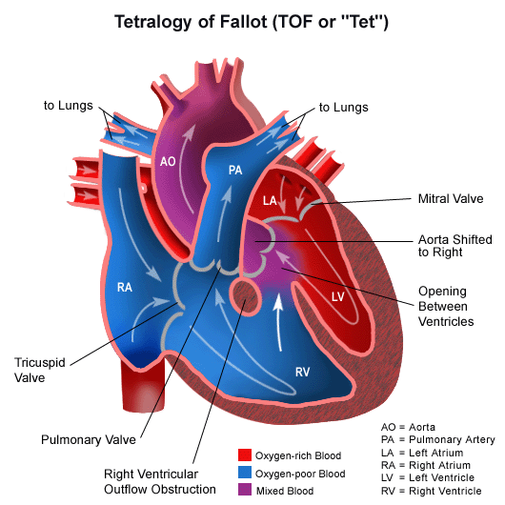
CCHD: Too little blood flow to the lungs
Right arm 85%
100%
60%
85%
Right/left leg 85%

Slide 9
CCHD: Too little blood flow to the body
Right arm 100%
100%
60%
100%
Right/left leg 95%

Slide 10
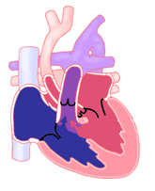
CCHD: Too little blood flow to the body
Interrupted Aortic Arch
Right arm 100%
100%
60%
100%
Right/left leg 75%

Slide 11
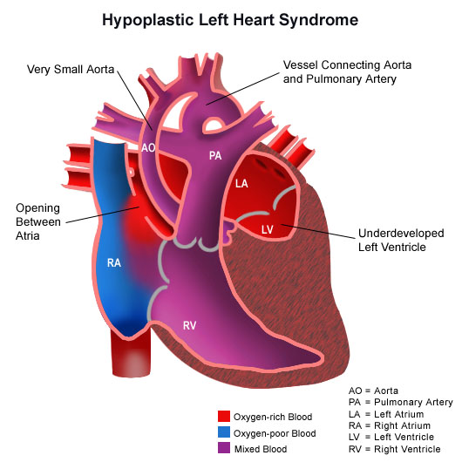
CCHD: Too little blood flow to the body
Right arm 75%
100%
60%
75%
Right/left leg 75%

Slide 12
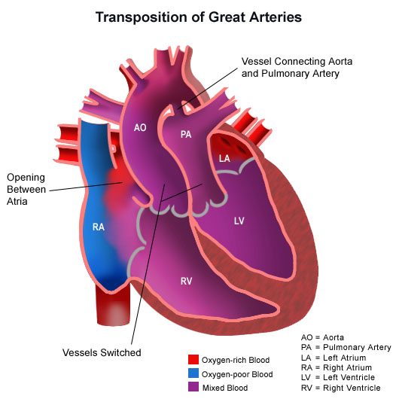
CCHD: Causing hypoxia
Right arm 75%
100%
90%
60%
75%
Right/left leg 75%

Slide 13
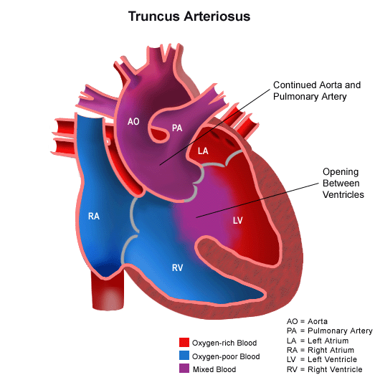
CCHD: Causing hypoxia
Right arm 75%
100%
60%
75%
Right/left leg 75%

Slide 14
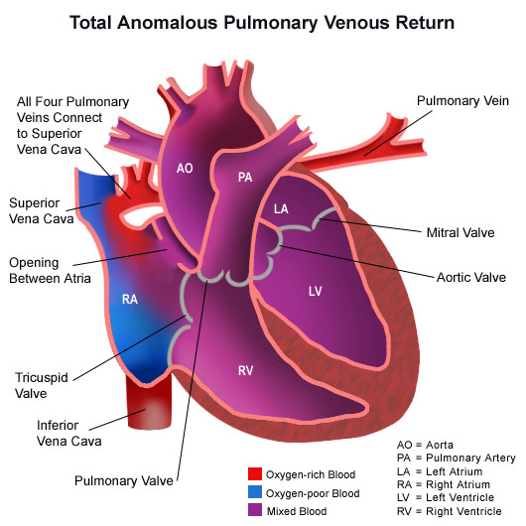
CCHD: Causing hypoxia
Right arm 75%
100%
75%
60%
Right/left leg 75%

Slide 15
Why Screen for CCHD
The disease is not always apparent on physical examination
Ductus arteriosus may close after discharge
Trend towards earlier discharge make this scenario more likely
How is CCHD diagnosed?
Prenatal ultrasound
Fetal echocardiography
Physical examination
Supplemental tests (ie ECG, CXR)
Pulse oximetry screening
Echocardiography

Slide 16
I have a positive screen. What next?
The infant’s provider should be notified immediately for evaluation of causes of hypoxia
Any infant with a positive screen should have a diagnostic pediatric echocardiogram
within the hospital or birthing center where they were born
transport to an institution with pediatric echocardiography
use of telemedicine for remote evaluation

Slide 17
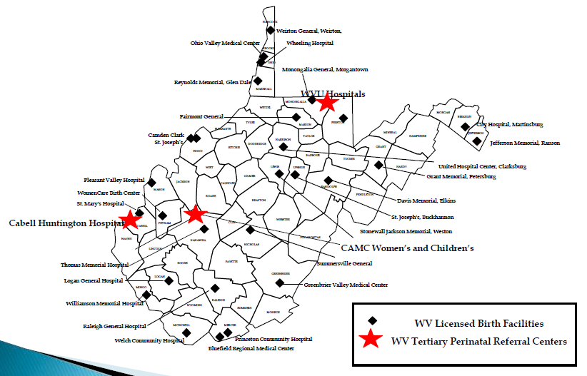
Locations of West Virginia Birth Facilities
Pediatric Echo

Slide 18
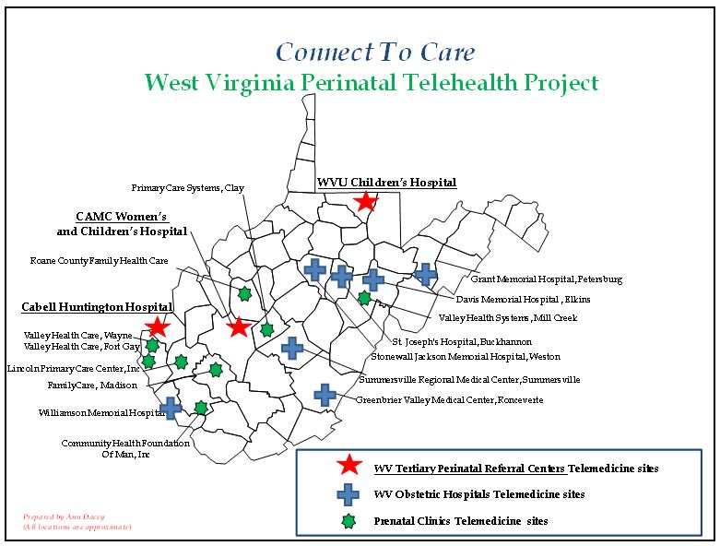
Connecting to Care

Slide 19
Connecting to Care
CONTACT NUMBERS:
Dr. Farah Garmany can be reached through her cell phone at (304) 549-4973.
Dr. Mohammad Iqbal can be reached through his office at (276) 322-3180 or cell phone at (276) 920-1382.
Marshall Pediatric Cardiology can be reached through the Cabell Huntington PICU at (304) 526-2399.
WVU Pediatric Cardiology can be reached through the MARS line at (304) 598-6000.

Slide 20
Screening processes and critical congenital heart disease (CCHD)
Collin John, MD MPH FAAP
Assistant Professor
Departments of Internal Medicine and Pediatrics
West Virginia University School of Medicine
WV Perinatal Summit, Charleston, WV
November 7, 2014

Slide 21
Disclosures
I serve as the medical director for Project WATCH/WV Birth score program, which has been charged by the West Virginia Department of Health and Human Resources to oversee the CCHD screening initiative West Virginia

Slide 22
Objectives
Revisit and become reacquainted with the basic principles of screening tests
Understand the basic properties of screening tests
Apply the principles and properties to screening for critical congenital heart disease
Briefly discuss the findings from the first year of CCHD screening in WV and future plans

Slide 23
Definition of Screening
The use of simple tests across an apparently healthy population in order to identify individuals who have risk factors or early stages of disease, but do not yet have symptoms (World Health Organization)
Types of screening strategies
Universal screening – Screening all individuals in a certain category
Newborn screening
CCHD screening in West Virginia
Case finding or “selective screening” – Screening a smaller group of individuals who may have certain risk factors for disease
Heritable diseases

Slide 24
Principles of screening
The Wilson criteria for screening from the World Health Organization
The condition should be an important health problem.
CCHD Incidence: 2/1,000
CCHD in 2/1000 = 42 CCHD/year
There should be a treatment for the condition.
Facilities for diagnosis and treatment should be available.
Dr. Phillips addresses
There should be a latent stage of the disease.
Asymptomatic period of CCHD

Slide 25
Latent (Lead time) period of disease
Disease Symptoms Death / Disability begins
Latent Period (target of screening)

Slide 26
Latent period of disease applied to CCHD
In utero Cyanosis Death
development Tachypnea
of CCHD Acidosis
Latent Period (target of pulse oximetry screening)

Slide 27
Principles of Screening
There should be a test or examination for the condition.
Pulse oximetry
The test should be acceptable to the population.
Very noninvasive, relatively easy to do
The natural history of the disease should be adequately understood.
Help from the pediatric cardiologists

Slide 28
Principles of Screening
There should be an agreed policy on whom to treat.
The total cost of finding a case should be economically balanced in relation to medical expenditure as a whole.
$5 to $10 depending on the protocol
1 case of circulatory collapse resulting from undiagnosed CCHD may exceed the cost of screening 2000 neonates (de-Wahl Grannelli, A: BMJ 2009; 338 )
Case-finding should be a continuous process, not just a "once and for all" project

Slide 29
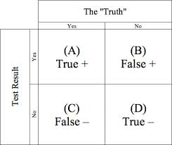
Properties of Screening tests
Sensitivity
Probability of positive test result GIVEN that an individual
has disease
True positives / All individuals who have disease = A / A+C
Specificity
Probability of a negative test results GIVEN that an individual does not have disease
True negatives / All individuals who do not have disease = D / B+D

Slide 30
Properties of Screening tests
Positive predictive value
Probability of an individual truly having disease
GIVEN a positive test result
True positives / All individuals who have positive tests results = A / A+B
Negative predictive value
Probability of an individual not having disease GIVEN that a negative test result
True negatives / All individuals who have a negative test result = D / C+D

Slide 31
Properties of screening tests
Sensitivity and Specificity are reliant on cutoff points, test administration, etc.
There is always a tradeoff between sensitivity and specificity
Sensitivity and Specificity of a test DO NOT CHANGE if the cutoff points are constant and the test is administered consistently

Slide 32
Properties of screening tests
Predictive values will vary depending upon the pre-test probability or prevalence of a condition
For an individual patient, predictive values are typically more meaningful since disease determination is typically made based on knowing the test result, and not knowing the disease status (hence, you order the test to see if the patient has disease, not the other way around)

Slide 33
Screening versus diagnostic tests
For a SCREENING TEST, the goal is to have the maximum sensitivity as possible (i.e., you don’t want to miss anybody with the disease, but you would be okay with false positives)
For a DIAGNOSTIC TEST, the goal is to have the maximum specificity possible (i.e., you want to make sure that the individual truly has disease and is not a false positive)
Most pundits would argue that at the diagnostic phase, you would ideally have a good balance between sensitivity and specificity which is typically achieved by creating a Receiver Operating Characteristics Curve.

Slide 34
Screening pathway for CCHD
Pulse oximetry at a minimum 24 hours of life on WELL babies
Screening aims to find disease in ASYMPTOMATIC folks
? Prenatal echos and CCHD identification (is screening in these kids appropriate)
Pulse oximetry stats with current CDC cutoffs (next slide)
Sensitivity – 77.8%
Specificity – 99.9%
PPV – 25.93% (affected by the prevalence)
NPV – 99.9%
(Riede FT, Wörner C, Dähnert I, Möckel A, Kostelka M, Schneider P.
Eur J Pediatr. 2010 Aug;169(8):975-81. doi: 10.1007/s00431-010-1160- Epub 2010 Mar 1.)

Slide 35
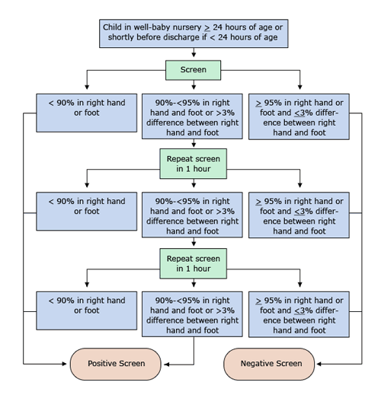

Slide 36
For babies that fail the screening, a transthoracic echocardiogram needs to be ordered, even if you think they could potentially have another diagnosis.

Slide 37
The WV Birth Score and CCHD
In Year 1, results of the CCHD screening were assessed with “Pass/Fail/Not screened/NICU” item
To assess for quality control, in year 2, the item was changed to include the following
Was CCHD screening done? (Yes/No)
Age of infant at screening in hours
Oxygen saturations in right hand/right foot

Slide 38
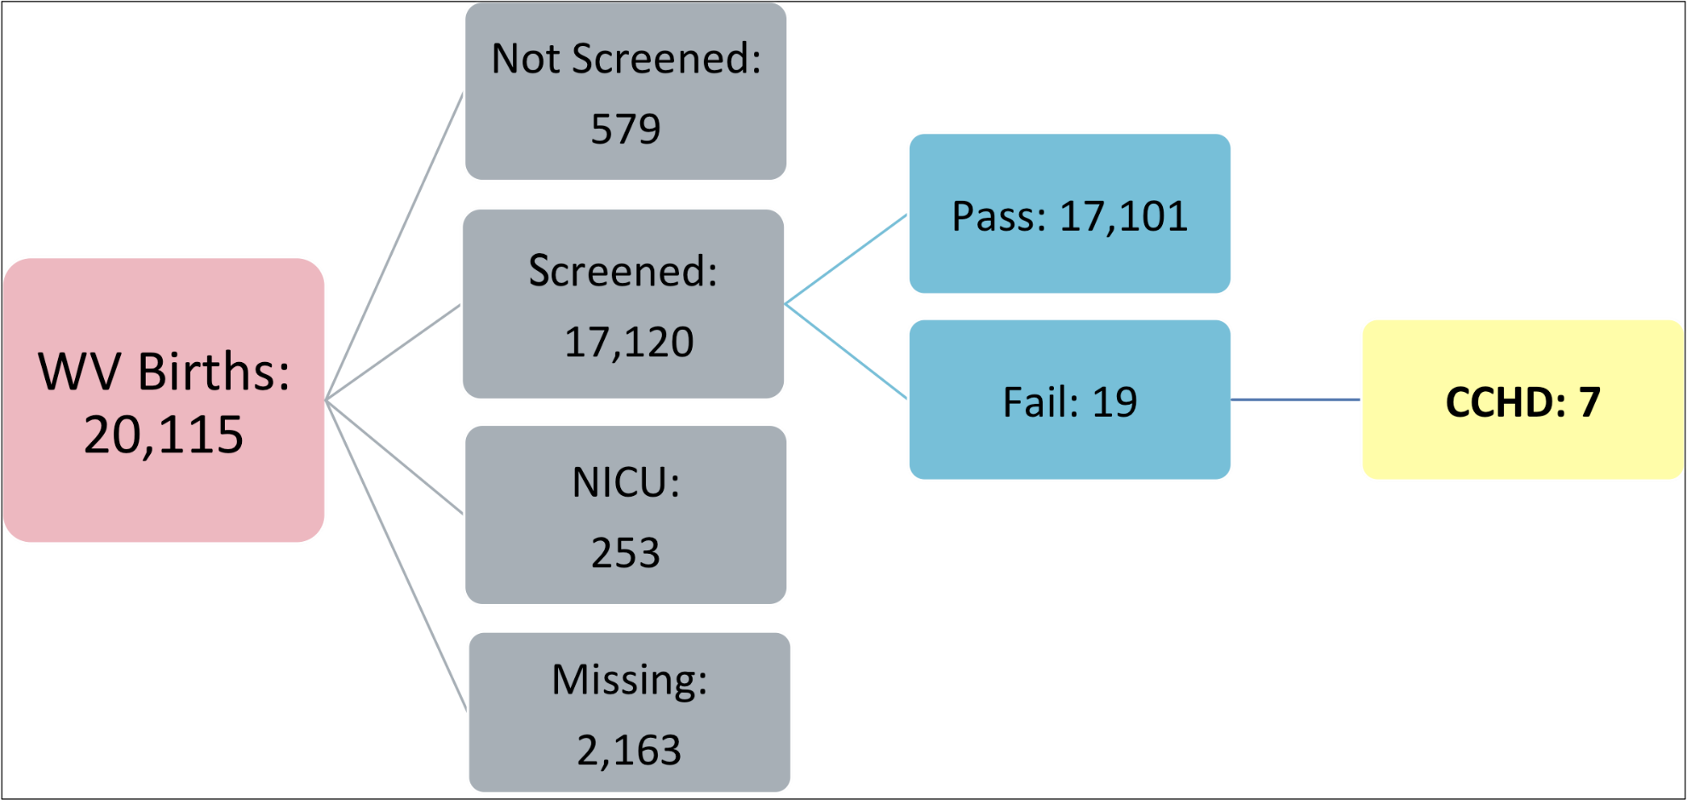
Year 1 data

Slide 39
Lessons learned through the process
The most common error we currently see is interpreting the “middle” scenario where a difference of >3% is not repeated.
A 96% in the right hand and a 100% in the right foot is a positive screen and needs to be repeated
We also see infants who have failed the screen who do not get echoes ordered.

Slide 40
Lessons learned through the process
Reliable data reporting
Numerous infants being reported having 100% in both extremities
Missing data
“Cheerleader” effect
Use of the EMR to pull values for each variable versus manually inputting data into the electronic WV Birth Score form

Slide 41
Future plans
Currently, we are currently involved with the CDC in a national study to review the current algorithm and cutoffs
Use of the birth defects registry to help track false negative results
Networking with referral centers outside of WV who receive infants transferred from in-state birthing centers

Slide 42
Future Plans
Collaboration with WV Perinatal Partnership to develop CCHD resources for hospitals
Tool-kit for staff training
Webinar

Slide 43
Acknowledgement
West Virginia Department of Health and Human Resources, Office of Maternal Child and Family Health
West Virginia Perinatal Partnership
All participating birth facilities

